Slide 1
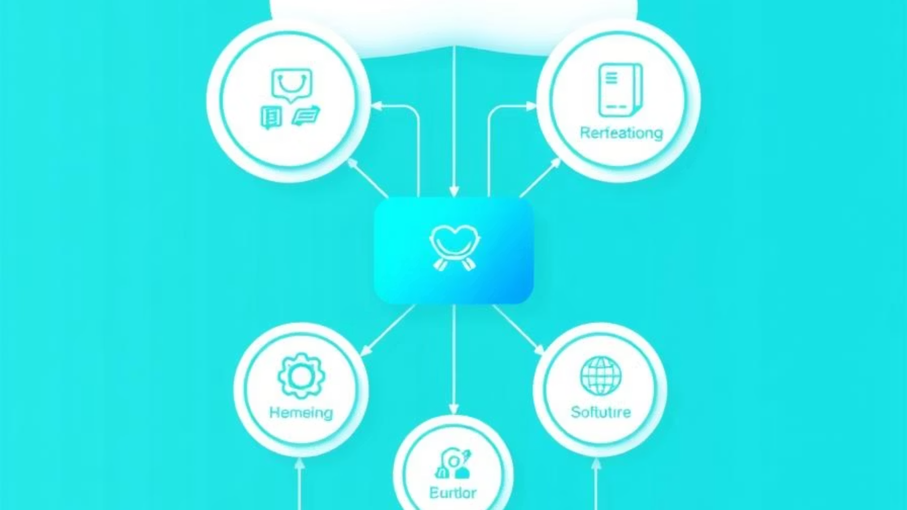
Healthcare System Architecture and API Documentation
Overview of system architecture (Controller → Service → Repo → DB → API).

Slide 2
Entity Relationship Diagram
Patient
Doctor
Appointment
Primary entity storing patient information
Primary entity storing doctor information
Relationship between patients and doctors
Medical Record
DoctorPatient
Patient health documentation
Many-to-many relationship mapping

Slide 3
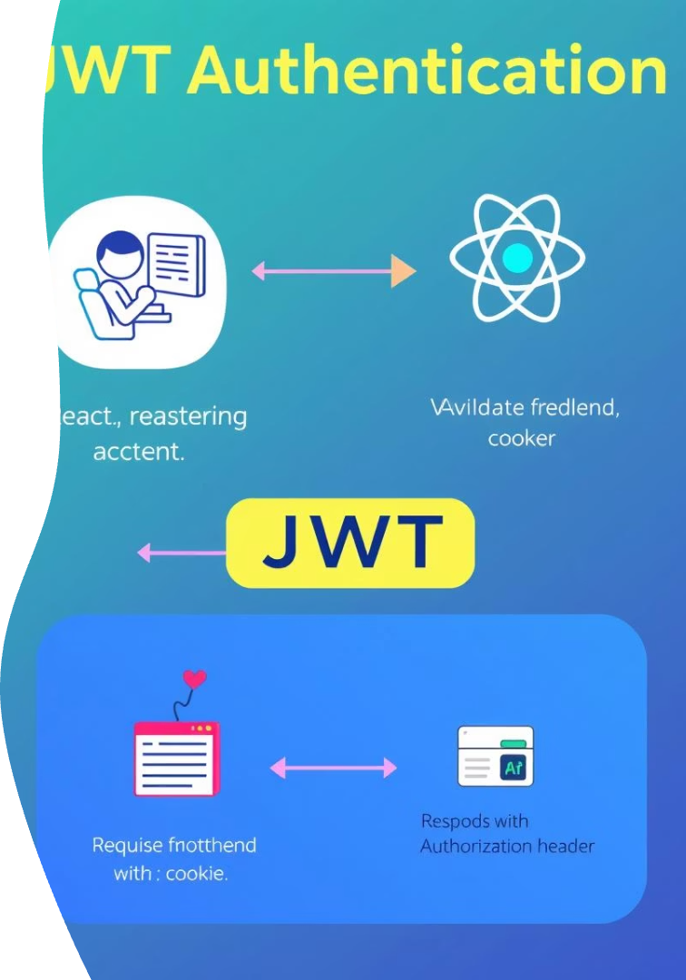




Authentication and Authorization Workflow
User Login
Credentials submitted to backend
JWT Generation
Backend validates and issues token
Token Storage
Frontend stores JWT securely
API Access
Token sent with each request

Slide 4
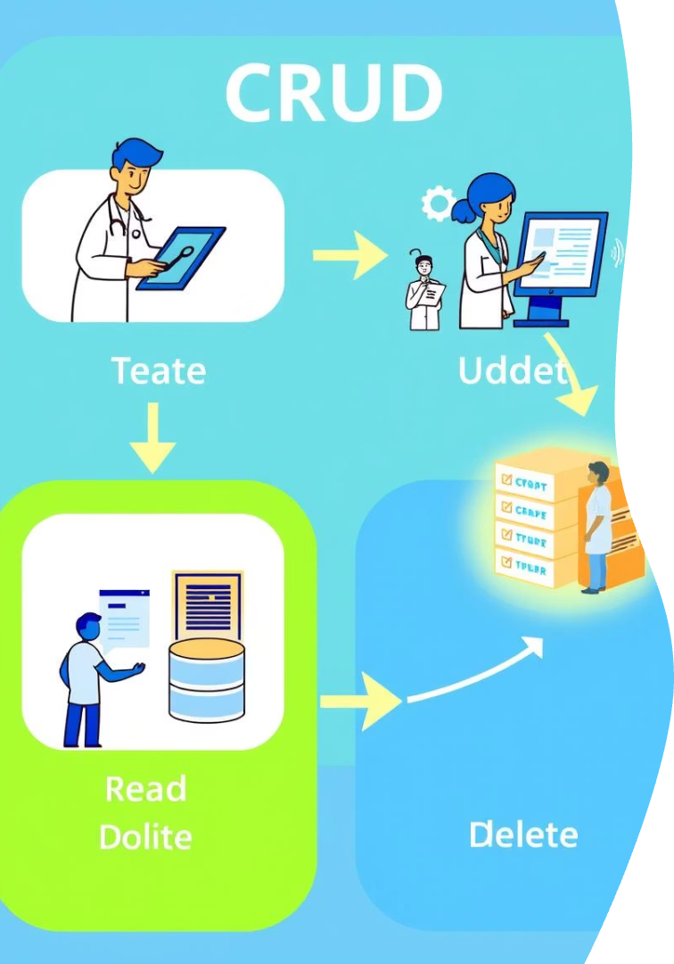
CRUD Operations
Entity
Create
Read
Update
Delete
Patients
✓
✓
✓
✓
Doctors
✓
✓
✓
✓
Appointments
✓
✓
✓
✓
Medical Records
✓
✓
✓
✓

Slide 5







Patient API Endpoints
GET /Patient/{id}/records
GET /Patient/{id}/appointments
Get all medical records for a patient
Get all appointments for a patient
GET /Patient/Filter
POST /Patient/{id}/assign-doctor/{doctorId}
Filter patients by name or criteria
Assign a doctor to a patient
POST /Patient/{id}/rate-doctor/{doctorId}
GET /Patient/{id}/doctors
Rate a doctor
Get doctors linked to a patient

Slide 6









Doctor API Endpoints
GET /Doctor/{id}/patients
GET /Doctor/{id}/appointments
GET /Doctor/{id}/rating/patient/{pid}
GET /Doctor/{id}/rating/summary
Get all patients under a doctor
Get doctor's appointments
Rating given by a specific patient
Doctor rating summary
GET /Doctor/Filter
GET /Doctor/{id}/rating
GET /Doctor/{id}/rating/average
GET /Doctor/{id}/income?date=
Filter doctors by specialty or years of experience
Get doctor's average rating
Average doctor rating
Get doctor's income on a specific date

Slide 7
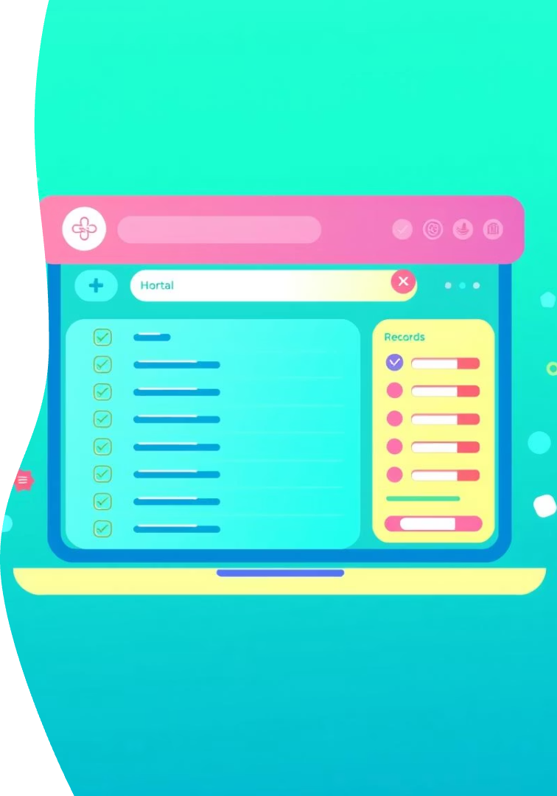

Medical Records API
GET /Medical-records/diagnosis/{keyword}
Get records filtered by diagnosis
Allows searching by specific medical conditions
Returns matching patient records
Supports partial keyword matching
GET /Medical-records/by-date-range
Get records filtered by date range
Supports filtering by start and end dates
Returns chronologically ordered results
Useful for periodic reporting

Slide 8




Appointments API
PUT /appointments/{id}/reschedule
GET /appointments/today
Reschedule an appointment
Get today's appointments
Updates appointment time and date
Returns all appointments scheduled for current date
Sends notifications to affected parties
Can be filtered by doctor or facility
Maintains appointment history
Includes patient and time information

