Slide 1

Machine Learning of the Ising Model
Lydia Elisabeth Morscher
Supervisor: Univ.-Prof. Christoph Dellago

Slide 2
Content
Part I:
Ising Model
Implementation
Results
Part II:
Introduction Machine learning
Logistic Regression
Dependency of the sample size
Outlook

Slide 3

The Ising Model

Slide 4
The Ising Model
Hamiltonian of the System:

Slide 5
The Ising Model
Hamiltonian of the System:

Slide 6
The Ising Model
Hamiltonian of the System:

Slide 7
The Ising Model
Hamiltonian of the System:

Slide 8
Implementation
Initialization (random or aligned)
Choosing a random spin ŝ
Proposal: Flip of ŝ
Calculation of energy difference
Accept or reject according to Metropolis
→ Back to 2.

Slide 9
Implementation
Initialization (random or aligned)
Choosing a random spin ŝ
Proposal: Flip of ŝ
Calculation of energy difference
Accept or reject according to Metropolis
→ Back to 2.
Metropolis:

Slide 10
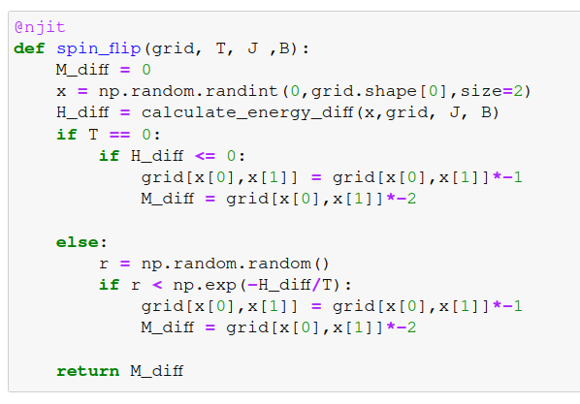
Implementation
Initialization (random or aligned)
Choosing a random spin ŝ
Proposal: Flip of ŝ
Calculation of energy difference
Accept or reject according to Metropolis
→ Back to 2.
Metropolis:

Slide 11
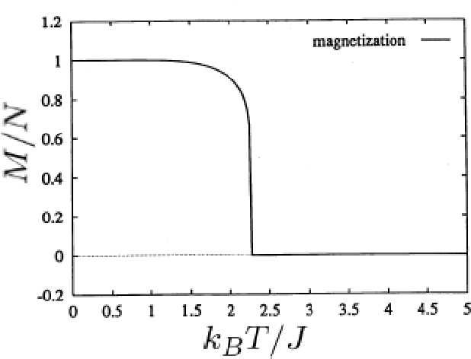
The Ising Model - Results
Onsager temperature:
for

Slide 12
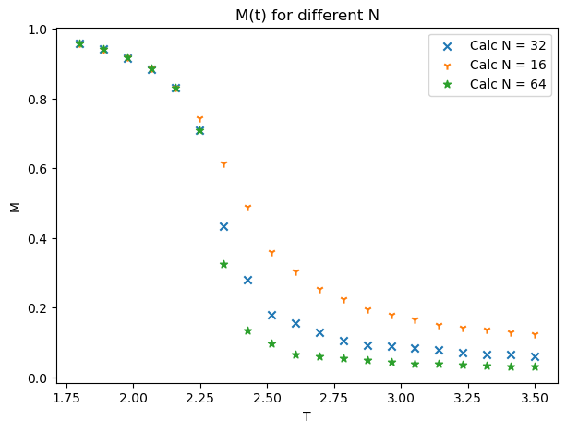
The Ising Model - Results

Slide 13
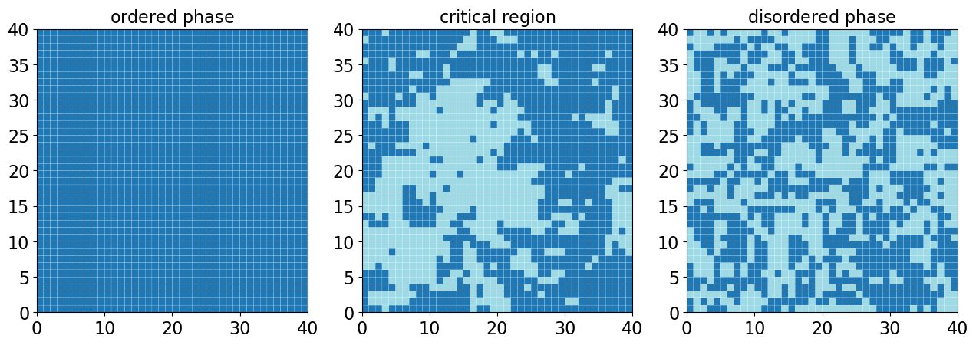
The Ising Model - Results

Slide 14
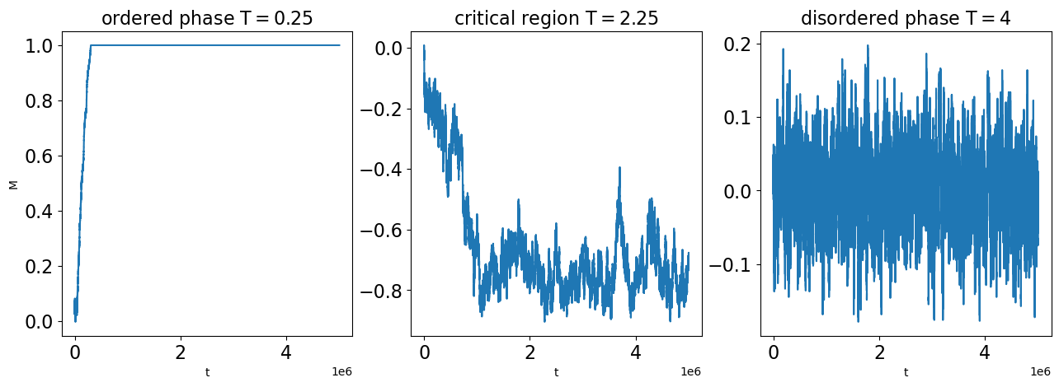
The Ising Model - Results

Slide 15
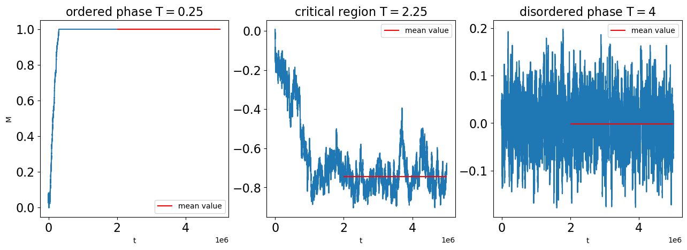
The Ising Model - Results

Slide 16
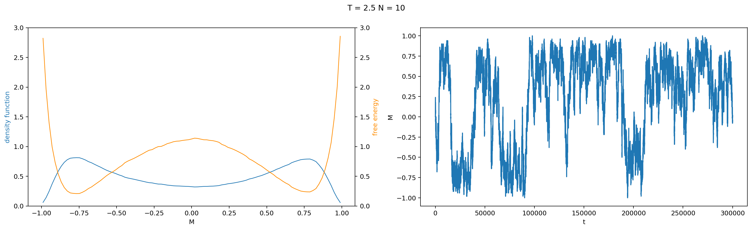
The Ising Model - Results

Slide 17
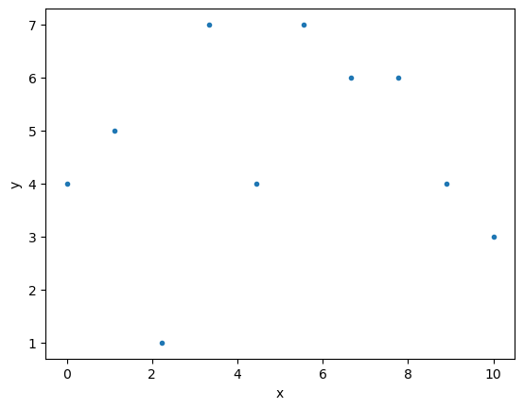
Machine learning
Dataset:
Model:
variables
parameter
Costfunction (to find optimal parameters):

Slide 18
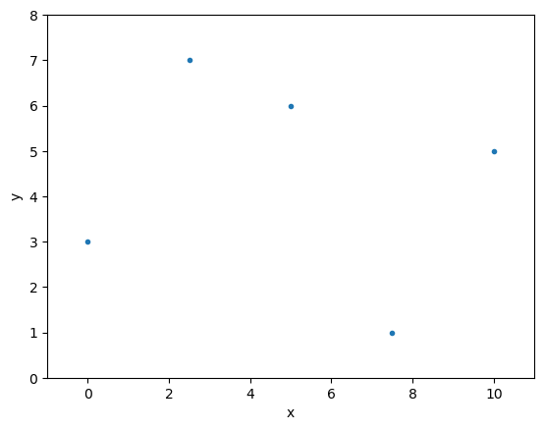
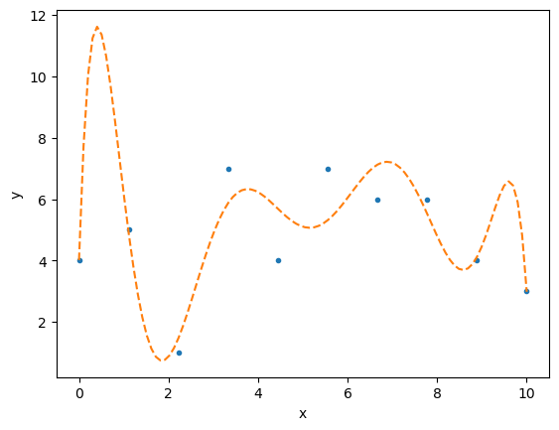
Machine learning
Dataset:
Model:
variables
parameter
Costfunction (to find optimal parameters):

Slide 19
Logistic regression
Model:
Costfunction:
Linear solver
Cross entropy
SGD stochastic gradient descent

Slide 20
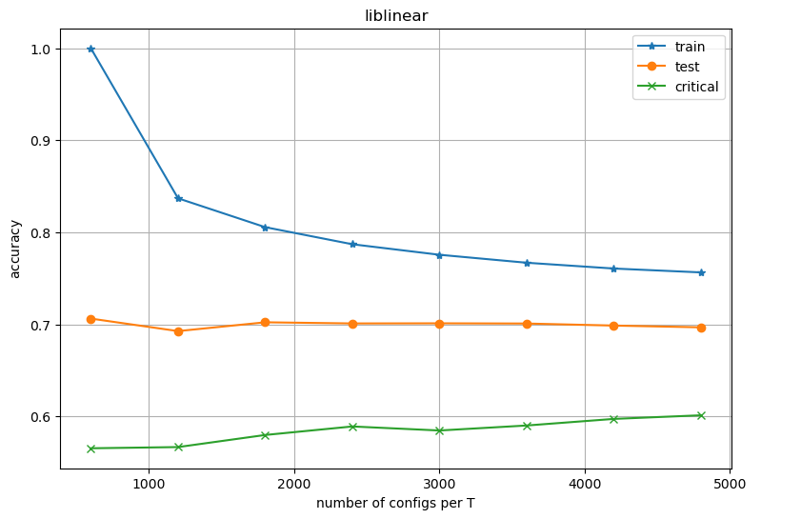
Sample size dependency

Slide 21
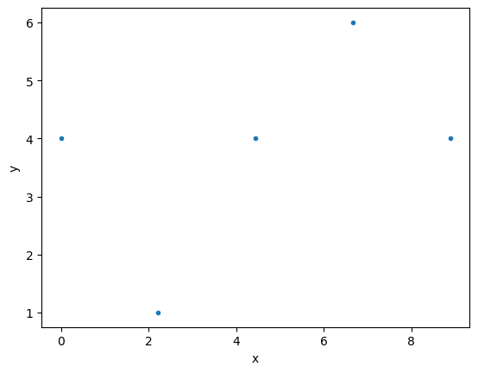
Sample size dependency

Slide 22
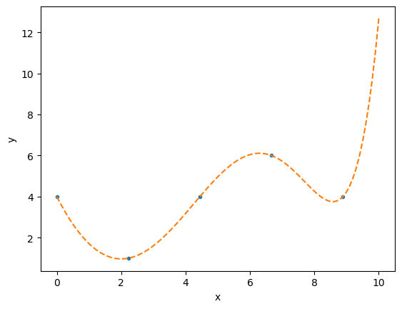
Sample size dependency

Slide 23
Sample size dependency

Slide 24
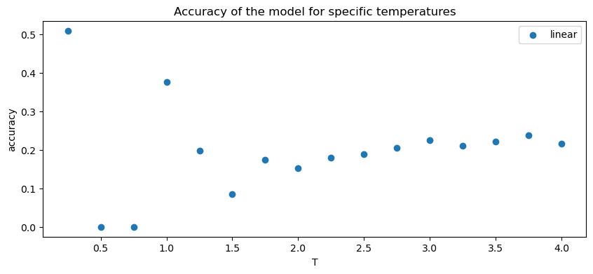
Outlook
Accuracy:
train : 0.2627
test : 0.1353

Slide 25
Sources
Gallavotti, G. (1999). Statistical mechanics : a short treatise. Texts and monographs in physics. Springer, Berlin [u.a.].
Landau, D., & Binder, K. (2014). A Guide to Monte Carlo Simulations in Statistical Physics (4th ed.). Cambridge: Cambridge University Press.
Mehta, P., Bukov, M., Wang, C.-H., Day, A. G., Richardson, C., Fisher, C. K., and Schwab, D. J. (2019).
A high-bias, low-variance introduction to machine learning for physicists. Physics Reports, 810:1–124.
Wu, X., Li, D., & Dai, Z. (2014).
MATH 505 Project : Ising model – Phase transition. (Picture)

