Slide 1
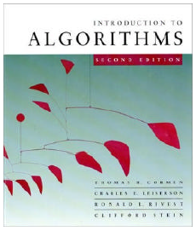
Introduction to Algorithms
Chapter 1: The Role of Algorithms in Computing

Slide 2
Computational problems
A computational problem specifies an input-output relationship
  What does the input look like?
  What should the output be for each input?
Example:
  Input: an integer number n
  Output: Is the number prime?
Example:
  Input: A list of names of people
  Output: The same list sorted alphabetically

Slide 3
Algorithms
A tool for solving a well-specified computational problem
Algorithms must be:
  Correct: For each input produce an appropriate output
  Efficient: run as quickly as possible, and use as little memory as possible – more about this later
Input
Algorithm
Output

Slide 4
Algorithms Cont.
A well-defined computational procedure that takes some value, or set of values, as input and produces some value, or set of values, as output.
Written in a pseudo code which can be implemented in the language of programmer’s choice.

Slide 5
Correct and incorrect algorithms
Algorithm is correct if, for every input instance, it ends with the correct output. We say that a correct algorithm solves the given computational problem.
An incorrect algorithm might not end at all on some input instances, or it might end with an answer other than the desired one.
We shall be concerned only with correct algorithms.

Slide 6
Problems and Algorithms
We need to solve a computational problem
  “Convert a weight in pounds to Kg”
An algorithm specifies how to solve it, e.g.:
  1. Read weight-in-pounds
  2. Calculate weight-in-Kg = weight-in-pounds * 0.455
  3. Print weight-in-Kg
A computer program is a computer-executable description of an algorithm

Slide 7

The Problem-solving Process
Analysis
Problem specification
Design
Algorithm
Implementation
Program
Compilation
Executable (solution)

Slide 8



From Algorithms to Programs
Problem
Algorithm: A sequence of instructions describing how to do a task (or process)
C++ Program

Slide 9
Practical Examples
Internet and Networks
  􀂄 The need to access large amount of information with the shortest time.
  􀂄 Problems of finding the best routs for the data to travel.
  􀂄 Algorithms for searching this large amount of data to quickly find the pages on which particular information resides.
Electronic Commerce
  􀂄 The ability of keeping the information (credit card numbers, passwords, bank statements) private, safe, and secure.
  􀂄 Algorithms involves encryption/decryption techniques.

Slide 10
Hard problems
We can identify the Efficiency of an algorithm from its speed (how long does the algorithm take to produce the result).
Some problems have unknown efficient solution.
These problems are called NP-complete problems.
If we can show that the problem is NP-complete, we can spend our time developing an efficient algorithm that gives a good, but not the best possible solution.

Slide 11
Components of an Algorithm
Variables and values
Instructions
Sequences
  A series of instructions
Procedures
  A named sequence of instructions
  we also use the following words to refer to a “Procedure” :
    Sub-routine
    Module
    Function

Slide 12
Components of an Algorithm Cont.
Selections
  An instruction that decides which of two possible sequences is executed
  The decision is based on true/false condition
Repetitions
  Also known as iteration or loop
Documentation
  Records what the algorithm does

Slide 13
A Simple Algorithm
INPUT: a sequence of n numbers
  T is an array of n elements
  T[1], T[2], …, T[n]
OUTPUT: the smallest number among them
Performance of this algorithm is a function of n
min = T[1]
for i = 2 to n do
{
if T[i] < min
min = T[i]
}
Output min

Slide 14
Greatest Common Divisor
The first algorithm “invented” in history was Euclid’s algorithm for finding the greatest common divisor (GCD) of two natural numbers
Definition: The GCD of two natural numbers x, y is the largest integer j that divides both (without remainder). i.e. mod(j, x)=0, mod(j, y)=0, and j is the largest integer with this property.
The GCD Problem:
  Input: natural numbers x, y
  Output: GCD(x,y) – their GCD

Slide 15
Euclid’s GCD Algorithm
GCD(x, y)
{
while (y != 0)
{
t = mod(x, y)
x = y
y = t
}
Output x
}

Slide 16
Euclid’s GCD Algorithm – sample run
while (y!=0) {
int temp = x%y;
x = y;
y = temp;
}
Example: Computing GCD(72,120)
temp x y
After 0 rounds -- 72 120
After 1 round 72 120 72
After 2 rounds 48 72 48
After 3 rounds 24 48 24
After 4 rounds 0 24 0
Output: 24

Slide 17
Algorithm Efficiency
Consider two sort algorithms
  Insertion sort
    takes c1n² to sort n items
    where c1 is a constant that does not depends on n
    it takes time roughly proportional to n²
  Merge Sort
    takes c2 n lg(n) to sort n items
    where c2 is also a constant that does not depends on n
    lg(n) stands for log₂ (n)
    it takes time roughly proportional to n lg(n)
Insertion sort usually has a smaller constant factor than merge sort
  so that, c1 < c2
Merge sort is faster than insertion sort for large input sizes

Slide 18
Algorithm Efficiency Cont.
Consider now:
  A faster computer A running insertion sort against
  A slower computer B running merge sort
  Both must sort an array of one million numbers
Suppose
  Computer A execute one billion (10⁹) instructions per second
  Computer B execute ten million (10⁷) instructions per second
  So computer A is 100 times faster than computer B
Assume that
  c₁ = 2 and c₂ = 50

Slide 19
Algorithm Efficiency Cont.
To sort one million numbers
  Computer A takes
    2 . (10⁶)² instructions
    10⁹ instructions/second
    = 2000 seconds
  Computer B takes
    50 . 10⁶ . lg(10⁶) instructions
    10⁷ instructions/second
    ≈ 100 seconds
By using algorithm whose running time grows more slowly, Computer B runs 20 times faster than Computer A
For ten million numbers
  Insertion sort takes ≈ 2.3 days
  Merge sort takes ≈ 20 minutes

Slide 20
Pseudo-code conventions
Algorithms are typically written in pseudo-code that is similar to C/C++ and JAVA.
Pseudo-code differs from real code with:
  It is not typically concerned with issues of software engineering.
  Issues of data abstraction, and error handling are often ignored.
Indentation indicates block structure.
The symbol "▹" indicates that the remainder of the line is a comment.
A multiple assignment of the form i ← j ← e assigns to both variables i and j the value of expression e; it should be treated as equivalent to the assignment j ← e followed by the assignment i ← j.

Slide 21
Pseudo-code conventions
Variables ( such as i, j, and key) are local to the given procedure. We shall not us global variables without explicit indication.
Array elements are accessed by specifying the array name followed by the index in square brackets. For example, A[i] indicates the ith element of the array A. The notation “…" is used to indicate a range of values within an array. Thus, A[1…j] indicates the sub-array of A consisting of the j elements A[1], A[2], . . . , A[j].
A particular attributes is accessed using the attributes name followed by the name of its object in square brackets.
  For example, we treat an array as an object with the attribute length indicating how many elements it contains( length[A]).

Slide 22
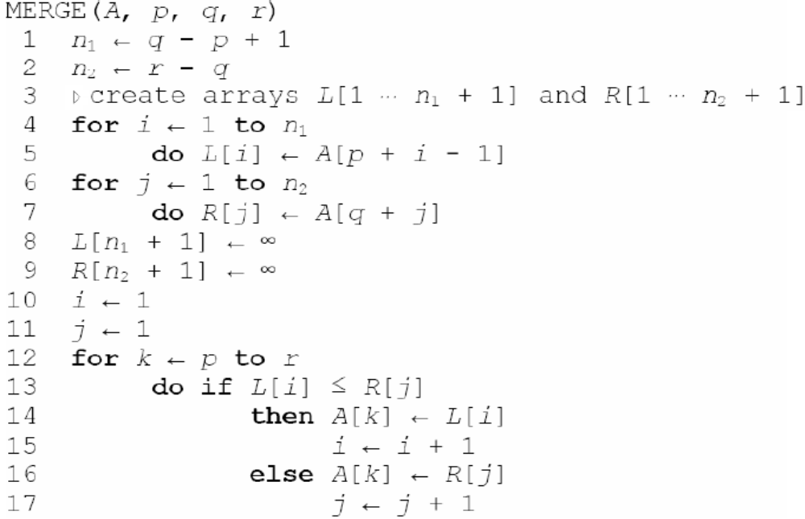
Pseudo-code Example

