Slide 1
Algorithmic Problem Solving CMSC 201 Adapted from slides by Marie desJardins

Slide 2
Algorithms
An algorithm is an ordered set of unambiguous steps that describes a process
Examples from real life:
Recipes
Project directions - chemistry lab, writing prompt
Instruction manual (IKEA)

Slide 3
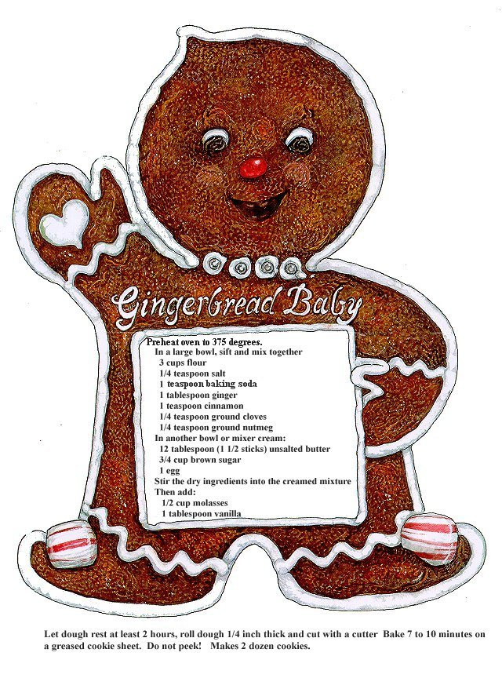

Slide 4
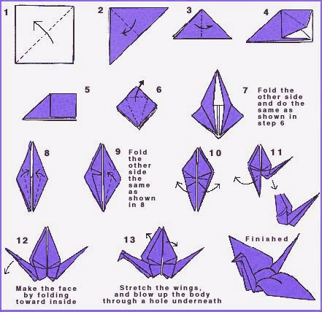

Slide 5
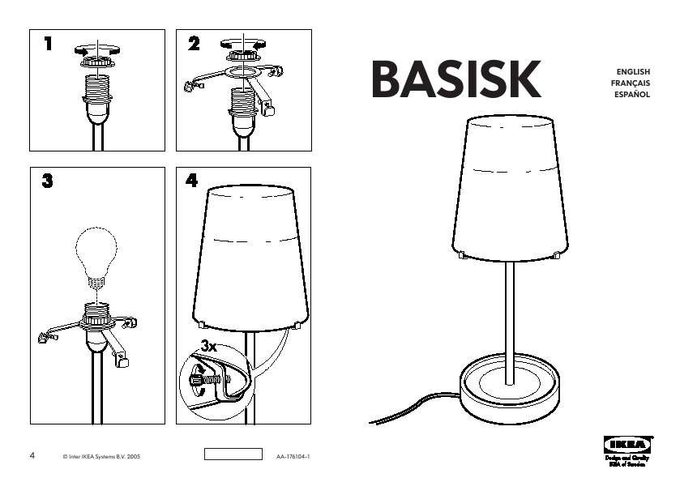

Slide 6
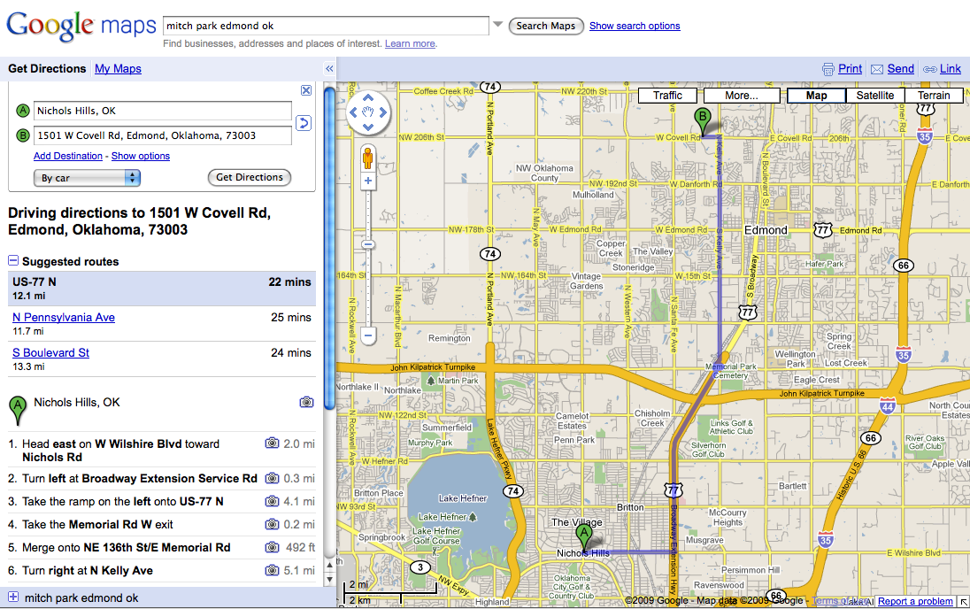

Slide 7
Algorithms Express Solutions to Computational Problems
Algorithms are expressed and implemented using languages
Possibilities: natural language, pseudocode, visual and textual programming languages
Different languages may be more suitable for solving different problems
The choice of language can affect clarity or readability, but not whether a solution exists
Algorithms can solve many, but not all, problems
Many problems can be solved in a reasonable time
Some require heuristic (approximate) approaches to solve them in a reasonable time
Some problems cannot be solved using any algorithm
Algorithms are evaluated analytically and empirically
Many possible criteria (e.g., efficiency, correctness, usability, ...)
Different algorithms for the same problem can have different measurements for these criteria

Slide 8
Algorithms: Syntax and Semantics
Before you can write an algorithm, you have to have a language in which to express it
Basic components of every algorithmic language:
“Primitive” actions
Conditionals: if <condition> then <actions>
Loops: repeat <actions> until <condition>
Variables: places to store information
Input and output: ways to get information into the algorithm and to return information to the invoker
Functions: ways to group instructions into a “macro-action” or “subgoal”

Slide 9
Three main control constructs for algorithm development
.
When developing algorithms, we have 3 control structures available to us
Sequence (i.e. one line after the other)
Decision making (e.g. using if/else constructs)
Looping (e.g. using while loops)

Slide 10
Example – Sequential
.
Develop an algorithm that will calculate an hourly employee’s weekly pay
Step 1 : Understand the problem
Input : pay rate and number of hours
Process: pay = rate * hours
Output: pay

Slide 11
Algorithm – Calculate pay
.
Plain English
Ask for the pay rate and the number of hours worked. Multiply the pay rate by the number of hours. The result is the pay
Pseudocode - looks like code, but not a real language
1. Variables: hours, rate, pay
2. Display “Number of hours worked: ”
3. Get hours
4. Display “Amount paid per hour: ”
5. Get rate
6. pay = hours * rate
7. Display “The pay is $” , pay
Notice the importance of order and lack of ambiguity

Slide 12
Example - Flowchart
Start
Display “Amount paid per hour: ”
Display “Number of hours worked: ”
Get rate
Get hours
pay = hours * rate
Display “The pay is $”, pay
End

Slide 13
Example – Decision Making
.
Develop an algorithm that will figure out if a number is positive
Step 1 : Understand the problem
Input : The number
Process: Is it greater than zero?
Output: Message that number is positive or non-positive

Slide 14
Algorithm
.
Plain English
Ask for the number. Check if it is greater than zero. If it is, it is a positive number. If not (i.e. else), it is not positive
Pseudocode -
1. Variable: num
2. Display “Enter the number: ”
3. Get num
if num > 0
Display “It is positive”
Else
7. Display “It is not positive”

Slide 15
Flowcharts-Decision Making Example
If num > 0 display “Positive”
Else (that means 0 or negative) display “Not Positive”
num >0?
True
False
Display “positive”
Display “Not positive”

Slide 16
Looping
Develop an algorithm that will add the numbers from 1 to 10. That is 1 + 2 + 3 + …+ 10 = 55
Step 1 : Understand the problem
Input : None needed
Process: Add 0 to 1 to get a new sum. Add 2 to the old sum to get a new sum. Add 3 to the old sum to get a new sum……Add 10 to the old sum to get a new sum
Output: The new sum after 10 iterations

Slide 17
Algorithm
.
Plain English
Start count at 1. Add to the sum (originally zero) to get a new sum. Increment the count. Repeat the last two steps 10 times
Pseudocode -
While_Example
Numeric Variables: counter = 1, sum = 0
2. While counter <= 10:
sum = sum + counter
counter = counter + 1
EndWhile
Display “ The sum is”, sum

Slide 18
Averaging Algorithm
Come up with an algorithm to average a list of numbers
For each number in the list, add that number to a counter (initially zero). Once this is done, divide the counter by the number of items in the list.
Notice that we had to create another number to 'store' information in. In a programming language something like this is called a variable. Variables are a name that is attached to a number or other piece of information. Think of it as a bucket with a number inside of it.

Slide 19
Averaging Algorithm
A more programmatic version of the algorithm:
Average(listOfNumbers, length)
Create a variable called counter starting at zero
For each number in listOfNumbers:
Add that number to counter
Set counter to (counter / length)
Return counter

Slide 20
Averaging Algorithm
What the algorithm looks like in python:
def average(listOfNumbers, length):
counter = 0
for currentNumber in listOfNumbers:
counter = counter + currentNumber
counter = counter / length
return counter

