Slide 1
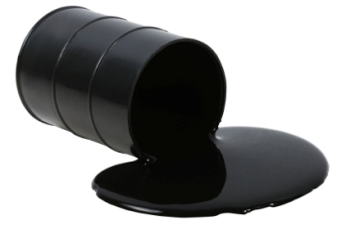
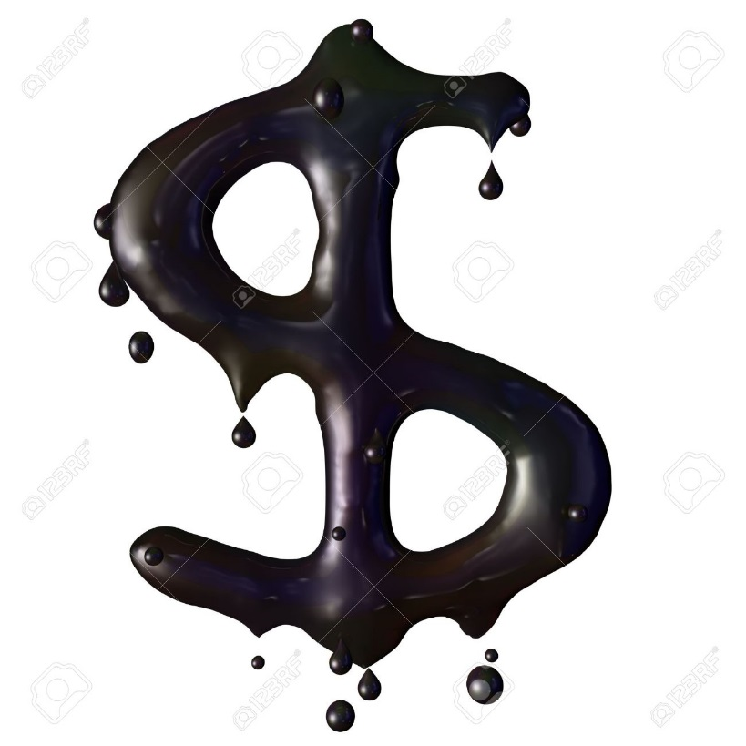
Crude oil…the traditional starting material of Organic Chemistry
What fraction of the oil pumped out of the ground is used to make plastics, road tar and anything else tangible ?
Answer: < 2%. The rest is burned for energy

Slide 2
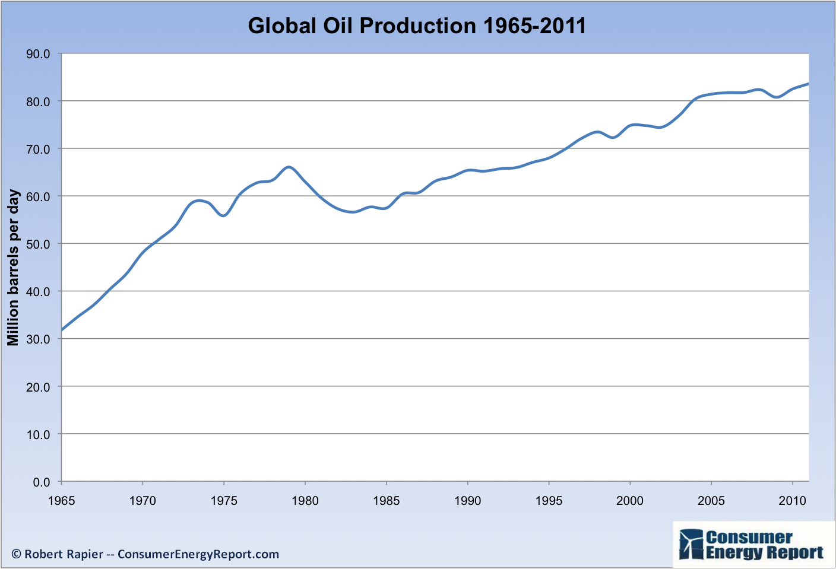
1 barrel of oil=42 gallons=> ~1.3*10¹² gallons of oil/year in 2010

Slide 3
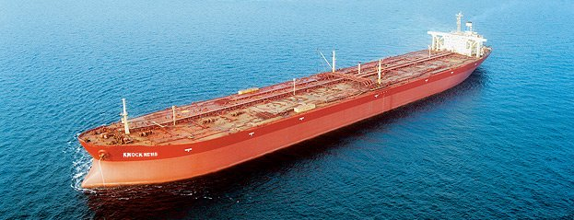
1 super tanker holds ~2 million gallons of crude
1.3*10¹²/2*10⁶=~ 630,000 tankers worth/year

Slide 4
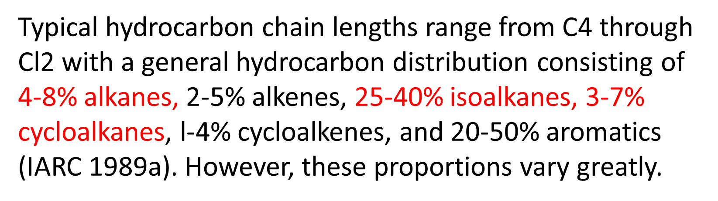
Crude oil composition
https://www.atsdr.cdc.gov/toxprofiles/tp123-c2.pdf

