Slide 1
Fire monitoring
Helwan forest firefighters
Forest fire Disaster
Current solutions

Slide 2



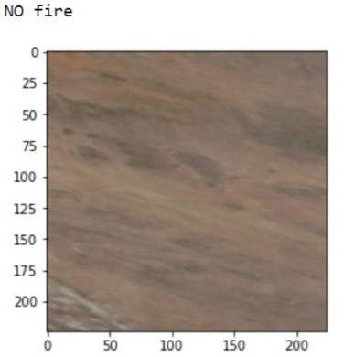
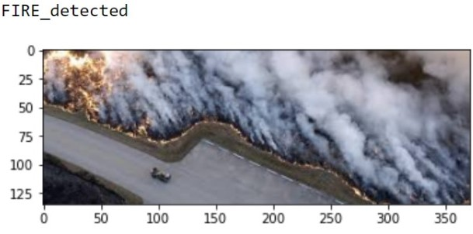



Fire
No Fire

Slide 3




Display the detected abnormal readings from the sensors

Slide 4





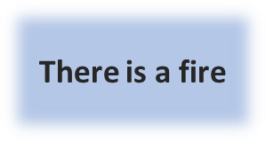
Java app
server
Sensor Node
SN
SN
unreliable readings detected
Main Cluster
Data given from NASA
SN
SN
SN
Cluster 2
SN
SN
SN
C V model
Cluster 1
There is a fire
SN

Slide 5
Main Cluster Head
Java app
SIM Card
ESP
LoRaWANModule
Sensor Node
Micro Controller
LoRaWAN Module
Server
Local Storage
Micro Controller
Smoke sensor
CO sensor
temperature sensor
Php file
Smoke sensor
CO sensor
temperature sensor
Battery
Solar system panel
Battery
Solar system panel
Cluster
Main cluster head
Sensor node
Sensor node
Cluster head
Cluster head
Cluster head
Cluster head

Slide 6
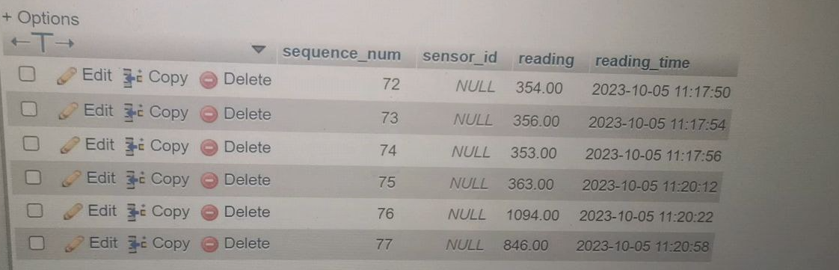
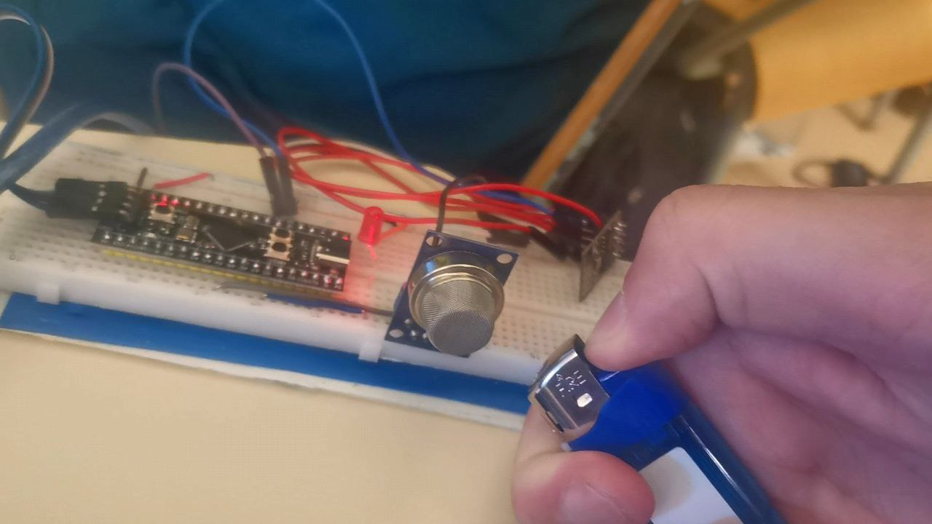
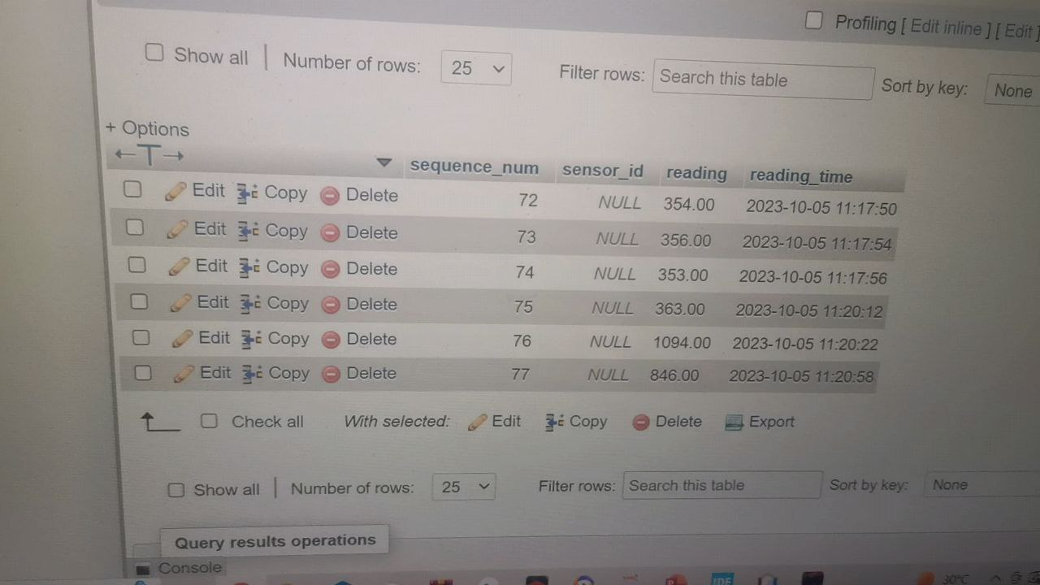
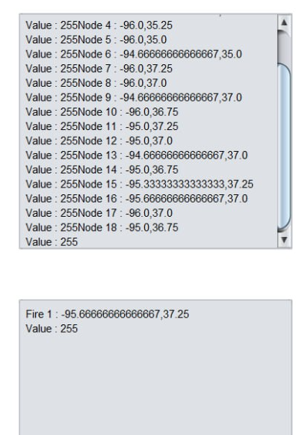
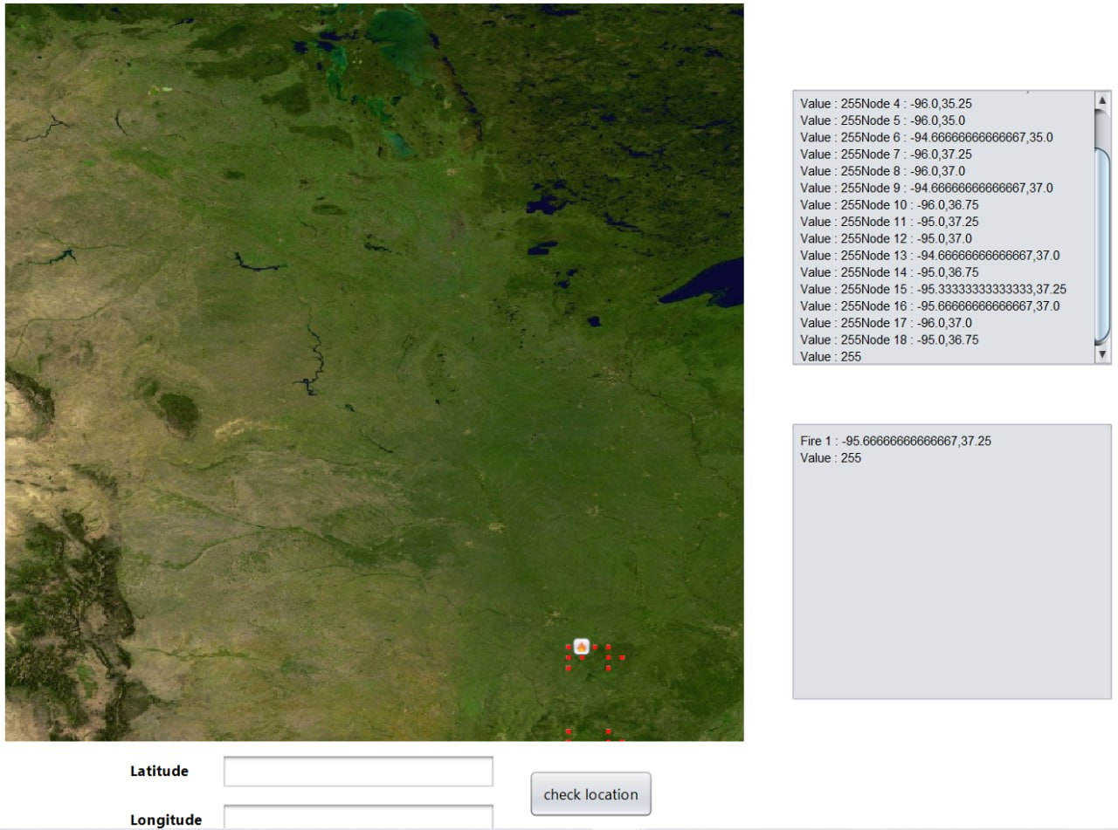
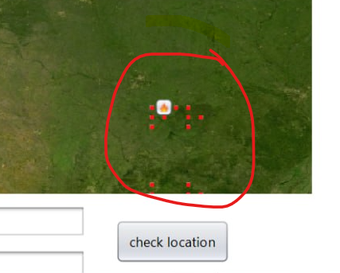

Slide 7
Why it is a well designed system
  Scalability (CLUSTERS)
  Reliability (BACKUP )
  security (Lora wan)
  Wide sensing range

