Slide 1
Midterm Project
© Templateswise.com
HEMN451-Medical Pattern Recognition
Team Members:
Hoda Hossam [1170156]
Mohammed Nader [1170366]
Tasneem Adel [1162182]

Slide 2
What is Image Segmentation ?
Image segmentation is the process of partitioning of digital images into various parts or regions (of pixels) reducing the complexities of understanding the images to machines.
Various image segmentation algorithms are used to split and group a certain set of pixels together from the image.

Slide 3
Image Segmentation Algorithms
1-Fuzzy-C-means
2-SNN
3-SVM

Slide 4
Problem-1 (Fuzzy-C-means)
Algorithm
This algorithm works by assigning membership to each data point corresponding to each cluster center based on distance between the cluster center and the data point.

Slide 5
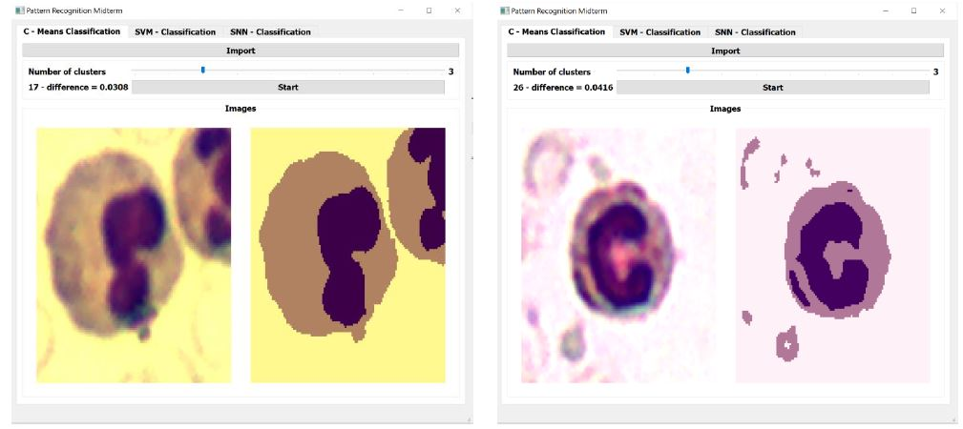
Outputs

Slide 6
Problem-2 (SNN)
Algorithm
In this work we implement a Simple Neural Network (SNN), with one hidden layer, that performs multi-label classification.

Slide 7
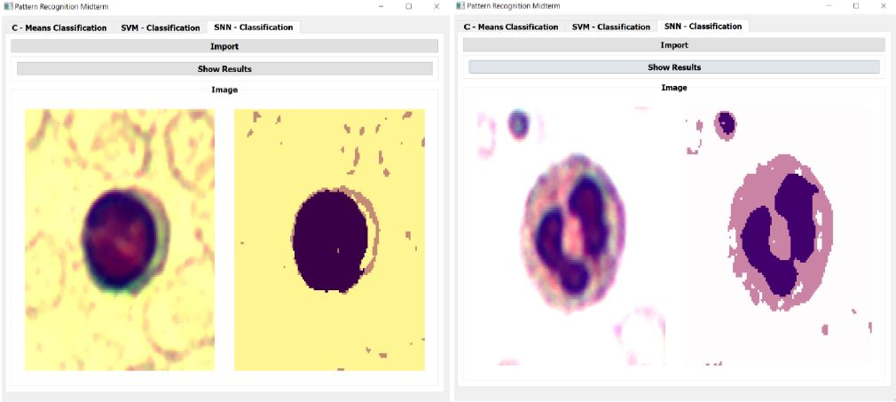
Outputs

Slide 8
Problem-3 (SNN)
Algorithm
In Support Vector Machine (SVM) algorithm we plot each data item as a point in n-dimensional space (where n is number of features you have) with the value of each feature being the value of a particular coordinate.
Then, we perform classification by finding the hyper-plane that differentiates the two classes very well.

Slide 9
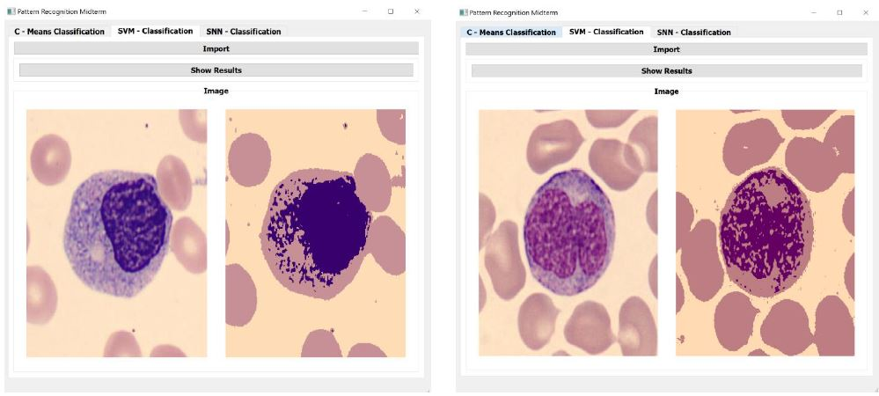
Outputs

Slide 10
Credits
This resource has been created by Templateswise.com

