Slide 1
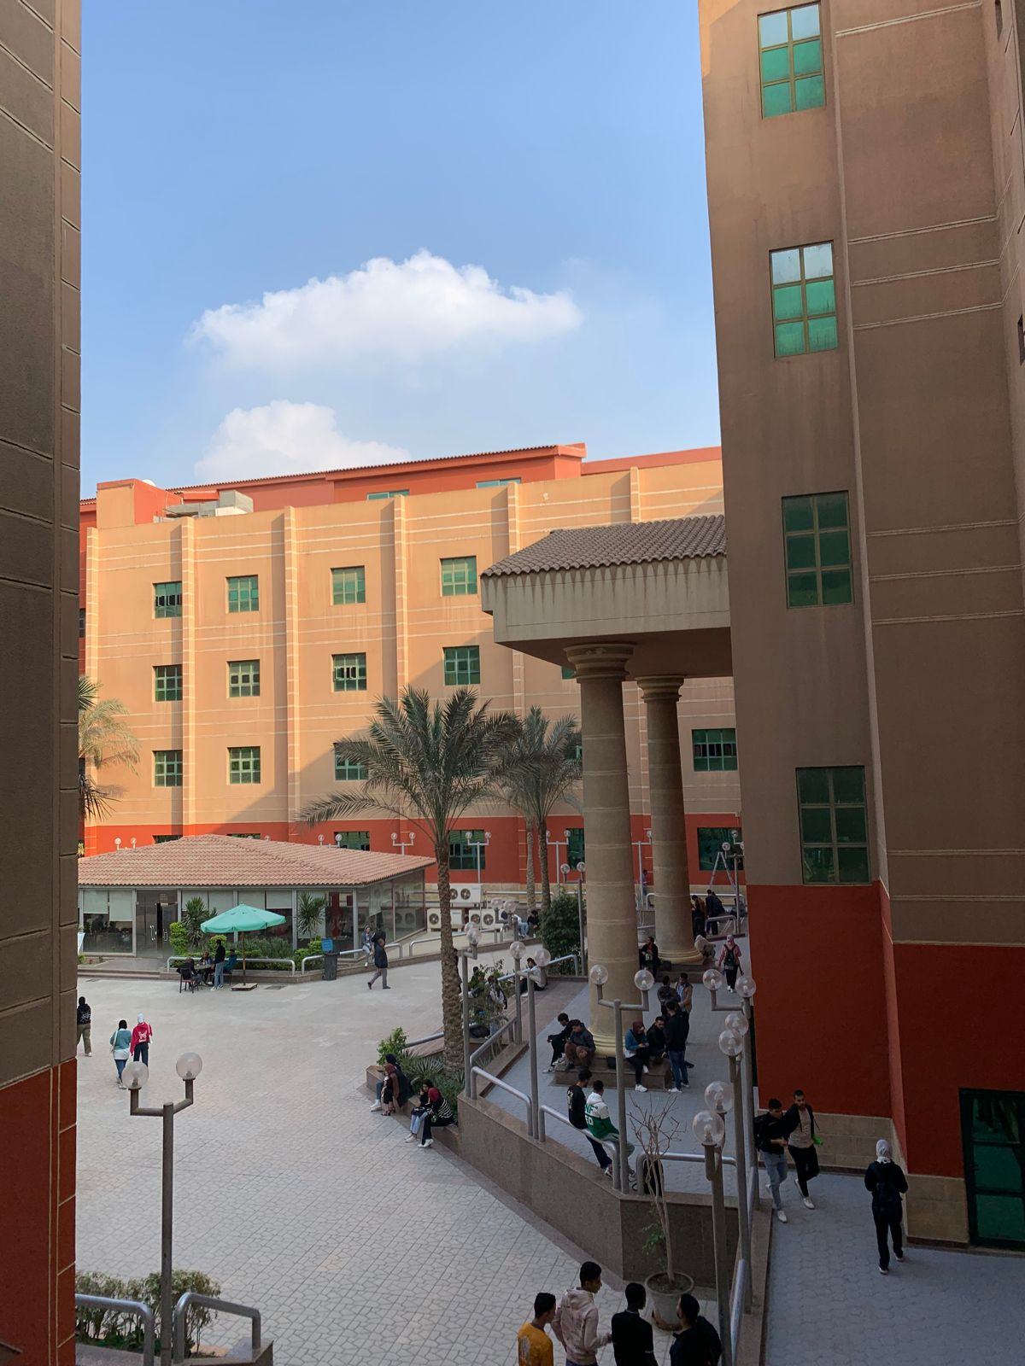
GIS Campus Safety
Application
Supervised By:
. Prof Dr. Elsheshtawy
. Dr. Kamel Soliman
. T.A. Aya Saber
Presented By:
. Abdelrahman Mohamed Eid Hassan
. Mohamed Shams Alden Ali Tarakji
. Abdulrahman Mohamed Sayed Khalaf
. Mohamed Mahmoud Khaled Mohamed
. Mohamed Abdelazeem Fathy
. Ali Ayman Abdelhaq Mabrouk
. Loaay Samir Helmy Hassan

Slide 2
Agenda
01
02
03
Project Background
Project Planning
Related Work
04
05
06
System Analysis &
Design
User interface
Conclusion & What’s
next

Slide 3

1.
Project Background

Slide 4
Introduction
. Using GIS in education
Using GIS helps students frame , visualize their problems. It even enables students to create solutions to those problems.
. Increase awareness of safety
Knowledge of security measures build trust and create positive learning environment
. Crime prevention
Reduce opportunities for incidents, decrease crimes rate and inform individuals to take precautions
. Accessible and usable resources
Safety guides and sos app to help students and staff through emergencies with an easy to use application

Slide 5
Problem Definition
with the continuous increase of our university batches every year , thousands of students commit to their colleges.
and they may face a problem that needs urgent help with.
For example :
Crimes as stealing and harrasement
Student fights , arguments , crowds
Health problems as Fainting , diabetes, blood pressure
Building problems as :
power cutoff , water leakage
broken window

Slide 6
Solution Approach
After the research and related works discussions We categorized the problems into 3 sections :
- Emergencies
- Health problems that require medicals involve as diabetes, angina
- General inquiries that can wait to get a response
Ensuring campus safety must be considered to encounter the following:
- Personal Safety: Immediate access to resources can be life-saving during
emergencies, impacting students, faculty, and staff.
- Trust Building: Knowledge of security measures fosters trust, creating a positive
learning environment.
- Crime Prevention: Awareness deters crimes; informed individuals take precautions,
reducing opportunities for incidents.
- Legal Obligations: Institutions must provide safety; failure leads to legal
consequences and damages reputation.

Slide 7
Objective
We aim for:
- Building an interactive mobile application for campus safety
. responsive app
. easy to use
- Increasing awareness of safety in our university
. useable application for whenever you face a problem in campus
- Accessible resources to all students and staff
. you can use our application for general inquiries and any safety question you have
- Monitoring students to solve any problems they may cause
as the security can access live cameras through the application, and the reports sent by students.

Slide 8
2.
Project Planning

Slide 9
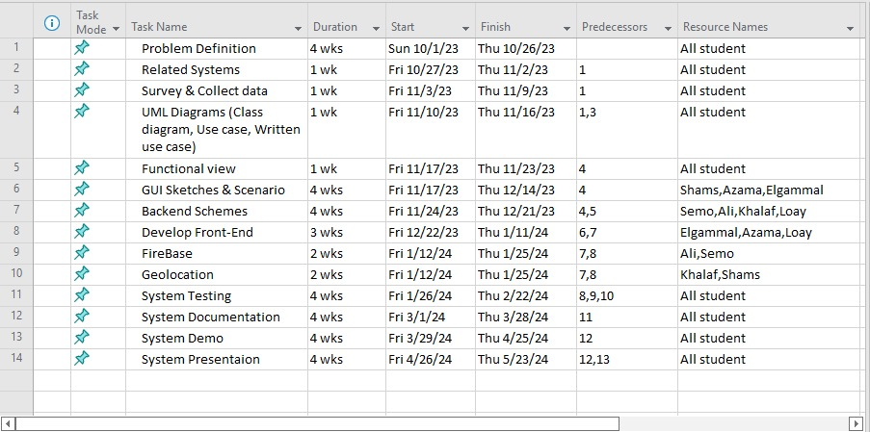

Slide 10
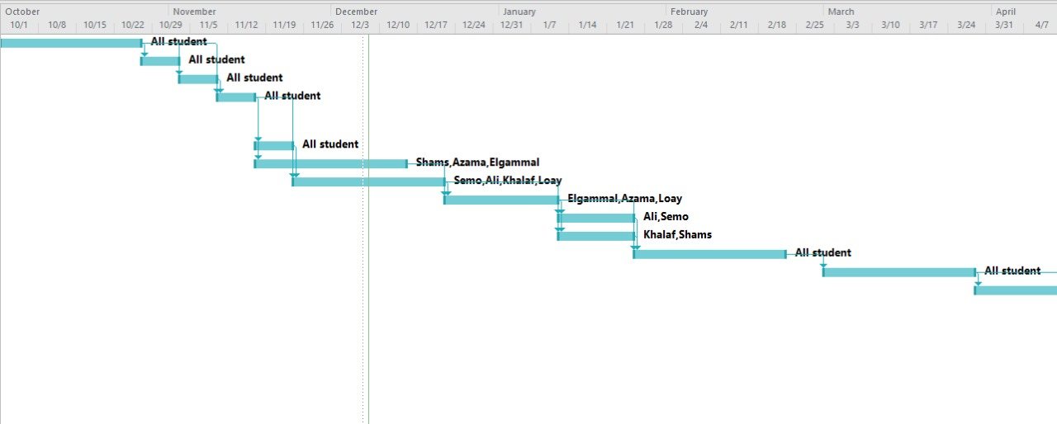
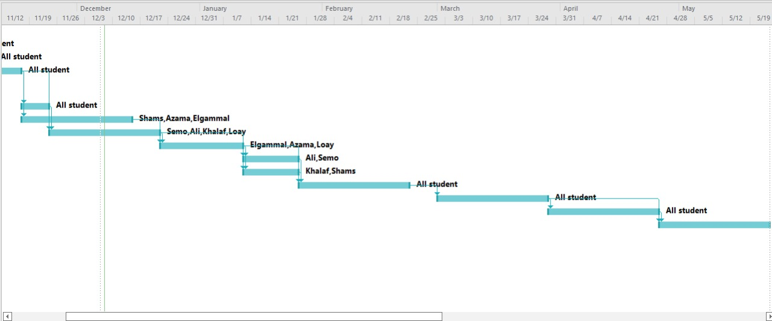

Slide 11
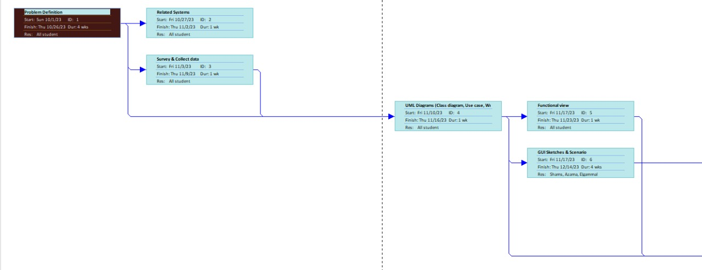

Slide 12
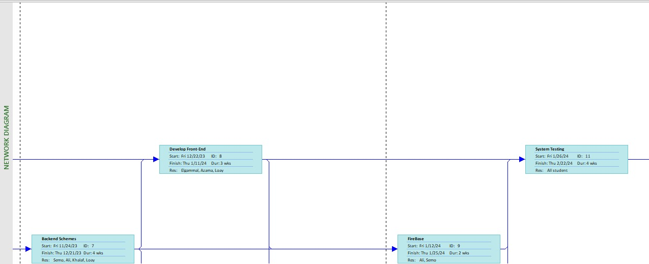

Slide 13
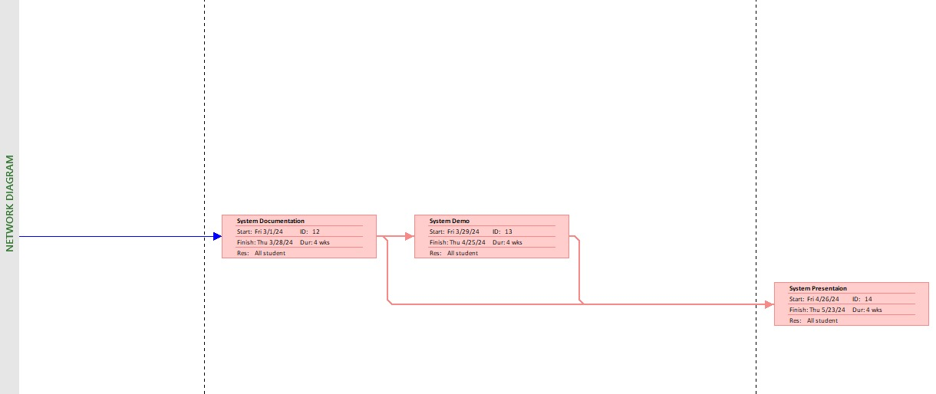

Slide 14
3.
Related Work

Slide 15



OWL SAFE
Safe Zone
Live Safe

Slide 16
1.
OWL SAFE
Partner in creating a secure and protected learning environment.
Designed with cutting-edge technology and a commitment to safeguarding educational institutions.
. Instant emergency notifications
. Two-Way communication
. Safety Check-Ins
. Safety tips and resources
. SoS button
. Anonymous reporting

Slide 17
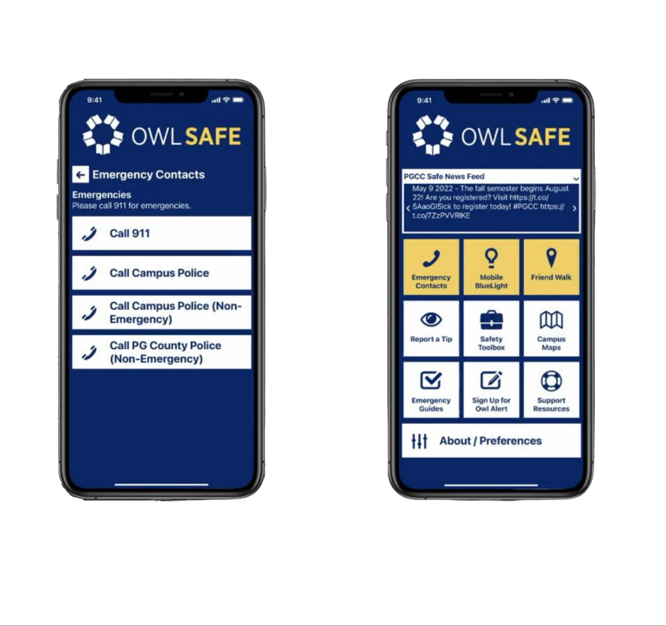

Slide 18
2.
Safe Zone
free-to-download application from Critical Arc that connects you directly to your organization's response team when you need help.
When you are in any Safe Zone area designated by your organization, the mobile app provides a variety of safety features, including: - Emergency alerts: Safe Zone can send emergency alerts to users in the event of a campus emergency. - Check-ins: Safe Zone allows users to check in with security personnel when they are walking alone or working late. - First aid calls: Safe Zone allows users to call for first aid assistance in the event of an injury or illness.

Slide 19
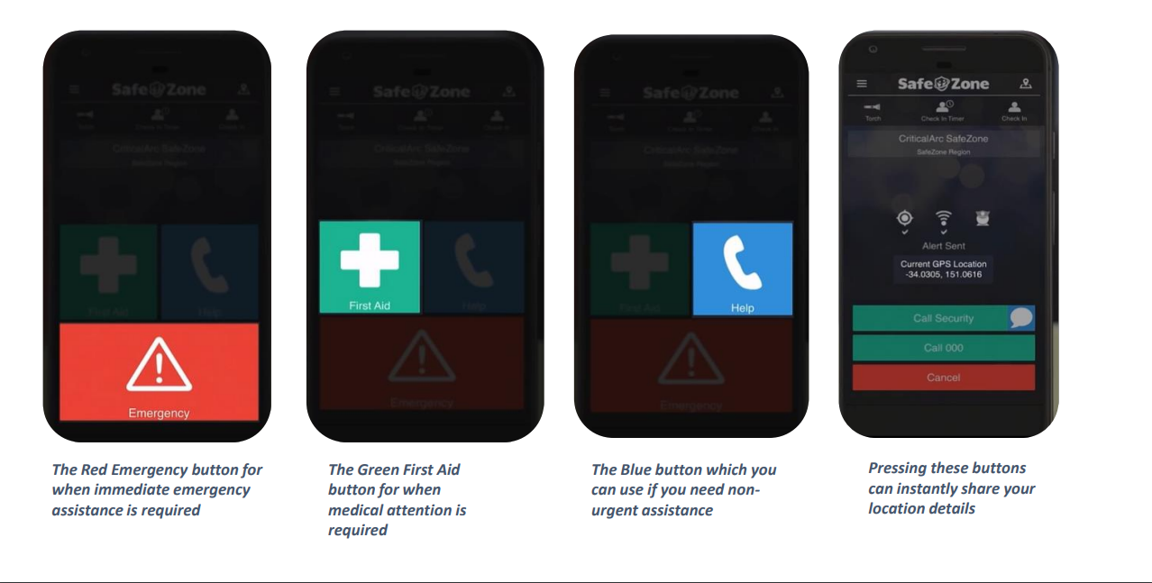

Slide 20
3.
Live SAFE
designed to empower Individuals and organizations with the tools they need to enhance safety, and communication in -Real Time- - Users can access a real-time safety map, which displays reported incidents and areas to avoid - Access a wealth of safety resources and information, including emergency contact numbers - Anonymous Reporting: Live Safe enables anonymous reporting, encouraging users to share concerns without fear of retaliation.

Slide 21
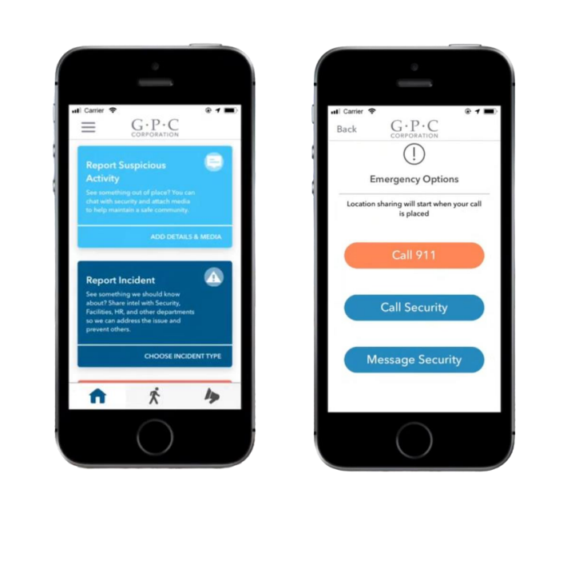

Slide 22
Safe Campus | Live Safe | Safe Zone | OWL SAFE
Yes | No | No | No | Live Camera
Yes | Yes | No | Yes | Upload images / videos
Yes | Yes | Yes | Yes | Location
No | Yes | Yes | Yes | Review Report
No | Yes | No | No | Chat

Slide 23
4.
System Analysis
& Design

Slide 24
Functional View
1-Maintain Basic Data:
Security Personnel
(First Name , Last Name ,Email ,Password ,Phone Number , ID Number).
Manager
(First Name ,Last Name , Email , Password ,ID Number)
3-Perform Transactions:
Student:
- Send Request to Security personnel
- Call security directly
Security Personnel:
-Respond to student request
2-Issue Query Subsystem:
1. Student:
- Access to emergency contact information and reporting incidents
- Ability to request security assistance
- Access to safety tips and guidelines
2. Security Personnel:
- Monitoring and tracking of users on the campus map
- Ability to receive and respond to emergency reports or requests for assistance.
- Show the best road based on google maps API.
3. Manager:
- Ability to view weekly updates for reports on the campus
4-Generate Reports:
Management Reports:
Generate reports about requests sent to security
Generate total weekly reports that happened

Slide 25
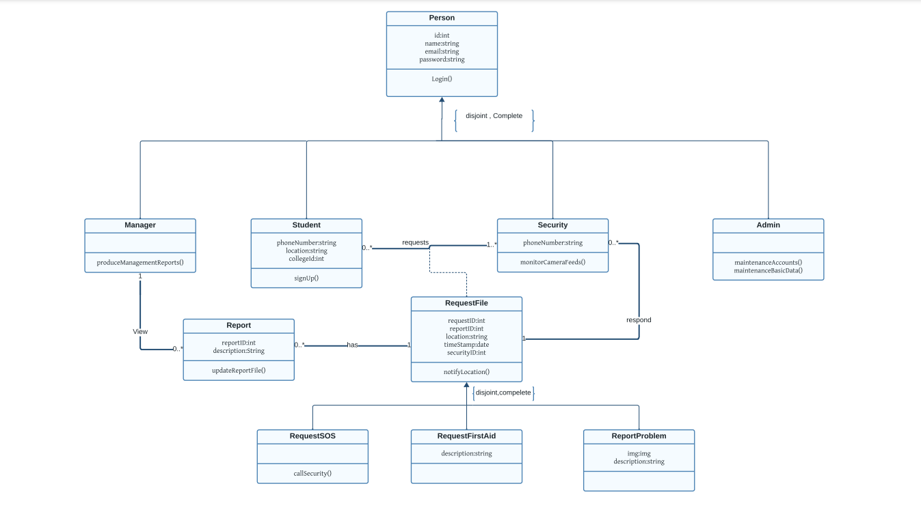
Class Diagram

Slide 26
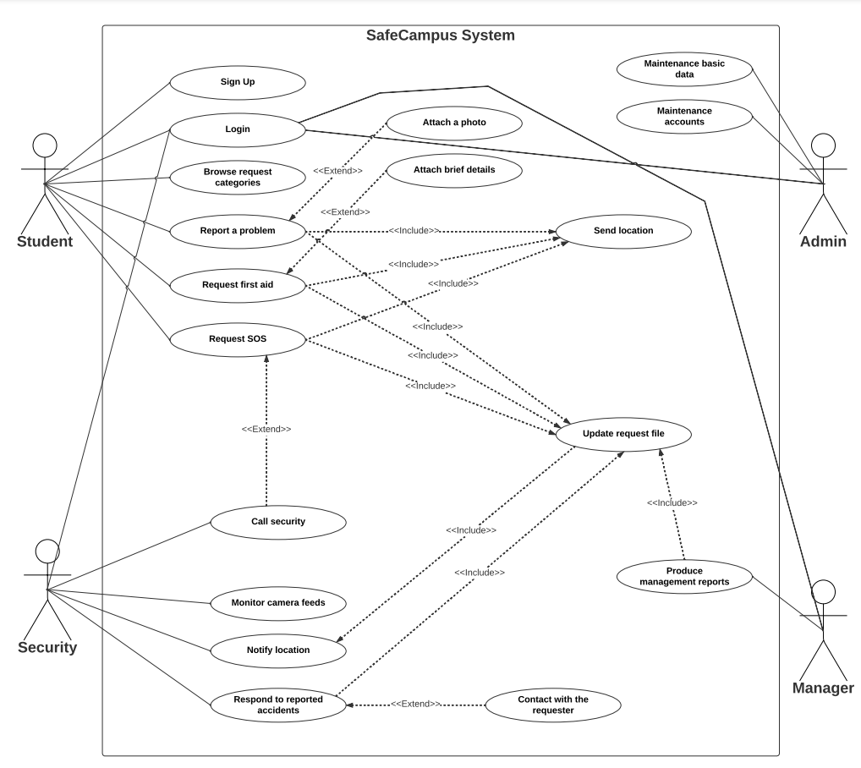
Use Case

Slide 27
Written Use Case
Login
1. If the student has a valid account on the SafeCampus application.
2. The student navigates to the SafeCampus application and enters his registered email address and password.
3. If the student forgets his password: The student clicks the "Forgot Password" link and follows the password reset instructions.
4. The student clicks the "Login" button.
5. The application validates the student's inputs.
6. If the inputs are valid, the student is logged into his account.
7. If the inputs are invalid, the student is prompted to enter his inputs again.

Slide 28
Sign Up
1. The student navigates to the SafeCampus application and clicks the "Sign Up" button.
2. The student enters his name, phone number, college ID, and email, and creates a password.
3. The student agrees to the SafeCampus terms of service and clicks the "Sign Up" button.
4. If the student enters invalid inputs: The student is prompted to enter valid inputs.
5. The student is redirected to the SafeCampus application login page.

Slide 29
Report a problem
1. The student launches the SafeCampus app on his mobile device.
2. The student logs in to the app.
3. From the home page, the student clicks on the "Report a problem" button.
4. The student is presented with a form to describe the problem.
5. The student provides a brief description of his problem.
6. The student attaches a photo of his problem (optional).
7. The student submits the problem report.
8. The application sends a confirmation alert to the user acknowledging his report.
9. A security reviews the problem report and takes appropriate action to resolve the issue.
10. The student informs the application that the problem has been solved.

Slide 30
Request first aid
1. The injured student or any person next to him contact Security via the application.
2. The injured student or the person else clearly states their need for first aid assistance by clicking the "first aid" button and providing main information, such as: Do you/Does he have any chronic diseases?, Provide brief details about your/his case.
3. Click the "Submit" button.
4. The injured Student or the person else follows the instructions provided by the application until assistance arrives.

Slide 31
Request SOS
1. The student clicks on the "SOS" button.
2. While the student is waiting for the security personnel, he can contact the security personnel to provide him with more clear information or send a message. 3. The system sends a confirmation alert to the user acknowledging his report and that his location has been sent to security.
4. A security reviews the problem report and takes appropriate action to resolve the issue.
5. The student informs the application that the problem has been solved.

Slide 32
Security’s Section
Monitor camera feeds
1. The security personnel logs into the application by its email address and password.
2. The application will check if the email address and password are valid or not.
3. The application confirms the validity of the information entered.
4. The application will open the security panel.
5. The security personnel taps on the "Monitor Camera Feeds" button in the mobile application.
6. The security personnel monitors the camera feed for any suspicious activity.
7. if the security guard observes suspicious activity on the camera feed: he takes appropriate action.

Slide 33
Responds to reported problem
1. The security guard receives a notification about a new problem report.
2. The security guard opens the notification and views the student's problem report.
3. The report provides essential information about the accident, including: the location of the accident, type of report (e.g., SOS, first aid, non-urgent problem), phone of the requester, more details if available
4. The security personnel decides how to respond to the problem report (e.g., Go to the location of the accident via the location sent through the application, contact the student (optional), ..).

Slide 34
Admin’s Section
Responds to reported problem
1. The admin selects the type of basic data they want to maintain (e.g., security personnel/manager accounts, maintenance requests, etc.).
2. The admin performs the desired actions (e.g., add, edit, delete data).
3. The admin saves the changes.

Slide 35
Responds to reported problem
1. The admin logs into his account by its email address and password.
2. The application will check if the email address and password are valid or not.
3. The application confirms the validity of the information entered.
4. The application will open the admin panel.
5. The admin will be able to maintain the data (add, delete & update) through the admin panel.

Slide 36
Managers Section
Responds to reported problem
1. The manager logs into his account.
2. The application generates the report and displays it to the manager.
3. The manager selects the time period for the reports they want to view (e.g., previous week, previous month, previous year)(optional).
4. The manager reviews the report and identifies any errors or deficiencies.
5. The manager takes action based on the insights gained from the report (e.g., optimizing security in a specific area, increasing security personnel, etc.).

Slide 37
5.
User Interface

Slide 38
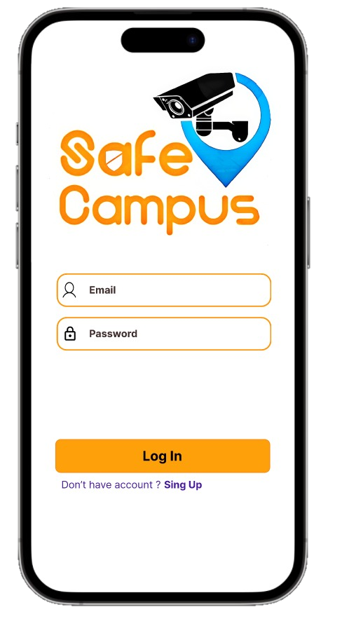
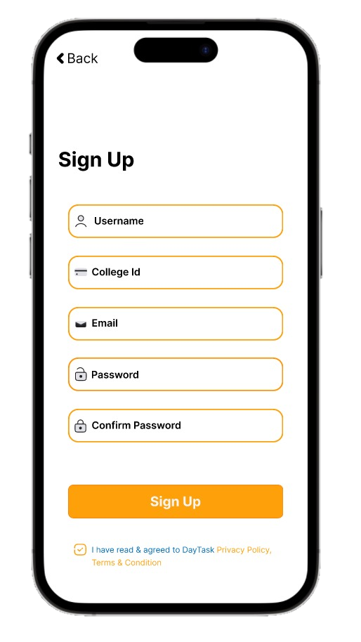

Slide 39
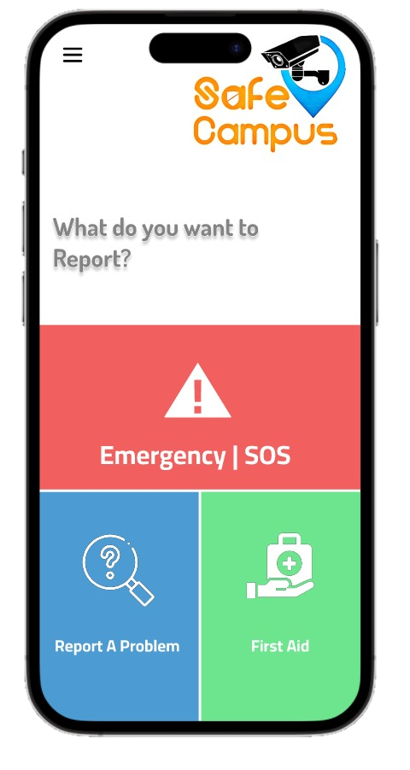
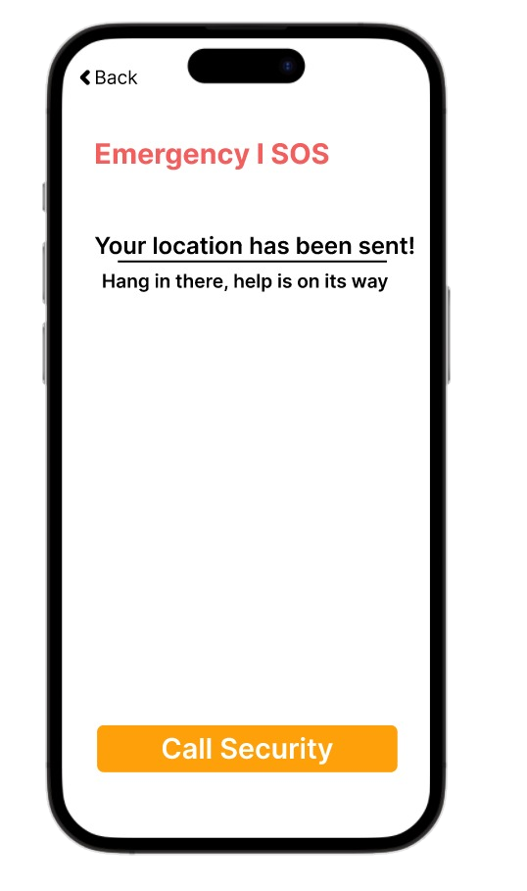

Slide 40
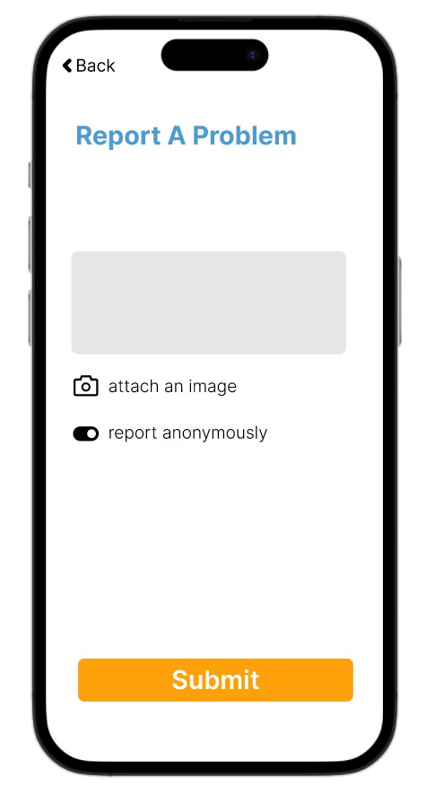

Slide 41
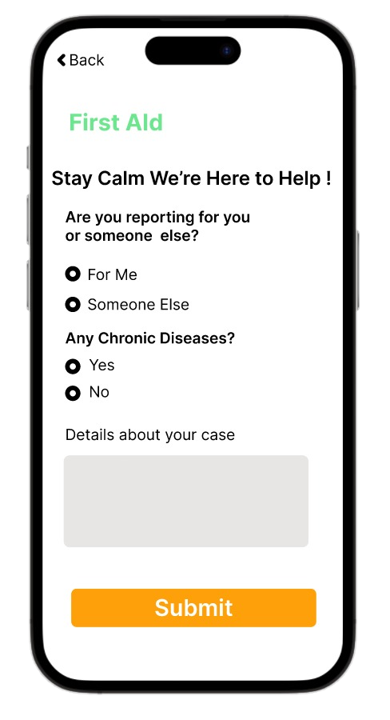

Slide 42
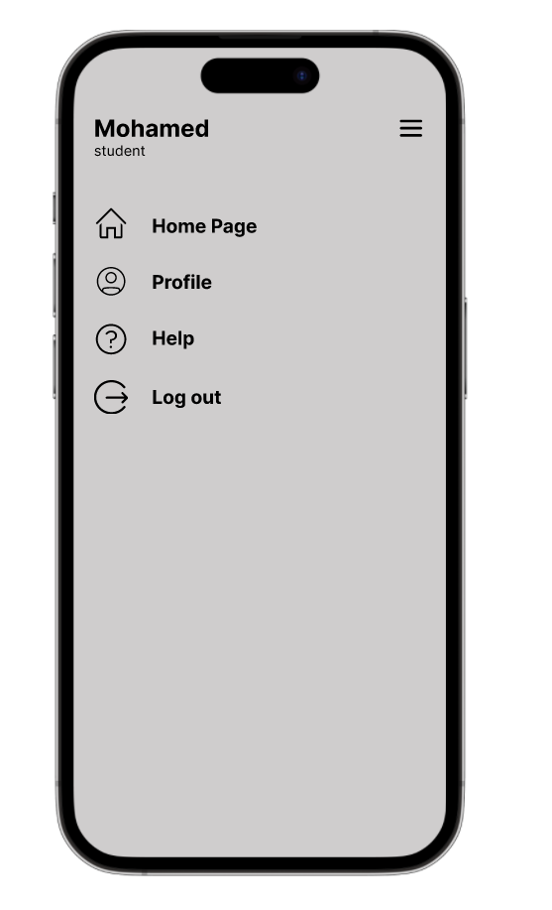
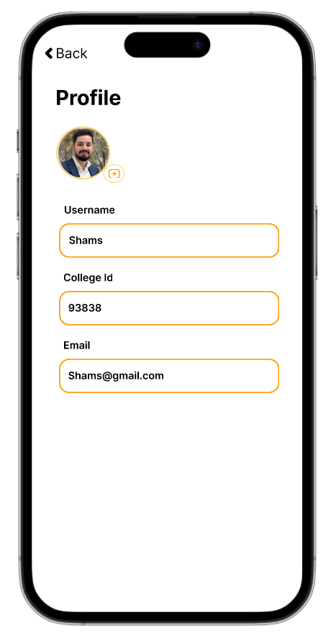
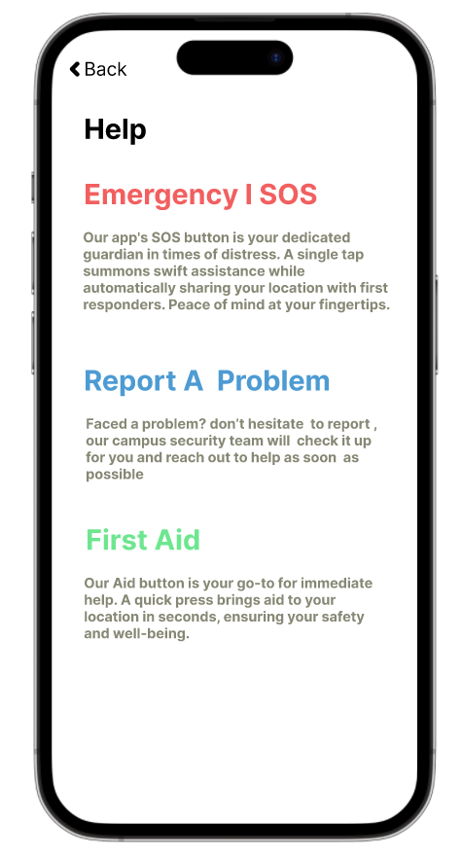

Slide 43
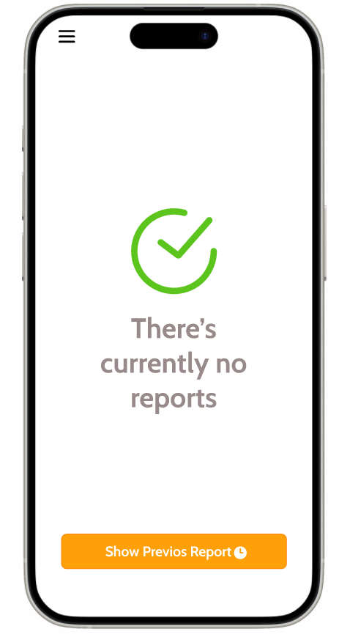
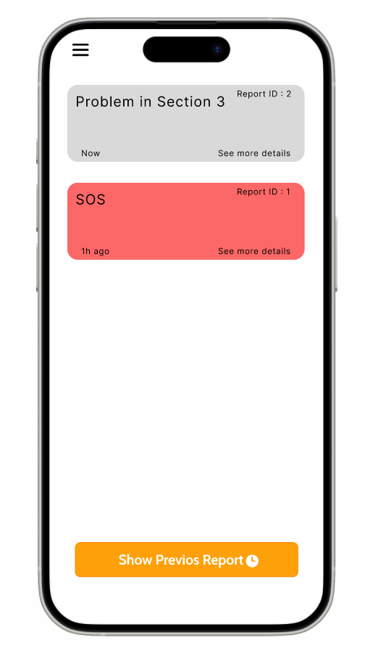

Slide 44
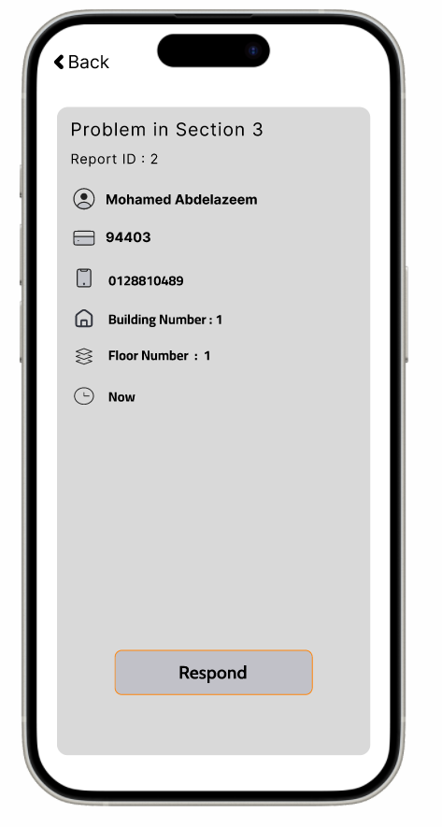
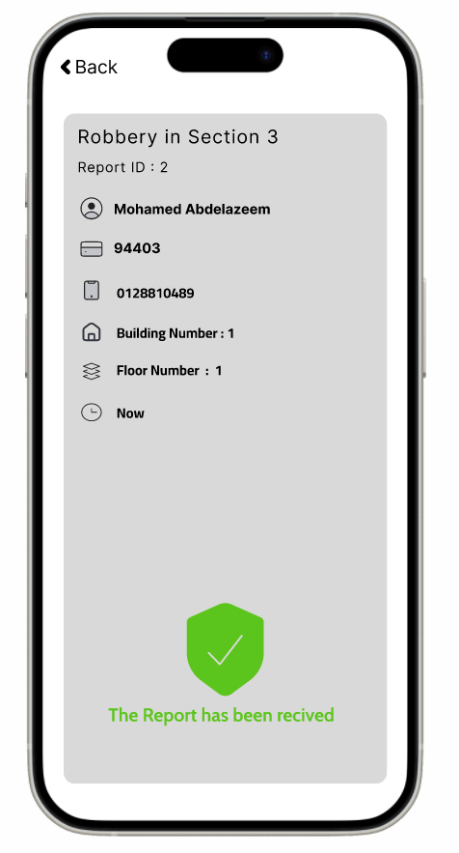

Slide 45
