Slide 1

Malware: Zusy (also known as TinyBanker, Tinba, and Zegost) Presented by: Mohammadali Rahnama
Digital Forensics – Final Project

Slide 2
HYPOTHESIS
A malware form the Zusy malware family was used to infect the victim’s computer.
We will investigate the memory and the network traffic of the victim’s computer to be able to prove our hypothesis.

Slide 3
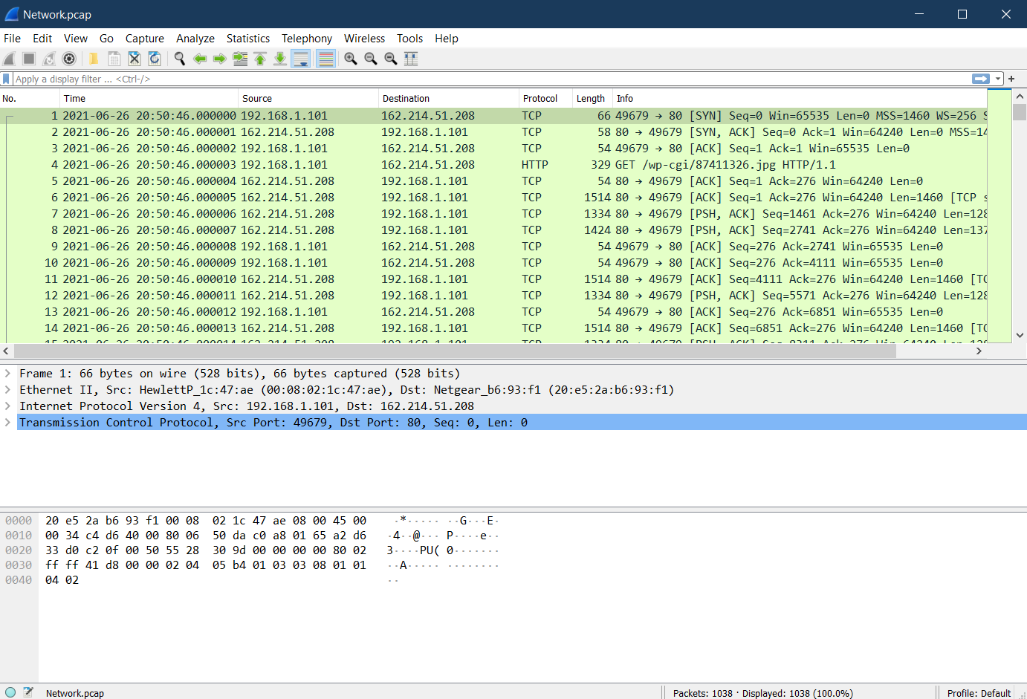
DATA SOURCE – NETWORK TRAFFIC

Slide 4
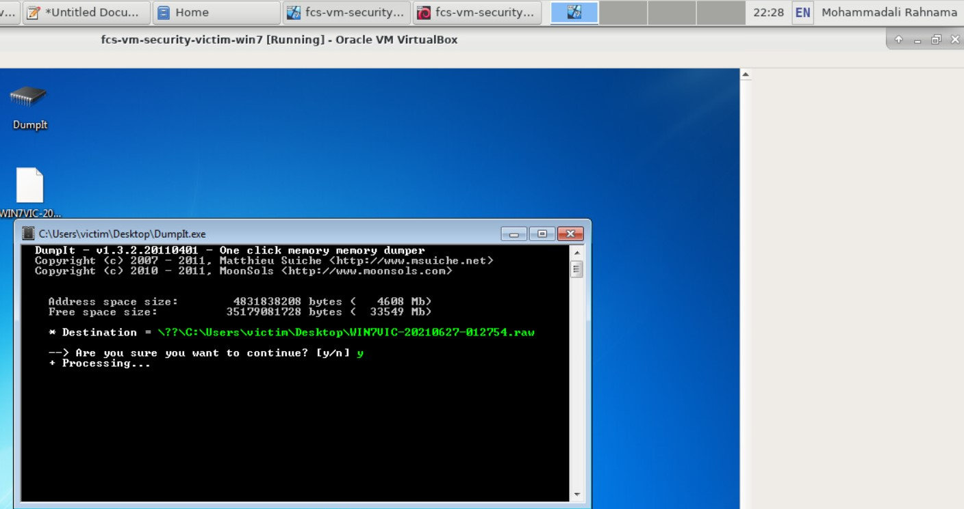
DATA SOURCE – MEMORY DUMP

Slide 5
TOOL(S)
Data Source | Tools used for acquisition | Tools used for analysis
Network traffic (Network.pcap) | Wireshark | Wireshark
Memory dump (WIN7VIC-20210627-012754.raw) | DumpIt | Volatility

Slide 6
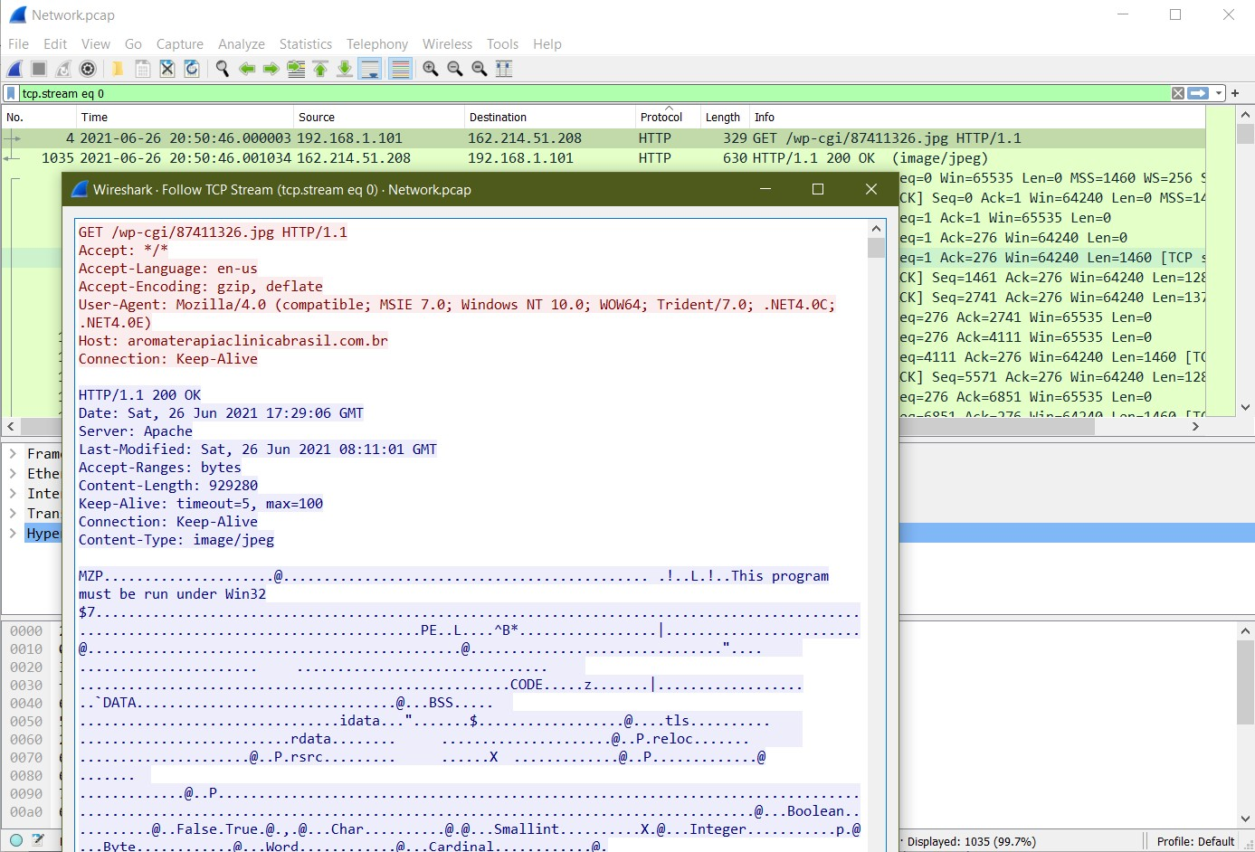
TOOL(S)

Slide 7
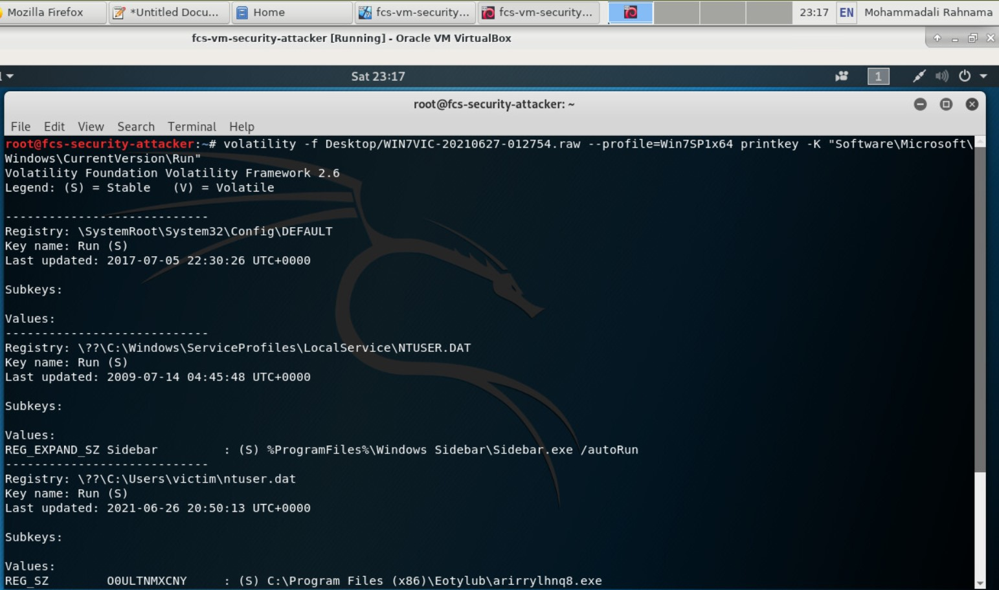
TOOL(S)

Slide 8
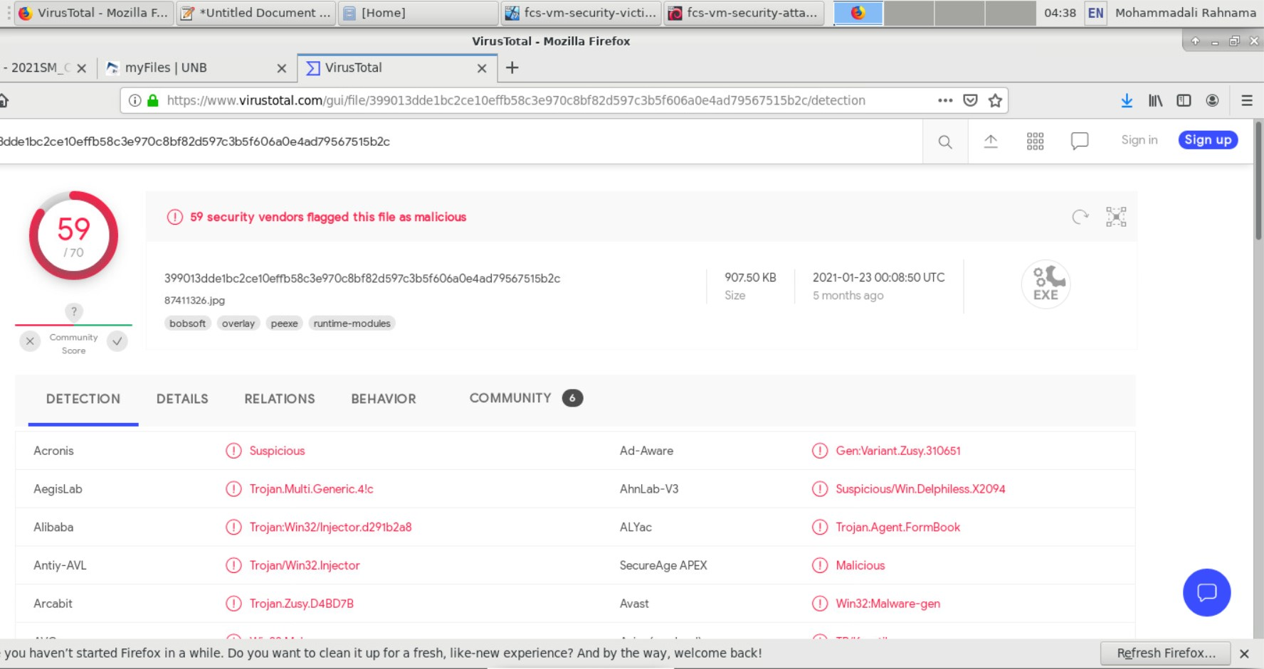
PROOF(S)

