Slide 1
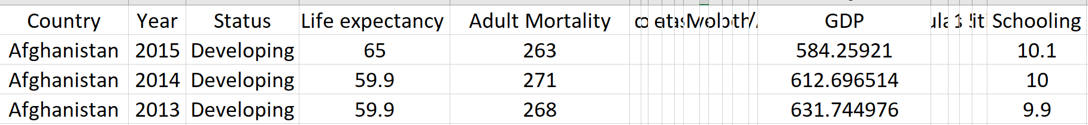


Null hypothesis ($H_{0}$): there is no correlation between life expectancy and Gross Domestic Product (GDP) per capita of countries in the UN. Alternative hypothesis ($H_{1}$): there is a correlation between life expectancy and Gross Domestic Product (GDP) per capita of countries in the UN.
Is there a correlation between life expectancy and Gross Domestic Product (GDP) per capita of countries in the UN?
7com1079-Group175

Slide 2
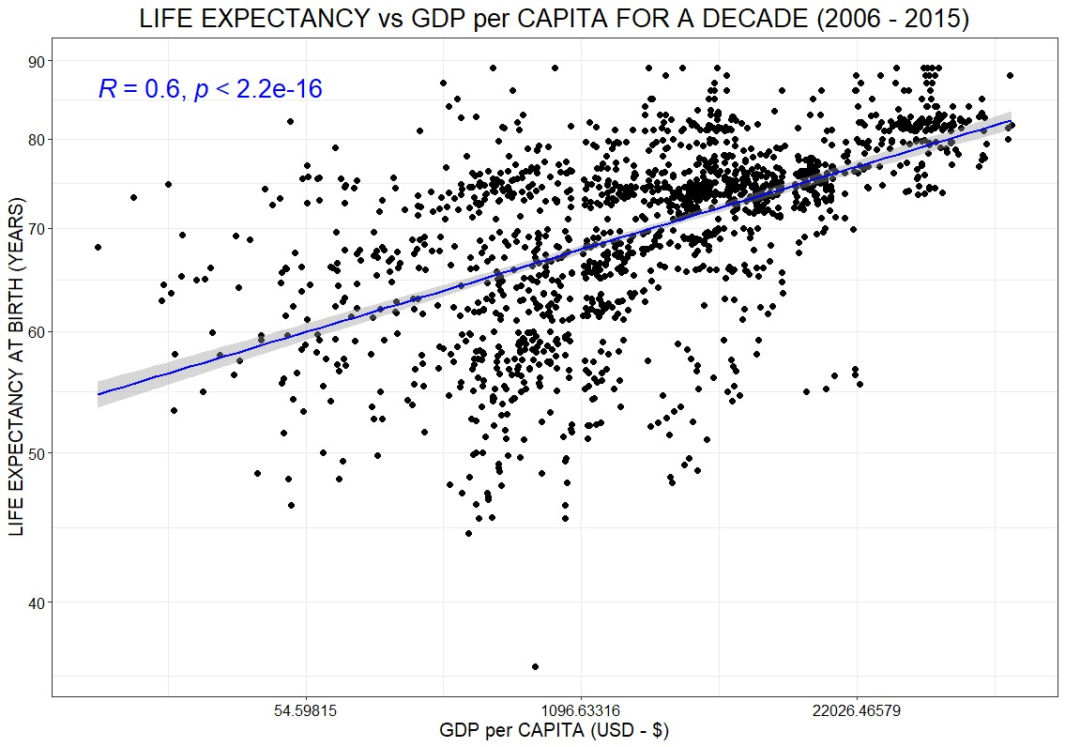
Is there a correlation between life expectancy and Gross Domestic Product (GDP) per capita of countries in the UN?
7com1079-Group175

Slide 3
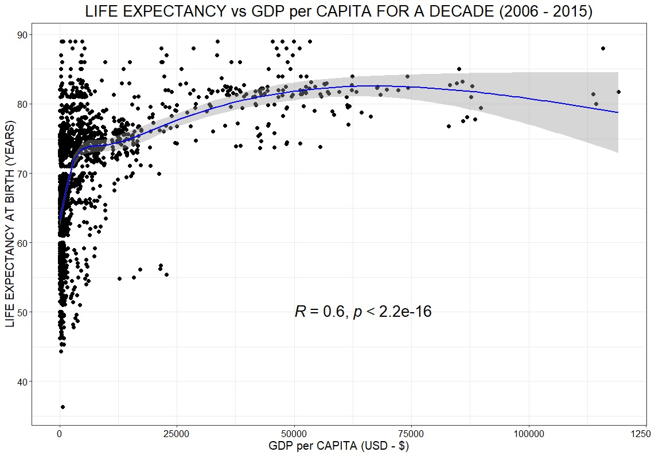
Is there a correlation between life expectancy and Gross Domestic Product (GDP) per capita of countries in the UN?
7com1079-Group175

Slide 4
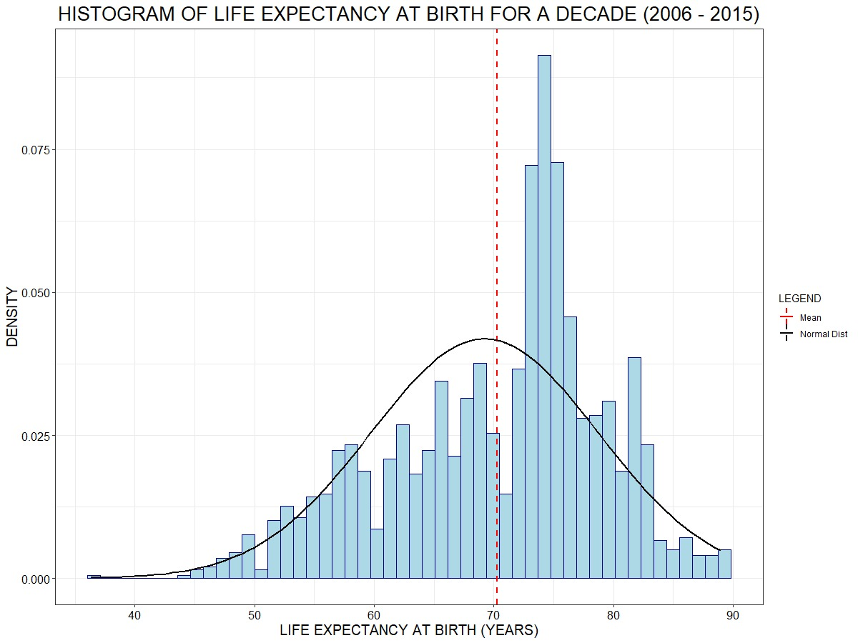
Is there a correlation between life expectancy and Gross Domestic Product (GDP) per capita of countries in the UN?
7com1079-Group175

Slide 5
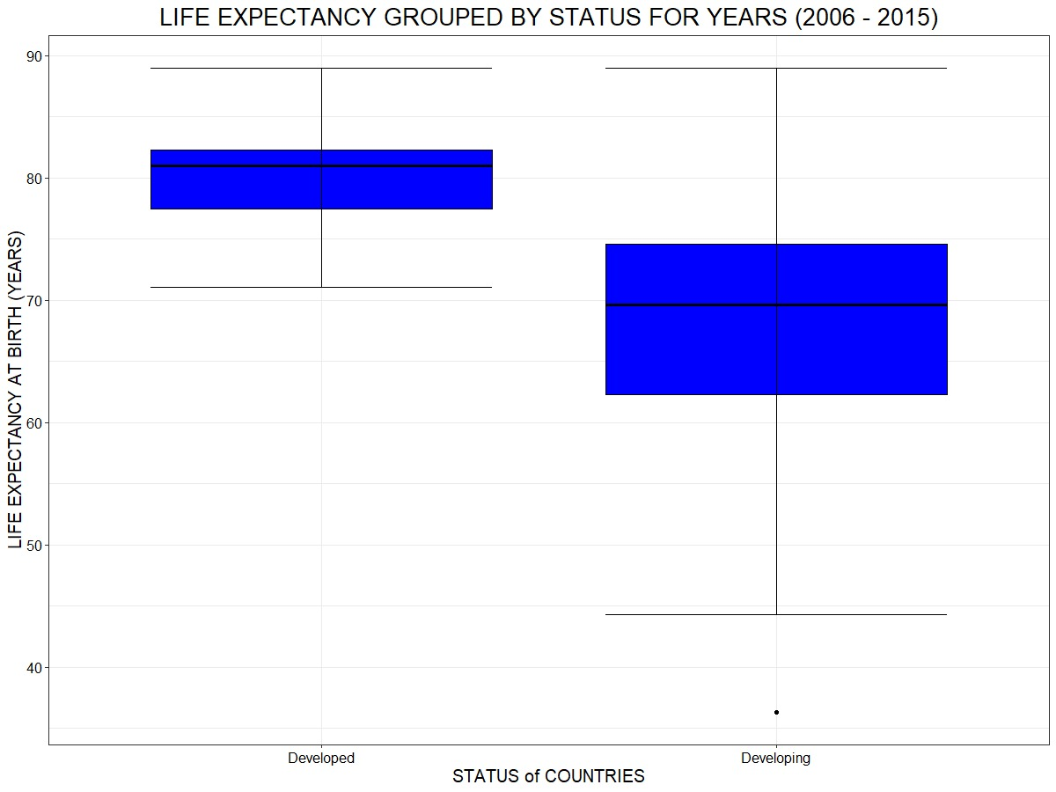
Is there a correlation between life expectancy and Gross Domestic Product (GDP) per capita of countries in the UN?
7com1079-Group175

