Slide 1
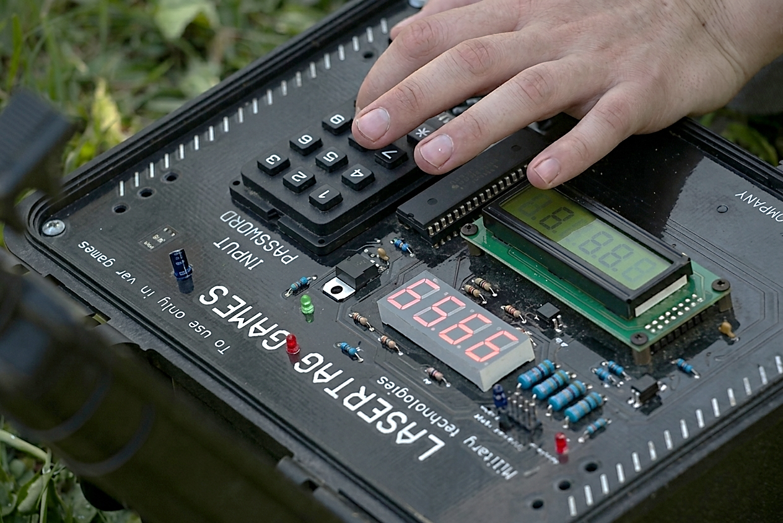

Slide 2


7
Future
Enhancements
6
System endings
1
Overview
Classic timed bomb
Interactive Bare-Metal Application using ATmega32
Final graduation project for ITI embedded systems AVR
5
Hardware integration
Instructor: Ziad Elmekawy
Assistant: Ahmed Azab
Made by: Mohamed Samir Khamis
Major: Communication and Electronics
2
_{System architecture}
4
3
Challenges
Software

Slide 3


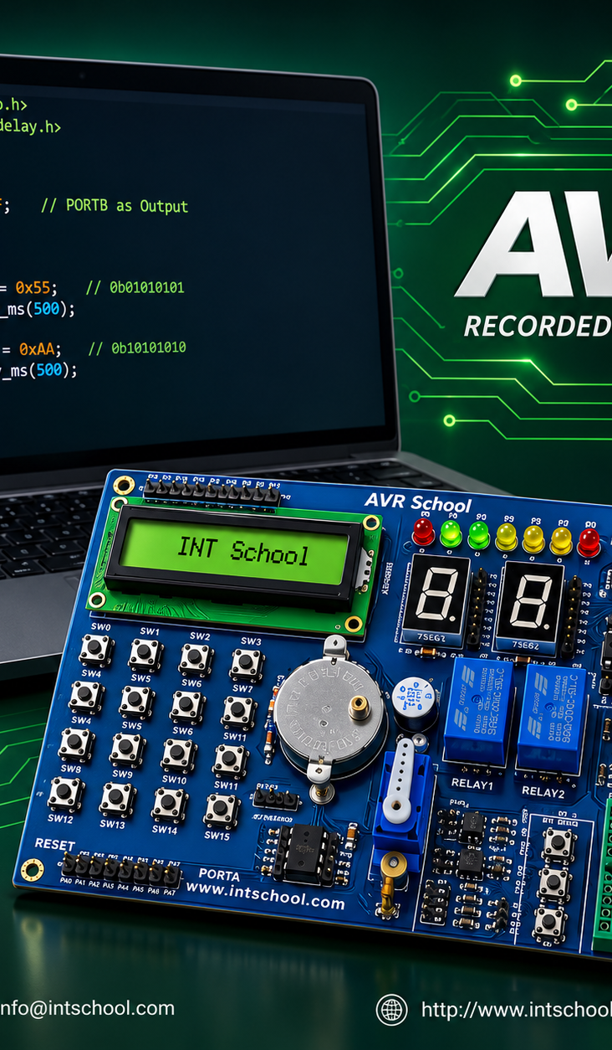
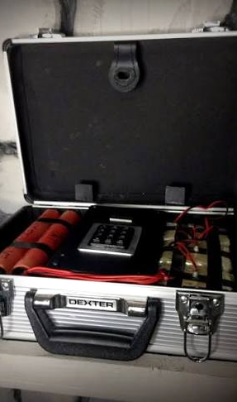



7
Classic timed bomb
Future
Enhancements
1
6
System endings
Overview
2
5
_{System architecture}
Hardware integration
3
4
Software
Challenges
Overview

Slide 4
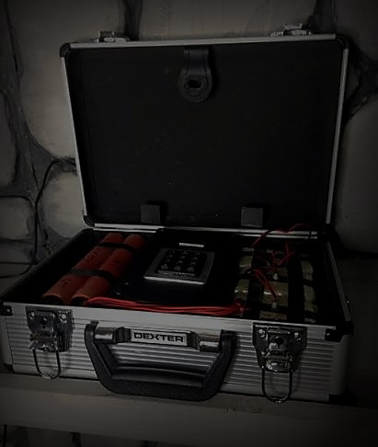
7
Future
Enhancements
6
System endings
7
1
Overview
الخـاتمة
Overview
Objective: Design a real-time, multi-tasking embedded system.
Concept: An interactive bomb defusal simulation requiring
quick decision-making under time pressure.
Gameplay Scenario:
● Solve an analog puzzle (Safe Dial).
● Bypass digital authentication (Password).
● Cut the correct emergency wire before time runs out.
5
Hardware integration
_{System architecture}
2
_{System architecture}
4
3
Challenges
Software

Slide 5

_{System architecture}
Design:
Bare-metal,
layered software architecture for high reusability.
MCAL:
DIO, ADC, Timer0 (CTC),
Timer1 (PWM), UART, Global Interrupts.
HAL:
LCD (4-bit), Keypad (4x4),
7-Segment (via Shift Register), Servo & DC Motors.
APP Layer:
A State Machine managing the complete game logic.
_{Software}

Slide 6

_{Software}
Non-Blocking Architecture:
Completely eliminated _delay_ms() in the main super loop.
Real-Time Processing:
Simultaneous execution of sensor reading,
command reception,
and display updates without system freezing.
State Machine Logic:
Parallel execution of game puzzles alongside
the countdown timer and hardware monitoring.
_{Challenges}

Slide 7

_{Challenges}
Interrupt-Driven Multi-tasking:
Configured Timer0 in CTC mode to generate a 1ms
"Tick," handling 7-segment multiplexing and
countdowns independent of the main CPU loop.
Asynchronous Communication:
Implemented a non-blocking UART receive function to
monitor remote villain commands seamlessly.
_{Hardware integration}

Slide 8
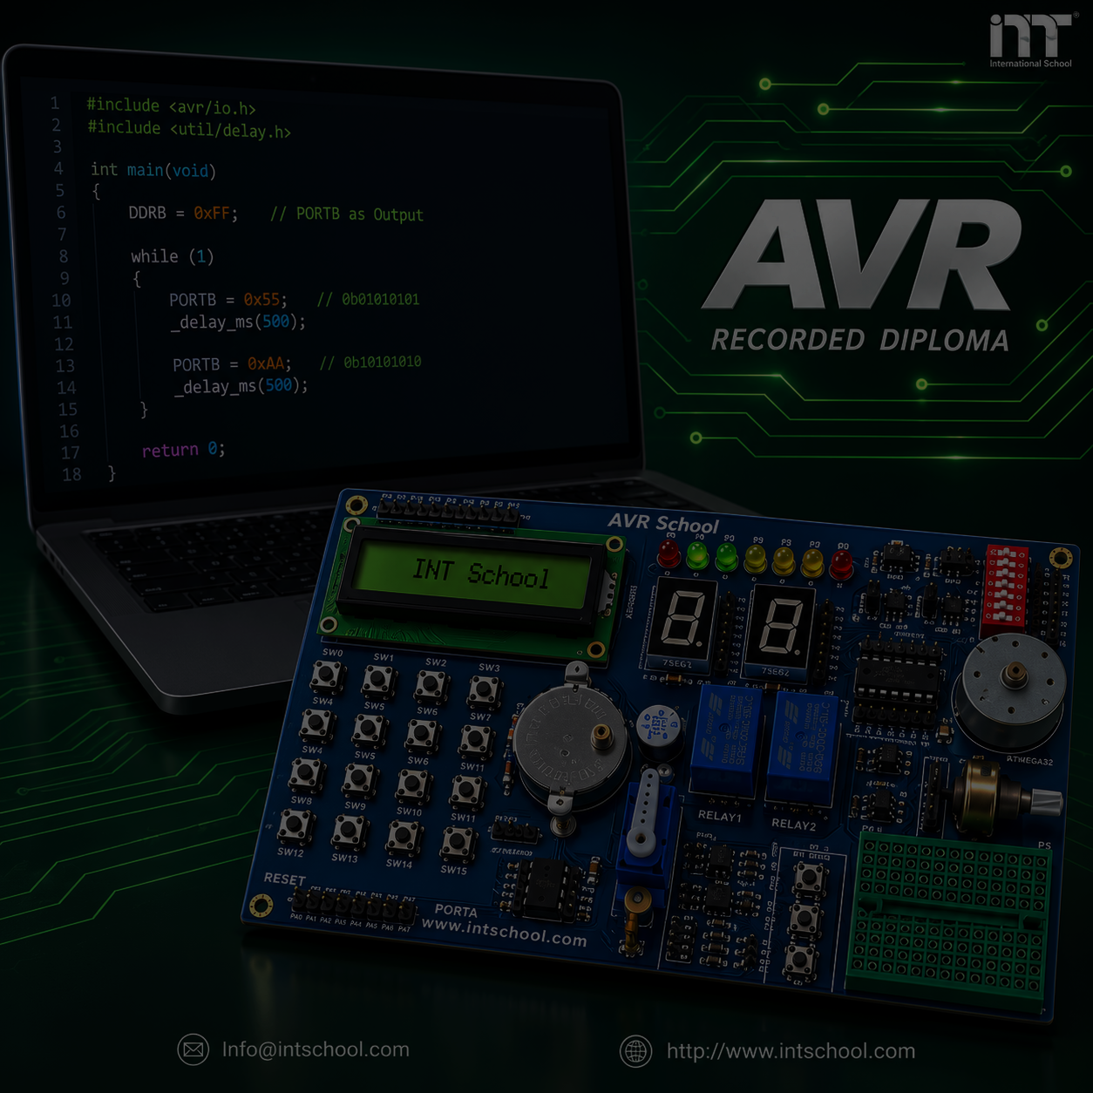
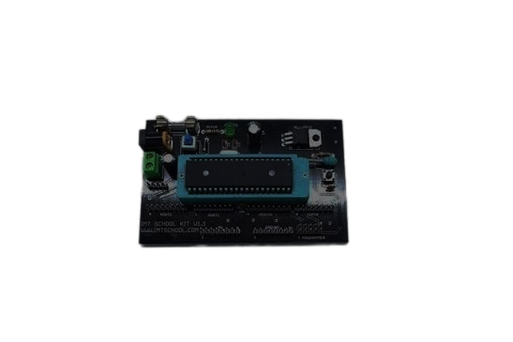
_{Hardware integration}
Inputs:
● Potentiometer (ADC)
● Emergency Wires (Internal Pull-ups)
● Keypad
Outputs:
● Buzzer (Timed pulses)
● DC Motor (System cooling fan)
● Servo Motor (Mechanical vault lock)
● 74HC595 Shift Register (Optimized pin usage for displays)
_{System endings}

Slide 9

_{System endings}
Defused (Success):
● Triggers: Correct password entered OR correct wire cut.
●Actions: Timer stops, displays turn off, vault opens (Servo 90°).
Detonated (Failure):
● Triggers: Time out, wrong wire cut,
OR remote kill command ('K') via UART.
●Actions: Continuous buzzer, system freezes,
"BOOM" message displayed.
Future Enhancements

Slide 10

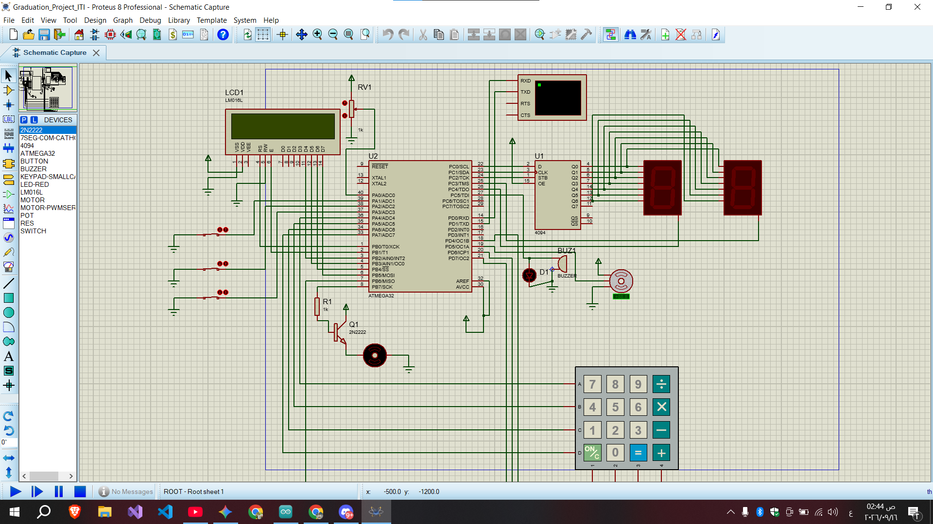
Future Enhancements
IoT Connectivity:
Connect the system to an ESP32 via UART
to send live telemetry data to a cloud dashboard.
_{Proetus simulation}

Slide 11


_{Proetus simulation}

Slide 12


_{Proetus simulation}

Slide 13
Eng\ Ziad Elmekawy
Eng\ Ahmed Azab

