Slide 1
Your pipeline ran.
Your tests passed.
Your numbers were 10× wrong.
Here is how that happens, and how you catch it.
Retail Lakehouse Pipeline · Mohamed Taha Abo Heiba

Slide 2




PROJECT SCOPE
From fragmented retail data to trusted decisions
At a glance
123/123 dbt tests passing
Galaxy schema gold layer
Built for sales, Supplies, and workforce analysis
Dual-surface consumption layer
Sources
Pipeline
Consumption
PostgreSQL: 6 OLTP tables
AWS S3: monthly supplier CSVs
Databricks lakehouse · dbt · Airflow · GitHub Actions CI
Power BI 3-page report
Databricks Genie Agent
Goal: Turn fragmented retail operational data into a trusted analytical layer for sales, procurement, and workforce decisions.

Slide 3
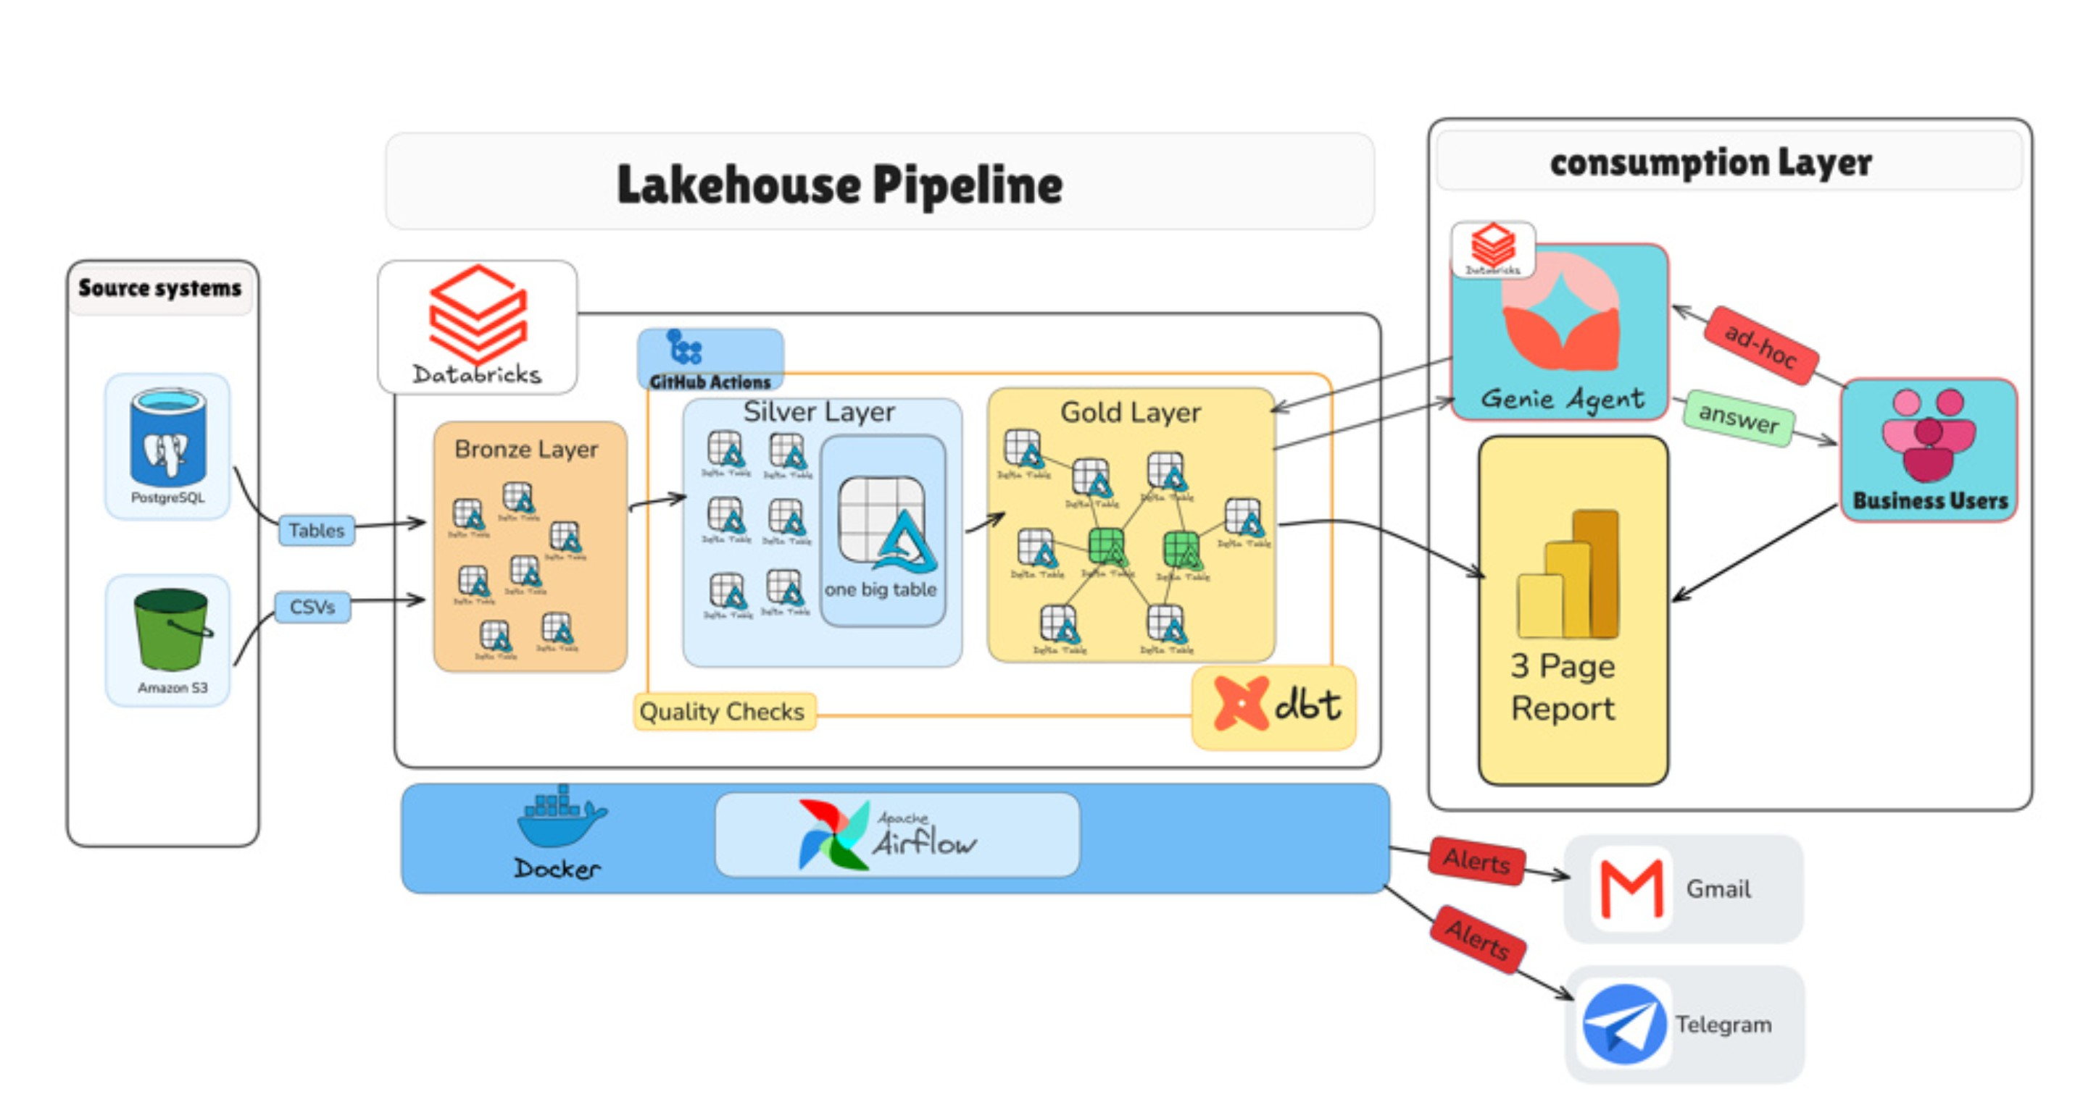


ARCHITECTURE
Two sources. Three layers. Two consumption surfaces.
Full-width architecture diagram — insert your own screenshot here
PostgreSQL and S3 enter through independent bronze paths, dbt transforms them, and become a trusted gold layer consumed by Power BI and Genie Agent.

Slide 4


INGESTION
Two ingestion paths. One bronze layer.
Primary Path — PostgreSQL
Secondary Path — AWS S3
Lakeflow Connect · cursor column + primary key upsert per table
CDC unavailable in this setup — downstream SCD2 design accounts for the limitation.
Supplier CSVs · managed Lakeflow pipeline (no custom code)
Airflow verifies terminal state before downstream runs

Slide 5
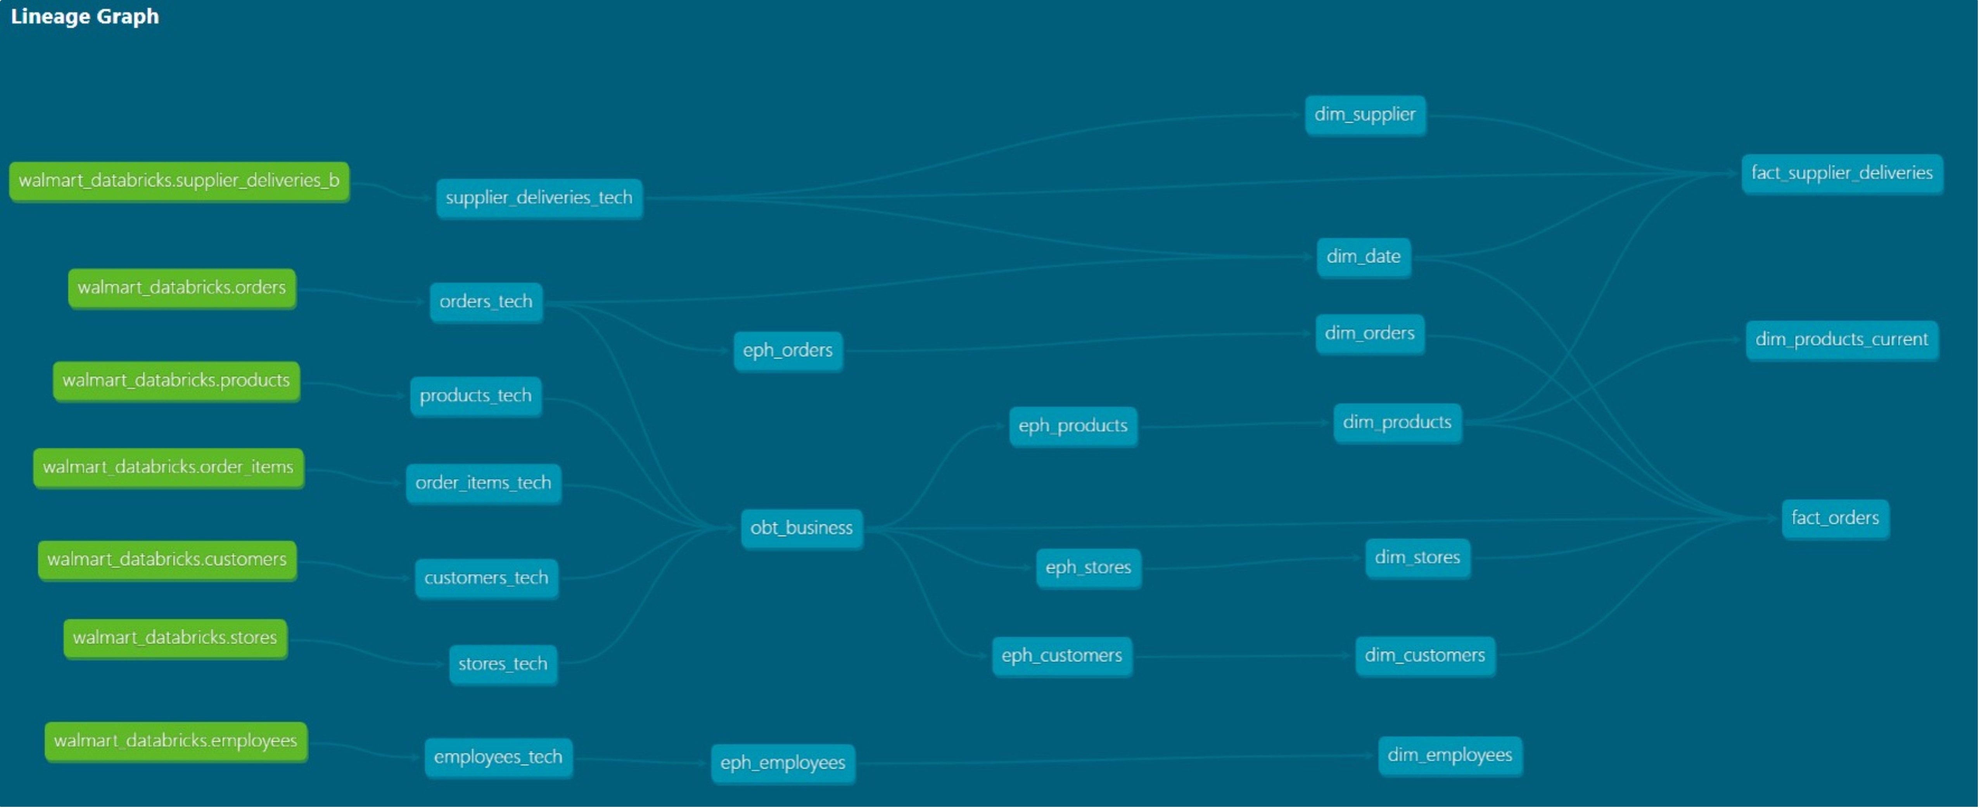


TRANSFORMATION
The pipeline was green.
The data was wrong.
7 incremental silver models
obt_business returned 300,513 rows.
SCD2 snapshots across 4 dimensions
Expected: 30,021.
Every dbt test passed clean.
Metadata-driven wide table
Root cause: employees were joined through store_id, creating a one-to-many fan-out.
Fix: removed the invalid relationship and added explicit grain validation.
One config entry per source — no hand-written SQL per join
dbt lineage diagram
dbt lineage diagram

Slide 6
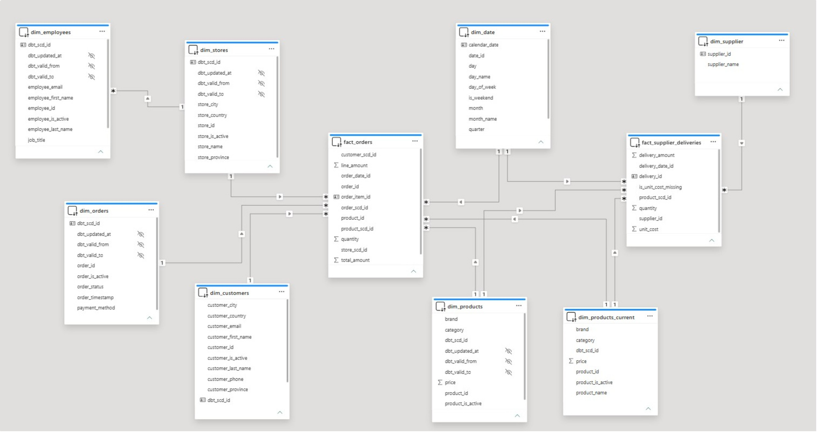


GOLD LAYER
Galaxy schema. Two business processes.Shared dimensions only where the grain supports them.
Galaxy schema ERD
fact_orders
fact_supplier_deliveries
Shared Dimensions
Sales · order line grain
Procurement · delivery grain
dim_date and dim_product shared across both facts

Slide 7
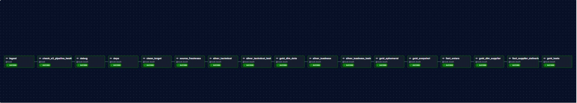
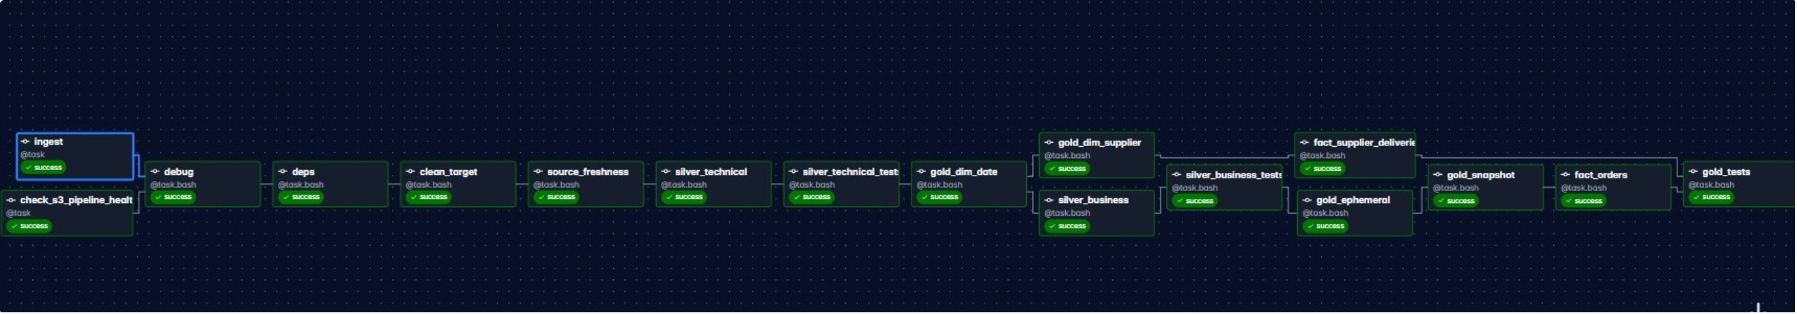
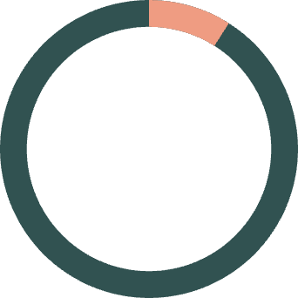
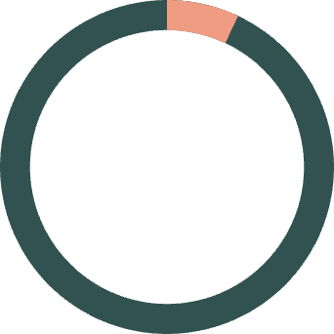
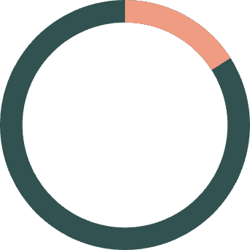

ORCHESTRATION
Sequential vs Parallel branches
Measured improvement. Two alert channels.
9:03
7:35
Sequential avg
~16%
Parallel avg
Runtime reduction
across 3 measured runs
Alerting
Task failure → Gmail + Telegram

Slide 8

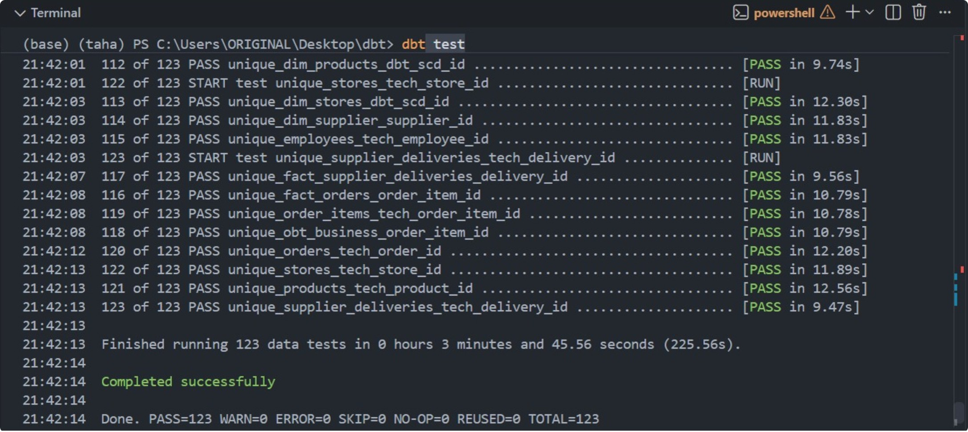


TESTING
Green tests do not guarantee correct data.
Referential integrity checks
across dimension relationships
Singular Grain Checks
for every fact table — catching the 10× fan-out class of bug
A green dbt run confirms execution. It does not confirm correctness.
CI Quality Gate
Every push · blocks merge on failure

Slide 9
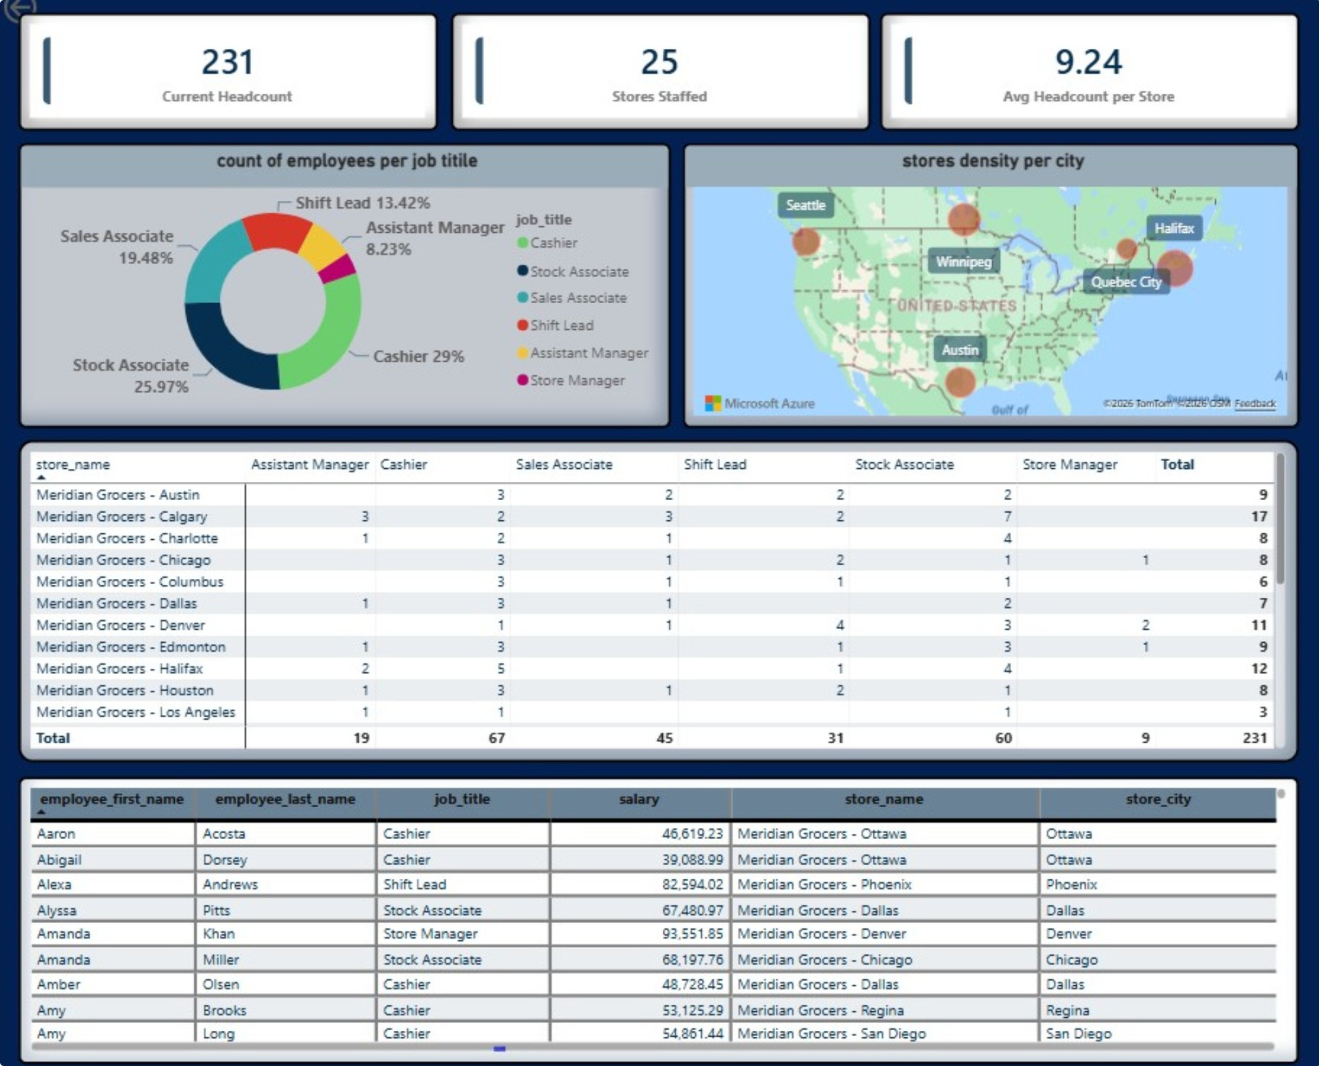
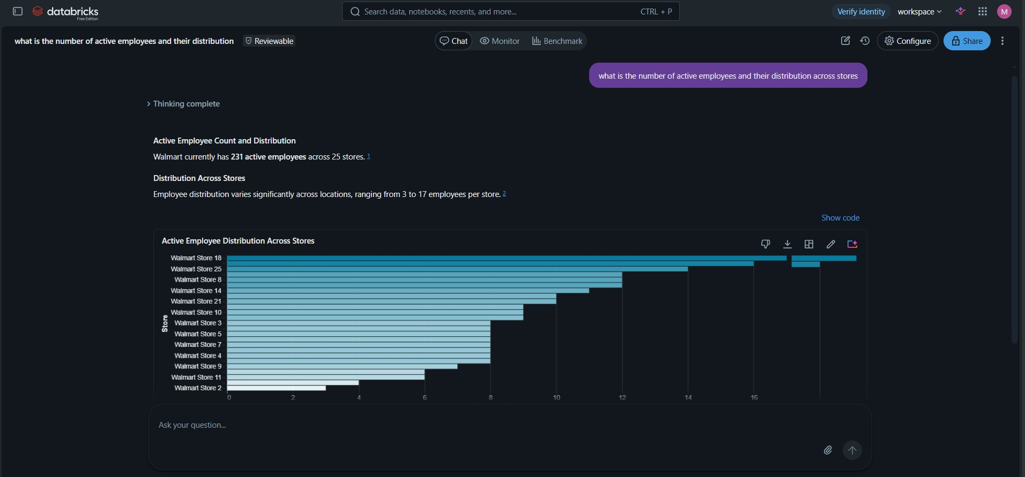



CONSUMPTION
Fixed report for the known questions. Agent for everything else.
Power BI
Genie Agent
3 pages: Sales · Supplies · Workforce
Designed for recurring operational questions
Import mode via Databricks Partner Connect
Natural-language exploration across the gold layer
Designed for questions beyond the predefined report
Table and column descriptions pre-annotated in Unity Catalog
Power BI Workforce page
Genie Agent
Not redundant. Power BI answers recurring questions. Genie explores the questions nobody wrote a query for yet.

Slide 10
CLOSING
This project is Built to be trusted, explained, and challenged, not just demonstrated.
Every decision has a reason
Every claim has a number
Every limitation is documented
Galaxy vs star schema
Import vs DirectQuery
Two alert channels vs one
16% DAG improvement
123/123 tests
10× row-count fan-out
3-run benchmark
No CDC, by design
No employee-to-order link in source
Report freshness bounded by refresh schedule

Slide 11



LET'S TALK
Thanks for making it this far.
If you want to talk data engineering, architecture, or building pipelines that can be trusted, I’d like to hear from you.
Beyond Building the Pipeline
This project taught me that building a pipeline is only half the job. The harder part is proving that the data is correct, understanding the trade-offs behind every design decision, and being honest about what the system cannot guarantee.
I built this project to demonstrate how I think as a Data Engineer: design for scale, test for correctness, measure what matters, and document the decisions
REACH OUT
Have a problem worth solving? Let’s talk.
Mohamed Taha Abo Heiba · Data / AI Engineer

