Slide 1
Phone or No Phone
Using pre-trained CNN models

Slide 2
Problem
More people are distracted while driving due to using phone be it calling or texting
Roads are more dangerous because of that

Slide 3
Our Solution
Train slightly lighter weight models so that cameras can be equipped with the tools to detect 3 types of drivers
Safe
Texting
Calling

Slide 4
Transfer Learning

Slide 5
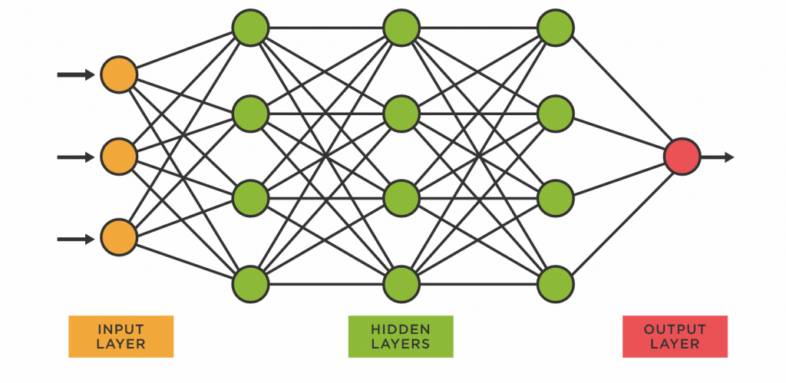
Transfer Learning
Using pre-trained model
Freezing layers with weights believe to be essential
Unfreezing layers to be trained

Slide 6
MobileNet

Slide 7
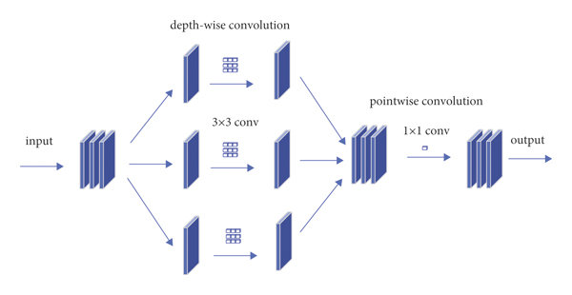
MobileNet
Fast and lightweight
Depthwise convolution
Pointwise convolution

Slide 8
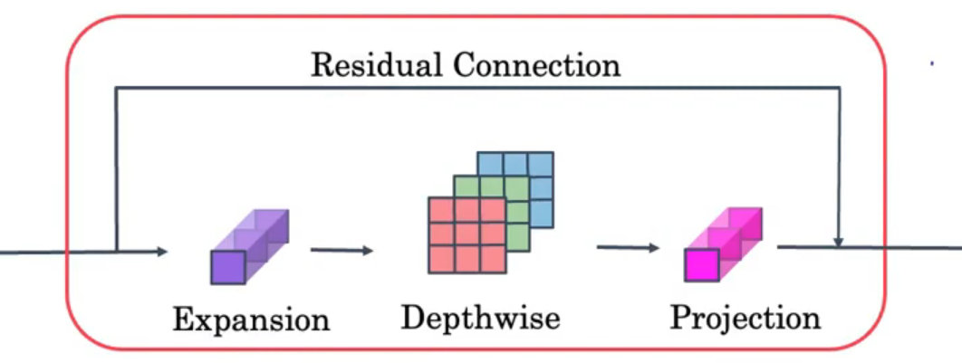
MobileNet
How did V2 Improve?
Expansion layer
Residual connection

Slide 9
MobileNet
How did V2 Improve?
Expansion layer
Residual connection

Slide 10
EfficientNet

Slide 11
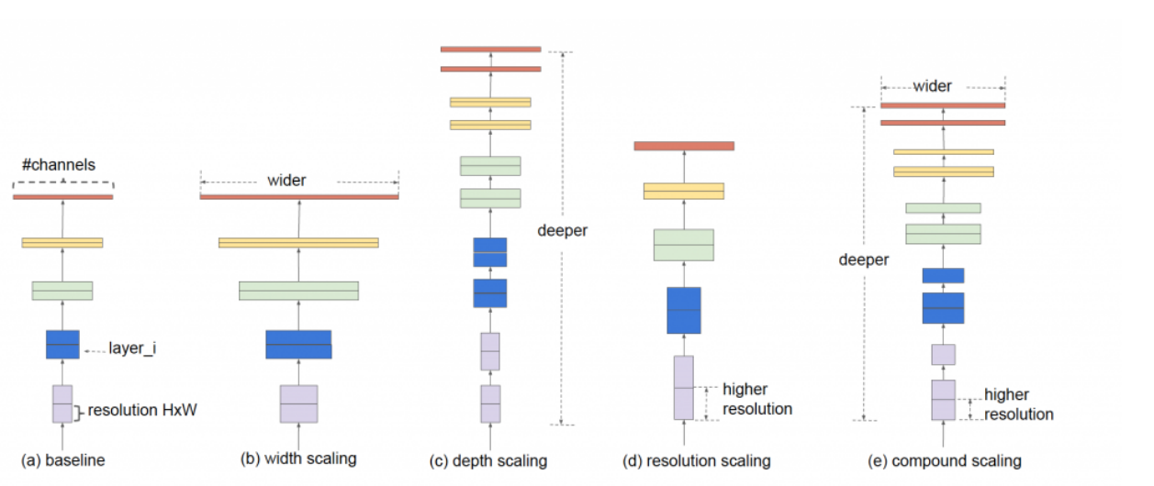
How to scale up?

Slide 12
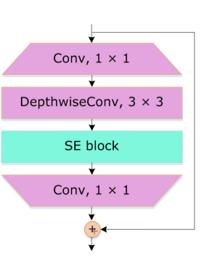
EfficientNet
Scales up in a specific way called compound scaling
Uses similar ideas called too MobileNet V2 to maintain a efficiency

Slide 13
Comparison
Topic | MobileNet | EfficentNet
Size | Small | Medium
Speed | Fast | Less fast
Accuracy | Less accurate | Accurate

Slide 14
Handling Issues
Splitting dataset by drivers to prevent leakage
Augmentation to prevent overfitting

Slide 15
Results
On the validation test
MobileNet model achieved 92% top accuracy
On our custom test
MobileNet model achieved 82% accuracy (9/11 correct classification in real world)

Slide 16
Contributions
Moaaz Saleh | 23-101263 | MobileNet
Mohamed Tarek | 23-101248 | MobileNet
Hana Medhat | 23-101222 | EfficientNet
Farah Sultan | 23-101224 | EfficientNet

