Slide 1
MoTrPAC PASS1B Gastrocnemius: Analysis of C-Means Clusters
Tyler Sagendorf
2024-08-29

Slide 2
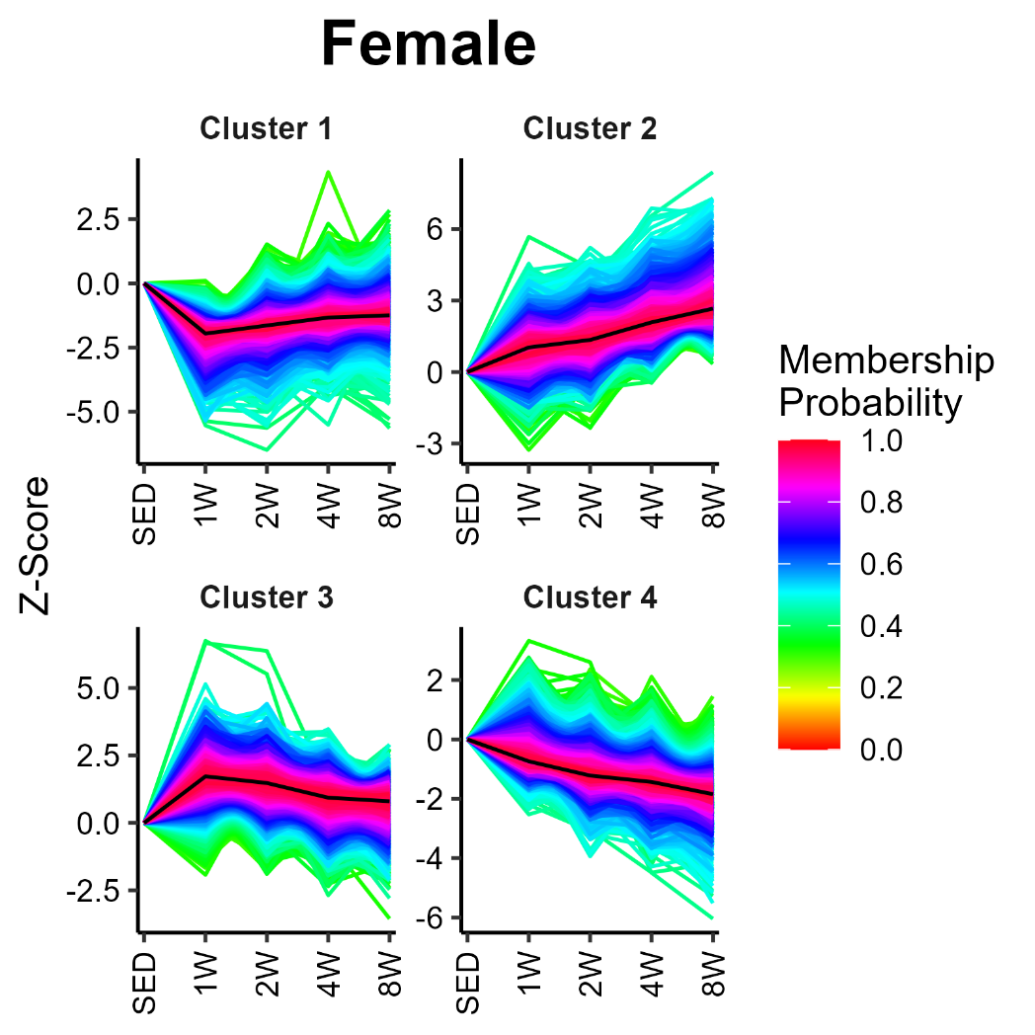
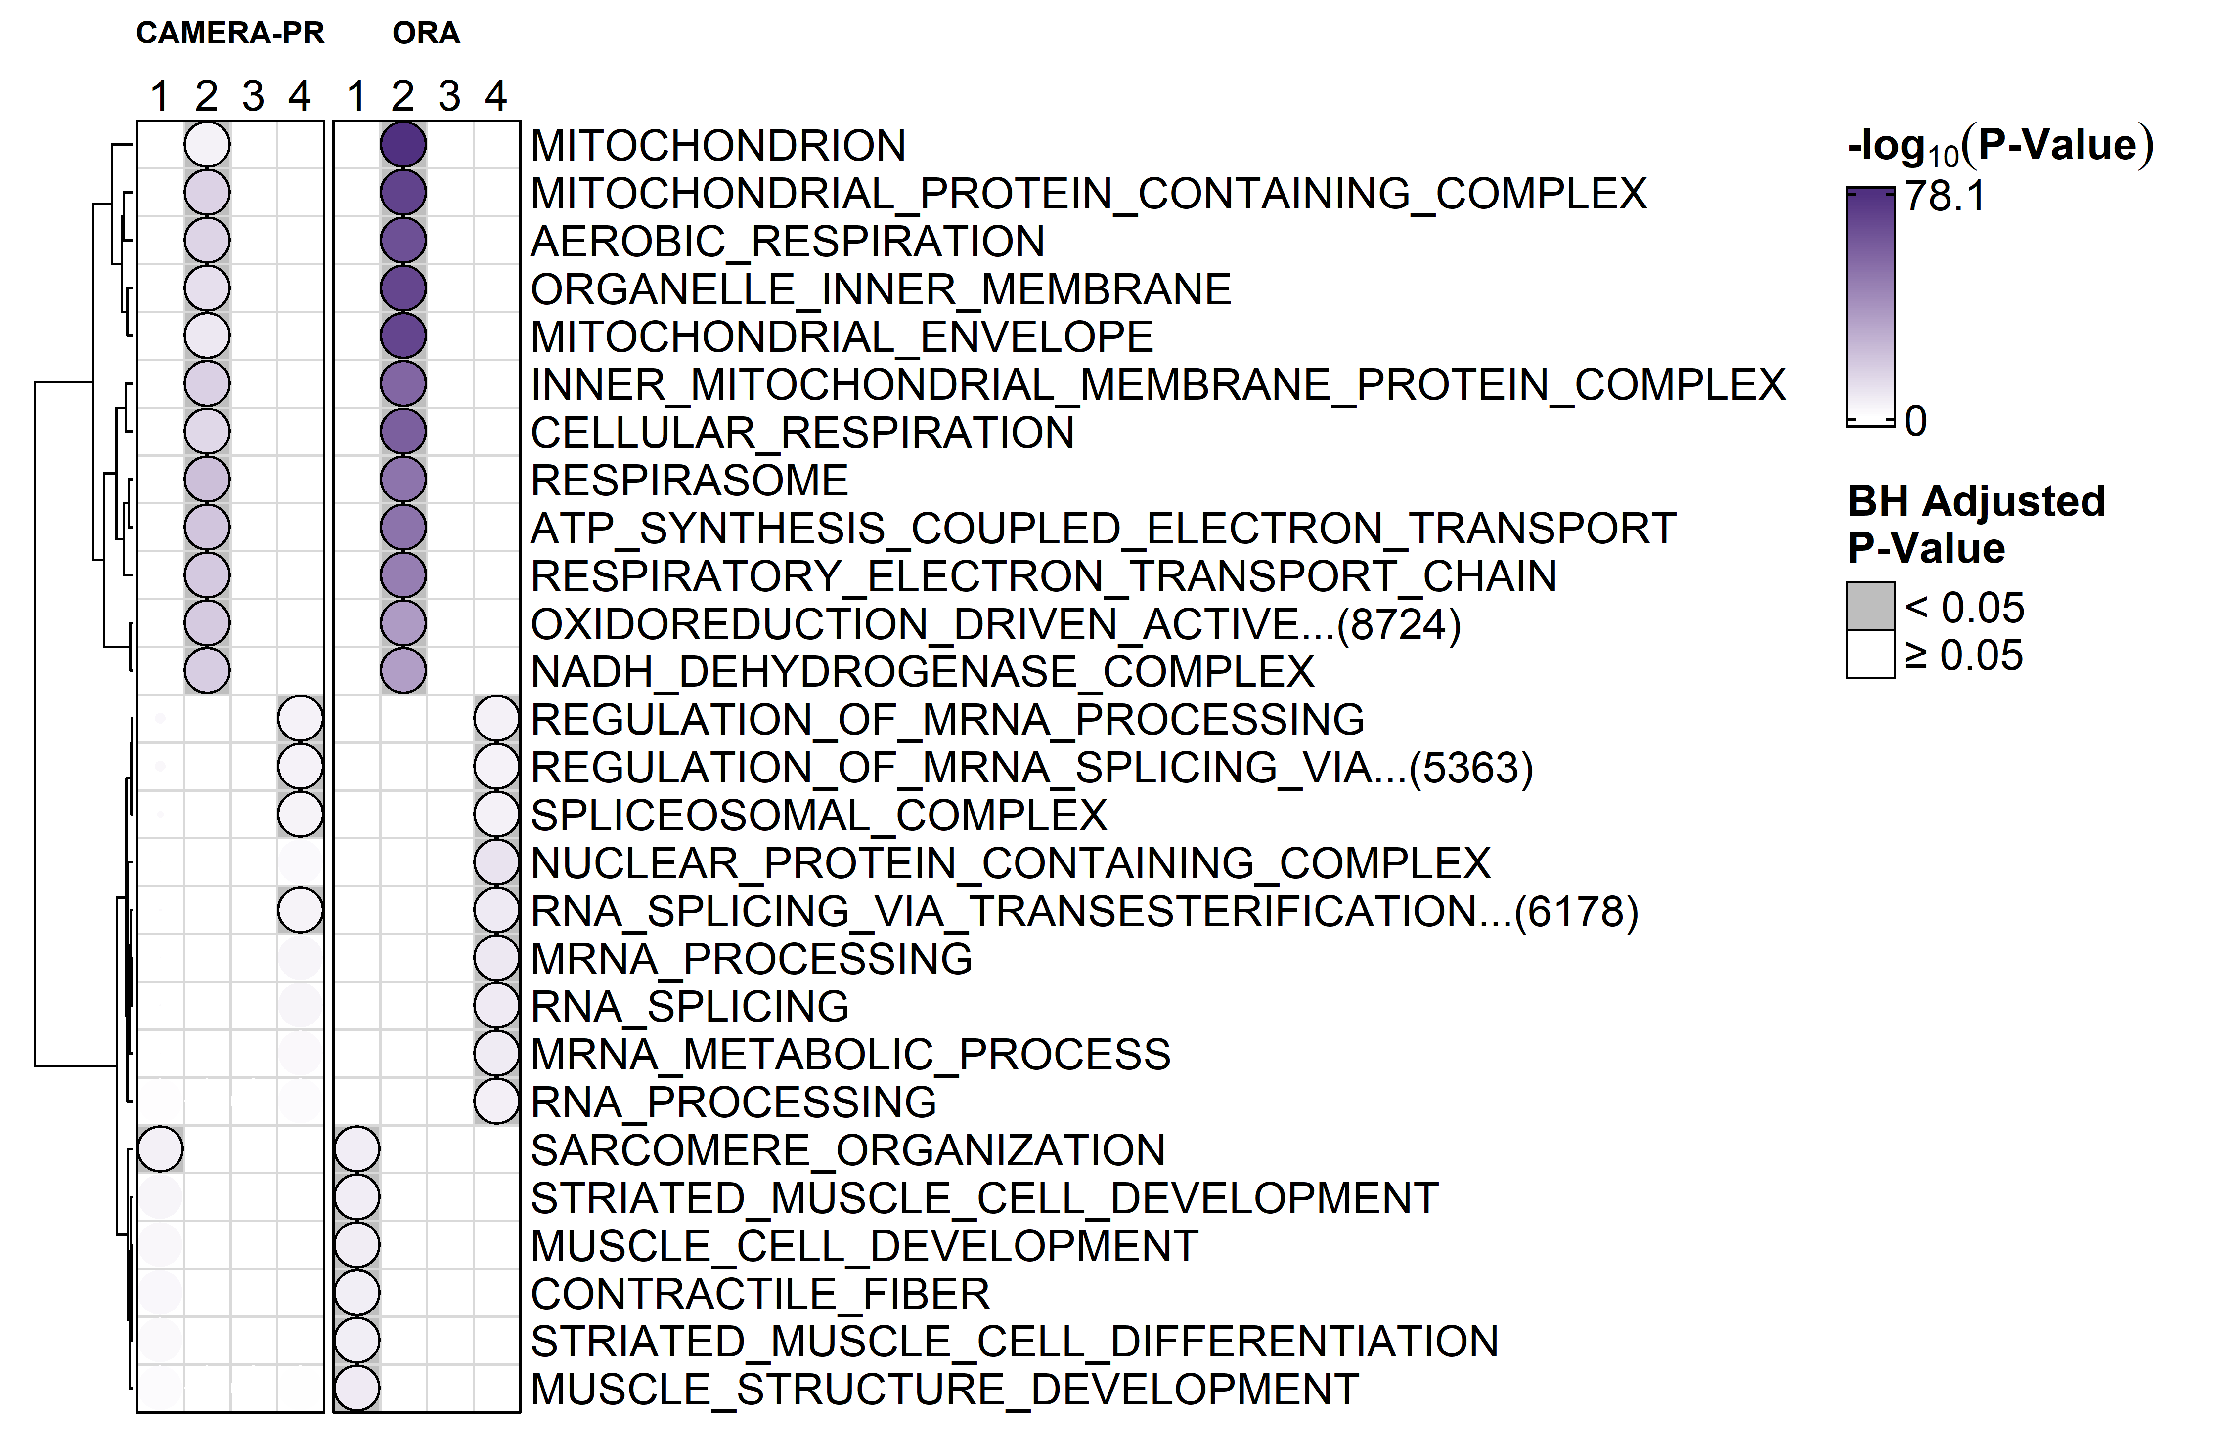
TRNSCRPT

Slide 3
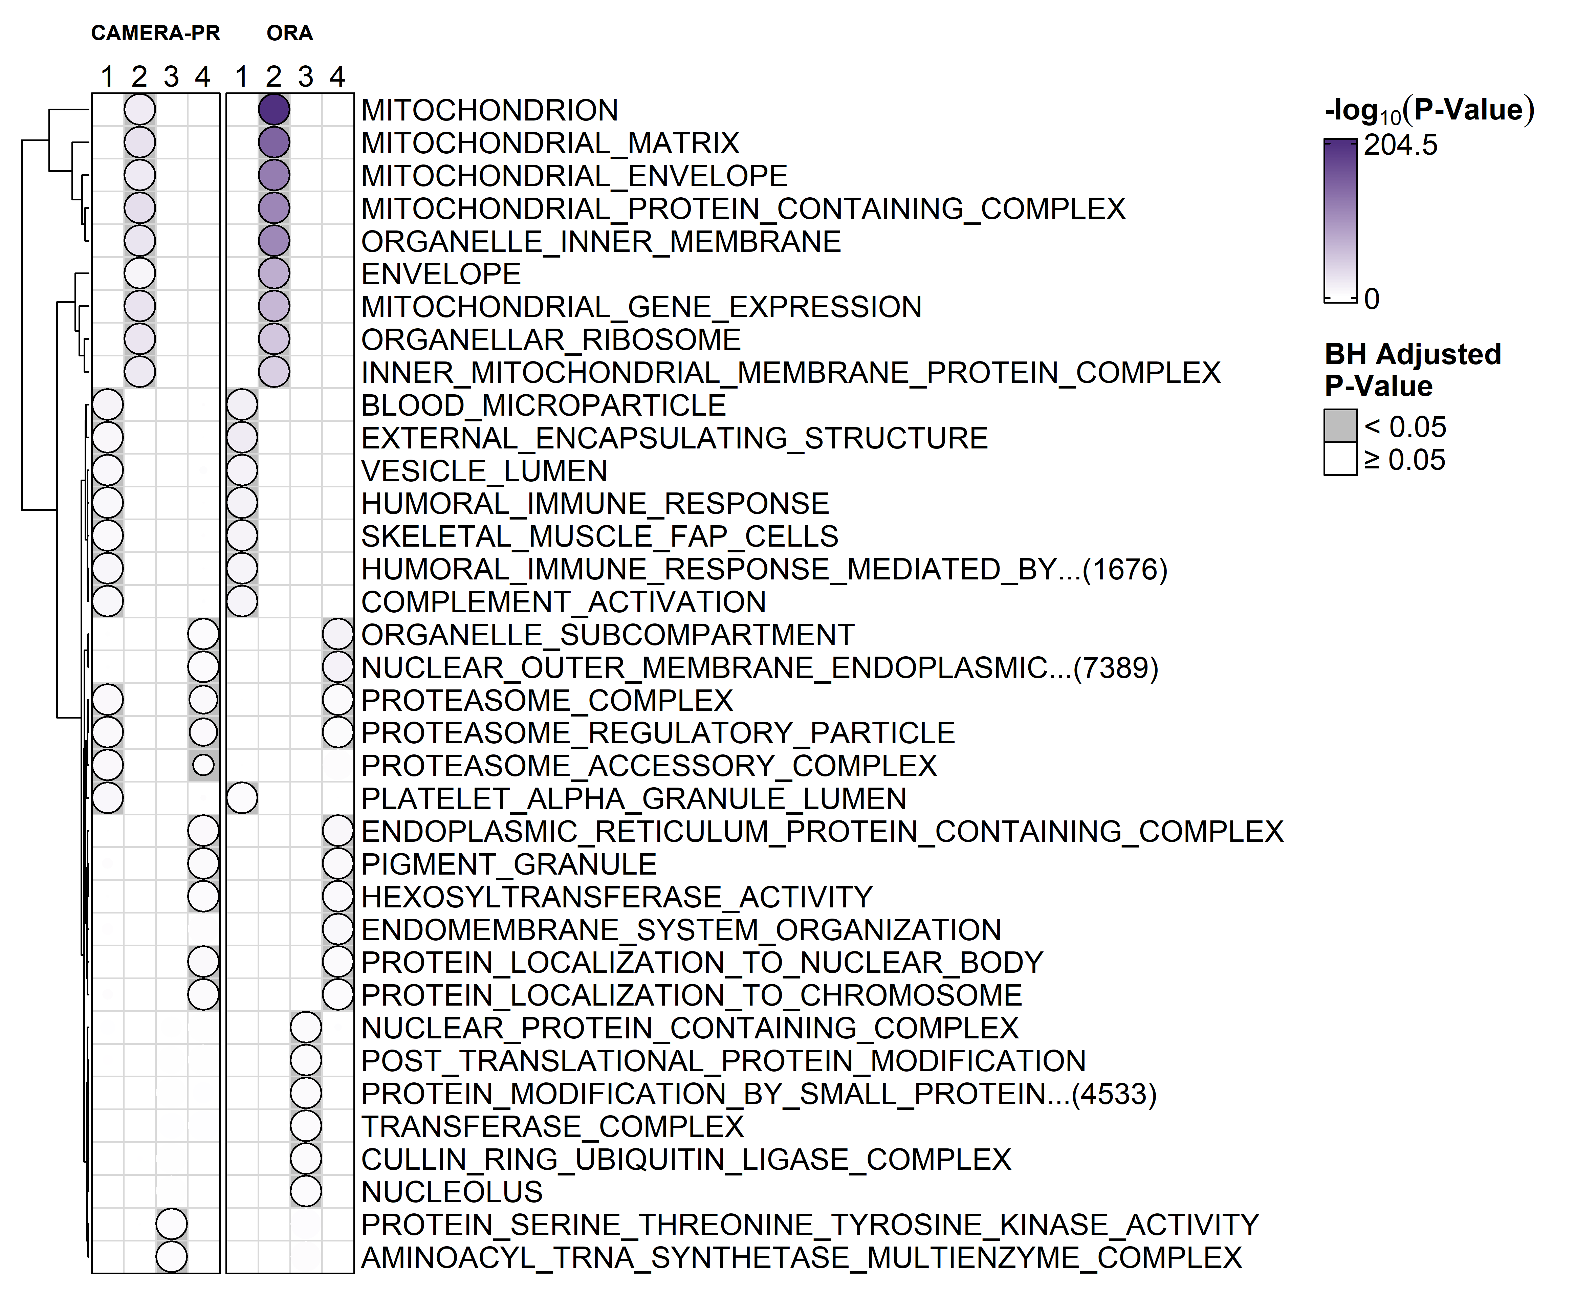
PROT

Slide 4
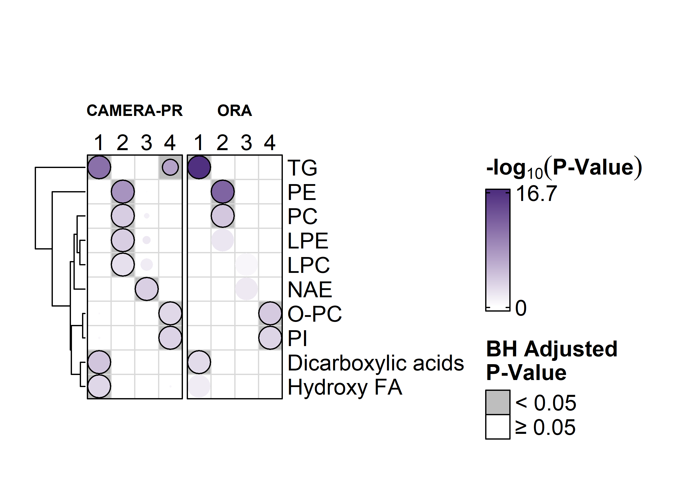
METAB

Slide 5
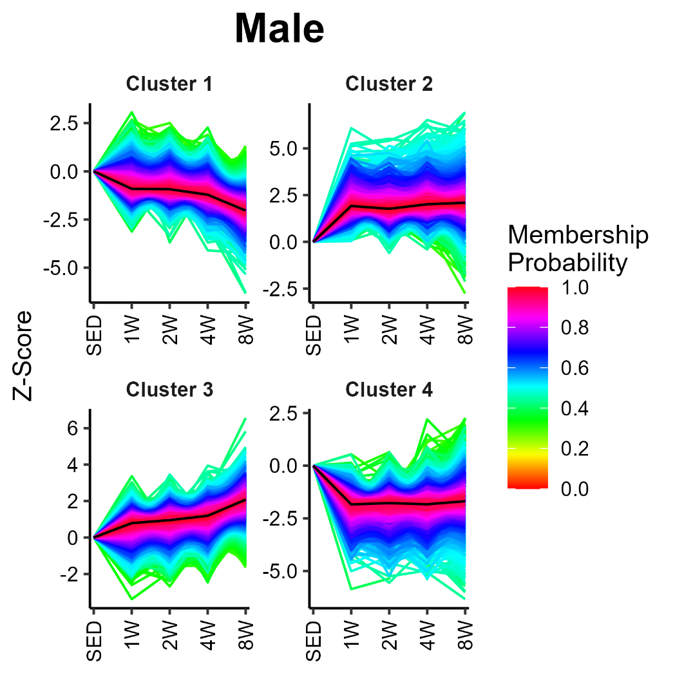
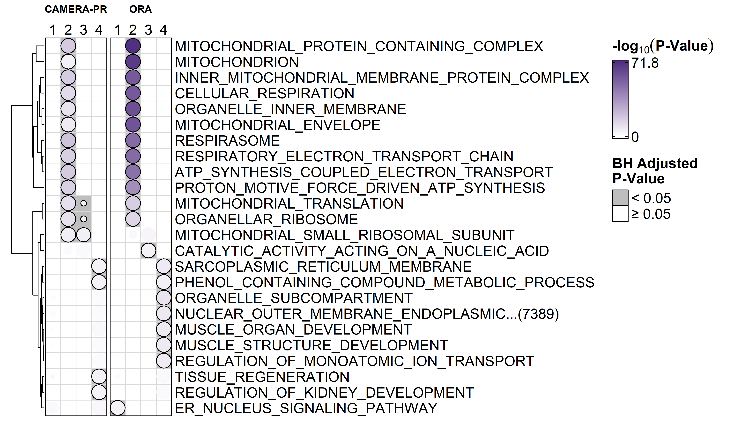
TRNSCRPT

Slide 6
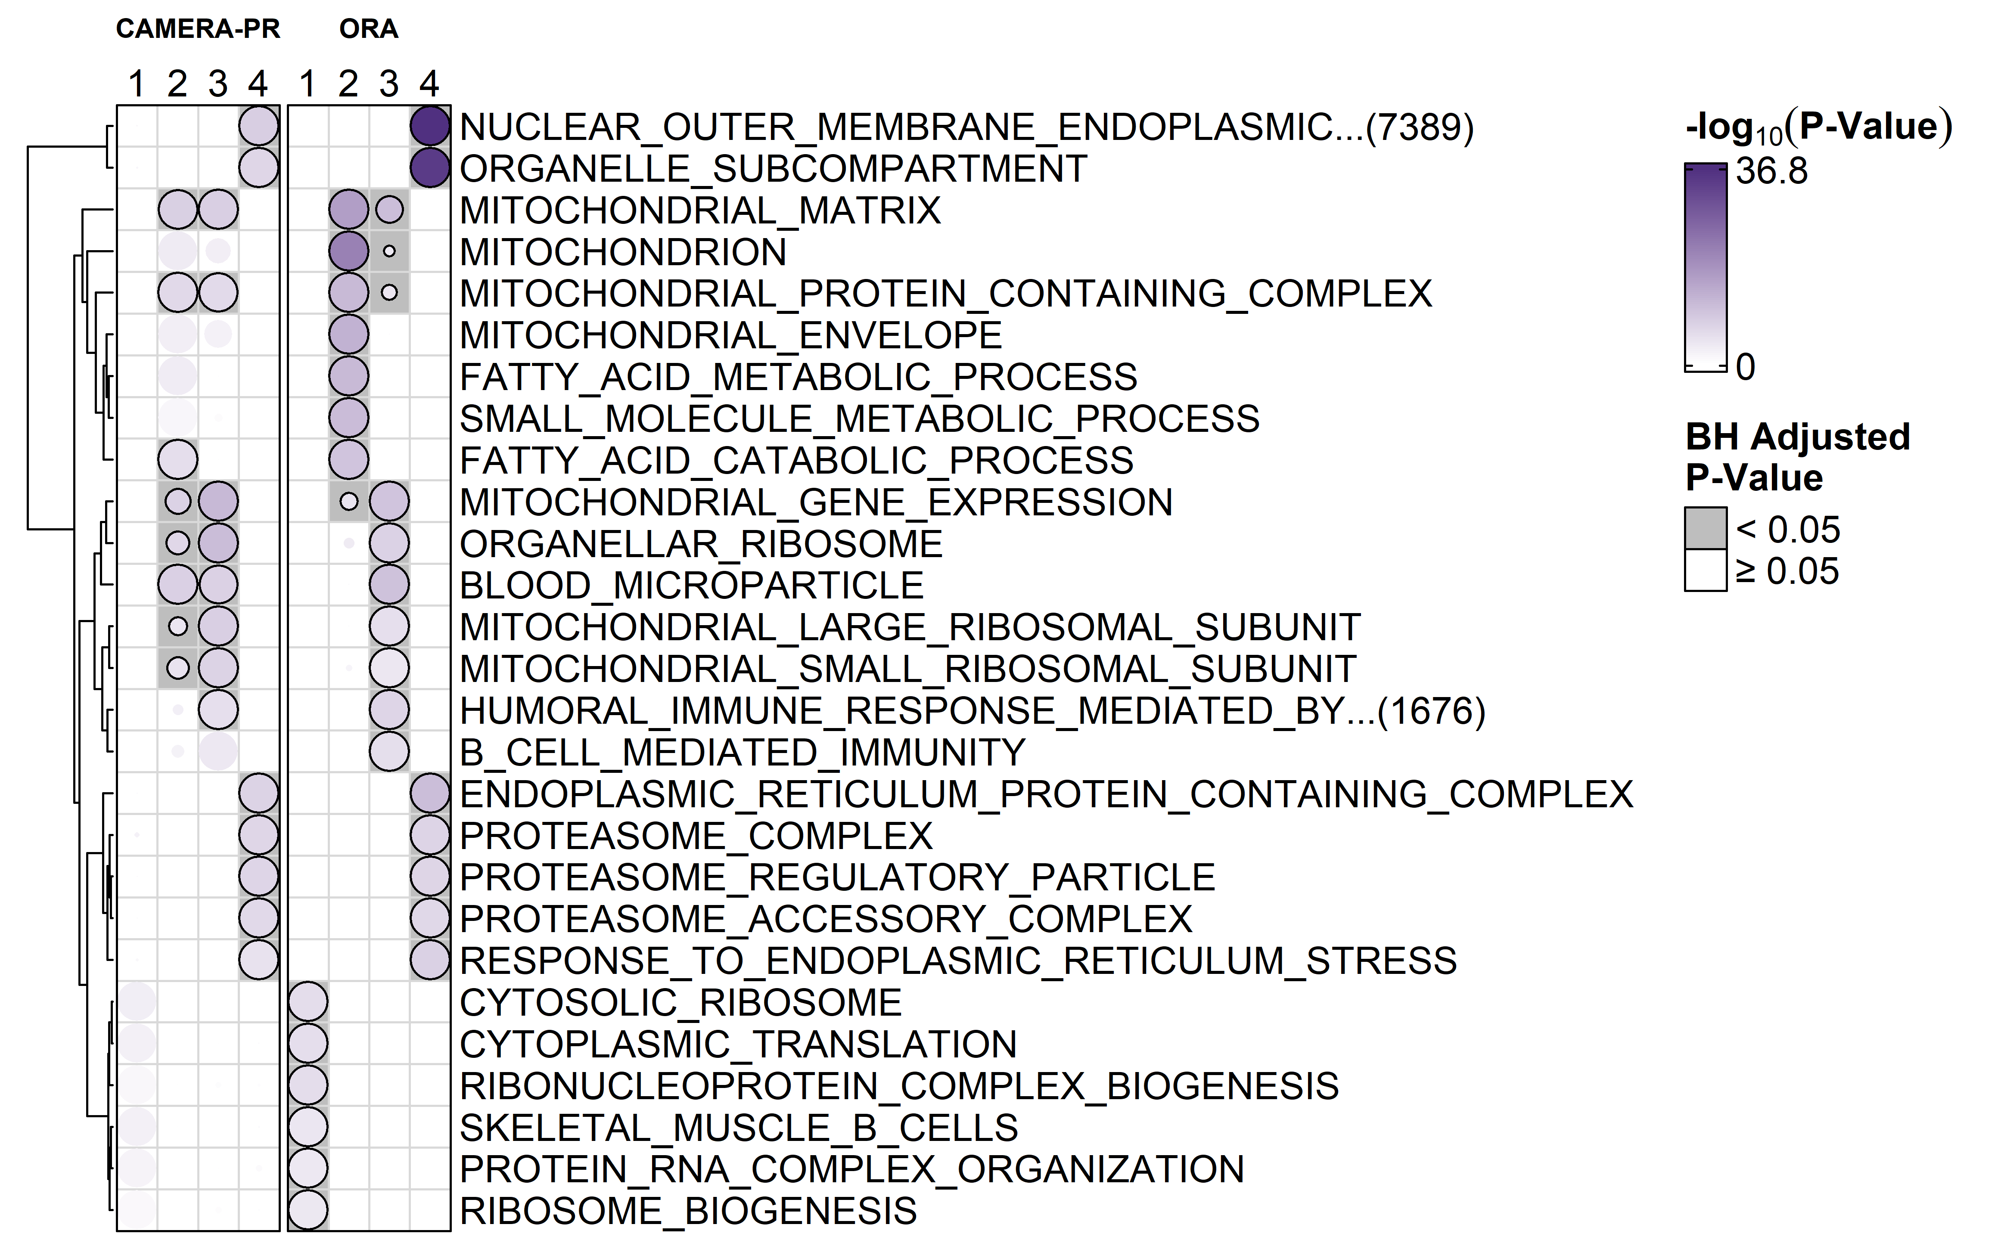
PROT

Slide 7
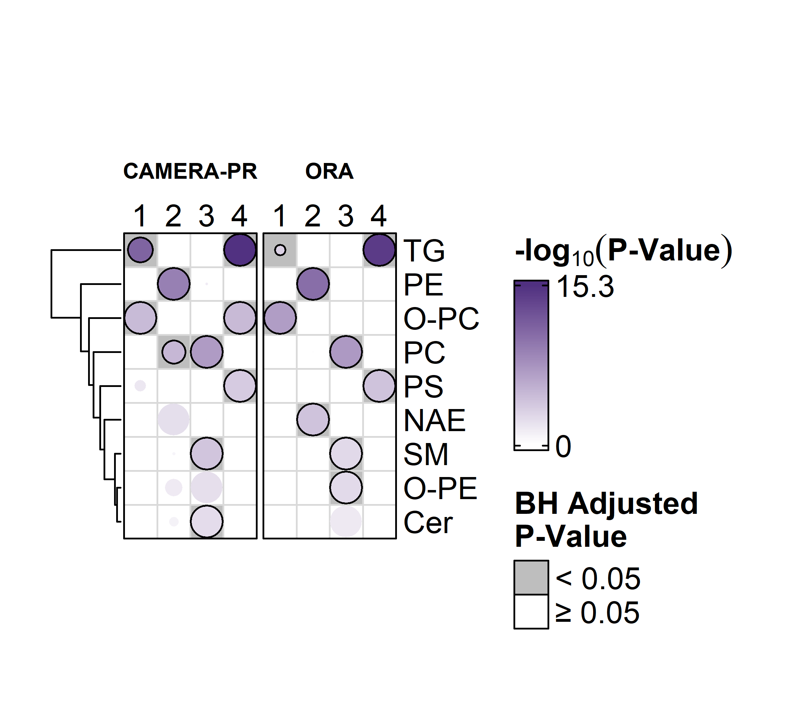
METAB

