Slide 1
Cyclistic bikeshare data analysis
A case study

Slide 2
Phases
Ask
Identify the problems relevant to the stakeholders.
Create the business task that shall be the purpose of the project.
Prepare
Gathering of data relevant to the problem.
Checking for bias and credibility of the data.
Process
Cleaning of data for added accuracy.
Transforming data into a usable format for data analysis.
Analyze
Recommendations
Aggregating the data to provide a more informed structure of the data to provide business insights.
Listing the top recommendations in solving the business task.
The concluding part of the project.

Slide 3
Ask
Phase 1

Slide 4
Background
I am part of the marketing analyst team of Cyclistic as a junior data analyst. The director believes that maximizing the number of annual memberships is relevant in the eventual success of the company. The finance analysts inferred that annual members are much more profitable than casual riders.
Notes:
Lily Moreno is the director.
The bikeshare company is Chicago based.
5800 bicycles and 600 dock stations.
8% use assistive bikes.
30% use bikes for commuting.

Slide 5
Business task
Identify key differences between annual members and casual riders.
Formulate top 3 recommendations on how casual riders may upgrade to annual membership from the result of the analysis.

Slide 6
Data preparation
Phase 2

Slide 7
Setting up the environment
Source
Cyclistic historical data
Software
The large amount of data is suitable to be processed at Rstudio.
Packages
The primary packages used are dplyr, tidyverse, lubridate, skimr and ggplot2.

Slide 8
The imported data
Downloading
Data is downloaded from company’s website and the function `readr::read_csv()` was used in importing the data into RStudio.
Joining
There are 12 data sets representing the last 12 months of latest trip data joined with an object name of `tripdata_all`.
Notes:
Full join was used as each data set has the same variable names and variable types.
Completion rate of the station names and station ids between 78 and 88 percent.
Most data sets have a completion rate of 99.9 percent for the `end_lat` and `end_lng` columns.

Slide 9
Data processing
Phase 3

Slide 10
Conversion to factor data type
Rideable type
electric
classic
Rider type
member
casual
docked
Notes:
Rider type is the member_casual column.
Member is the rider with annual subscription and casual riders are the ones who purchased single ride or one day ride pass.

Slide 11
Rows with missing values
Missing values on station names and station ids appear simultaneously.
Missing values on end latitude and longitude appear simultaneously as well.
The count of unique grid coordinates per station names is large.
These rows of station names with missing values shall be deleted as a more comprehensive way of data analysis is needed in filling these values.

Slide 12
Data cleaning and aggregation
Dropping of irrelevant values
Missing values on station names and ids
Missing values on end grid coordinates
String manipulation
Correcting station names to 1 id only
Additional columns
Day of the week per observation
Month of the year per observation
Grid coordinates outliers
Duration of each ride
Notes:
Missing values on station names and station ids appear simultaneously.
Missing values on end latitude and longitude appear simultaneously as well.
The count of unique grid coordinates per station names is large.
These rows of station names with missing values shall be deleted as a more comprehensive way of data analysis is needed in filling these values.
There are 17 station names with two station ids.
Station ids have multiple names due to misspellings and synonymous wordings.
Outliers on grid coordinates were deleted.

Slide 13
Data analysis
Phase 4

Slide 14
Statistical summary based on membership type
Type | Mean | Median | Min | Max
casual | 1451 | 835 | 0 | 2061244
member | 747 | 539 | 0 | 89594
Riders that have annual membership spent lesser time per ride when compared to casual riders. Annual members spent a limited time biking.
Notes:
The measures are in seconds.

Slide 15
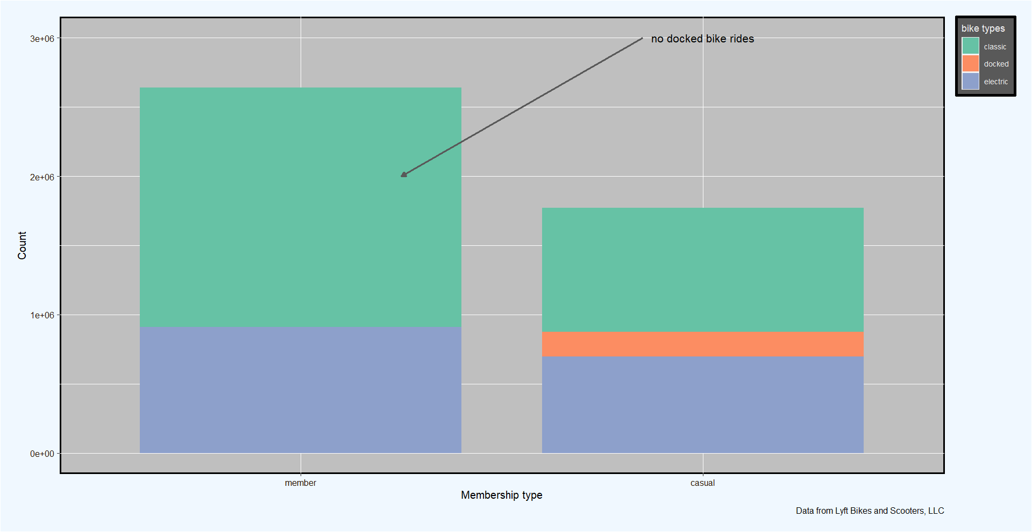
Count of rides per membership type
Electric and classic bike use for casual riders do not differ greatly
More classic bike rides for members
Notes:
Classic bike use can be prioritized in the marketing strategies.

Slide 16
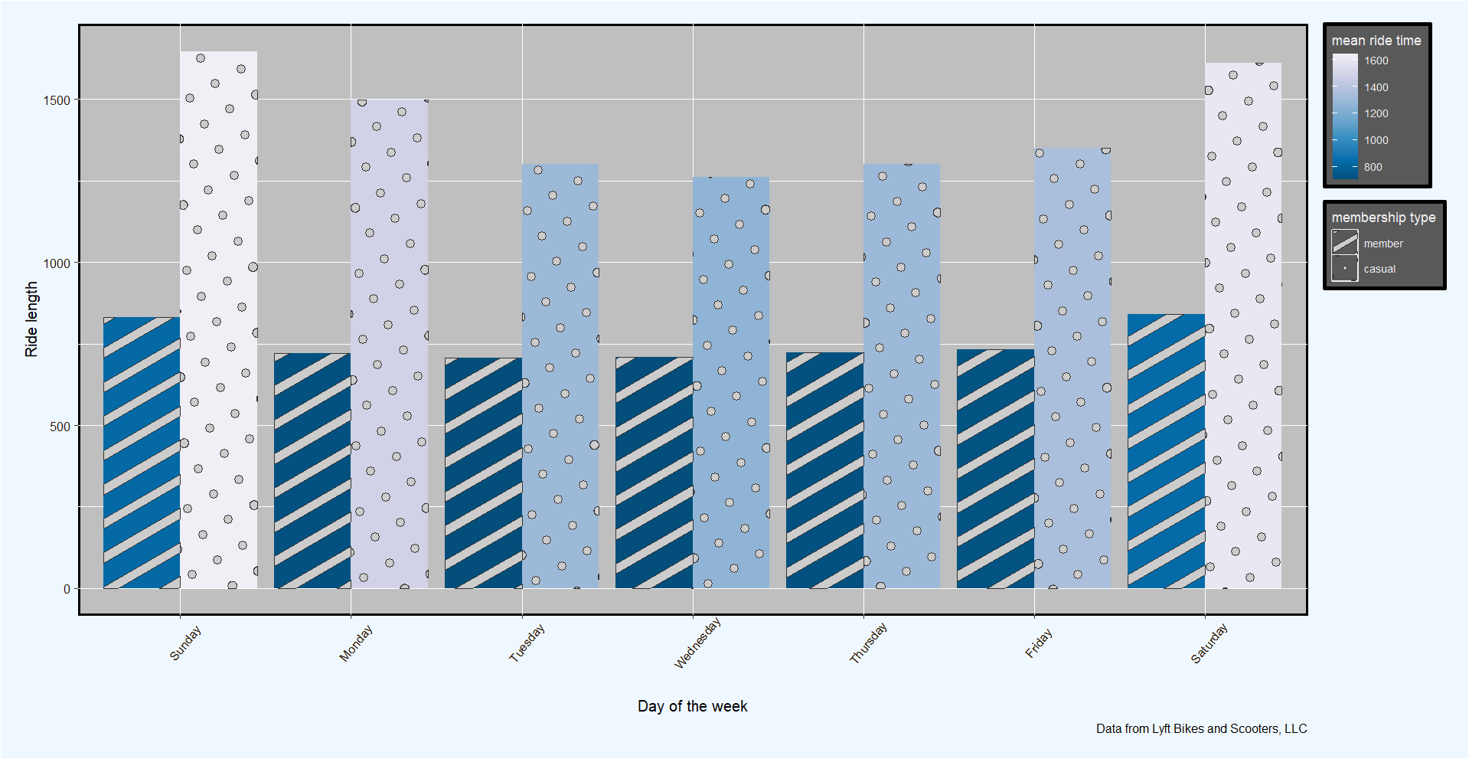
Mean ride time per day
For any day, the ride time for casual riders is always greater than members.
An increase in ride time on weekends both for casual riders and members.
Notes:
Annual members ride time per day do not vary widely, this is an indicator that they use Cyclistic bikes steadily in a week.

Slide 17
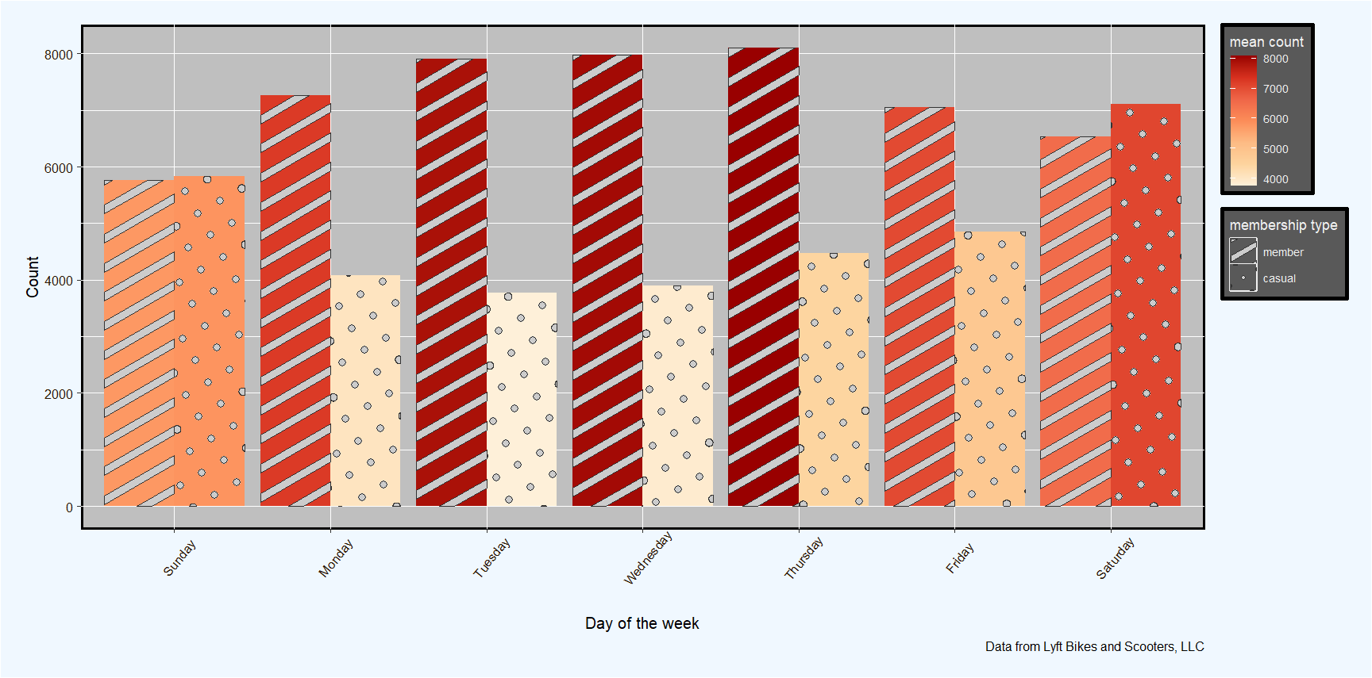
Mean count of rides per day
The average count of rides is significantly higher for members
The average count of rides for members decreases on weekends while increases for casual riders

Slide 18
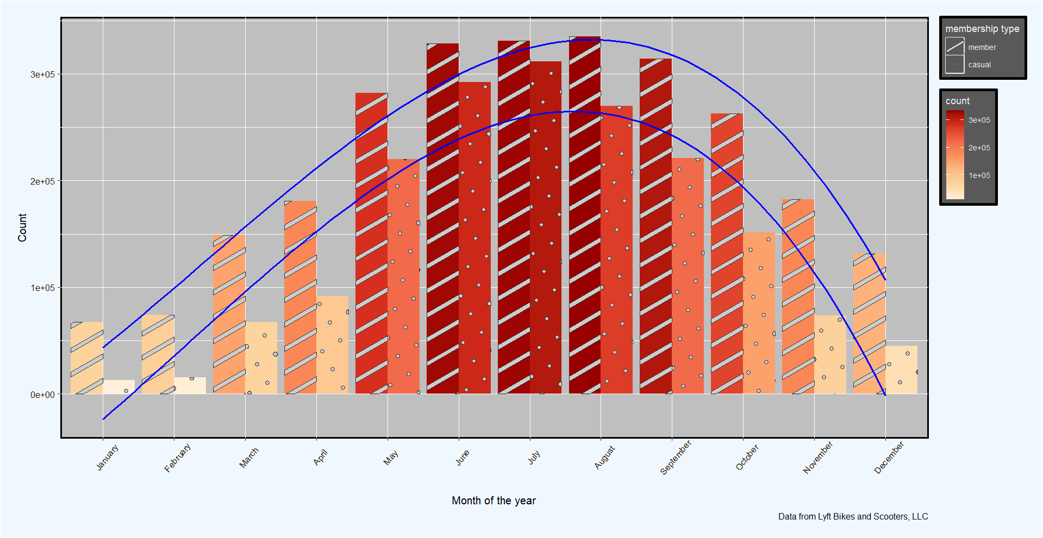
Total count of rides by month
The count of rides are highest on the months of May up to September.
The lowest number of rides are on the months of January, February and December.
Similar trends.

Slide 19
Density maps by start station id
Casual riders
Members
Rides are concentrated around the center of the city for both membership type.
Notes:
The data set is aggregated showing counts of ride by path taken(from initial station id to final station id), it is also grouped by membership type.

Slide 20
Routes with highest count rides
Casual riders
Members
Routes of casual riders were dense around the center of the city. Routes for members are scattered.
Notes:
Only the routes with counts of at least 1000 was considered.

Slide 21
Recommendations
Phase 5

Slide 22
First recommendation
Riders with annual memberships tend to use bikes for commuting as described by the low ride time for them while casual tend to use the bikes for a longer period of time for a leisurely manner. The greater volume of riders with annual membership on weekdays also signifies a strong correlation on using of Cyclistic bikes as a mode of transportation to work. The marketing team can tend toward promoting using Cyclistic bikes as a primary commute transportation.

Slide 23
Second recommendation
Ride volume is larger on the months of May up to September when compared to the other months. Further data analysis should be conducted to identify trends on the monthly count of rides per annum to be able to make future marketing strategies based on the monthly behavior of users.

Slide 24
Last recommendation
Casual rides are highly concentrated at the center of the town. As to convert majority of the casual riders to annual members, prioritization of marketing strategies based on location should be administered on the center of the town.

Slide 25
Thank you!

