Slide 1
Data Structure
Maps
Hasan Alkhatib

Slide 2
Agendas
Introduction
Map Terminology
Map Implementation
Map Types & Characteristics

Slide 3

Libraries use a system that depends on keys to find values (books)

Slide 4
Introduction
A map is an abstract data type designed to efﬁciently store and retrieve values based upon a uniquely identifying search key for each.
Based on Java documentation, A structure that maps keys to values.
A map cannot contain duplicate keys; each key can map to at most one value.
In java we have an interface for Map, and there are several implementations.

Slide 5
Map Terminology
A map stores key-value pairs (k,v), which we call entries, where k is the key and v is its corresponding value.
Keys are required to be unique, so that the association of keys to values deﬁnes a mapping.

Slide 6
Map Terminology
Map: A structure that stores data as keys and values.
Entry: the pairs that links keys and values and represent the map.
Key: a unique value that is associate to an entry value.
Value: the value we need to retrieve using a key to point to it.

Slide 7
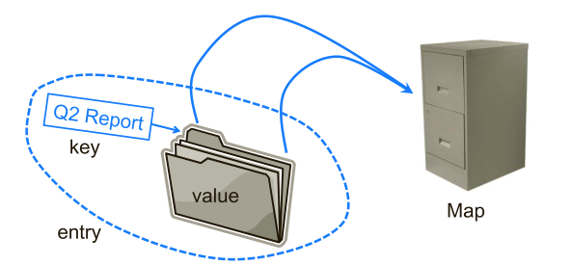
Data in file systems could use maps too, the keys will be folders and names we see, then values are what stored.

Slide 8
Agendas
Introduction
Map Terminology
Map Implementation
Map Types & Characteristics

Slide 9
Map implementation
Maps has a special structure within it, which is the Entry pair.
Each entry has a key and a value.
The map consists of multiple entries, which can be represented as an array.

Slide 10
public class MapADT<K,V> { Entry<K,V>[] entries = new Entry[16]; class Entry<K,V>{ K key; V value; } }
A simple map implementation

Slide 11
Map Operations
size(): Returns the number of entries in M.
isEmpty(): Returns a boolean indicating whether M is empty.
get(k): Returns the value v associated with key k, if such an entry exists; otherwise returns null.
put(k, v): If M does not have an entry with key equal to k, then adds entry (k,v) to M and returns null; else, replaces with v the existing value of the entry with key equal to k and returns the old value.

Slide 12
Map Operations
remove(k): Removes from M the entry with key equal to k, and returns its value; if M has no such entry, then returns null.
keySet(): Returns an iterable collection containing all the keys stored in M.
values(): Returns an iterable collection containing all the values of entries stored in M (with repetition if multiple keys map to the same value).
entrySet(): Returns an iterable collection containing all the key-value en-tries in M

Slide 13
Agendas
Introduction
Map Terminology
Map Implementation
Map Types & Characteristics

Slide 14
Map Types in Java
HashMap.
ConcurrentHashMap.
TreeMap.
Attributes.
EnumMap.
Hashtable
You can see more implementations from here.

Slide 15
Map Types – HashMap & HashTable
Hash table based implementation of the Map interface.
HashMap: This implementation provides all of the optional map operations, and permits null values and the null key. And it is unsynchronized.
HashTable: The same as HashMap, but it doesn’t allow null keys, and it’s synchronized.

Slide 16
Map Types – HashMap & HashTable
Why we use these implementations?
Because the time complexity of its major operations like put, get and remove is O(1).
What is difference between HashMap and ConcurrentHashMap?
ConcurrentHashMap is a thread-safe implementation of HashMap.

Slide 17
Map Types – Attributes
The Attributes class maps Manifest attribute names to associated string values.
Valid attribute names cannot exceed 70 characters in length.
Attribute values can contain any characters and will be UTF8-encoded when written to the output stream

Slide 18
Map Types – TreeMap
A map that is sorted according to the natural ordering of its keys, or by a Comparator provided at map creation time, depending on which constructor is used.
This implementation provides guaranteed log(n) time cost for the containsKey, get, put and remove operations.

