Slide 1
Data Structure
Trees (Binary tree & Multi-way tree)
Prof. Alaa Alhalees
Hasan Alkhatib

Slide 2

Agendas
Introduction & Tree Terminology
Binary Trees
Binary Search Tree
Binary Search Tree Definition
Binary Search Tree Operations & Complexity
B-Tree
B-Tree Definition
B-Tree Operations & Complexity

Slide 3
Introduction
A tree is a nonlinear data structure used to represent entities that are in some hierarchical relationship
Examples in real life:
Family tree
Table of contents of a book
Class inheritance hierarchy in Java
Computer file system (folders and subfolders)

Slide 4

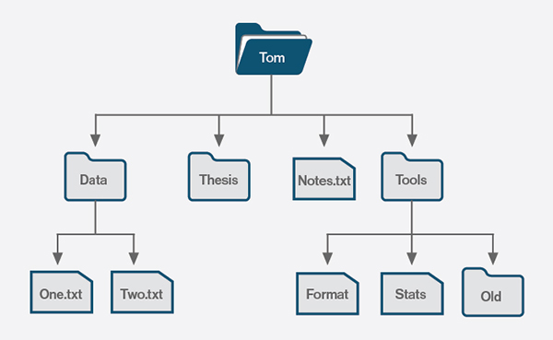
Introduction – Example
One of the most common examples is the file system.

Slide 5
Introduction – Importance
Why would we need the Tree structure?
It’s a faster solution for scenarios where we want to implement hierarchal relation, like company management flow or data flow from a network.
Trees also provide a natural way to organize data in many areas such as file systems and gui.

Slide 6
Tree Terminology
Nodes: the elements in the tree
Edges: connections between nodes
Root: the distinguished element that is the origin of the tree. There is only one root node in a tree.
Leaf node: a node without an edge to another node
Interior node: a node that is not a leaf node
Empty tree: has no nodes and no edges

Slide 7
Tree Terminology
Parent or predecessor: the node directly above in the hierarchy. A node can have only one parent.
Child or successor: a node directly below in the hierarchy.
Siblings: nodes that have the same parent.
Ancestors of a node: its parent, the parent of its parent, etc.
Descendants of a node: its children, the children of its children, etc.
Tree Height: the number of edges from root to the deepest leaf.

Slide 8
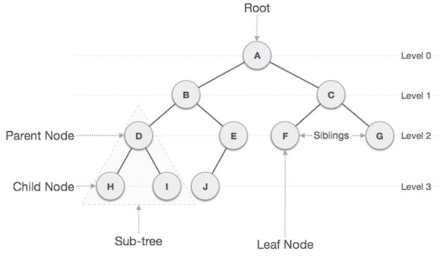
Tree Terminology

Slide 9
A
An example of a tree T:
T root is node A
Leaves are nodes E, I, J, K, G, H, D
Ancestors of node H are C and A
Children of node A are B, C and D
Nodes B, C and D are siblings
Descendants of node B are E, F, I, J and K
Tree Height is 3
B
C
D
E
F
G
H
subtree
I
J
K
Tree Terminology

Slide 10
Bonus Question
Implement a simple Tree data structure. Follow the specification of the tree we described earlier.
public class Tree<T> { private Node<T> root; public Tree(T rootData) { root = new Node<T>(); root.data = rootData; root.children = new ArrayList<Node<T>>(); } class Node<T> { private T data; private Node<T> parent; private List<Node<T>> children; } }

Slide 11
Agendas
Introduction & Tree Terminology
Binary Trees
Binary Search Tree
Binary Search Tree Definition
Binary Search Tree Operations & Complexity
B-Tree
B-Tree Definition
B-Tree Operations & Complexity

Slide 12
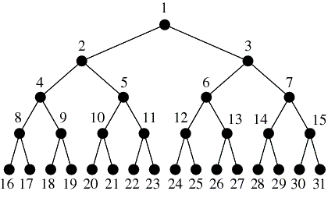
Binary Trees
It’s a tree data structure that has nodes capable of having at most two children.
Binary is composed of zero or more nodes.

Slide 13
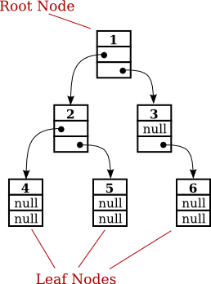
Binary Trees - Node
In binary trees, each node has a value and two pointers for the children nodes. Left pointer and Right pointer.
Binary trees doesn’t have to be sorted.

Slide 14
Binary Trees – Size and Depth
Size is the total number of nodes consisting the tree.
Depth is the number of edges from root to the required node.
e.g. Node(4) depth equals 2.

Slide 15
Agendas
Introduction & Tree Terminology
Binary Trees
Binary Search Tree
Binary Search Tree Definition
Binary Search Tree Operations & Complexity
B-Tree
B-Tree Definition
B-Tree Operations & Complexity

Slide 16
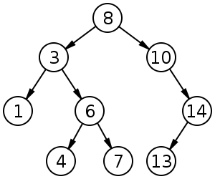
Binary Search Tree – Definition
This tree data structure is a modified version from Binary trees, it inherited it’s node structure.
(BST) Binary Search Tree is a rooted binary tree, in which each node has at most two children, the left children is less than the parent, and the right children is larger than the parent.

Slide 17
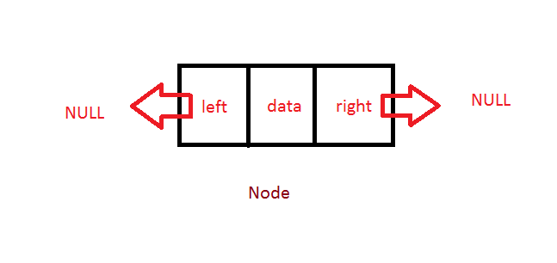
Binary Search Tree – Node
Nodes in BST has the same structure in Binary trees.
The only difference is the way of nodes arrangement. Left child is smaller than parent, Right child is larger.

Slide 18
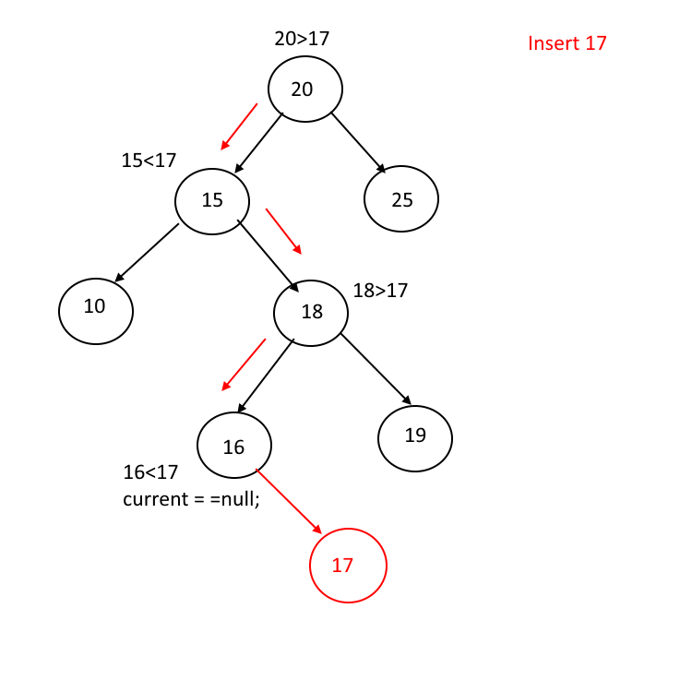
BST Operations – Insertion
Inserting a value x in a Binary Search Tree has O(n) complexity.
The process of inserting starts from the root and comparing it’s value to x, if x>root we go to the right, if x<root we go to the left.

Slide 19
BST Operations – Delete
Deleting a node from Binary Search Tree has 3 possible scenarios, all of them have O(n) complexity.
Node to be deleted is a leaf node ( No Children).
Node to be deleted has only one child.
Node to be deleted has two children.

Slide 20
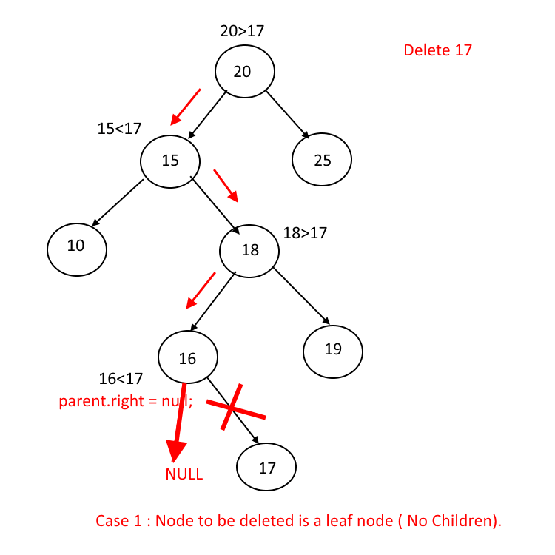
BST Operations – Delete (case #1)
Case #1
Deleting a node that has no children is the simplest scenario.
To delete node x, we first find it, then make the parent points to null instead of x node.

Slide 21
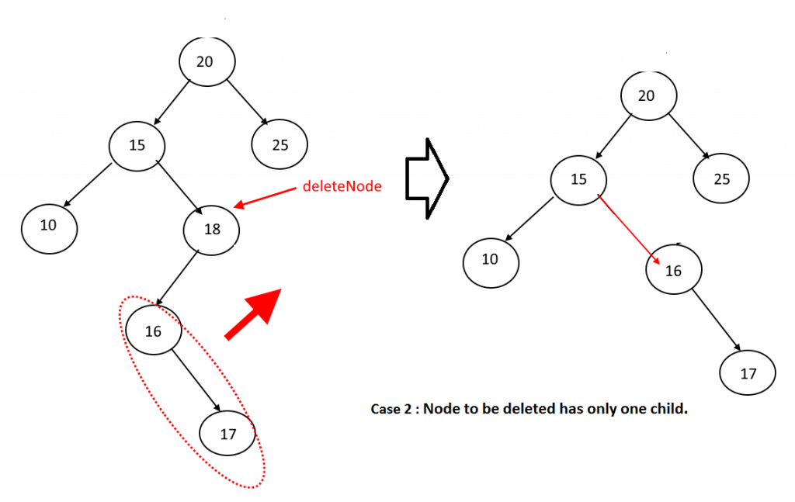
BST Operations – Delete (case #2)
Case #2
Deleting a node that has one child.
To delete node x that has one child, we first find x, then make it’s parent points to the child x node.

Slide 22
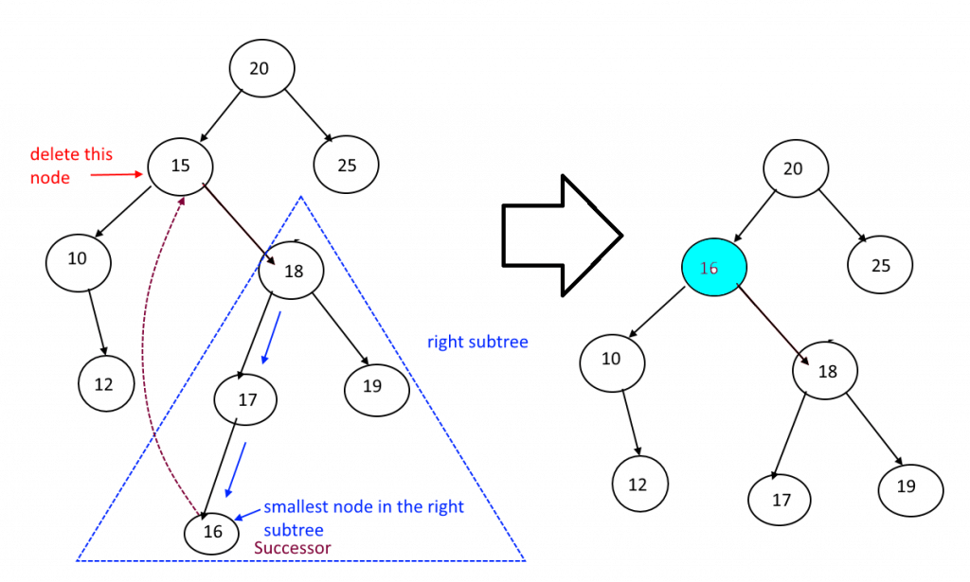
BST Operations – Delete (case #3)
Case #3
Deleting a node that has two children.
This scenario is the most complex scenario in deleting from Binary Search Tree.
See next slide.

Slide 23
BST Operations – Delete (case #3)
Case #3 steps:
Find the node (x) that will be deleted.
If it has 2 children, then we start with deleting the x node itself.
Then we move the smallest node in the right side of node x to the place deleted node.

Slide 24
BST Operations – Display
Displaying all nodes from a BST has O(n) complexity.

Slide 25
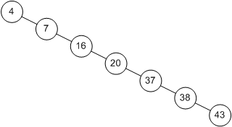
BST Operations Complexity – Bonus
Why we have a O(n) complexity for all operations, even though the tree is sorted and has to possible paths for each node?
Because in the worst scenario, we may have ordered elements that starts from 1 to n.

Slide 26
Agendas
Introduction & Tree Terminology
Binary Trees
Binary Search Tree
Binary Search Tree Definition
Binary Search Tree Operations & Complexity
B-Tree
B-Tree Definition
B-Tree Operations & Complexity

Slide 27
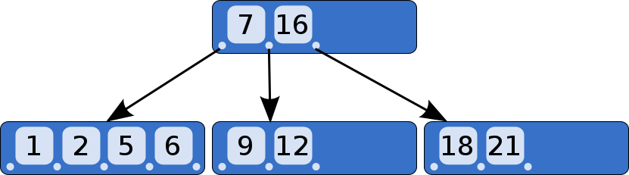
B-Tree – Definition
B-Tree (Balanced BST) is a generalization of BST, in which each node can have more than two children.
B-Tree is a self-balancing tree, it keeps data sorted as keys in nodes according to some constraints.

Slide 28
B-Tree – Node
B-Tree Node has a special structure compared to Binary Tree Nodes.
Each node has more than one value, called Keys.
Number of children per node is calculated by the number of the parent Keys.
e.g. Node x children number = (x keys) + 1
The root has at least two children.
All leave appears in the same level.

Slide 29
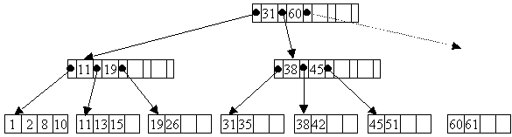
B-Tree Order
The term (Tree order) refers to the most number of children a node can has.
Example: let’s say we have a tree of order 5, this means that the node has a maximum of 5 children.

Slide 30
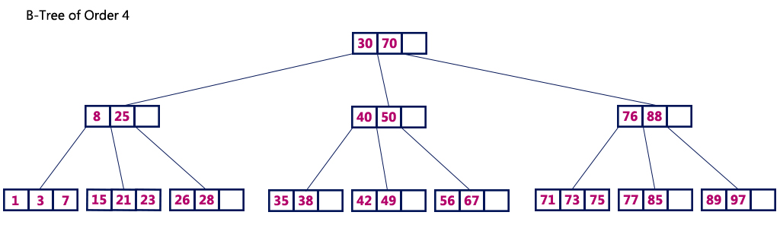
B-Tree – Number of keys
Example: B-tree of order 5 has (5-1) keys.
#Keys = order value (m) - 1

Slide 31
B-Tree – Search Operation
Searching for a specific node with value has O(log n) complexity.
Let’s say we are searching for Key x in B-Tree:
For the first level (root), we determine if the key is existed in this node or not.
If not, we move to the next level by following the pointer in between the two keys surrounding x.
Repeat those steps until we found it, or if we arrived to the leaf without finding it, then it’s not existed.
Notes:
https://www.cs.helsinki.fi/u/mluukkai/tirak2010/B-tree.pdf

Slide 32
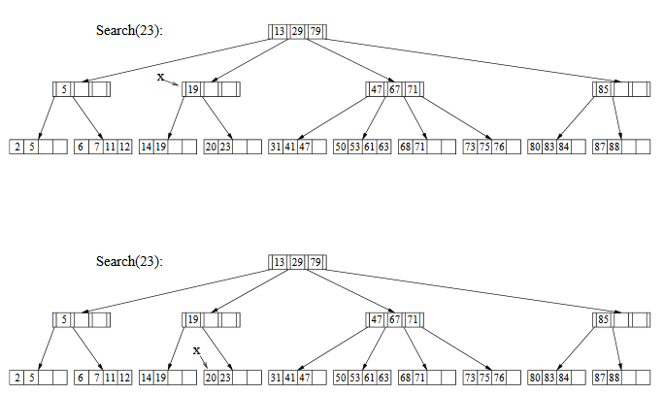
B-Tree Searching Example
Notes:
https://www.cs.helsinki.fi/u/mluukkai/tirak2010/B-tree.pdf

Slide 33
B-Tree – Insert Operation
Inserting operation uses the search operation to find the node where key x will be added, and it’s always has O(log n) complexity.
This process has two possible scenarios:
The node where to add x has space (not full).
The node where to add x is full.

Slide 34
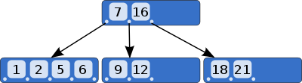
B-Tree – Insert Operation
Case #1: Node has space
Inserting x = 13 to the next tree will has these steps:
Search in the root for value x, if not existed then move to the next level by comparing x to the keys. (if larger than key #1 and smaller than key #2, then go to the right of key #1)
Check if the node we arrived to has space or not. If yes, then add the key to this node.

Slide 35
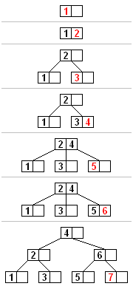
B-Tree – Insert Operation
Case #2.1: Node don’t has space
Inserting x = 5 to the next tree will has these steps:
After applying the search operation, we find ourselves in the last node on the right in the second level (3,4).
Because this node is full, we apply the splitting operation in which we find the median value, and move it to the parent. (3,4,5)
By moving the median to parent, we have a new node to add the key to according to it’s value if larger or smaller than parent.

Slide 36
B-Tree – Insert Operation
Case #2.2: Node don’t has space
Inserting x = 7 to the next tree will has these steps:
After applying the search operation, find ourselves in the last node on the right in the second level (5,6).
Because this node is full, we apply the splitting operation, but here the parent is full too, so we apply splitting for parent too.
After applying splitting for each full parent, then we add the elements according to there order.

Slide 37
B-Tree – Delete Operation
Deleting operation uses the search operation to find the node where key x will be deleted, and it’s always has O(log n) complexity.
Rebalancing maybe required if the deleted key left behind an empty node.

Slide 38
Agendas
Introduction & Tree Terminology
Binary Trees
Binary Search Tree
Binary Search Tree Definition
Binary Search Tree Operations & Complexity
B-Tree
B-Tree Definition
B-Tree Operations & Complexity

