Slide 1

DSA Visualizer
Supervised by: Dr/ Ali AbdElAziz
By Moaaz Mahmoud, Ziad Hussien, AbdElRahman Yasser, and Mohamed AbdElRahim

Slide 2
Overview
This application performs visualization for data structures and analyzes their common operations performance using plots.
The application supports three sequential data structures, namely the linked list, stack, and queue, beside the heap, which is hierarchical.
Tools Used
• JavaFX
• Scene Builder

Slide 3
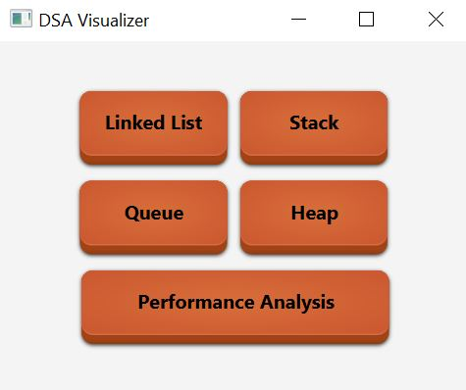
Home Page
You can navigate from this page to:
A page for each data structure
A page for performance analysis

Slide 4
Visualization

Slide 5
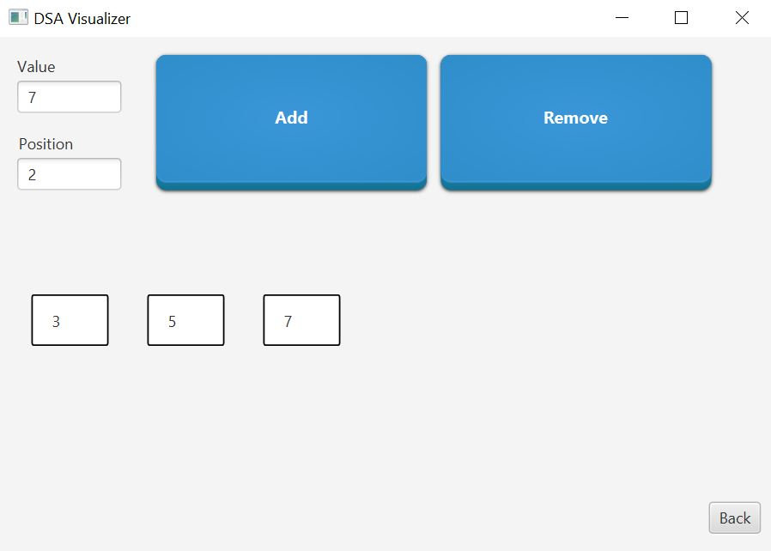
List Page
Main Elements
Textfield ‘Value’: receives the value to add to the list
Textfield ‘Position’: receives the position to add/remove the specified value from
Button ‘Add’: adds an element to the list with the desired value at the desired position
Button ‘Remove’: removes the list element from the specified position
Visualization pool

Slide 6
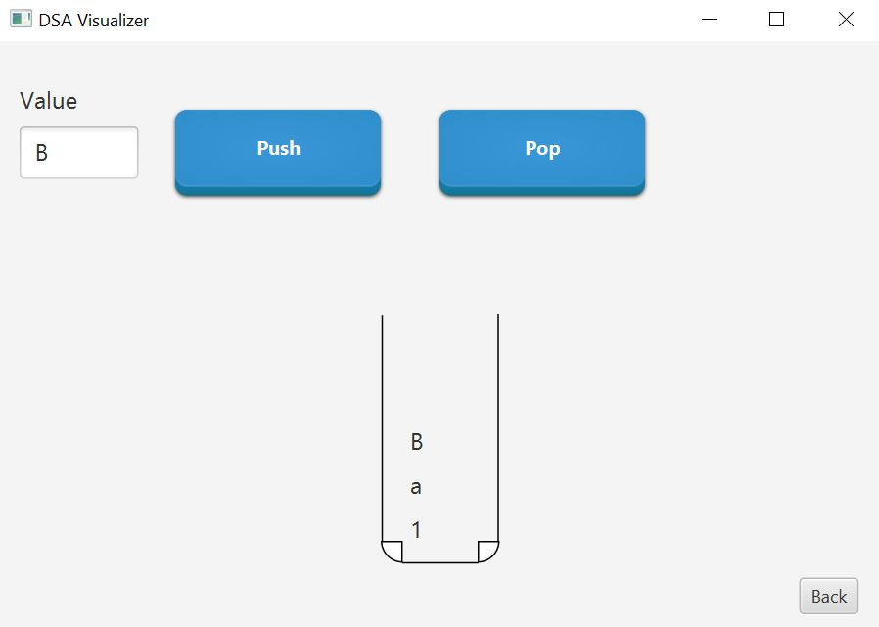
Stack Page
Main Elements
Textfield ‘Value’: receives the value to add to the stack
Button ‘Push’: adds an element to the top of the stack with the desired value
Button ‘Pop’: removes the element at the top of the stack
Visualization pool

Slide 7
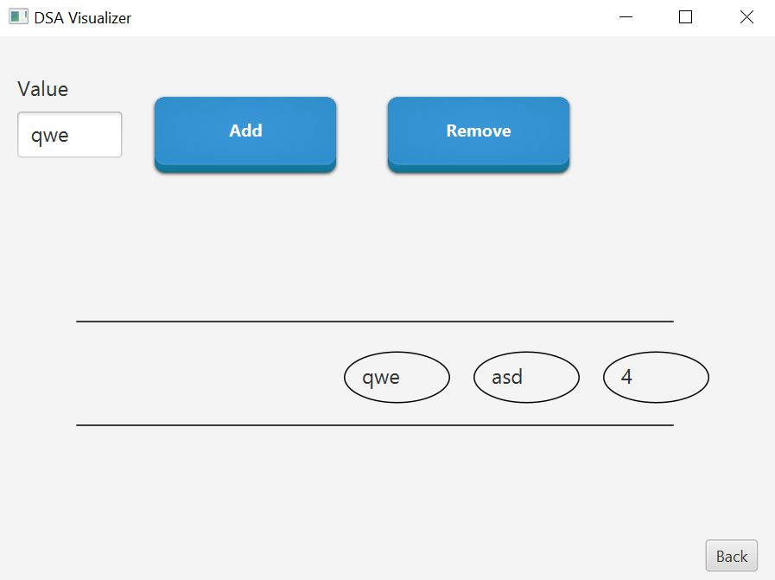
Queue Page
Main Elements
Textfield ‘Value’: receives the value to add to the queue
Button ‘Add’: adds an element to the rear end of the queue with the desired value
Button ‘Remove’: removes the element at the front end
Visualization pool

Slide 8

Heap Page
We used a ‘max’ heap
Main Elements
Textfield ‘Value’: receives the value to add to the heap
Button ‘Add’: adds an element to the heap with the desired value and re-renders the page
Button ‘Remove’: removes the element with the highest value from the heap
Visualization pool

Slide 9
Performance Analysis

Slide 10
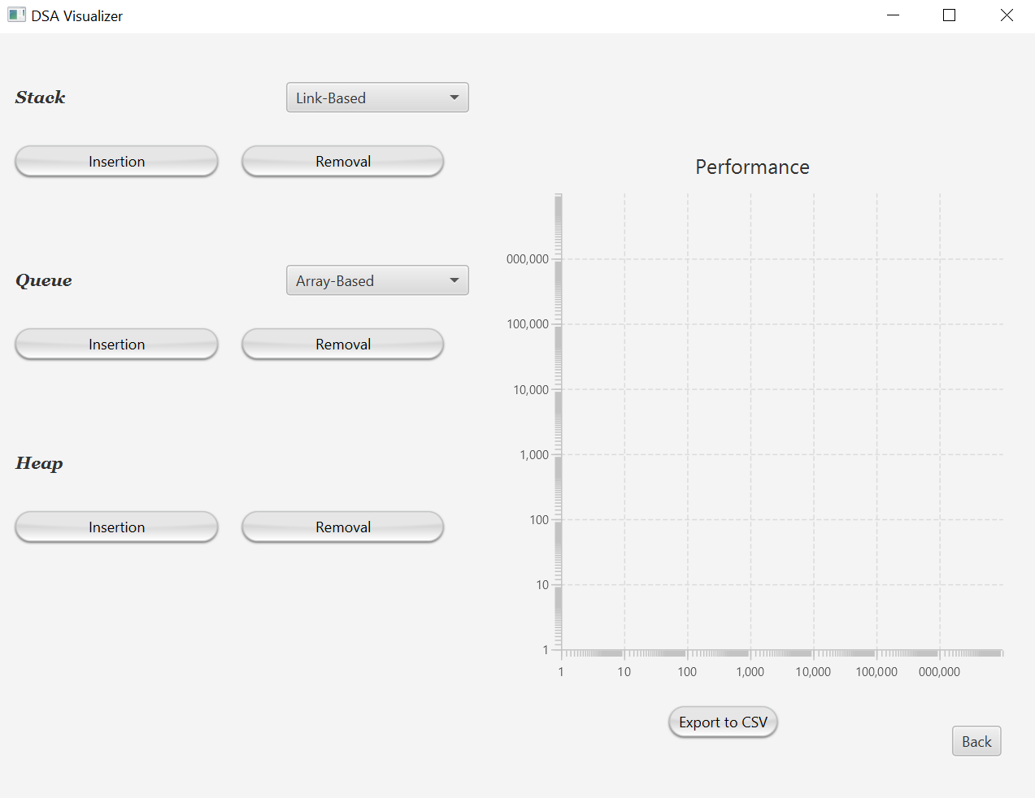
Page Overview
Main Elements
ComboBoxes for the stack and queue to specify the implementation (array/link-based)
Buttons to specify the operation (insertion/removal)
A line chart to view the results
The ‘Export to CSV` button

Slide 11
Capabilities
Supported structures:
Stack (both array- and link-based)
Queue (both array- and link-based)
Heap
On this page, you select a data structure, specify its implementation (if applicable), and specify an operation (insertion/removal).
The application then performs this operation in a repetitive manner in logarithmically-growing chunks to measure the performance.
The application plots the number of operations versus the time elapsed.
The application first performs one operation, records its time, then 10 operations, records their time, and proceeds logarithmically till 10^6.
You can export the plot data to a CSV file.

Slide 12
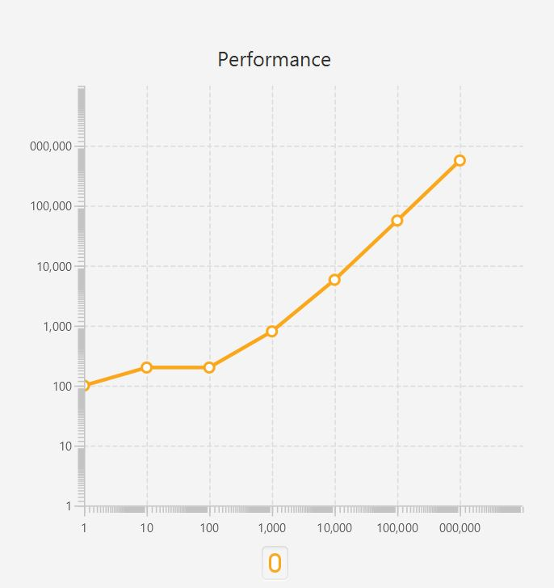
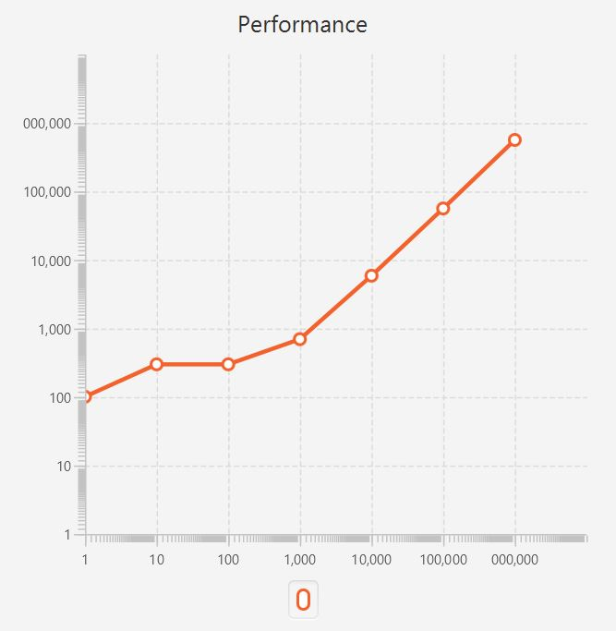
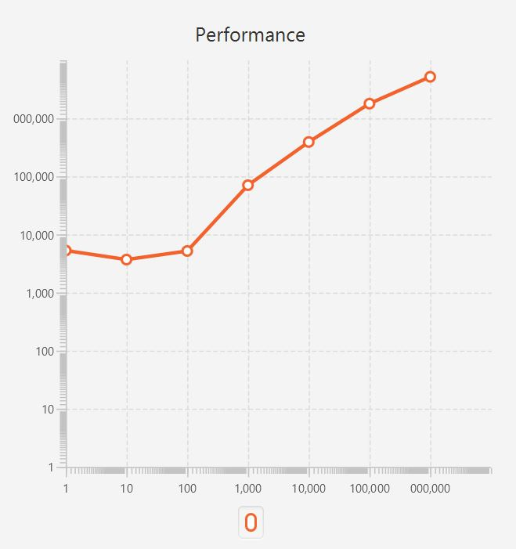
Example Plots
Insertion for the heap
Removal for the heap
Removal for the array-based queue

Slide 13
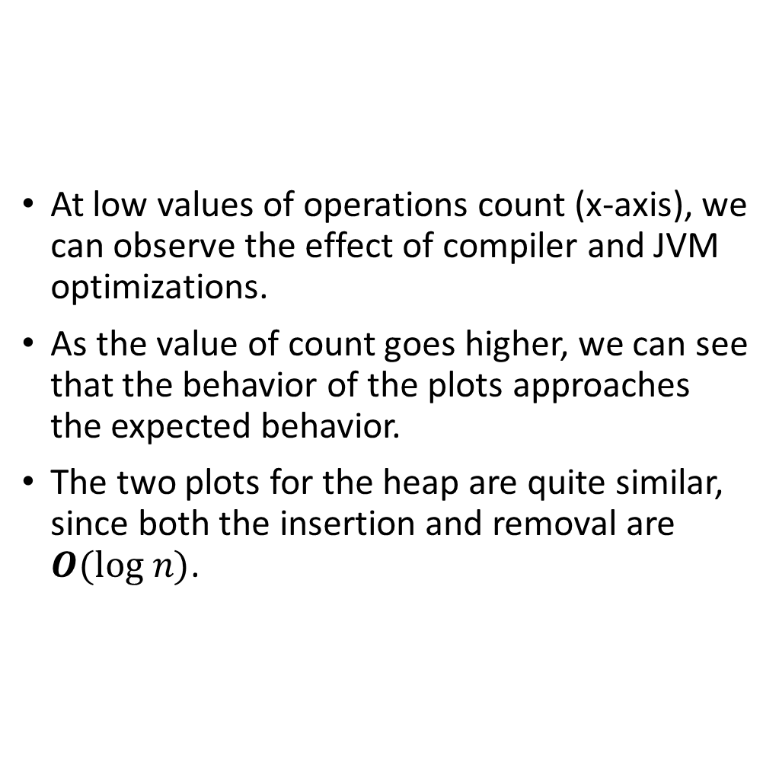
Remarks About the Plots
At low values of operations count (x-axis), we can observe the effect of compiler and JVM optimizations.
As the value of count goes higher, we can see that the behavior of the plots approaches the expected behavior.
The two plots for the heap are quite similar, since both the insertion and removal are $O(log n)$.

