Slide 1
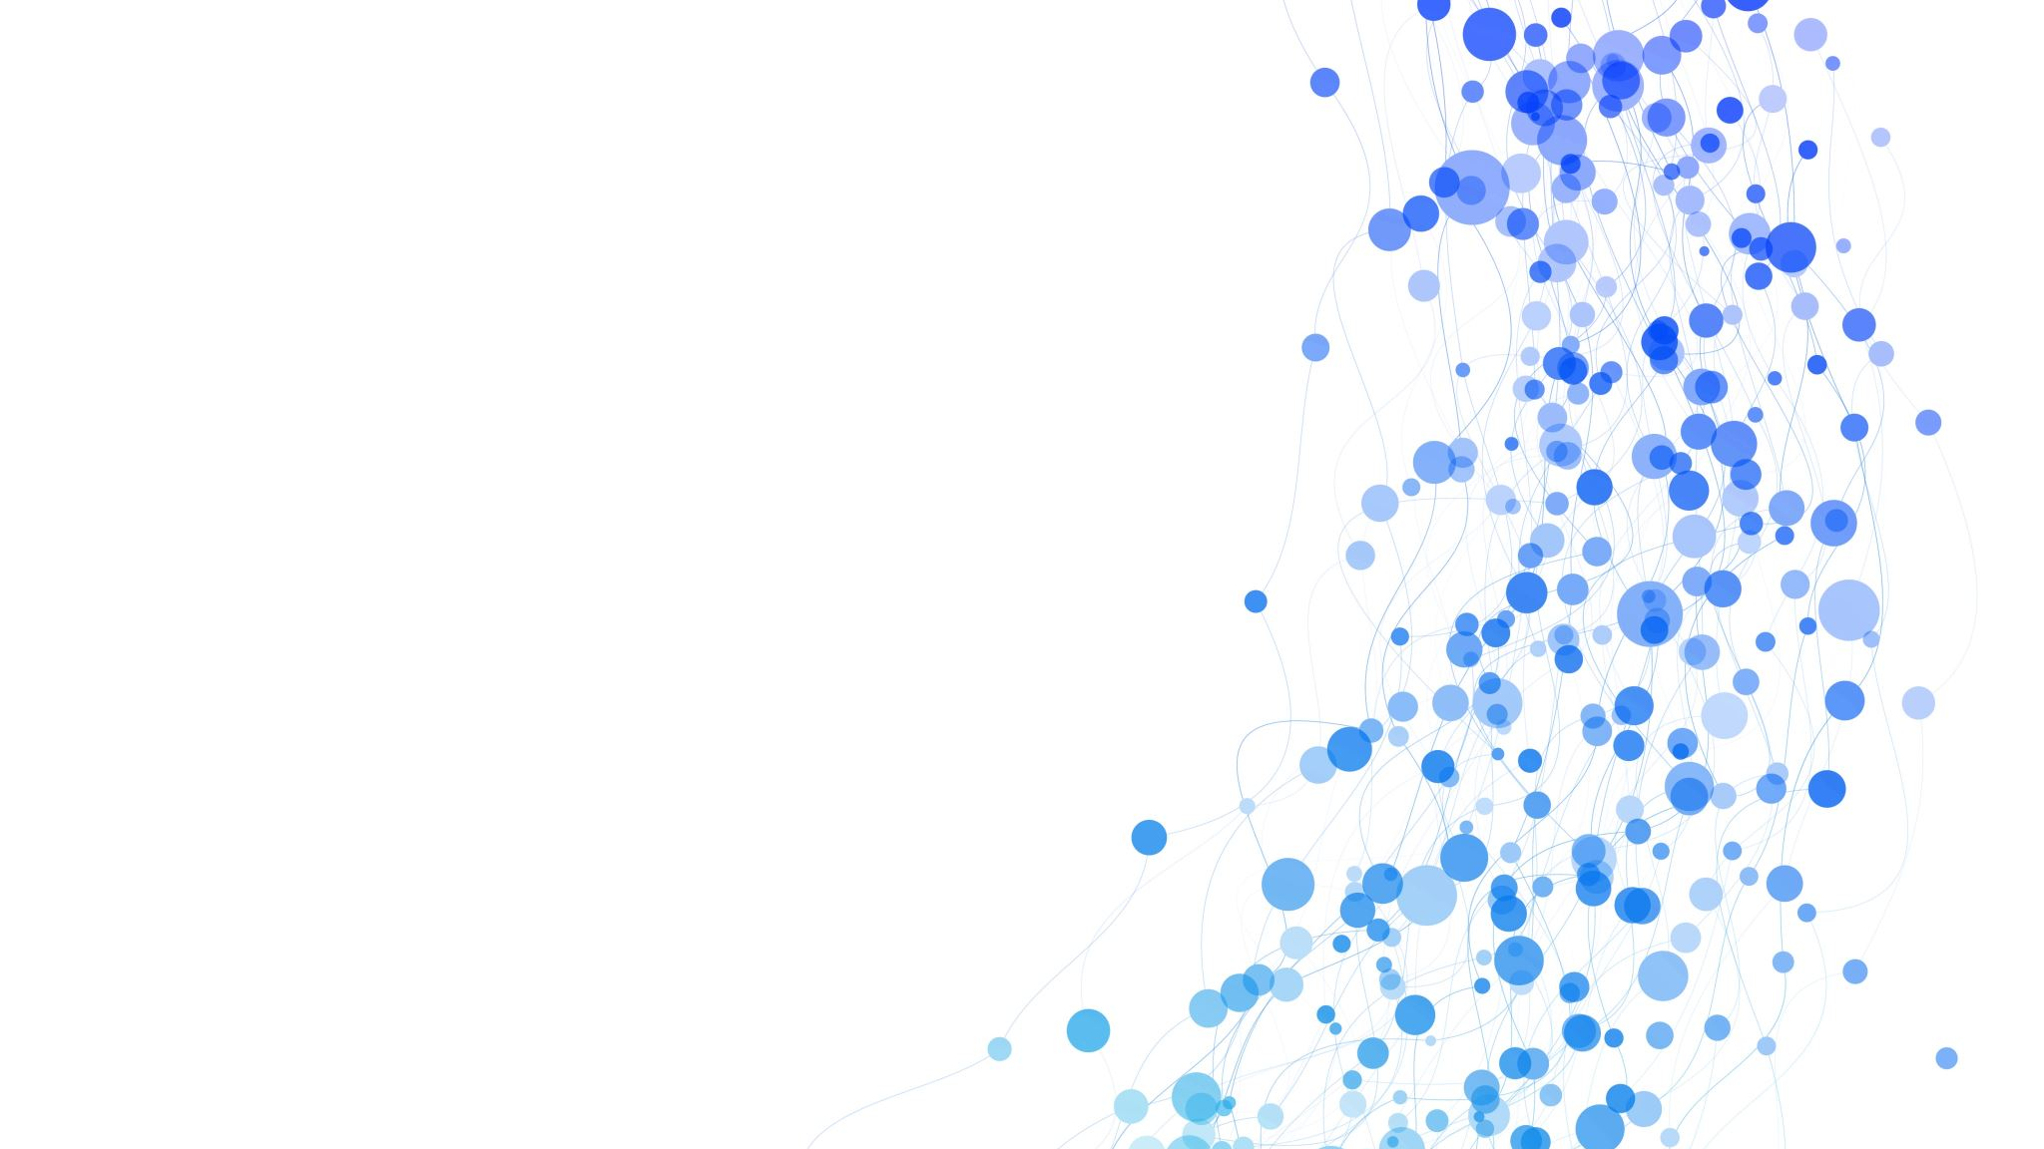
Hiring Platform
Presented to: Dr. Mahmoud A. Saber
Presented by: Moaaz Mahmoud

Slide 2

Overview

Slide 3
Overview Aim and Scope
This project is mainly a platform that aims to help hiring managers make hiring decisions.
The platform supports two types of users — hiring managers and job candidates.

Slide 4
Overview Main Use Cases
Hiring managers can:
Invite candidates to take certain assessments
Create new scenarios
Create templates for certain roles
View the status of the sent invitations (sent/finished) along with the candidate ID, role, and score (for the finished assessments)
Candidates can:
Review their previous assessments (role, manager, score)
View their pending invitations and take assessments

Slide 5

Database

Slide 6
Database Schema
The database has tables for:
Hiring managers and their accounts
Candidates and their accounts
Assessment templates
Scenarios (questions)
Invitations

Slide 7
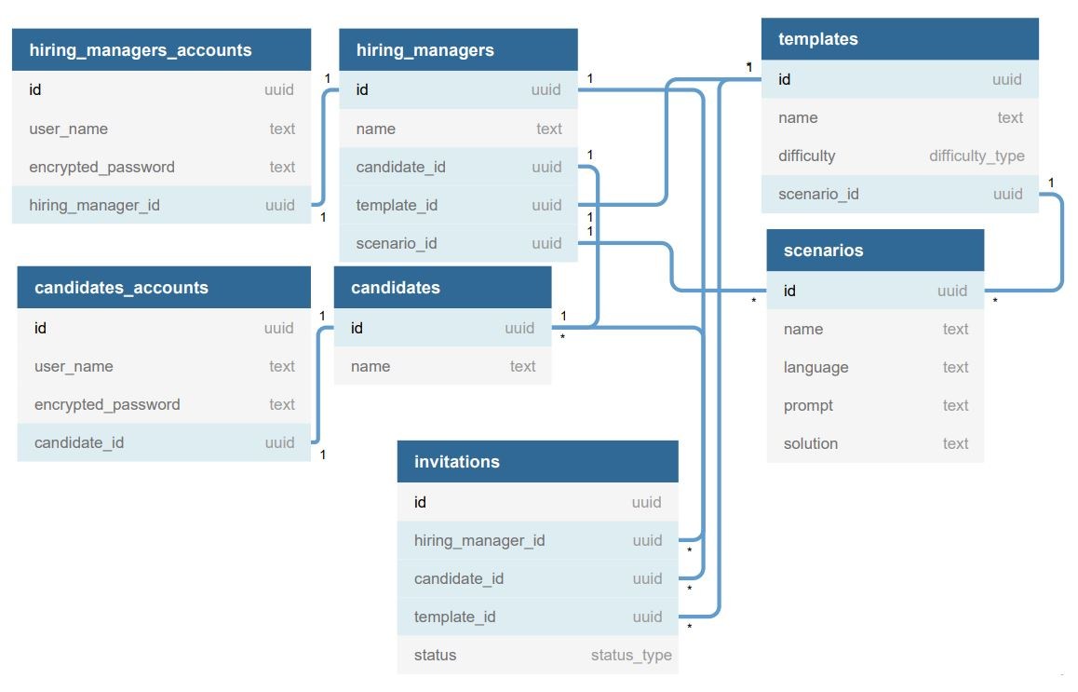
Database Schema

Slide 8
Database Design Rationale

Slide 9

Frontend

Slide 10
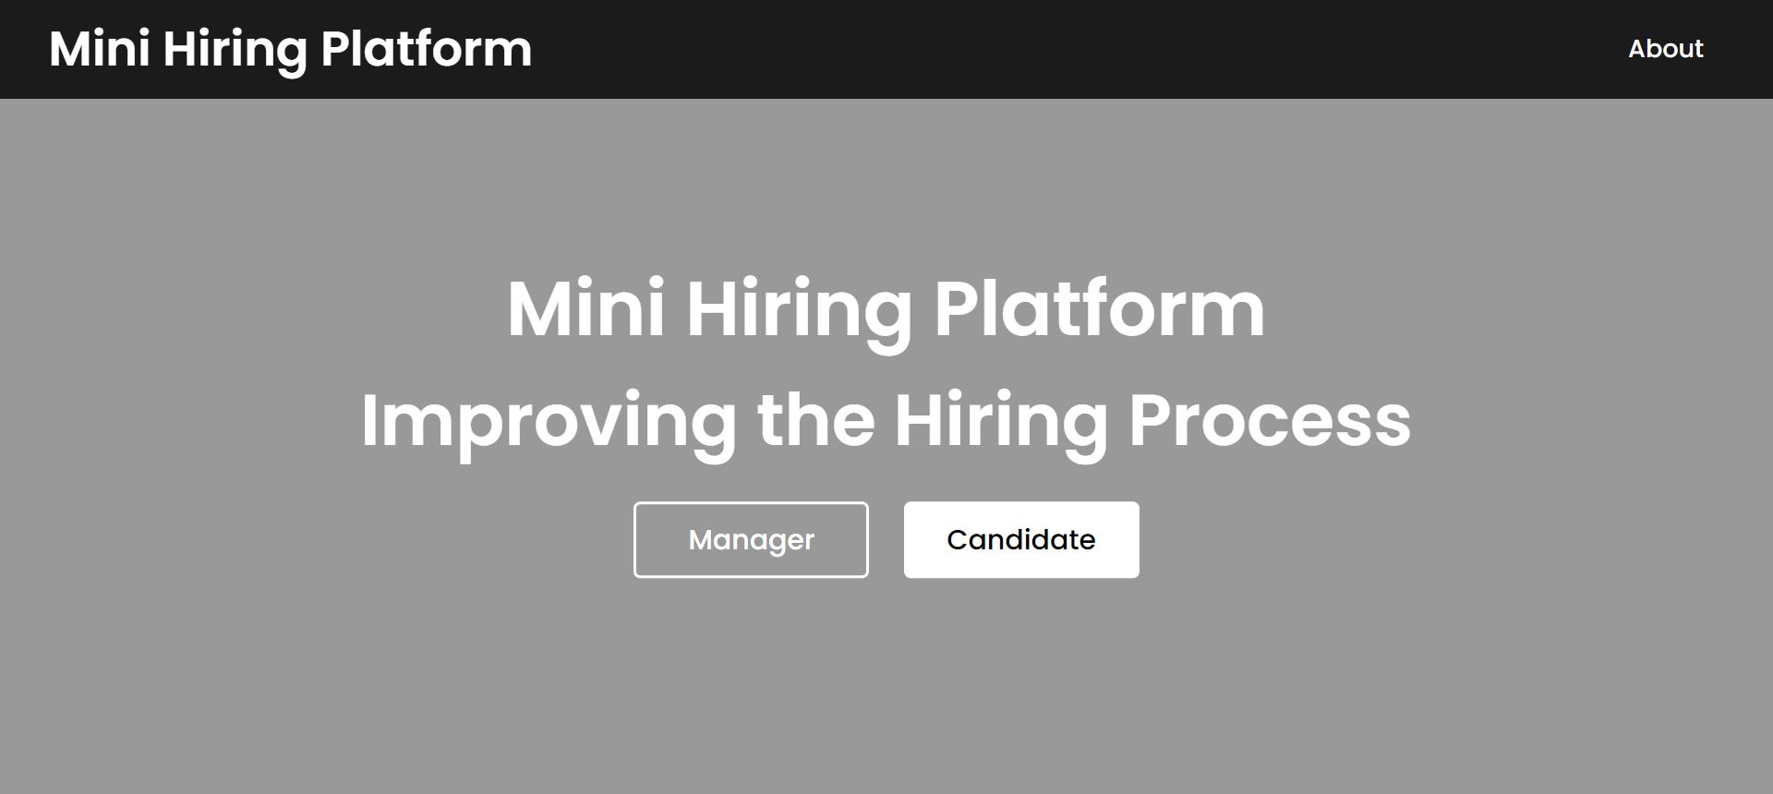
Frontend Home Page

Slide 11

Frontend Sign In/Sign Up

Slide 12
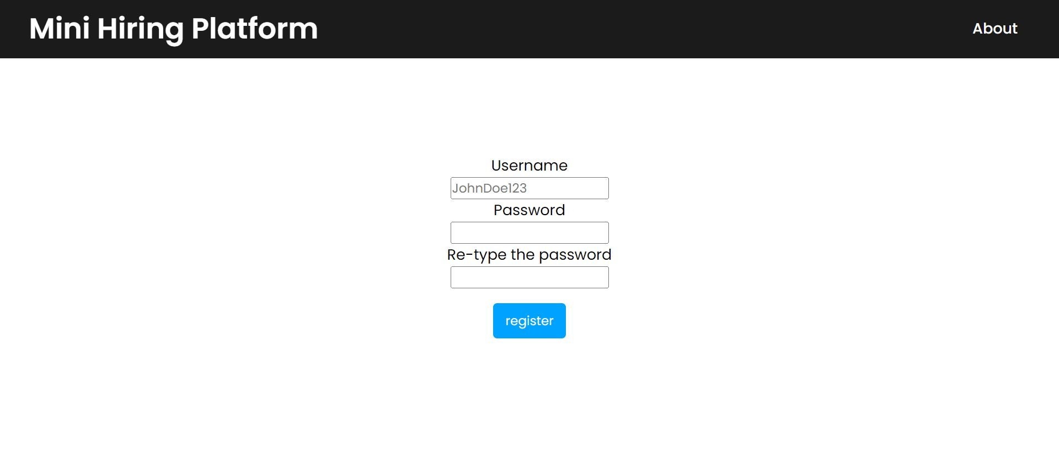
Frontend Sign Up Form

Slide 13
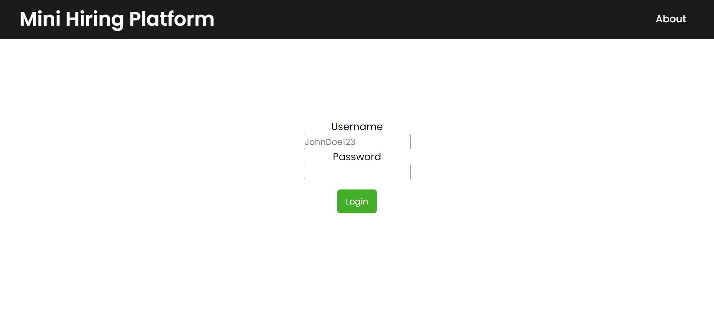
Frontend Sign In Form

Slide 14
Hiring Manager UX Tour

Slide 15
Database Schema
The database has tables for:
Hiring managers and their accounts
Candidates and their accounts
Assessment templates
Scenarios (questions)
Invitations

Slide 16
Candidate UX Tour

Slide 17
Database Schema
The database has tables for:
Hiring managers and their accounts
Candidates and their accounts
Assessment templates
Scenarios (questions)
Invitations

Slide 18

Implementation for Selected Parts

Slide 19
Database Schema
The database has tables for:
Hiring managers and their accounts
Candidates and their accounts
Assessment templates
Scenarios (questions)
Invitations

