Slide 1
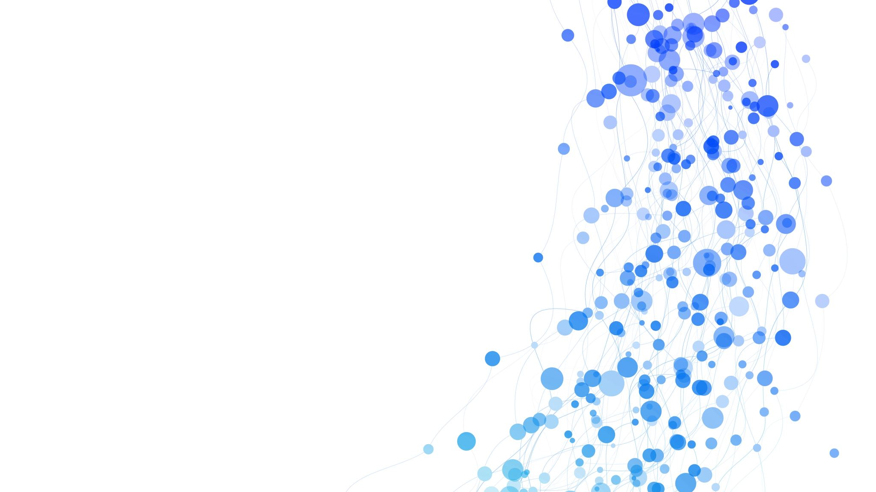
Hiring Platform
Presented to: Dr. Mahmoud A. Saber
Presented by: Moaaz Mahmoud

Slide 2

Overview

Slide 3
Overview Aim and Scope
This project is mainly a platform that aims to help hiring managers make hiring decisions.
The platform supports two types of users — hiring managers and job candidates.

Slide 4
Overview Main Use Cases
Hiring managers can:
Invite candidates to take certain assessments
Create new scenarios
Create templates for certain roles
View the status of the sent invitations (sent/finished) along with the candidate ID, role, and score (for the finished assessments)
Candidates can:
Review their previous assessments (role, manager, score)
View their pending invitations and take assessments

Slide 5
Overview Tools Used
Frontend
HTML5
CSS3
Font Awesome
JavaScript
Backend
PHP
MySQL

Slide 6

Database

Slide 7
Database Schema
The database has tables for:
Hiring managers and their accounts
Candidates and their accounts
Assessment templates
Scenarios (questions)
Invitations

Slide 8
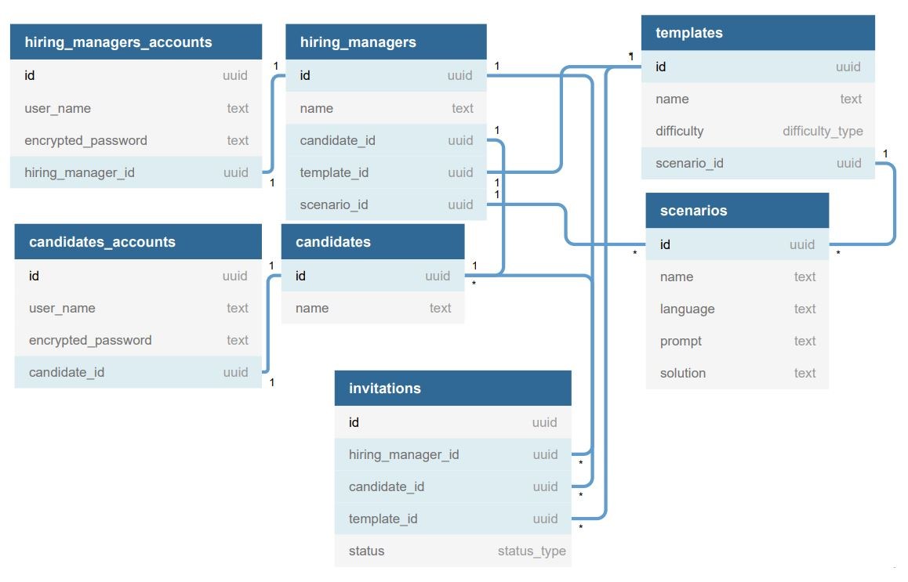
Database Schema

Slide 9
Database Rationale for Some Design Decisions
The account data for users was held in a JOIN table rather than the original table. This helps eliminate redundancy and reduce the size of the resulting tables from JOINs involving users.
A JOIN table was created for each type of user. This helps simplifies the JOINs involving one kind of users.
The difficulty was included as an attribute of the assessment template rather than the scenario. Both are nearly equally reasonable, but recruiters might wish to assess their candidates on several rounds.

Slide 10
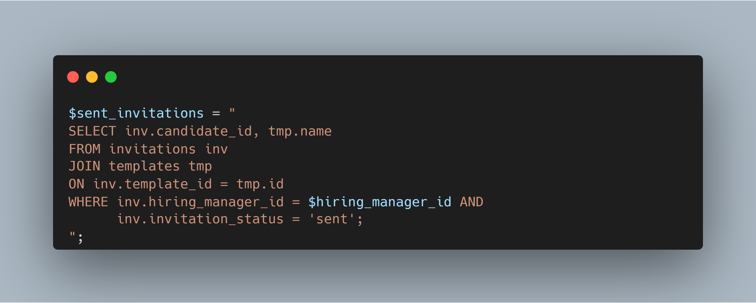
Selected Query #1
The following query is used to get the sent invitations to view on the dashboard for the hiring manager.

Slide 11
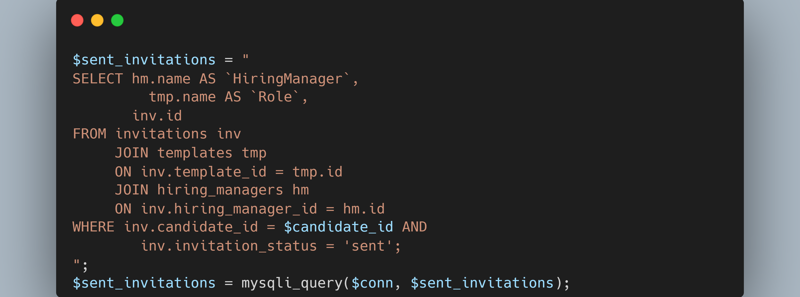
Selected Query #2
The following query is used to get the finished invitations to view on the dashboard for the candidate.

Slide 12
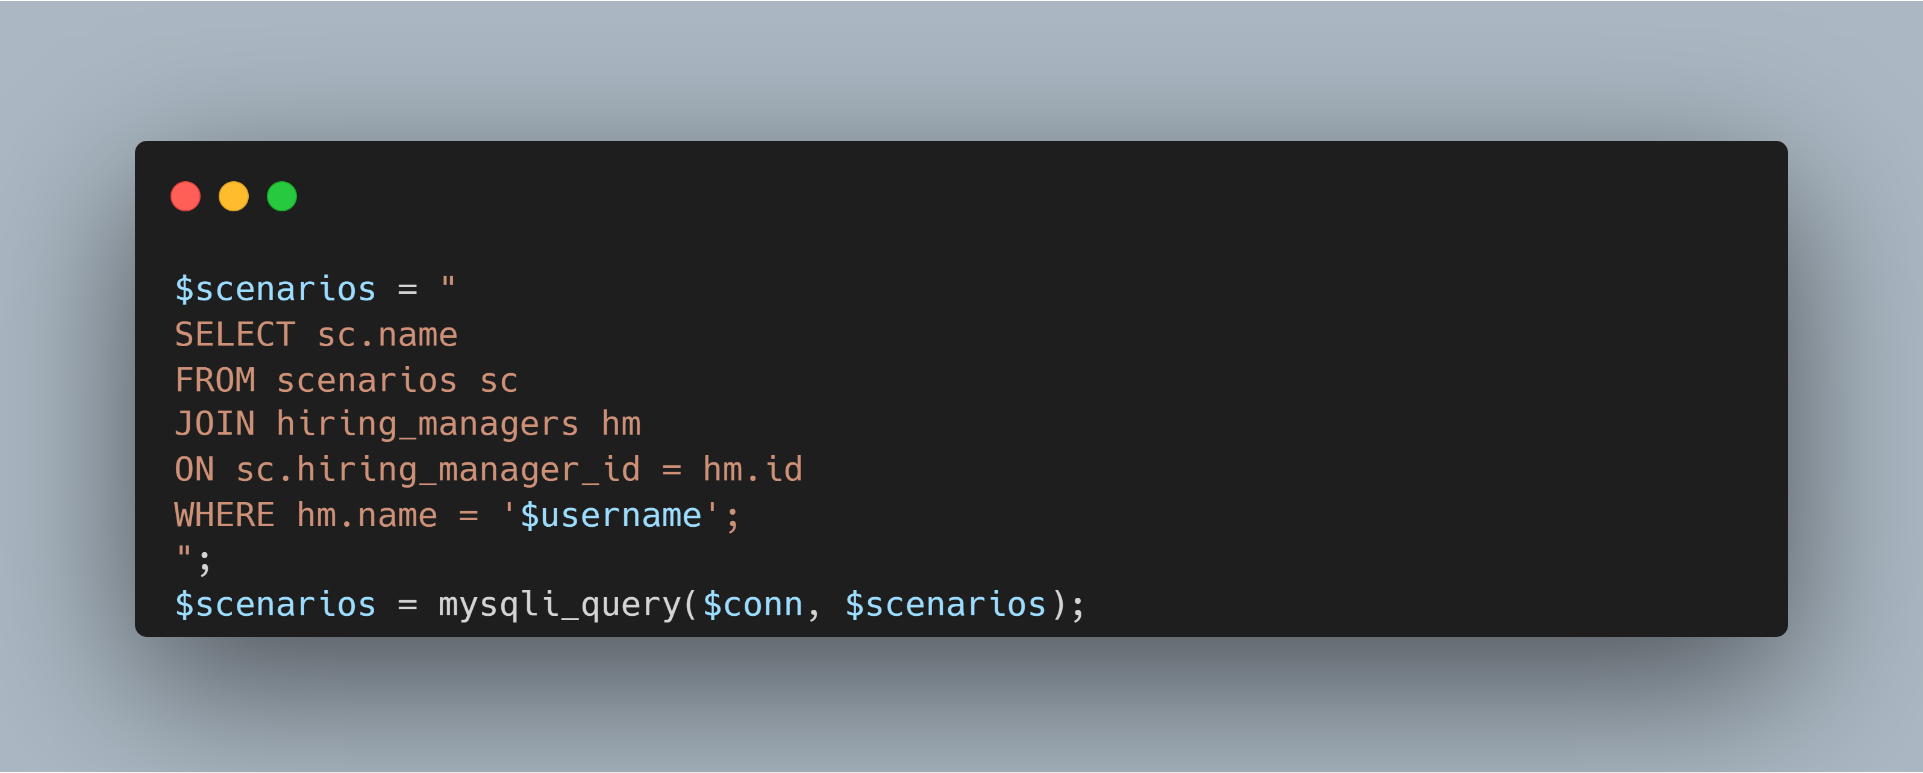
Selected Query #3
The following query is used to retrieve the scenarios to view them on the “Create Scenario” page. The hiring manager can then choose from these scenarios to build the assessment.

Slide 13

Frontend

Slide 14
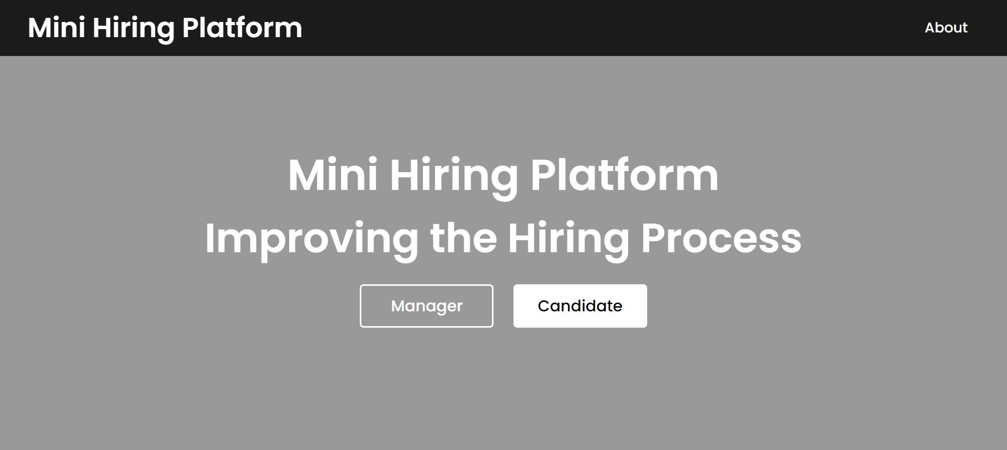
Frontend Home Page

Slide 15

Frontend Sign In/Sign Up

Slide 16
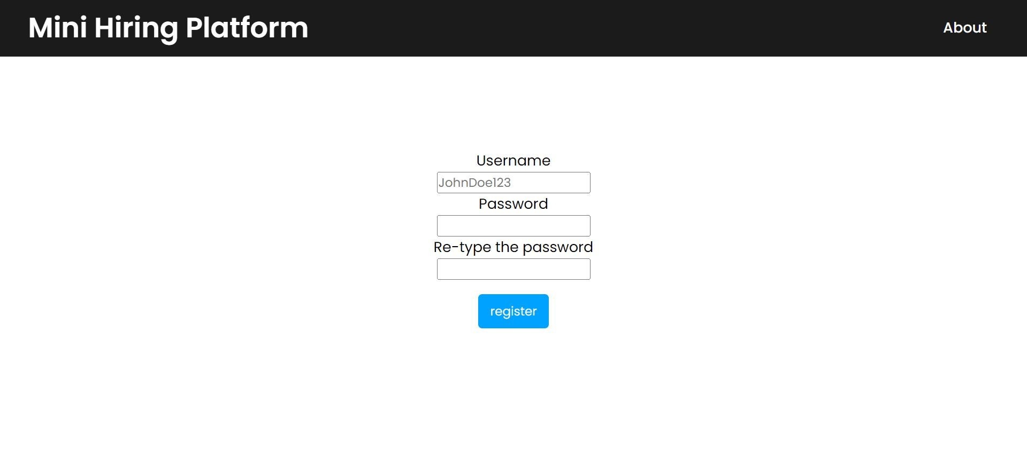
Frontend Sign Up Form

Slide 17
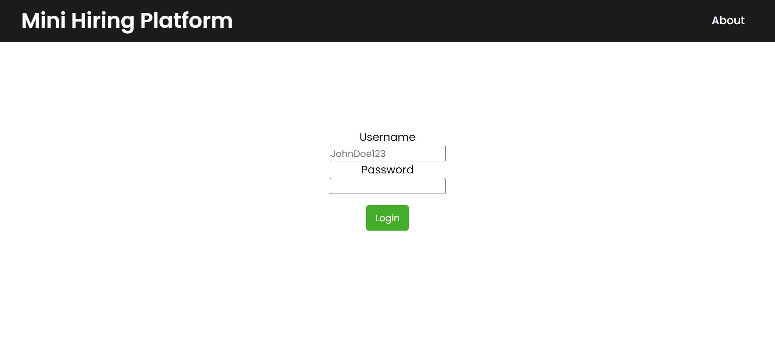
Frontend Sign In Form

Slide 18
Hiring Manager UX Tour

Slide 19
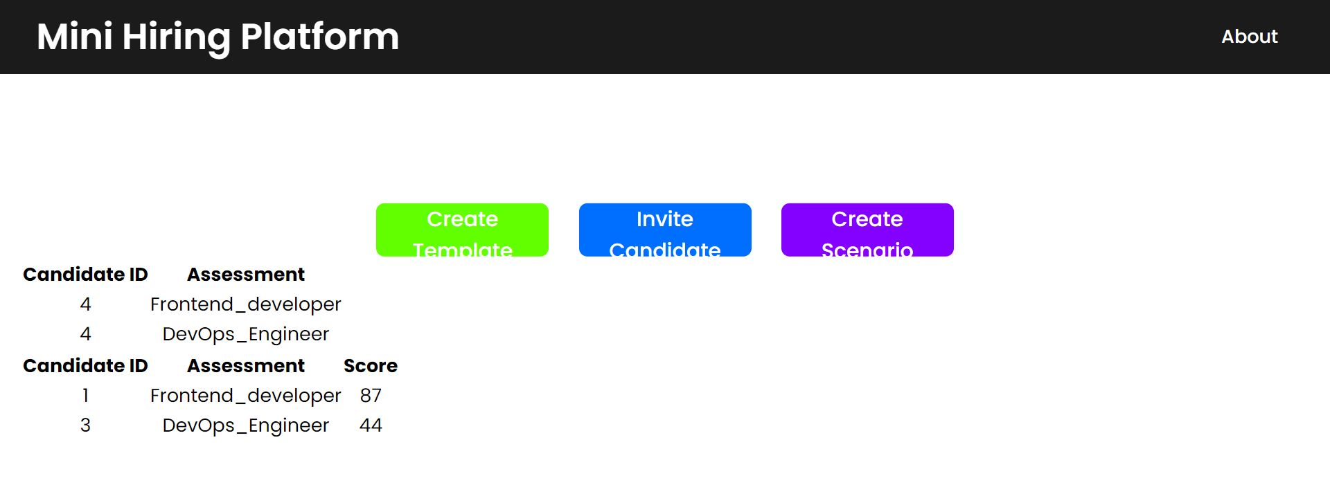
Manager Dashboard
On the dashboard, the hiring manager can:
See the sent invitations with their status (sent/finished)
Navigate to other pages to perform other tasks

Slide 20
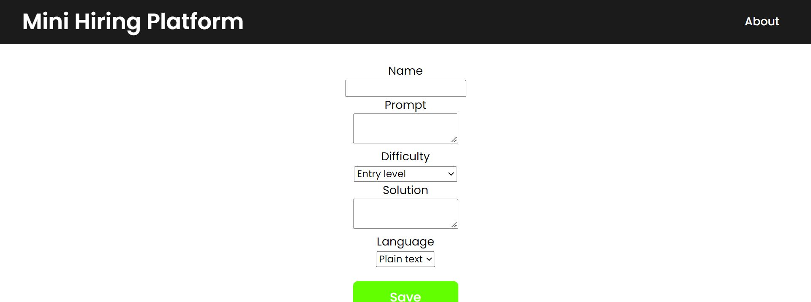
Manager Create Scenario
On the “Create Scenario” page, the hiring manager can:
Set the fields shown for the scenario

Slide 21
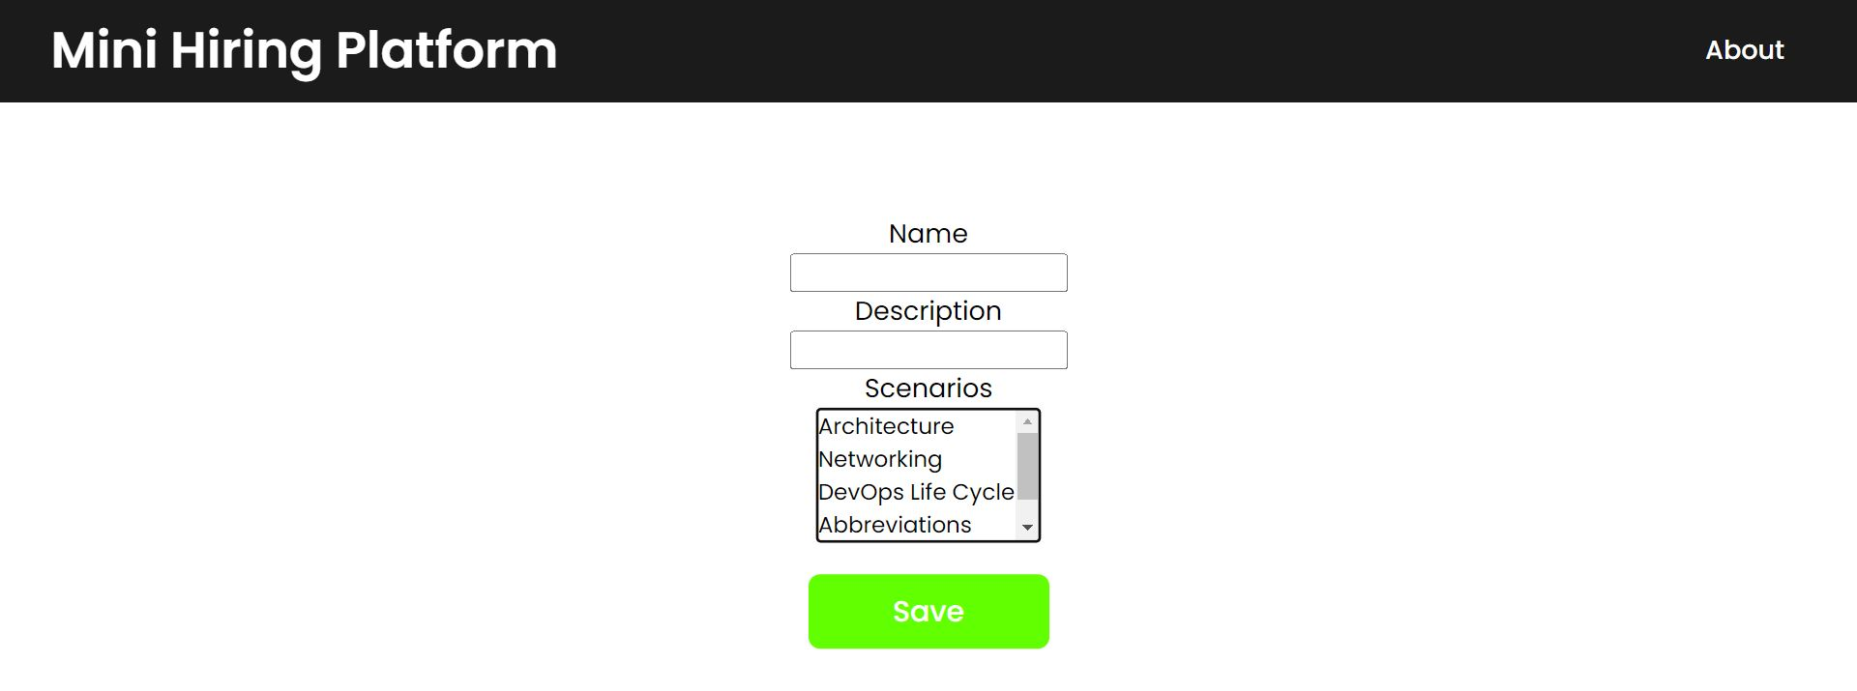
Manager Create Assessment Template
On the “Create Template” page, the hiring manager can:
Specify the shown fields for the assessment
Choose one or more previously created scenarios and add them to the assessment template

Slide 22
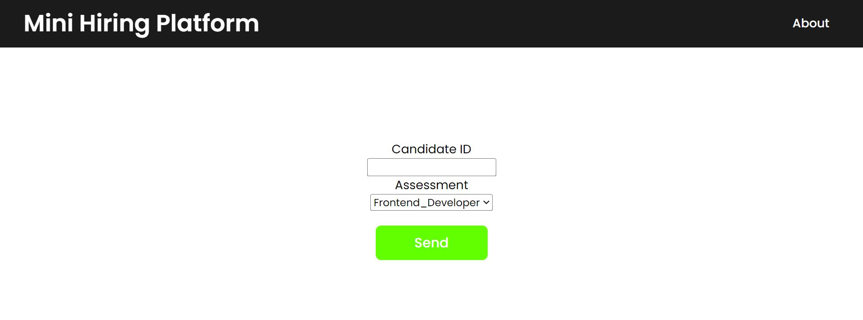
Manager Create Invitation
On the “Invite Candidate” page, the hiring manager can:
Specify the candidate and assessment
Send the invitation to the candidate

Slide 23
Candidate UX Tour

Slide 24
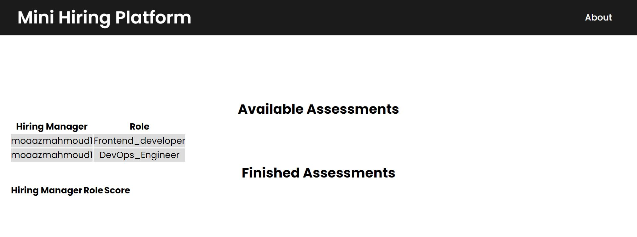
Candidate Dashboard
On the dashboard, the candidate can:
View their previous assessments scores
Take one of the available assessments

Slide 25
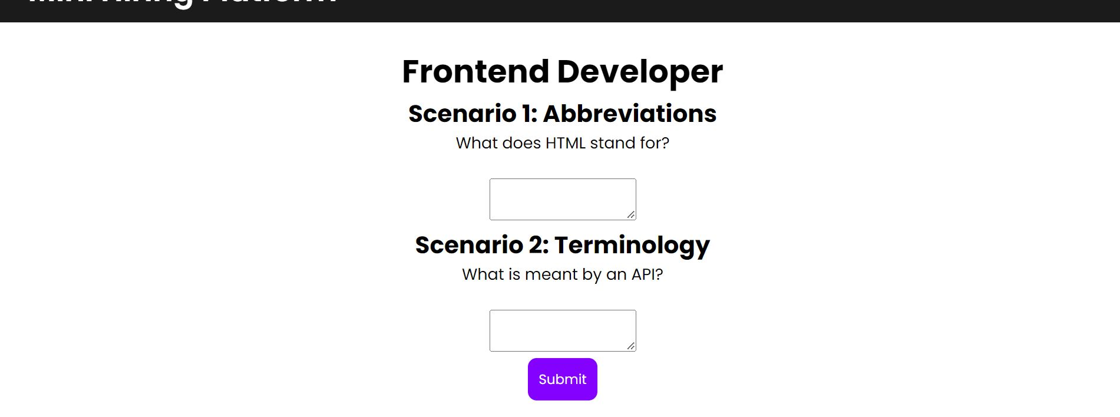
Candidate Sample Assessment #1
Here’s a sample frontend assessment taken by a candidate

Slide 26
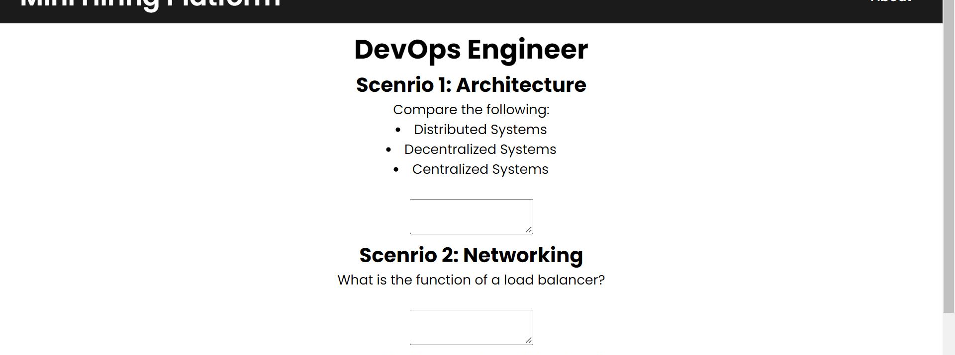
Candidate Sample Assessment #2
Here’s a sample DevOps assessment taken by a candidate

