Slide 1

Turning Your Home Into a Smart Home
Presented to: Eng. Yousra Hesham
Prepared By: Moaaz Mahmoud

Slide 2
Introduction
Smart homes are revolutionizing the way we live, leveraging advanced technology to create connected and intelligent living spaces.
Benefits of a smart home:
Enhanced convenience and comfort: Control various aspects of your home with ease, such as lighting, temperature, and entertainment systems, through smart devices or voice commands.
Energy efficiency and cost savings: Smart home automation allows for optimized energy usage, with features like automated lighting, thermostats, and smart appliances that can help reduce energy consumption and lower utility bills.
Improved security and safety: Integrated smart security systems, including surveillance cameras, door locks, and motion sensors, provide enhanced protection and the ability to monitor your home remotely.
Streamlined control and automation: Automate routine tasks and create personalized schedules for appliances and devices, making your home more efficient and freeing up your time.

Slide 3
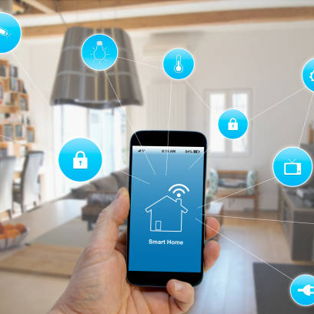
Understanding Smart Home Technology
Smart home technology enables convenient control and automation of devices and systems in a home.
Key Components:
Smart Speakers and Voice Assistants: Central hubs for voice control and device integration.
Smart Lighting and Switches: Remote control, scheduling, and energy-efficient lighting.
Smart Thermostats and Climate Control: Precise temperature management and energy optimization.
Smart Security Systems: Surveillance cameras, motion sensors, and remote monitoring.
Smart Locks and Access Control: Secure and convenient entry management.
Smart Appliances: Connected appliances for remote operation and energy monitoring.
Home Automation Hubs: Centralized control and integration of various smart devices.

Slide 4
Scenario Example
Smart homes are revolutionizing the way we live, leveraging advanced technology to create connected and intelligent living spaces.
Benefits of a smart home:
Automated Door Access: Arrive home, and the smart security system automatically unlocks the door as it recognizes your presence.
Intelligent Lighting: Enter a well-lit home as the smart lighting system adjusts the lights based on the time of day or occupancy.
Climate Control at Your Fingertips: Control the temperature from your smartphone or using voice commands with a smart thermostat, ensuring comfort and energy efficiency.
Entertainment Made Effortless: Activate your entertainment system with a voice command, allowing you to enjoy your favorite shows or music instantly.
Streamlined Kitchen Experience: Access a smart refrigerator's shopping list on your phone while grocery shopping and receive alerts for deliveries, making kitchen management a breeze.

Slide 5
Steps to Transform Your Home
Assess Your Needs: Evaluate your lifestyle and identify areas where automation and control can bring the most value, such as lighting, security, energy efficiency, or convenience.
Research Smart Devices: Explore the wide range of smart devices available on the market, considering features, compatibility, and customer reviews to make informed decisions.
Plan Your System: Determine how the smart devices will work together, considering connectivity options, compatibility with your existing infrastructure, and the ability to integrate with a central hub if desired.
Installation and Setup: Install and configure the smart devices according to the manufacturer's instructions, ensuring proper connectivity and functionality.
Customization and Expansion: Personalize your smart home system by creating automation routines, schedules, and voice commands tailored to your preferences. Consider expanding your system over time as new devices and technologies become available.

Slide 6
Conclusion and Next Steps
Key Takeaways:
Consider your specific needs: Identify areas where smart home technology can enhance your lifestyle and address pain points.
Start small: Begin by implementing smart devices or systems that align with your priorities and budget.
Research and choose reliable products: Read reviews, compare features, and select reputable brands for optimal performance and compatibility.
Plan for integration: Ensure devices and systems can work together seamlessly by selecting compatible technologies and platforms.
Learn and explore: Familiarize yourself with the features and capabilities of your smart home devices, and experiment with automation and scheduling options.
Next Steps:
Explore additional smart home possibilities: Discover advanced features like smart blinds, energy monitoring, or water leak detectors based on your requirements.
Stay informed: Keep up with evolving technologies, new releases, and updates in the smart home industry.
Seek professional assistance if needed: Consult experts or technicians for complex installations or integrations.

