Slide 1
ALU
Presented to : dr. Mahmoud A. Saber
Supervised by : eng. fatma gamal
by : moaaz Mahmoud – marko barsoum –
Abdelrahman Yasser – ziad husien – Ahmed Shawki

Slide 2
Overview
The arithmetic-logic unit (ALU) is that functional part of the digital computer that carries out arithmetic and logic operations on machine words …
In this design we implemented it to have 2 arithmetic and 2 logic operations as follows:
Logic operations
Bitwise AND
Bitwise OR
Arithmetic operations
Add
Subtract
For demonstration we will show all the modules as 4-bit modules.

Slide 3
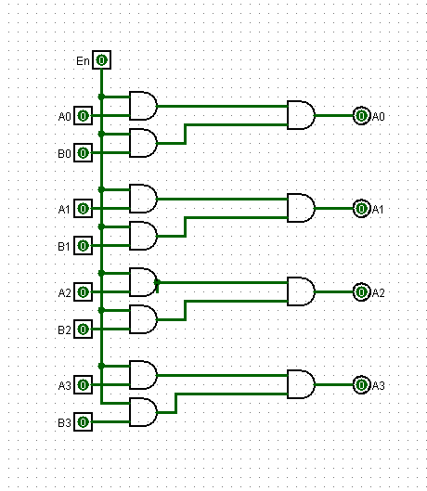
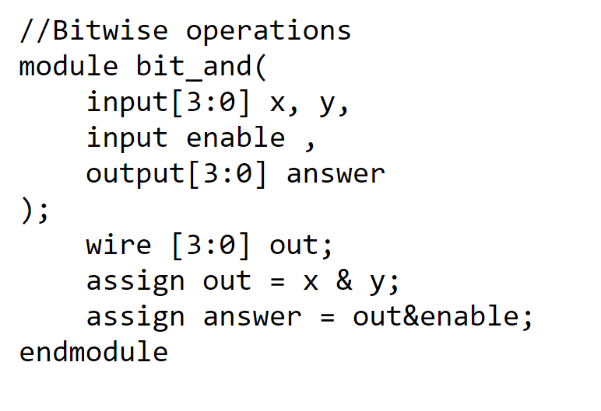
AND
A simple module that is used to Bit-And the two four-bit inputs.
Verilog code
AND circuit

Slide 4
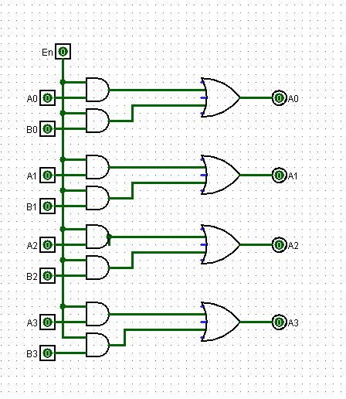
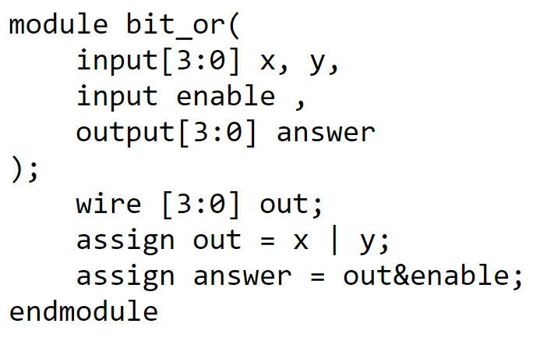
OR
A simple module that is used to Bit-Or the two four-bit inputs.
Verilog code
OR circuit

Slide 5
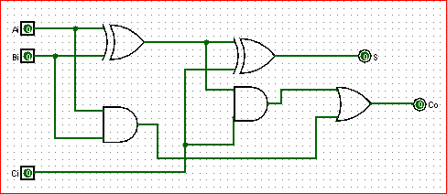
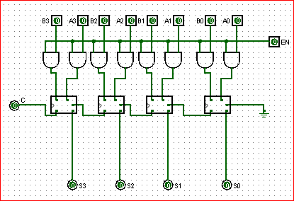
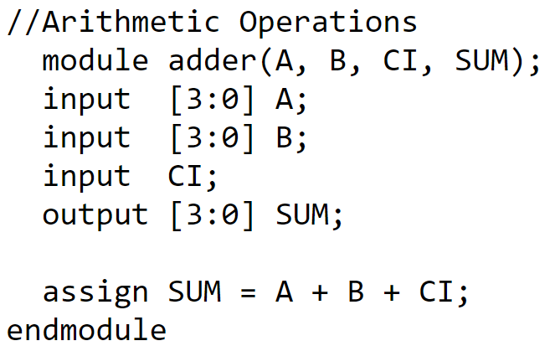
Adder
We made a full adder block, then we used it to make a four-bit adder
Full Adder circuit
4 Bits Adder circuit
Verilog code

Slide 6
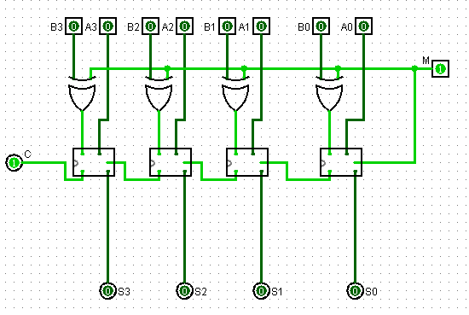
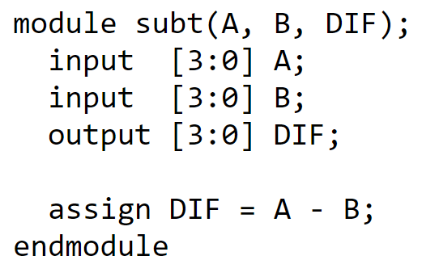
Subtractor :
We made some changes on the adder circuit to make it able to subtract, first we made the enable signal goes to both carry-in and o invert the B input using Nor gates
Verilog code
4 Bits Adder subtractor circuit

Slide 7
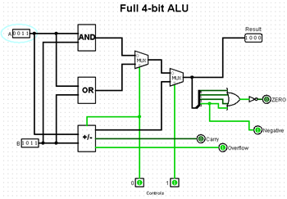
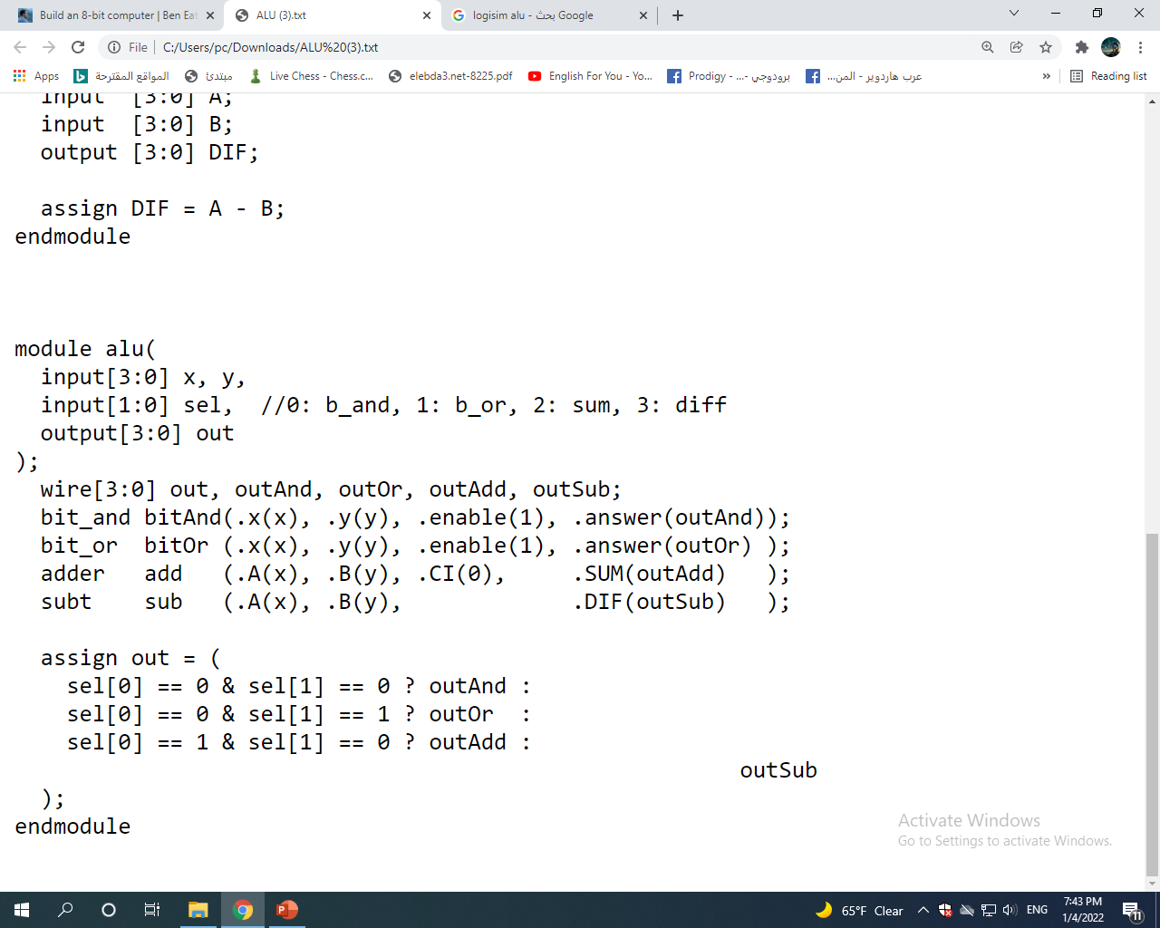
Top overview
We used 2 multiplexe: one to select And or OR function and the other to select Add or Subtract ( cause logisim has 2*1 rsmux only).
4 Bits ALU
Verilog code

Slide 8
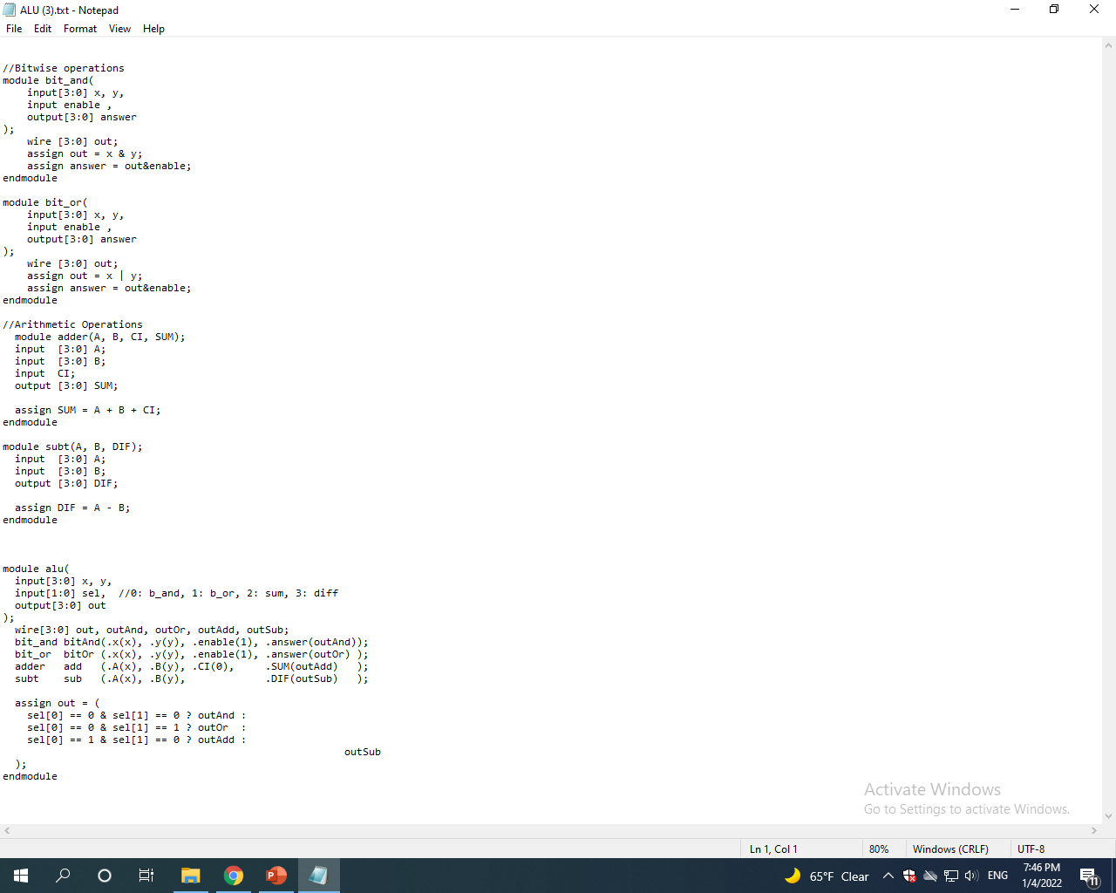
Here is the full code

