Slide 1

Titanic
Using Machine Learning to Predict Survival/Death
Presented to: Dr. Mahmoud A. Saber
Presented by: Moaaz Mahmoud – Marco Barsoum – AbdElRahman Yasser

Slide 2

The Process – An Overview
Data Analysis
Data Loading
Data Cleaning
Removing Duplicates
Exploratory Data Analysis
Machine Learning
Training the Model
Evaluating the Model
Removing Columns With 50%+ NaN/NA
Handling Outliers
Handling Missing Values

Slide 3


Part I Data Analysis

Slide 4
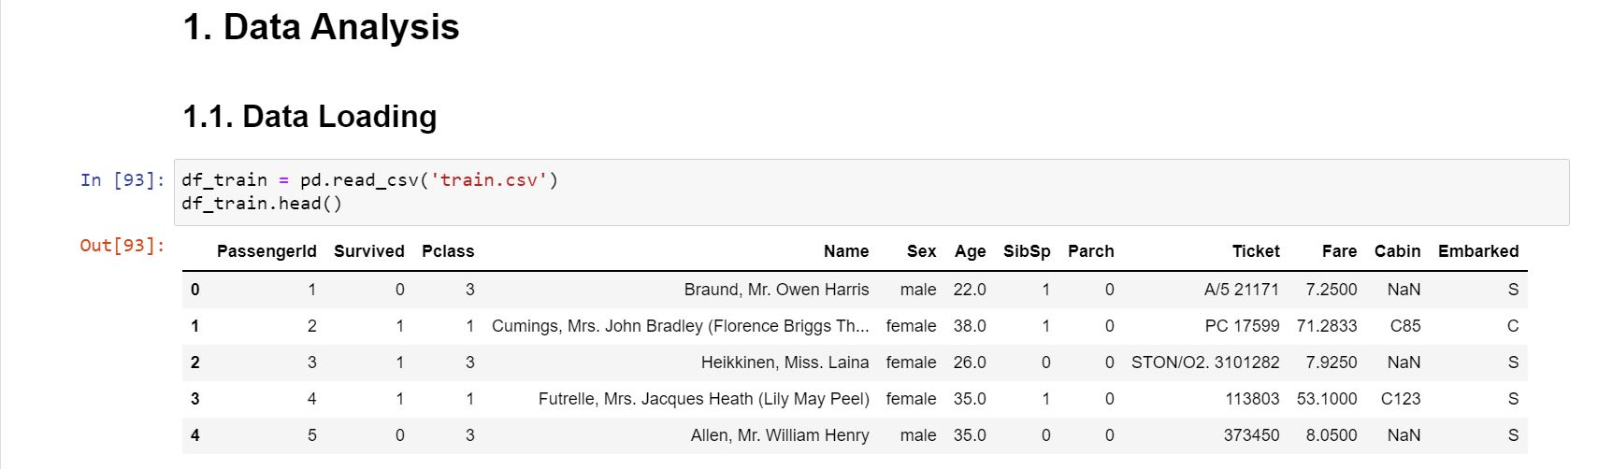
Data Loading
We begin by importing the dataset into the environment. Whether the data is stored in flat files, database files, or on the web, we can import this data using a Python library called pandas.
In this case, our dataset is stored in two flat files, train.csv and test.csv. The former will be used to train the model and the latter will be used to test it and evaluate it.
For that, we use the following code cell to create a dataframe, train_df and a similar cell to create another dataframe, test_df.

Slide 5
Data Cleaning – An Overview
For data cleaning, we will follow the following approach:
Handle the duplicate rows
Remove the columns with 50%+ NaN/NA
Handle the outliers
Handle the missing values

Slide 6
Data Cleaning – Handling Duplicate Rows
We first check for duplicate rows using the statement
print(
df_train[df_train.duplicated()].size,
df_test[df_train.duplicated()].size,
sep=‘, ‘
)
This statement yields this output:
0, 0
It turns out that there are no duplicate rows in the dataset, which implies that there’s no action needed.

Slide 7
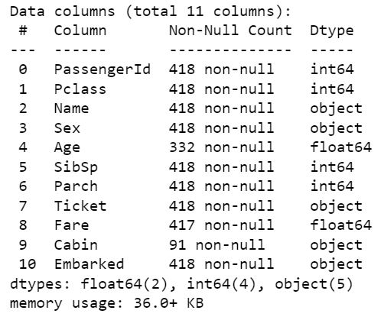
Data Cleaning – Removing Columns with 50%+ Null
We use the following statement to view data about the counts of null in every column:
df_train.info()
Based on the output data, we will remove the column Cabin, as it has more null values than existing values. We will also remove the columns Ticket, PassengerId, and Name, as we will not use them later in the analysis.
Notes:
Ticket, PassengerId, and Name, as we will not use it later in the analysis

Slide 8
Data Cleaning – Handling the Outliers
Sometimes the dataset contains abnormal data that might negatively influence the analysis, such abnormal data points are termed outliers.
We can check for outliers by plotting our data columns.
For that, we can use seaborn histplots.
We will not present the plots here to save space.

Slide 9
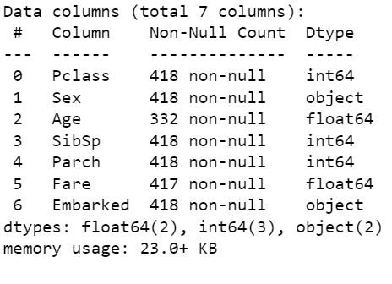
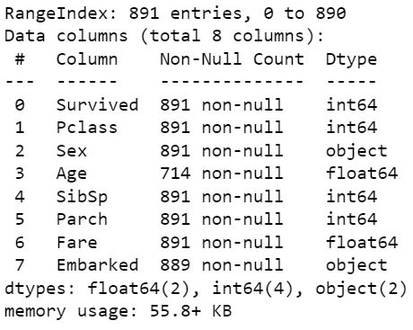
Data Cleaning – Handling Missing Values
Handling missing values can be done two ways:
Removing the rows with those values entirely
Compensating for the missing values with a reasonable value/values, e.g. the mean, median, …etc
After checking the info() method for the two dataframes, it seems best to take the following actions with df_train:
Remove the two rows that have missing values for the Embarked column.
Compensate with the average for the Age column.
Similar actions can be taken with df_test.

Slide 10
Exploratory Data Analysis (EDA)
For exploratory data analysis, we will create some count plots to help us get some insight about how the data columns are related. For each plot we will create two versions, one for the passengers who survived, and the other for those who didn’t.

Slide 11

Part II Machine Learning

