Slide 1

Titanic
Using Machine Learning to Predict Survival/Death
Presented to: Dr. Mahmoud A. Saber
Presented by: Moaaz Mahmoud – Marco Barsoum – AbdElRahman Yasser

Slide 2
Overview of the Problem
This problem deals with data about Titanic passengers. This data includes their ages, p-classes, and more.
The main purpose is to create a machine learning model that can make guesses about whether a passenger has survived or not based on some data (for example their age, Pclass, …etc) describing the passenger. That is, to classify the passengers into two categories based on that data.

Slide 3
The Process – An Overview
Data Analysis
Data Loading
Data Cleaning
Removing Duplicates
Exploratory Data Analysis
Machine Learning
Training and Evaluating a Decision Tree Model
Training and Evaluating an SVM Model
Removing Columns With 50%+ NaN/NA
Handling Outliers
Handling Missing Values
Converting Categorical Data into Quantitative Data
Training and Evaluating a Gaussian Naïve Bayes Model

Slide 4


Part I Data Analysis

Slide 5
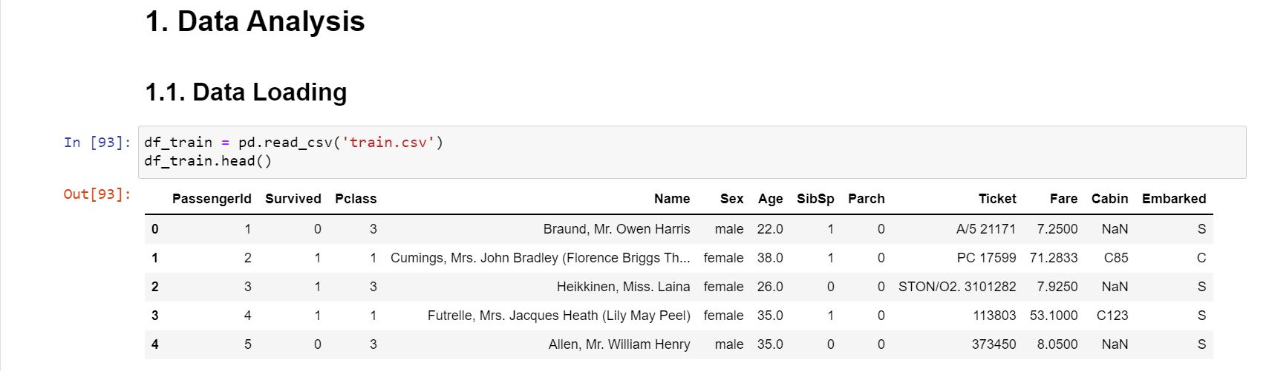
Data Loading
We begin by importing the dataset into the environment. Whether the data is stored in flat files, database files, or on the web, we can import this data using a Python library called pandas.
In this case, our dataset is stored in two flat files, train.csv and test.csv. The former will be used to train the model and the latter will be used to test it and evaluate it.
For that, we use the following code cell to create a dataframe, train_df and a similar cell to create another dataframe, test_df.

Slide 6
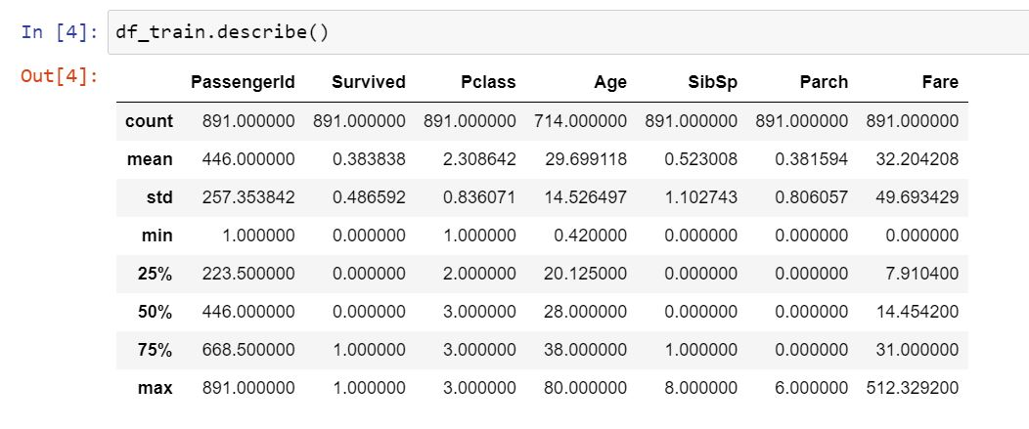
Data Loading – Cont.
It might be useful to display some extra information about the data here.

Slide 7
Data Cleaning – An Overview
For data cleaning, we will follow the following approach:
Handle the duplicate rows
Remove the columns with 50%+ NaN/NA
Handle the outliers
Handle the missing values

Slide 8
Data Cleaning – Handling Duplicate Rows
We first check for duplicate rows using the statement
print(
df_train[df_train.duplicated()].size,
df_test[df_train.duplicated()].size,
sep=‘, ‘
)
This statement yields this output:
0, 0
It turns out that there are no duplicate rows in the dataset, which implies that there’s no action needed.

Slide 9
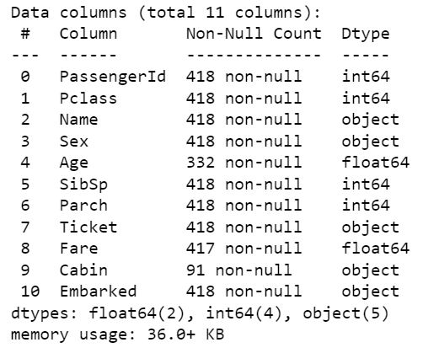
Data Cleaning – Removing Columns with 50%+ Null
We use the following statement to view data about the counts of null in every column:
df_train.info()
Based on the output data, we will remove the column Cabin, as it has more null values than existing values. We will also remove the columns Ticket, PassengerId, and Name, as we will not use them later in the analysis.
Notes:
Ticket, PassengerId, and Name, as we will not use it later in the analysis

Slide 10
Data Cleaning – Handling the Outliers
Sometimes the dataset contains abnormal data that might negatively influence the analysis, such abnormal data points are termed outliers.
We can check for outliers by plotting our data columns.
For that, we can use seaborn histplots.
The next few slides will present those plots.

Slide 11
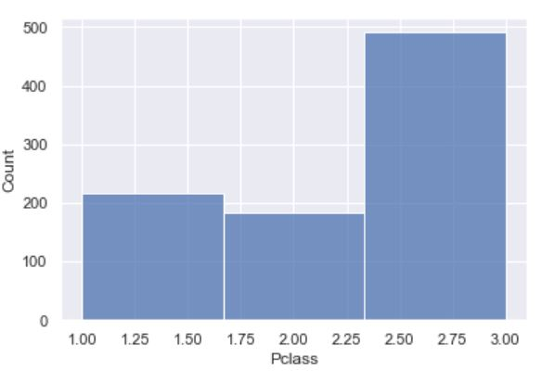
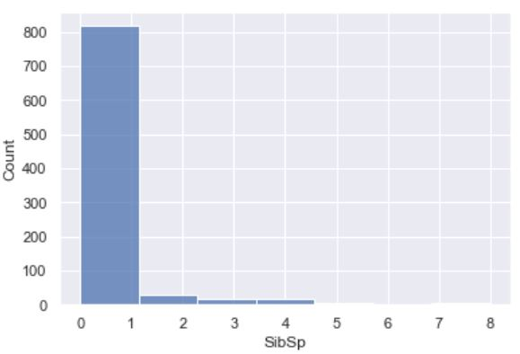
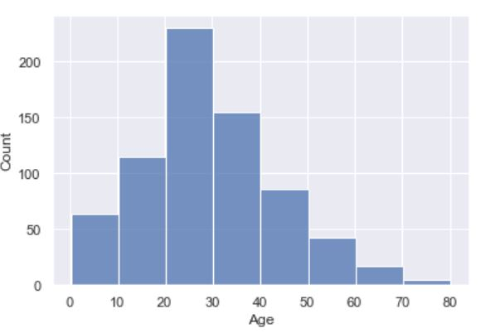
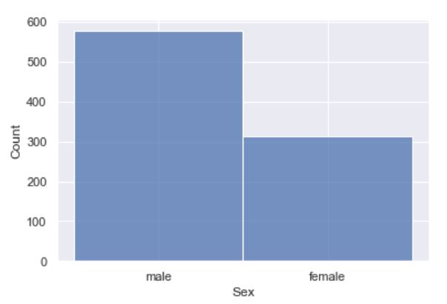

Slide 12
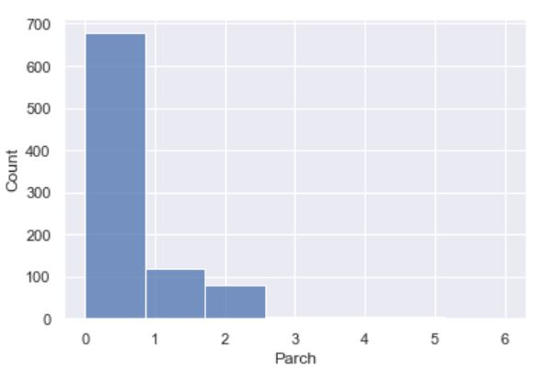
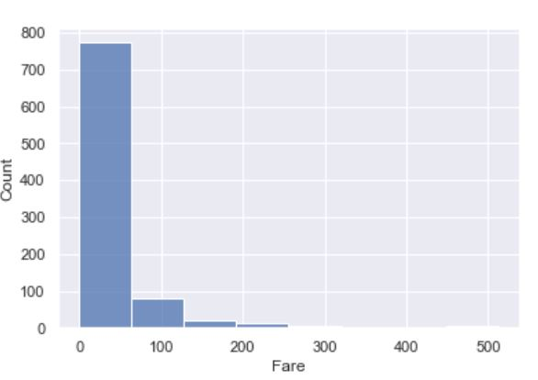
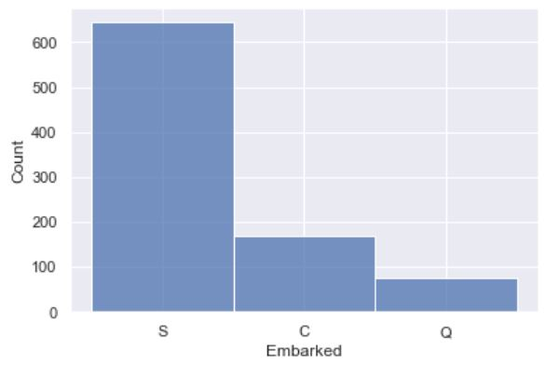

Slide 13
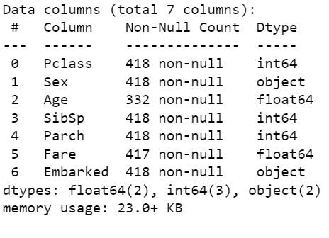
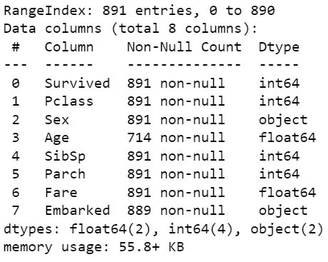
Data Cleaning – Handling Missing Values
Handling missing values can be done two ways:
Removing the rows with those values entirely
Compensating for the missing values with a reasonable value/values, e.g. the mean, median, …etc
After checking the info() method for the two dataframes, it seems best to take the following actions with df_train:
Remove the two rows that have missing values for the Embarked column.
Compensate with the average for the Age column.
Similar actions can be taken with df_test.

Slide 14
Exploratory Data Analysis (EDA)
For exploratory data analysis, we will create some plots to help us get some insight about how the data columns are related. For each plot we will create two versions, one for the passengers who survived, and the other for those who didn’t.
We will next give a brief look to each of those plots.

Slide 15
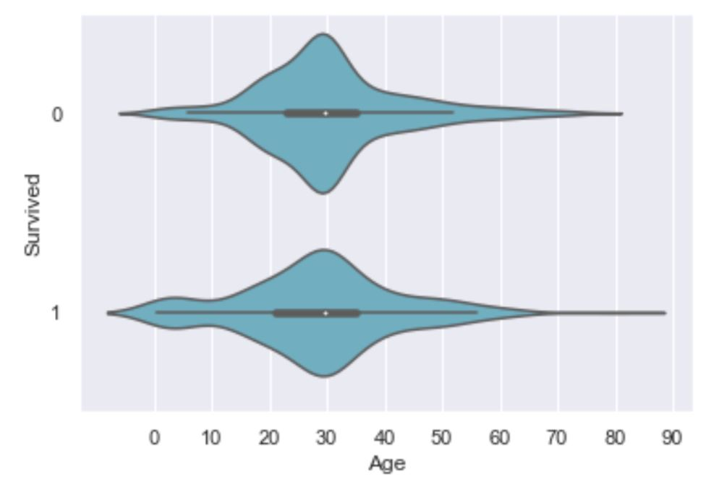
EDA – Age
The ages of the passengers, either survived or not, seem to follow some kind of normal distribution.

Slide 16
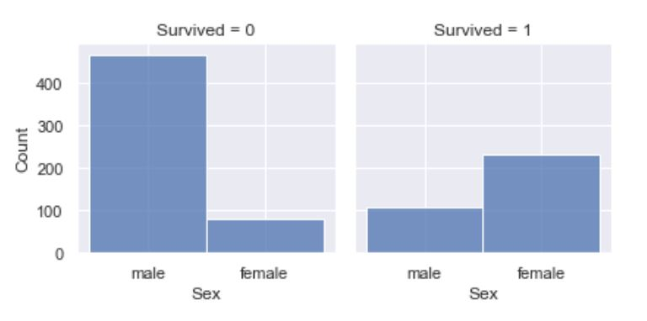
EDA – Sex
The count of males who drowned is way more than that of the females, where as the count of males who survived is considerably less than that of the females.

Slide 17
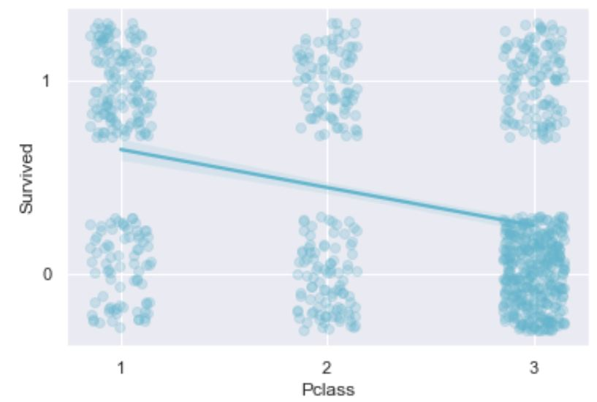
EDA – P-class
To represent the relationship between the p-class and survival, we have chosen to use a matplotlib regplot with jitter.
The plot reveals the following:
For p-class 1, the count of passengers who survived is considerably higher than those who drowned.
For p-class 2, the count of the passengers who survived is slightly higher.
For p-class 3, the count of those who drowned is extremely higher.

Slide 18
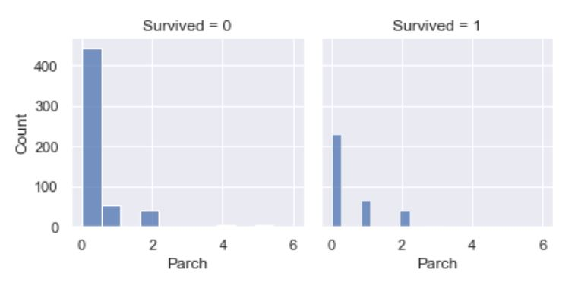
EDA – Parch
Parch does not seem to be corelated with the survival/death.

Slide 19
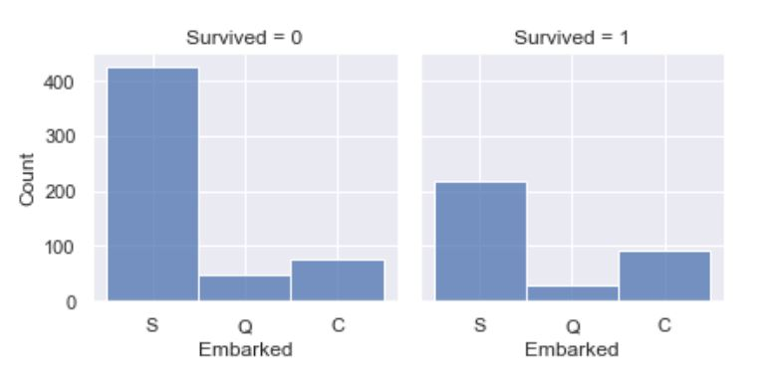
EDA – Embarkment Place
The embarkment plot is not very insightful, it shows that the order of counts from high to low for both cases is the same.

Slide 20
Converting Categorical Data into Quantitative Data
Some of the columns have their data in textual format, this will not allow the model to be trained.
To resolve that issue, we will use the following scheme for conversion:
Sex
male → 0
female → 1
Embarked
S → 0
Q → 1
C → 2
The code for conversion is present in the html file accompanying the presentation.

Slide 21

Part II Machine Learning

Slide 22
Preparing Data
In order to train the model, we need to specify the inputs and outputs (what the model predicts).
We use the following code cell after importing some modules from Sci-Kit Learn (sklearn):
X_train = df_train.drop("Survived", axis=1).copy()
Y_train = df_train["Survived"]
X_test = df_test.copy()
X_train.shape, Y_train.shape, X_test.shape

Slide 23
Decision Tree
For this project, we have chosen three machine learning methods to create our model, namely Decision Tree, Support Vector Machine, and Gaussian Naïve Bayes. We will compare the accuracy of those three models.
For the decision tree, we use this code to train the model using the specified data:
decision_tree = DecisionTreeClassifier()
decision_tree.fit(X_train, Y_train)
Y_pred = decision_tree.predict(X_test)
To estimate the accuracy of this model, we use these statements:
acc_decision_tree = round(decision_tree.score(X_train, Y_train) * 100, 2)
acc_decision_tree
The accuracy of the model is 98.2%

Slide 24
Support Vector Machine
For the SVM, we use this code to train the model using the specified data:
svc = SVC()
svc.fit(X_train, Y_train)
Y_pred = svc.predict(X_test)
To estimate the accuracy of this model, we use these statements:
acc_svc = round(svc.score(X_train, Y_train) * 100, 2)
acc_svc
The accuracy of the model is 68.39%

Slide 25
Gaussian Naïve Bayes
For this project, we have chosen three machine learning methods to create our model, namely Decision Tree, Support Vector Machine, and Gaussian Naïve Bayes. We will compare the accuracy of those three models.
For the decision tree, we use this code to train the model using the specified data:
gaussian = GaussianNB()
gaussian.fit(X_train, Y_train)
Y_pred = gaussian.predict(X_test)
To estimate the accuracy of this model, we use these statements:
acc_gaussian = round(gaussian.score(X_train, Y_train) * 100, 2)
acc_gaussian
The accuracy of the model is 79.19%

