Slide 1

Principal Component Analysis (PCA)

Slide 2
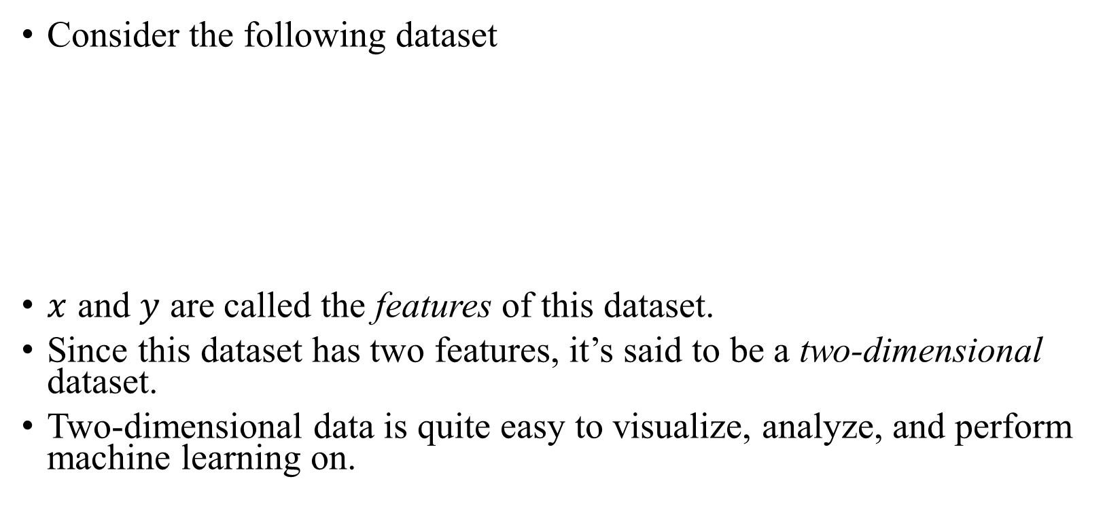

Curse of Dimensionality
Consider the following dataset
$x$ and $y$ are called the features of this dataset.
Since this dataset has two features, it’s said to be a two-dimensional dataset.
Two-dimensional data is quite easy to visualize, analyze, and perform machine learning on.
$$x$$ | $$y$$
0 | -2.4
1 | 3.1
3 | 2.3

Slide 3
Curse of Dimensionality
It’s not always the case that data is two-dimensional. In fact, this almost never happens.
Higher dimensional data can be cumbersome to deal with and can be impossible to visualize.
Fortunately, there are some techniques which we can use to reduce the dimensions of the data.
Dimensionality reduction techniques work with labeled data as well as with unlabeled data.
Among those techniques is the Principal Component Analysis, which we will cover briefly.

Slide 4
Why Dimensionality Reduction?
Visualization is not the only challenge with higher dimensional data. There are many other reasons why we may wish to reduce the number of dimensions. Here are some of them:
Reducing the computational cost of some algorithms
Making the dataset easier to use
Making the results easier to interpret

Slide 5
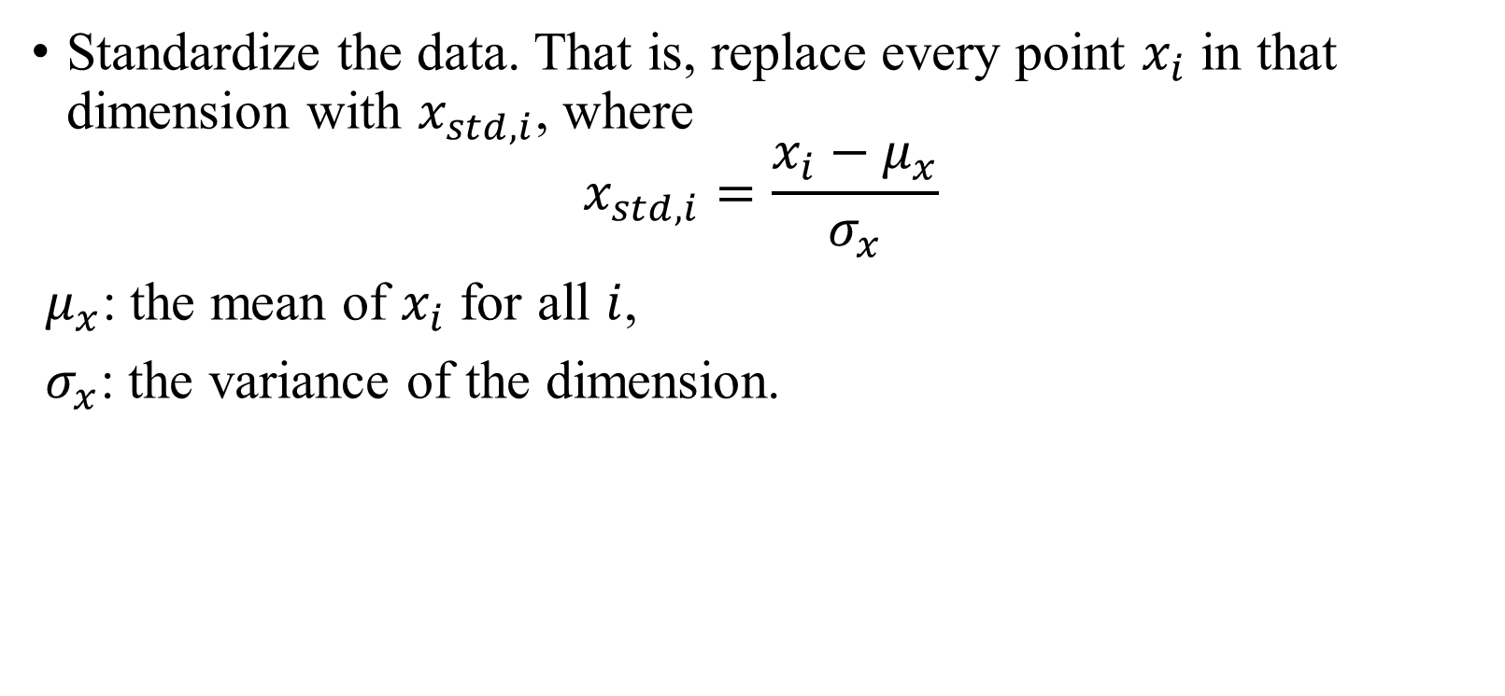
PCA – Steps
Standardize the data. That is, replace every point $x_{i}$ in that dimension with $x_{std, i}$, where
$$x_{std, i}=\frac{x_{i}−μ_{x}}{σ_{x}}$$
$μ_{x}$: the mean of $x_{i}$ for all $i$,
$σ_{x}$: the variance of the dimension.

Slide 6
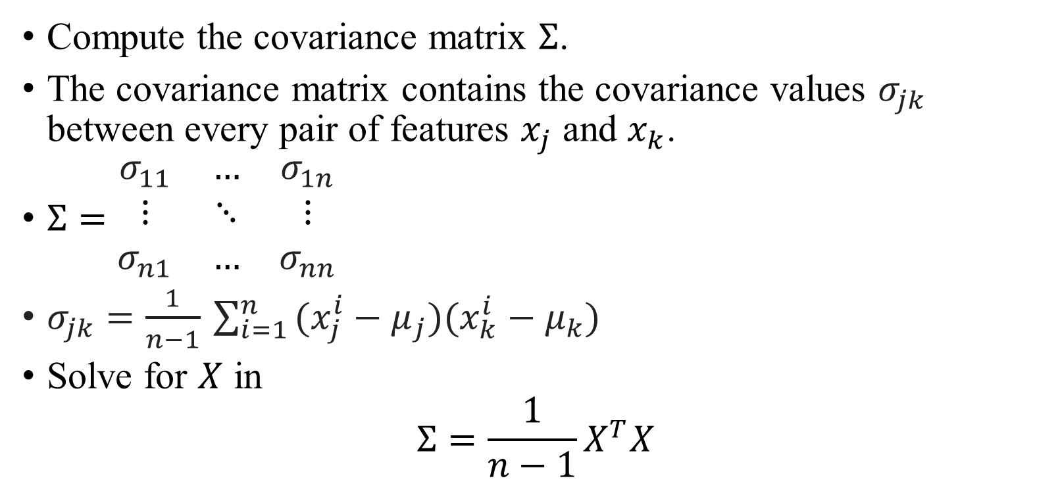
PCA – Steps
Compute the covariance matrix $Σ$.
The covariance matrix contains the covariance values $σ_{jk}$ between every pair of features $x_{j}$ and $x_{k}$.
$Σ=\begin{matrix}σ_{11} & … & σ_{1n} \\ \text{⋮} & \text{⋱} & \text{⋮} \\ σ_{n1} & … & σ_{nn}\end{matrix}$
$σ_{jk}​=\frac{1}{n−1}​\sum_{i=1}^{n}{​(x_{j}^{i}​−μ_{j}​)(x_{k}^{i}​−μ_{k}​)}$
Solve for $X$ in
$$Σ=\frac{1}{n−1}X^{T}X$$

Slide 7
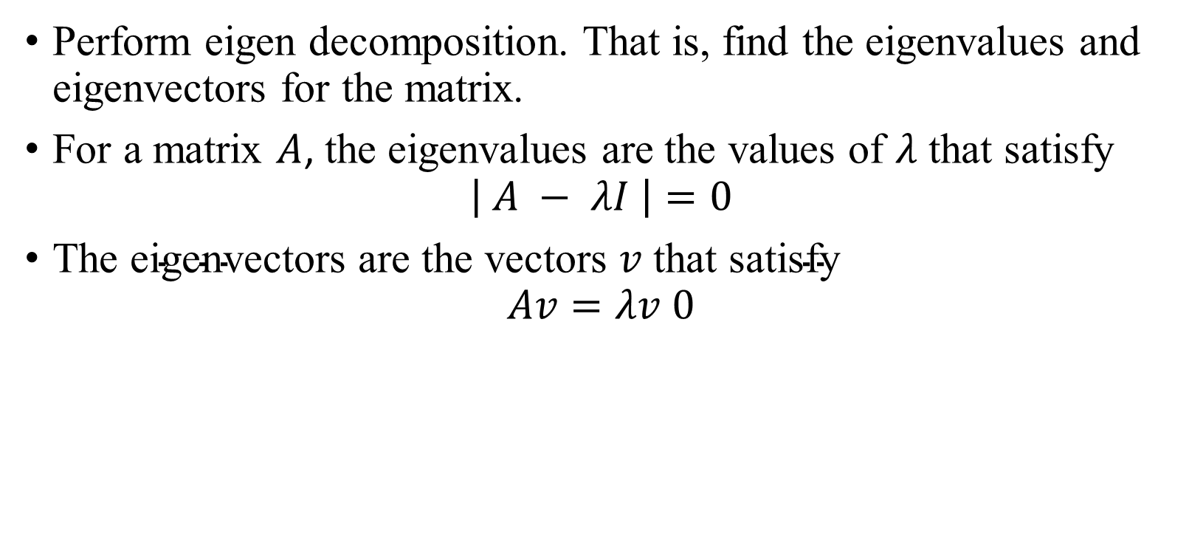
PCA – Steps
Perform eigen decomposition. That is, find the eigenvalues and eigenvectors for the matrix.
For a matrix $A$, the eigenvalues are the values of $λ$ that satisfy
$$\left| A − λI \right|=0$$
$\text{The} \text{eigenvectors} \text{are} \text{the} \text{vectors} v \text{that} \text{satisfy}$
$$Av=λv 0$$

Slide 8
PCA – Steps
Compute the transformation

