Slide 1

Principal Component Analysis (PCA)

Slide 2
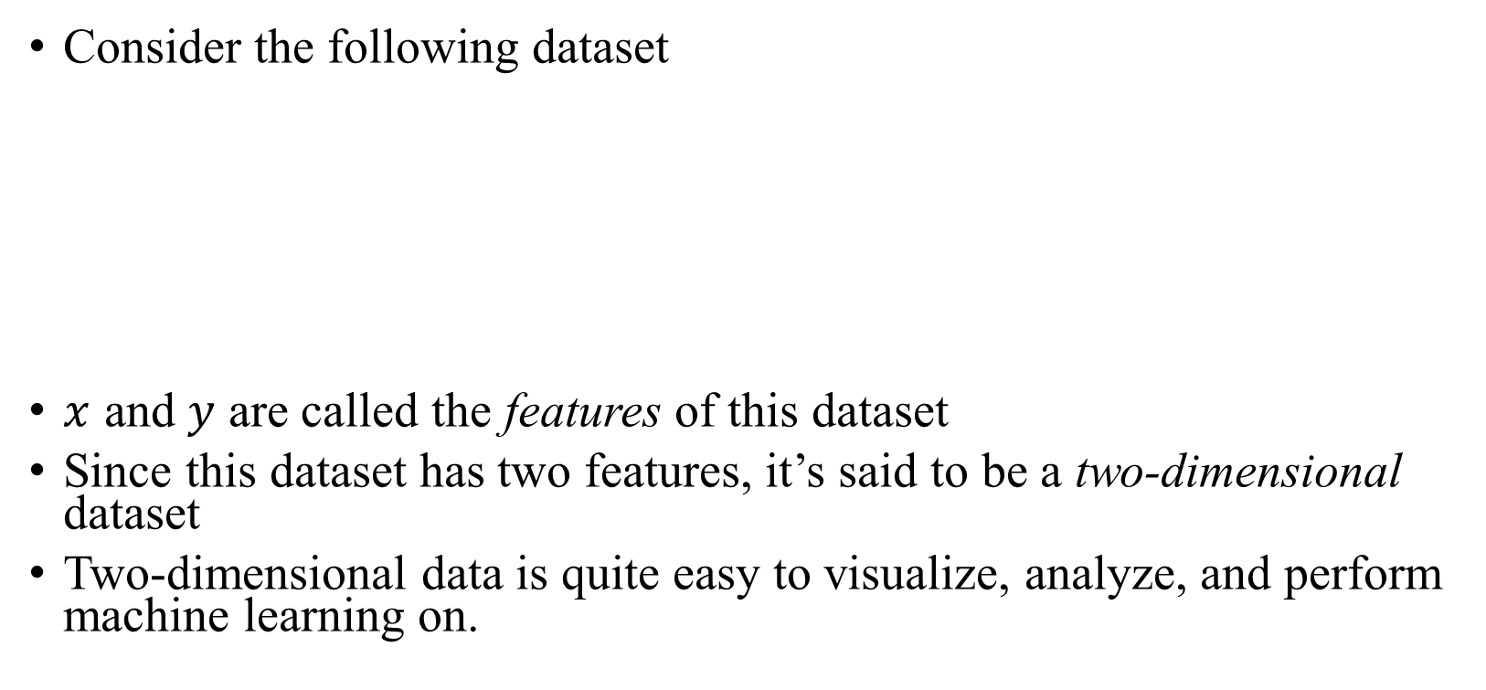

Curse of Dimensionality
Consider the following dataset
$x$ and $y$ are called the features of this dataset
Since this dataset has two features, it’s said to be a two-dimensional dataset
Two-dimensional data is quite easy to visualize, analyze, and perform machine learning on.
$$x$$ | $$y$$
0 | -2.4
1 | 3.1
3 | 2.3

Slide 3
Curse of Dimensionality
It’s not always the case that data is two-dimensional. In fact, this almost never happens.
Higher dimensional data can be cumbersome to deal with.
Fortunately, there are some techniques which we can use to reduce the dimensions of the data.
Among those techniques is the Principal Component Analysis, which we will cover briefly

