Slide 1

The Data Analysis Process
House Pricing Data
Presented to: Dr. Mahmoud A. Saber
By: Moaaz Mahmoud, Marko Barsoum, and AbdElRahman Yasser

Slide 2
Overview The Data Analysis Process
The Data Analysis process consists of four stages, namely:
Data Loading
Bringing the data to the working environment
Data can be in various formats, like flat files, excel files, SQL databases, HTML or XML (on the web).
Data Cleaning
Preparing the data for the next stages.
Involves getting rid of harmful and defected data.
Typical actions include handling outliers, handling missing values, and removing duplicates.

Slide 3
Overview The Data Analysis Process Cont.
Exploratory Data Analysis
Involves the use of plots to further understand the data and the correlations among various variables in order to observe patterns and extract useful insights.
Plots in this stage only need to be understandable by the analyst.
Explanatory Data Analysis
Communicating the final findings to the decision maker(s).
Involves the use of plots to help deliver the final message.
Plots at this stage need to be polished. That is, highly clear and readable.

Slide 4

Data Loading

Slide 5
Data Loading
The first stage of the process.
In our case, data is available in the form of a csv file (csv stands for comma-separated values).
We load our data into a pandas dataframe.
We use a method called read_csv for that.
Code
df = pd.read_csv('dataset.csv’)

Slide 6
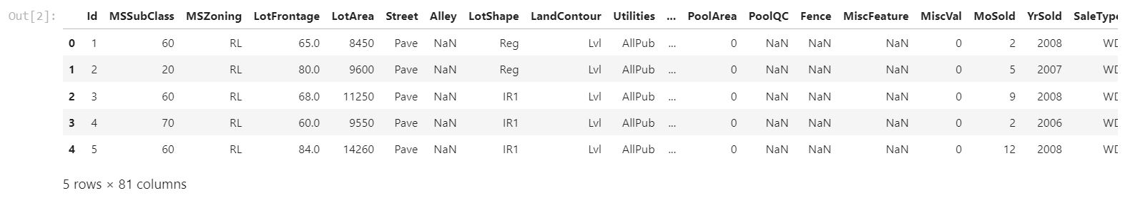
Data Loading
It’s common to have a look at the top few rows of data at this stage using the method head.

Slide 7
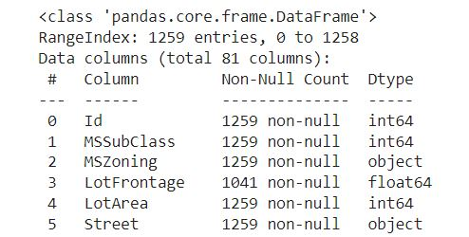
Data Loading
We also view some information about our data using the method info.

Slide 8
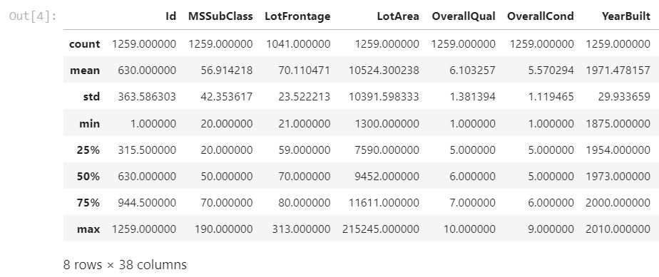
Data Loading
We finally view some summary statistics about the data using the method describe.

Slide 9

Data Cleaning

Slide 10
Data Cleaning Filtering Columns
We have chosen to keep the following list of columns:
LotArea
LotShape
RoofStyle
GarageArea
SaleConditi
YrSold
Heating
HeatingQC
CentralAir
BsmtExposur
OverallQual
SalePrice
This can be done using fancy indexing.

Slide 11
Data Cleaning Removing Duplicates
We will next filter-out any duplicate rows.
This can be done using the following line of code:
df.drop_duplicates(inplace=True)

Slide 12
Data Cleaning Handling Missing Data
After examining the missing value count within the dataframe at this stage, it seems reasonable to remove all the rows with at least one missing value.
For that we use
df = df.dropna(how='any',axis=0)

Slide 13
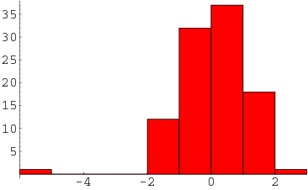
Data Cleaning Handling Outliers
The last step we perform for cleaning the data is handling the outliers.
In order to detect outlier values, we iterate on the columns and plot the distribution for each column.
A typical outlier look in a distribution is shown in the following plot from mathworld.wolfram.com:

Slide 14
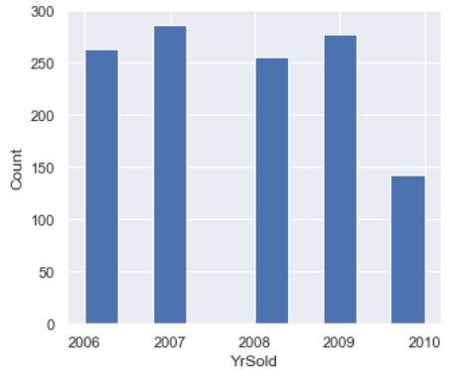
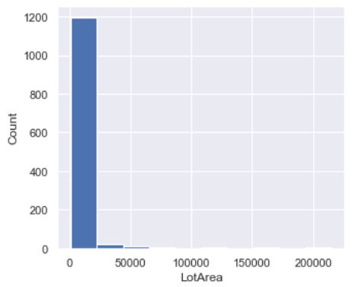
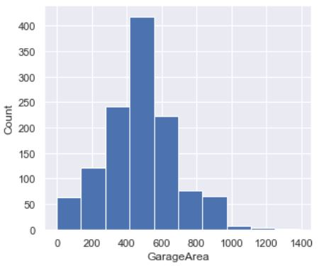
Data Cleaning Handling Outliers

Slide 15
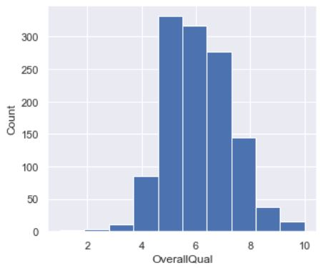
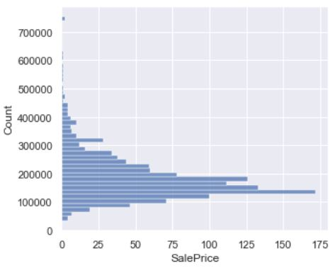
Data Cleaning Handling Outliers

Slide 16
Data Cleaning Handling Outliers
For categorical data, we can filter the categories with extremely low appearance.
More details on this in the html report.

Slide 17

Exploratory Data Analysis

Slide 18
Exploratory Data Analysis Preliminaries
Up till now, we have 1154 rows and 12 columns in the dataset, namely:
LotArea • LotShape
RoofStyle • GarageArea
SaleCondition • YrSold
Heating • HeatingQC
CentralAir • BsmtExposure
OverallQual • SalePrice
Among those columns, 5 have numeric data, and 7 have categorical data.
The variable of main interest is the 'SalePrice' and our hypothesis is that it's most highly dependent on those variables:
LotArea • HeatingQC
CentralAir
We will not present univariate exploration, but rather will jump to bivariate exploration.

Slide 19
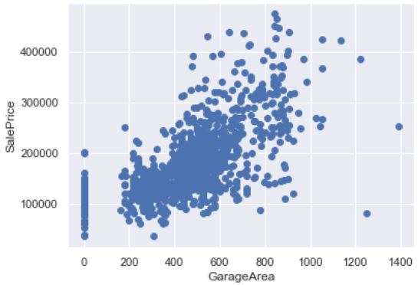
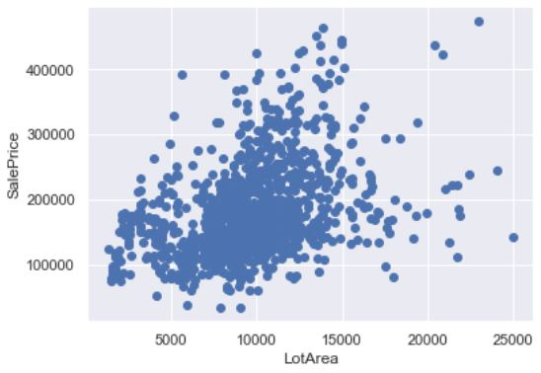
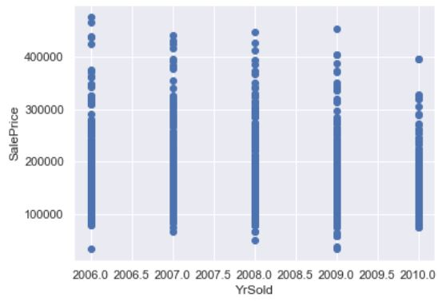
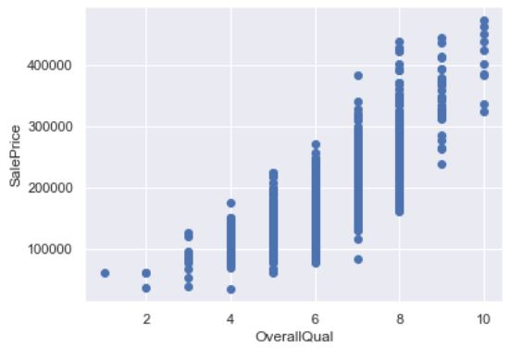
Exploratory Data Analysis Bivariate Exploration

Slide 20
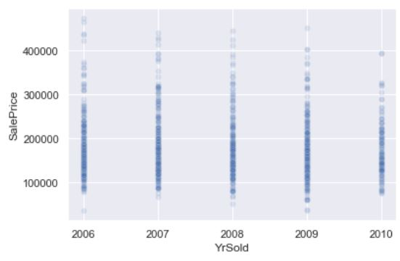
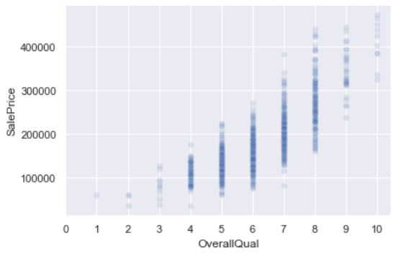
Exploratory Data Analysis Bivariate Exploration
We repeated two of the plots with a lower opacity for points to emphasize the distributions and enhance the readability.

Slide 21
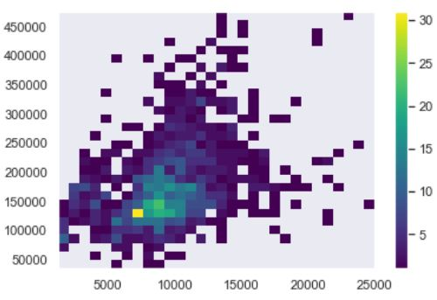
Exploratory Data Analysis Bivariate Exploration
Lot Area – Sale Price Distribution

Slide 22
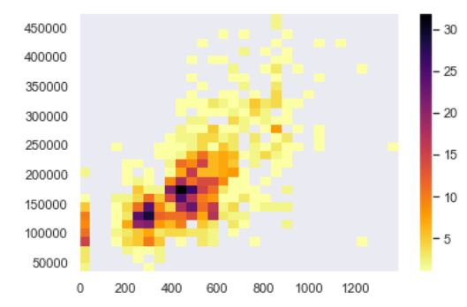
Exploratory Data Analysis Bivariate Exploration
Garage Area – Sale Price Distribution

Slide 23
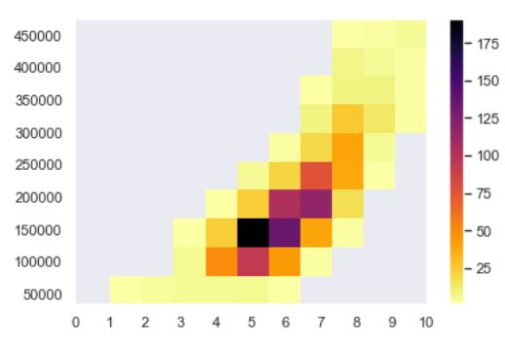
Exploratory Data Analysis Bivariate Exploration
Overall Quality – Sale Price Distribution

Slide 24
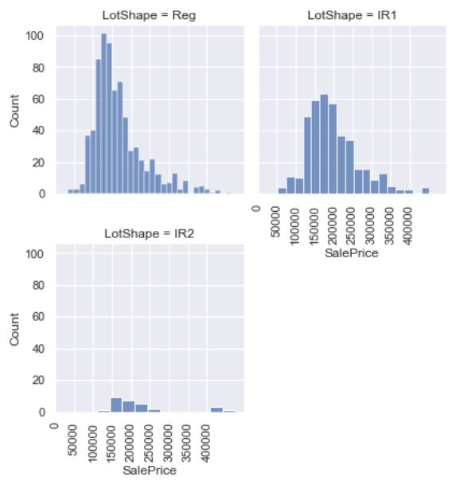
Exploratory Data Analysis Bivariate Exploration
Sale Price Distribution for Different Lot Shapes

Slide 25
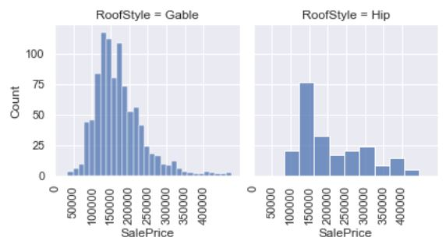
Exploratory Data Analysis Bivariate Exploration
Sale Price Distribution for Different Roof Styles

Slide 26
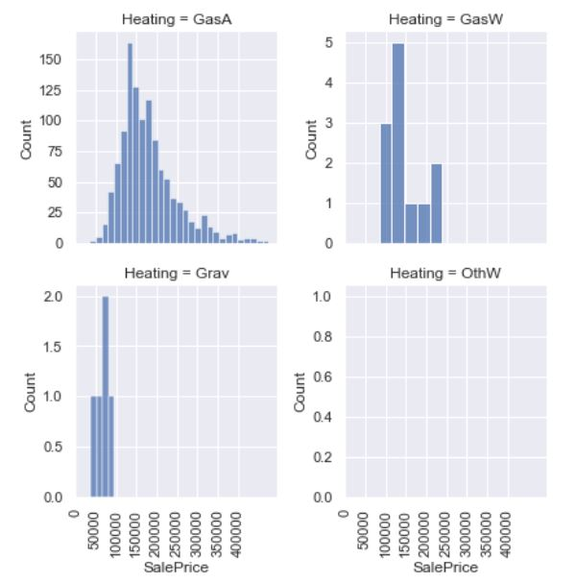
Exploratory Data Analysis Bivariate Exploration
Sale Price Distribution for Different Heating Systems

Slide 27
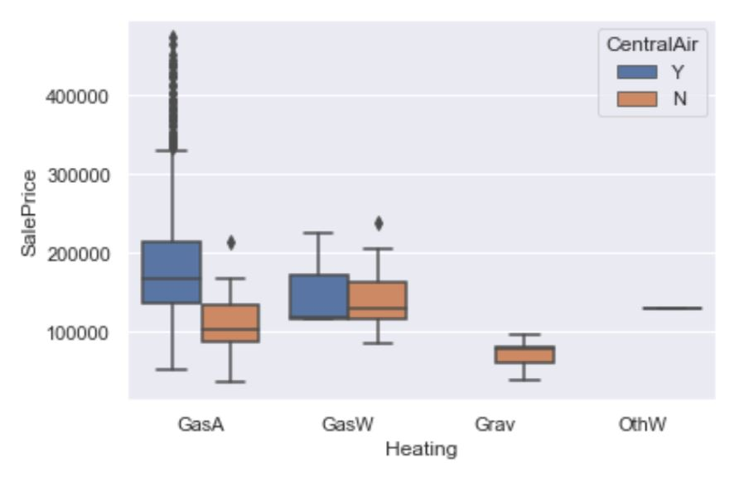
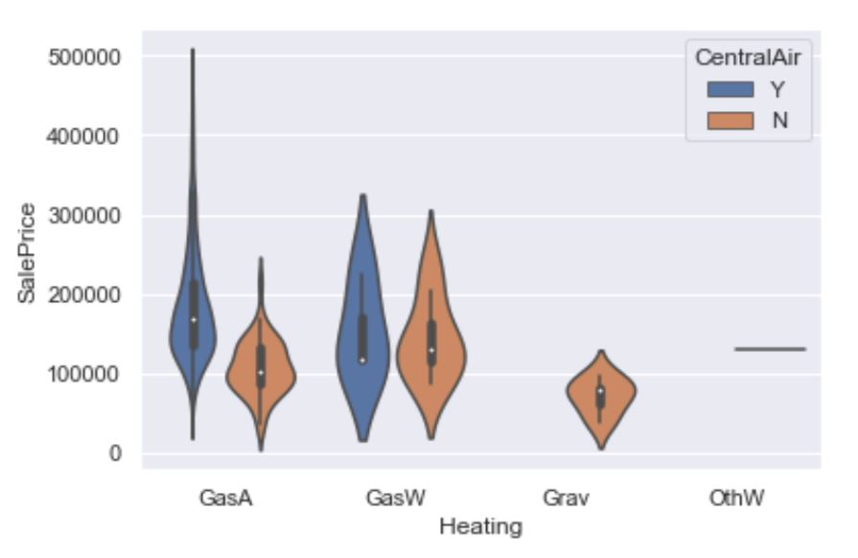
Exploratory Data Analysis Multivariate Exploration
Relating the heating type, existence of central air conditioning, and the price.

Slide 28
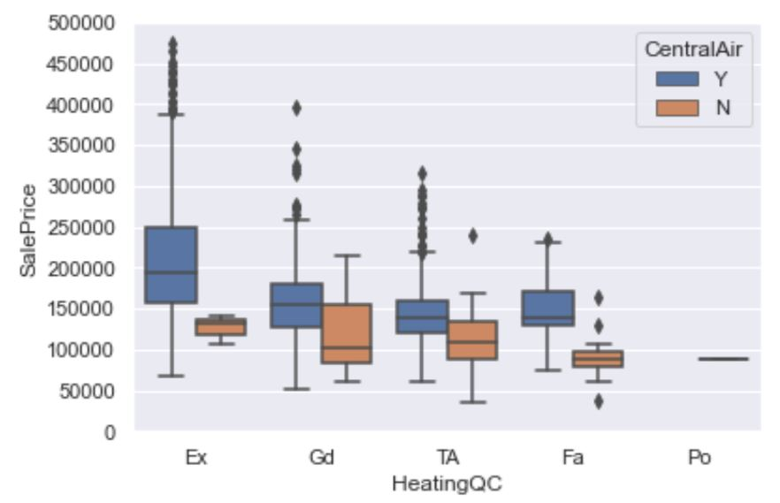
Exploratory Data Analysis Multivariate Exploration
Relating the heating quality, existence of central air conditioning, and the price.

Slide 29
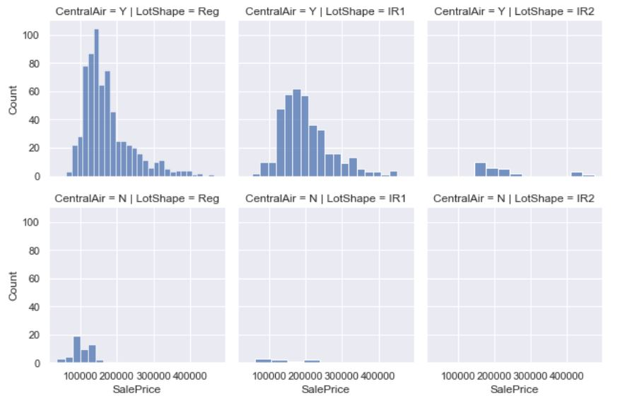
Exploratory Data Analysis Multivariate Exploration
Relating the lot shape, existence of central air conditioning, and the price.

Slide 30
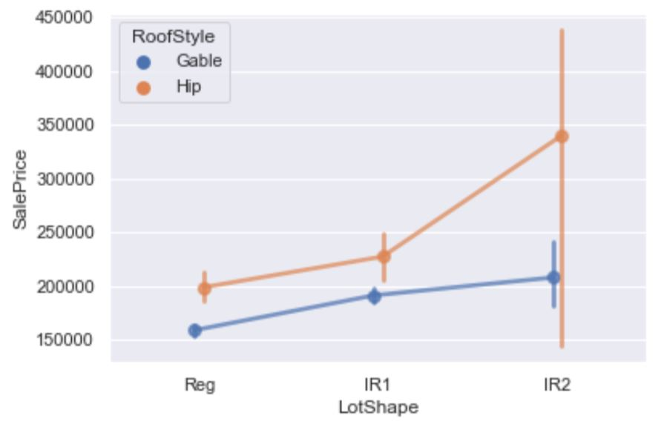
Exploratory Data Analysis Multivariate Exploration
Relating the roof style, lot shape, and the price.

Slide 31

Explanatory Data Analysis

Slide 32
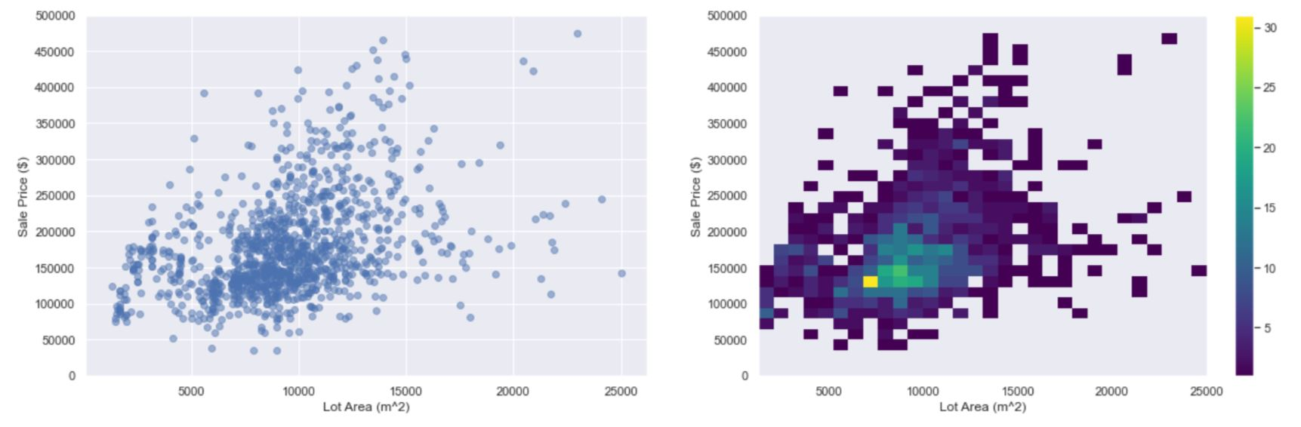
Lot Area VS Sale Price
Probably the strongest factor that impacts a house’s price within this dataset is the lot area. This is obvious through the previous plots.

Slide 33
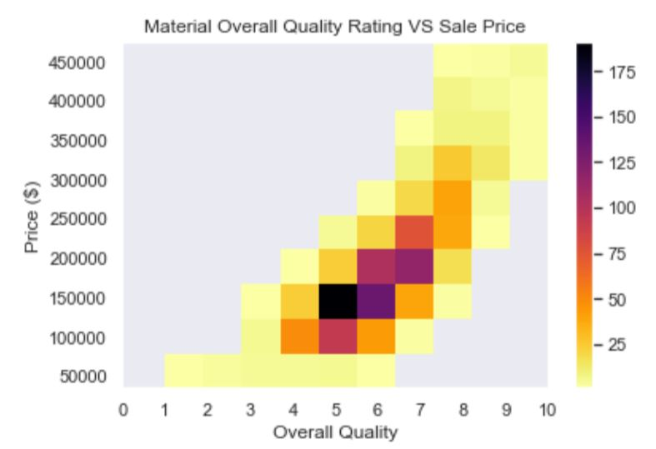
Overall Quality VS Sale Price
Also, one of the factors that appeared to have a great impact on the prices is the overall rating quality of materials used in construction and finishing.

Slide 34
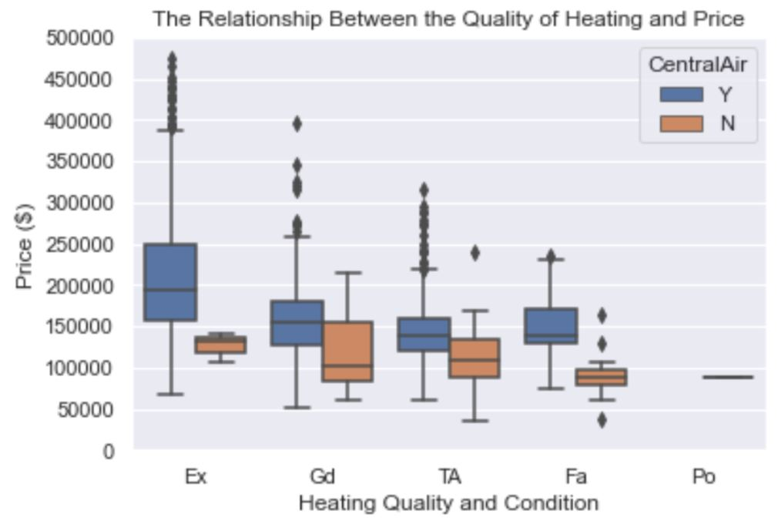
Overall Quality VS Sale Price
This plot is also one of the most insightful ones. It reveals the positive correlation between the the heating quality and the price. It also shows that houses with central air conditioning generally have higher prices.

