Slide 1

RESTO PROJECT
SW2-Documentation

Slide 2
TABLE OF CONTENTS
01
Functional Requerments
05
ERD
02
Non-Functional Requerments
06
Class & OCL(Object Constraint Language)
03
07
Sequence Diagram
Use-Case
04
Activites

Slide 3
Functional
Requirements
01
SignUp
User registration requires unique username, email, phone number, name, password, and role; system checks for existing username and email; successful sign-up generates JWT token for authentication
02
SignIn
-Users can sign in using their email and password.
-The system should authenticate the user and return a JWT token for accessing protected resources.
03
Manage Category
Create an Update Category
04
Manage Checkout
-Add Checkout: Users can add a new checkout entry by providing a cart ID, username, phone number, address, and total amount.
-Update Checkout: Users can update the status of a checkout entry to indicate it has been processed.
-Find Shopping CartById: Users can find a shopping cart by its ID.
-Find AllCheckouts: Users can retrieve a list of all checkouts.
-FindOrderDetails:Users can retrieve a list of order details including checkout ID, food name, quantity, status, checkout date, and total amount.
-FindCheckoutById:Users can find a checkout entry by its ID.

Slide 4
Functional
Requirements
05
Manage Food
Create and delete Food from menu
ManageReservation
06
-GetAllReservation
-GetReservationByID
-AddandUpdateReservation
-FindDatesByTableID
07
ShoppingCart
-FindShoppingCart
-SaveShoppingCart
-ClearCart

Slide 5
Non-Functional
Requirements
01
Usability
User-friendly application in English with intuitive interfaces, self-descriptive buttons, easy memorization, cancel operation, and detailed error explanations.
02
Performance
High-performance application featuring a fast-searching algorithm, response time under 1 second, and immediate availability of functions upon completion.
03
Look and feel
Sleek design for comfortable viewing, balanced colors, smooth and subtle animations/transitions, and a dark mode option for improved visibility in low-light environments.
04
Cultural
The language used is polite and formal and isn’t offensive in anyway.
05
Legal REQS
The language used is polite and formal and isn’t offensive in anyway.
06
Security
All the data in the database are safely stored and cannot be modified by anyone unless he conformed his identity through logging in.

Slide 6
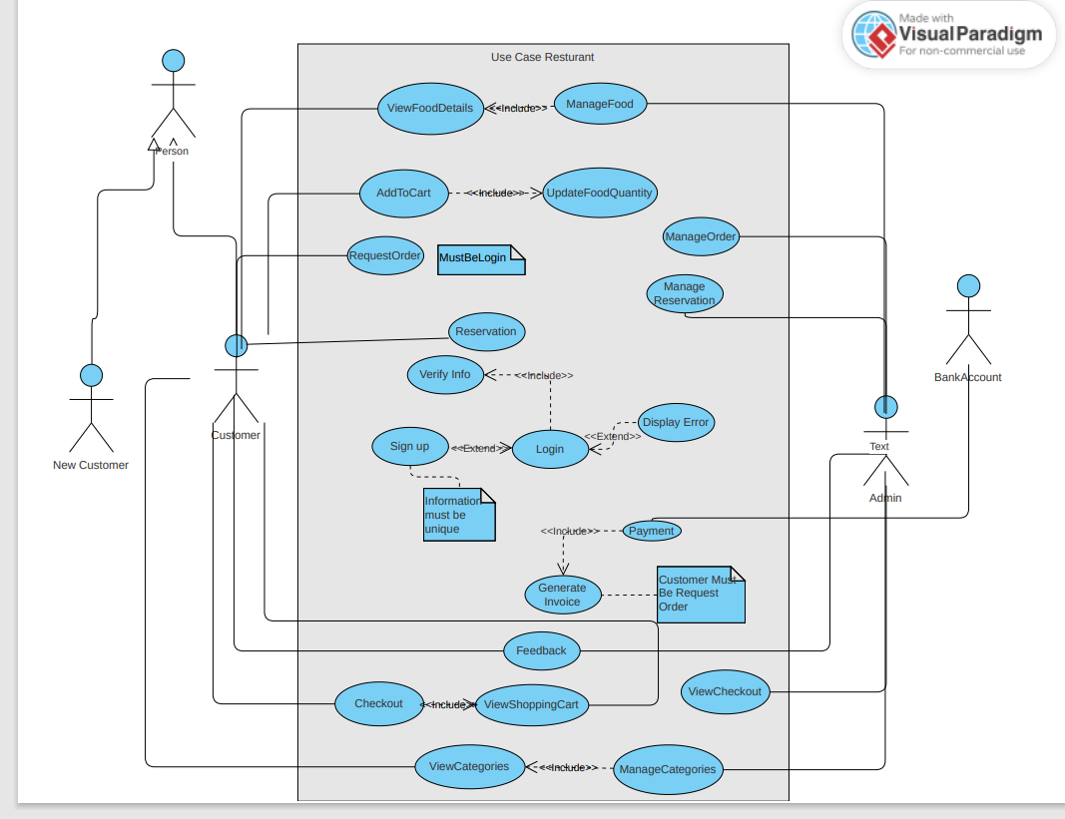
USE CASE

Slide 7
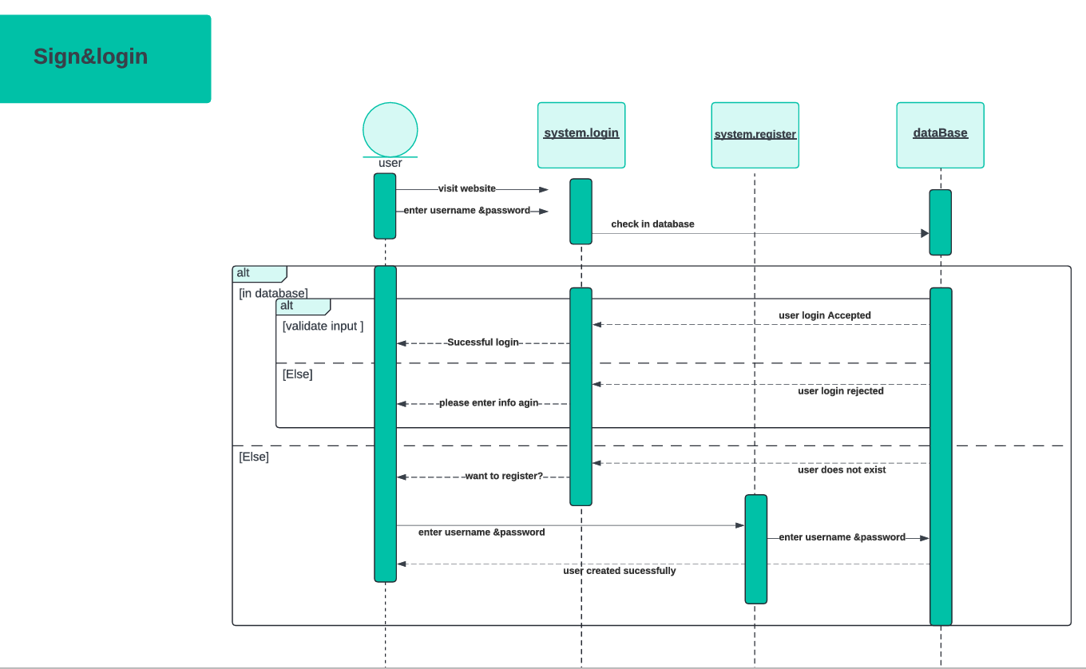
Sequence Diagram

Slide 8
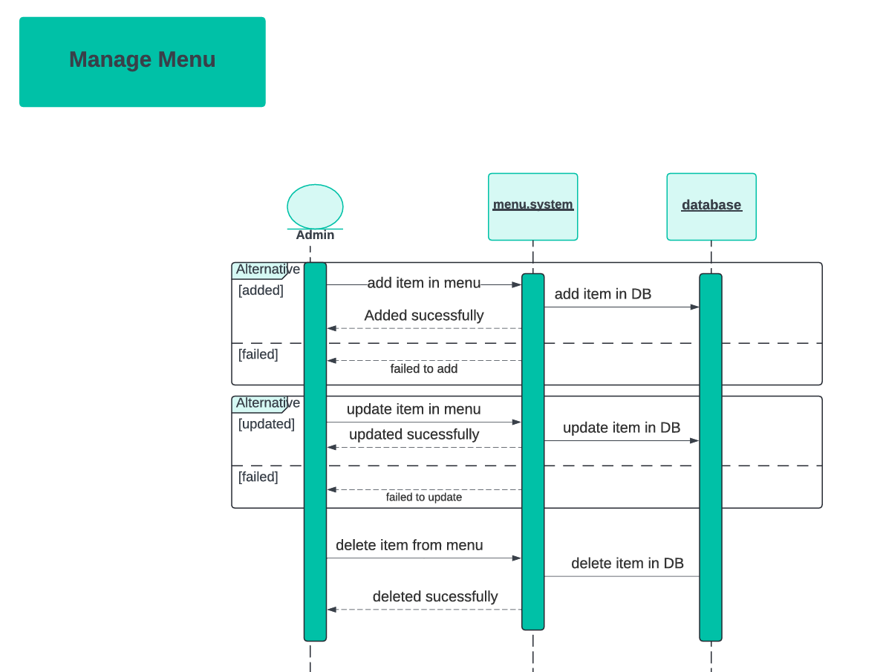
Sequence Diagram

Slide 9
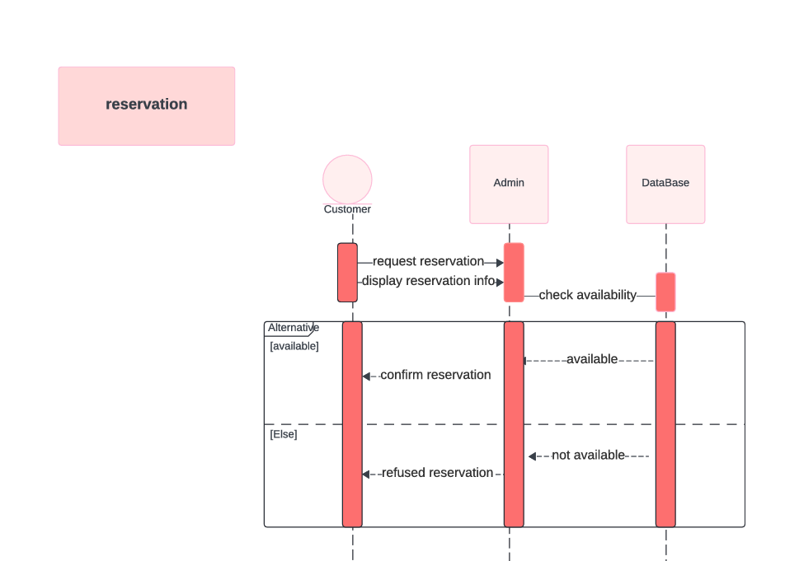
Sequence Diagram

Slide 10
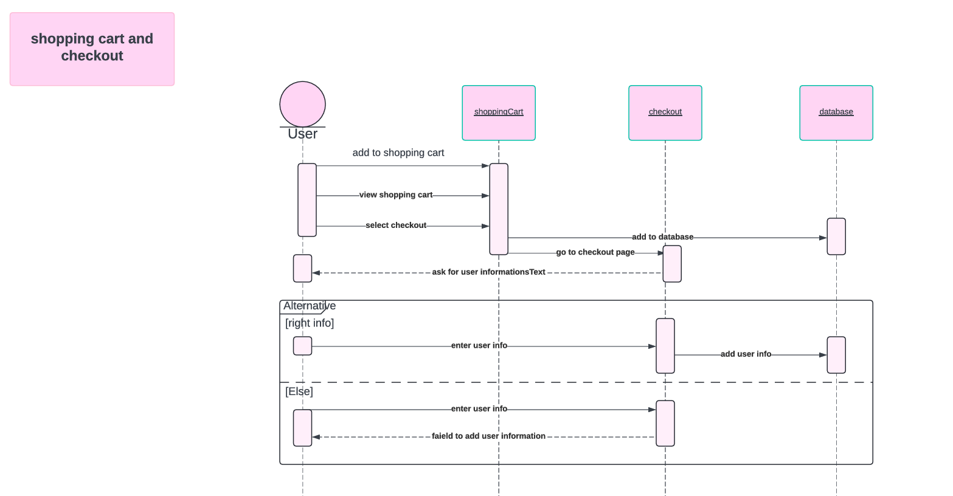
Sequence Diagram

Slide 11
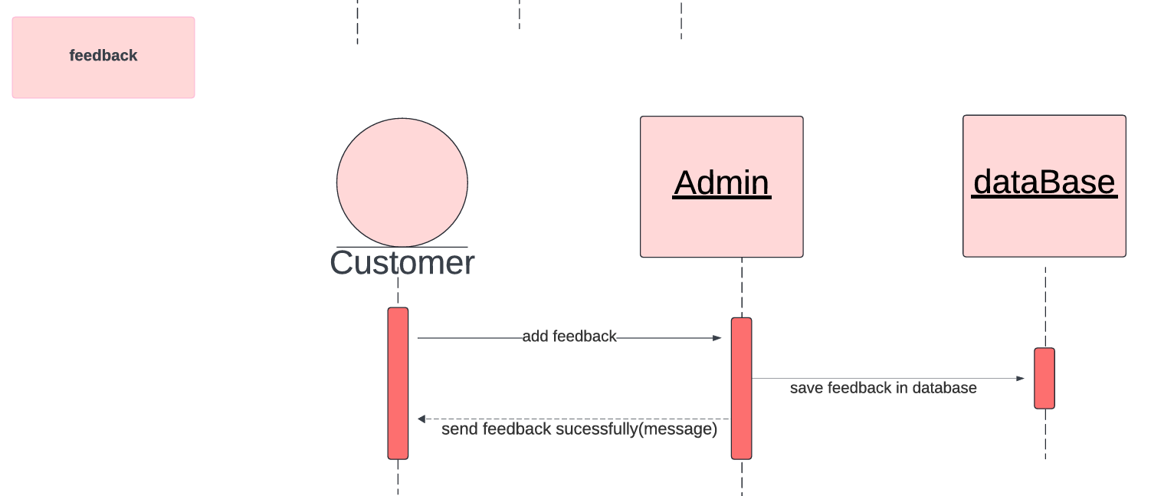
Sequence Diagram

Slide 12
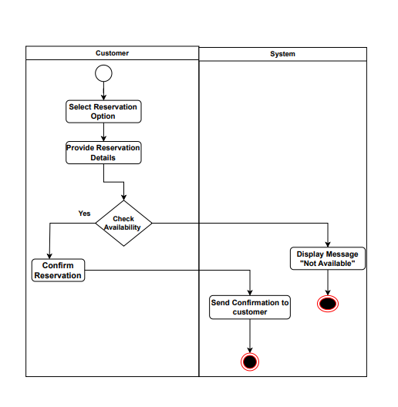
Activity Diagram
Reservation

Slide 13
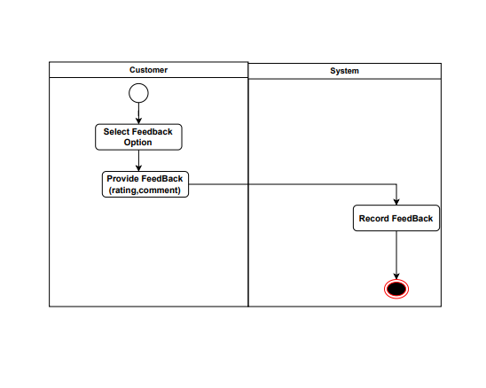
Activity Diagram
FeedBack

Slide 14
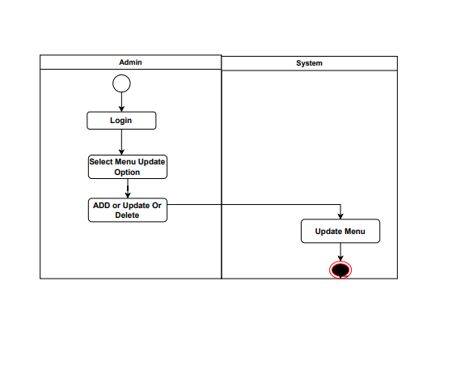
Activity Diagram
Menu

Slide 15
Activity Diagram
Menu

Slide 16
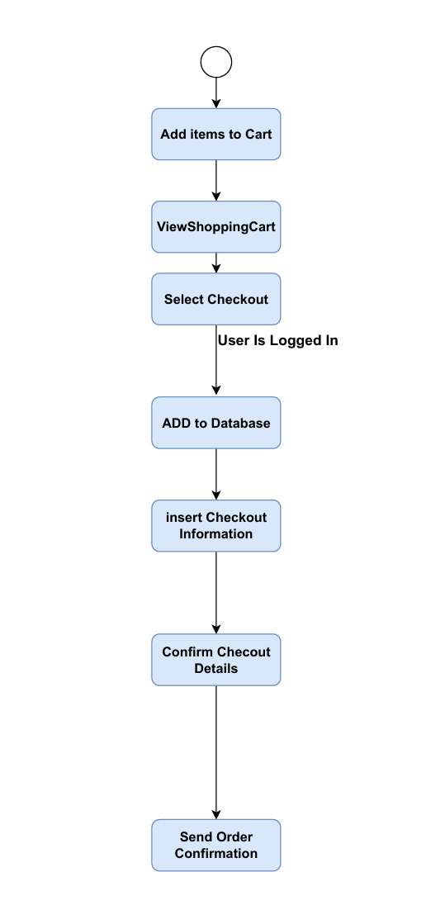
Activity Diagram
ShoppingCartAnd
Checkout

Slide 17
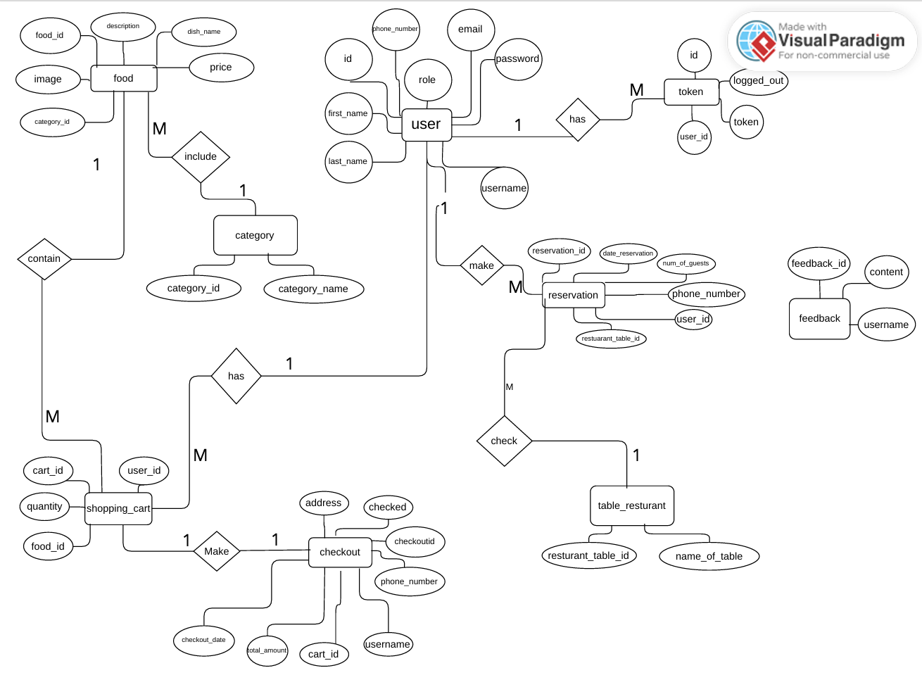
ERD

Slide 18
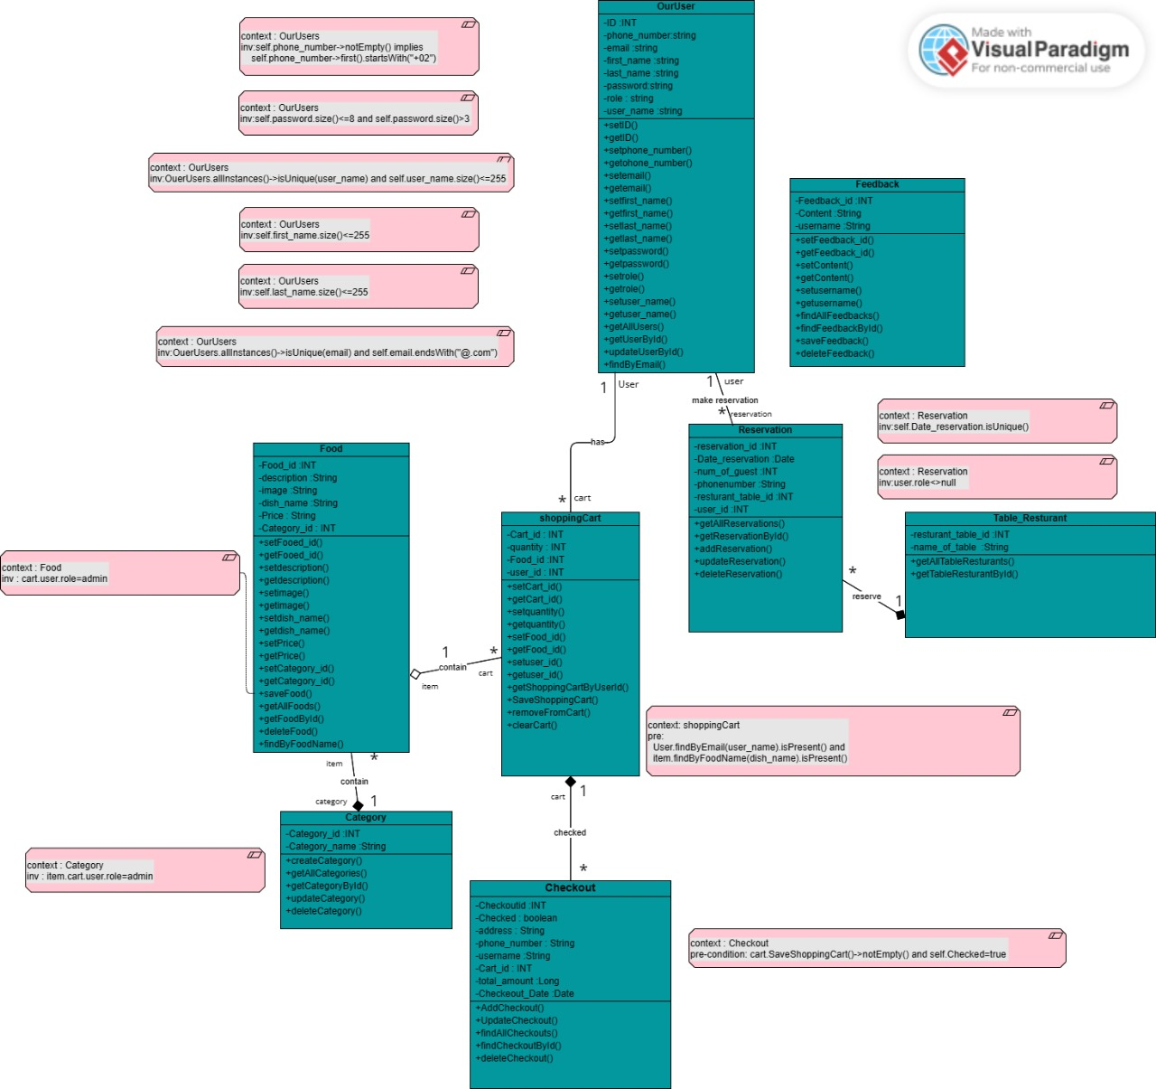
OCL

