Slide 1

Fast Accurate Fixable pharmacy management and cashiering system
Higher Technological Institute | May 2025

Slide 2
Project Team
Agenda
Problem Statement
System requirements
Methodology
Implementation & deployment
Website
Database & Backend Services
Application
Data collection and the object detection model
System show case
Q&A & System trial
Moaaz Ahmed Abdulfattah
Mahmoud Attia Fathy
Mustafa Hany Mustafa
Mahmoud Mohammed Elhusseini
Anas Elsaid Abdulmaati
Abdulrahman Atif Abdullah
Supervised by
Dr/ Hend Shaaban
Higher Technological Institute | May 2025
Fast Accurate Fixable pharmacy management and cashiering system

Slide 3
Agenda
Outdated Pharmacy Point-of-Sale Systems
Inflexible Legacy Systems for Owners
Long Queues Despite Available Staff
Problem Statement
System requirements
Methodology
Implementation & deployment
Website
Database & Backend Services
Application
Data collection and the object detection model
Future Work & Conclusion
Q&A
Rely on fixed counter computers and barcode scanners
Limit flexibility, speed, and mobility in daily operations
Ignore advances in AI, mobile computing, and computer vision
Pharmacies need smarter, portable, and AI-driven solutions
Customers wait in line at a single cashier point
Other staff remain idle, unable to assist with checkout
Centralized cashiering causes bottlenecks during peak hours
Leads to frustration, slower service, and lost sales opportunities
Business insights are tied to desktop software or in-store computers
No real-time access to stock levels, sales, or staff activity remotely
Lack of centralized dashboards across multiple branches
Owners are forced to manage reactively, not proactively

Slide 4
Agenda
Outdated Pharmacy Point-of-Sale Systems
Inflexible Legacy Systems for Owners
Long Queues Despite Available Staff
Problem Statement
System requirements
Methodology
Implementation & deployment
Website
Database & Backend Services
Application
Data collection and the object detection model
System show case
Q&A & System trial
Rely on fixed counter computers and barcode scanners
Limit flexibility, speed, and mobility in daily operations
Ignore advances in AI, mobile computing, and computer vision
Pharmacies need smarter, portable, and AI-driven solutions
Customers wait in line at a single cashier point
Other staff remain idle, unable to assist with checkout
Centralized cashiering causes bottlenecks during peak hours
Leads to frustration, slower service, and lost sales opportunities
Business insights are tied to desktop software or in-store computers
No real-time access to stock levels, sales, or staff activity remotely
Lack of centralized dashboards across multiple branches
Owners are forced to manage reactively, not proactively
Problem Statement

Slide 5
Agenda
Outdated Pharmacy Point-of-Sale Systems
Inflexible Legacy Systems for Owners
Long Queues Despite Available Staff
Problem Statement
System requirements
Methodology
Implementation & deployment
Website
Database & Backend Services
Application
Data collection and the object detection model
System show case
Q&A & System trial
Rely on fixed counter computers and barcode scanners
Limit flexibility, speed, and mobility in daily operations
Ignore advances in AI, mobile computing, and computer vision
Pharmacies need smarter, portable, and AI-driven solutions
Business insights are tied to desktop software or in-store computers
No real-time access to stock levels, sales, or staff activity remotely
Lack of centralized dashboards across multiple branches
Owners are forced to manage reactively, not proactively
Customers wait in line at a single cashier point
Other staff remain idle, unable to assist with checkout
Centralized cashiering causes bottlenecks during peak hours
Leads to frustration, slower service, and lost sales opportunities
Problem Statement

Slide 6
Agenda
Outdated Pharmacy Point-of-Sale Systems
Inflexible Legacy Systems for Owners
Long Queues Despite Available Staff
Problem Statement
System requirements
Methodology
Implementation & deployment
Website
Database & Backend Services
Application
Data collection and the object detection model
System show case
Q&A & System trial
Rely on fixed counter computers and barcode scanners
Limit flexibility, speed, and mobility in daily operations
Ignore advances in AI, mobile computing, and computer vision
Pharmacies need smarter, portable, and AI-driven solutions
Customers wait in line at a single cashier point
Other staff remain idle, unable to assist with checkout
Centralized cashiering causes bottlenecks during peak hours
Leads to frustration, slower service, and lost sales opportunities
Business insights are tied to desktop software or in-store computers
No real-time access to stock levels, sales, or staff activity remotely
Lack of centralized dashboards across multiple branches
Owners are forced to manage reactively, not proactively
Problem Statement

Slide 7
Pharmacy employee
Agenda
Outdated Pharmacy Point-of-Sale Systems
Inflexible Legacy Systems for Owners
Long Queues Despite Available Staff
Rely on fixed counter computers and barcode scanners
Limit flexibility, speed, and mobility in daily operations
Ignore advances in AI, mobile computing, and computer vision
Pharmacies need smarter, portable, and AI-driven solutions
Customers wait in line at a single cashier point
Other staff remain idle, unable to assist with checkout
Centralized cashiering causes bottlenecks during peak hours
Leads to frustration, slower service, and lost sales opportunities
Business insights are tied to desktop software or in-store computers
No real-time access to stock levels, sales, or staff activity remotely
Lack of centralized dashboards across multiple branches
Owners are forced to manage reactively, not proactively
Problem Statement
Branch Manager
Requirements
Pharmacy Owner

Slide 8
Pharmacy employee
Outdated Pharmacy Point-of-Sale Systems
Inflexible Legacy Systems for Owners
Long Queues Despite Available Staff
Rely on fixed counter computers and barcode scanners
Limit flexibility, speed, and mobility in daily operations
Ignore advances in AI, mobile computing, and computer vision
Pharmacies need smarter, portable, and AI-driven solutions
Customers wait in line at a single cashier point
Other staff remain idle, unable to assist with checkout
Centralized cashiering causes bottlenecks during peak hours
Leads to frustration, slower service, and lost sales opportunities
Business insights are tied to desktop software or in-store computers
No real-time access to stock levels, sales, or staff activity remotely
Lack of centralized dashboards across multiple branches
Owners are forced to manage reactively, not proactively
Branch Manager
Requirements
stockholders Requirements
Pharmacy Owner Requirements
Register pharmacy profile and manage multiple branches
Create and manage employee and manager accounts
Monitor stock levels, expiry dates, and profits
Access real-time sales analytics through a web dashboard
Set alerts for low stock and soon-to-expire drugs
Branch Manager Requirements
Access the system with branch-restricted login
Register and manage employees for their branch
Monitor employee activity and shift schedules
Track real-time sales, receipts, inventory, and profits
Get alerts for near-expiry stock for timely action
Pharmacy Employee Requirements
Log in through the Android app with a branch-specific account
Use phone camera to search for or scan drugs (barcode-free detection)
Add items to cart, adjust quantities, and complete sales
Access receipt history for returns or replacements within 14 days
Receive expiry alerts and guidance on shelf arrangement by expiry date
Pharmacy Owner

Slide 9

stockholders Requirements
Pharmacy Owner Requirements
Register pharmacy profile and manage multiple branches
Create and manage employee and manager accounts
Monitor stock levels, expiry dates, and profits
Access real-time sales analytics through a web dashboard
Set alerts for low stock and soon-to-expire drugs
Branch Manager Requirements
Access the system with branch-restricted login
Register and manage employees for their branch
Monitor employee activity and shift schedules
Track real-time sales, receipts, inventory, and profits
Get alerts for near-expiry stock for timely action
Pharmacy Employee Requirements
Log in through the Android app with a branch-specific account
Use phone camera to search for or scan drugs (barcode-free detection)
Add items to cart, adjust quantities, and complete sales
Access receipt history for returns or replacements within 14 days
Receive expiry alerts and guidance on shelf arrangement by expiry date
Pharmacy employee
Branch Manager
Requirements
Pharmacy Owner

Slide 10

stockholders Requirements
Pharmacy Owner Requirements
Register pharmacy profile and manage multiple branches
Create and manage employee and manager accounts
Monitor stock levels, expiry dates, and profits
Access real-time sales analytics through a web dashboard
Set alerts for low stock and soon-to-expire drugs
Branch Manager Requirements
Access the system with branch-restricted login
Register and manage employees for their branch
Monitor employee activity and shift schedules
Track real-time sales, receipts, inventory, and profits
Get alerts for near-expiry stock for timely action
Pharmacy Employee Requirements
Log in through the Android app with a branch-specific account
Use phone camera to search for or scan drugs (barcode-free detection)
Add items to cart, adjust quantities, and complete sales
Access receipt history for returns or replacements within 14 days
Receive expiry alerts and guidance on shelf arrangement by expiry date
Pharmacy employee
Branch Manager
Requirements
Pharmacy Owner

Slide 11

stockholders Requirements
Pharmacy Owner Requirements
Register pharmacy profile and manage multiple branches
Create and manage employee and manager accounts
Monitor stock levels, expiry dates, and profits
Access real-time sales analytics through a web dashboard
Set alerts for low stock and soon-to-expire drugs
Branch Manager Requirements
Access the system with branch-restricted login
Register and manage employees for their branch
Monitor employee activity and shift schedules
Track real-time sales, receipts, inventory, and profits
Get alerts for near-expiry stock for timely action
Pharmacy Employee Requirements
Log in through the Android app with a branch-specific account
Use phone camera to search for or scan drugs (barcode-free detection)
Add items to cart, adjust quantities, and complete sales
Access receipt history for returns or replacements within 14 days
Receive expiry alerts and guidance on shelf arrangement by expiry date
Pharmacy employee
Branch Manager
Requirements
Pharmacy Owner

Slide 12

stockholders Requirements
Pharmacy Owner Requirements
Register pharmacy profile and manage multiple branches
Create and manage employee and manager accounts
Monitor stock levels, expiry dates, and profits
Access real-time sales analytics through a web dashboard
Set alerts for low stock and soon-to-expire drugs
Branch Manager Requirements
Access the system with branch-restricted login
Register and manage employees for their branch
Monitor employee activity and shift schedules
Track real-time sales, receipts, inventory, and profits
Get alerts for near-expiry stock for timely action
Pharmacy Employee Requirements
Log in through the Android app with a branch-specific account
Use phone camera to search for or scan drugs (barcode-free detection)
Add items to cart, adjust quantities, and complete sales
Access receipt history for returns or replacements within 14 days
Receive expiry alerts and guidance on shelf arrangement by expiry date
Pharmacy employee
Methodology
In this section, I will walk you through the methodology behind developing the system.
We’ll explore the technical decisions, data preparation steps, and model deployment strategies.
This explanation is based on the detailed “System Explanation” page from the website.
Branch Manager
Requirements
Pharmacy Owner

Slide 13
Forntend Implementation​
Core Frameworks & Languages:​ The project is built using React, TypeScript, and Vite for fast and modern frontend development.​
Styling & UI Components:​ Tailwind CSS is used for utility-first styling, and Shadcn provides accessible and customizable UI components.​
Routing & State Management:​ It includes React Router for navigation and uses both Zustand and Context API for managing application state.​
Data Handling & Forms:​ TanStack Query manages server state and async data, while React Hook Form and Zod handle form validation and schema parsing.​
Animations & User Experience:​ Framer Motion is used to create smooth animations and enhance the interactivity of the UI

Slide 14
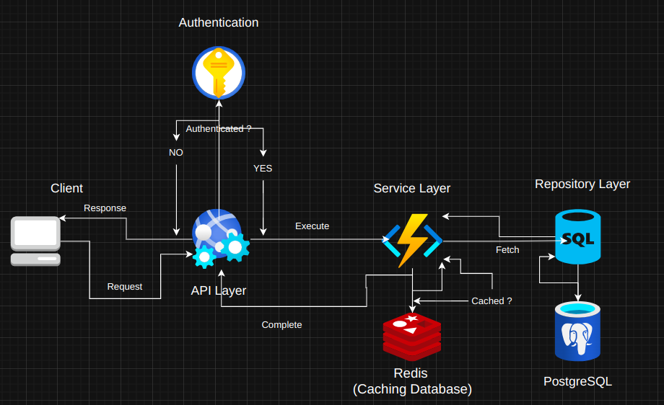
Data Flow Architecture

Slide 15
Android Implementation
Using MVVM and MVI architecture for clean structure and navigation.
Data Binding simplifies UI updates with ViewModel data.
Coroutines handle asynchronous tasks efficiently.
Implemented Socket Web Service to communicate with the AI model.
Applied DiffUtil for optimized RecyclerView performance.

Slide 16
Data Collection Process
Building a Comprehensive Drug Dataset
Web Scraping the Egyptian Drug Authority
Scraped the official database to collect 11,639 unique drug entries including names and forms.
Enabled full market coverage for identification and stock tracking.
Image Scraping from Google Search
Used SERP API to collect drug packaging photos automatically.
Many results were irrelevant or too similar, risking model overfitting.
Manual Drug Photo Capturing
Captured over 2,000 images of real drug packages using a phone camera.
Ensured diverse, accurate, and high-quality training data.

Slide 17
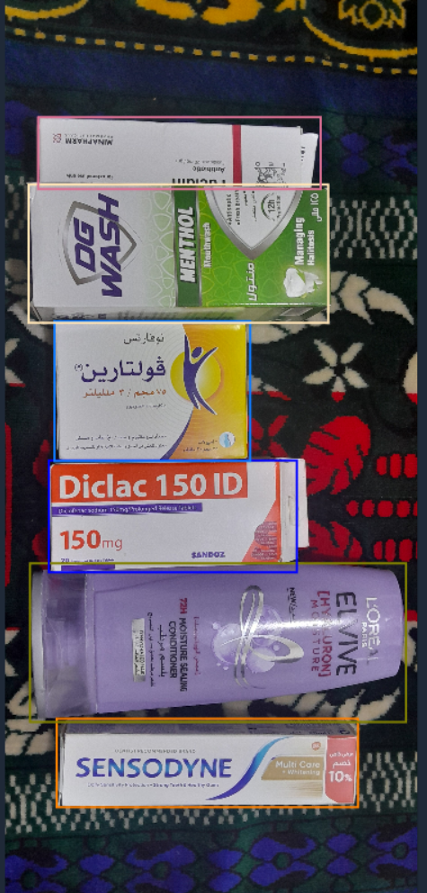
Data Annotation with Roboflow
Preparing High-Quality Training Data
Dataset Upload and Organization
Collected images (web-scraped + manually captured) were uploaded to Roboflow.
Organized by drug class to streamline annotation and versioning.
Bounding Box Annotation
Each drug image was annotated with precise bounding boxes around drug boxes. Ensured accurate object localization for the detection model.
Version Control and Augmentation
Roboflow was used to generate dataset versions with augmentations. Improved generalization through flips, brightness changes, and rotations.

Slide 18




High Accuracy
Easily exported to ONNX and deployed on mobile or server.
Detection and Localization
Model to detects both the class and exact position of each drug in the image.
Lightweight and Deployable
Easily exported to ONNX and deployed on mobile or server.
Real-Time Speed
Optimized for lightning-fast inference, and perfect for live camera use.

Slide 19
High Accuracy
Easily exported to ONNX and deployed on mobile or server.
Detection and Localization
Model to detects both the class and exact position of each drug in the image.
YOLO
Lightweight and Deployable
Easily exported to ONNX and deployed on mobile or server.
Real-Time Speed
Optimized for lightning-fast inference, and perfect for live camera use.

Slide 20
Model Comparison
Model 1
YOLOv11m (60 epochs)
No augmentation used.
mAP@50: 0.941
Prec/Rec: 0.91 / 0.90
Val Loss: Box 0.57, Cls 0.44
AdamW, lr=0.000196
Model 2
YOLOv11m (150 epochs + Aug)
Aug: flip, mixup, rotate.
mAP@50: 0.956
Prec/Rec: 0.92 / 0.91
Val Loss: Box 0.60, Cls 0.46
AdamW, lr=0.0002
Model 3
YOLOv11s (300 epochs + Aug)
Light model, heavy aug
mAP@50: 0.977
Prec/Rec: 0.96 / 0.95
Val Loss: Cls 0.34 (lowest)
SGD, lr=0.01
Model 4
Custom (350 epochs + Aug)Full aug + close mosaic
mAP@50: 0.980 (best)
Prec/Rec: 0.96 / 0.95
Val Loss: Cls 0.29, Box 0.54
AdamW, lr=0.0003

Slide 21
Model Comparison
Model 1
YOLOv11m (60 epochs)
No augmentation used.
mAP@50: 0.941
Prec/Rec: 0.91 / 0.90
Val Loss: Box 0.57, Cls 0.44
AdamW, lr=0.000196
Model 2
YOLOv11m (150 epochs + Aug)
Aug: flip, mixup, rotate.
mAP@50: 0.956
Prec/Rec: 0.92 / 0.91
Val Loss: Box 0.60, Cls 0.46
AdamW, lr=0.0002
Model 3
YOLOv11s (300 epochs + Aug)
Light model, heavy aug
mAP@50: 0.977
Prec/Rec: 0.96 / 0.95
Val Loss: Cls 0.34 (lowest)
SGD, lr=0.01
Model 4
Custom (350 epochs + Aug)Full aug + close mosaic
mAP@50: 0.980 (best)
Prec/Rec: 0.96 / 0.95
Val Loss: Cls 0.29, Box 0.54
AdamW, lr=0.0003

Slide 22
Model Comparison
Model 1
YOLOv11m (60 epochs)
No augmentation used.
mAP@50: 0.941
Prec/Rec: 0.91 / 0.90
Val Loss: Box 0.57, Cls 0.44
AdamW, lr=0.000196
Model 2
YOLOv11m (150 epochs + Aug)
Aug: flip, mixup, rotate.
mAP@50: 0.956
Prec/Rec: 0.92 / 0.91
Val Loss: Box 0.60, Cls 0.46
AdamW, lr=0.0002
Model 3
YOLOv11s (300 epochs + Aug)
Light model, heavy aug
mAP@50: 0.977
Prec/Rec: 0.96 / 0.95
Val Loss: Cls 0.34 (lowest)
SGD, lr=0.01
Model 4
Custom (350 epochs + Aug)Full aug + close mosaic
mAP@50: 0.980 (best)
Prec/Rec: 0.96 / 0.95
Val Loss: Cls 0.29, Box 0.54
AdamW, lr=0.0003

Slide 23
Model Comparison
Model 1
YOLOv11m (60 epochs)
No augmentation used.
mAP@50: 0.941
Prec/Rec: 0.91 / 0.90
Val Loss: Box 0.57, Cls 0.44
AdamW, lr=0.000196
Model 2
YOLOv11m (150 epochs + Aug)
Aug: flip, mixup, rotate.
mAP@50: 0.956
Prec/Rec: 0.92 / 0.91
Val Loss: Box 0.60, Cls 0.46
AdamW, lr=0.0002
Model 3
YOLOv11s (300 epochs + Aug)
Light model, heavy aug
mAP@50: 0.977
Prec/Rec: 0.96 / 0.95
Val Loss: Cls 0.34 (lowest)
SGD, lr=0.01
Model 4
Custom (350 epochs + Aug)Full aug + close mosaic
mAP@50: 0.980 (best)
Prec/Rec: 0.96 / 0.95
Val Loss: Cls 0.29, Box 0.54
AdamW, lr=0.0003

Slide 24
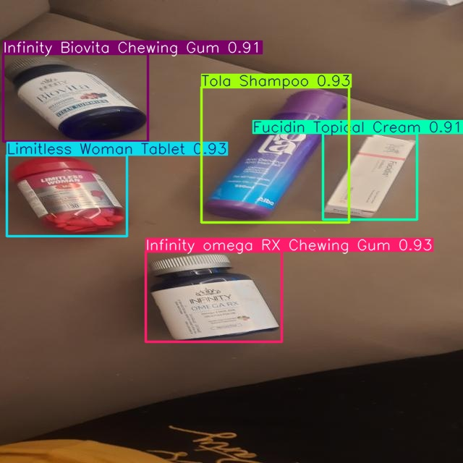
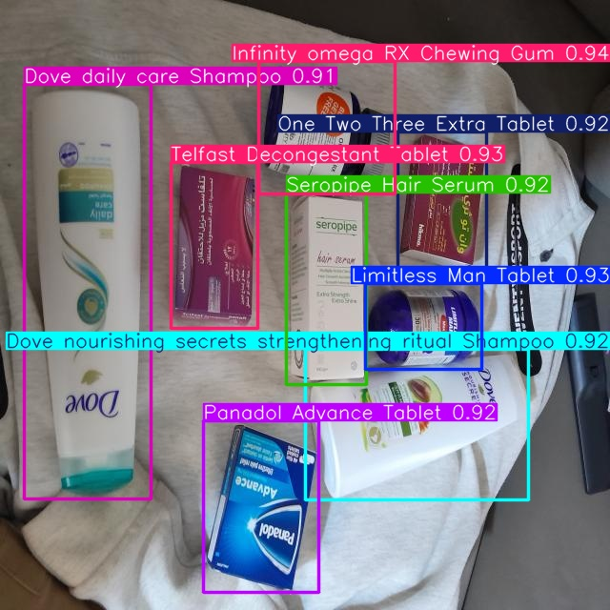
Here is some model predictions against the validation set

Slide 25
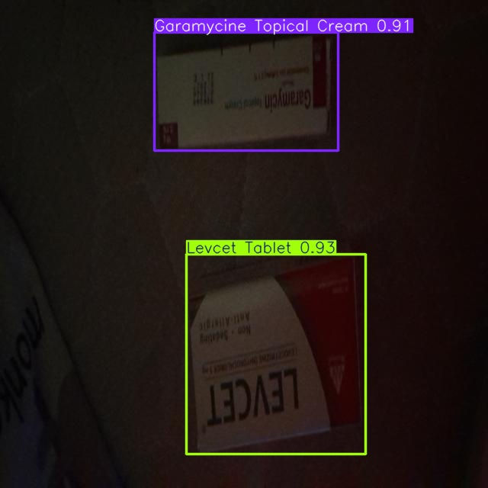
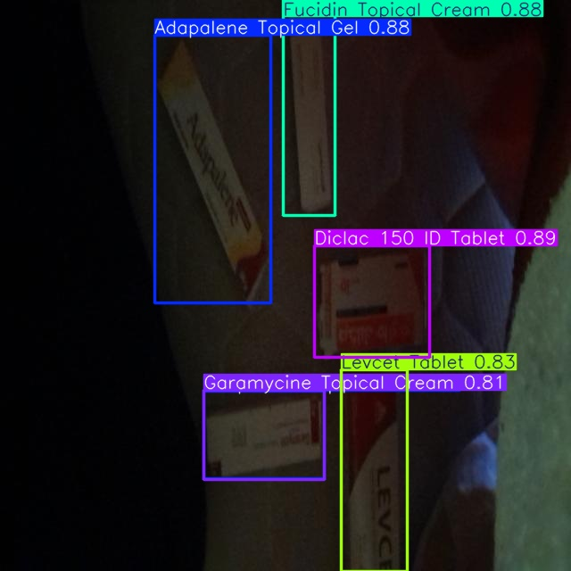
Here is some model predictions against the validation set

Slide 26
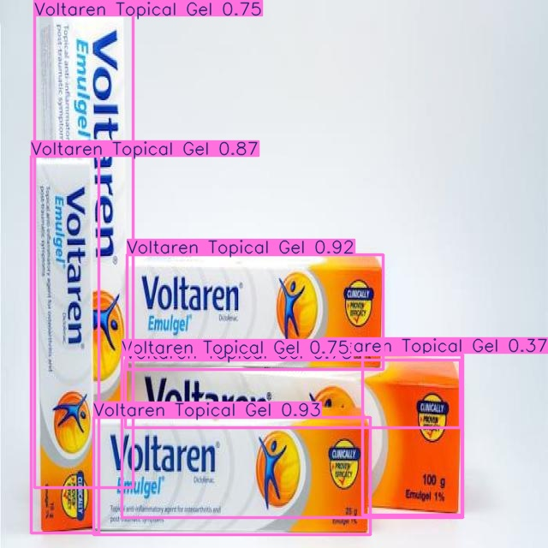
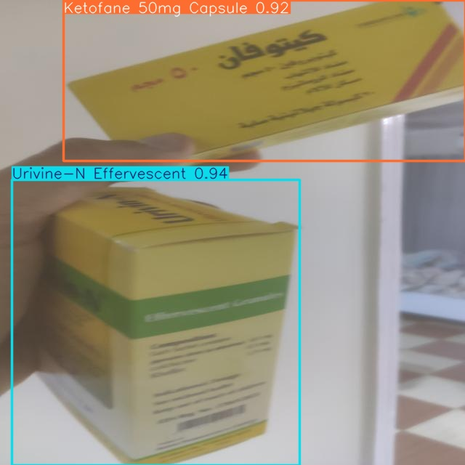
Here is some model predictions against the validation set

Slide 27
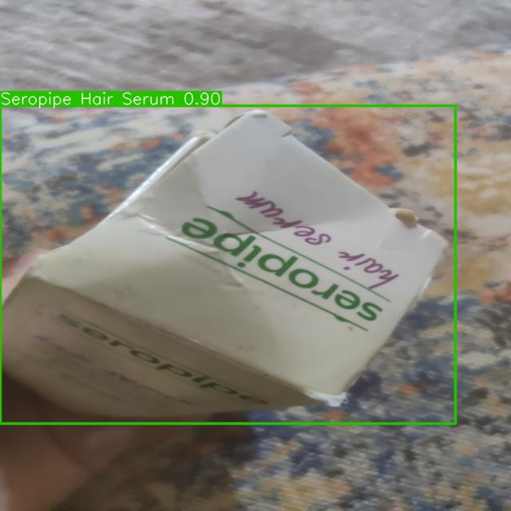
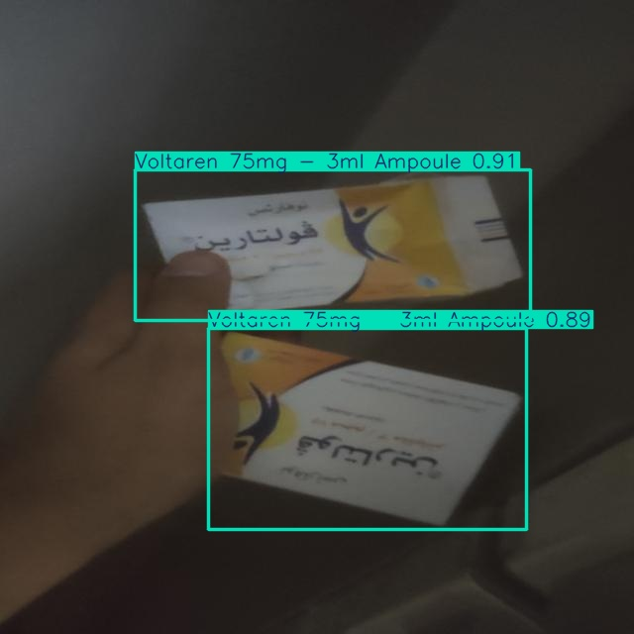
Here is some model predictions against the validation set

Slide 28
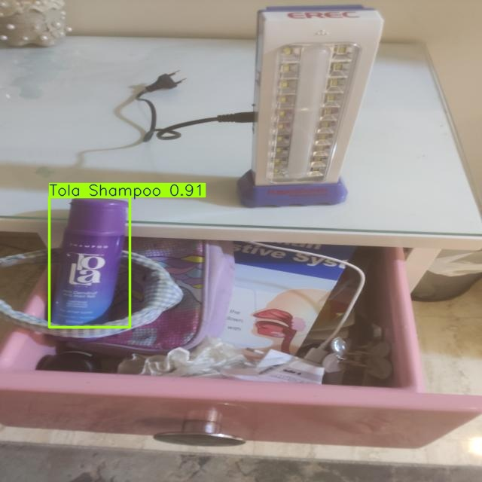
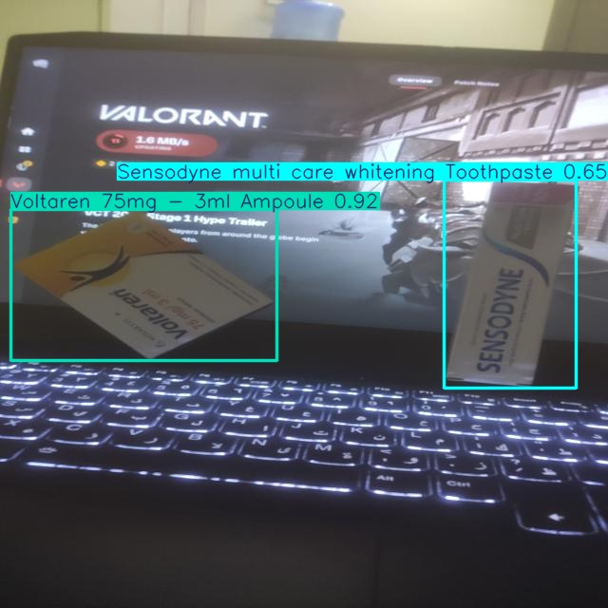
Here is some model predictions against the validation set

Slide 29
Future Work and Enhancements
Prescription Parsing Train a vision-language model to extract drug names from handwritten prescriptions.
Stock Check Assistant Add camera-based guidance to help workers check for the inventory quantity match the database.
Offline Mode for App Enable offline sales logging that syncs automatically when internet returns.
Advanced Analytics Dashboard Include drug movement patterns, seasonal demand, and loss analysis for business optimization.
Collect more data and include more drugs increasing the dataset will increase the accuracy and the reliability of the scanning system.

Slide 30
Thank You for Your Time!
We appreciate your attention and interest.
Questions & Answers
We're happy to answer any questions you may have.
Higher Technological Institute | May 2025

