Slide 1

MoabiTech

Slide 2
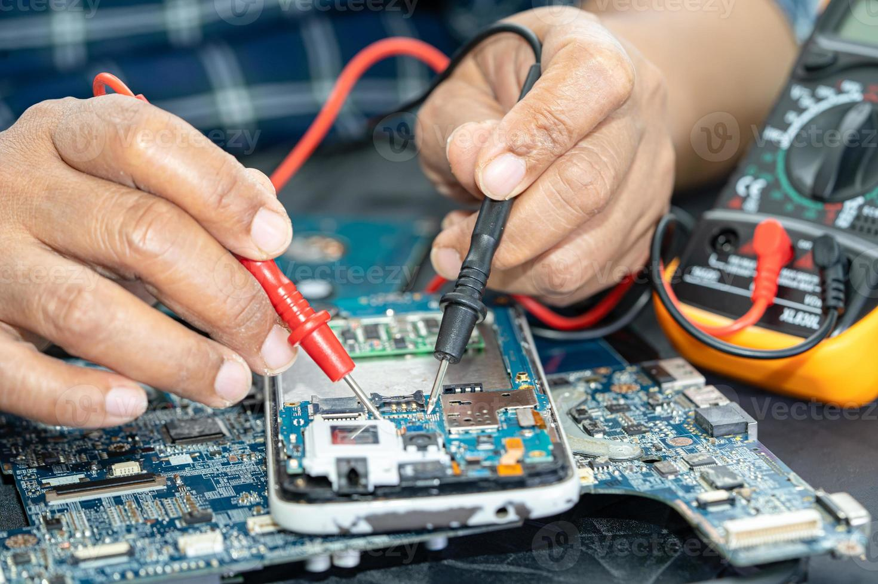
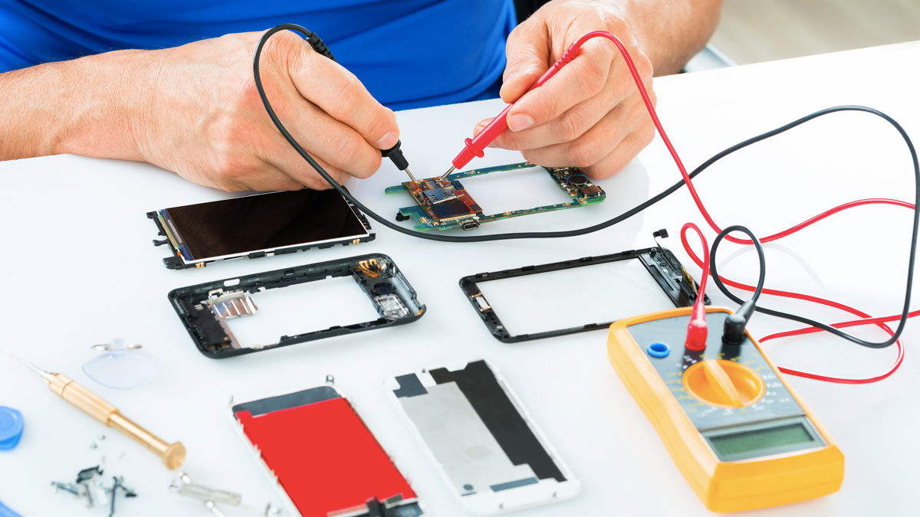
MoabiTech
Water damage problem
Repairing Charge system

Slide 3
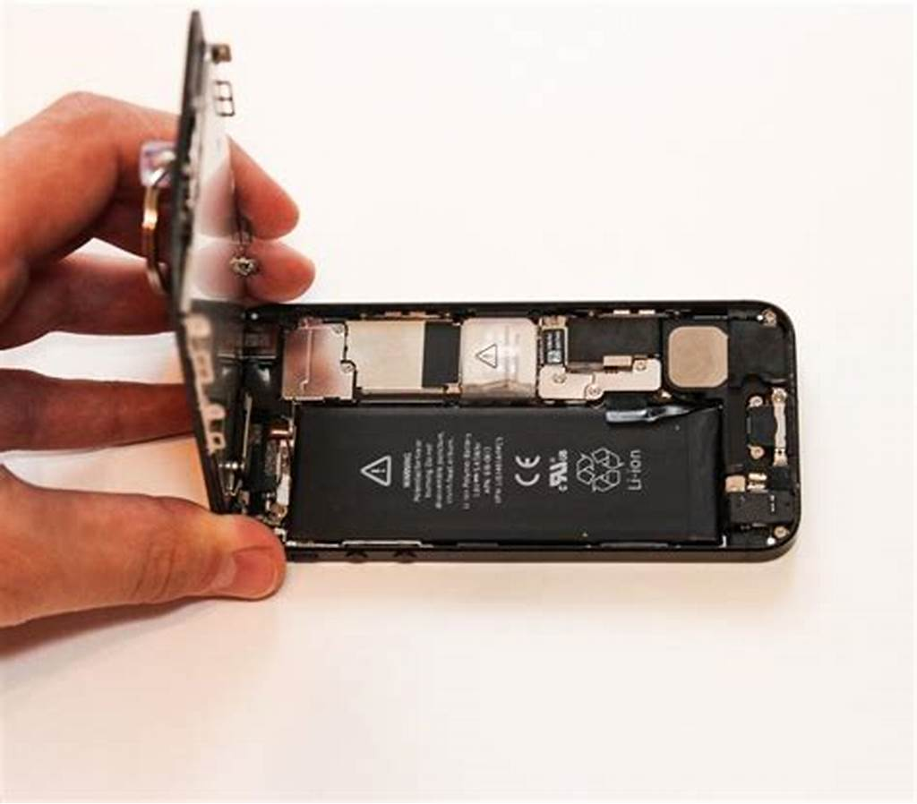
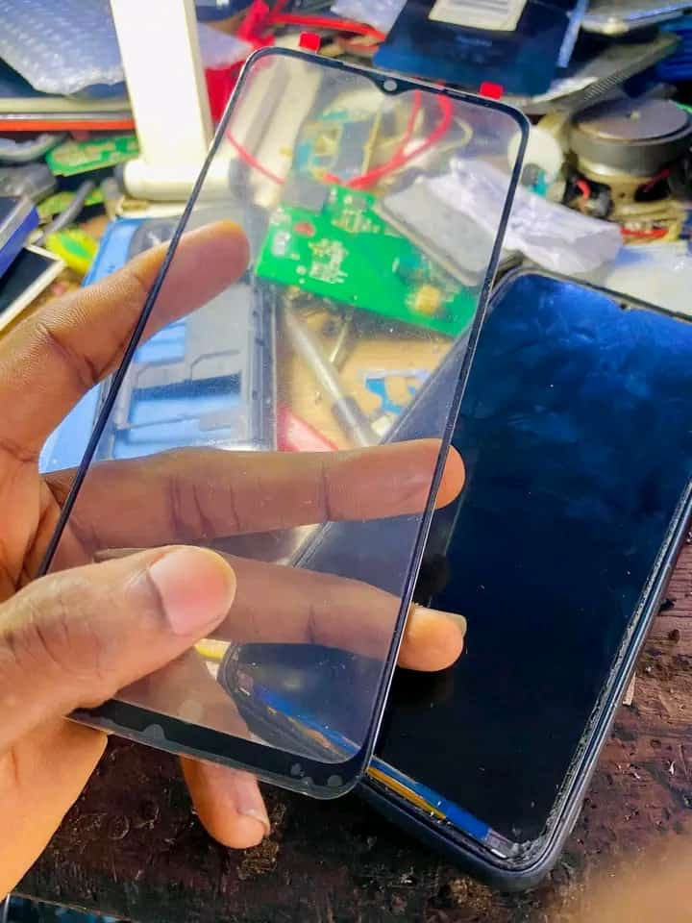
MoabiTech
Battery replacement
Screen Replacement

Slide 4
MoabiTech pty
Our contacts
+266 59041005
+266 62347738

