Slide 1

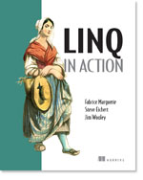

C# 6, 7 and beyond https://github.com/jwooley/RoslynAndYou https://jwooley.github.io/
Jim Wooley
www.ThinqLinq.com
Twitter: @JimWooley

Slide 2



Be Sure to thank our sponsors:

Slide 3
C# History (before Roslyn)
2002
2005
2008
2010
2012
2013
2015
C# 1/VB7
C# 2: Generics, Iterators, Anonymous Delegates, Nullable, Partial, co/contravariance
C# 3: LINQ, Lambda, Anonymous, AutoProp, Extension Methods, Expression
C# 4: Parallel, Dynamic, optional params, named arguments, embedded interop
C# 5: Async, Caller info
Roslyn
???

Slide 4
Roslyn Language Enhancements
Await in Catch/ Finally
Null propagation
#pragma
Getter only auto property
Dictionary Initializer
Nameof operator
Partial Modules
Exception Filters
Partial Interface
Auto property initializer
#Region inside methods
Using Static
String interpolation
Parameterless struct ctor
Line continuation comments
Multiline string literals

Slide 5
C# Post Roslyn
2015
12/2016
8/2017
8/2017
C# 6: Static imports, prop initializers, null propagator, string interpolation, nameof
C# 7.0: Out variables, tuples, pattern matching, local functions, ref locals and returns
C# 7.1: Async main, default literal, inferred tuple names, reference assembly gen
C# 7.2: ref semantics with value types, non-trailing named args, numeric literals, private protected
??
C# 7.3: tuple equality, constraints, expression variables, custom fixed, ref reassignment
???
C# 8.0: Default interface, nullable reference types, async streams, generic attributes, ranges
https://docs.microsoft.com/en-us/dotnet/csharp/whats-new/
https://github.com/dotnet/roslyn/blob/master/docs/Language%20Feature%20Status.md

Slide 6
C#7
Named Tuples
Binary Literals
static void Main(string[] args)
{
object[] numbers = { 0b1, 0b10, new object[] { 0b10, 0b100, 0b1000 }, 0b1000_0, 0b1000_00 };
(int sum, int count) Tally(IEnumerable<object> list)
{
var r = (sum:0, count:0);
foreach (var v in list)
{
switch(v)
{
case int i:
r.sum += i, r.count++;
break;
case IEnumerable<object> l when l.Any():
var t1 = Tally(l);
r.s += tl.sum; r.c += tl.count;
break;
case null:
break;
}
}
return r;
}
var result = Tally(numbers);
Console.WriteLine($"Sum: {result.sum} Count: {result.count}");
}
Digit Separators
Local Functions
Pattern Matching

Slide 7
(C# 7.x).Where(x => x > 0) Objectives
Safe, efficient code
Avoid garbage collection
Avoid copying
Stay safe
More Freedom
Allow more things
Less code
Say it shorter

Slide 8
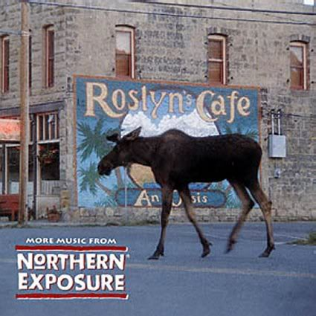
Roslyn Resources
Github: https://github.com/dotnet/roslyn
Language feature status: https://github.com/dotnet/roslyn/blob/master/docs/Language%20Feature%20Status.md
Dotnet: https://github.com/dotnet
Reference Source: http://source.roslyn.io/
This presentation: https://github.com/jwooley/RoslynAndYou

Slide 9
.Net Compiler Platform (Roslyn) And You https://github.com/jwooley/RoslynAndYou https://jwooley.github.io/
Jim Wooley
www.ThinqLinq.com
Twitter: @JimWooley

