Slide 1



C# 7, .Net Compiler Platform (Roslyn) And You https://github.com/jwooley/RoslynAndYou https://jwooley.github.io/
Jim Wooley
www.ThinqLinq.com
Twitter: @JimWooley

Slide 2
Agenda
What is Roslyn?
New Compiler
Language Enhancements
Code Analytics, Refactorings
Build a Diagnostic with Code Fix

Slide 3

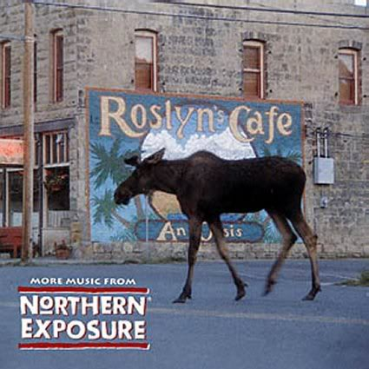
What is Roslyn?

Slide 4
C# History (before Roslyn)
2002
2005
2008
2010
2012
2013
2015
C# 1/VB7
C# 2: Generics, Iterators, Anonymous Delegates, Nullable, Partial, co/contravariance
C# 3: LINQ, Lambda, Anonymous, AutoProp, Extension Methods, Expression
C# 4: Parallel, Dynamic, optional params, named arguments, embedded interop
C# 5: Async, Caller info
Roslyn
???

Slide 5
Roslyn Language Enhancements
Await in Catch/ Finally
Null propagation
#pragma
Getter only auto property
Dictionary Initializer
Nameof operator
Partial Modules
Exception Filters
Partial Interface
Auto property initializer
#Region inside methods
Using Static
String interpolation
Parameterless struct ctor
Line continuation comments
Multiline string literals

Slide 6
C# Post Roslyn
2015
12/2016
8/2017
8/2017
C# 6: Static imports, prop initializers, null propagator, string interpolation, nameof
C# 7.0: Out variables, tuples, pattern matching, local functions, ref locals and returns
C# 7.1: Async main, default literal, inferred tuple names, reference assembly gen
C# 7.2: ref semantics with value types, non-trailing named args, numeric literals, private protected
??
C# 7.3: tuple equality, constraints, expression variables, custom fixed, ref reassignment
???
C# 8.0: Default interface, nullable reference types, async streams, generic attributes, ranges
https://docs.microsoft.com/en-us/dotnet/csharp/whats-new/
https://github.com/dotnet/roslyn/blob/master/docs/Language%20Feature%20Status.md

Slide 7
C#7
Named Tuples
Binary Literals
static void Main(string[] args)
{
object[] numbers = { 0b1, 0b10, new object[] { 0b10, 0b100, 0b1000 }, 0b1000_0, 0b1000_00 };
(int sum, int count) Tally(IEnumerable<object> list)
{
var r = (sum:0, count:0);
foreach (var v in list)
{
switch(v)
{
case int i:
r.sum += i, r.count++;
break;
case IEnumerable<object> l when l.Any():
var t1 = Tally(l);
r.s += tl.sum; r.c += tl.count;
break;
case null:
break;
}
}
return r;
}
var result = Tally(numbers);
Console.WriteLine($"Sum: {result.sum} Count: {result.count}");
}
Digit Separators
Local Functions
Pattern Matching

Slide 8
(C# 7.x).Where(x => x > 0) Objectives
Safe, efficient code
Avoid garbage collection
Avoid copying
Stay safe
More Freedom
Allow more things
Less code
Say it shorter

Slide 9
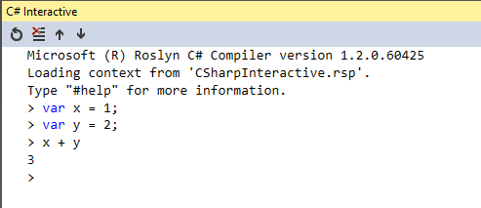
C# Scripting / Interactive
var script = CSharpScript.Create<int>("int x = 1;")
.ContinueWith("int y = 2;")
.ContinueWith("x + y");
Assert.AreEqual(
3,
(int)(await script.RunAsync()).ReturnValue);

Slide 10
Out of the Box Refactorings
Code Fixes (30)
Refactorings (13)
Add Await
Add Async
Change Return Type
Change To Yield
Convert To Async
Convert To Iterator
Add Missing Reference
Add Using
Fully Qualify
Generate Method
Add Constructor Parameters from members
Change Signature
Encapsulate Field
Extract Interface
Extract Method
Generate Constructor from members
Generate default constructors
Inline temporary
Introduce Variable
Invert If
Simplify Lambda
Microsoft.CodeAnalysis.Internal.Log

Slide 11
Third Party Code Fixes
Roslyn Analyzers
Code Cracker
DotNetAnalyzers
StyleCop
AsyncUsageAnalyzers
TSqlAnalyzer
DotNetDoodle
RoslynDiagnostics
AzureAnalytics
Wintellect.Analyzers
Xunit.Analyzers

Slide 12

Opening up the compiler
AST
AST
AST
CSC/VBC
IL

Slide 13
Building your own Diagnostic with Code Fix
public class TestControllerMisnamed : Controller
{
public TestControllerMisnamed() {}
public ActionResult Index()
{
return View();
}
}

Slide 14
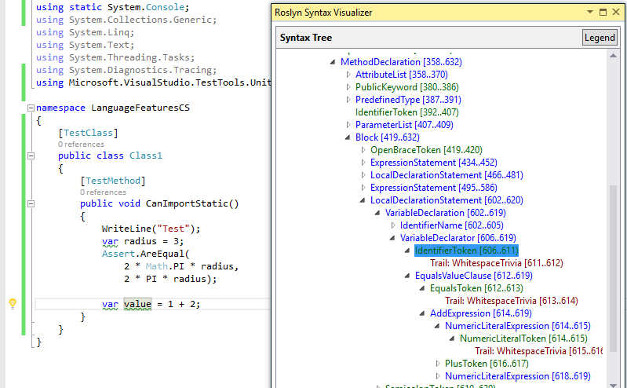
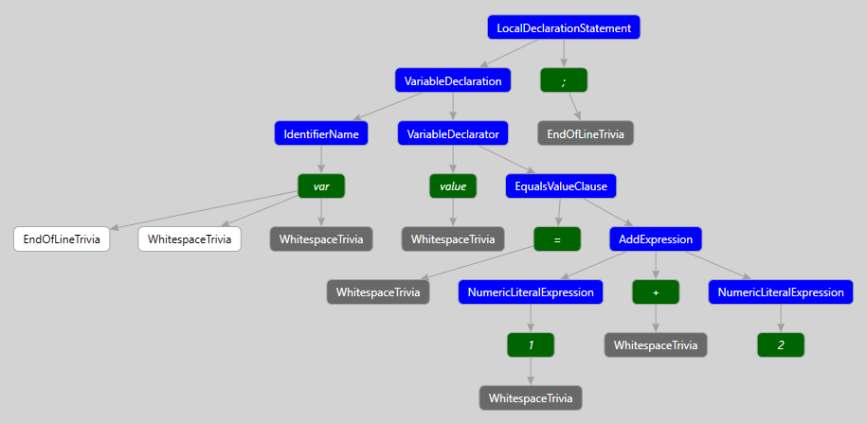
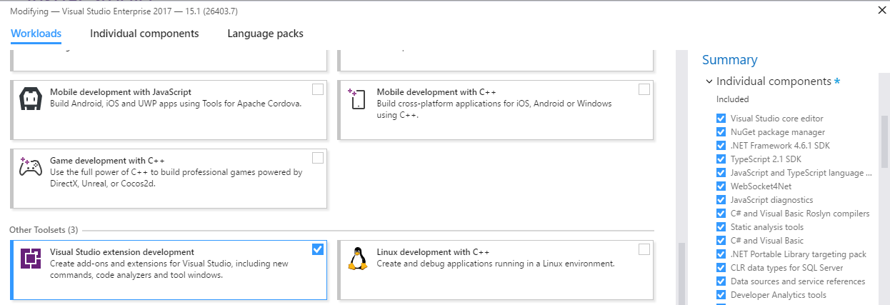
Building your own Fix
ExpressionSyntax
SyntaxToken
SyntaxTrivia
var value = 1 + 2;
var equalsValue =
SyntaxFactory.EqualsValueClause(
SyntaxFactory.BinaryExpression(
SyntaxKind.AddExpression,
SyntaxFactory.LiteralExpression(
SyntaxKind.NumericLiteralExpression, SyntaxFactory.Literal(1)),
SyntaxFactory.LiteralExpression(
SyntaxKind.NumericLiteralExpression,SyntaxFactory.Literal(2))
));
var typeSyntax =
SyntaxFactory.VariableDeclaration(
SyntaxFactory.ParseTypeName("var"),
new SeparatedSyntaxList<VariableDeclaratorSyntax>()
.Add(SyntaxFactory.VariableDeclarator(“value")
.WithInitializer(equalsValue)))
.NormalizeWhitespace(" ")
.WithAdditionalAnnotations(Formatter.Annotation);
var declaration = SyntaxFactory.LocalDeclarationStatement(typeSyntax);

Slide 15
Custom Diagnostic - Analyzer
[DiagnosticAnalyzer(LanguageNames.CSharp)]
public class WebApiControllerNamingConventionAnalyzer : DiagnosticAnalyzer
{
string DiagnosticId = “WA0001";
string Description = "Controller type should end in 'Controller'";
string MessageFormat = "Type name '{0}' does not end in Controller";
internal const string Category = "Naming";
private static DiagnosticDescriptor Rule = new DiagnosticDescriptor(
DiagnosticId, Description, MessageFormat, Category,
DiagnosticSeverity.Warning, true);
// Add implementation
}
private void Analyzer(SymbolAnalysisContext context)
{
var symbol = (INamedTypeSymbol)context.Symbol;
if (symbol.BaseType == null) return;
if ((symbol.BaseType.Name == "Controller"
|| symbol.BaseType.Name == "ApiController")
&& !symbol.Name.EndsWith("Controller"))
{
var diagnostic = Diagnostic.Create(
Rule, symbol.Locations[0], symbol.Name);
context.ReportDiagnostic(diagnostic);
}
}

Slide 16
Custom Diagnostic - CodeFixProvider
private async Task<Document> MakeEndInControllerAsync(
Document document,
TypeDeclarationSyntax typeDecl,
CancellationToken cancellationToken)
{
var identifierToken = typeDecl.Identifier;
var originalName = identifierToken.Text;
var nameWithoutController = Regex.Replace(
originalName, "controller", String.Empty, RegexOptions.IgnoreCase);
var newName = nameWithoutController + "Controller";
var newIdentifier = SyntaxFactory.Identifier(newName)
.WithAdditionalAnnotations(Formatter.Annotation);
var newDeclaration = typeDecl.ReplaceToken(identifierToken, newIdentifier);
var root = await document.GetSyntaxRootAsync();
var newRoot = root.ReplaceNode(typeDecl, newDeclaration);
var newDocument = document.WithSyntaxRoot(newRoot);
return newDocument;
}
[ExportCodeFixProvider("ControllerNameCodeFixProvider", LanguageNames.CSharp)]
public class ControllerNameCodeFixProvider : CodeFixProvider
{
public override ImmutableArray<string> GetFixableDiagnosticIds()
{
return ImmutableArray.Create(DiagnosticId);
}
public override async Task ComputeFixesAsync(CodeFixContext context)
{
var root = await context.Document.GetSyntaxRootAsync(
context.CancellationToken).ConfigureAwait(false);
var diagnostic = context.Diagnostics.First();
var diagnosticSpan = diagnostic.Location.SourceSpan;
var declaration = root.FindToken(diagnosticSpan.Start)
.Parent.AncestorsAndSelf()
.OfType<TypeDeclarationSyntax>().First();
context.RegisterFix(
CodeAction.Create("Ensure type ends in 'Controller'",
c => MakeEndInControllerAsync(context.Document, declaration, c)),
diagnostic );
}

Slide 17
Roslyn Resources
Github: https://github.com/dotnet/roslyn
Dotnet: https://github.com/dotnet
Reference Source: http://source.roslyn.io/
Code Cracker: http://code-cracker.github.io/
LLILC (LLVM for .NET Core): https://github.com/dotnet/llilc
This presentation: https://github.com/jwooley/RoslynAndYou

Slide 18
.Net Compiler Platform (Roslyn) And You https://github.com/jwooley/RoslynAndYou https://jwooley.github.io/
Jim Wooley
www.ThinqLinq.com
Twitter: @JimWooley

