Slide 1

WalkOn
Karma in Every Step

Slide 2
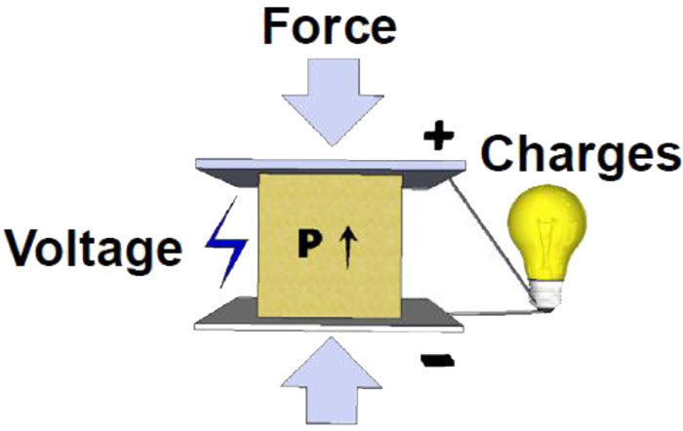
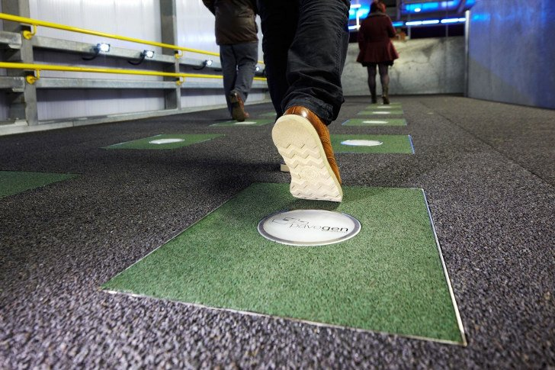
What is WalkOn ?
15*15 Piezoelectric tile.
Uses Vibrations to generate electricity.
Used in flooring.
Textures Available - Ceramic, Onyx etc.
Produces 20 watts of power per step.

Slide 4
Why WalkOn ?
Most Common Form of Movement-Walking
Pollution Free.
Low Maintenance.
Easy Replacement.
Provides Green Energy.
Movement =
Energy

Slide 5
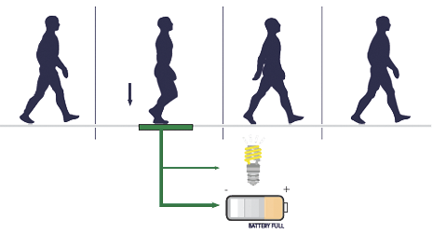
Where WalkOn ?
Power Generating Sidewalks.
Gyms.
Workplaces.
Schools & Colleges.
Parking.
Entrances of Malls, Hospitals, etc.

Slide 6


Marketing Strategy for WalkOn ?
P.S. Food for Sharks

Slide 7
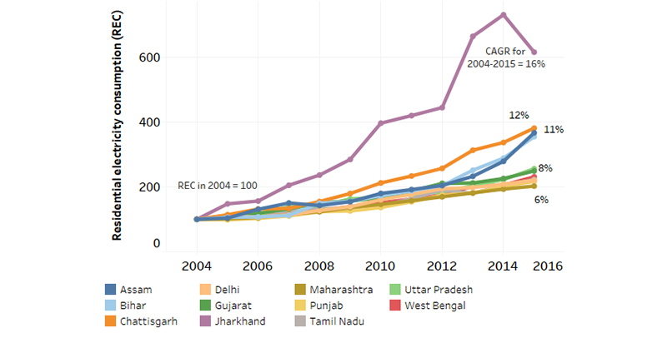
Electricity Consumption in India

Slide 8
Piezoelectric Devices Market

Slide 9
Piezoelectric Devices Demand

Slide 10
Risks
First Time Move.
Requires Huge Funding.
Fast Moving Market.
Time Consuming.

Slide 11
Monetization Strategy
Price Skimming-
First Mover Advantage And High Price
Avg Cost Per Tile Rs.6500
Expected Future Cost- Rs.4200
Profit Margin = 53%
Selling Price= Rs 10000
The Tiles Measure 0.38 M X 0.38 M And Are Made From Approximately 90% Recycled Materials.

Slide 12
Target Market for Piezoelectric Tiles
Household
Public Places
Hospitality Industry
Entertainment Industry
Potential Markets

Slide 13
Advertising Strategy
Part 1- Assessment
Part 2- Action
First Mover Advantage
Part 3 – Influence Strategy
Comical Ads
Brand Endorsements
Sponsorship
Branding
Labelling And Packaging

Slide 14
Electricity consumption in households-
The percentage of households with access to electricity has increased from 55% in 2001 to more than 80% in 2017.
An indian household consumes about 90 units (kWh) of electricity per month on an average.
Our product will complete that requirement in just few days.
Saving tons of energy

Slide 15
Future Plans
We are hoping to partner with Govt Departments like BSES , Indian Railways etc.
5 year Contract for supplying electricity to SEZs.
Revenue from electricity generated from public spaces.

Slide 16
Imagine…
Imagine if you put around 10-15 tiles at the entrances of your home and in hospitals, workplaces and shopping centers at railway stations and pavements. Than how much electricity can be produced by just the simple act of walking. We just need 1000 footsteps to meet the average demand of electricity.
WE ARE JUST A FEW STEPS BEHIND TO THE BRIGHTER FUTURE OF OUR COUNTRY !!!
Made with love by Vansh Bharadwaj

