Slide 1

Slide 1
Profitability of S&P 500 Industrials
(2012-2016)

Slide 2
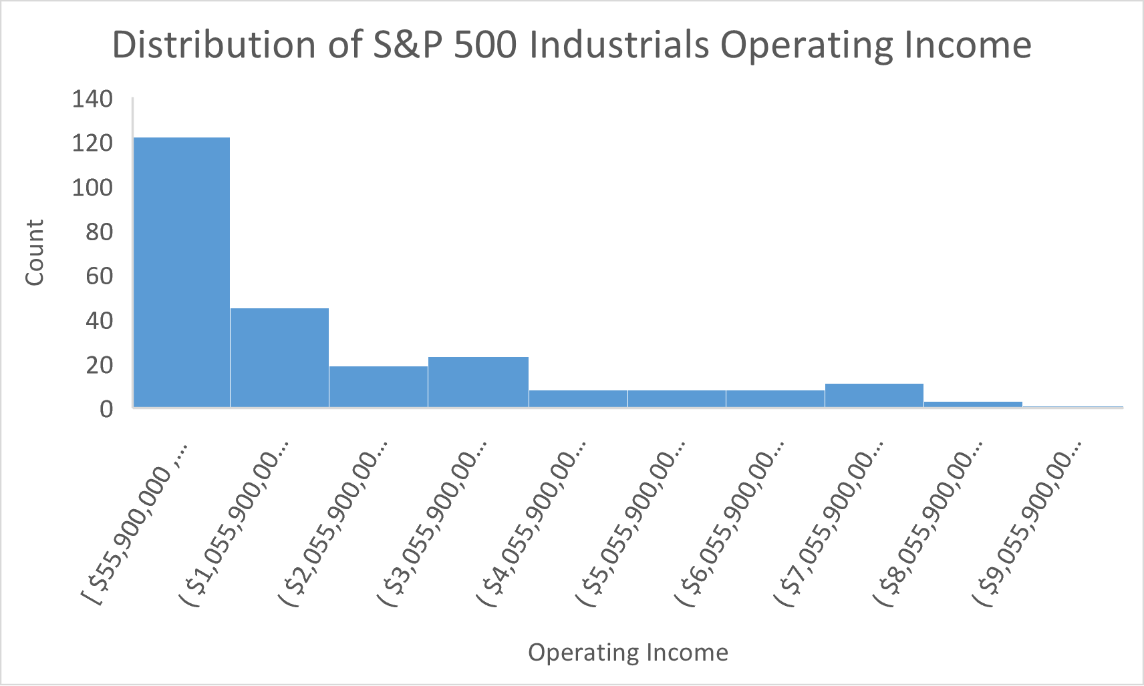
Slide 3
Operating Income Statistics and Distribution
These descriptive statistics cover Operating Income for S&P 500 Industrials in all years in the dataset.
50% of industrial companies had operating income less than $1,094,500,000 (the median) but the mean was $2,089,050,633.
Since the distribution is positively skewed, mean > median > mode.
The standard deviation is greater than the mean which indicates that the data points have a high degree of dispersion.
Data dispersion can also be seen in the very large range of data. The maximum Operating Income is 177 times the minimum value, leading to a range of $9,537,100,000.
This high level of variability in the dataset, combined with the positive skewness, make the mean a poor representation of the data. It is better to use the median as a measure of central tendency in this case.
With a kurtosis of 1.43, this distribution is relatively flat compared to a normal distribution.
Mean | $2,089,050,633
Median | $1,094,500,000
Mode | $1,053,000,000
Standard Deviation | $2,161,646,919
Kurtosis | 1.43
Skewness | 1.55
Range | $9,537,100,000
Minimum | $55,900,000
Maximum | $9,593,000,000
Count | 248
2

Slide 3
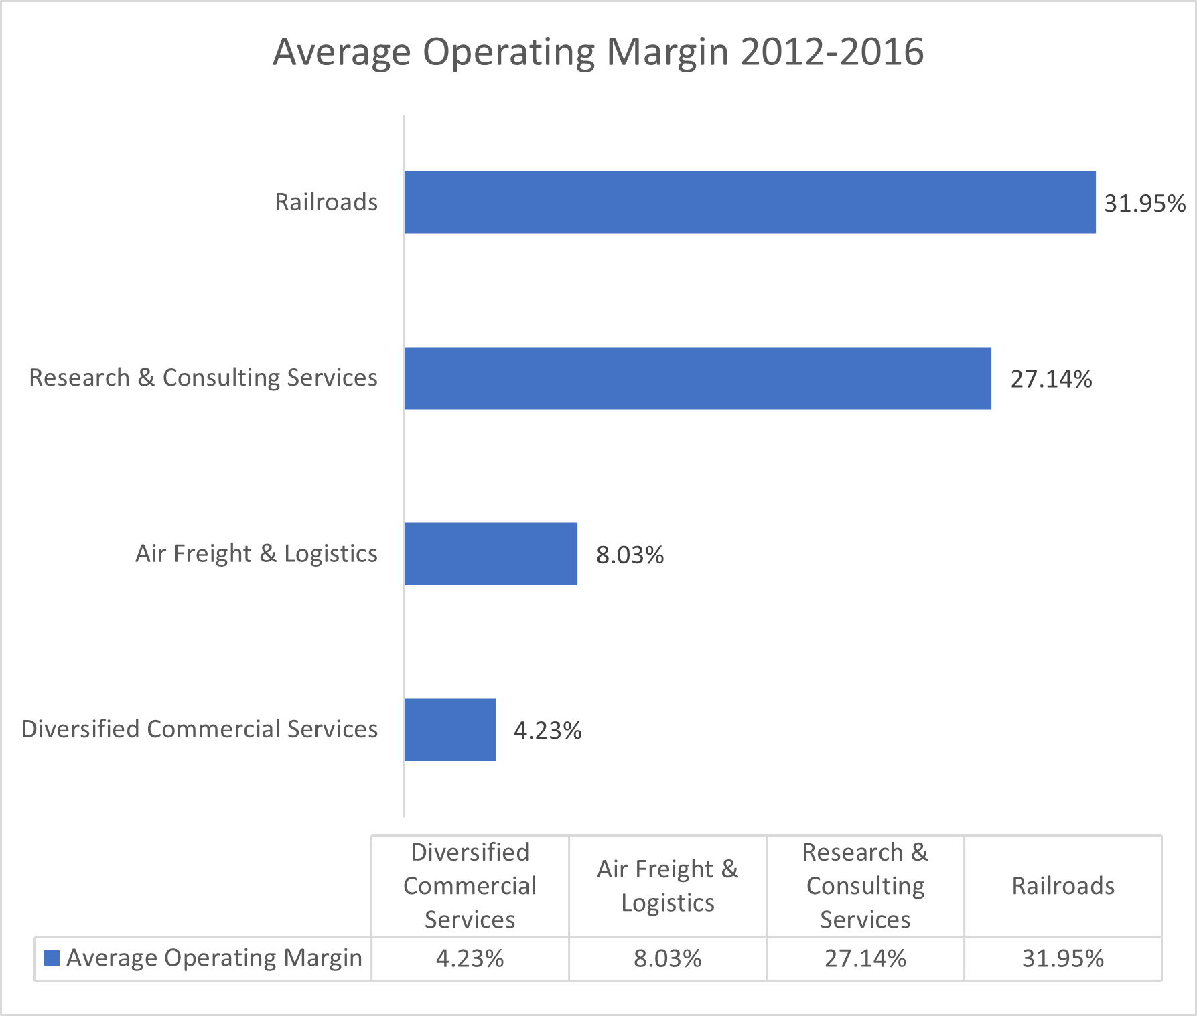
Slide 5
Winners & Losers
Based on Average Operating Margin from 2012-2016, Railroads and Research & Consulting Services were the top two performers; while Air Freight & Logistics and Diversified Commercial Services performed the worst.
3

Slide 4
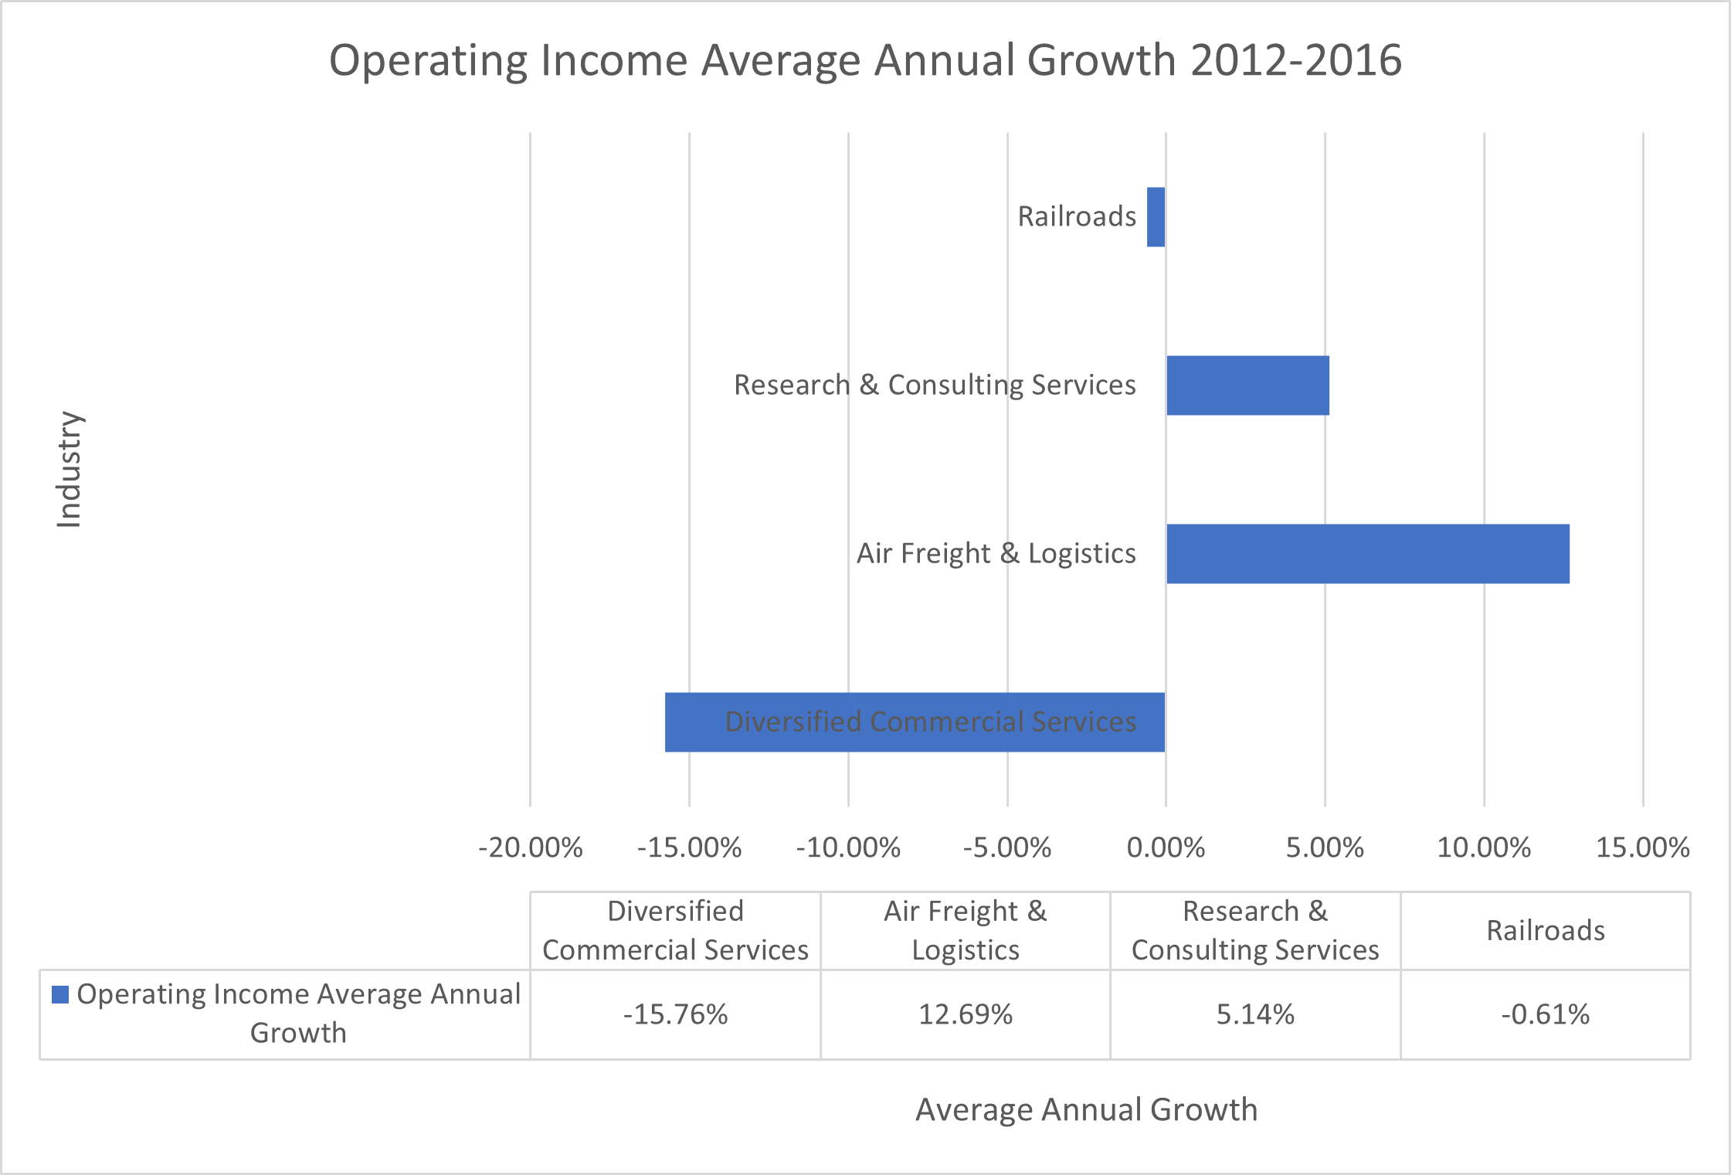
Among the top two, Railroads industry has a very high Operating Margin of 31.98% which is twice the industrial sector average of 15.8%, but the industry seems stagnant with -0.61% annual growth in Operating Income. Research & Consulting Services numbers paint a rosier picture; with a very high 27.14% Operating Margin and 12.69% annual growth rate in Operating Income.
A similar pattern appears among the two underdogs. Diversified Commercial Services is a declining industry with a very low 4.23% Operating Margin and an annual growth of -15.76%. While Air Freight & Logistics is on the rise with 12.69% annual growth which should increase its Operating Margin of 8.03% in later periods.

Slide 5
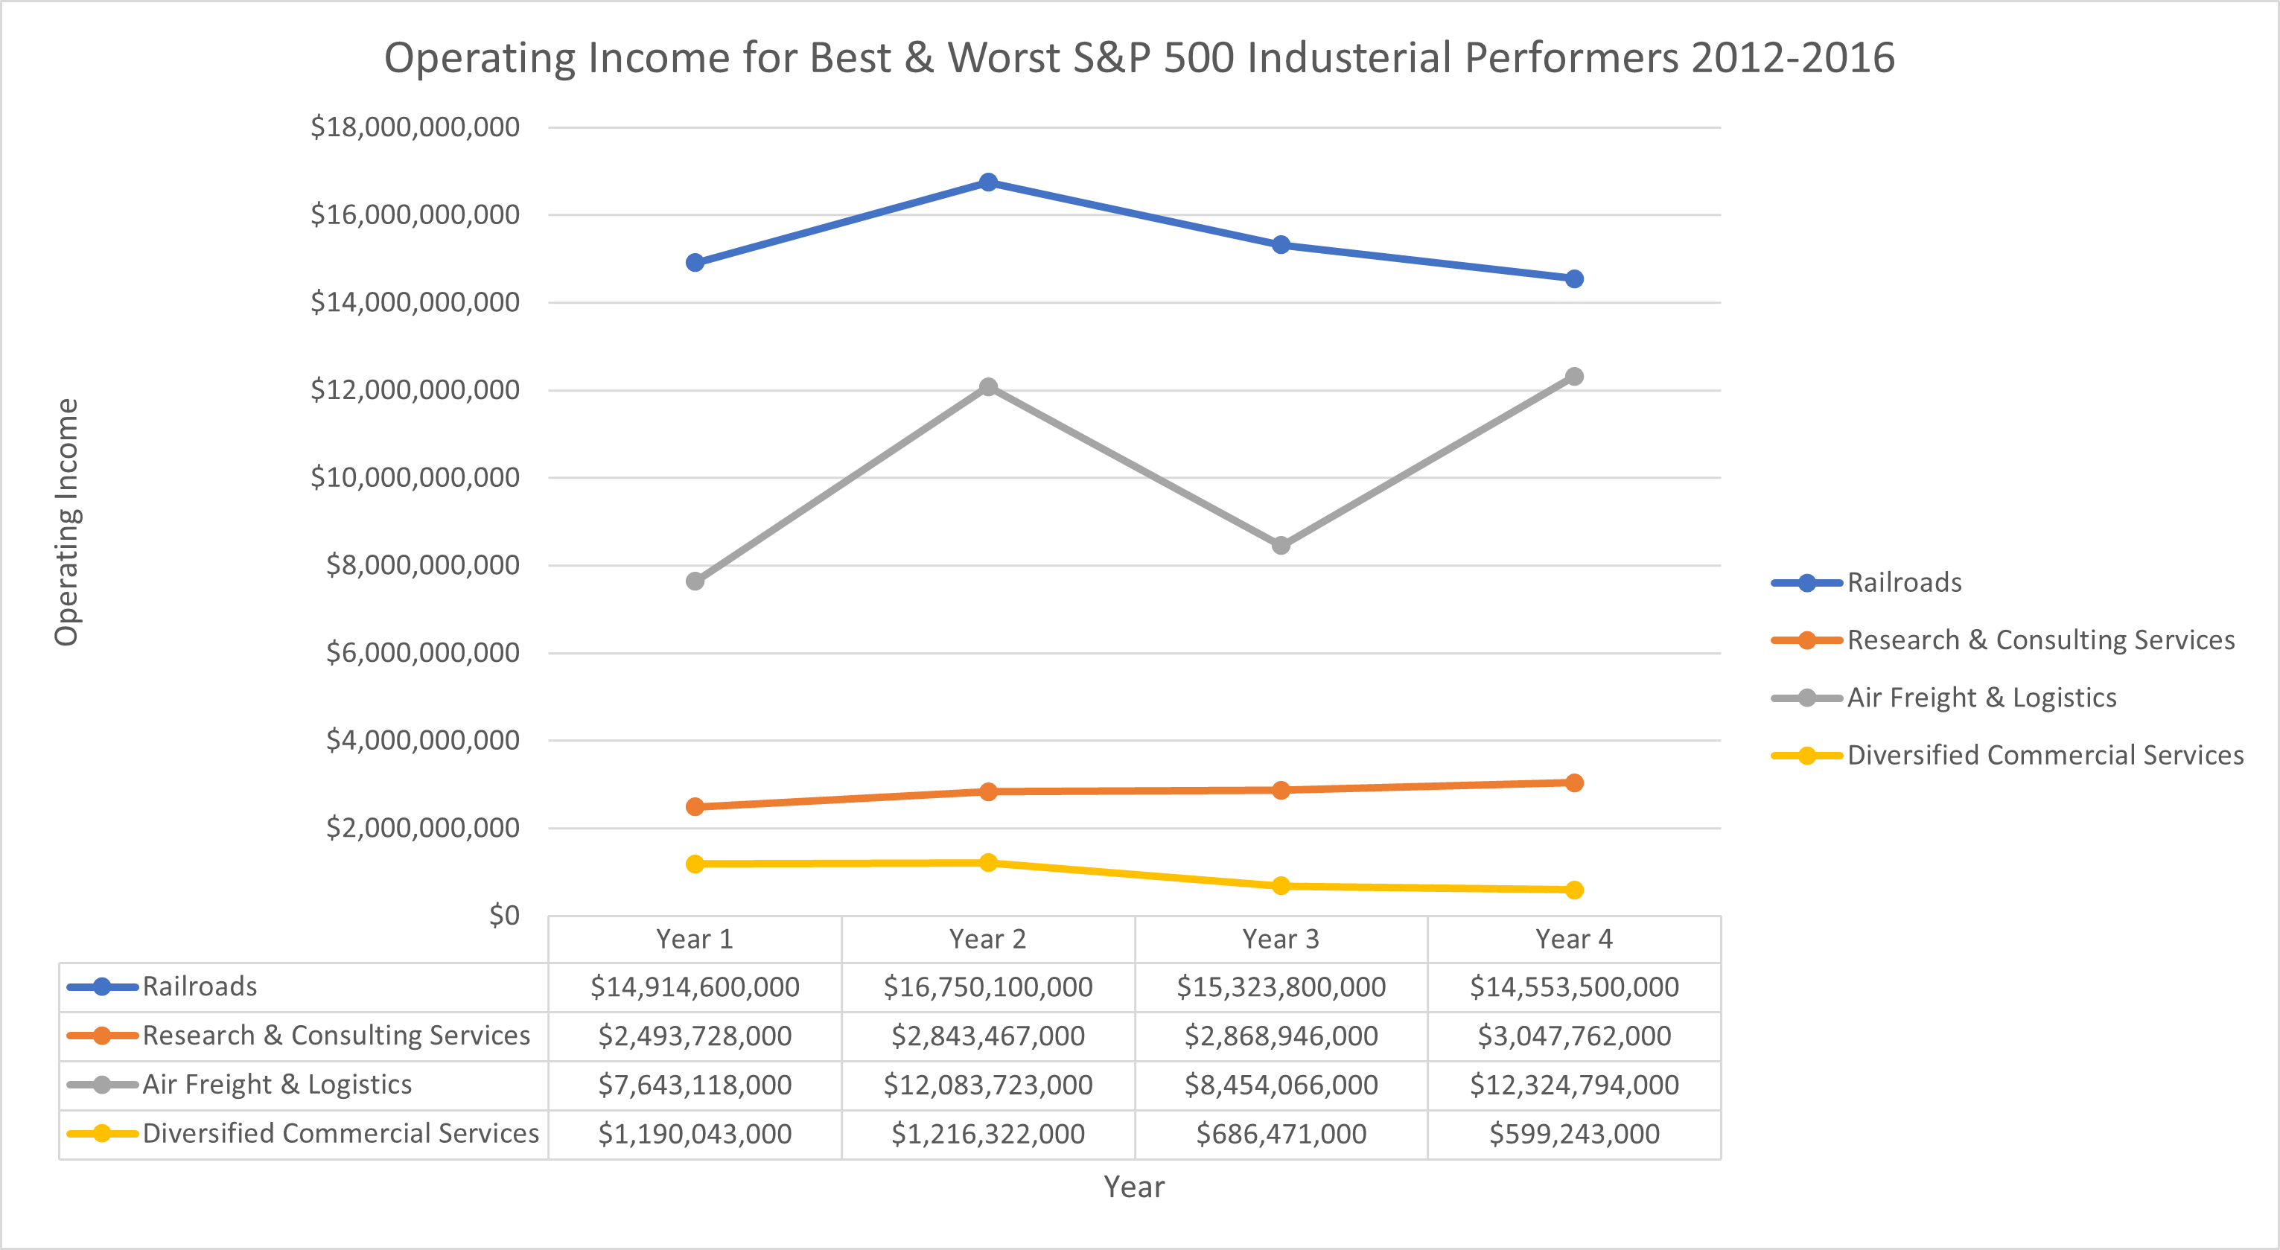
Growth patterns are easier to grasp with this line graph.

Slide 6

Slide 11
THANK YOU

