Slide 1



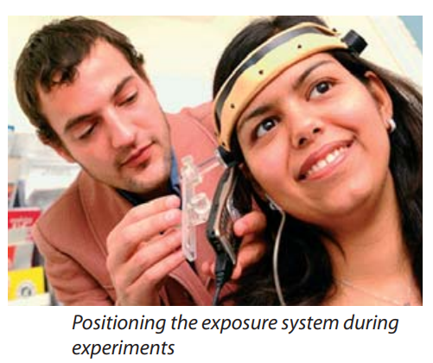
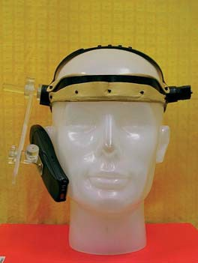
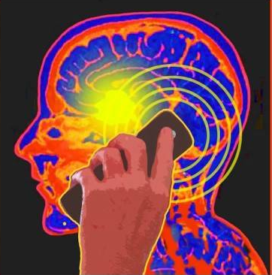
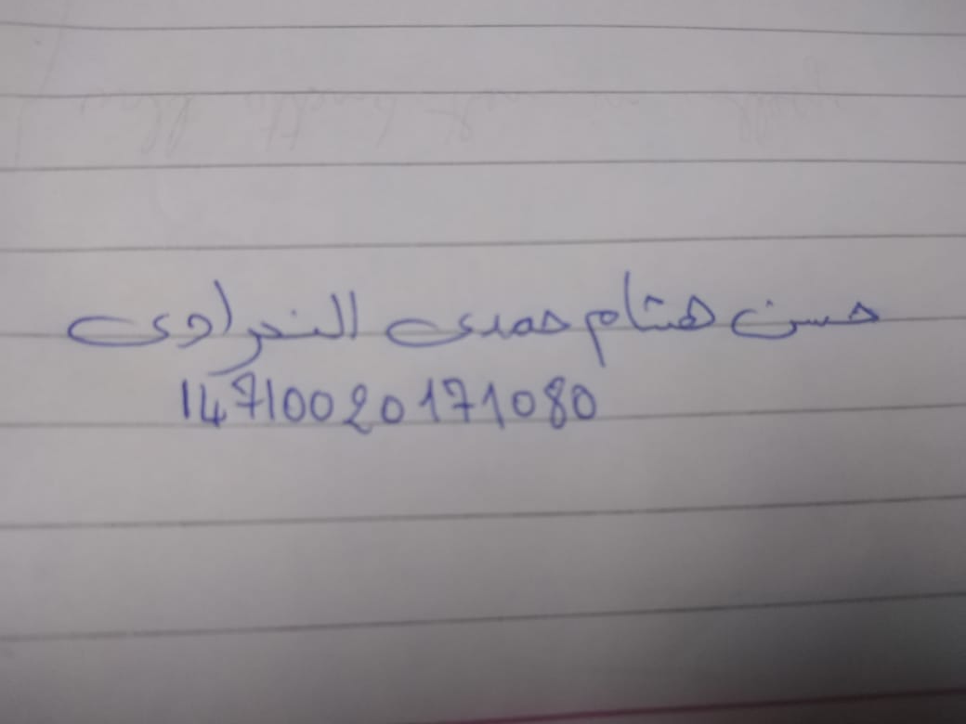
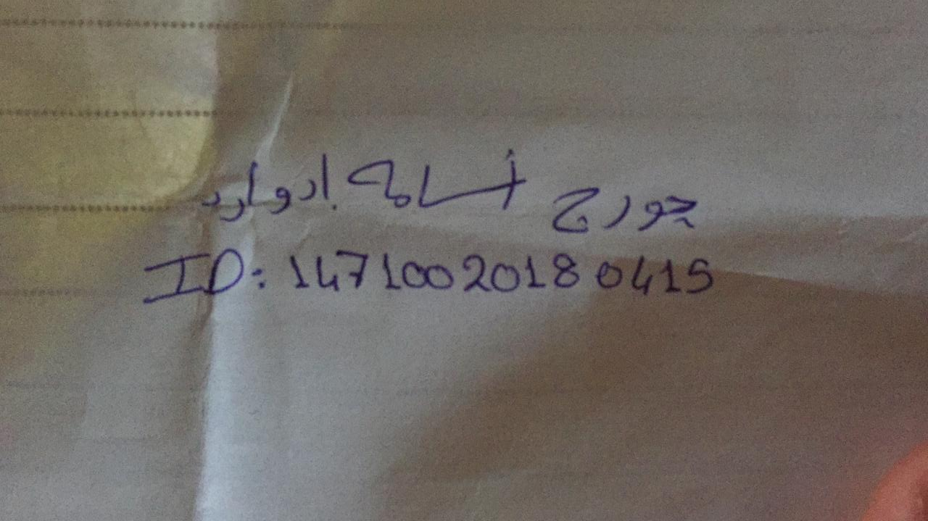
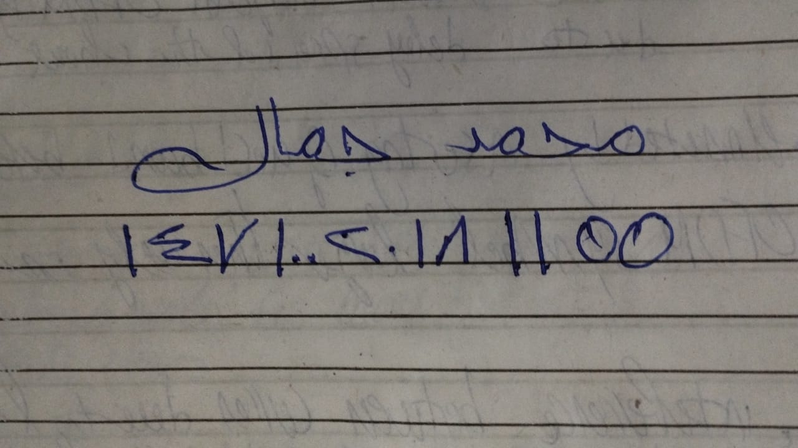
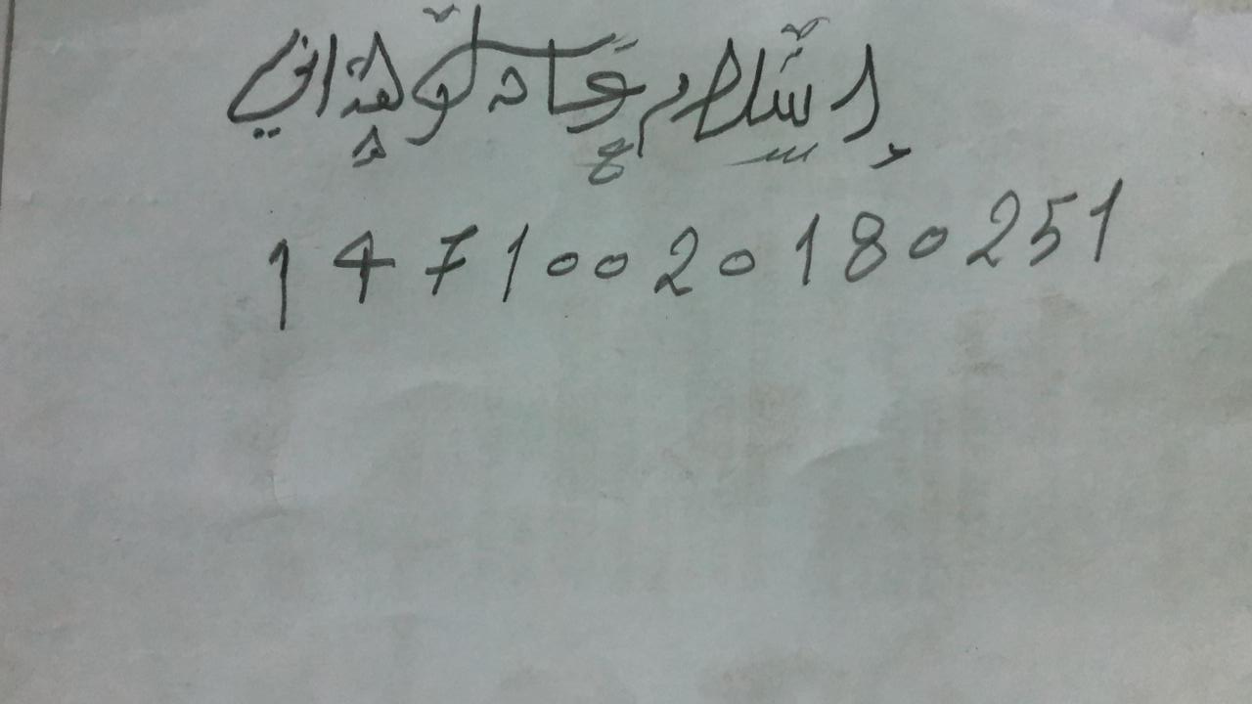
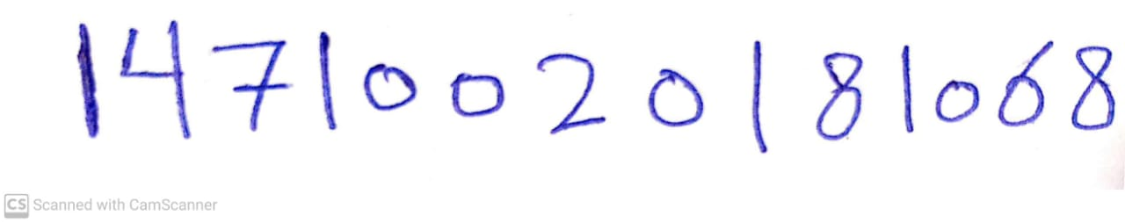
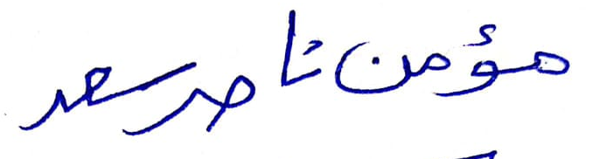
Department of Electronics and Electrical Communications Engineering Faculty of Engineering - Cairo University
Potential adverse effects of GSM cellular phones on hearing (GUARD)
Submitted for Waves Course Project Prof. Mohammed Alaa
Introduction
With the rise of mobile phones, a very important question came to light, does mobile phones affect the human hearing? Taking the proximity of these devices to the human ear into account, this question is really justified. Therefor nine research-performing organizations joined together in the Guard project with the coordination of the Istituto di Ingegneria Biomedica ISIB of the Consiglio Nazionale delle Ricerche in Italy to answer the long-neglected question. The main goal of the Guard project was to detect the changes, if any, in hearing associated with the low intensity use of GSM mobile phones. To answer this question a team of specialists in biology, biomedicine, engineering and physics was assembled. The project was in action between 2002 and 2004. Figure(1) Figure(2)
What experiments were conducted in the Guard project?
As in all medical trials, we start with animals. Experiments started with exposing rats to RF-EMFs at the two frequencies of GSM, 900 Mhz and 1800 Mhz, for two hours daily during 4 weeks using loop antennas. To detect any effects on their hearing, they measured the otoacoustic emissions, which are low intensity sounds generated in the inner ear in response to an auditory stimulus. Measurements were conducted before, during and after the exposure experiment.Another thing the scientists investigates is whether RF-EMFs at GSM frequencies interfere with the reuptake of chemicals that could lead to toxicity in the ear. Particularly they investigated gentamicin antibiotic which is a known drug that have a side effect of irreversible hearing loss if not monitored properly. The subjects of their trials this time were guinea pigs and the measured parameter is the otoacoustic emissions as in the previous experiment in addition to measuring the responses of the auditory brainstem-nerve pathways. Next, experiments on human volunteers were conducted. All participants were healthy young adults with no evidence of any hearing problem whatsoever.The experiments included behavioral hearing tests and otoacoustic emissions test.
What tests could help us in measuring hearing impairments?
Auditory Brainstem Response: It’s conducted by attaching electrodes to the subject’s head, scalp or earlobes and given him headphones to wear then the subject’s brainwave activity is measured and its response to sounds of varying intensities is observed. Otoacoustic emissions: Otoacoustic emissions are the sound that get generated by the vibrations of the hair cells in the cochlea of the inner ear. This test is conducted using a tiny probe equipped with a microphone to measure these sounds and a speaker to stimulate the cochlea. The lack of emissions indicates a hearing loss exceeding 25-30 decibels. It’s worth noting that the human ear is non linear thus the greatest effects can be expected for low-intensity stimulation. Behavioral hearing tests: The subject is subjected to sounds of varying intensities via a calibrated speaker or headphone, including speech or music, specific frequencies Figure(3) that are critical to hear different sounds of speech. The subject response is then recorded or is asked for verbal response in case the subject was of appropriate age.
How to generate sham EMF exposure?
A 50 Ohm load and a dummy load (open circuit load) identical in shape, were used to create both sham and real exposure respectively. The 50 Ohm load allows maximum power transfer due to it being a matched load thus all power gets intercepted on its way to the internal antenna of the phone and gets dissipated in the load whereas the dummy load does nothing allowing power to reach the internal antenna.
Experiments Constrains
All experiments were conducted in a double blinded manner. The exposure was done twice, once real- and another time sham. In both cases both the participant and the tester where blind to which was real and which was sham. The interval between both experiments was at least a 24 hours gap.Due to ethical constrains, EMF exposure to human participants was low in both terms of duration and intensity but comparable with the use of the device in normal daily life. SAR measured at a distance of 30mm and averaged over 1g of mass (representing the cochlea) were 0.41 and 0.19 W/kg, for the 900 MHz and 1800 MHz frequencies, respectively which are lower than the 2W/kg restrictions put by the European council
Results
No hearing effects what so ever were found on either animals or humans. Although the results are not definitive but they are quite assuring. It’s worth noting that this project studied the effects of GSM only, 3rd generation and other following generations were not a part of the study due to it preceding their existence. These results must be taken with a grain of salt due to the limitations on EMF exposure due to ethical reasons.
Comparative Studies
A comparative study investigating the effects of more repeated usage and using comparative hearing tests were conducted. The study was carried on two groups, a low-use group of members using mobile phones for less than 5 minutes daily and a high usage group using mobile phones for a duration exceeding 30 minutes daily.The experiments were conducted on a total of 490 animals and 550 humans.
We certify that this submission is the original work of members of the group and meets the Faculty's Expectations of Originality 27/5/2022
By: Group 3 Moamen Nasser Saad George Osama Edward Hassan Hesham Hamdi Mohammed Gamal Mohammed Islam Adel Wahdany
References:
Cite Parazzini M, Brazzale AR, Paglialonga A, Tognola G, Collet L, Moulin A, Lutman ME, Bell SL, Thomas NA, Uloziene I, Uloza V, Thuroczy G, Tavartkiladze G, Tsalighopoulos M, Kyriafinis G, Ravazzani P. Effects of GSM cellular phones on human hearing: the European project "GUARD". Radiat Res. 2007 Nov;168(5):608-13. doi: 10.1667/RR1020.1. PMID: 17973552.
The Seven Types of Hearing Tests | Tucson | Green Valley, AZ (arizonahearing.com)
Hearing Tests | Pediatric Audiology | Dartmouth Health Children's (chadkids.org)
Figure(1) and Figure(3) EU-funded research into the impact of electromagnetic fields and mobile telephones on health
Figure(2) picture from The American Institute of stress

