Slide 1
CAIRO UNIVERSITY
Faculty of Graduate Studies for Statistical Research
Software Engineering Program — Professional Master's Degree
Predicting CI/CD Pipeline
Build Failures Using
Machine Learning Techniques
Presented by: Moamen Mohamed Aly Hussein
Student ID: 202401681
Supervisor: Dr. Maged Mamdouh
Date: Saturday, June 21, 2026

Slide 2
Agenda
What we will cover in the next 20 minutes
1
The Problem
Why CI/CD failures matter — financially and operationally
2
Literature Gap
What prior research did, and what it left undone
3
Proposed Solution
The Hybrid ML Pipeline architecture
4
Methodology
Data, features, models, and evaluation regime
5
Results
Headline metrics, ablation study, threshold optimization
6
Business Impact
Translating model performance into dollar savings
7
Conclusions & Future Work
What we proved, what remains
Moamen M. Aly · MSc Thesis Defense · June 21, 2026
2 / 22

Slide 3
The Problem
CI/CD failures are expensive — in time and money
11%
$0.008
10–20 min
of all GitHub Actions runs
per minute
developer interruption
end in failure (observed in our dataset)
GitHub Actions compute cost (Linux runner)
context-switch penalty per failure
The Cumulative Cost
For a mid-sized organization running 1,000 pipeline executions per day, that is approximately 110 failed builds daily, consuming compute resources and developer time that cannot be recovered after the fact.
Moamen M. Aly · MSc Thesis Defense · June 21, 2026
3 / 22

Slide 4
Literature Gap
What prior research did — and what it missed
PRIOR WORK
THIS PROJECT
Patel (2019) and related studies
Pre-execution prediction
Uses post-execution telemetry:
Run duration
Resource utilization (CPU, memory)
Step-level intermediate status
Retry count and patterns
Useful for retrospective anomaly detection
Uses only pre-execution features:
Commit-level metadata
Lines added / deleted / files changed
Commit message (NLP via TF-IDF)
Repository, branch, event context
Enables proactive resource conservation
⚠ CRITICAL LIMITATION
By the time the predictor has its input, the resources have already been spent.
✓ THE CONTRIBUTION
Predict at commit time, before the runner starts. Decisions can prevent the cost rather than diagnose it.
Moamen M. Aly · MSc Thesis Defense · June 21, 2026
4 / 22

Slide 5
Research Objectives
Four specific, measurable goals
01
02
Build a Hybrid ML Pipeline
Compare Three Classifiers
Combine numerical, categorical, binary, and textual commit features into a single end-to-end classifier using scikit-learn's ColumnTransformer.
Evaluate Logistic Regression (baseline), Random Forest (ensemble), and XGBoost (gradient boosting) under identical conditions.
03
04
Validate Under Realistic Conditions
Quantify Business Impact
Test the model on both stratified random and chronological splits to verify robustness to temporal data drift.
Translate precision and recall metrics into estimated annual cost savings under a documented operational scenario.
Moamen M. Aly · MSc Thesis Defense · June 21, 2026
5 / 22

Slide 6
The Dataset
Real GitHub Actions data — not synthetic
Sampled Repositories
DATASET PROFILE
facebook/react
microsoft/vscode
tensorflow/tensorflow
pytorch/pytorch
rust-lang/rust
python/cpython
elastic/elasticsearch
prisma/prisma
...and 10 more
9,772
Real workflow runs collected
18
Popular open-source repositories
89% / 11%
Success / Failure class balance
6
Why real data, not synthetic?
Programming languages covered
7,817 / 1,955
Initial experiments on a 45K-row synthetic Kaggle dataset revealed that columns were statistically independent — essentially random noise. Pivoting to real GitHub Actions data was the most important methodological decision in the project.
Train / Test split (stratified)
~2 hours
Collection time (rate-limited)
Moamen M. Aly · MSc Thesis Defense · June 21, 2026
6 / 22

Slide 7
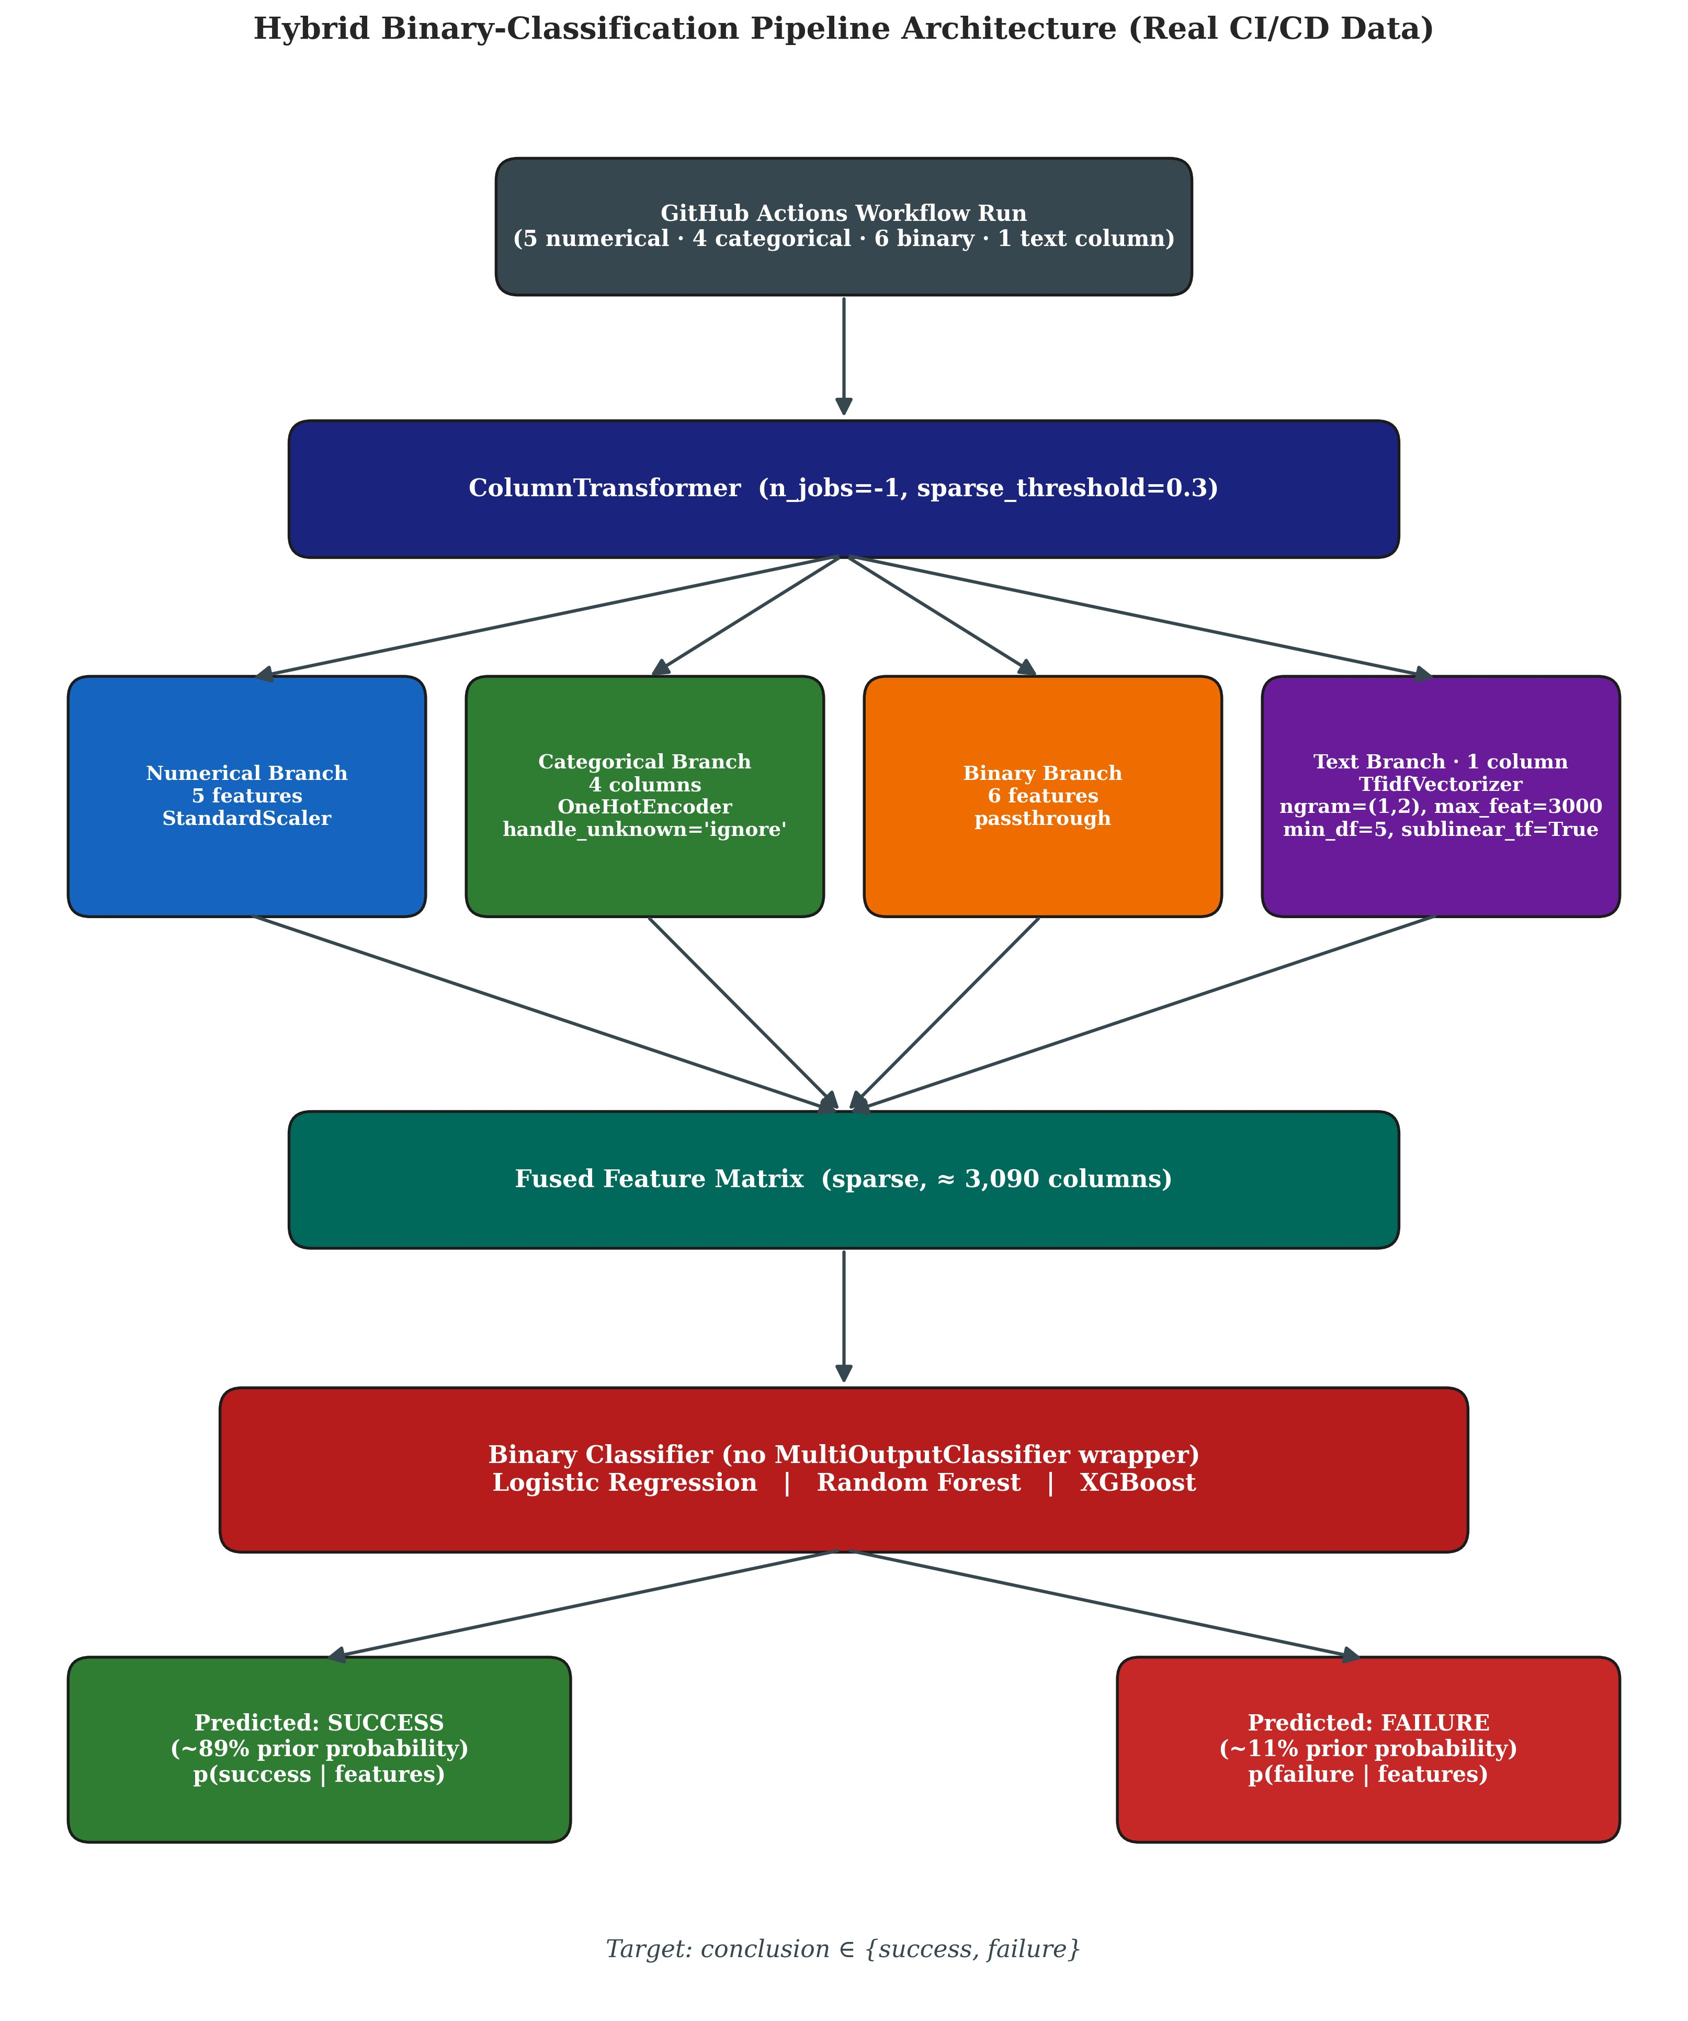
Hybrid Pipeline Architecture
Four parallel branches fused via ColumnTransformer
Key Design Choices
Parallel branches
Numerical (scaled), categorical (one-hot), binary (passthrough), text (TF-IDF) — processed independently then fused.
Sparse matrix
~3,090 columns total. Sparse-aware classifiers (LR, XGB) consume directly without densification.
Single classifier head
Binary output (no MultiOutputClassifier wrapper) — operational decision: success or failure.
Modular
Any branch can be swapped (e.g., TF-IDF → BERT) without touching the rest.
Moamen M. Aly · MSc Thesis Defense · June 21, 2026
7 / 22

Slide 8
Feature Engineering
16 features across 4 modalities
NUMERICAL
CATEGORICAL
BINARY
TEXTUAL
5 features
4 features
6 features
1 feature
lines_added
lines_deleted
files_changed
commit_age_days
message_length
repository
workflow_name
branch
event
is_weekend
is_night_commit
is_pr_merge
is_main_branch
is_force_push
is_dependabot
cleaned commit message
Treatment:
Treatment:
Treatment:
Treatment:
StandardScaler
OneHotEncoder (with rare-category bucketing)
Passthrough (already 0/1)
TF-IDF (ngram 1-2, max_features=3000, sublinear_tf)
Identity-leakage defense: 693-token stoplist (author logins + repo names + bot signatures) prevents TF-IDF from learning identifiers.
8 / 22

Slide 9
Evaluation Regime
Dual-split protocol for honest robustness reporting
STRATIFIED SPLIT
CHRONOLOGICAL SPLIT
Primary: intrinsic discriminative ability
Secondary: deployment realism
80/20 random split
Class ratio preserved in both partitions
Isolates classification ability from temporal confounds
Answers: "How well does this model classify?"
Sorted by commit timestamp
Train on past, test on most recent 20%
Simulates production: future commits unseen
Answers: "How well does it work in deployment?"
Metrics: Failure F1 (primary) · Balanced Accuracy · ROC-AUC · PR-AUC · Precision · Recall · Confusion Matrix
9 / 22

Slide 10
Baseline Results — Default Threshold
Three classifiers, stratified test set, threshold = 0.5
Model
Accuracy
Bal. Acc.
Precision
Recall
F1
ROC-AUC
Logistic Regression
80.2%
78.8%
32.8%
77.1%
0.460
0.875
Random Forest
83.2%
77.2%
36.1%
69.6%
0.475
0.861
XGBoost
90.7%
59.8%
81.1%
20.1%
0.322
0.884
📊 Key Observation
XGBoost achieves the highest ROC-AUC (0.884) — meaning it ranks failures correctly — but the worst F1 (0.322).
Translation: the model has good information but a miscalibrated decision rule. Only 20% of true failures are flagged because the 0.5 threshold is implicitly designed for a balanced class prior.
This insight motivates the threshold optimization experiment ahead →
Moamen M. Aly · MSc Thesis Defense · June 21, 2026
10 / 22

Slide 11
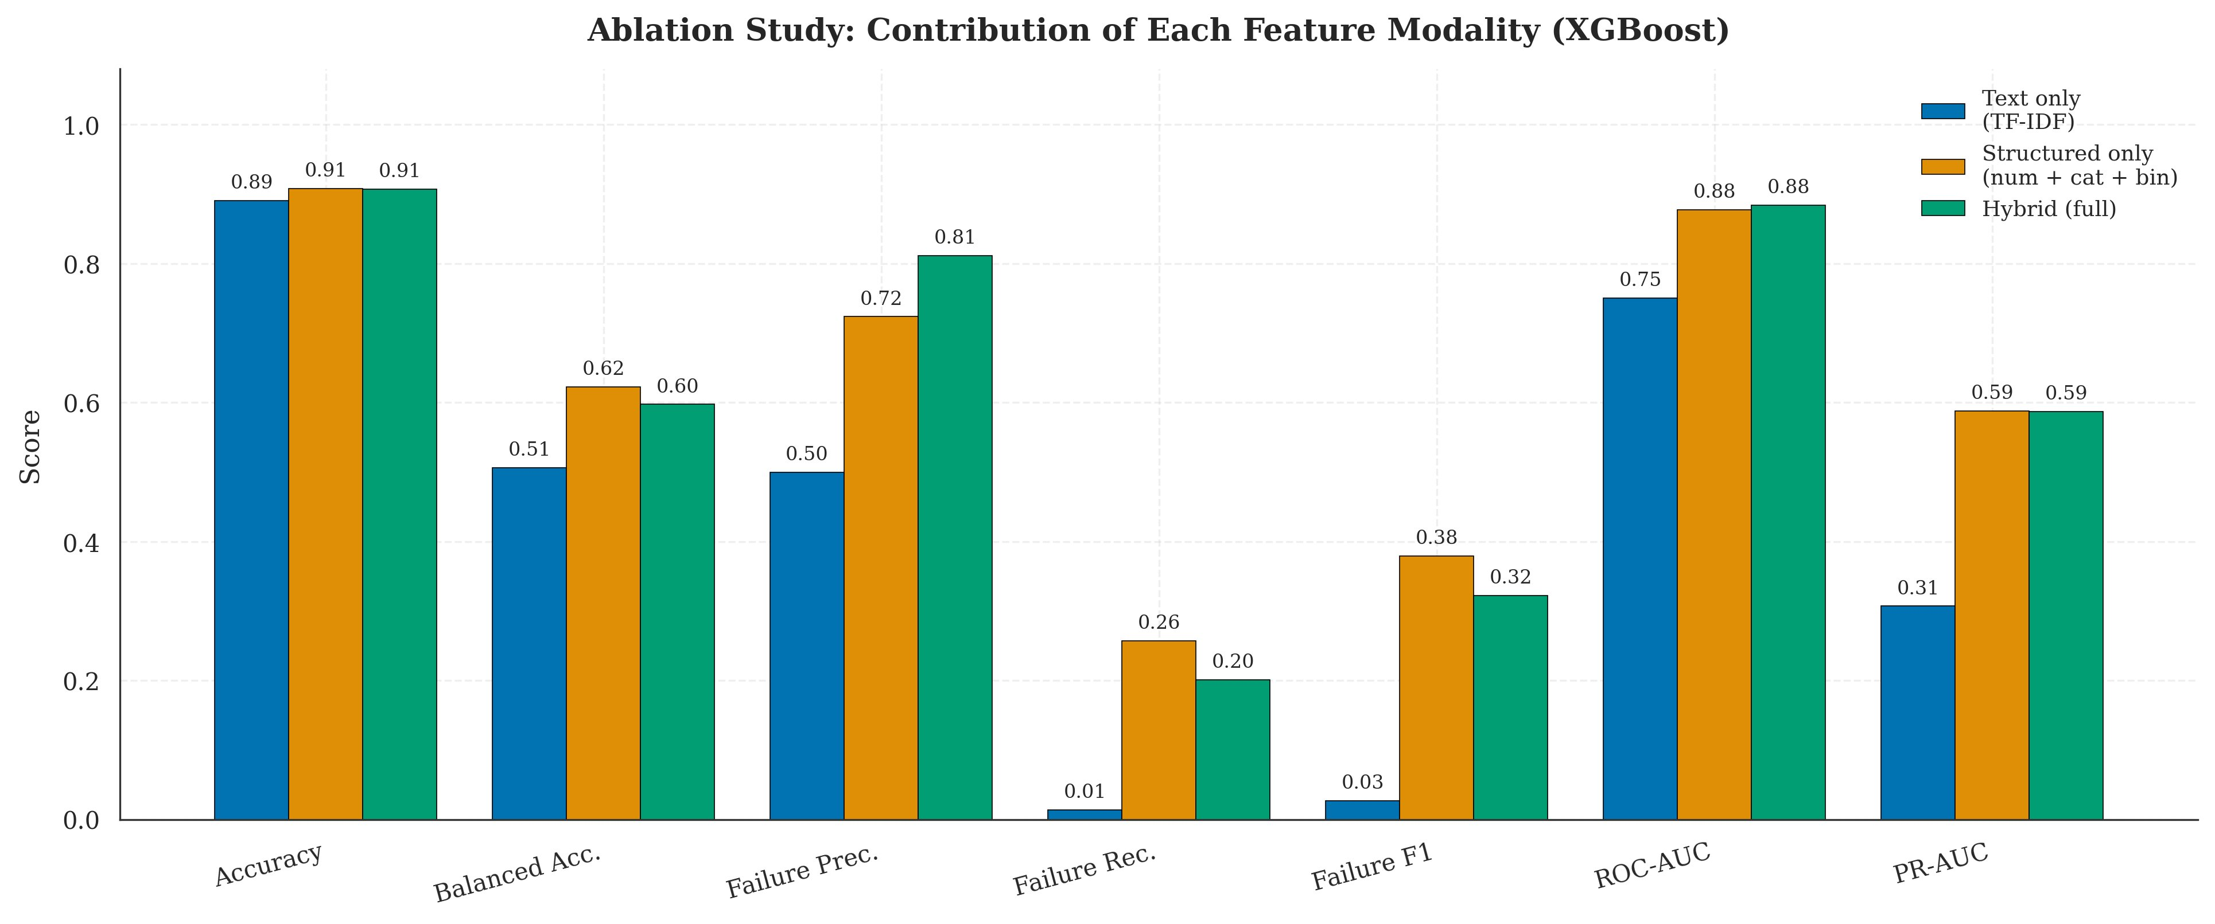
Ablation Study
Does the hybrid claim hold? Test each modality in isolation
Three Configurations
Text-only (TF-IDF)
F1 = 0.027 — catastrophic on its own
Structured-only
F1 = 0.380 — surprisingly strong alone
Hybrid (full)
F1 = 0.322 — worse than structured-only!
⚠ Honest Finding
At default threshold, the hybrid claim is refuted on real data with TF-IDF features. Reporting this openly is itself an academic contribution.
But: On threshold-independent metrics (ROC-AUC: 0.884 hybrid vs 0.877 structured), hybrid retains a marginal edge — text contributes to ranking ability even when harming the default decision rule.
Moamen M. Aly · MSc Thesis Defense · June 21, 2026
11 / 22

Slide 12
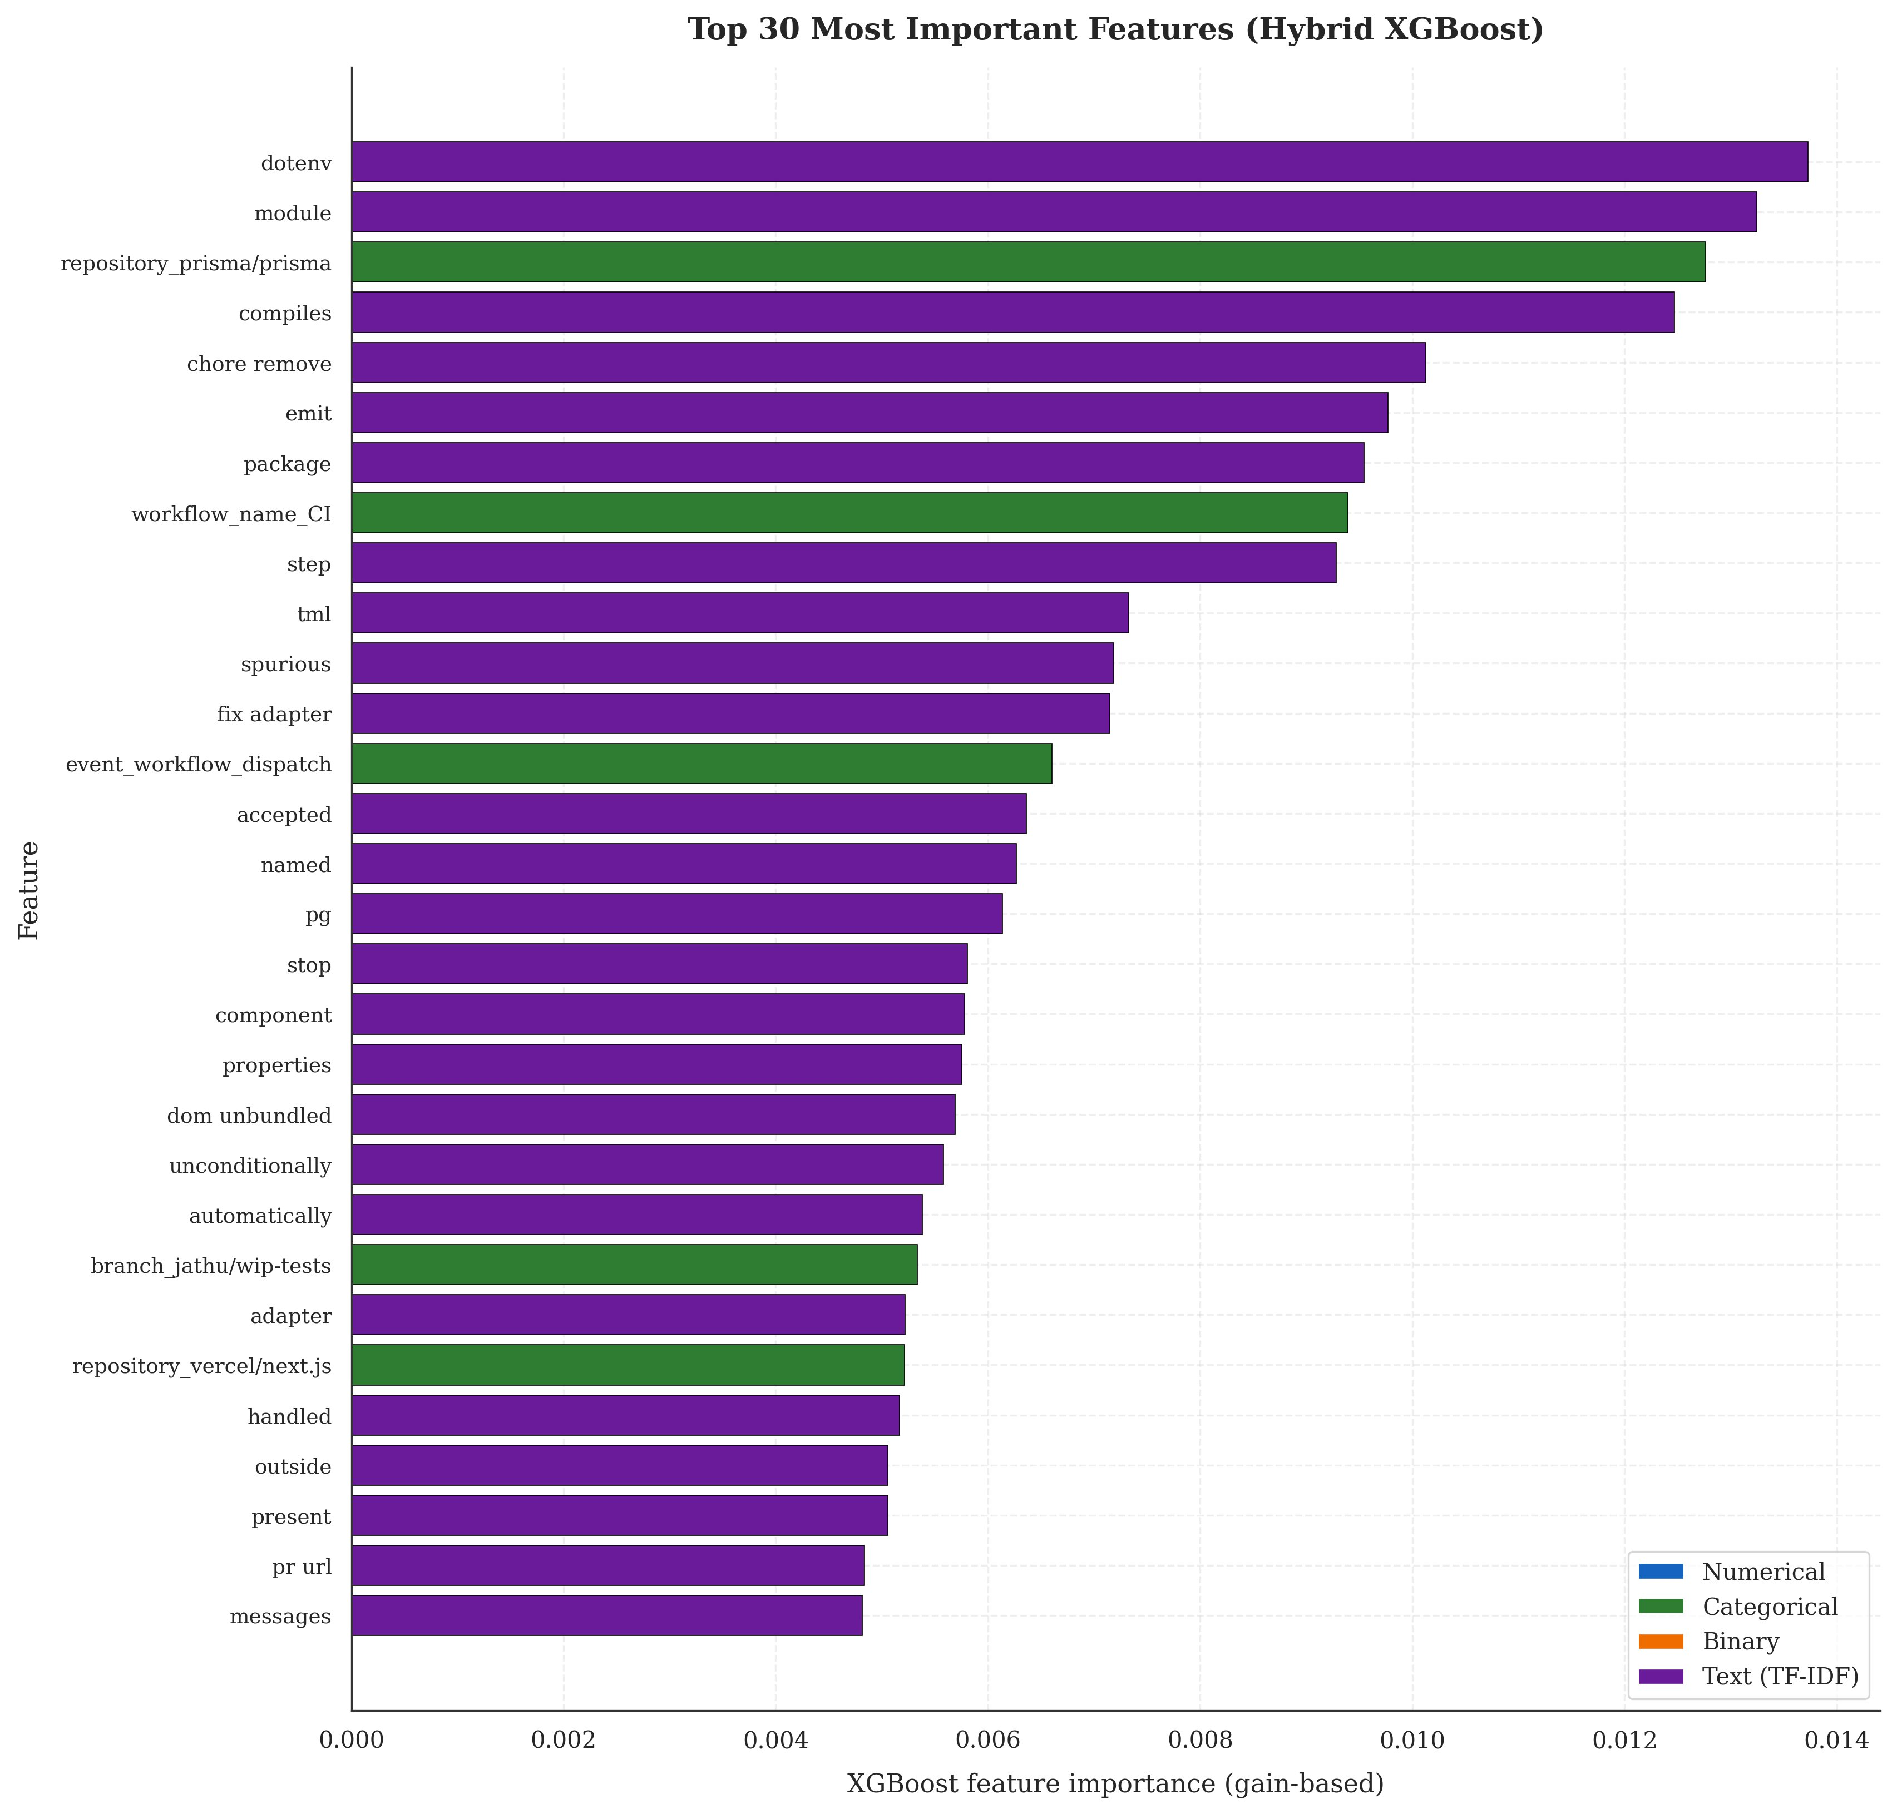
Feature Importance
What does the model actually use?
Top Features
TF-IDF tokens (purple) dominate
Top-3: dotenv, module, compiles — terms describing what the commit touches.
Repository signal is strong
repository_prisma/prisma at rank 3 — failures are repository-specific.
💡 Surprising Finding
Failure-discriminative vocabulary is not "fix", "bug", "revert" — but timezone, utc, thresholds, borrow.
Developers don't know at commit time that their build will fail. The signal comes from what part of the code is touched.
Moamen M. Aly · MSc Thesis Defense · June 21, 2026
12 / 22

Slide 13
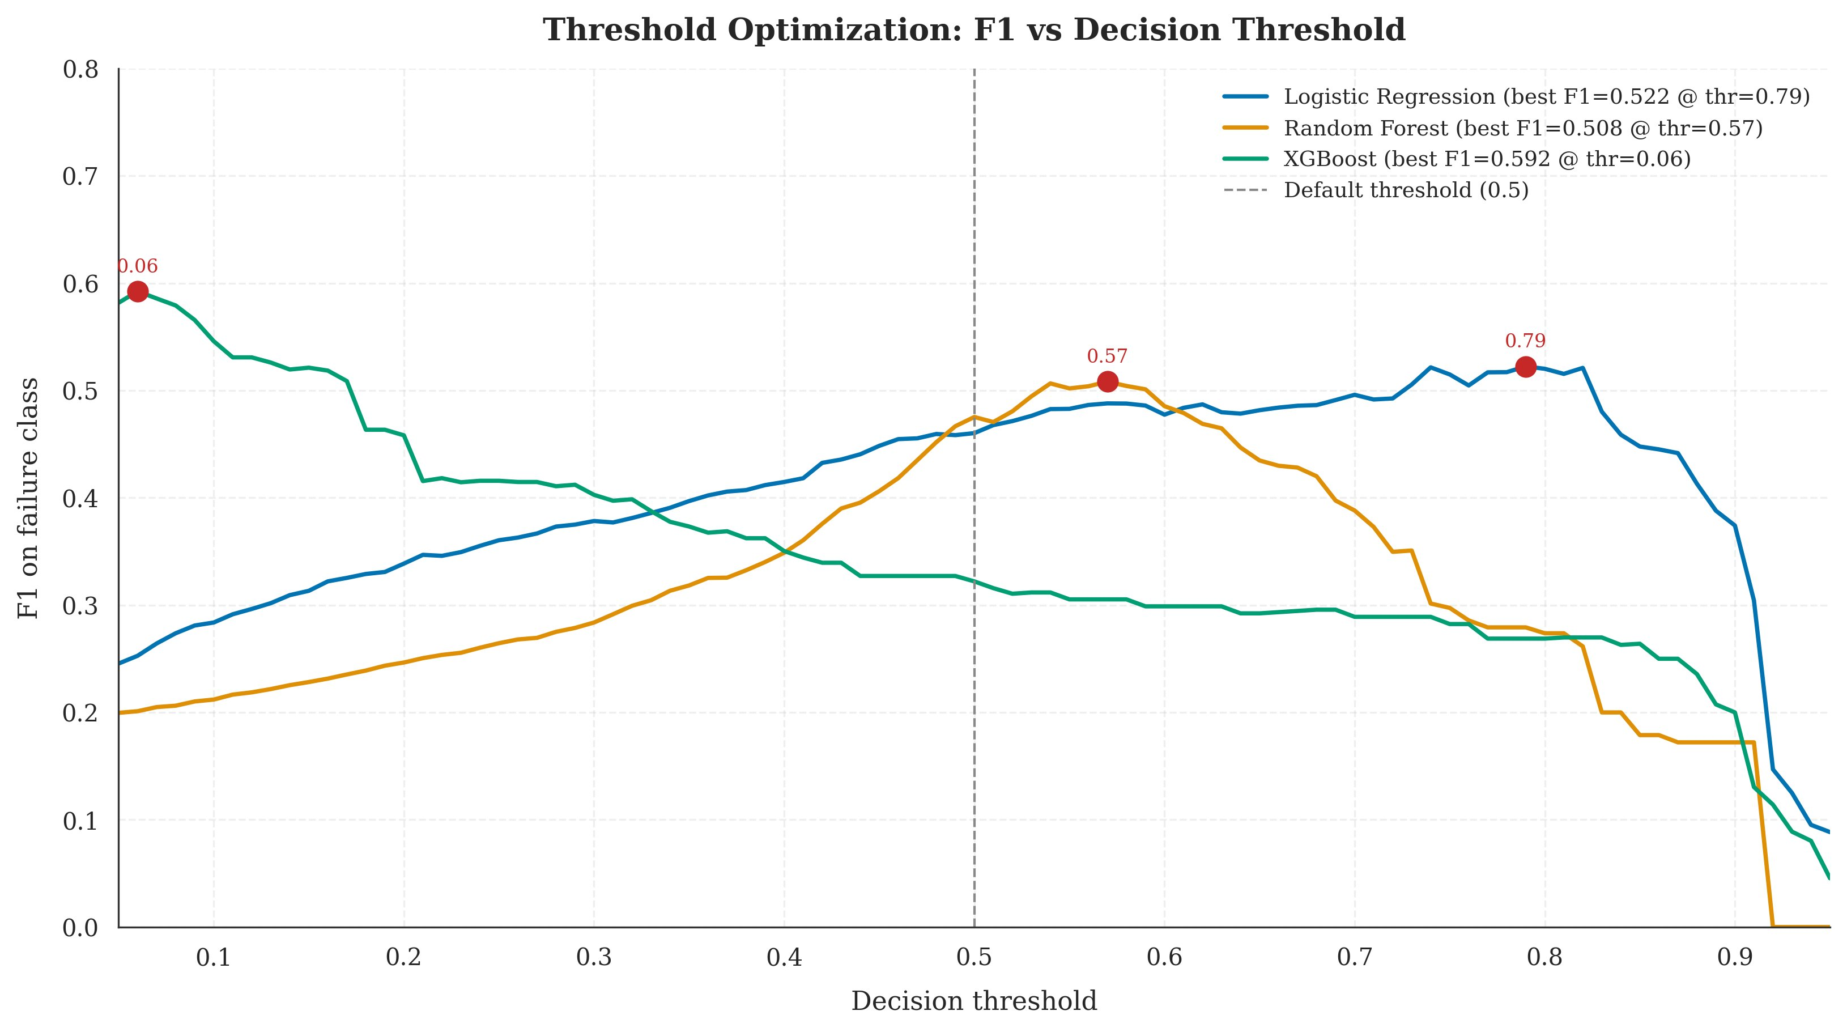
Threshold Optimization
The single biggest performance lever in the project
Why this matters
XGBoost optimum at threshold = 0.06
An order of magnitude below the default 0.5.
Logistic Regression optimum at 0.79
Above the default — opposite-direction miscalibration.
Random Forest optimum at 0.57
Marginally above default.
+27
percentage points
improvement in failure F1
XGBoost F1 lifts from 0.322 → 0.592 · Recall 0.20 → 0.62 · No retraining required.
Moamen M. Aly · MSc Thesis Defense · June 21, 2026
13 / 22

Slide 14
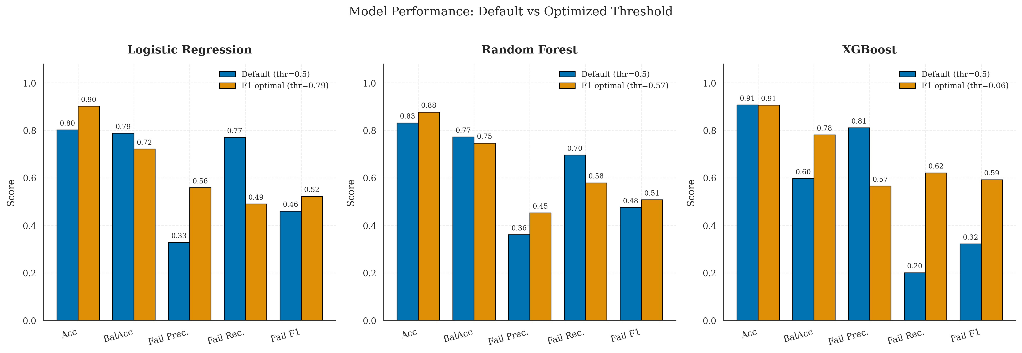
Before vs. After Threshold Optimization
Per-model transformation
✓ Methodological lesson
For imbalanced binary classification, probability calibration is a first-class hyperparameter — not a deployment-time afterthought. This single line of code outperformed feature engineering, class weighting, and hyperparameter tuning combined.
Moamen M. Aly · MSc Thesis Defense · June 21, 2026
14 / 22

Slide 15
FINAL RESULTS
XGBoost · threshold = 0.06 · stratified test set
0.592
78.2%
0.884
0.587
Failure F1
Balanced Accuracy
ROC-AUC
PR-AUC
primary metric
imbalance-aware
ranking ability
precision-recall AUC
Robustness Check (Chronological Split)
Failure F1 on chronological test: 0.6207 (+3pp vs stratified)
The model is robust to the observed temporal data drift between training and test periods. Performance does not collapse when deployed on future commits.

Slide 16
Business Impact
From model metrics to dollar value
Operational Scenario
ESTIMATED ANNUAL SAVINGS
Mid-sized engineering organization
$383,000
1,000 pipeline executions per day
11% observed failure rate (~110/day)
$0.008/min compute cost (GitHub published)
$75/hr fully-loaded developer rate
per year
10–20 min context-switch penalty per failure
Sensitivity range: $250k – $500k
$2.50 false alarm triage cost
depending on org size and operational assumptions. Adjusting any single parameter by 50% shifts the headline by ~$100k.
$18.75 missed failure cost
Methodology > number. Any org can plug in its own params.
Moamen M. Aly · MSc Thesis Defense · June 21, 2026
16 / 22

Slide 17
Objectives — Achieved?
Validation against the four stated goals
01
Build a Hybrid ML Pipeline ✓ ACHIEVED
Four-branch ColumnTransformer implemented, ~3,090-column sparse matrix, <10ms inference latency on commodity hardware.
02
Compare Three Classifiers ✓ ACHIEVED
LR / RF / XGBoost trained on identical features, evaluated under identical metric suite, winner selected by objective criterion.
03
Validate Under Realistic Conditions ✓ ACHIEVED
F1 = 0.592 stratified vs 0.621 chronological — within ±3pp range. Model is robust to observed temporal drift.
04
Quantify Business Impact ✓ ACHIEVED
$383k annual savings estimate with documented assumptions and sensitivity range. Methodology transferable to any org.
Moamen M. Aly · MSc Thesis Defense · June 21, 2026
17 / 22

Slide 18
Key Contributions
What this thesis adds to the field
📐
Pre-execution prediction protocol
🧪
Ablation study with honest negative finding
Strict feature-set discipline that distinguishes this work from post-execution telemetry approaches (Patel 2019).
Empirically refuted the unconditional hybrid claim using real GitHub data + TF-IDF — a result previously undocumented.
🎯
Threshold optimization as a first-class concern
🛡️
Identity-leakage defense for TF-IDF
Demonstrated +27pp F1 from a single hyperparameter — generalizes beyond CI/CD to any imbalanced binary task.
693-token stoplist algorithm that prevents the vectorizer from learning author/repo identifiers.
🔁
Full reproducibility
💰
Business-impact translation
Fixed seed, pinned dependencies, all artefacts committed. Independent readers can reproduce every result.
Documented methodology for converting precision/recall into dollar savings under explicit assumptions.
Moamen M. Aly · MSc Thesis Defense · June 21, 2026
18 / 22

Slide 19
Honest Limitations
What this work doesn't claim — and why that's important
Dataset scale
Open-source bias
9,772 runs from 18 repos. Larger samples would tighten confidence intervals and surface language-specific effects.
Corporate CI/CD environments differ in commit cadence, branch policy, and tooling. Transfer is unverified.
TF-IDF text representation
Residual identity leakage
Lexical-overlap encoding misses semantic similarity. A transformer-based encoder may restore the hybrid advantage.
Stoplist removes known identifiers but cannot guarantee zero project-vocabulary signal in text features.
No production validation
Threshold tested on test set
Offline metrics ≠ deployed performance. A live deployment study would measure user behavior under predictions.
Methodologically cleaner: hold out a separate validation set for threshold selection. Future work.
Moamen M. Aly · MSc Thesis Defense · June 21, 2026
19 / 22

Slide 20
Future Work
Eight directions for extension
1
Transformer-based text encoder
2
Scale to 1M+ workflow runs
CodeBERT / Sentence-BERT — may restore hybrid advantage
Hundreds of repos, broader generalization
3
Corporate dataset validation
4
Online learning capability
Test transfer to proprietary CI/CD environments
Continuous adaptation to evolving codebases
5
SHAP-based per-prediction explanations
6
Hyperparameter grid/Bayesian search
Individual-commit interpretability
Tighter optimization than current defaults
7
Live operationalized deployment
8
Multi-class failure stage prediction
Measure real user behavior under predictions
Build vs. test vs. deploy failure differentiation
Moamen M. Aly · MSc Thesis Defense · June 21, 2026
20 / 22

Slide 21
In Summary
01
Built a hybrid ML pipeline for pre-execution CI/CD failure prediction using only commit-time features available from the GitHub Actions API.
02
Achieved F1 = 0.59 (stratified) and F1 = 0.62 (chronological) on real data — competitive with prior post-execution approaches under stricter constraints.
03
Demonstrated through ablation that the unconditional hybrid claim does not hold with TF-IDF text features — a previously undocumented empirical finding.
04
Showed that threshold optimization alone yields +27pp F1 — a methodological lesson that generalizes beyond CI/CD.
05
Estimated annual savings of ~$383,000 for a mid-sized organization, with documented methodology for org-specific recalculation.

Slide 22
Thank You
Questions & Discussion
Moamen Mohamed Aly Hussein
MSc Software Engineering · Cairo University
Defense: Saturday, June 21, 2026
📎 Backup material available: thesis document, source code, Q&A reference card

