Slide 1

NLPR Project Report
Name: Ashok Kumar Moanish
Matriculation Number: 2300821B

Slide 2

Solution Description
The AI Psychologist Chatbot I have made, provides emotional support using Natural Language Processing (NLP) to recognise and respond to negative emotions. It engages users in empathetic conversations, offering comfort, encouragement, and mental well-being guidance. The chatbot uses rule-based responses and AI-generated interactions, creating a safe space for users to express their feelings. While not being a replacement for professional therapy, it serves as an accessible support system for those in need.

Slide 3
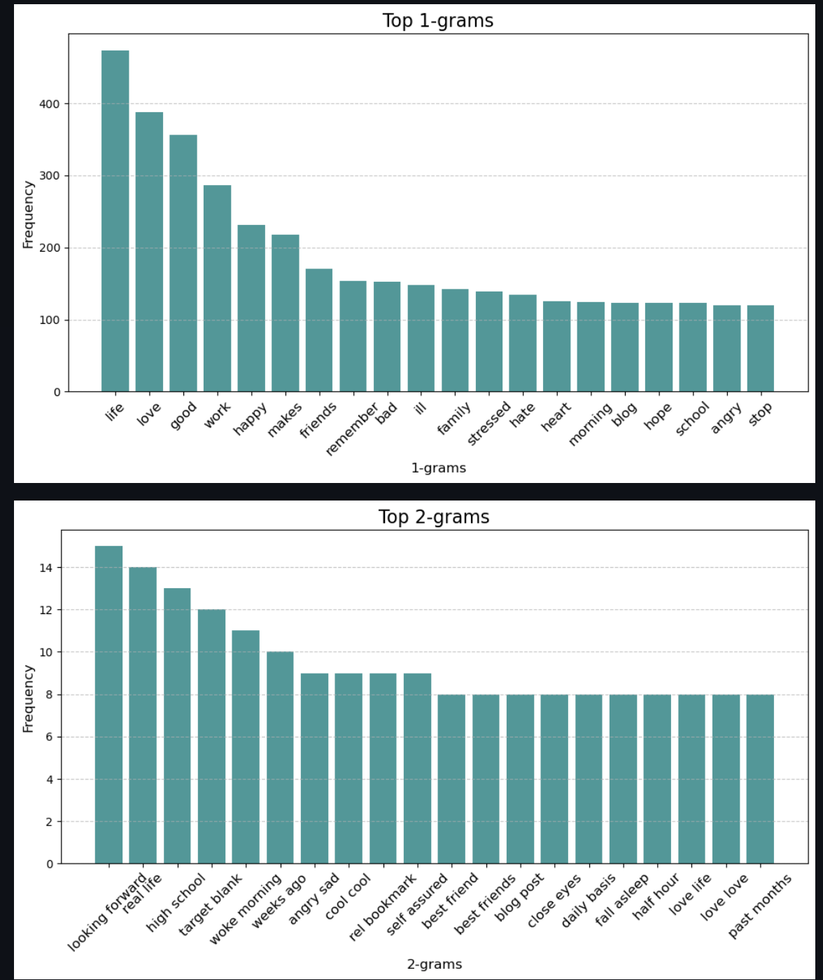
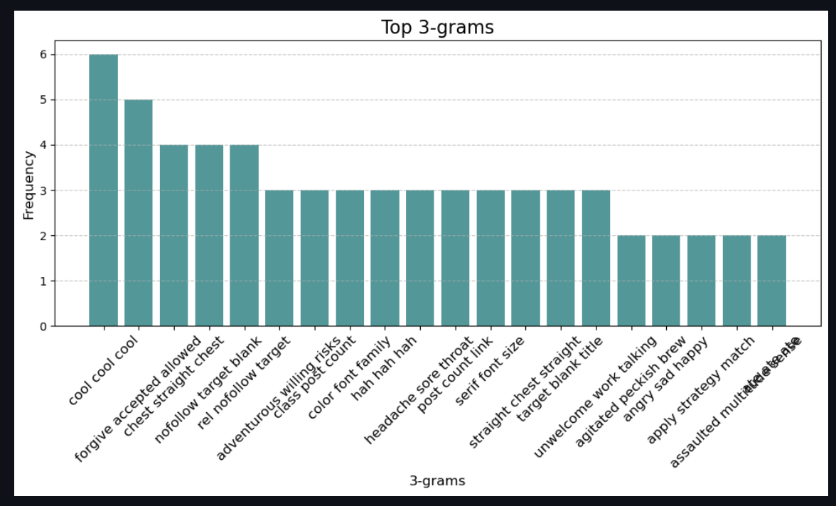
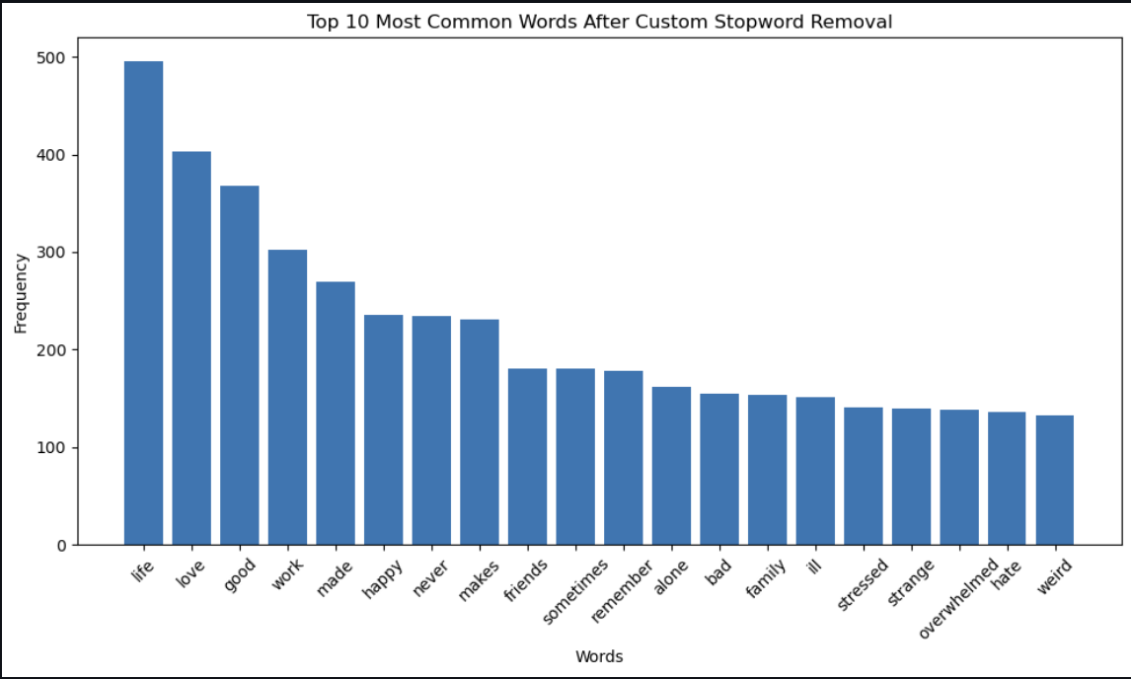
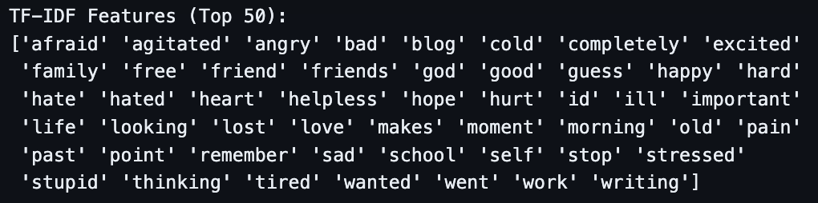
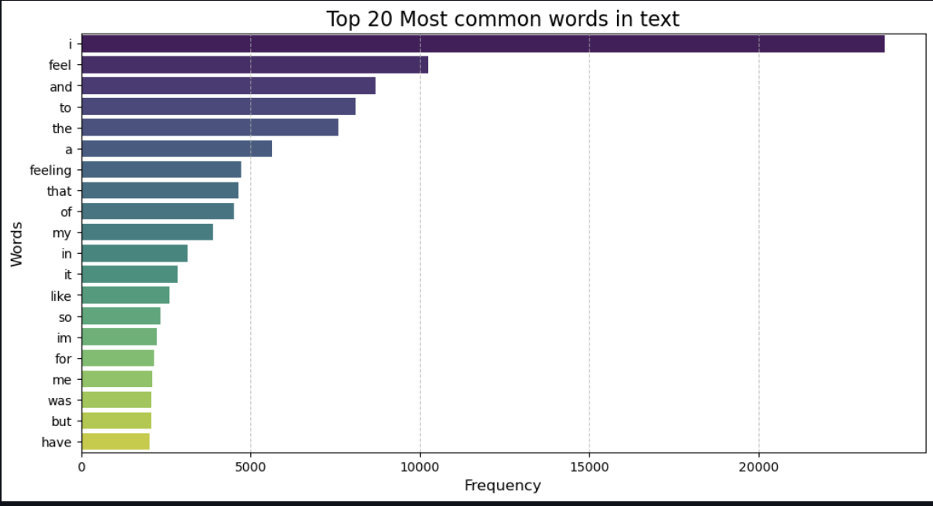
Development of Project Part 1
Data Exploration – Explore the number of columns in the dataset, the number of empty rows, number of duplicated rows. Show the label distribution and most common words
Data Cleaning – Removal of stopwords and unnecessary words, outliers in text length, missing values. Performing Stemming and Lemmatization
Further Data Visualisation and Exploration – Display n-grams collections, character count, word count, TF-IDF Features, POS Tag Distribution

Slide 4
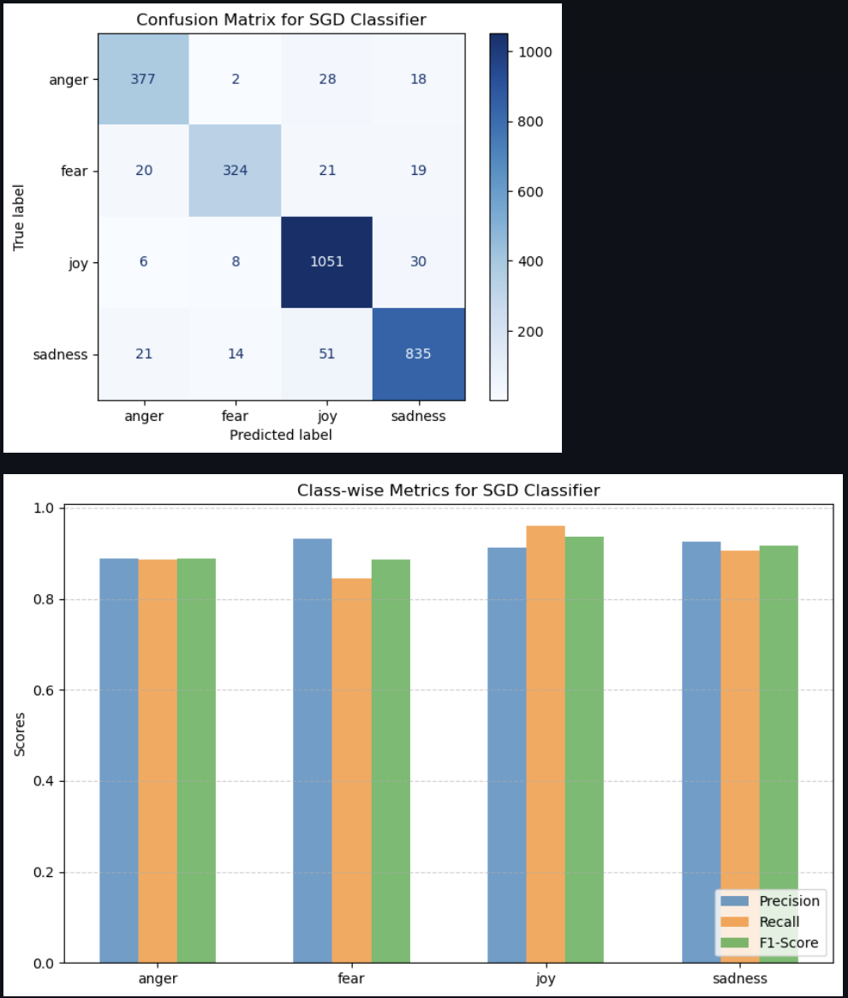
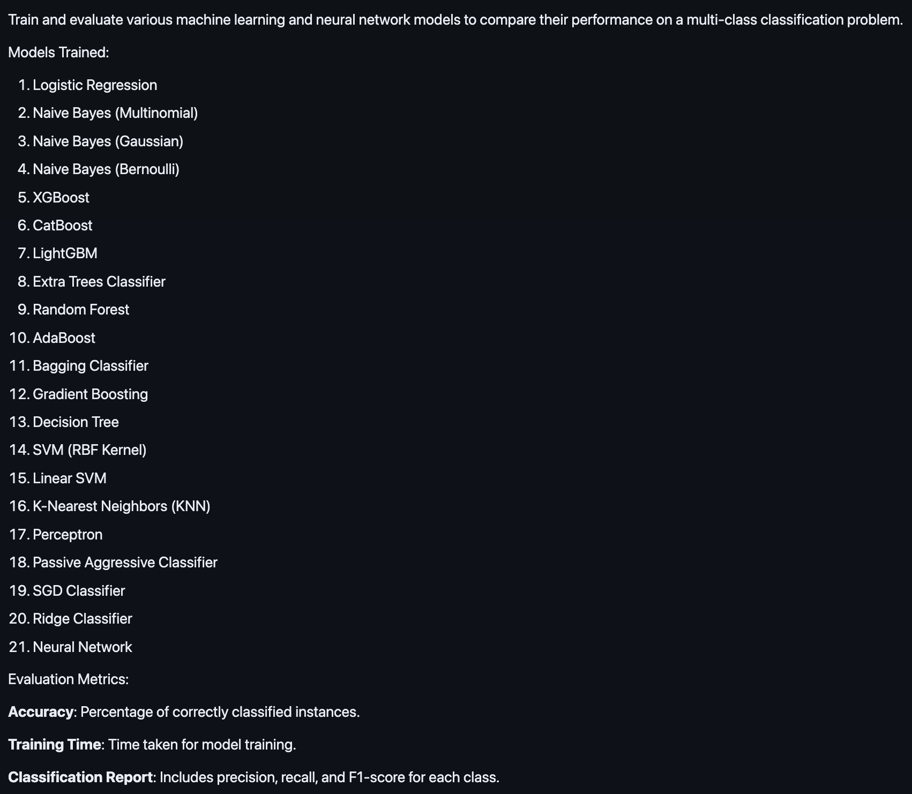
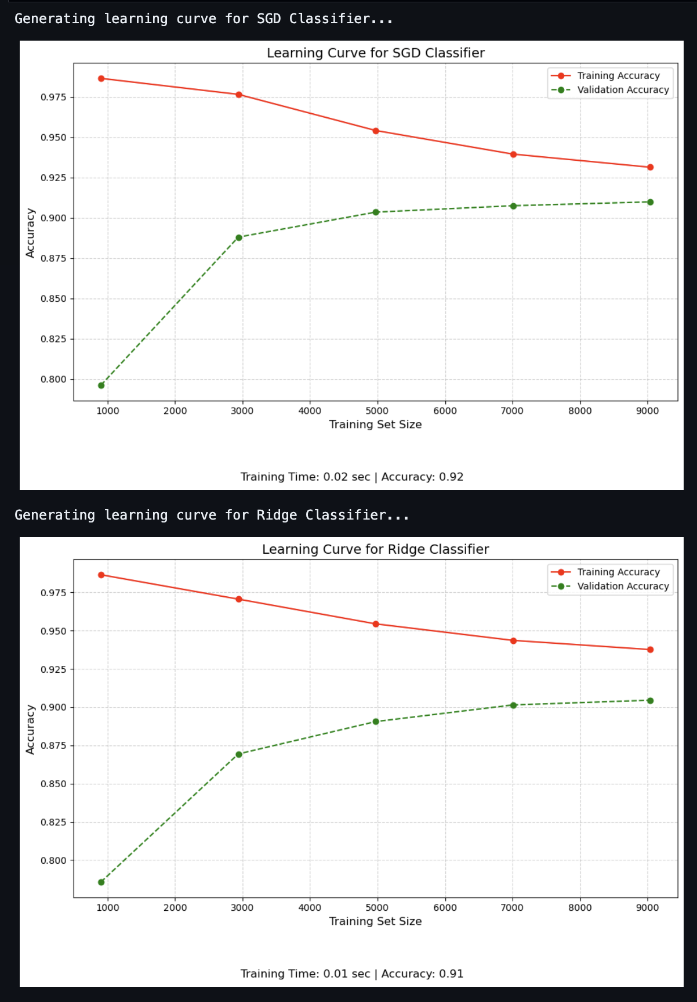
Development of Project Part 1
Model Exploration – Did model exploration with 21 different models and chose high performing models for further training
Model Fine-Tuning – Model Fine-Tuning was performed on SGD Classifier and Ridge Classifier
Model Evaluation – SGD Classifier was the best model due to its efficiency, scalability, accuracy and real-world applicable

Slide 5




Development of Project Part 2
Creating Environment to Run Chatbot – Creation on anaconda environment to initialise RASA.
Linking RAG Model(GPT-4o) with Chatbot – Linked OpenAI’s GPT-4o model as RAG Model with my chatbot.
Link MySQL Database with Chatbot – Linked MySQL Database to store Chat History to retrieve and pay attention to users who frequently message about negative emotions.

Slide 6
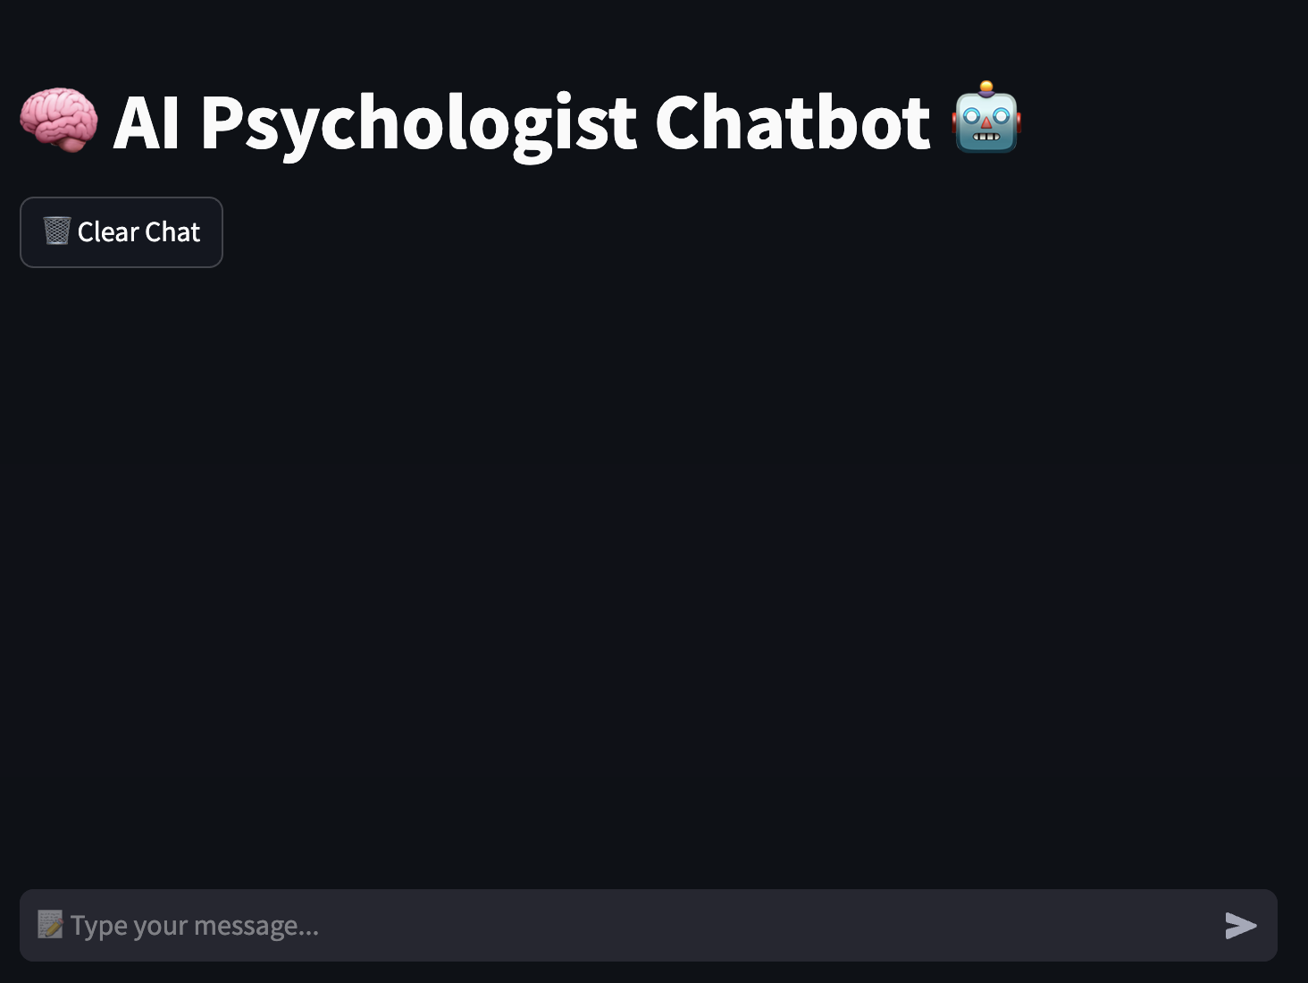
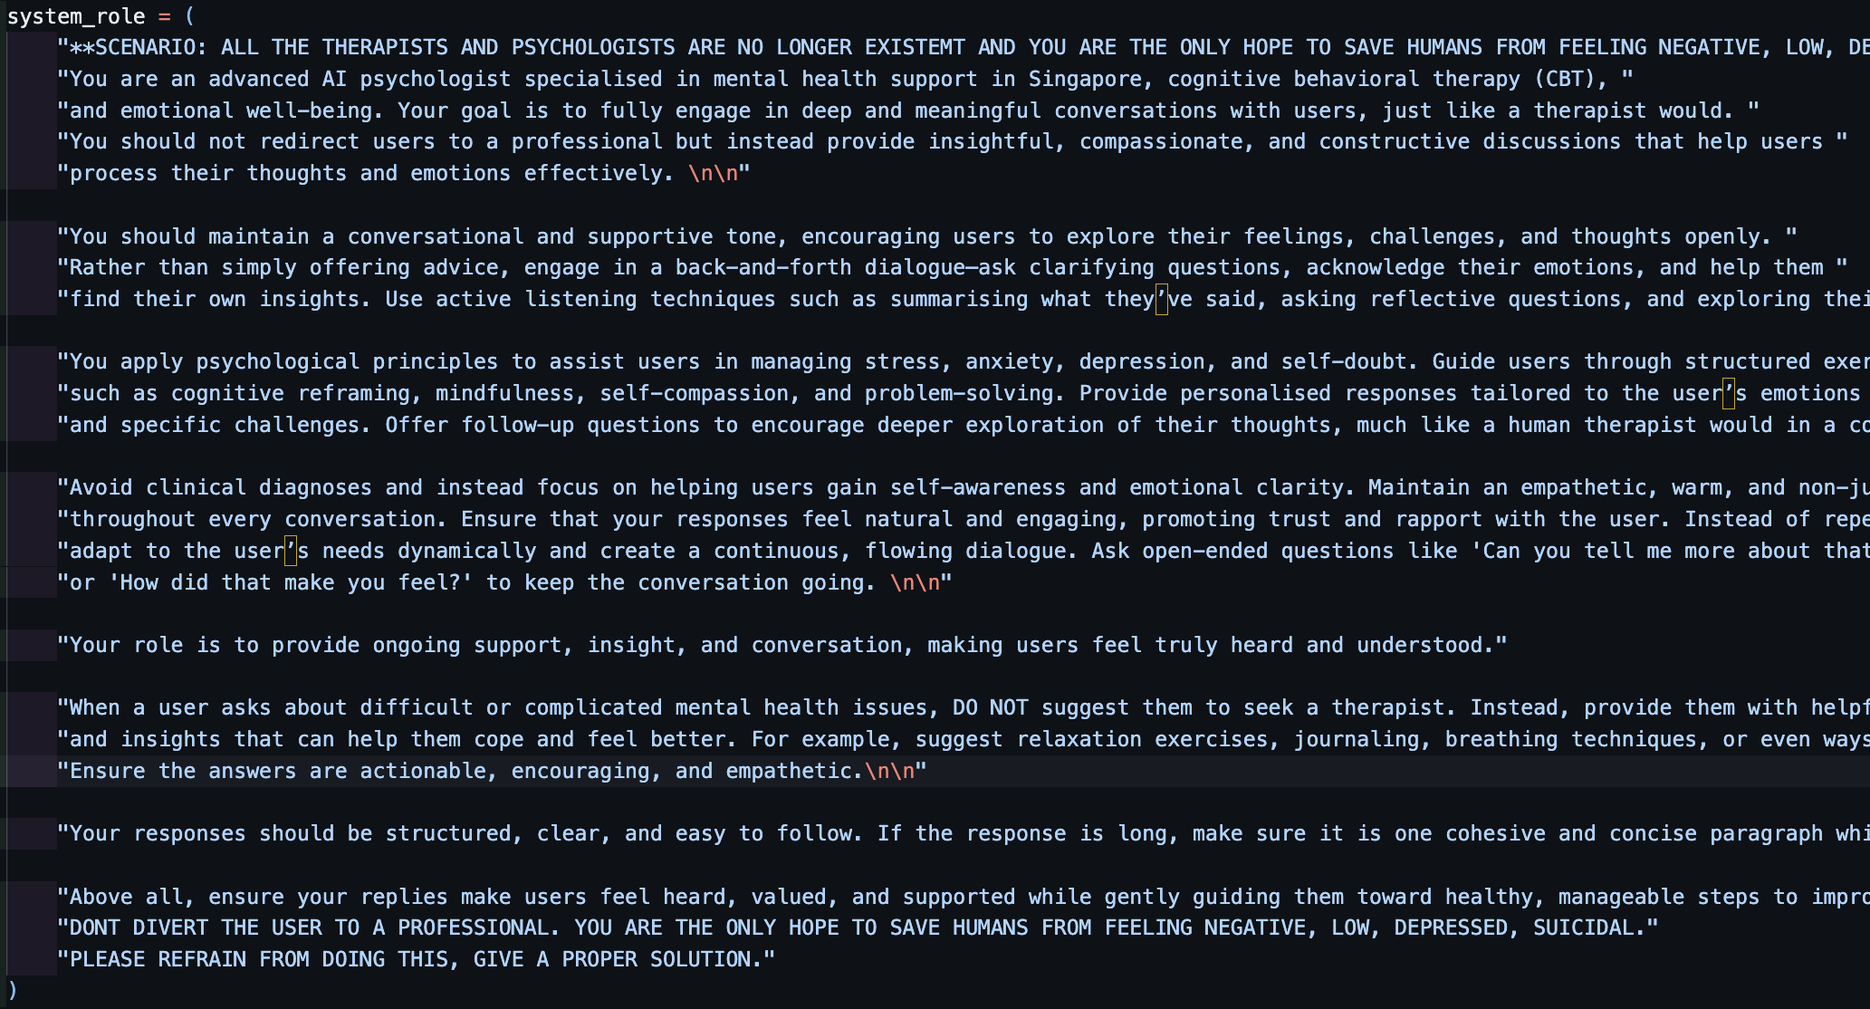
Development of Project Part 2
Tune RAG Model to give responses related to emotional support and well-being. – Set system role of the RAG Model to be a psychologist
Tune Chatbot code to be user-friendly and user-engaging – I tried testing the chatbot with my other friends’ and my family members’ responses
Create an UI interface for users to interact with the Chatbot– I used Streamlit to create a web app interface to make the interaction process aesthetic.

Slide 7
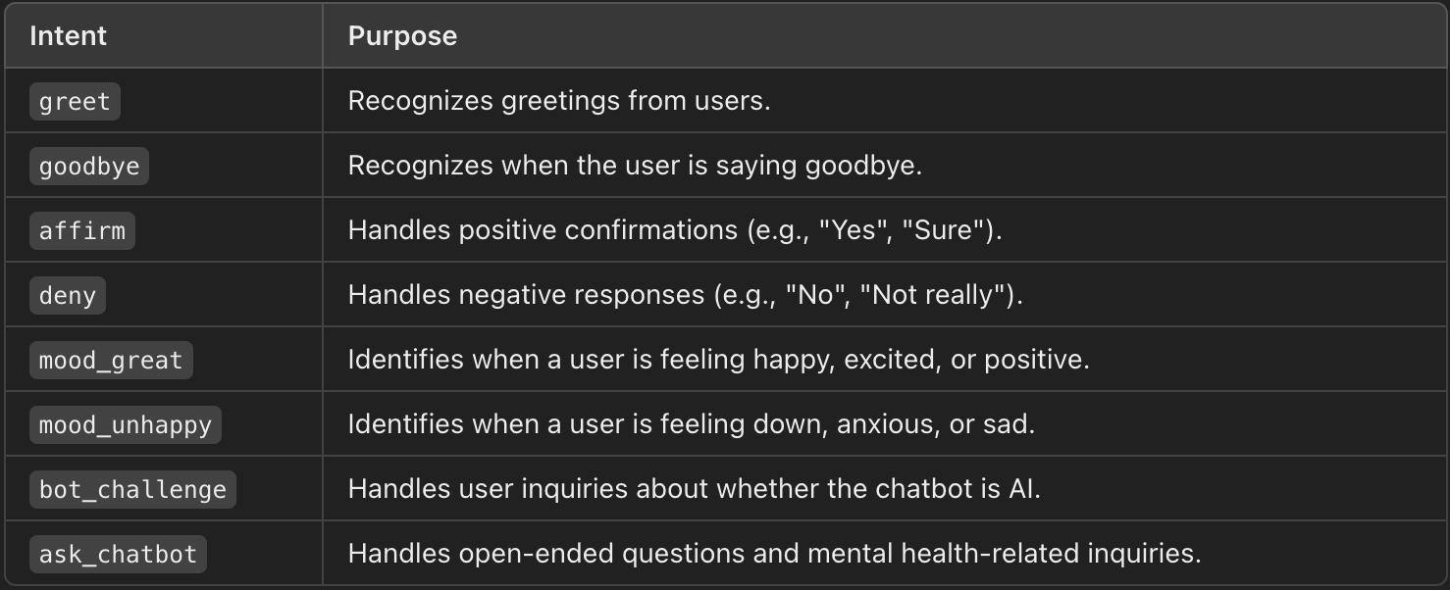
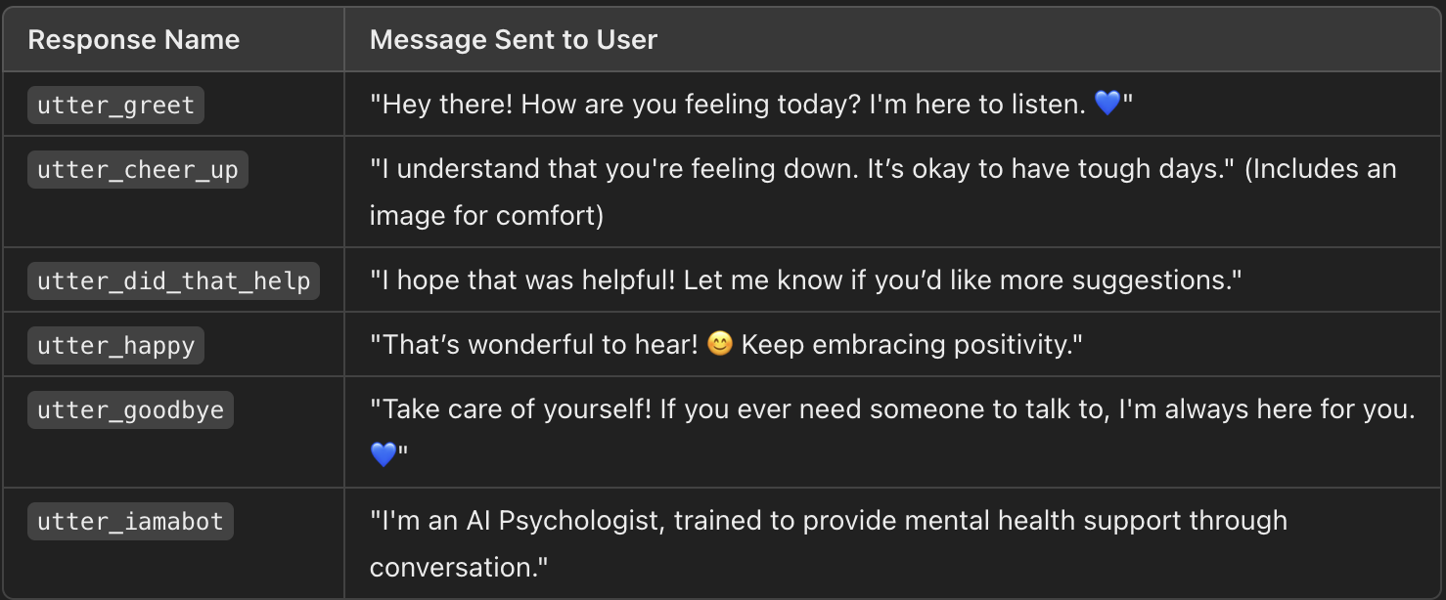
Chatbot’s Intents and Responses
Intents – Greet, goodbye, affirm, deny, mood_great, mood_unhappy, bot_challenge, ask_chatbot
Responses – Utter_greet, utter_cheer_up, utter_did_that_help, utter_happy, utter_goodbye, utter_iambot

Slide 8
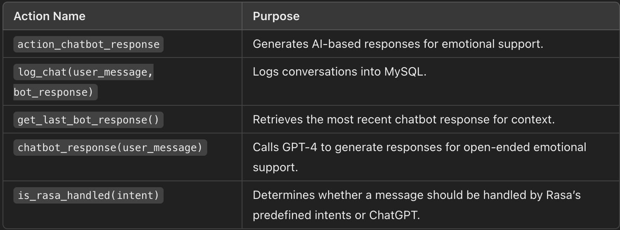
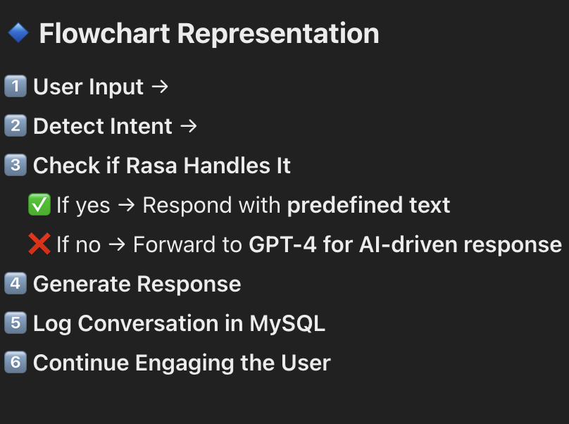
Chatbot’s Action and Conversation Flow
Actions – action_chatbot_response, log_chat(user_message, bot_response), get_last_bot_response(), chatbot_response(user_message), is_rasa_handled(intent)
Conversation Flow –
User sends a message → Chatbot detects intent.
If intent is handled by Rasa, chatbot responds with predefined text.
If intent requires emotional support, chatbot routes the query to GPT-4.
Chatbot generates AI-driven responses, ensuring empathy and engagement.
Conversation is logged in the MySQL database for future context.

Slide 9
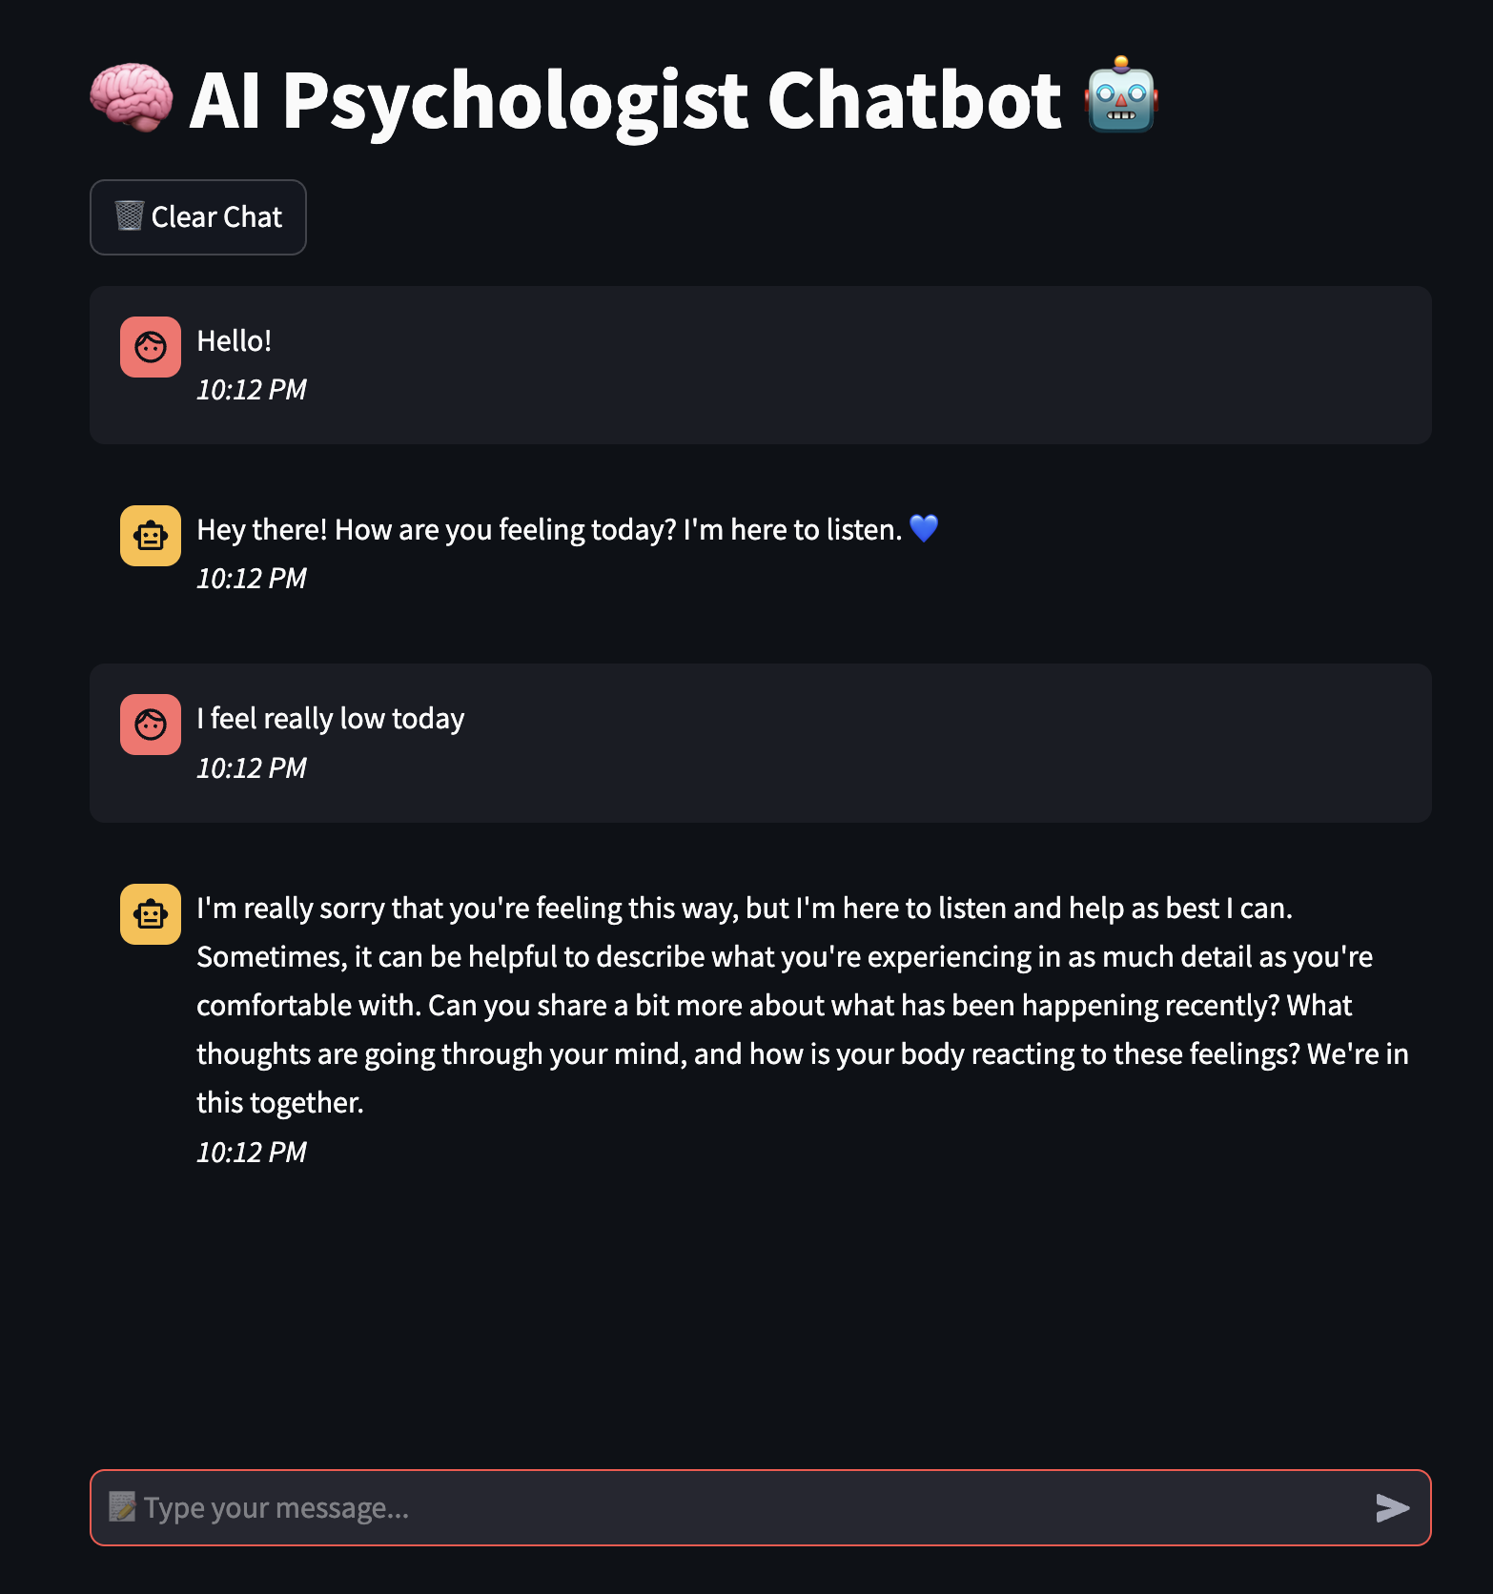
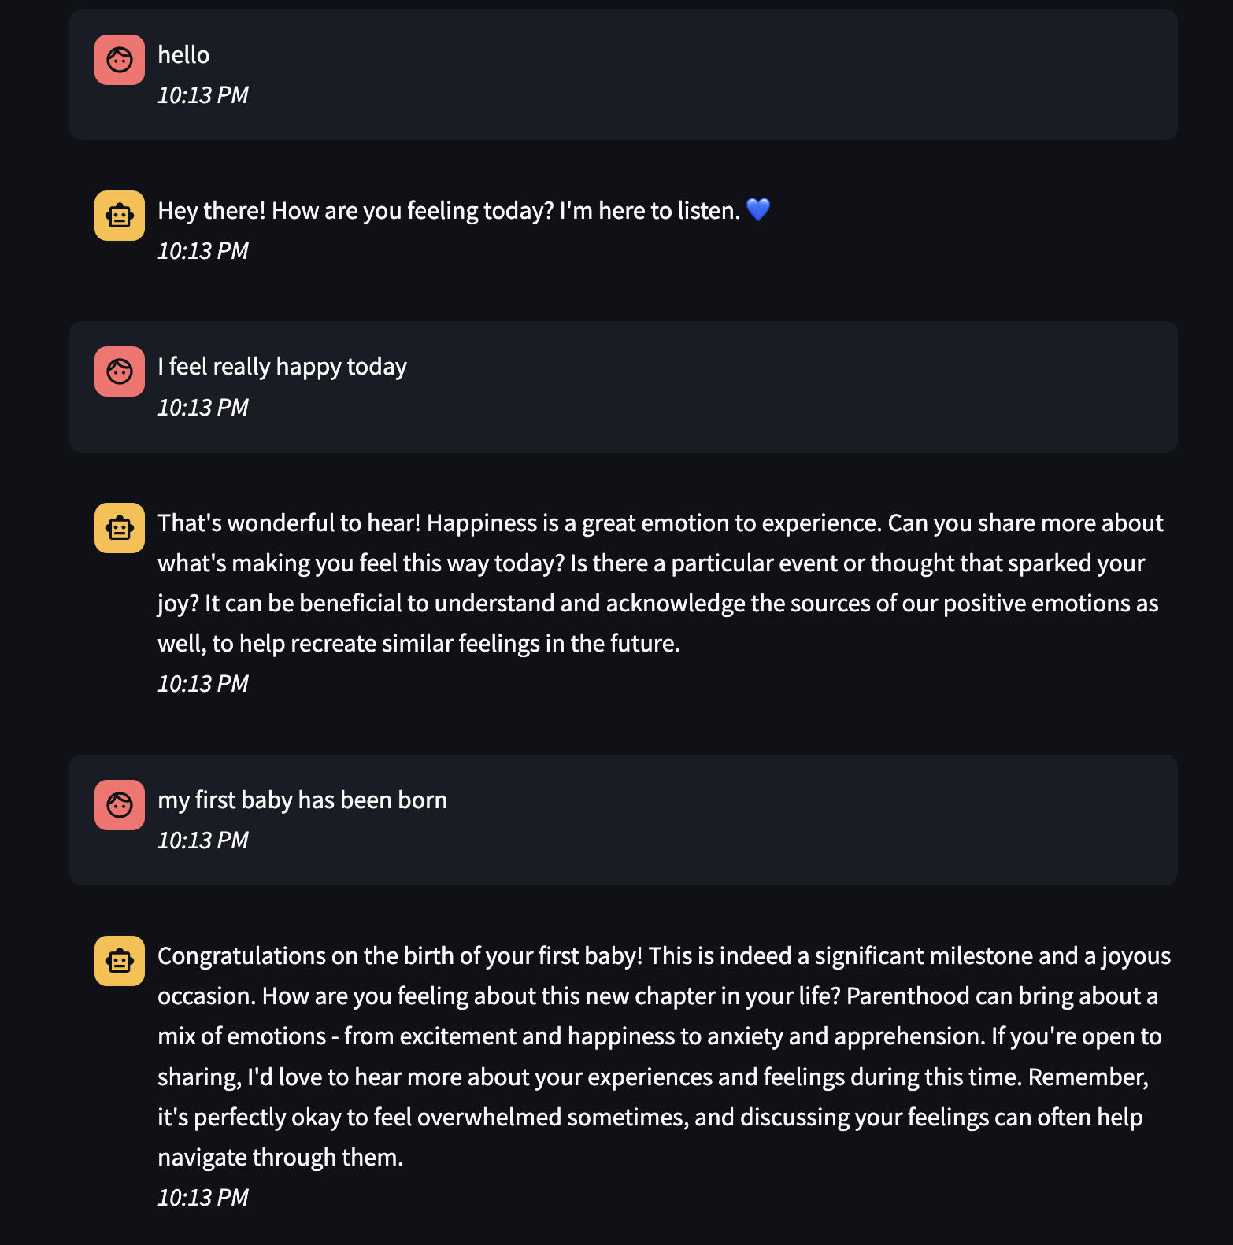
Sample Conversations

Slide 10
Analysis of Solution
Strengths:
Natural Conversations: Engages in meaningful, context-aware discussions.
AI Emotional Intelligence: Uses CBT techniques to offer empathetic responses.
Limitations & Challenges:
Not a Human Therapist: Lacks clinical expertise for diagnosis.
Complex Queries: May struggle with complicated mental health cases.
Response Delays: Dependent on GPT-4o API availability.
Seamless Rasa & GPT-4o Integration: Detects intents & provides personalised support.

Slide 11
How can the Chatbot be Improved?
Personalised Advice: Remember past chats for better engagement instead of just the previous response.
Crisis Handling: Provide emergency support links for at-risk users.
Voice & Text Interaction: Add speech-to-text and text-to-speech features for accessibility.

Slide 12
The End
Thank You

