Slide 1
CNN
Stands for Convolutional Neural Network (ConvNN)

Slide 2
CNN
Convolutional neural network (CNN) is a regularized type of feed-forward neural network that learns feature engineering by itself via filters (or kernel) optimization.
Notes:
A feedforward neural network (FNN) is one of the two broad types of artificial neural network, characterized by direction of the flow of information between its layers. Its flow is uni-directional, meaning that the information in the model flows in only one direction—forward—from the input nodes, through the hidden nodes (if any) and to the output nodes, without any cycles or loops, in contrast to recurrent neural networks(RNN), which have a bi-directional flow. Modern feedforward networks are trained using the backpropagation method and are colloquially referred to as the "vanilla" neural networks.

Slide 3
CNN applications examples:
image and video recognition
image classification,
medical image analysis,
natural language processing

Slide 4
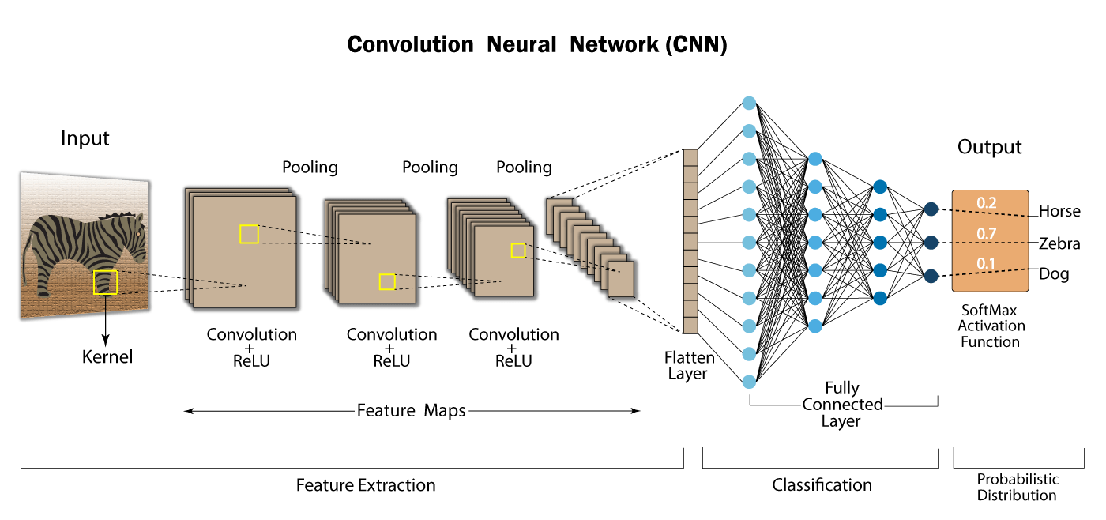
Architecture
Image Source: Medium.com
Notes:
The architecture of ConvNet is designed to take advantage of the 2D structure of an input image
Architecture:
Convolutional layer
rectified linear unit (ReLU) activation function
Pooling Layer
Flatten Layer
Fully Connected Layer

Slide 5
Convolutional Layer
Convoluted Feature Map Image
Input Image
Notes:
Convolution is the process of combining two functions to produce the output of the other function
A convolution is a grouping function in mathematics. Convolution occurs in CNNs when two matrices (rectangular arrays of numbers arranged in columns and rows) are combined to generate a third matrix.

Slide 6
Applying filters Convolutional layer cont..
Input Image Size = 5 X 5 Filter Size = 3 x 3 Stride = 1 Padding = 0 Feature map size(output) = 3 x 3

Slide 7
Applying filters Convolutional layer cont..
Image Source: vitalflux.com
Input Image Size = 5 X 5 Filter Size = 3 x 3 Stride = 1 Padding = 1 Feature map size(output) = 5 x 5

Slide 8
Feature map size Convolutional layer cont..
Depends on:
Input Image Size n×n
Filter Size f×f
Stride s
Padding p

Slide 9
Stride Convolutional layer cont..
Stride: It denotes how many steps we are moving the filter at each step. [default is 1]
Stride = 1
Stride = 2

Slide 10
Padding Convolutional layer cont..
Padding is a process of adding (row or column) to the input at each side
Padding = 0
Padding = 1
Padding = 2
Notes:
it aids in preventing any information loss, particularly from the edges of the image

Slide 11
Padding Types Convolutional layer cont..
Same Padding
Valid Padding
Padding = 0
Padding = 1
Notes:
3. Different Types of Padding:
Valid Padding
Same Padding
Causal Padding

Slide 12
Calculate Padding Convolutional layer cont..
$p=\frac{n∗s−n+f−s}{2}$
$lets=1,p=\frac{f−1}{2}$

Slide 13
Calculate the feature map size
$featuremap=\frac{n−f+2p}{s}+1$
n×n image f×f filter
Padding p
Stride s

Slide 14
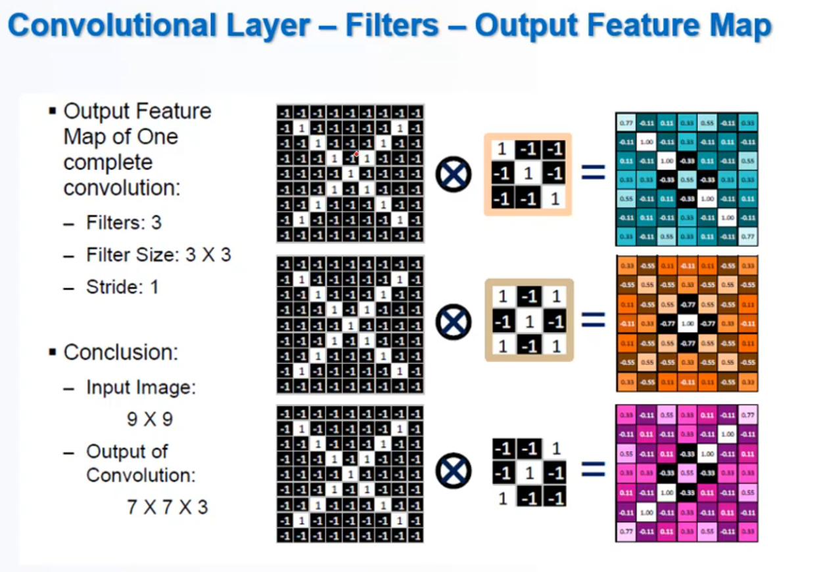

Slide 15
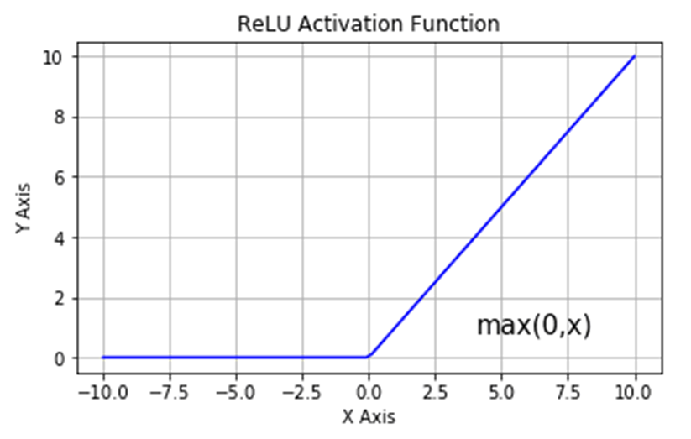
ReLU layer
Applying max(0, x) on the previous feature map layers
This one does not change size unlike the previous one

Slide 16
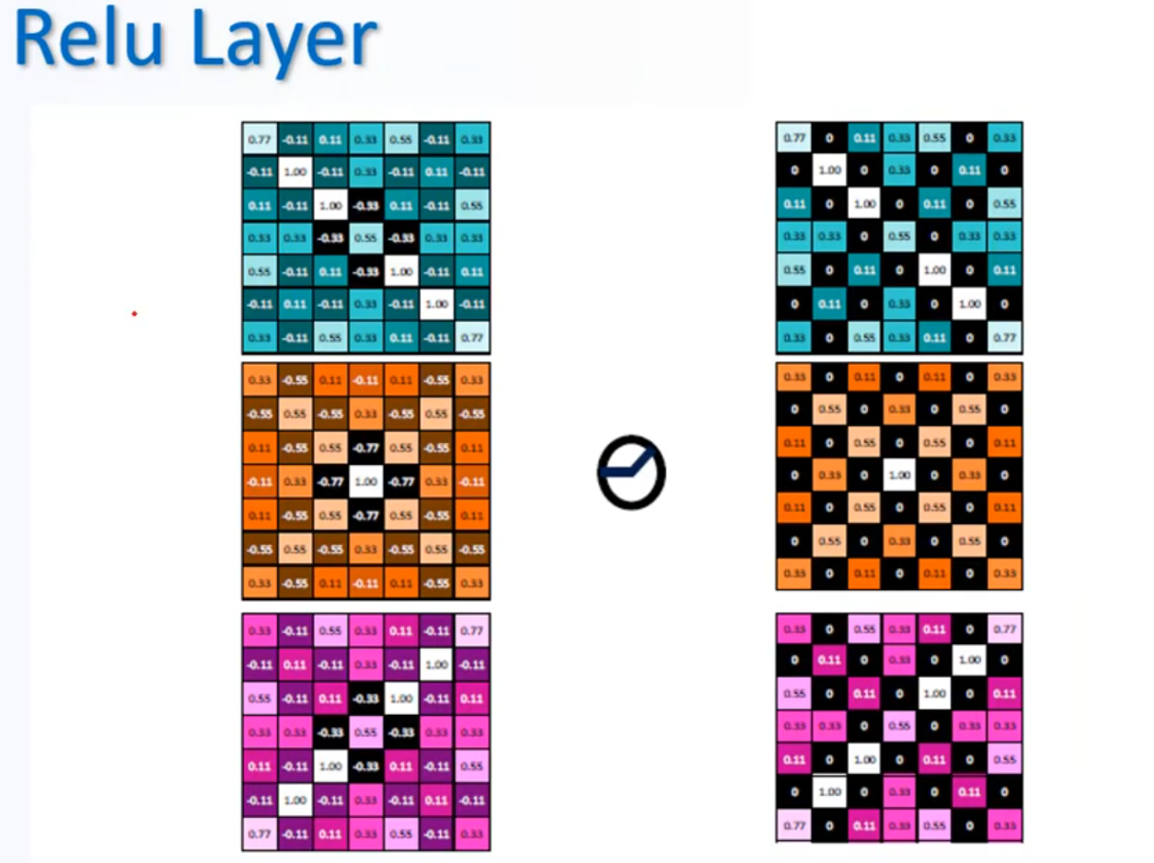

Slide 17
Pooling layer
Its purpose is to gradually shrink the representation’s spatial size to reduce the number of parameters and computations in the network.
The pooling layer treats each feature map separately.

Slide 18
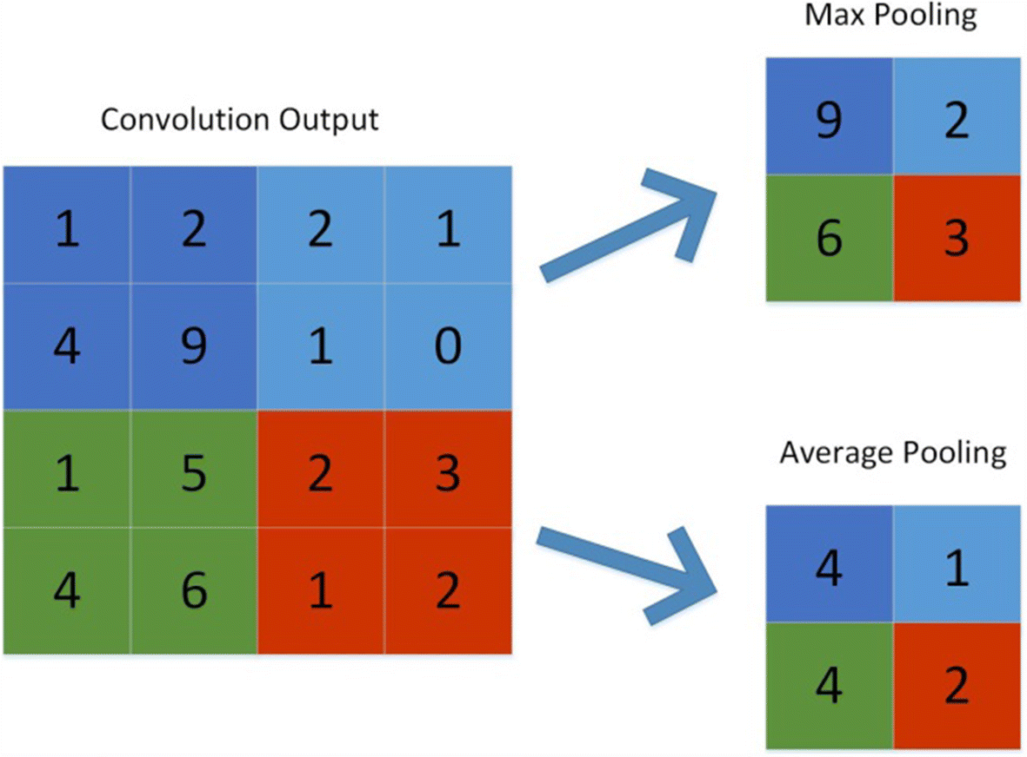
Pooling layer methods (types)
- Max pooling
- Average Pooling
Source: Springer.com
Notes:
The following are some methods for pooling:
Max-pooling: It chooses the most significant element from the feature map. The feature map’s significant features are stored in the resulting max-pooled layer. It is the most popular method since it produces the best outcomes.
Average pooling: It entails calculating the average for each region of the feature map.

Slide 19
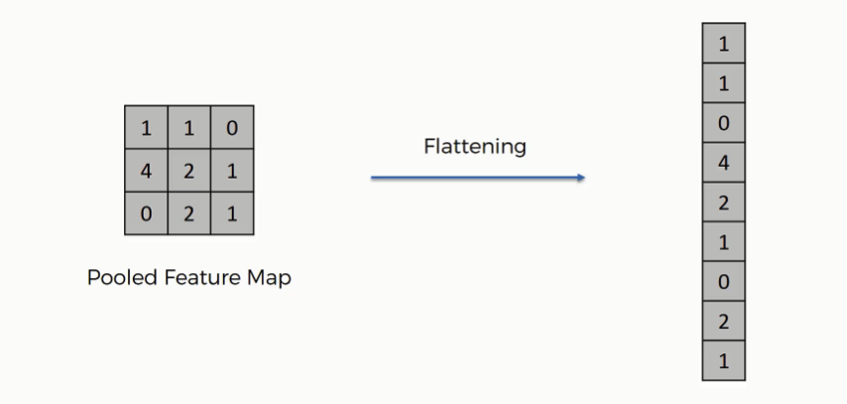
Flatten Layer
Flatten is used to flatten the input. For example, if flatten is applied to layer having input shape as (3,3), then the output shape of the layer will be (9)
image source: superdatascience.com

Slide 20
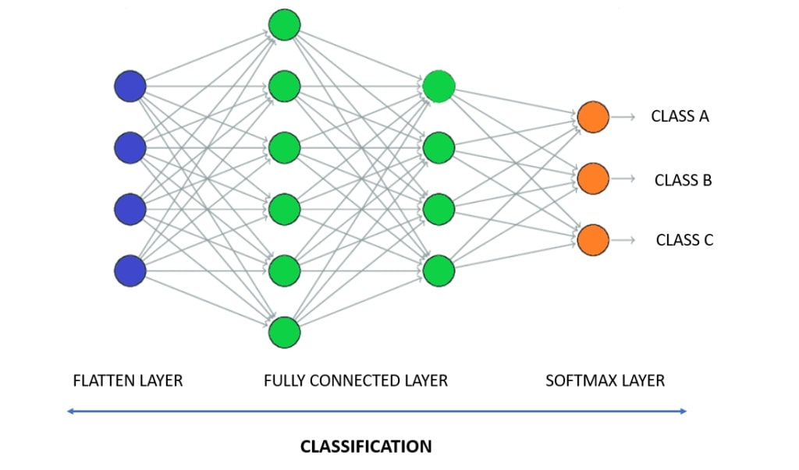
Fully Connected layer
Is a fully connected neural networks – the classic neural network architecture, in which all neurons connect to all neurons in the next layer.

Slide 21
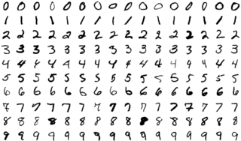
MNIST Example
MNIST is a subset of a larger set available from NIST (it's copied from http://yann.lecun.com/exdb/mnist/)
The MNIST database of handwritten digits has a training set of 60,000 examples, and a test set of 10,000 examples.
Notes:
The MNIST database (Modified National Institute of Standards and Technology database[1]) is a large database of handwritten digits that is commonly used for training various image processing systems.[2][3] The database is also widely used for training and testing in the field of machine learning.[4][5] It was created by "re-mixing" the samples from NIST's original datasets

Slide 22
Resources
Convolutional neural network [wikipedia]
Feed-forward neural network [wikipedia]
Basics of CNN in Deep Learning
Intuitively Understanding Convolutions for Deep Learning
Convolutional Neural Network CNN- الشبكات العصبية الملتفة by dr. Ahmed Yousry [youtube]
What is ReLU and Sigmoid activation function?
Convolutional Neural Networks (CNN): Step 3 - Flattening
Feature map size calculate in CNN | Stride, Padding | Deep Learning Animation [youtube]
Fully Connected Layers in Convolutional Neural Networks
Deep Neural Networks: Padding

