Slide 1


Examination System

Slide 2

Team Members
Omar
El-Qersh
Ahmed Mekky
Abdelrahman
Hisham
Moataz
El-Mesmary
Seif
Salah

Slide 3
Overview
- Build SQL database for exam management.
- Manage student, exam, and course data.
- Develop CRUD stored procedures.
- Automate exam creation/evaluation.
- Generate performance and exam reports.
- Visualize key metrics with Power BI.

Slide 4








Software Tools

Slide 5
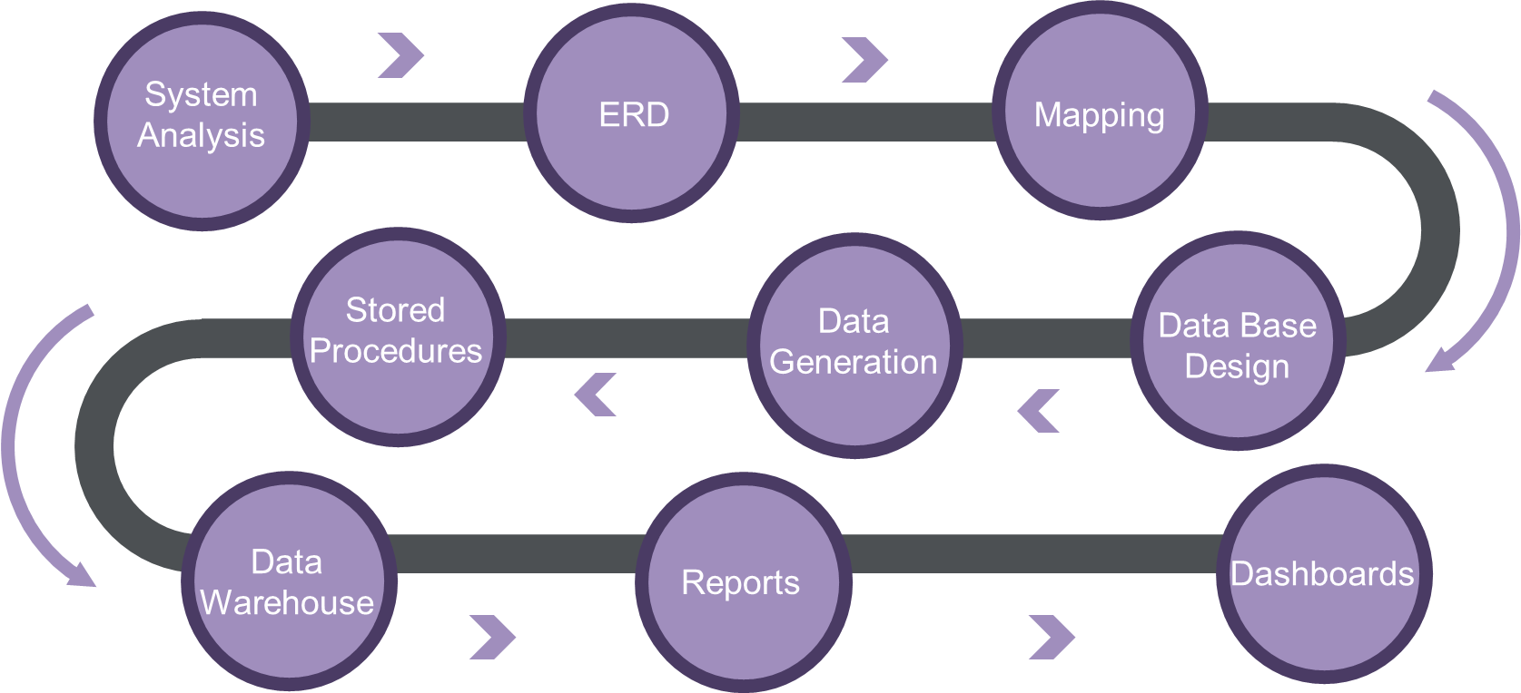
Project Workflow

Slide 6
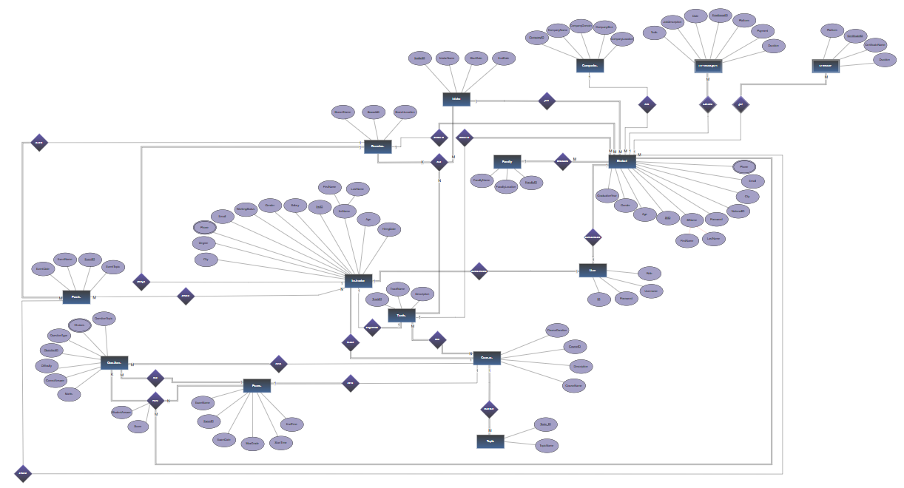
ERD

Slide 7
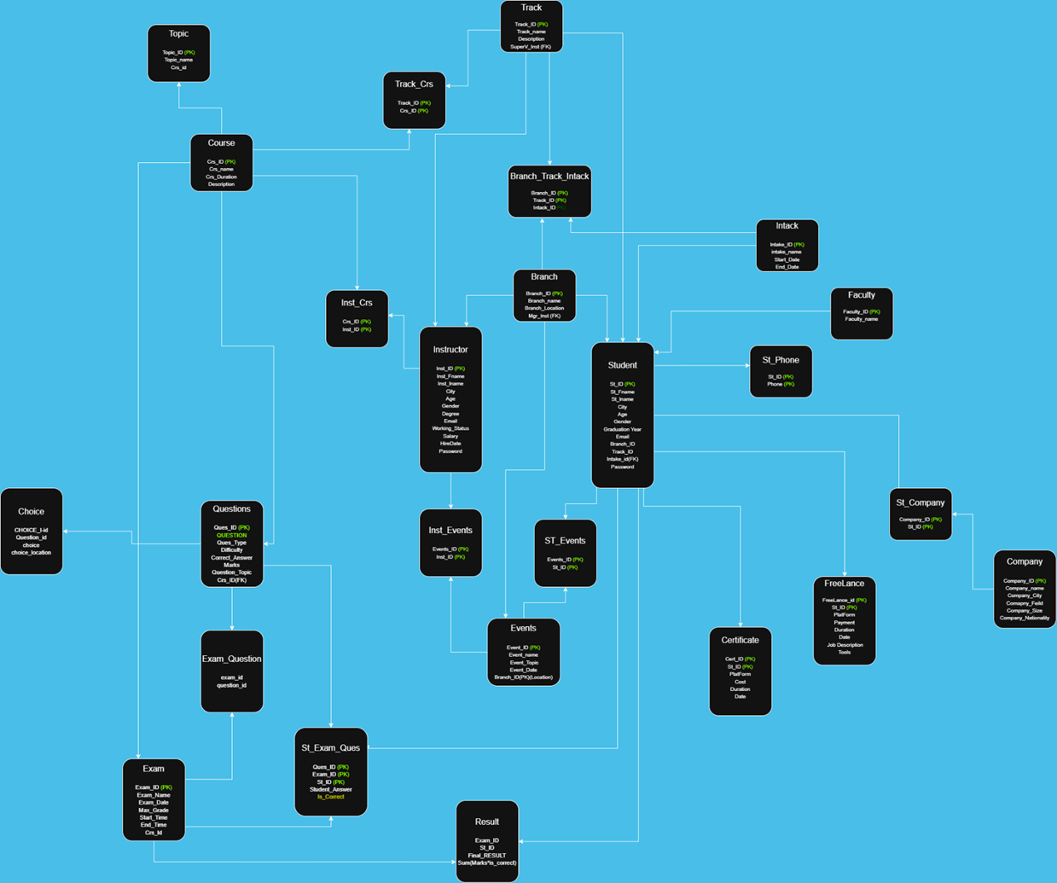
Mapping

Slide 8
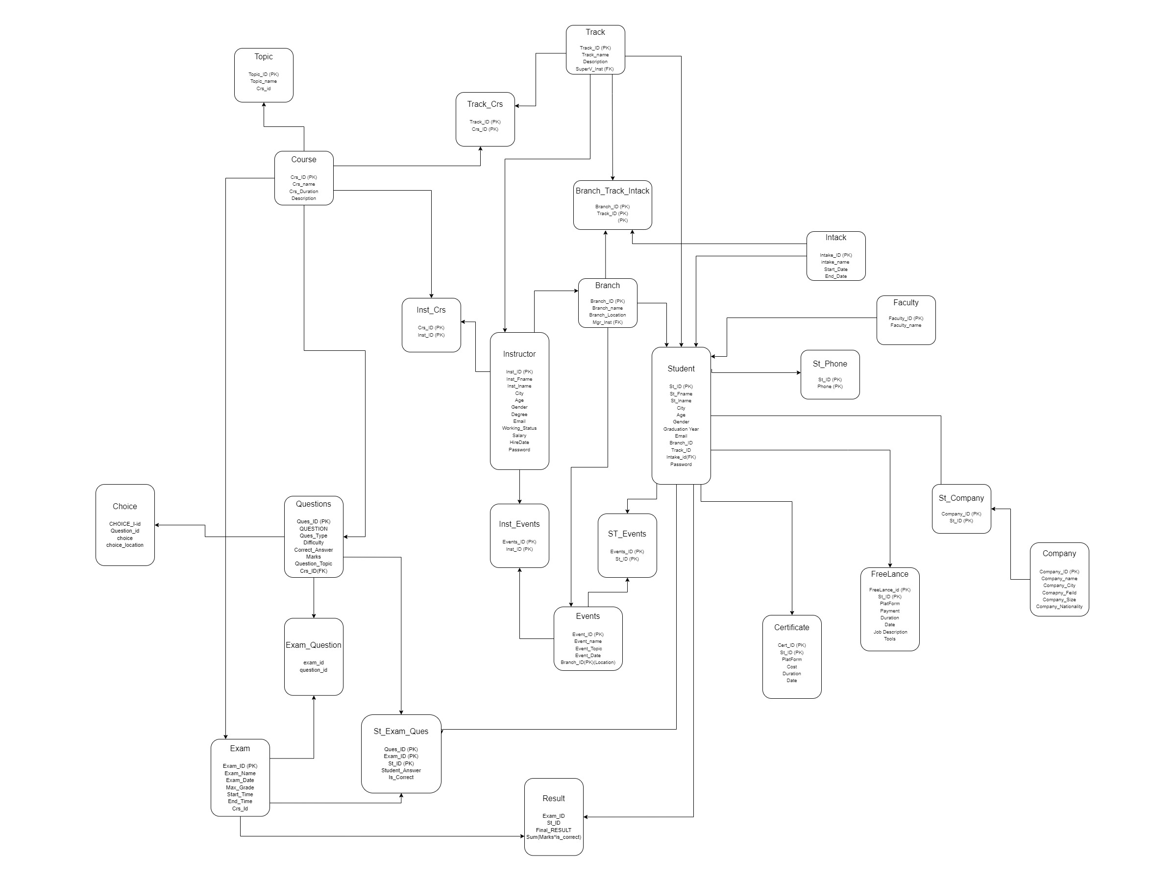
Mapping

Slide 9
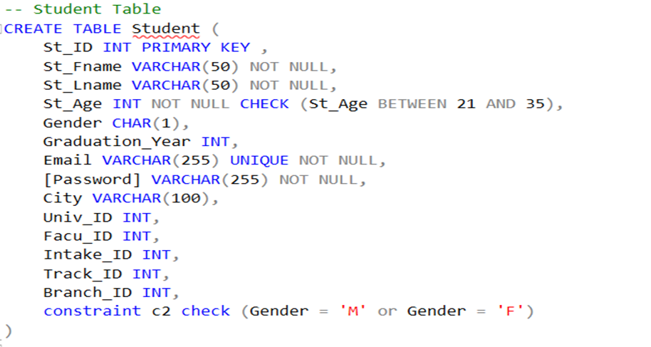
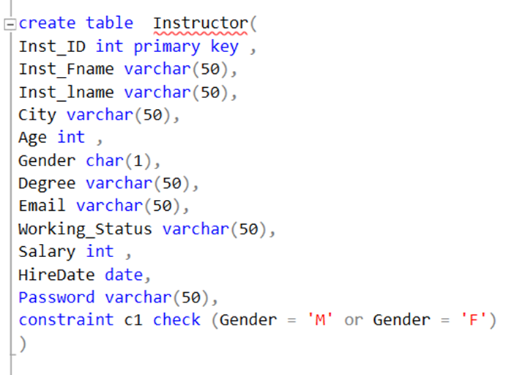
Database
Creation

Slide 10
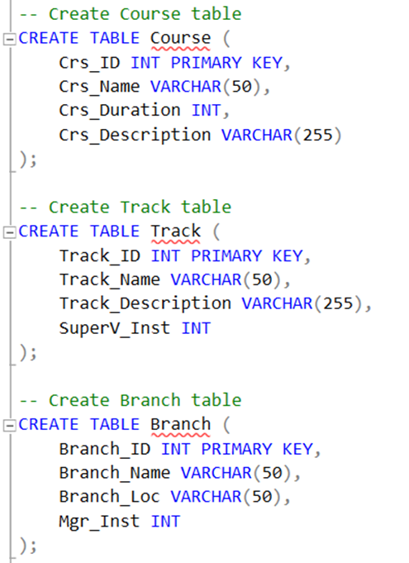
Database
Creation

Slide 11
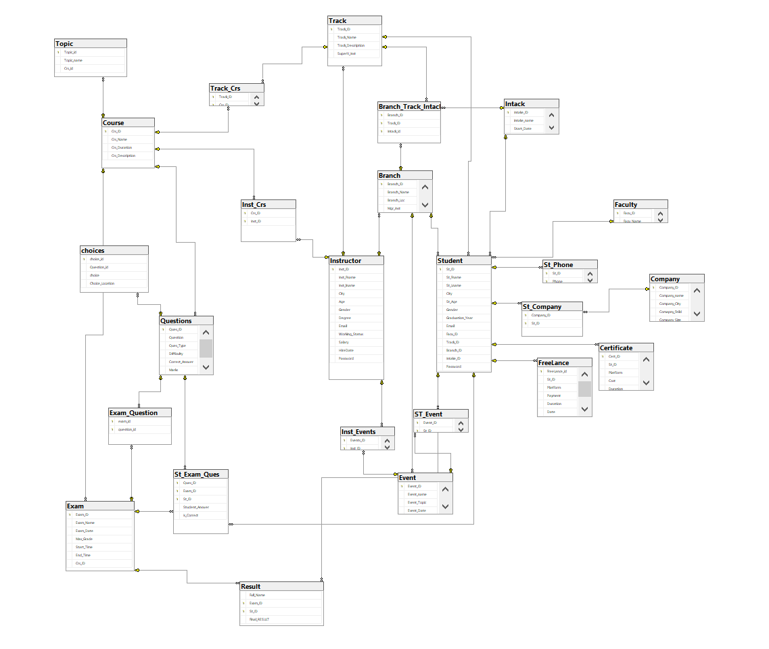
Database
Diagram

Slide 12
Data
Generation
Used ChatGPT to generate varied dummy data
Ensured data consistency and coverage of all database entities for effective testing.
Saved time and effort while maintaining data diversity for queries and reports.

Slide 13
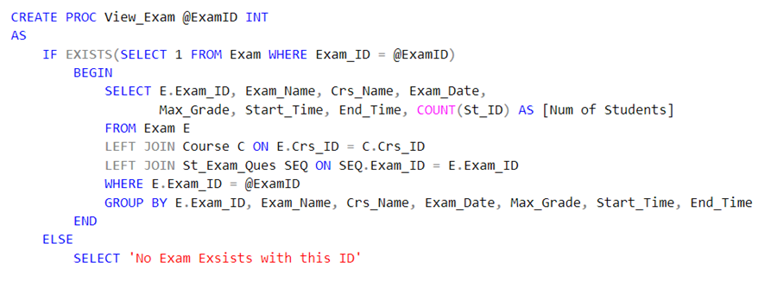
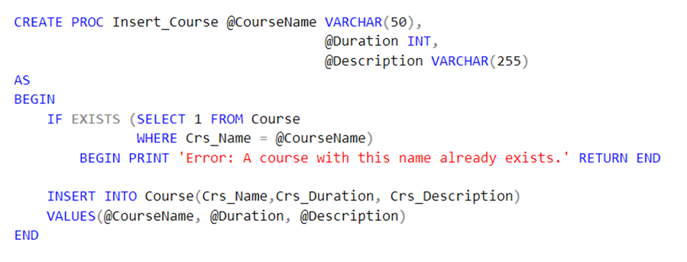
Stored
Procedures

Slide 14
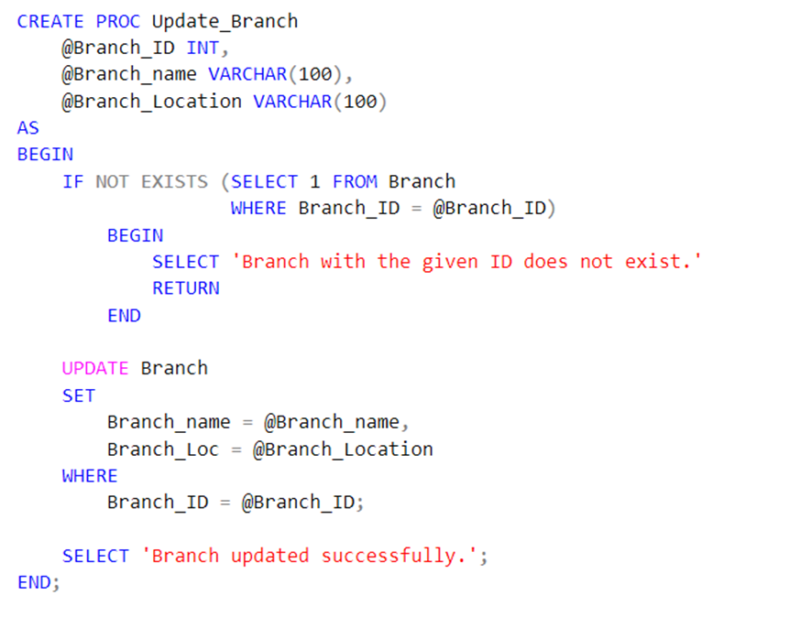
Stored
Procedures

Slide 15
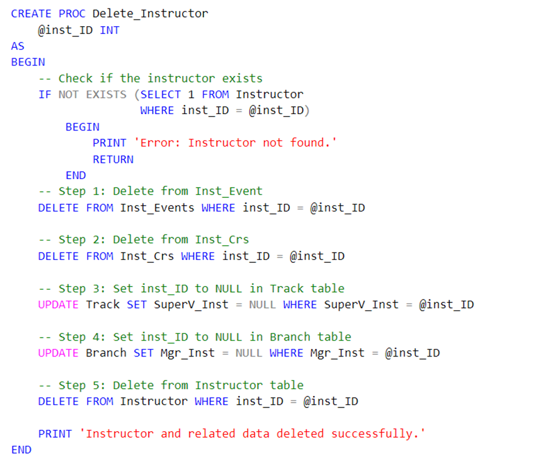
Stored
Procedures

Slide 16
Mapping

Slide 17
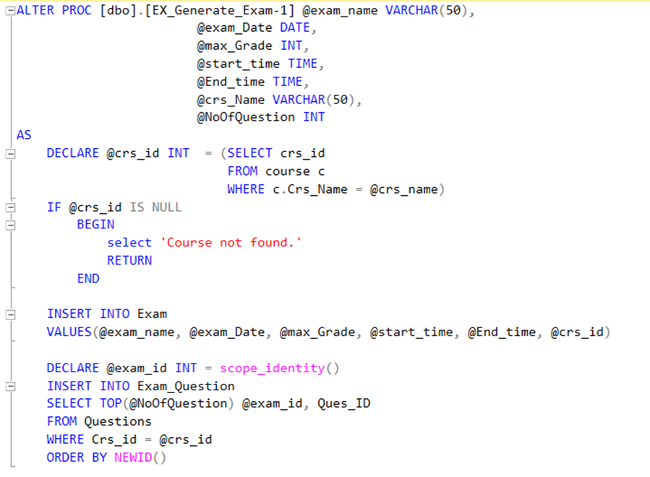
Stored
Procedures
A. Exam generation
Exam SPs

Slide 18
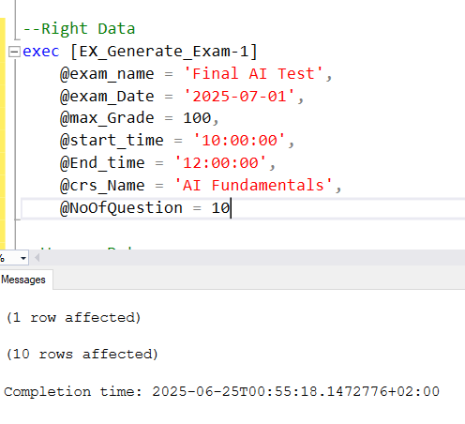
Stored
Procedures
A. Exam generation
Exam SPs

Slide 19
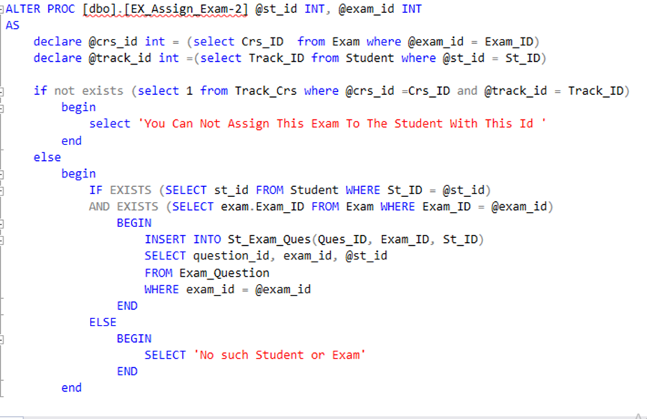
Stored
Procedures
B. Assigning Exam
Exam SPs

Slide 20
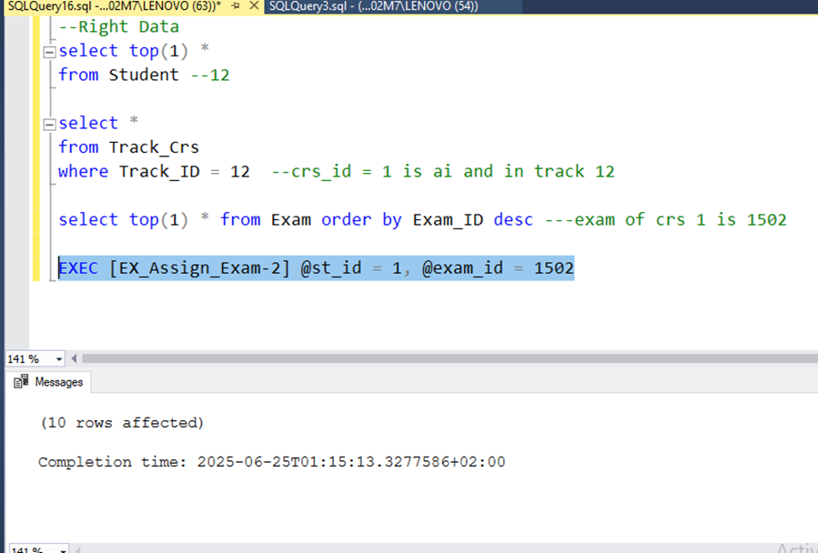
Stored
Procedures
B. Assigning Exam
Exam SPs

Slide 21
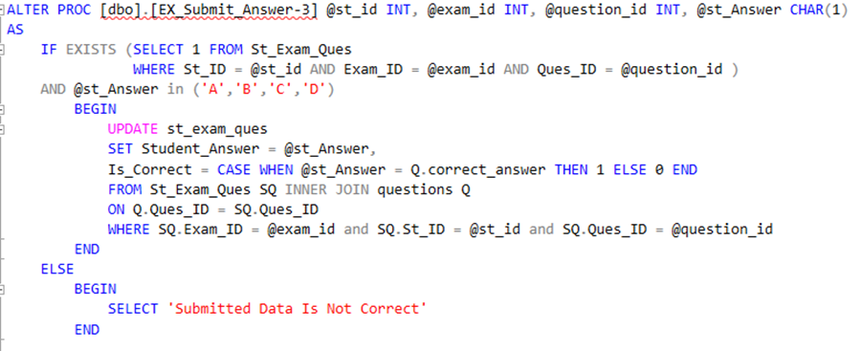
Stored
Procedures
C. Taking Student Answer
Exam SPs

Slide 22
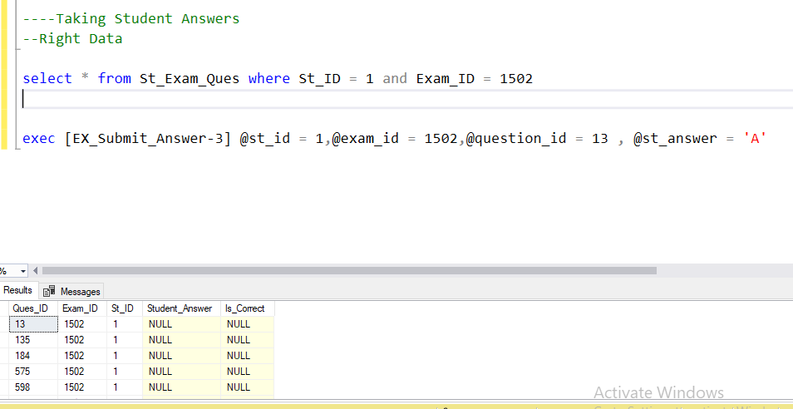
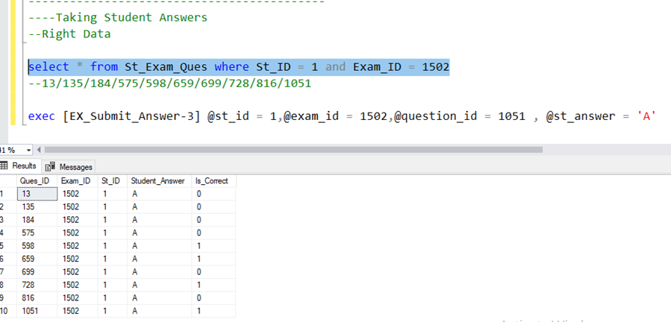
Stored
Procedures
C. Taking Student Answer
Exam SPs

Slide 23
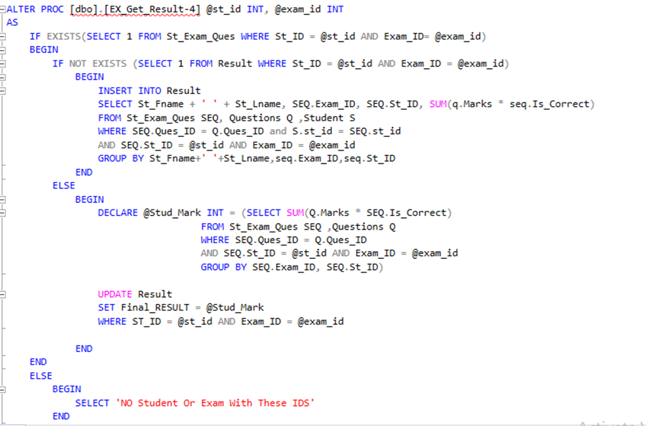
Stored
Procedures
D. Grouping Final Result
Exam SPs

Slide 24
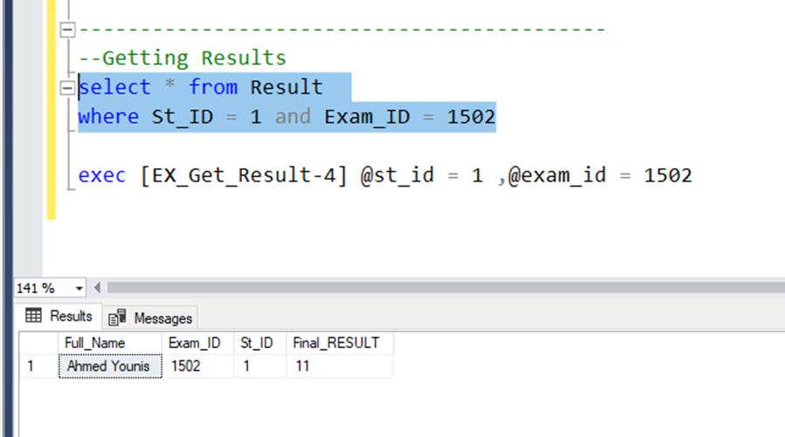
Stored
Procedures
D. Grouping Final Result
Exam SPs

Slide 25
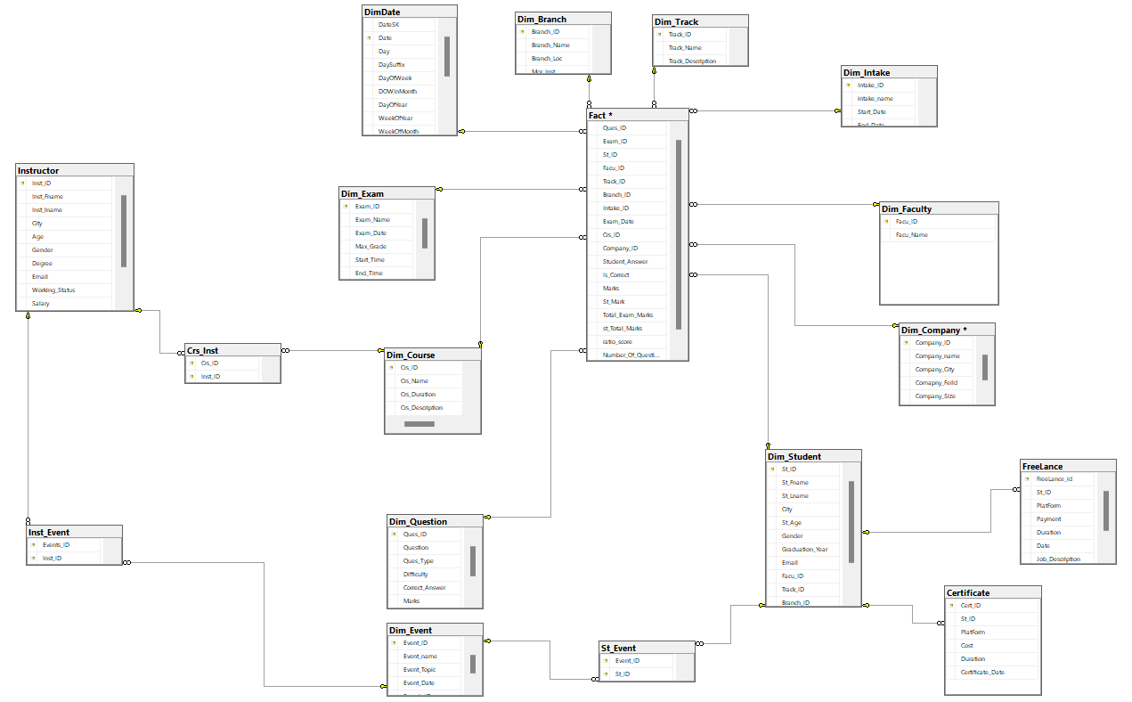
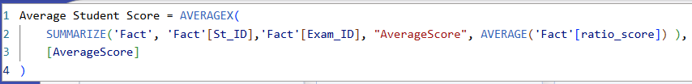
Data
Warehouse

Slide 26
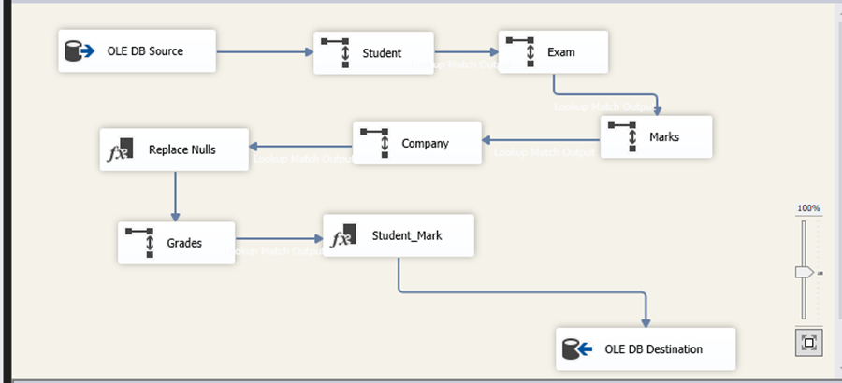
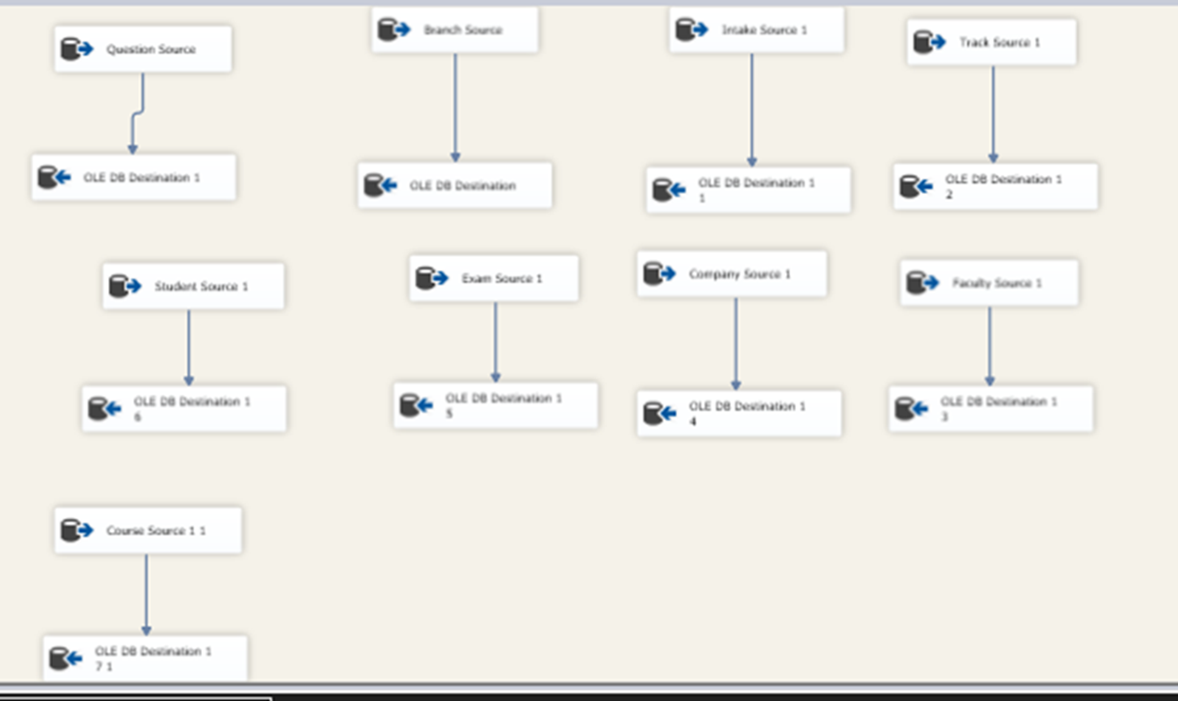
ETL
Process
• Fact Table
(in SSIS)
• Dimensions

Slide 27
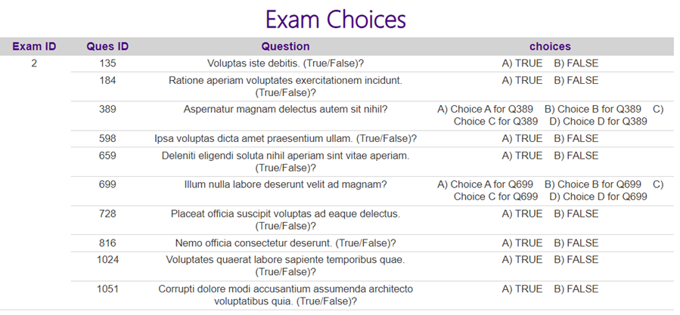
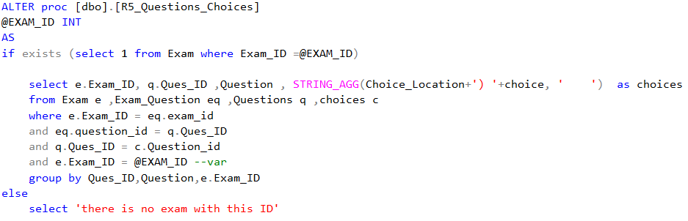
SSRS

Slide 28
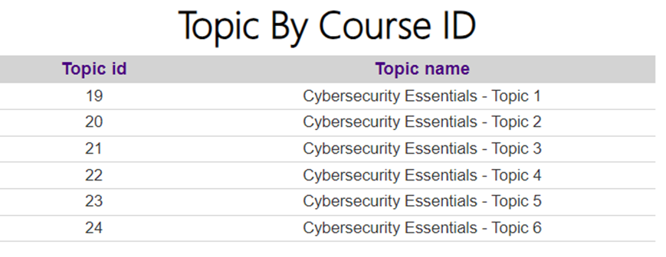
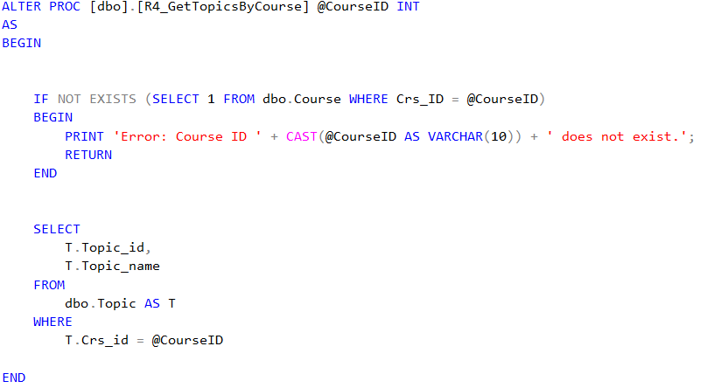
SSRS

Slide 29
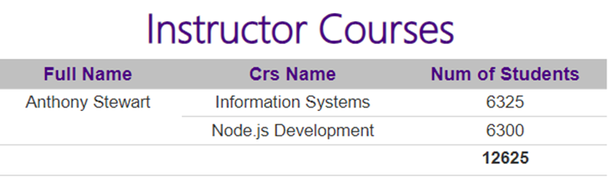
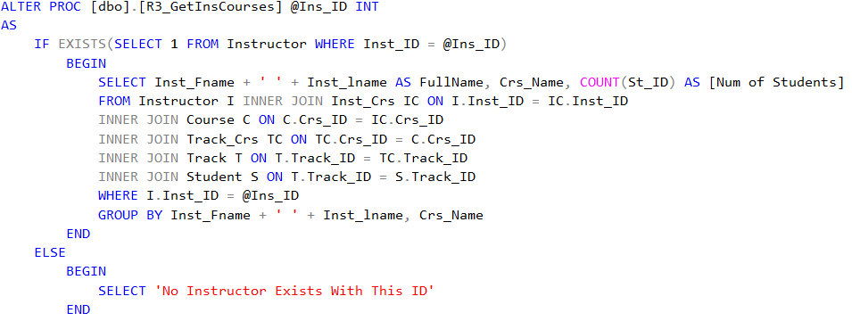
SSRS

Slide 30
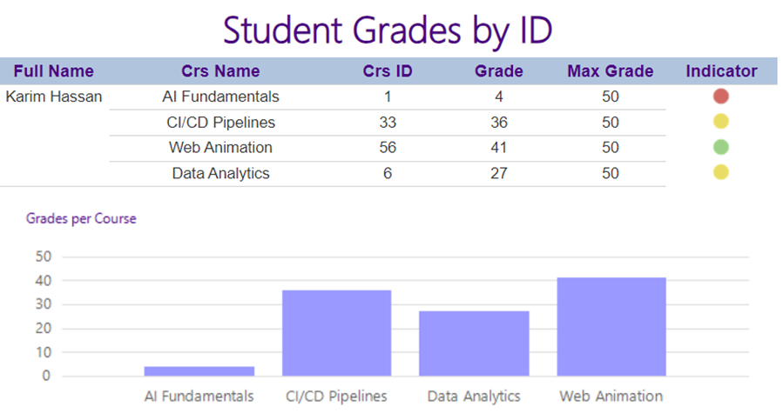
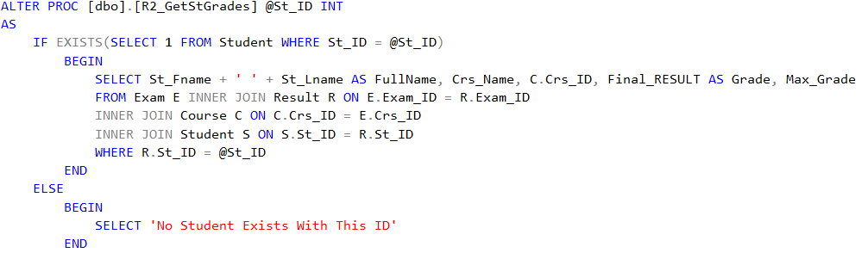
SSRS

Slide 31
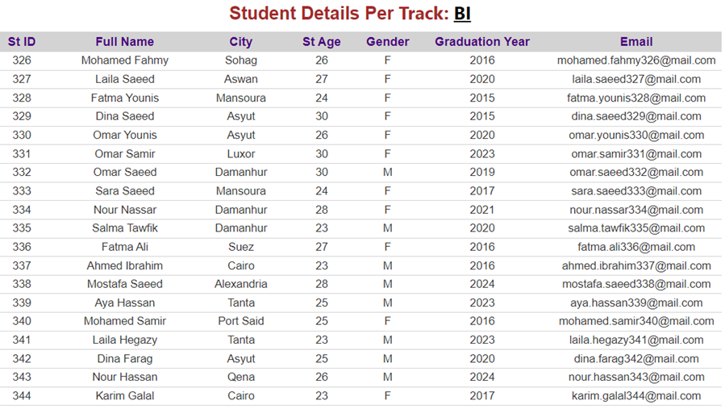
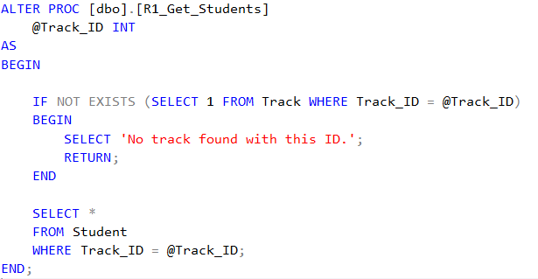
SSRS

Slide 32
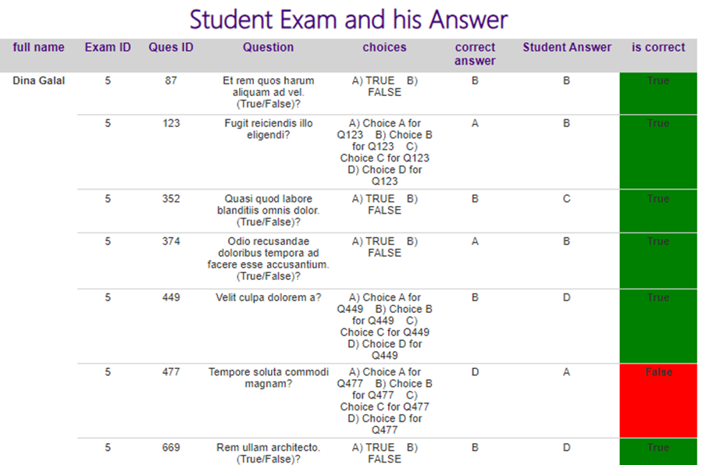
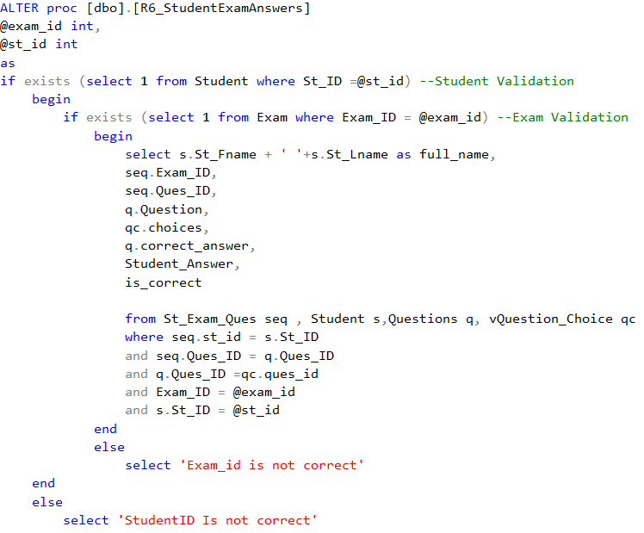
SSRS

Slide 33
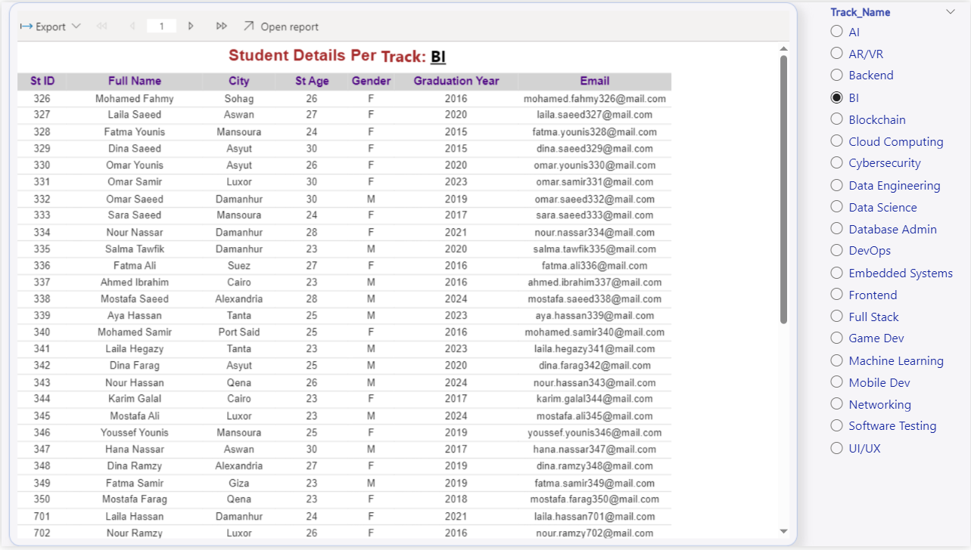
Dashboard

Slide 34
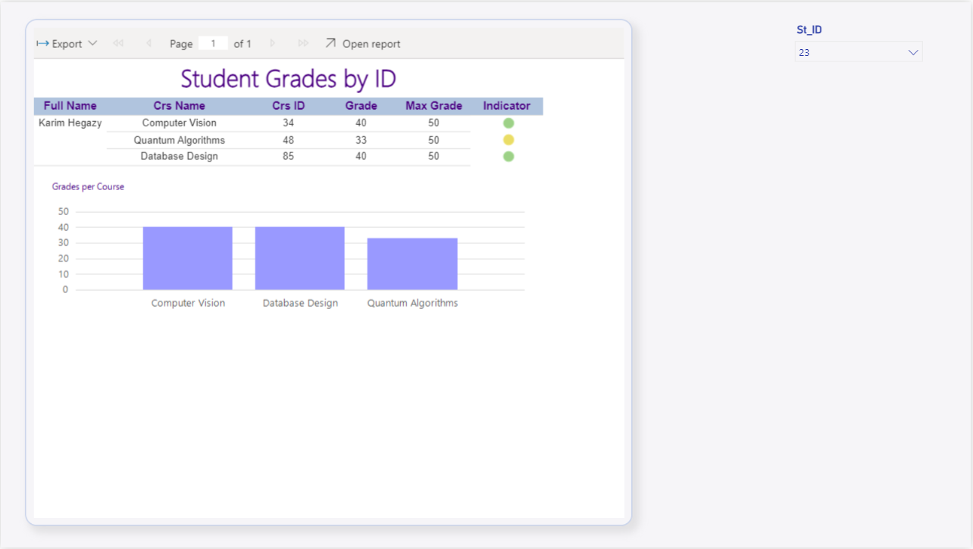
Dashboard

Slide 35
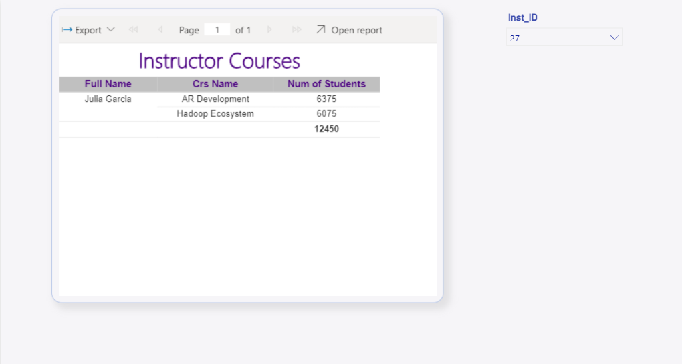
Dashboard

Slide 36
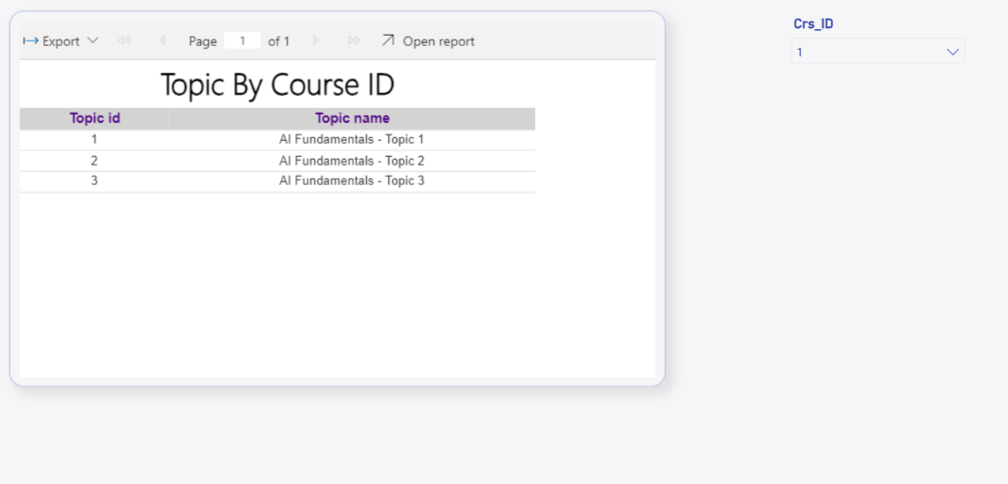
Dashboard

Slide 37
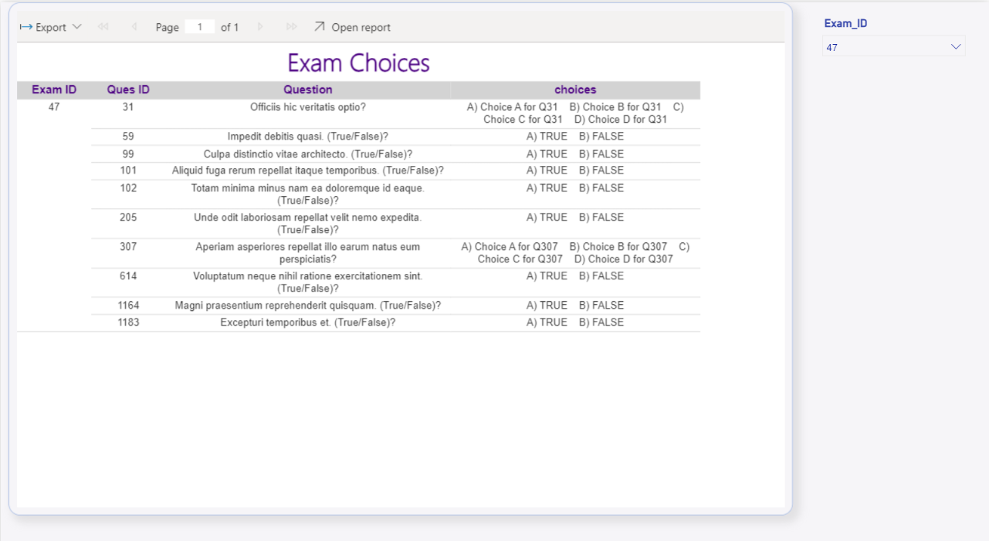
Dashboard

Slide 38
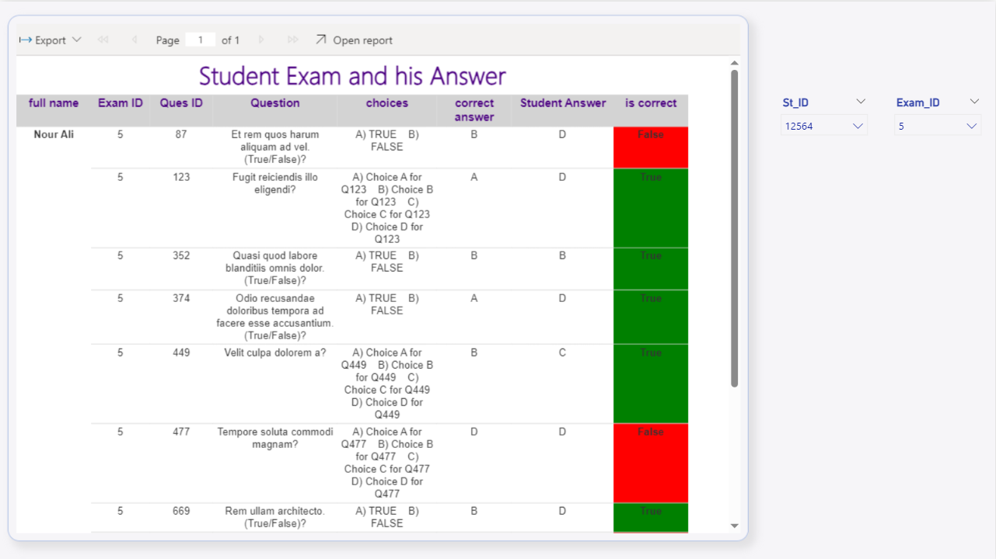
Dashboard

Slide 39
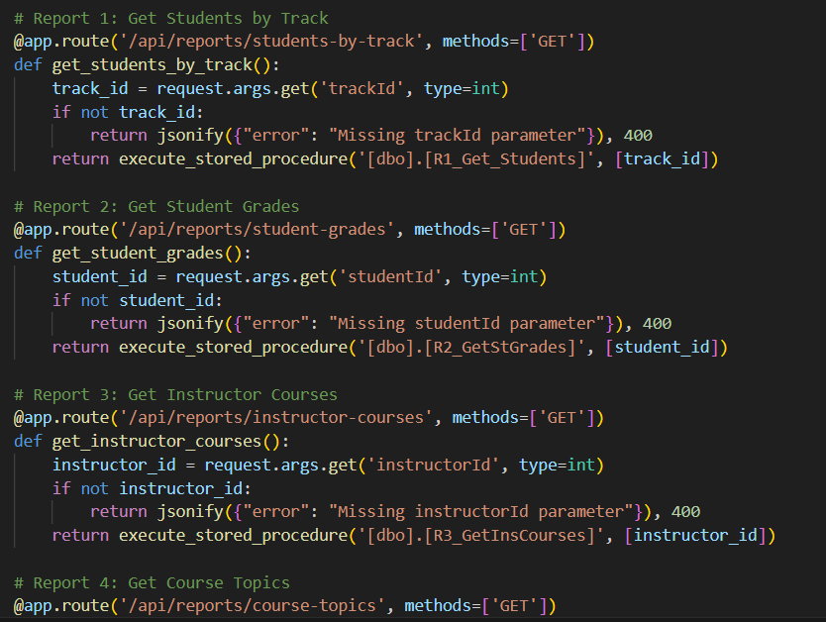
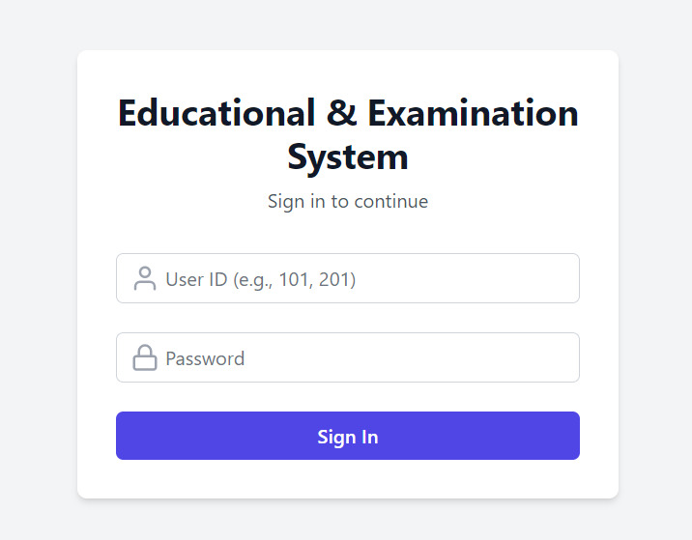
APP

Slide 40
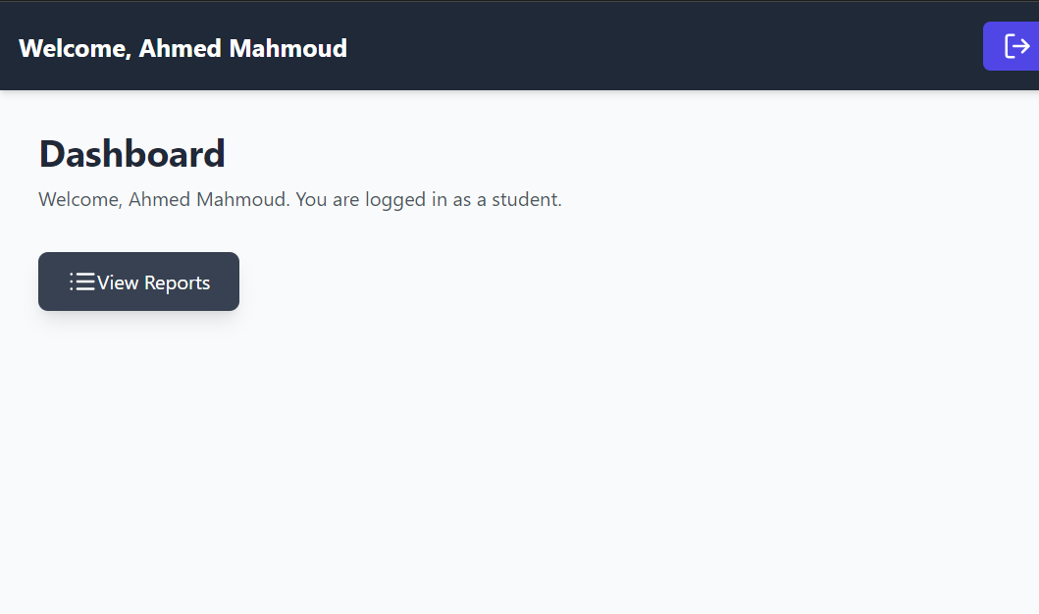
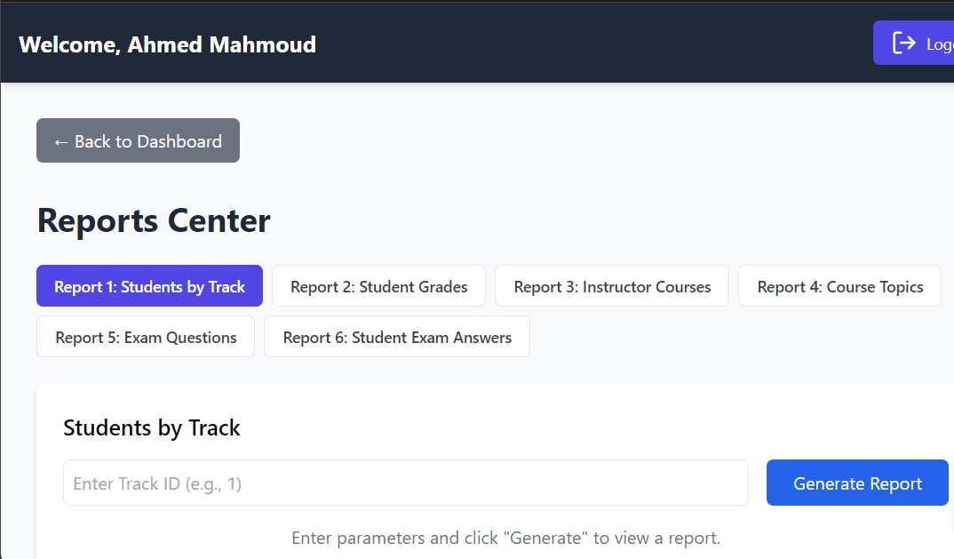
APP

Slide 41
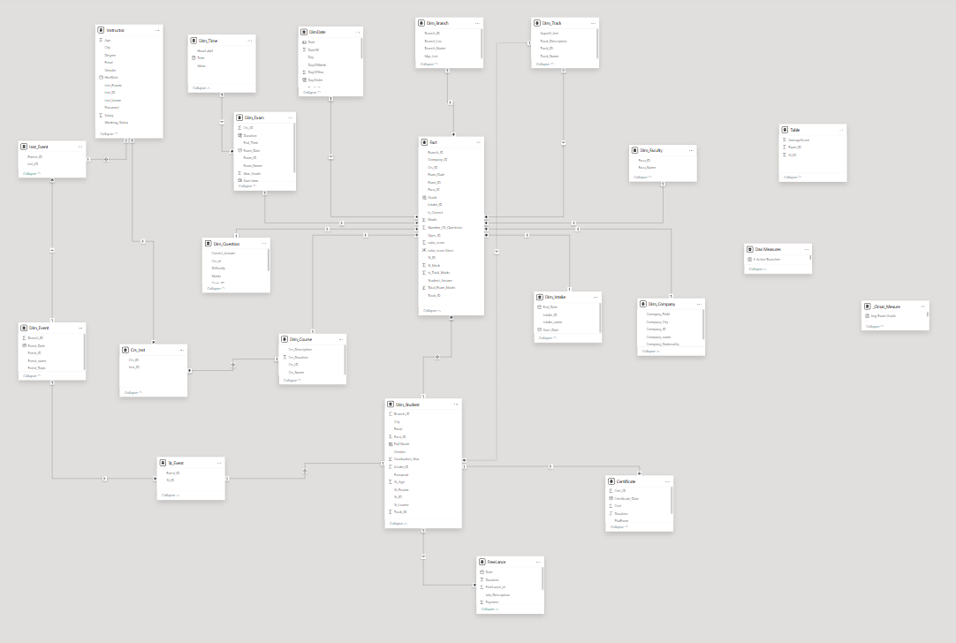
Power BI
Modeling

Slide 42

Dashboard

Slide 43
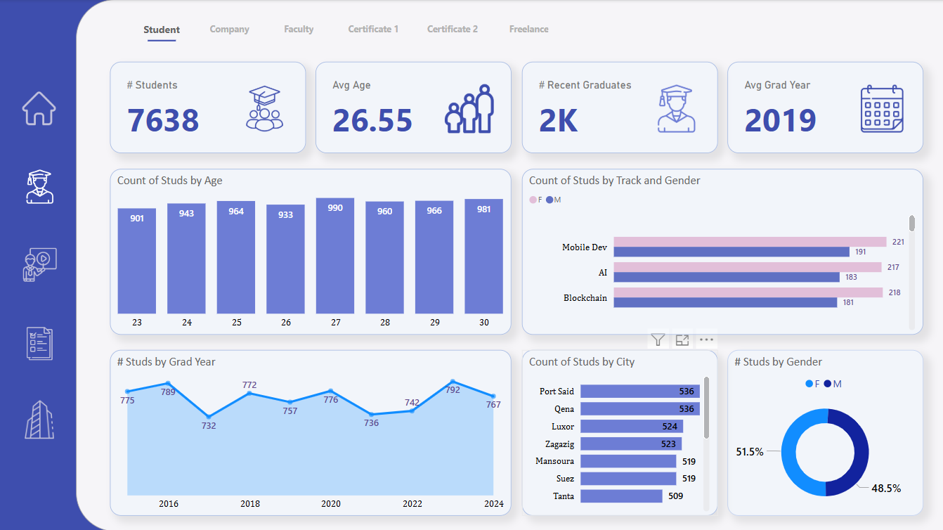
Dashboard

Slide 44
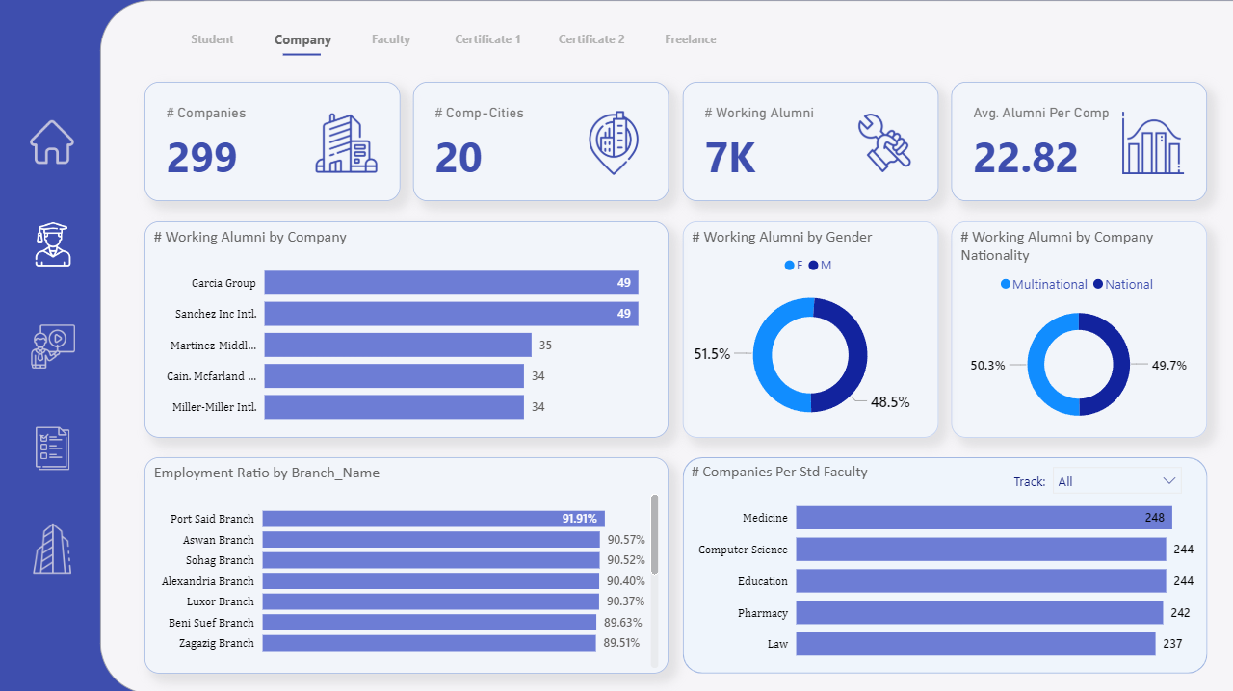
Dashboard

Slide 45

Dashboard

Slide 46

Dashboard

Slide 47

Dashboard

Slide 48

Dashboard

Slide 49

Dashboard

Slide 50

Dashboard

Slide 51

Dashboard

Slide 52

Dashboard

Slide 53

Dashboard

Slide 54

Dashboard

Slide 55

Dashboard

Slide 56

Dashboard

Slide 57

Dashboard

Slide 58

Dashboard

Slide 59

Dashboard

Slide 60
Thank You

