Slide 1
HR Attrition
Where we lose people, why, and what to do about it
Moataz Elmesmary · BI Developer Case Study
1,470 employees · 237 leavers · 16.1% attrition · $6.8M to replace them

Slide 2
The number is 16.1% — but that is not the story
The average hides an eight-fold spread. This is concentrated, not company-wide.
1,470
employees
237
left this year
16.1%
attrition rate
$6.8M
cost to replace them
Three facts that change what we do next
▪ Overtime staff are 28% of the workforce and 54% of everyone who left.
▪ Three frontline roles produce 60% of all leavers — Lab Technician, Research Scientist, Sales Representative.
▪ One in three people who leave does so inside their first year.
A spread-out problem needs a company-wide budget. A concentrated one needs a short, targeted list — which is the rest of this deck.
Notes:
237 people out of 1,470, and roughly 6.8 million dollars to replace them at six months of salary each. But the average misleads. Overtime staff are a quarter of the workforce and more than half the losses. Three roles account for 60%. A third leave in year one. That concentration is actually good news - it means a short targeted list, not a company-wide programme.

Slide 3
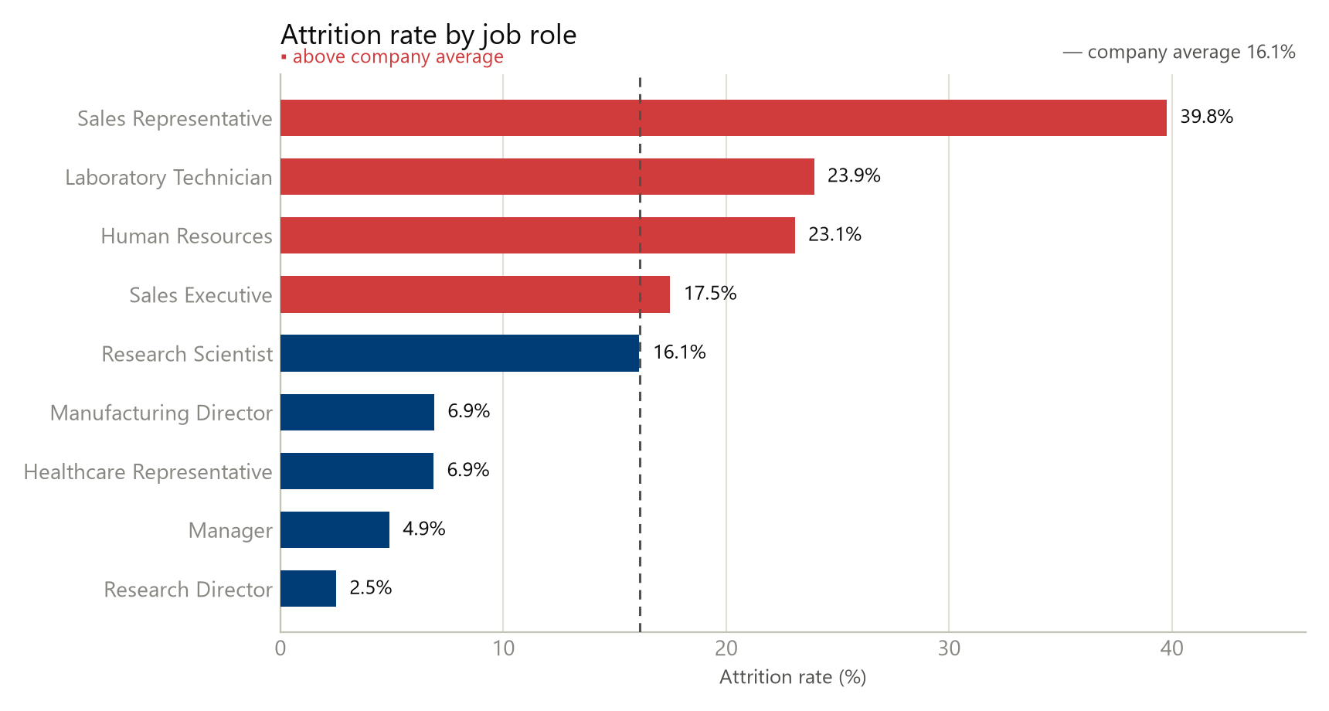
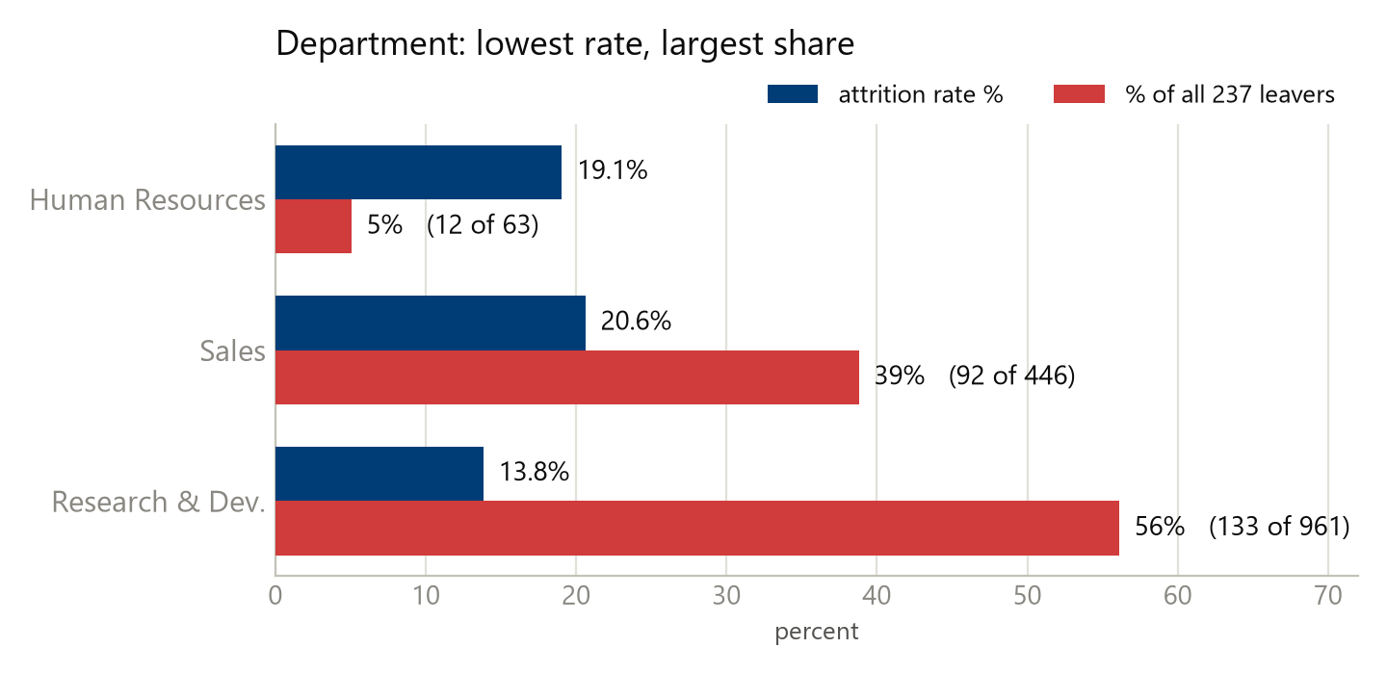
Where it happens
Rate shows intensity. Count shows where the money goes. You need both.
R&D has the lowest rate of any department and still supplies 56% of the leavers — because it holds 961 of the 1,470 people.
RECOMMENDATION
Set department targets on leaver count, not on rate alone
A two-point improvement in R&D saves more people than a four-point improvement in HR. Rate finds the hot spots; count finds the cost.
focus
expected saving / year
Notes:
Ranked by rate, Sales Representatives are worst at nearly 40% - that role turns over completely every two and a half years. But look at the second box: R&D has the lowest rate of any department and still supplies 56% of all leavers, because it holds two thirds of the people. If we ranked only by rate we would send the budget to Sales and miss where most of the cost is. That is why I would set targets on count.

Slide 4
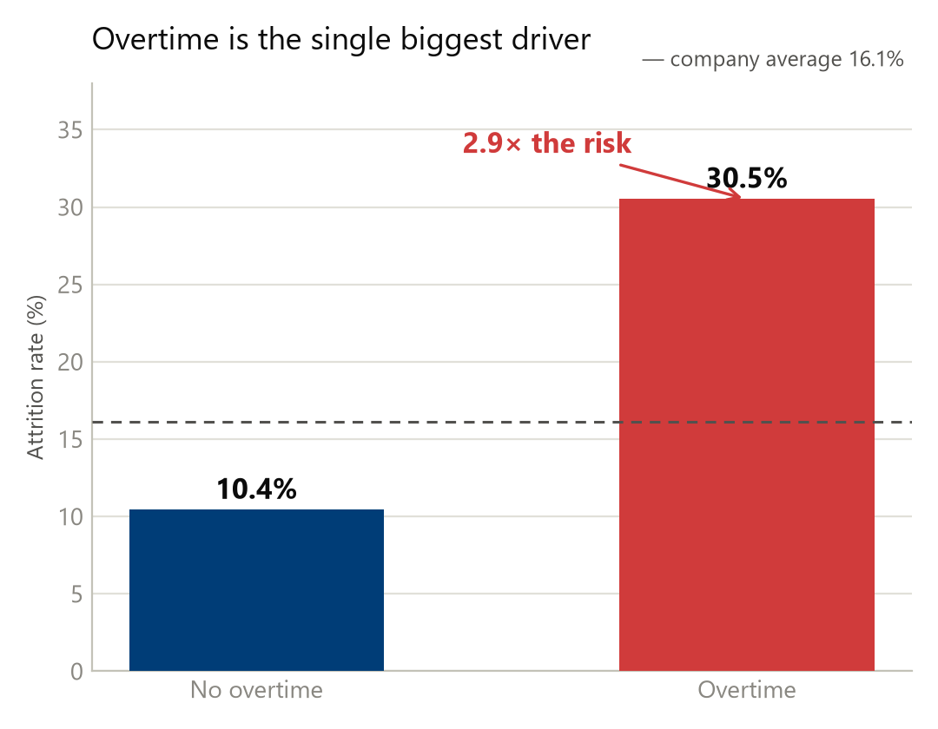
The strongest driver is overtime
It beats job role, pay and age on every statistical test we ran.
2.9×
more likely to leave if you work overtime
54%
of all leavers come from just 28% of staff
87.6
chi-square — the highest of every factor tested
RECOMMENDATION
Overtime governance — mandatory approval, workload rebalancing, comp-off
If overtime staff left at the same rate as everyone else we would lose 43 instead of 127. This costs policy, not budget.
~84 exits
expected saving / year
Notes:
Overtime is the strongest factor in the data. 30.5% against 10.4% - 2.9 times the risk. They are 28% of the workforce and 54% of the losses, and the chi-square is the highest of anything we tested, ahead of job role. Here is the size of the prize: if that group left at the normal rate we would lose 43 instead of 127. That is 84 exits a year, a third of our total attrition, for a policy change rather than a budget line.

Slide 5
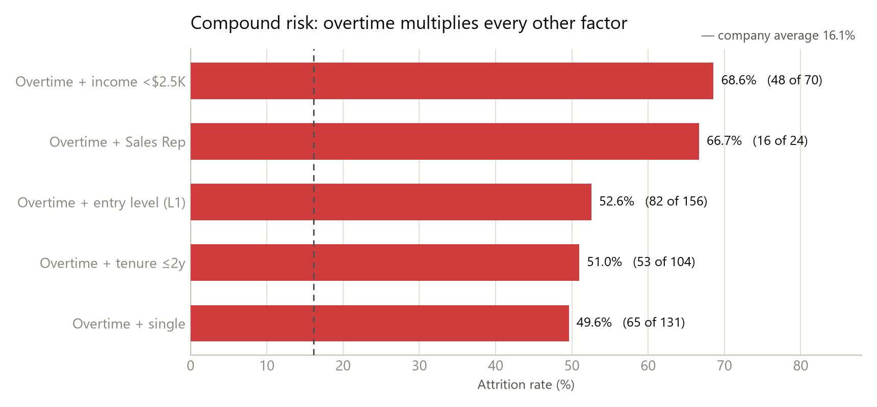
Risk multiplies — it does not add up
Overtime on top of any other weakness turns attrition into a coin flip.
68.6%
of overtime workers earning under $2,500 left.
They are more likely to leave than to stay.
Overtime + entry level is 156 people — 10% of staff, a third of all attrition.
RECOMMENDATION
Build a named 156-person watch list — overtime + job level 1, reviewed monthly
The dashboard already produces this list. Halving that segment is worth 41 people a year; bringing it to the no-overtime rate is worth 66.
~41 exits
expected saving / year
Notes:
Now the important part: these factors do not add, they multiply. Overtime plus low pay is 68.6% - those employees are more likely to leave than to stay. Overtime plus entry level is 52.6%, and that one cell is only 156 people yet produces a third of all our attrition. That is the precision we can act at — not 'improve engagement', but a named list of 156 people that the dashboard already generates.

Slide 6
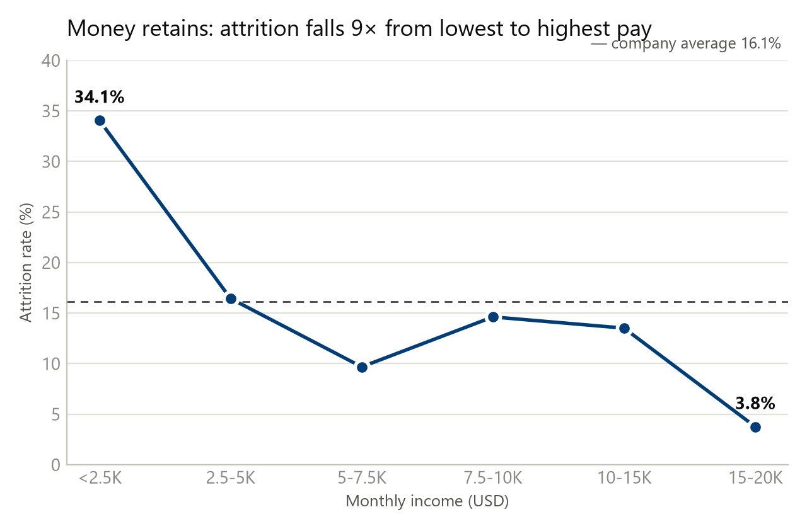
Pay and equity are doing the work
Both show a clean gradient — which is what separates a cause from a coincidence.
$4,787 vs $6,833
Leavers earned 30% less than those who stayed
24.4% vs 9.4%
Zero stock options versus one level of equity
4.4%
Attrition among the 114 top earners — money retains
RECOMMENDATION
A pay floor for the under-$2,500 band, and a first equity grant for the 631 with none
Fixing only the 70 lowest-paid overtime salaries is worth about 36 exits. The equity effect sits entirely in the step from no options to one level.
~55-70 exits
expected saving / year
Notes:
Pay shows a clean gradient - attrition falls nine-fold from the lowest band to the highest, and a gradient that clean is what separates a cause from a coincidence. Leavers earned 30% less than stayers. Equity is sharper still: 24.4% with no stock options against 9.4% with one level, and 65% of everyone who left held none. The whole effect is in the first grant, which makes it a cheap intervention.

Slide 7
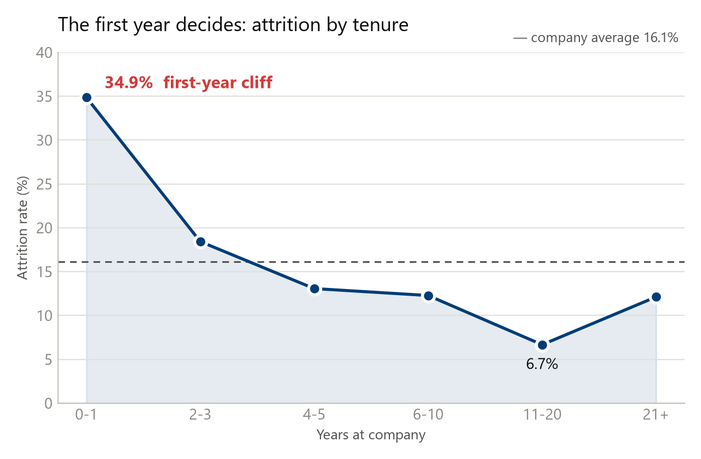
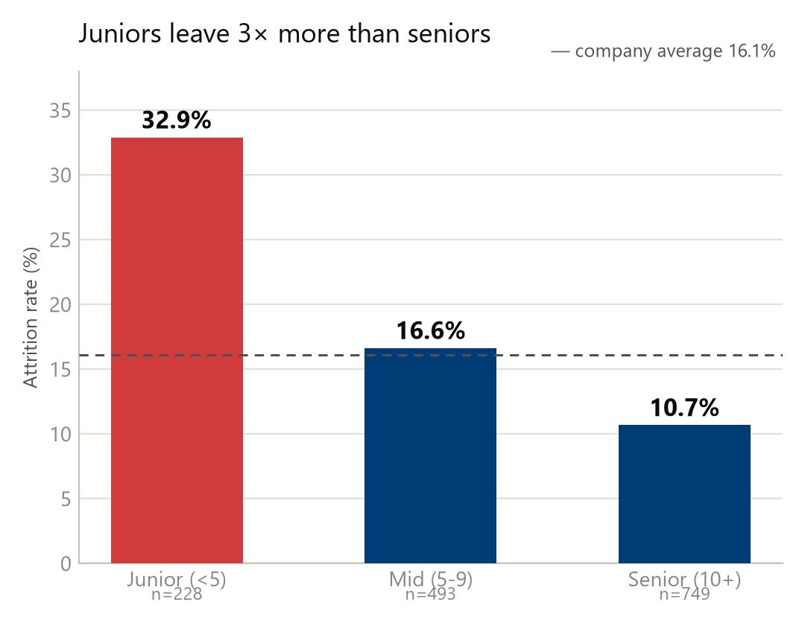
The first year decides
One in three new hires never reaches year two — before onboarding has paid for itself.
RECOMMENDATION
A 12-month protection window — no overtime in year one, plus 30-60-90 onboarding
34.9% leave in year one against 18.4% in years two to three. Half of overtime-loaded new joiners are gone within two years.
~35 exits
expected saving / year
Notes:
Timing matters as much as money. Nearly 35% of first-year employees leave, and juniors leave three times more than seniors. When a new joiner is also given overtime we lose every second one. Every one of those is recruiting and onboarding cost written off before it returns anything - which is why the first-year action sits in the quick wins.

Slide 8
The plan, sequenced
Policy first because it is free. Money second, only where the evidence says it pays back.
0 – 3 MONTHS
governance · no budget
3 – 9 MONTHS
targeted spend
9+ MONTHS
structural
Overtime caps for entry level and first-year staff
~60 exits
Stop routine overtime for Sales Representatives
~11 exits
Triage the bottom satisfaction scores only
~29 exits
Rebuild reporting around risk tiers
focus
Pay floor for the under-$2,500 band
~36 exits
Market benchmark for the three bleeding roles
part of 142
Level-1 equity for the 631 with none
~25-30 exits
Structured 30-60-90 onboarding
~35 exits
Published L1 → L2 progression framework
durable
Manager continuity as a tracked risk flag
durable
Differentiated merit matrix for top performers
15-20 stars
Early-career retention track
durable
Notes:
Sequenced by what it costs. The first three months are policy only - overtime caps, no routine overtime for Sales Reps, triage of only the bottom satisfaction scores, and a rebuilt report. Months three to nine is where money goes in, and only where the data says it pays back. Beyond that it is structural: a published promotion path, manager continuity, and a merit matrix that actually differentiates — because right now we pay our top performers and our flight risks the same raise.

Slide 9
What it is worth
Conservative arithmetic on segments we can name — not a target pulled from the air.
Overtime governance
~84 exits
35% of total attrition
First-year protection + onboarding
~35 exits
15%
Pay floor + first equity grant
~55–70 exits
23–30%
The programmes overlap, so I would not add these up. The honest target is 16.1% → 10–11% within 12 to 18 months.
All of it is reproducible from the model: star schema · 31 DAX measures · what-if simulator · SQL · Python.
Notes:
To close. Overtime governance alone is worth about 84 prevented exits, a third of our attrition. First-year protection another 35. Pay and equity between 55 and 70. I would not add those up, because the programmes overlap - the same person can sit in two of them. The honest combined target is 16.1% down to 10 or 11% within twelve to eighteen months. There is a what-if page in the report where you can move the overtime slider yourself and watch those numbers change. Happy to take questions.

