Slide 1

Mathematical Foundations of AI
Scalars, Vectors, Matrices, and how AI uses them
Scalar
5
Magnitude only
Vector
[3, 4]
Magnitude + direction
Matrix
[[1, 2], [3, 4]]
Collection of vectors
1 / 16
Next

Slide 2

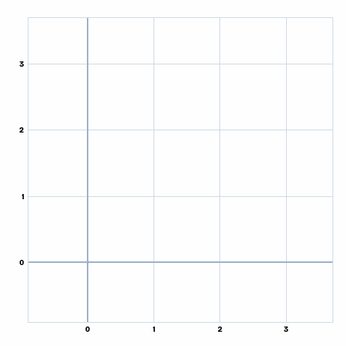
What is a vector?
An ordered list of numbers: order matters, [1, 2] ≠ [2, 1]
Geometrically: an arrow with magnitude (length) and direction, from the tail at the origin to the head
Dimension = number of elements. [1, 2] ∈ R², [1, 4, 7] ∈ R³
R^{n} = every vector of dimension n
Replay
Back
2 / 16
Next

Slide 3

Vector addition
v1 = [1, 2], v2 = [2, 1], v1 + v2 = [3, 3]
Dimensions (number of elements) must match to add
Triangle rule: put the tail of v2 at the head of v1; the sum runs from the very start to the very end
Take either arrow, tail to head (dotted): you land on the same sum
Addition is commutative: A + B = B + A
Matrices follow the same rule: add matching positions, same size required
Replay
Back
3 / 16
Next

Slide 4
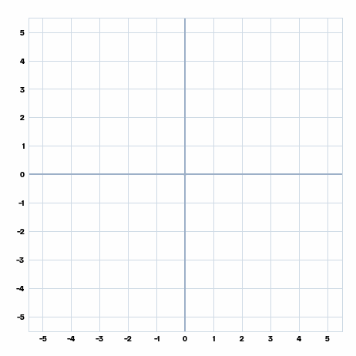
Vector subtraction
v1 = [3, 3], v2 = [4, 1], v1 − v2 = [−1, 2]
v1 − v2 is really v1 + (−v2)
Step 1: draw v1 and v2 from the origin
Step 2: flip v2 into −v2 (rotate it 180°)
Step 3: put the tail of −v2 at the head of v1 (dotted)
Step 4: the arrow from the origin to that new tip is v1 − v2
Not commutative: v1 − v2 ≠ v2 − v1 (opposite directions)
Replay
Back
4 / 16
Next

Slide 5

Vector space & linear combination
Vector space: a set of vectors with addition and scalar multiplication; the result stays in the space
Linear combination: c1·v1 + c2·v2, scale the vectors then add them
Example: v1 = (3, 1), v2 = (−1, 2), w = 2v1 + v2
w = (6, 2) + (−1, 2) = (5, 4)
Replay
Back
5 / 16
Next

Slide 6
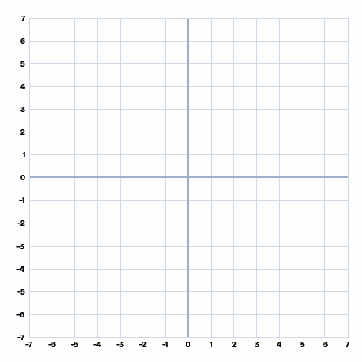
Linear dependence
Dependent: one vector can be written from the others, e.g. w = 2v
Here v = (1, 2) and w = (2, 4)
Every combination a·v + b·w lands on the same line (green dots)
They span only a line: stuck on one line
Replay
Back
6 / 16
Next

Slide 7
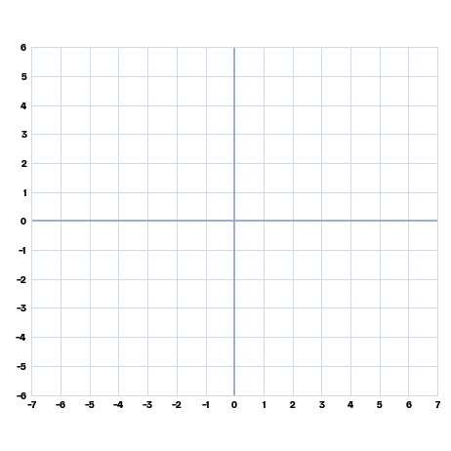
Linear independence & span
Independent: none of them can be built from the others
v = (2, 1), w = (−1, 1): the combinations a·v + b·w (green dots) spread over the plane
Span: the set of ALL combinations of a group of vectors
Two independent vectors span R²; n independent vectors are needed to span R^{n}
Replay
Back
7 / 16
Next

Slide 8
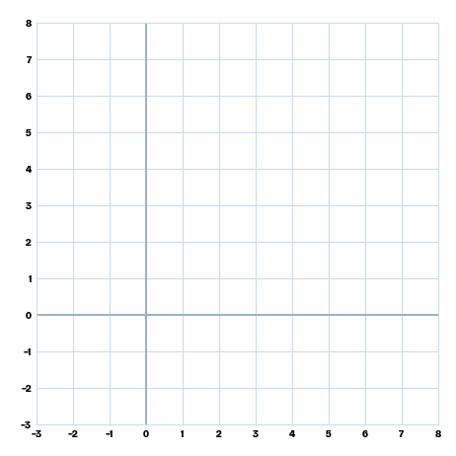
Basis
Basis: linearly independent vectors that span the whole space
In R², any 2 independent vectors form a basis
They give a new grid: here b1 = (2, 1), b2 = (−1, 1)
u = 3·b1 + 1·b2, so u = (5, 4) has coordinates (3, 1) in this basis
Replay
Back
8 / 16
Next

Slide 9
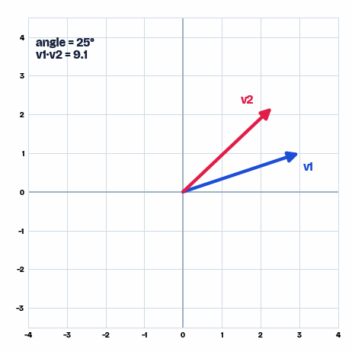
Orthogonal basis
Orthogonal basis: basis vectors that are perpendicular, v1·v2 = 0
Example: v1 = (3, 1), v2 = (−1, 3)
3·(−1) + 1·3 = 0
Turn v2 until the angle reaches 90°: the dot product drops to 0
They do not need to have length 1
Replay
Back
9 / 16
Next

Slide 10
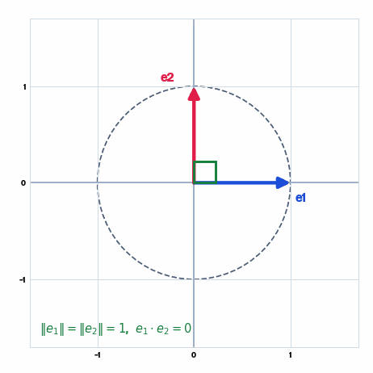
Orthonormal basis
Orthonormal basis: orthogonal AND each vector has length 1 (unit vectors)
Example: v1 = [1, 0], v2 = [0, 1]: ‖v1‖ = ‖v2‖ = 1 and v1·v2 = 0
Rotating the pair keeps it orthonormal: (cos φ, sin φ) and (−sin φ, cos φ)
Both tips stay on the unit circle
Replay
Back
10 / 16
Next

Slide 11

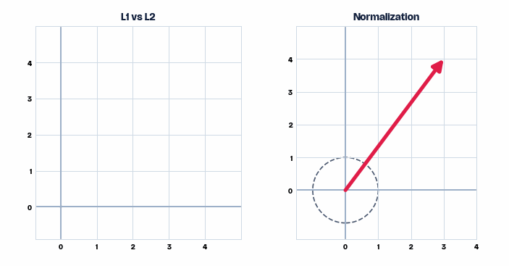
Norms (length) & unit vectors
L1 · Manhattan: ‖v‖₁ = |x| + |y| = |3| + |4| = 7
L2 · Euclidean: ‖v‖₂ = √(x² + y²) = √25 = 5
Norm = length = magnitude. L1 walks the grid; L2 cuts straight through
Normalization: v̂ = v / ‖v‖, same direction, length 1
Example: v = (3, 4): ‖v‖₂ = √(3² + 4²) = 5, so v̂ = (3/5, 4/5) = (0.6, 0.8)
Replay
Back
11 / 16
Next

Slide 12
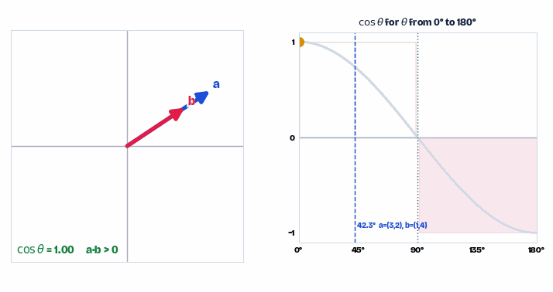
Dot product & cosine similarity
Algebraic: a·b = a₁b₁ + a₂b₂
Geometric: a·b = ‖a‖‖b‖ cos θ, so cos θ = a·b / (‖a‖‖b‖)
a·b > 0 → θ < 90°
a·b = 0 → θ = 90° (orthogonal)
a·b < 0 → θ > 90°
Example: a = (3, 2), b = (1, 4): a·b = 3 + 8 = 11 = √13·√17·cos 42.3°. Turn b from 0° to 180° and cos θ falls from 1 to −1.
The angle between two vectors always runs from 0° to 180°
Replay
Back
12 / 16
Next

Slide 13

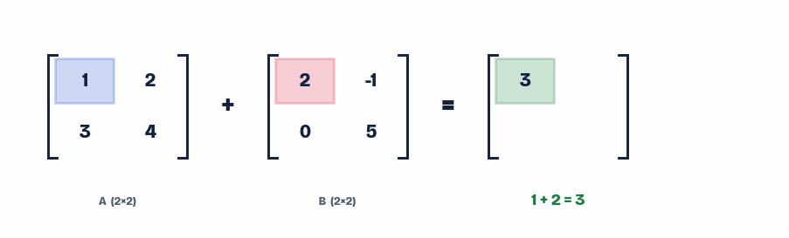
Matrix basics: addition
A rectangular grid of numbers, dimensions written rows × columns
Dimensions rule
m×n · n×p = m×p
inner n's must match
3×4 · 4×2 = 3×2
A + B = B + A (commutative) · A − B ≠ B − A (not commutative) · Scalar multiplication: 2 × [[3, −2], [1, 4]] = [[6, −4], [2, 8]], every entry doubled.
Replay
Back
13 / 16
Next

Slide 14
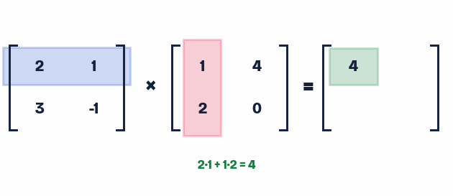
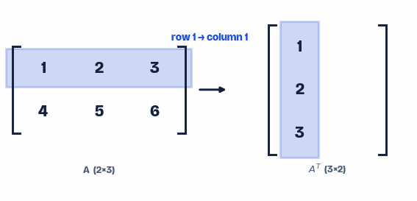
Matrix multiplication & transpose
Multiplication
Transpose
Each result entry = dot product of a row with a column.
Flip rows into columns. (A^{T})^{T} = A. If A = A^{T}, A is symmetric.
AB ≠ BA in general: order matters for matrix multiplication.
Replay
Back
14 / 16
Next

Slide 15




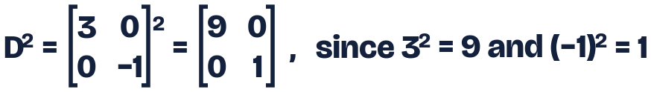
Special matrices & matrix power
Square (n×n)
Zero matrix O
Identity I
Diagonal D
Identity property: A I = A (and I A = A), like multiplying by 1
Matrix powers A^{n} = A × A × … × A only work for SQUARE matrices: multiplication needs matching dimensions every time. Powers of a diagonal matrix are easy: raise each diagonal entry on its own.
Back
15 / 16
Next

Slide 16

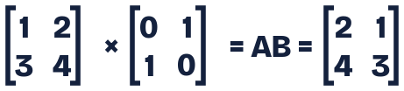
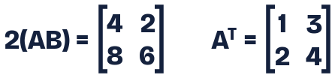

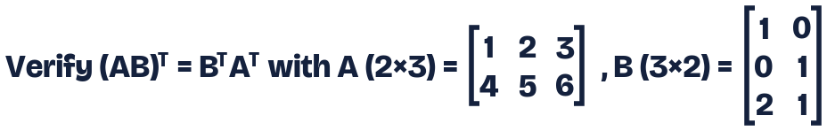
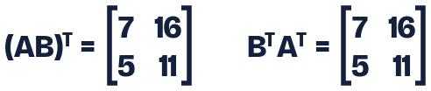
Worked example
Both sides match: transposing a product reverses the order, (AB)^{T} = B^{T}A^{T} (not A^{T}B^{T}).
Back
16 / 16

