Slide 1

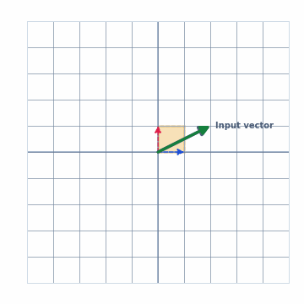
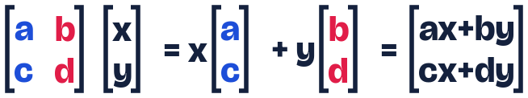
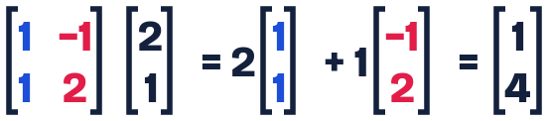
Linear transformation
A matrix is a function: an input vector, multiply, and an output vector.
The output vector is a linear combination of column 1 and column 2: scale column 1 by x, scale column 2 by y, then add.
Replay
Back
1 / 21
Next

Slide 2
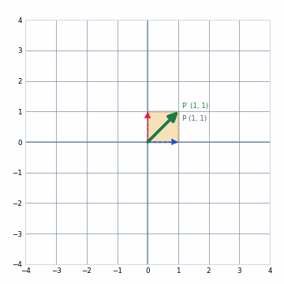
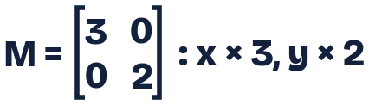
Scaling: stretch
P (1, 1) → P′ (3, 2)
Square becomes a 3 × 2 rectangle: area × 6 (det = 6)
Blue: where (1,0) lands. Pink: where (0,1) lands. Yellow square: unit square (dashed = before). Gray arrow: input vector. Green arrow: output vector.
Replay
Back
2 / 21
Next

Slide 3
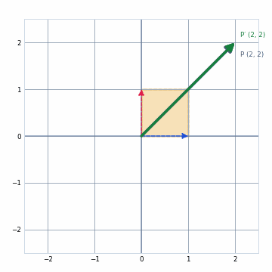
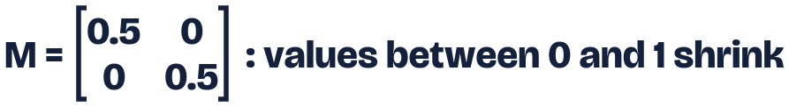
Scaling: shrink
P (2, 2) → P′ (1, 1)
Area × 0.25 (det = 0.25)
Replay
Back
3 / 21
Next

Slide 4
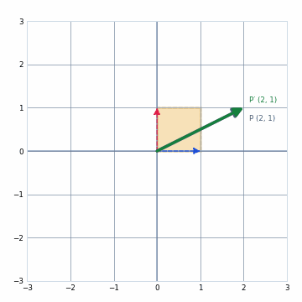

Rotation
P (2, 1) → P′ (0.13, 2.23)
Green arc = 60°, the angle from P to P′
Area unchanged (det = 1)
Replay
Back
4 / 21
Next

Slide 5

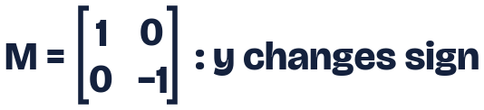
Reflection: across the x-axis
P (2, 1) → P′ (2, −1)
Orientation reverses (det = −1)
Replay
Back
5 / 21
Next

Slide 6

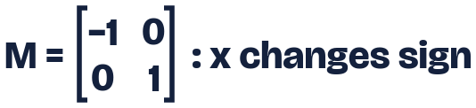
Reflection: across the y-axis
P (2, 1) → P′ (−2, 1)
Orientation reverses (det = −1)
Replay
Back
6 / 21
Next

Slide 7
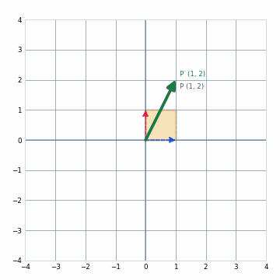
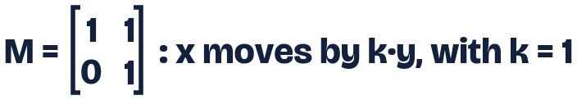
Shear: horizontal
P (1, 2) → P′ (3, 2)
The square leans; area unchanged (det = 1)
Replay
Back
7 / 21
Next

Slide 8
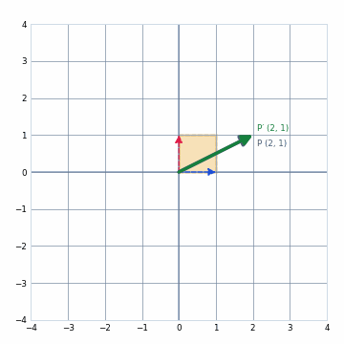
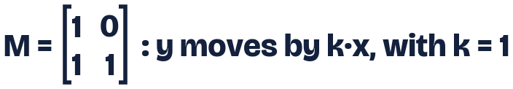
Shear: vertical
P (2, 1) → P′ (2, 3)
The square leans; area unchanged (det = 1)
Replay
Back
8 / 21
Next

Slide 9
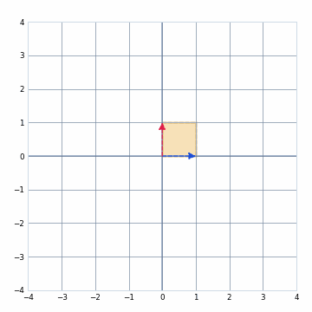

The determinant
|det| is the factor the area is multiplied by
Sign: positive keeps orientation, negative flips it
Zero: the plane collapses onto a line
Replay
Back
9 / 21
Next

Slide 10
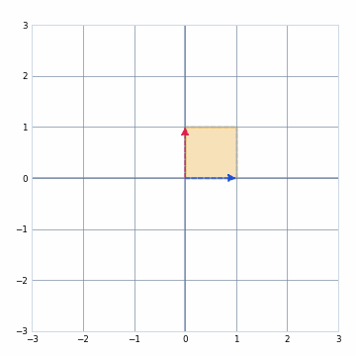
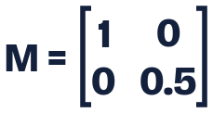
Area gets smaller: |det| below 1
det = 1·0.5 − 0·0 = 0.5
Unit square (area 1) becomes area 0.5
Replay
Back
10 / 21
Next

Slide 11
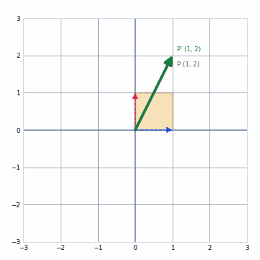
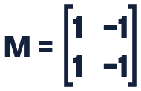
Area becomes 0: dependent columns
Columns (1, 1) and (−1, −1) lie on one line: linearly dependent
det = 0: the plane collapses onto y = x
P (1, 2) → P′ (−1, −1). The move cannot be undone
Replay
Back
11 / 21
Next

Slide 12

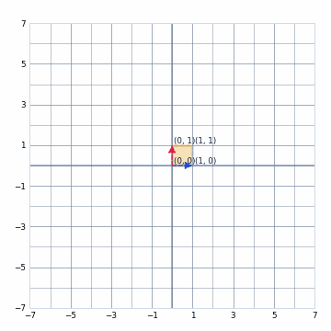
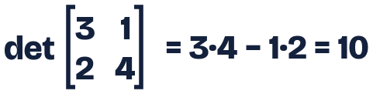
Q10: 2×2 determinant
Unit square becomes area 10
Orientation kept (positive sign)
Replay
Back
12 / 21
Next

Slide 13
Q11: det(A) = −6
Areas are multiplied by 6
Negative sign: orientation is reversed (mirror image)
Replay
Back
13 / 21
Next

Slide 14
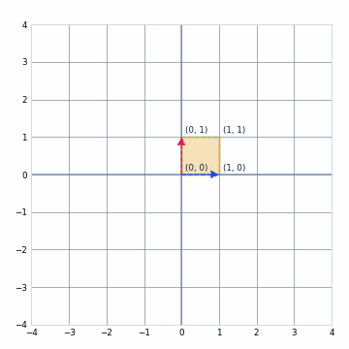
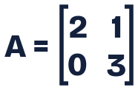
Q12: Unit square transformation
(0,0) → (0, 0) and (1,0) → (2, 0)
(1,1) → (3, 3) and (0,1) → (1, 3)
Area = 6 = det(A) = 2·3 − 1·0
Replay
Back
14 / 21
Next

Slide 15
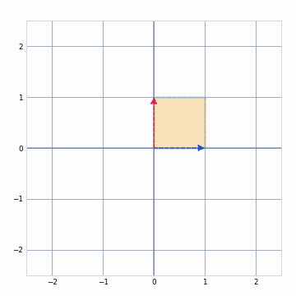
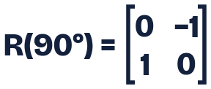
Q16: 90° counterclockwise matrix
(1, 0) → (0, 1) and (0, 1) → (−1, 0)
cos 90° = 0 and sin 90° = 1
Green arc = 90°
Replay
Back
15 / 21
Next

Slide 16
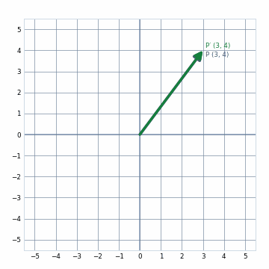
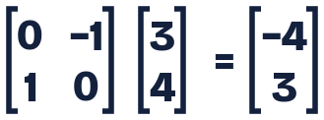
Q17: Rotate (3, 4) by 90°
(3, 4) → (−4, 3)
Distance from the origin stays 5
Replay
Back
16 / 21
Next

Slide 17
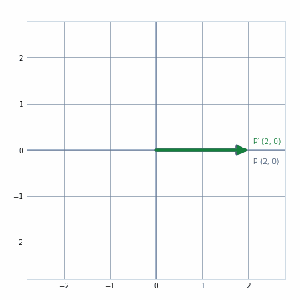
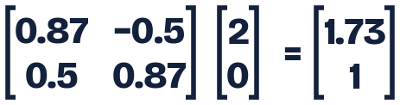
Q18: 30° rotation of (2, 0)
(2, 0) → (√3, 1) ≈ (1.73, 1)
Green arc = 30°
Replay
Back
17 / 21
Next

Slide 18
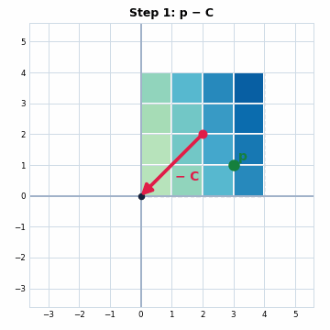
Q19: Rotate a 4×4 image by 45°
A rotation spins around the origin, not the image center C = (2, 2).
1 Move to origin: p₁ = p − C
2 Rotate 45°: p₂ = R(45°)·p₁
3 Move back: p₃ = p₂ + C, then resample
p′ = R(45°)(p − C) + C
Example: p = (3, 1) → (1, −1) → (1.41, 0) → (3.41, 2)
Play all
1 Move
2 Rotate
3 Move back
Back
18 / 21
Next

Slide 19
Q19, step 1: move to origin
p₁ = p − C, with C = (2, 2)
The red dot (center) lands on the origin O
Example: (3, 1) − (2, 2) = (1, −1)
Play all
1 Move
2 Rotate
3 Move back
Back
19 / 21
Next

Slide 20
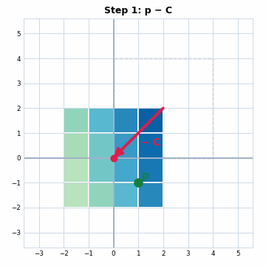
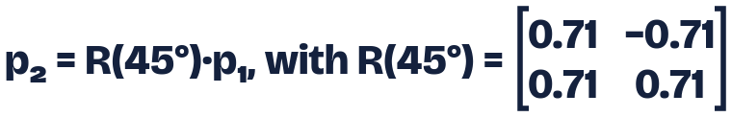
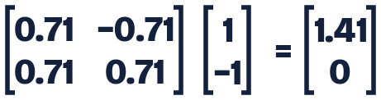
Q19, step 2: rotate 45°
The whole image turns around O
Play all
1 Move
2 Rotate
3 Move back
Back
20 / 21
Next

Slide 21
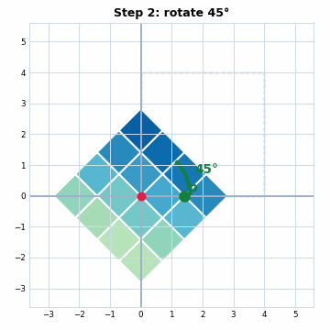
Q19, step 3: move back
p₃ = p₂ + C, then resample the pixels
Example: (1.41, 0) + (2, 2) = (3.41, 2)
Resampling fills each new pixel from nearby old ones
Play all
1 Move
2 Rotate
3 Move back
Back
21 / 21
Next

