Slide 1
Used Cars Market Analysis in Egypt
Final Project – Data Analysis Course
Faculty of Computer and Information Systems
Egypt University of Informatics
Students: Al Moataz bellah Mohamed, Ali Amin, Ahmed El Khateeb, Ahmed Sherif

Slide 2
Introduction
The automotive sector in Egypt has changed significantly due to economic pressure and shifting consumer demand. This study analyzes how factors like brand, mileage, model year, and transmission type affect used car prices.

Slide 3
Research Objectives
1. How does mileage affect car price?
2. Does color effect the pricing of a car?
3. Do newer high-mileage models sell for more than older low-mileage models?
4. Is there a price difference between automatic and manual transmissions?

Slide 4
Hypotheses
H1: Cars with higher mileage are priced lower.
H3: Newer models retain value even with high mileage.
H4: There is a significant price difference between automatic and manual cars.
H2:There is no statistically significant difference in the average prices of used cars based on their color.

Slide 5

Car Brand Distribution
Most listed brands are Hyundai, Chevrolet, and Fiat. These brands are common due to their reliability and affordability.

Slide 6
Mileage vs Price
Pearson correlation shows a significant but weak negative relationship (r = -0.17, p = 0.000).
This means higher mileage generally lowers the price.

Slide 7
Top Brands by Price
Luxury brands like Bentley and Aston Martin command the highest average prices.
This confirms brand value strongly influences used car prices.

Slide 8
Model Year vs Mileage
Using Welch’s t-test, we found that newer high-mileage cars are priced higher than older low-mileage cars (p = 0.015).
Newer models hold value better despite mileage.

Slide 9
Transmission Impact
Automatic cars show a significant price advantage over manual ones (p = 1.26e-13).
They also have broader price ranges, showing higher demand.

Slide 10
Methodology
We used Pearson correlation and Welch’s t-test to test our hypotheses.
Statistical significance set at α = 0.05.

Slide 11
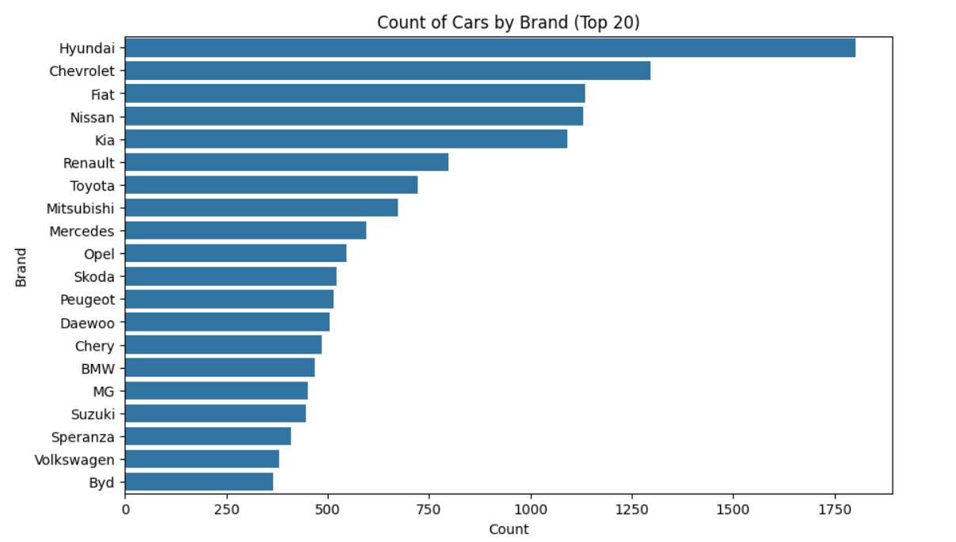
Top Listed Car Brands
This count plot chart shows the 20 most frequently listed car brands in Egypt's used car market.

Slide 12
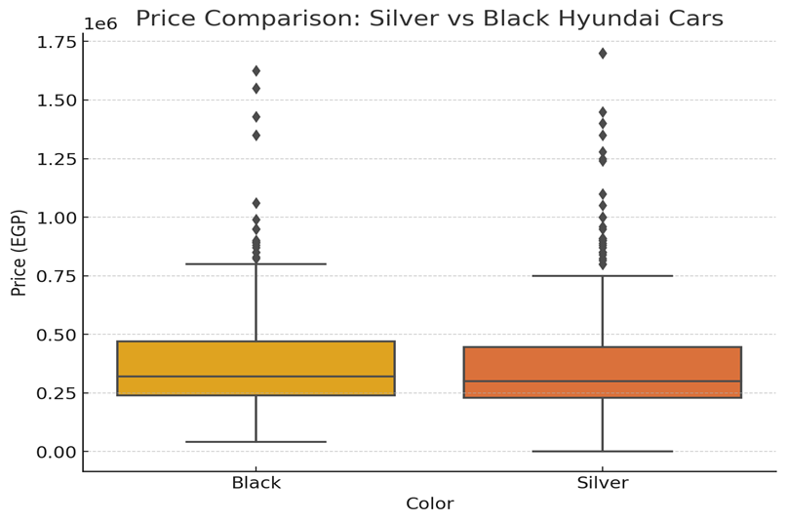
Color vs price
This box plot shows a price comparison between Black and Silver Hyundai cars in Egypt.

Slide 13
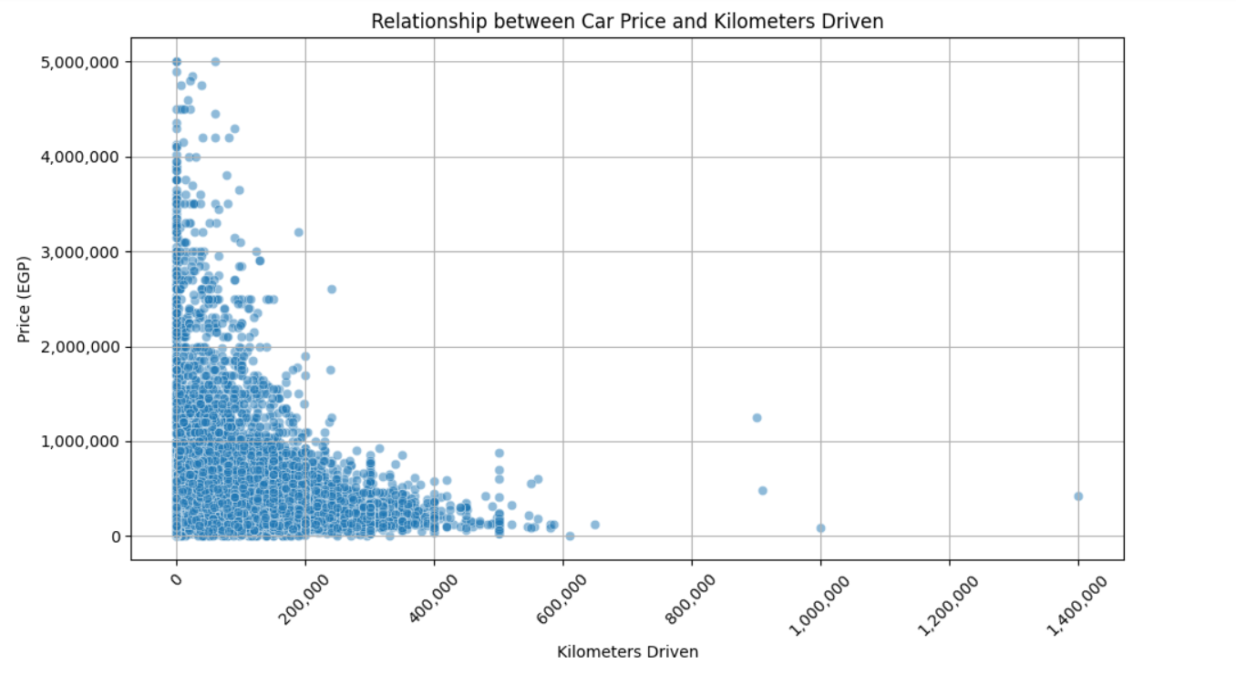
Mileage vs. Average Price
This scatter plot chart illustrates the declining trend of car prices as mileage increases.

Slide 14
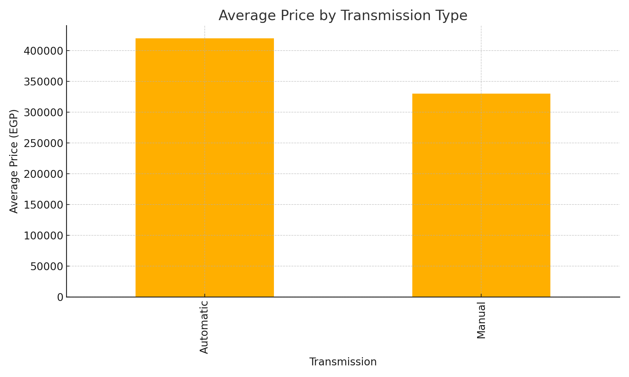
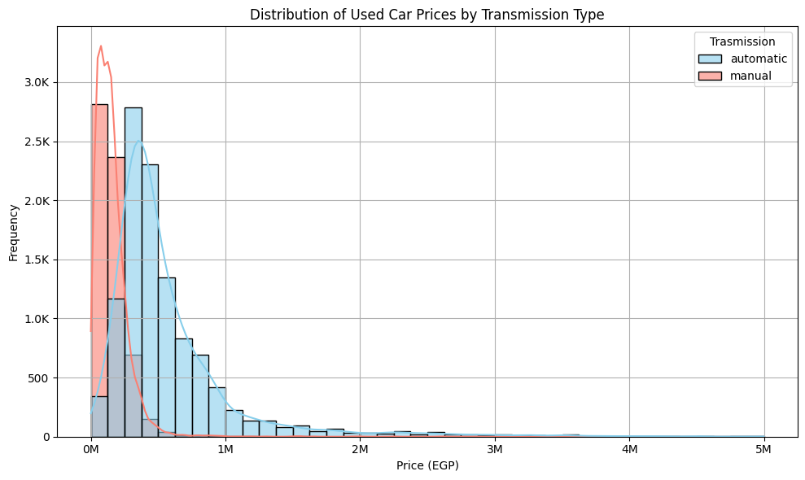
Average Price by Transmission Type
Automatic cars are priced significantly higher than manual cars, as shown in this bar chart.

Slide 15
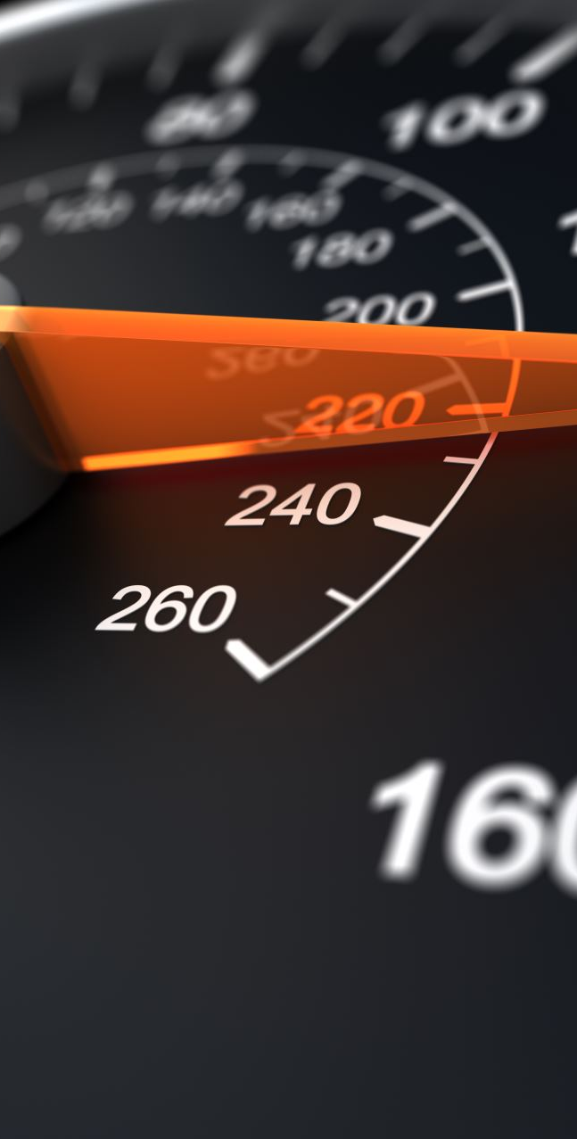
Conclusion
While mileage does influence car pricing, it is not the most decisive factor. Our analysis reveals that brand reputation, model year, and transmission type play a significantly greater role in determining a vehicle's value. In particular, automatic transmissions and luxury brands consistently command higher prices, highlighting buyer preferences and market trends in Egypt’s used car market.

