Slide 1



PRESENTATION
I am thrilled to introduce you to the market leader in multivendor platforms. Our platform is designed to revolutionize the way businesses sell and consumers buy, making it easier and more efficient than ever before. Get ready to be amazed by the features and capabilities of our platform, and learn how it can help your business grow. Trust me, you don't want to miss this!"

Slide 2

HOTELS VENDORS
Smarter Together

Slide 3

Value As A Service
"As a former financial auditor and business analyst, I have always been fascinated by the inner workings of the hospitality industry. Through my experience, I noticed that many hotels were struggling with their procurement process, facing high costs and inefficiencies. I knew there had to be a better way. That's why I founded Hotels Vendors, a multivendor platform designed to streamline the procurement process for hotels. Our platform leverages my background in financial audit and business analysis to bring transparency and efficiency to the purchasing process, resulting in significant cost savings for our clients. We are committed to helping hotels succeed by providing them with the tools they need to optimize their purchasing process and stay competitive in today's economy.”
Moataz Ghani
FOUNDER & CEO

Slide 4
Index
Slide 1-4: Introduction
Title of presentation: "Hotels Vendors: Streamlining Procurement for the Hospitality Industry"
Brief overview of Hotels Vendors and its mission
Slide 5-6 : Problem
Overview of common issues faced by hotels in the procurement process
Statistics and data on the costs and inefficiencies of traditional procurement methods
Slide 7: Solution
Introduction of Hotels Vendors as a solution to these problems
Explanation of how Hotels Vendors streamlines the procurement process for hotels
Slide 4: Example
Real-life examples of hotels that have successfully implemented Hotels Vendors and the cost savings they have achieved
Testimonials from satisfied customers
Slide 5: Features
Detailed overview of the features and benefits of using Hotels Vendors, such as:
  Automated purchasing and negotiation
  Multi-vendor marketplace
  Factoring and logistics solutions
  Real-time data and analytics
  Customizable and secure platform
Slide 6: Conclusion
Summary of the benefits of using Hotels Vendors
Call to action for interested parties to visit the website and learn more
Contact information for further inquiry

Slide 5
The Pains common issues faced by hotels in the procurement process include:
High costs: Traditional procurement methods often involve lengthy negotiations and bidding processes, which can result in higher costs for hotels.
2. Lack of transparency: It can be difficult for hotels to get a clear overview of their purchasing process, making it difficult to identify areas for improvement.
3. Inefficiencies: Traditional procurement methods can be time-consuming and resource-intensive, resulting in delays and increased costs.
4. Limited vendor options: Hotels may have limited options for vendors, which can result in higher prices and reduced flexibility.
5. Maintaining adequate inventory levels and tracking inventory movements can be a challenge for hotels.
6. Delayed payment terms: Traditional procurement methods may involve delayed payment terms, which can negatively impact a hotel's cash flow.
7. Difficulty in achieving economies of scale: Many hotels may not have the purchasing power to achieve cost savings through bulk purchasing.
8. Lack of data and analytics: Traditional procurement methods may not provide real-time data and analytics, making it difficult for hotels to make informed purchasing decisions.

Slide 6
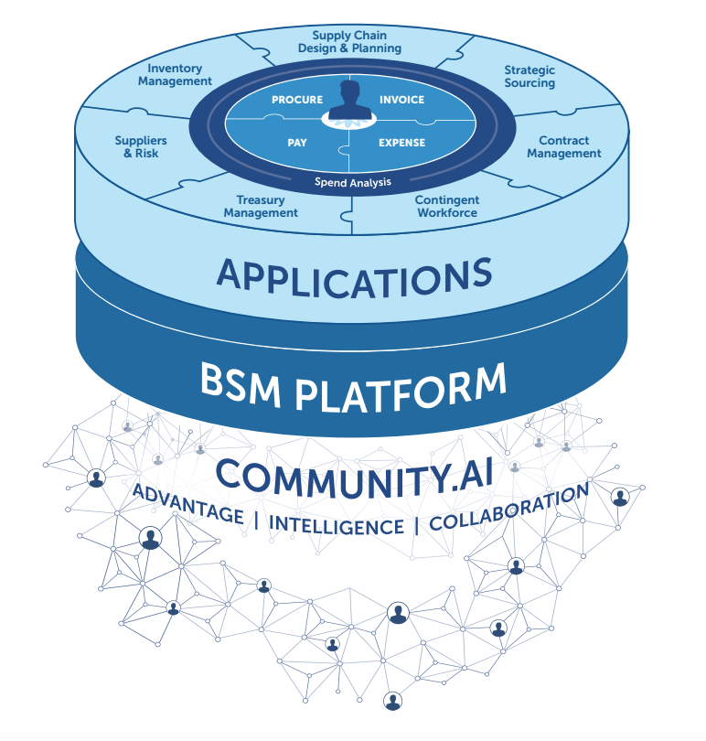
  Hotels Vendors?
Hotels Vendors is an automated purchasing platform for the hospitality industry. It aims to streamline the procurement process for hotels by providing a multi-vendor marketplace, factoring and logistics solutions, real-time data and analytics, and a customizable and secure platform. By using Hotels Vendors, hotels can negotiate better prices, reduce inventory carrying costs, and improve cash flow through early payment terms. The mission of Hotels Vendors is to help hotels save costs and improve their bottom line by optimizing their purchasing process and stay competitive in today's economy.

Slide 7


Hotels Vendors
Hotels Vendors is a powerful solution for streamlining the procurement process for hotels.
Our platform offers a centralized location for hotels to purchase goods and services from multiple vendors, making it easy to search, compare and purchase.
Say goodbye to manual sourcing and negotiations with individual vendors, Hotels Vendors saves time and money.
By using Hotels Vendors, hotels can take control of costs and improve supplier relationships with centralized purchasing and tracking capabilities.
Our solution offers a more efficient and cost-effective way for hotels to manage their procurement needs.
With Hotels Vendors, hotels can focus on providing the best service to their guests, while we handle the procurement process for them.

Slide 8
  4 Reasons Hotels Vendors is Different
COMPREHENSIVE
TRANSPARENCY
USER-CENTRIC
INSIGHTS
We take a comprehensive approach to spend management with a unified platform that allows you to see all your spend in one place. No matter what our customers need, we have a solution for them.
We believe in being open, always. We build trust through transparency, support genuine partnerships, and welcome new ideas. With a focus on strengthening relationships with suppliers to integrating with leading technologies and providing a healthy competitive market.
Easy for every user in your organization to
get things done fast. From Forecasting Procurement needs and supplies shortages to search suppliers and creating POs our
customers can often be up and running on the platform within
minutes.
We’re smarter together, which is why we help our customers be more effective in managing their spend by offering prescriptive recommendations, from savings opportunities to supplier insights

Slide 9
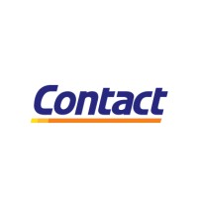
  Digitally Transforming Logistics
Source to Pay
Inventory Management
Supply Chain
Design & Planning Cashflow & Payments Risk & Compliance Platform
Automating the Procurement Process
Optimizing Inventory to Avoid Carrying Costs
Cash flow ( Hotels with a certain budget ) finding alternatives in prices
Cash flow finding cash prices and better advantage with the supplier
Forced competitive pricing
Reducing procurement costs on hotels
Reducing sales and marketing costs
Optimizing the logistics process
Digital transformation of procurement processes
Proper Purchase Order Approvement Cycles
Financing Suppliers instead of delayed payments

Slide 10
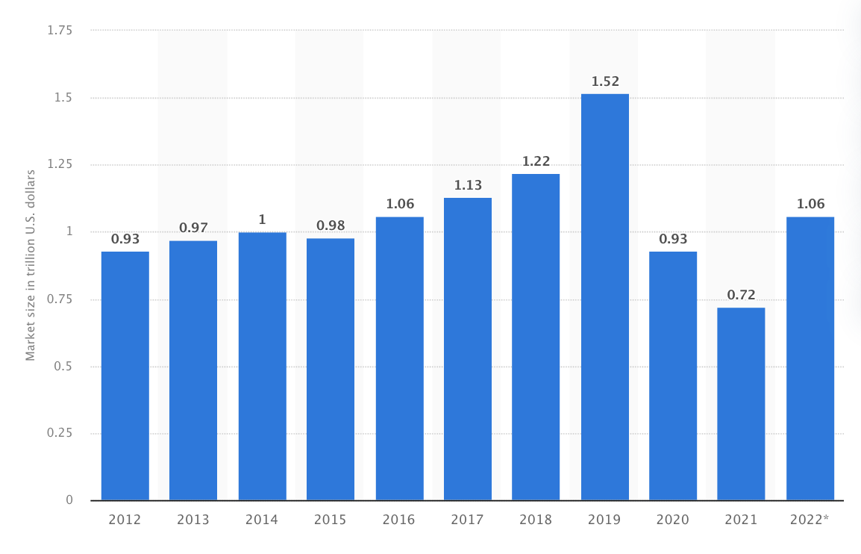
Estimated Market Size
  Market
1.14 B USD
Our Target Market Share
  Egyptian Hospitality Market Size
32% Egyptian Market
Hotels Target in Sharm & Hurgada
50% Acquisition of Hotels
Management Software Market | 4.38% YOY growth in 2020 amid COVID-19 Spread

Slide 11
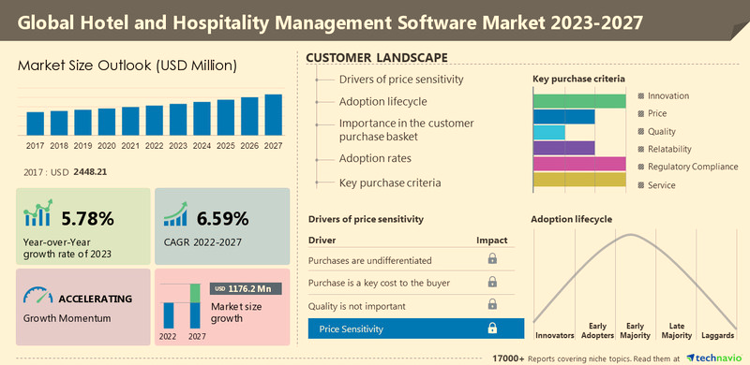

Slide 12
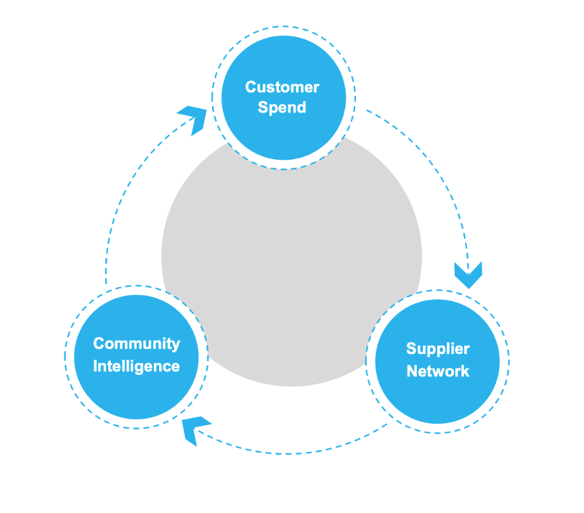

  Revenue Model
Financing Commision for Hotels
Subscription Model for Suppliers
Ads Scheme
Boosting Product Listing
Added Value Services
Outsourcing Procurement

Slide 13

  How can we collaborate?

