Slide 1
Deep Learning Project
Submitted by: Moataz Alaa Eldeeb
Under supervision of:
Dr. Alaa Hamdy

Slide 2
Project Description

Slide 3
Resnet50 Pretrained
Face Emotion Detection FER2013
To our best knowledge, our model achieves state-of-the- art single-network accuracy of 73.28 %
The data consists of 48x48 pixel grayscale images of faces. The faces have been automatically registered so that the face is more or less centered and occupies about the same amount of space in each image.
Seven categories (0=Angry, 1=Disgust, 2=Fear, 3=Happy, 4=Sad, 5=Surprise, 6=Neutral).

Slide 4
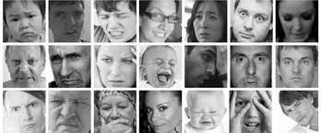
Sample Images from FER2013

Slide 5
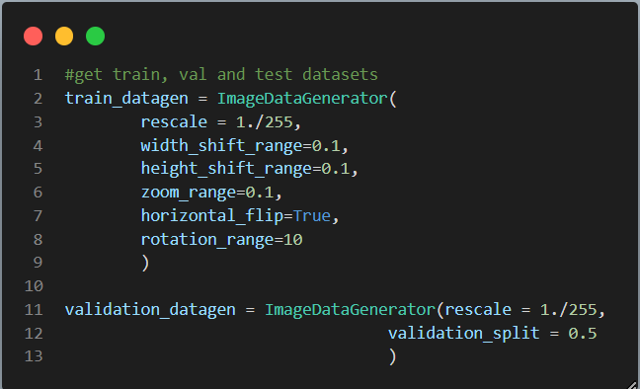
Data Augmentation

Slide 6
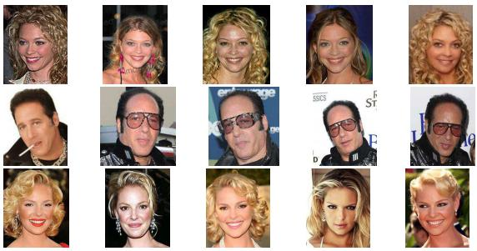
Pretrained Models
Using VGGFace pretrained weights instead of imagenet .
Imagenet weights was tried but the accuracy saturated near 40% after 30 epochs.
Sample VGGFace Dataset.

Slide 7
Resnet50 Pretrained

Slide 8
Resnet50 Pretrained
Freezing the first 170 layer with the same weights as vggface data.
Using dropout before each fully connected layer for regularization
Two models were trained using resnet50, one with class weights because fer2013 data is unbalanced, one without.
Final test accuracy = 70.65
Final validation accuracy = 73.43

Slide 9
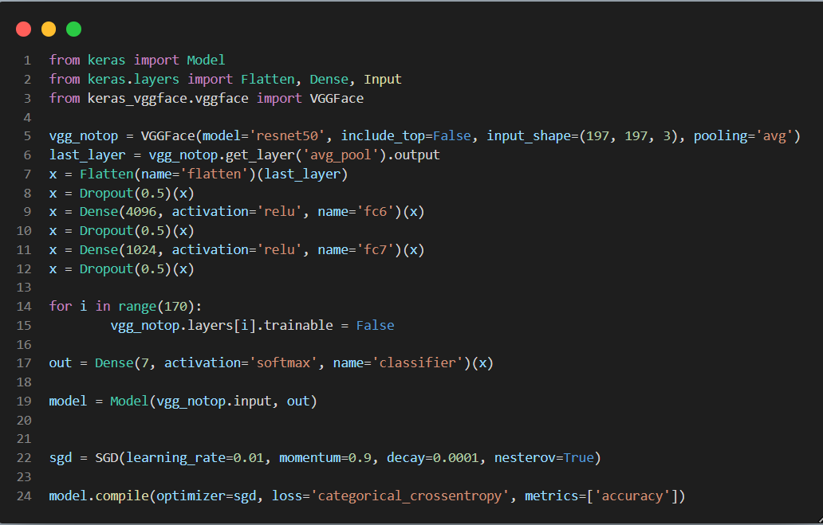
Code Snippet of Pretrained ResNet50

Slide 10
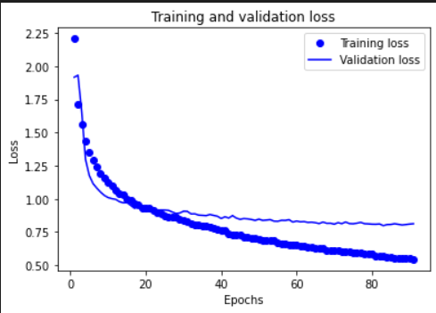
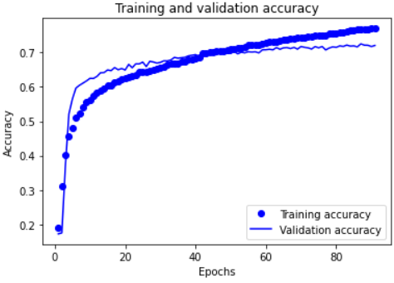
Training curve (with Weighted classes)

Slide 11
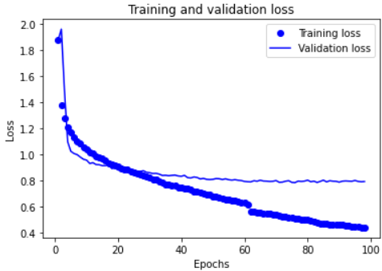
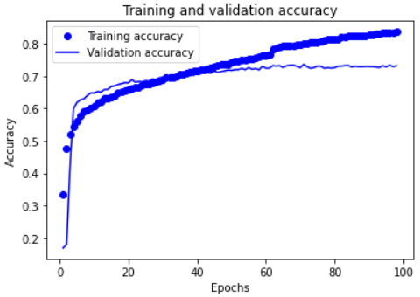
Training curve (without Weighted classes)

Slide 12
VGG16 Pretrained

Slide 13
VGG16 Pretrained
Freezing the first 19 layer with the same weights as vggface data.
Using dropout before each fully connected layer for regularization
Here I only trained one model with weighted classes to balance data.
Final test accuracy = 0.69
Final validation accuracy = 0.70

Slide 14
Code Snippet of Pretrained VGG16

Slide 15
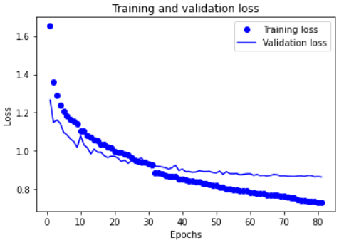
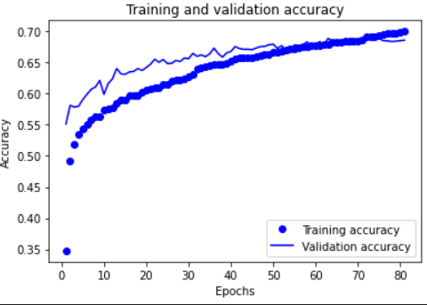
Training curve (with Weighted classes)

Slide 16
Live Testing App

Slide 17
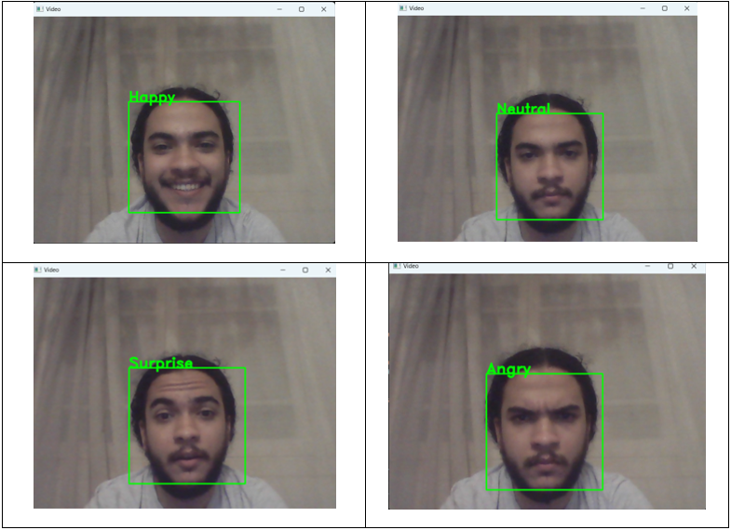
Sample Screenshots of App

Slide 18
Thank You

