Slide 1
Distribution Shift in Medical Imaging
Autoencoder Reconstruction Error as Predictor of Model Performance

Slide 2
Abstract
This project investigates whether autoencoder reconstruction error (RE) can predict machine learning model performance degradation under distribution shift in medical imaging. A convolutional autoencoder trained on NIH adult chest X-rays is evaluated on pediatric and CheXpert datasets. We examine correlations between RE and classifier AUROC drop, demonstrating that RE is a useful unsupervised indicator of dataset shift severity.

Slide 3
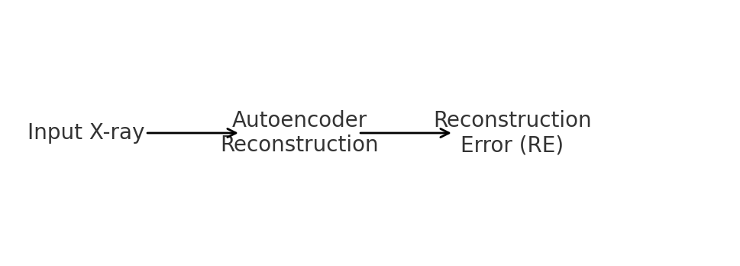
Pipeline Diagram

Slide 4
Limitations
- Autoencoders may miss semantic shifts that do not change pixel-level structure.
- Pediatric vs adult anatomical differences introduce confounding factors.
- Imaging device variability affects texture and quality.
- Reconstruction error may not always correlate linearly with accuracy drop.

