Slide 1
Startups Fail/Success forecast
By Moataz Allam

Slide 2
Startups features background
Who is going to initialize a startup is in doubt if he is going to succeed or fail, We assume that the stakeholders will give all support needed for the start up to succeed but still there are other parameters to take into account
The Goal value, the pledge value, the backers, the time frame (start and deadline difference) and also the business field are all parameters that can affect the result of the startup project.

Slide 3
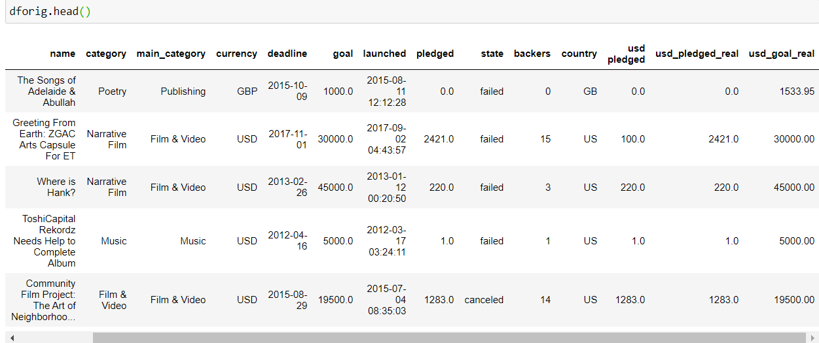
Dataset
From Kaggle we acquired a startup data set collected for three years 2015 to 2018 as follows:

Slide 4
Data cleansing
We removed null rows in any value, and removed some un needed columns then we calculated the time frame (difference between deadline and launched dates).
We also removed all projects that cancelled or in progress . So we kept only the failed and the successful proejcts.

Slide 5
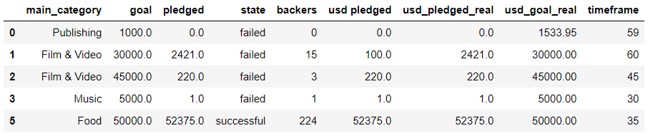
Dataset after cleaning
Total Startups is 331,462 startup with 11 parameter each.

Slide 6
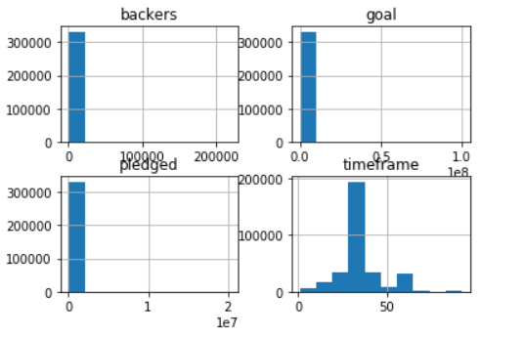
Data analysis & Feature extraction 1
We inspected the histograms of the features and found that they are mostly narrow near Guassian as of below :

Slide 7
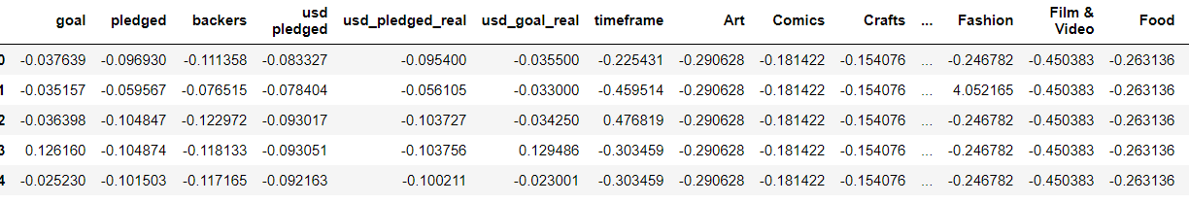
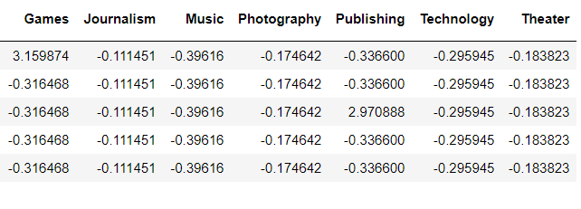
Data analysis & Feature extraction 2
Using Standardization and label Binarizer for the business category we got a float quatity for all the features are now 22.

Slide 8
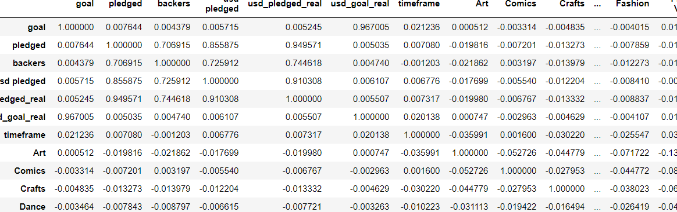
Data analysis & Feature extraction 3
Calculating the correlation matrix yields that we can reduce the feature set to 20. due to high correlations between some features

Slide 9
Data Splitting
We extracted a numver of 33% of the data to be for test and validation while the left 67% is for training
So Training set for Startups = 204581
Test set for Startups = 50383
Validation set for Startups = 50383

Slide 10
Data visualization 1
Visualizing sum of the new 20 features yields that we can have a good set to train as we see clusters of fail/successful for many scattered plots for every 3 features

Slide 11
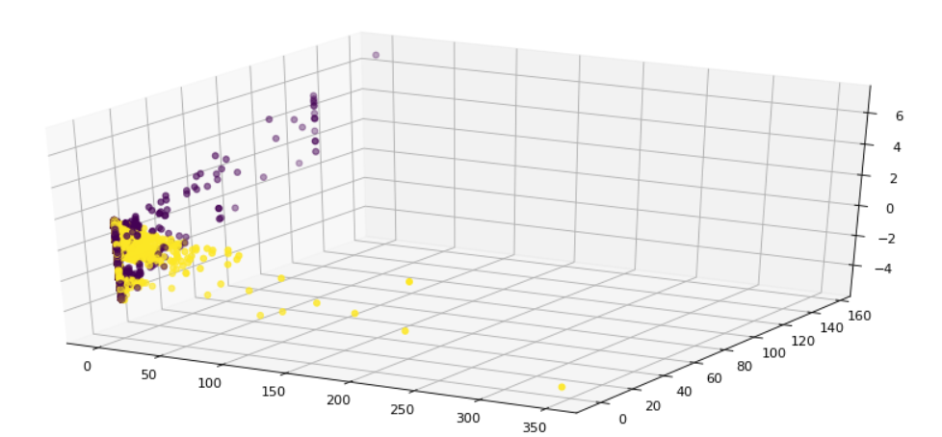
Data visualization 2

Slide 12
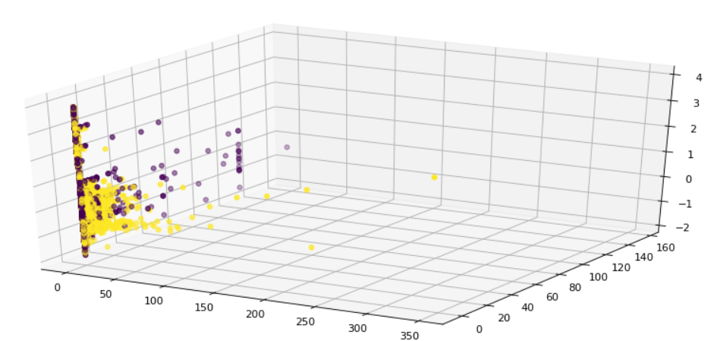
Data visualization 2

Slide 13
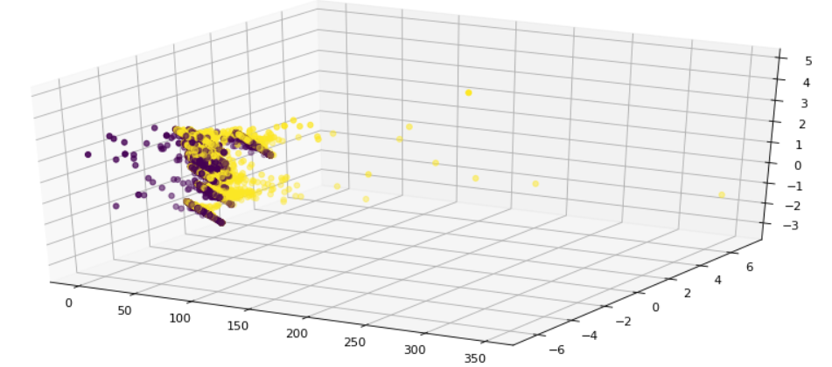
Data visualization 3

Slide 14
Training: LogistcRegression using Sklearn
Using the fast training algorithm we yield training and test scores nearly : 0.91
This is can be enhanced. We may try to tweak the parameters. Or to go for a deep learning model using Keras.

Slide 15
Training: Keras model 1
We used three layers :
Layer 1: 150 neuron with ‘Relu’ activation.
Layer 2: 120 neuron with ‘Relu’ activation.
Layer 3: 1 neuron with ‘Sigmoid’ activation.
Epochs : 100 ,
Loss is MSE, optimizer is adam and the performance metrics are MAE and Accuracy

Slide 16
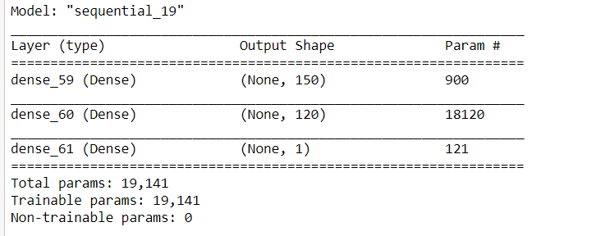
Training: Keras model 2

Slide 17
Training: Keras model 1
We’ve got better performance : accuracy score : 0.977 and MAE : 0.036

Slide 18
Running predictions
We prepared a python script that will evaluate the parameters from a csv file and predict if it is successful or failed project

Slide 19
Future
Web interface
Add more
features
Tweak the
model more

