Slide 1
ECE 326 — Integrated Circuits
4 Stage CMOS Inverter
Delay Line Circuit
4-Stage IC Layout | Cadence Virtuoso | TSMC 65nm
Dr. Ahmed Wahba
Project Team
1. عبد الرحمن عبدالهادي عبدالرحمن — Section 3
4. معتز رفيق حمدي موسى — Section 5
2. عبدالله رضا عبدالله عبدالمنعم — Section 3
5. أحمد طارق عبدالحميد — Section 1
3. عمر أيمن محمد سعيد — Section 3

Slide 2
Presentation Outline
01
Circuit Description & Operating Principle
06
LVS Verification Results
02
Schematic Diagrams
07
PEX Setup & Results
03
Pre-Layout Simulation Results
08
Post-Layout Simulation & Comparison
04
Layout Design & Screenshots
09
Discussion & Conclusions
05
DRC Verification Results

Slide 3
01
Circuit Description & Operating Principle
What is a CMOS Inverter?
4-Stage Inverter Chain
A fundamental logic gate using a PMOS (pull-up) and NMOS (pull-down) transistor in series, producing a logic complement of the input.
VDD
4-Stage Delay Line
Four inverters connected in cascade. Each stage introduces a propagation delay, and the overall delay is the sum of all four stage delays.
INV
INV
INV
INV
Vin →
→ Vout
1
2
3
4
Technology
TSMC 65nm process node — enables low power and high-speed operation, implemented and verified in Cadence Virtuoso.
VSS
PMOS: Pull-Up Network
Operating Principle
NMOS: Pull-Down Network
When Vin = VDD → NMOS ON, PMOS OFF → Vout = 0. When Vin = 0 → PMOS ON, NMOS OFF → Vout = VDD. The complementary switching ensures low static power.

Slide 4
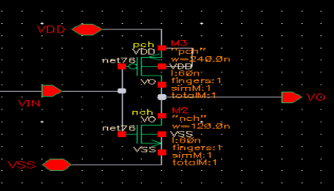
02
Schematic Diagrams
Single CMOS Inverter — Schematic

Slide 5
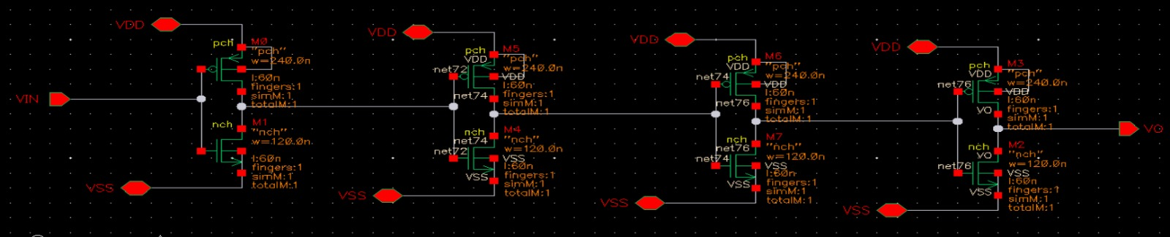
02
Schematic Diagrams
4 Stages CMOS Inverter — Schematic

Slide 6
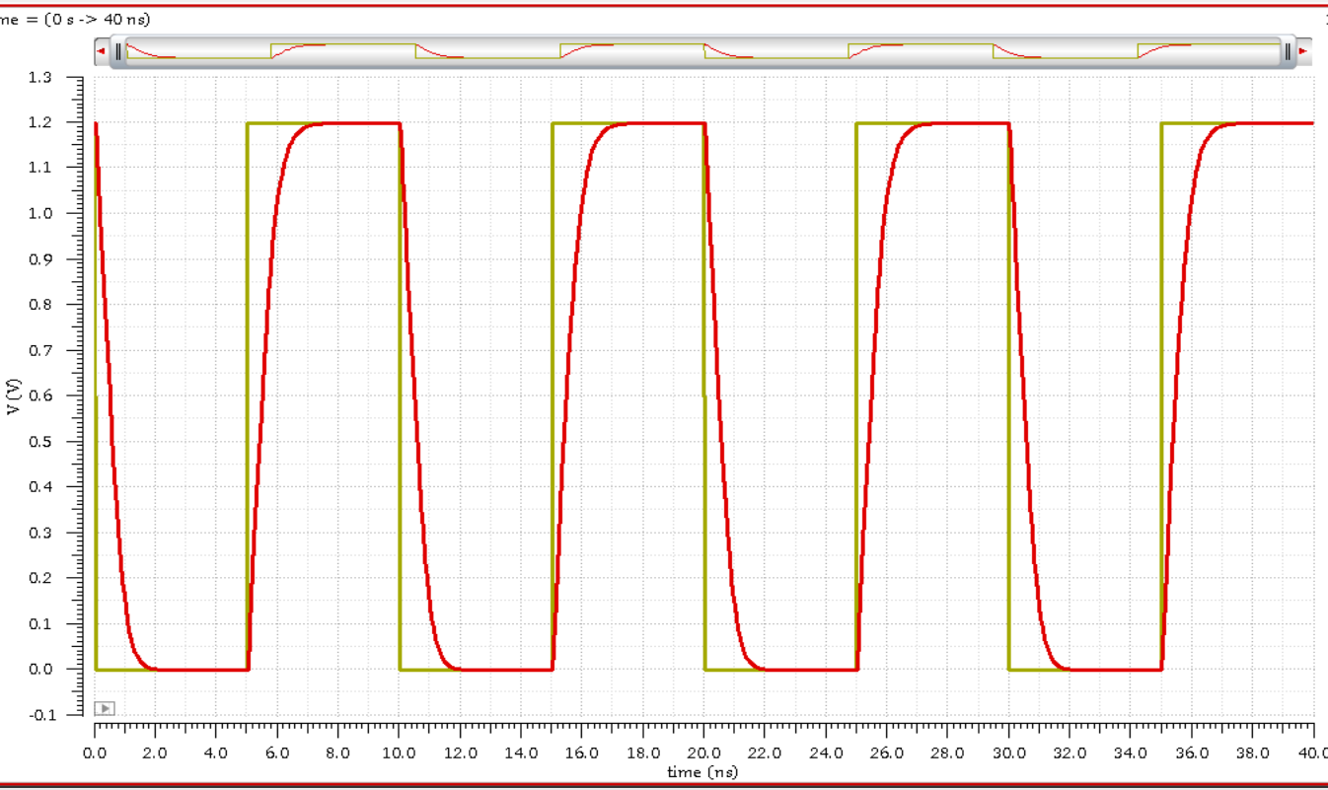
03
Pre-Layout Simulation Results
Simulation Setup
Vin vs Vout — Pre-Layout Transient Waveform
Analysis Type:
Transient Analysis (tran)
Input Signal:
Vin — pulse waveform
Supply Voltage:
VDD = 1.2V
Technology:
TSMC 65nm
Tool:
Cadence Virtuoso Spectre
Purpose:
Functional verification before layout
✓ Pre-layout simulation confirmed correct logic inversion behavior with clean waveform transitions at each stage.

Slide 7
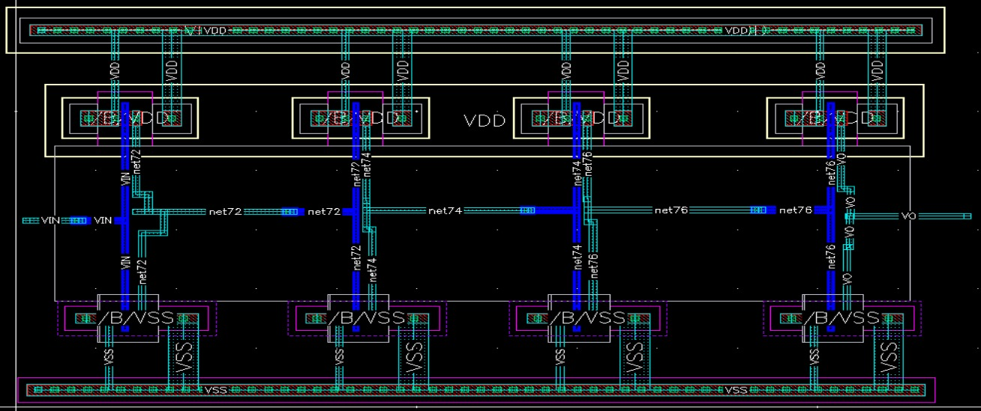
04
Layout Design
Layout Design Practices rules
Minimum spacing between layers respected per TSMC 65nm DRC rules
4-Stage Delay Line Layout
PMOS placed in N-well region, NMOS in P-substrate
Symmetrical layout for matched transistor performance
Poly gate connections made via contacts and local metal routing
Power rails (VDD/VSS) routed horizontally on metal layers
Pins (Vin, Vout, VDD, VSS) labeled and connected to schematic ports
4 stages placed in a compact, area-efficient floorplan

Slide 8
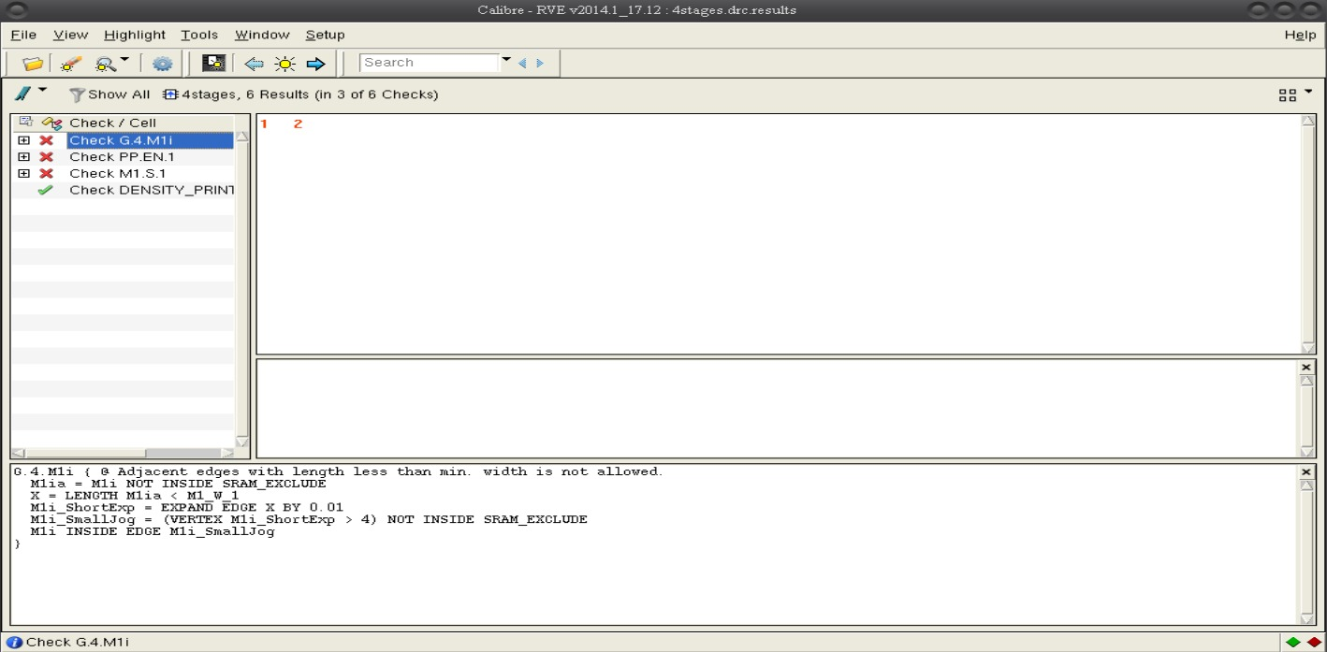
05
DRC Verification Before solving all errors

Slide 9
05
DRC Verification Results
01
Missing N-Well
⚠ The PMOS transistors in the pull-up network had no N-Well region defined around them.
✓ Added the N-Well layer to fully surround all PMOS devices in the pull-up circuit.
02
NP Layer Coverage
⚠ Areas containing poly-to-poly connections within the Pull-up and down circuit were not covered by the NP (N+ implant) layer.
✓ Extended the NP layer to cover all regions with poly-to-poly connections in the pull-up and down circuit.
03
Poly–Metal Connection Outside NP
⚠ A connection between the poly layer and a metal layer existed outside the NP region boundary, violating DRC rules.
✓ Extended the NP area to fully cover this poly-to-metal connection, bringing it within the required implant region.
04
Pin Label Errors (VSS, Vin, VDD, Vout)
⚠ Pins in the layout were missing labels, causing a mismatch between layout and schematic port connections.
✓ Added text labels for each pin (VSS, Vin, VDD, Vout) in the layout to correctly link all ports to the schematic.

Slide 10
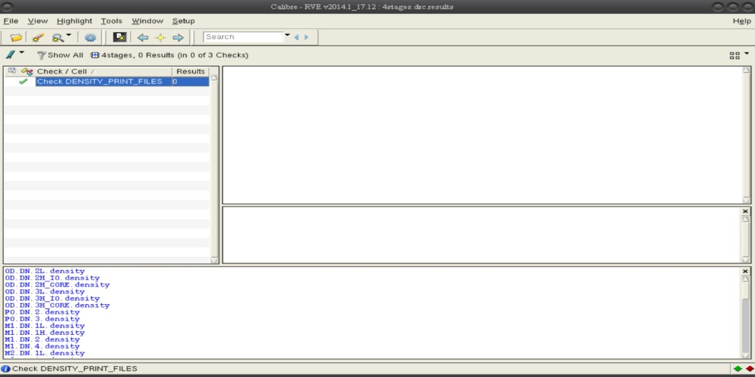
05
DRC Verification After solving all errors

Slide 11
06
LVS — Layout Versus Schematic
What is LVS?
Tool Used
LVS Result
LVS compares the extracted netlist from the physical layout against the original schematic netlist to confirm they are electrically identical.
Cadence Virtuoso Calibre LVS was used to run the netlist comparison on the 4-stage CMOS inverter delay line circuit.
LVS passed with zero discrepancies — the layout is confirmed to be a correct physical implementation of the schematic design.
LVS Verification Flow
Schematic Netlist
Layout Extraction
Netlist Comparison
LVS CLEAN ✓

Slide 12
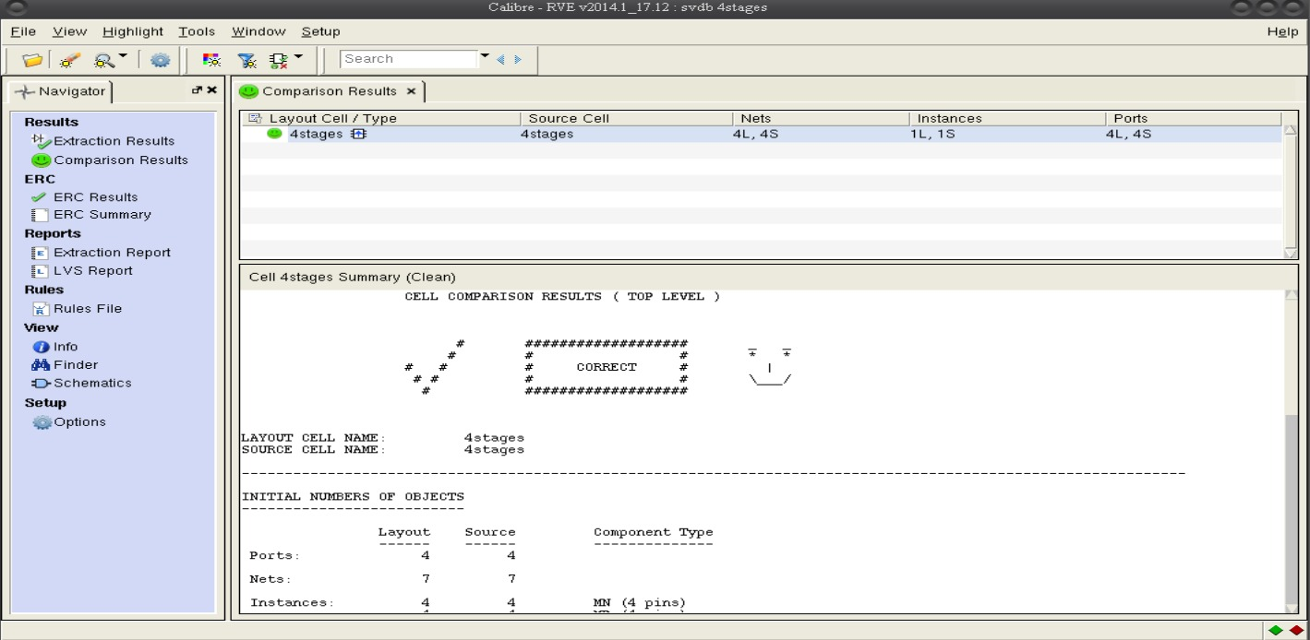
06
LVS — Layout Versus Schematic
LVS Result

Slide 13
07
Parasitic Extraction (PEX) — Setup & Results
PEX Setup
Tool:
Cadence Calibre / Quantus PEX
Extraction Type:
RC Extraction (Resistance + Capacitance)
Technology File:
TSMC 65nm process corner
Input:
Verified LVS-clean layout database
Output:
Post-layout netlist with parasitics
Purpose:
Accurate post-layout simulation input

Slide 14
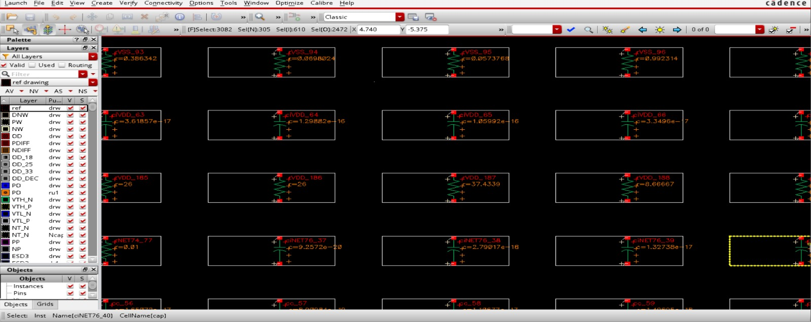
07
Parasitic Extraction (PEX) — Setup & Results
PEX Results & Extracted View

Slide 15
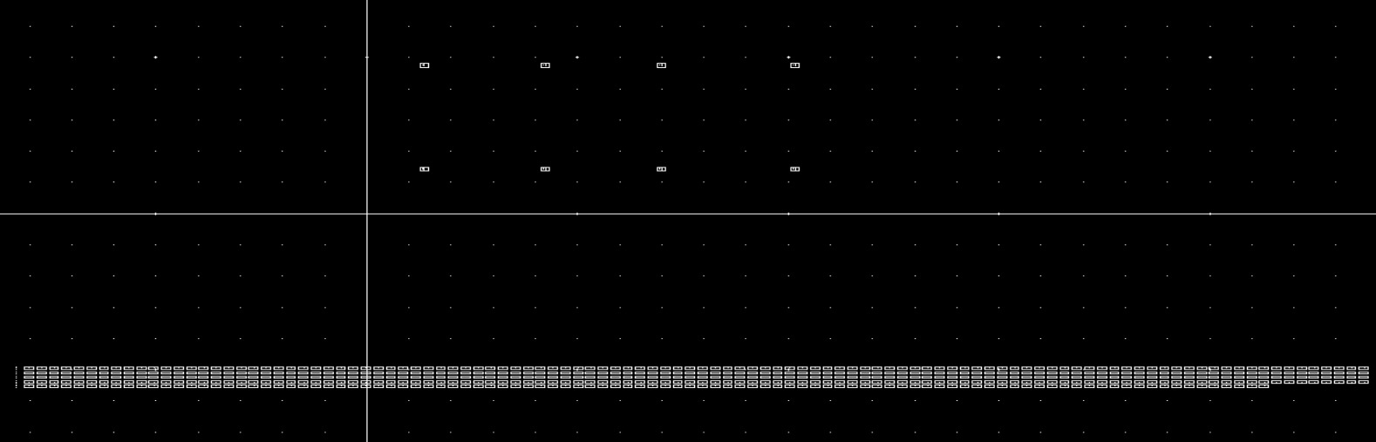
07
Parasitic Extraction (PEX) — Setup & Results
PEX Results & Extracted View

Slide 16
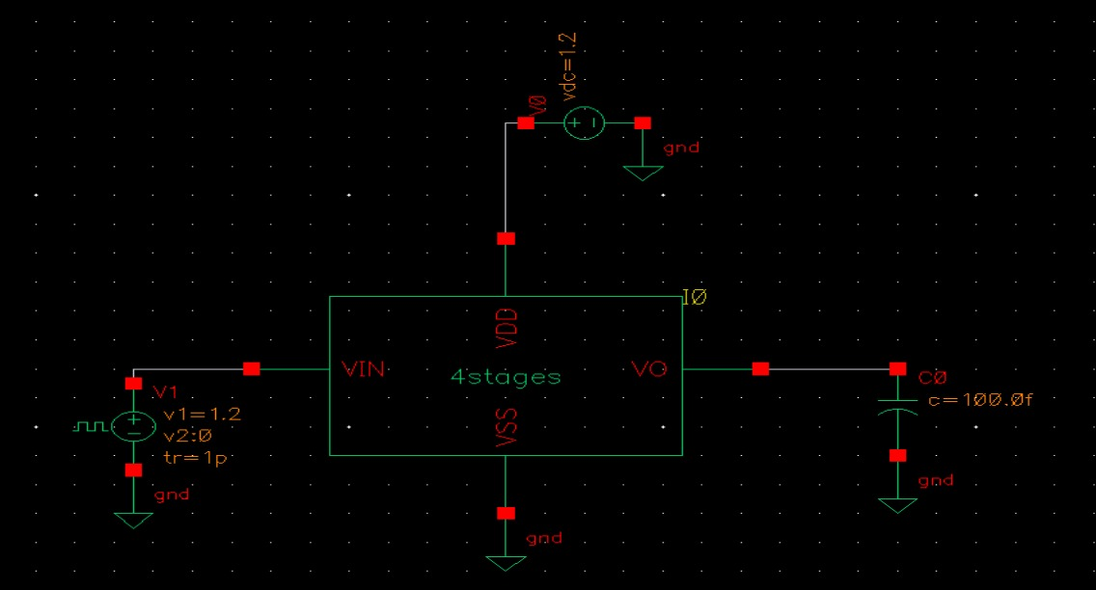
07
Schematic Symbol Used in Testbench

Slide 17
08
Post-Layout Simulation & Performance Comparison
Post-Layout Transient Waveform — Vin vs Vout
↑
Rising Time
475.2 ps
↓
Falling Time
481.7 ps
⏱
Propagation Delay
478.4 ps
⚡
Avg. Power
14.82 µW
Pre-Layout vs Post-Layout Comparison
Parameter
Pre-Layout
Post-Layout
Difference
Propagation Delay
~Ideal
478.4 ps
Due to RC parasitics
Power Consumption
~Ideal
14.82 µW
Slight increase

Slide 18
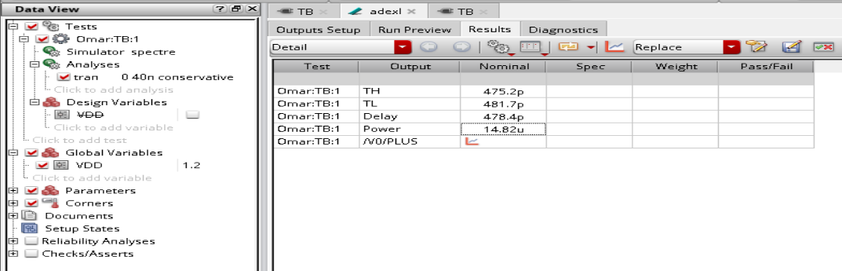
08
CALCULATIONS

Slide 19
09
Discussion & Conclusions
01
Successful Full IC Design Flow
04
Parasitic Impact on Performance
The complete analog/digital IC design flow was successfully executed: schematic → simulation → layout → DRC → LVS → PEX → post-layout simulation.
Post-layout simulation revealed the effect of parasitic RC elements: propagation delay = 478.4 ps, average power = 14.82 µW — consistent with expected parasitics in 65nm technology.
02
DRC Errors Identified & Resolved
05
Key Learning Outcomes
Four DRC violations were identified and resolved: missing N-Well, NP coverage gaps, poly-metal connection outside NP, and missing pin labels.
Practical experience gained in Cadence Virtuoso, TSMC 65nm DRC rules, layout matching techniques, and the impact of physical implementation on circuit performance.
03
LVS — Layout Matches Schematic
LVS verification confirmed a perfect match between the physical layout and the original schematic, with zero discrepancies found.

Slide 20
Thank You
Questions & Discussion
ECE 326 — Integrated Circuits | CMOS 4-Stage Inverter Delay Line | TSMC 65nm
Cadence Virtuoso | TSMC 65nm | Spectre Simulator

