Slide 1

◆ SENTINEL
Anti-Money
AML Detection System
Laundering
Detection System
INSTITUTION
OSTIM Technical University
DEPARTMENT
Moavia Mahmood | 210208693
Software Engineering
Supervisor: Asst. Prof. Dr. Yücel Tekin
COURSE
MFBP 402 – Graduation Project II
AWS · Serverless · Real-Time

Slide 2

PRESENTATION OVERVIEW
Agenda
01
Background & Problem Statement
05
AML Detection Engine
02
Research Questions & Objectives
06
Implementation & Technologies
03
Related Work & Comparative Analysis
07
Testing, Evaluation & Performance
04
System Architecture & Design
08
Results, Conclusion & Future Work

Slide 3
INTRODUCTION
Background
The Global AML Challenge
Money laundering integrates illicit funds into the legitimate financial system.
It’s threat to global economic stability.
Estimated at 2 – 5% of global GDP annually according to United Nations Office on Drugs and Crime (UNODC).
2–5%
>90%
of Global GDP
laundered annually
False-Positive
rate (legacy AML)

Slide 4
INTRODUCTION
Problem Statement
Core Problems
⏱
High Latency
Overnight batch processing — 8 to 24 hours before a suspicious transaction is evaluated
8–24h
⚠
False Positives
Legacy rule engines generate >90% false-positive rates, overwhelming analyst workloads
Detection latency
(batch systems)
⚙
Operational Overhead
Modern stream processors (Kafka, Spark, Flink) require expensive cluster management

Slide 5
RESEARCH FRAMEWORK
Research Questions
RQ1
Can a fully serverless AWS architecture (Kinesis + Lambda + DynamoDB) sustain sub-minute end-to-end AML detection latency — from transaction emission to alert availability in the analytics layer?
RQ2
What data-quality patterns emerge when streaming transactional data into a partitioned data lake alongside slowly-changing dimensions, and can they be resolved at the query layer using Athena views?

Slide 6
RESEARCH FRAMEWORK
Objectives
Simulate realistic banking data with embedded ground-truth labels.
Stream transactions via Kinesis.
Implement AML detection rules covering structuring, layering, rapid movement, high-value transfers.
Resolve slowly-changing dimension issues using Athena window functions.
Measure end-to-end latency and document all data-quality patterns encountered.

Slide 7
LITERATURE REVIEW
Existing Systems & Related Work
Legacy Batch Systems
Actimize, FICO Falcon, Fircosoft
Overnight batch → 8 to 24h detection lag
Static rule engines → >90% false-positive rate
High regulatory exposure window
Academic Frameworks
Kafka+Flink: 45ms latency (excellent)
VAE-QLSTM + Federated Learning (privacy-safe)
Cost-sensitive CSDT/CSLR classification
Require self-managed clusters — high ops cost

Slide 8
PROPOSED SOLUTION
Why Serverless Cloud-Native?
Feature | Legacy AML | Academic Frameworks | Proposed System ✓
Processing | Overnight Batch | Distributed Streaming | Event-Driven Serverless
Ingestion | ETL Scripts | Kafka + Flink | Amazon Kinesis
Compute | Self-hosted Servers | Self-managed Clusters | AWS Lambda (auto-scale)
Latency | 8 – 24 hours | < 1 second (in-memory) | 8 – 11 seconds end-to-end
Idle Cost | High (always-on HW) | High (always-on cluster) | Near Zero
Scalability | Vertical, limited | Horizontal, manual | Horizontal, automatic
Operational Complexity | High (legacy) | High (cluster ops) | Low (managed services)
Prototyping | Poor | Moderate | High
The proposed system bridges academic streaming performance with production accessibility — no cluster management, near-zero idle cost.

Slide 9
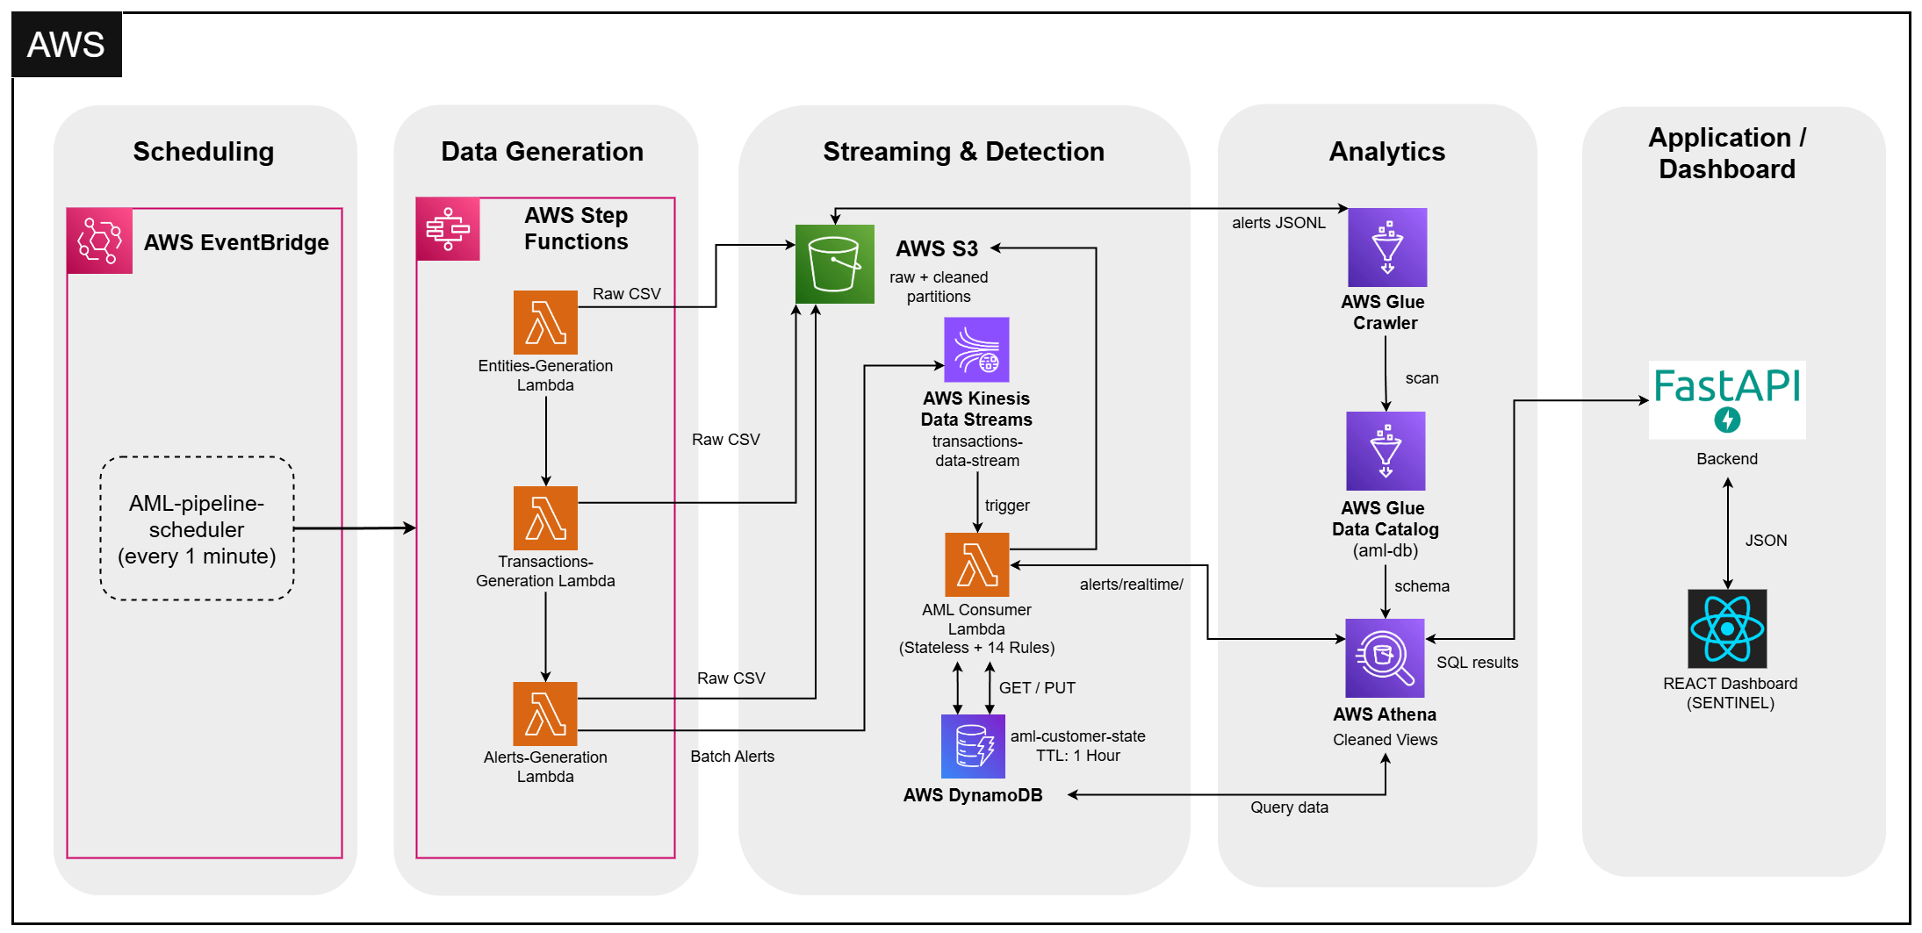
ARCHITECTURE
Five-Layer Event-Driven Architecture

Slide 10












TECHNOLOGY STACK
Technologies Used
Streaming & Compute
Storage & State
Amazon Kinesis Data Streams (on-demand)
AWS Lambda – Python 3.11
AWS Step Functions (orchestration)
Amazon EventBridge (scheduling)
Amazon S3 (Hive-partitioned data lake)
Amazon DynamoDB (rolling window state + TTL)
Hive-style dt=YYYY-MM-DD partitioning
Analytics Layer
Application Layer
AWS Glue (crawlers + data catalog)
Amazon Athena (SQL on S3, cleaned views)
Partition projection (zero-latency discovery)
6 Athena views for data quality
FastAPI + Uvicorn (Python REST backend)
React 19 + TypeScript + Vite (SENTINEL UI)
AWS IAM (least-privilege roles)
AWS CloudWatch (logging & monitoring)

Slide 11
DETECTION ENGINE
AML Detection Rules — Three Tiers
Tier 1 : Stateless Rules (10 rules) · Per-transaction evaluation · No memory required
HIGH_VALUE
CROSS_BORDER_HIGH
HIGH_RISK_COUNTRY
SANCTIONED_COUNTRY
LAYERING
6. ROUND_TRIP
7. SHELL_COMPANY
8. TRADE_BASED
9. LARGE_RAPID
10. IMPOSSIBLE_TRAVEL
Tier 2 : Stateful Rules (3 rules) · Time-windowed · DynamoDB rolling window per customer
1. STRUCTURING_WINDOW ≥3 deposits of $8K–$10K within 30 minutes
2. VELOCITY_BURST ≥10 transactions within 10 minutes
3. RAPID_MOVEMENT Large credit + matching debit within 15 minutes
Tier 3 : Upstream-Tag Rule (1 rule) · Propagates generator-stamped AML pattern labels downstream
Score 0–100 per rule · Multiple rules can fire per transaction · Alert fires on any threshold breach

Slide 12
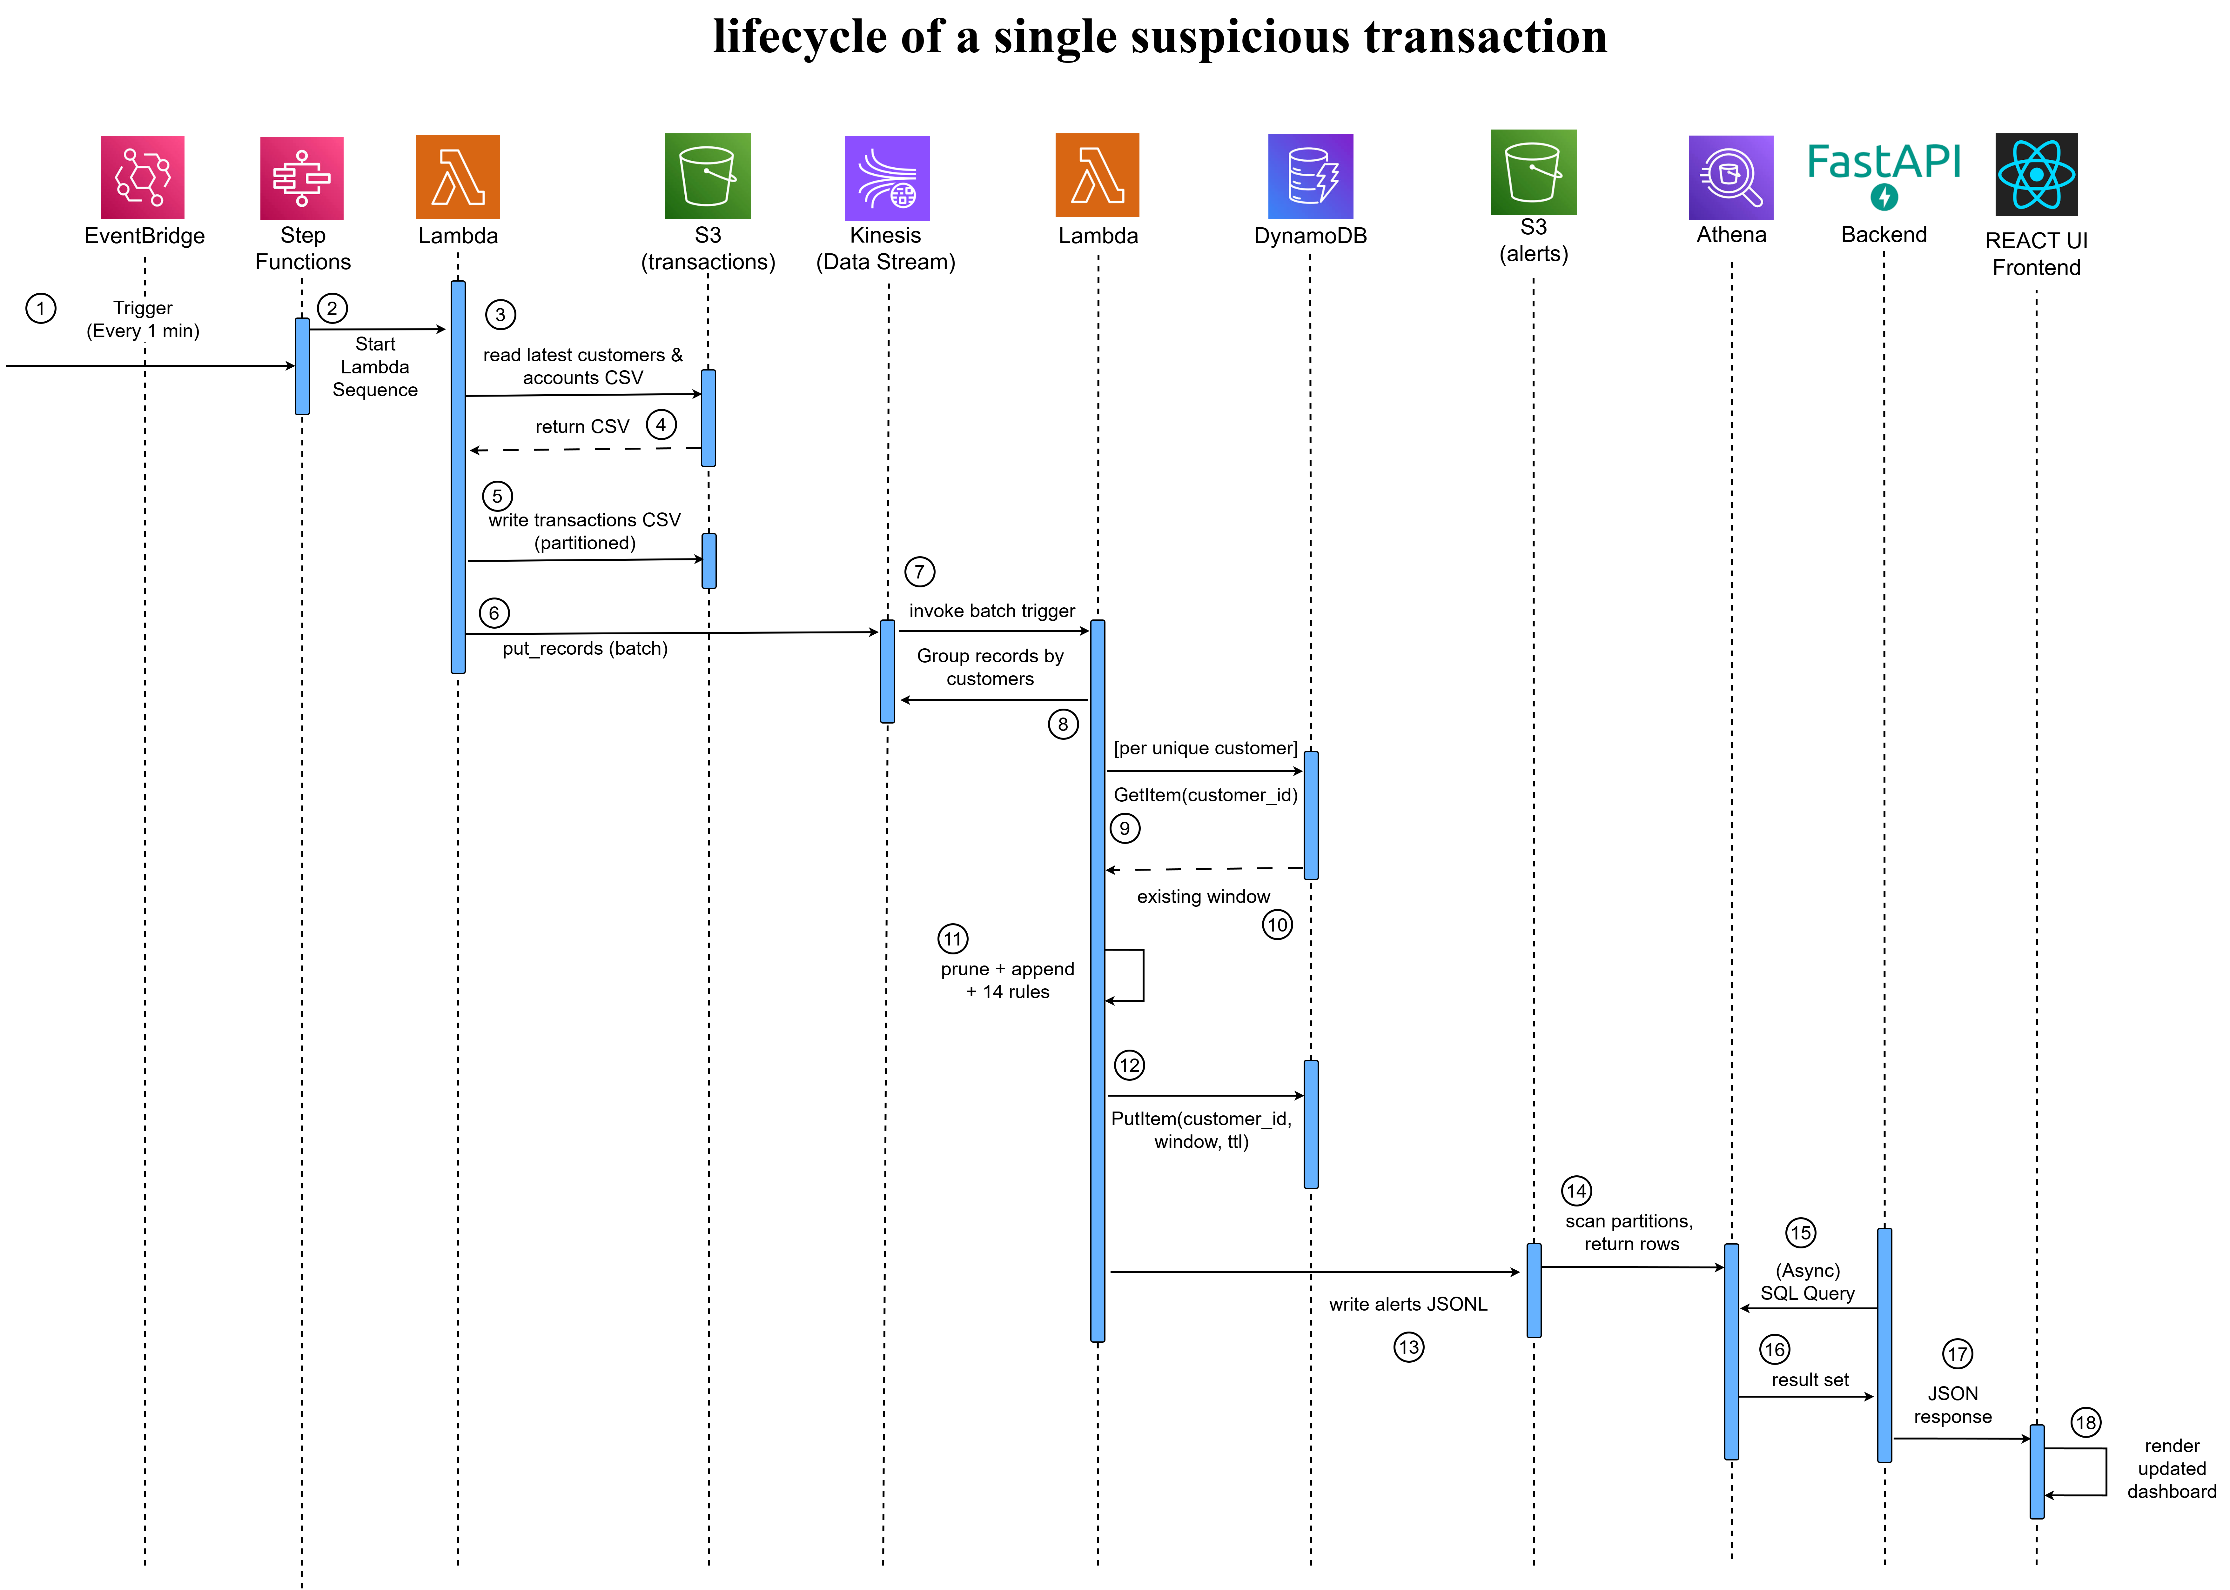
IMPLEMENTATION
Data Pipeline: End-to-End Flow

Slide 13
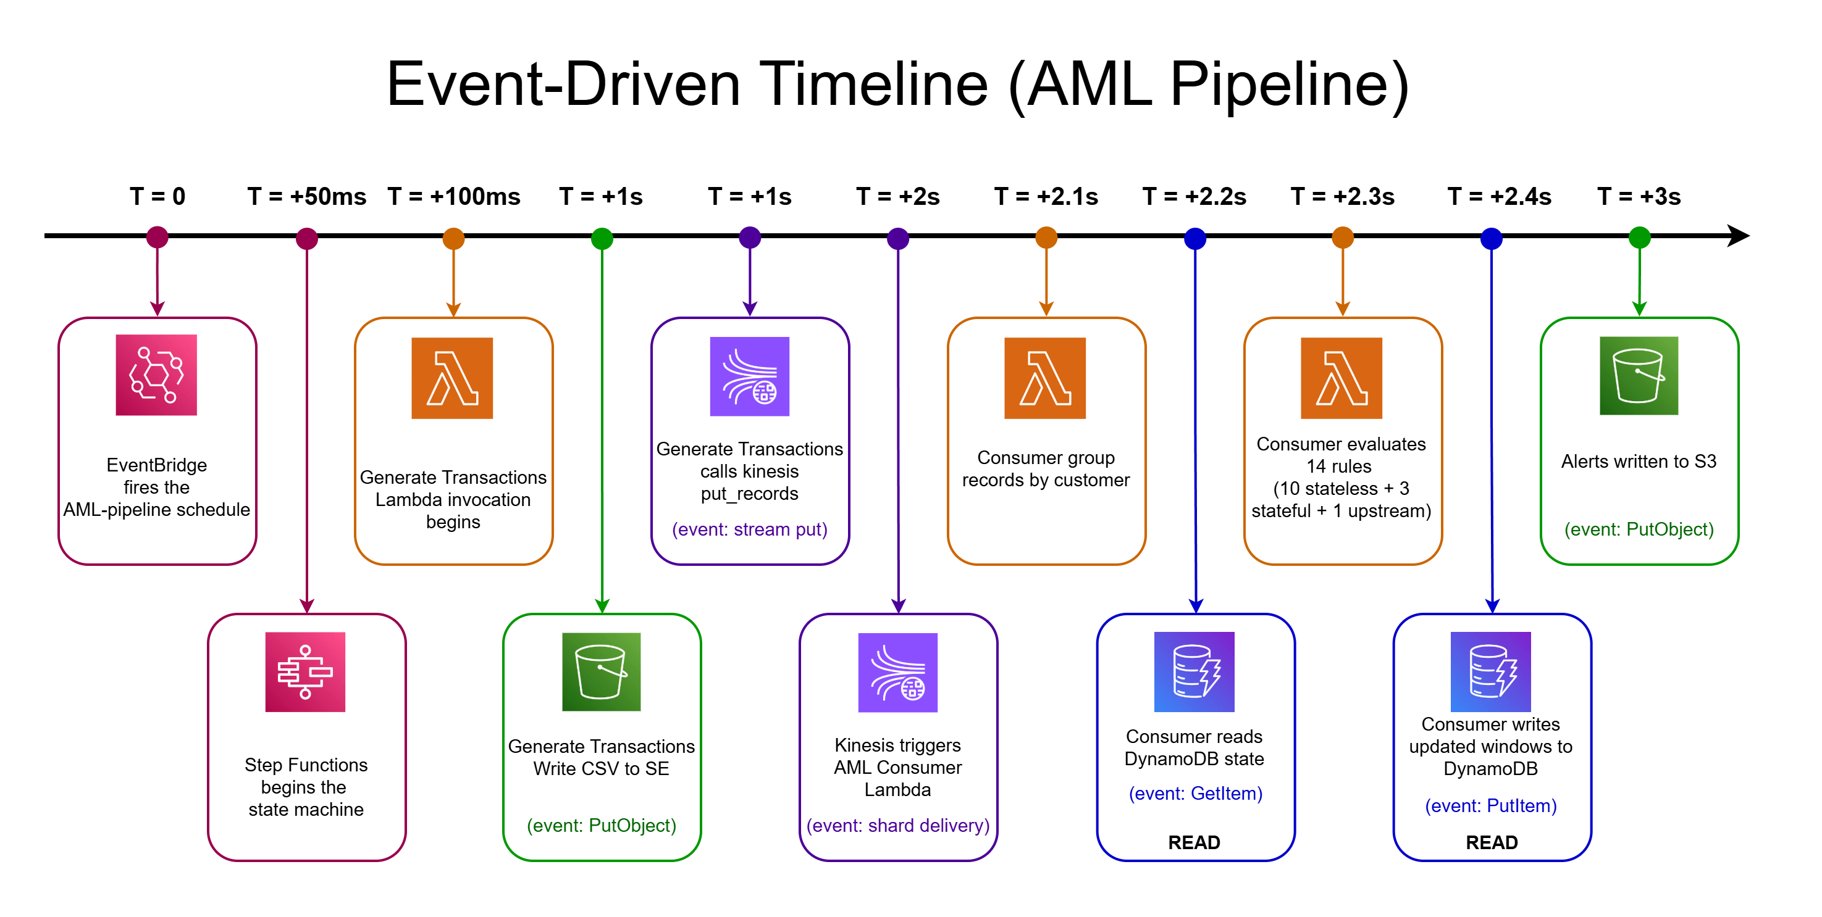
IMPLEMENTATION
Event-Driven Timeline

Slide 14
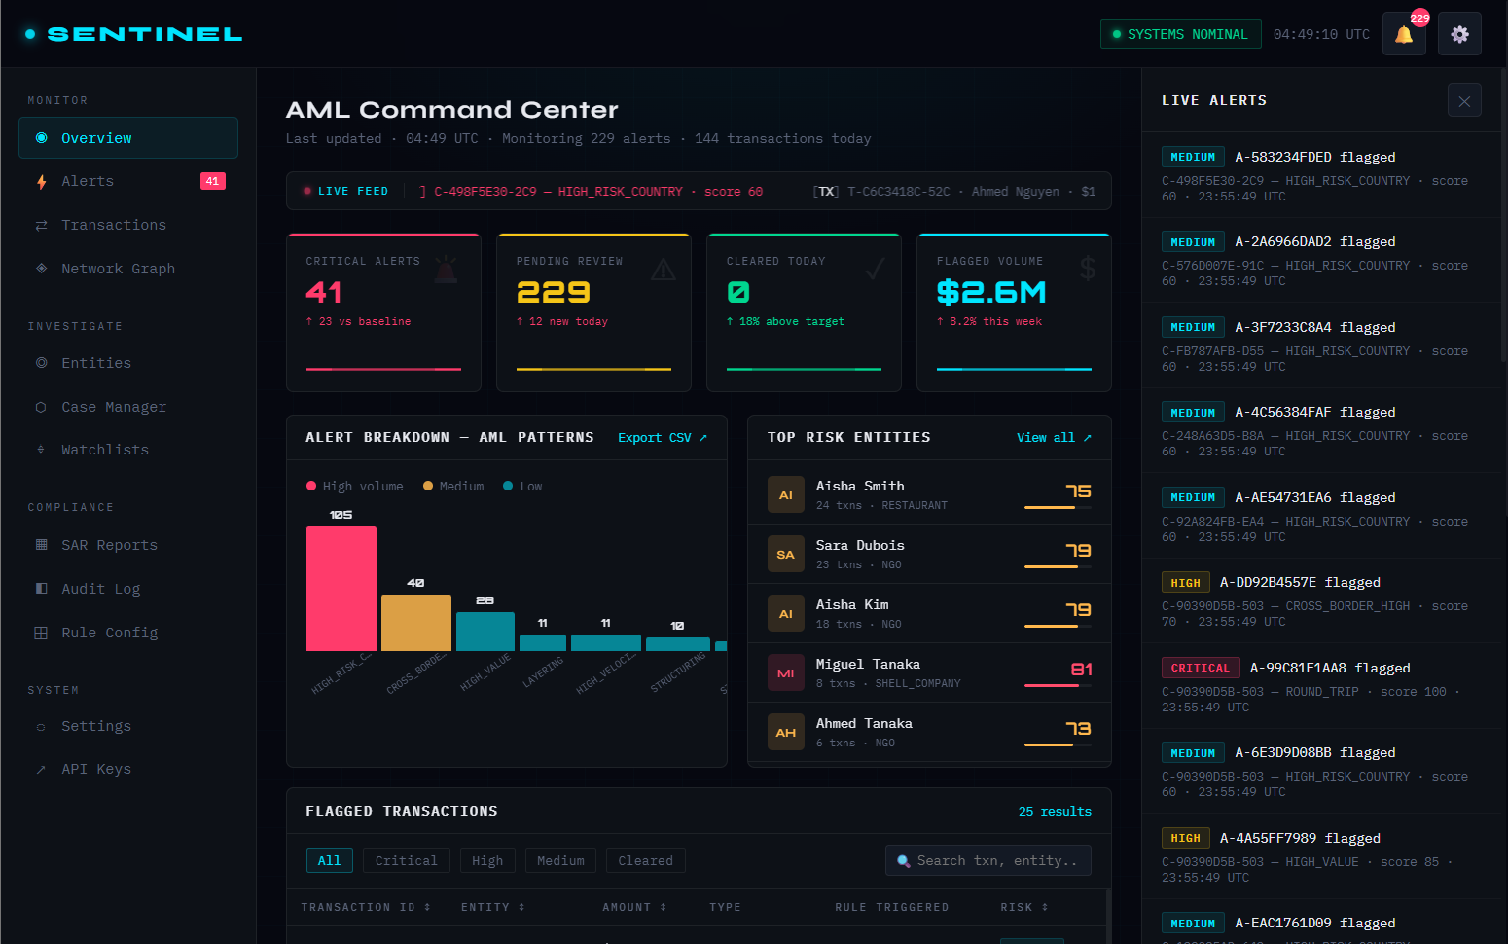
SYSTEM INTERFACES
SENTINEL Dashboard — Operational Overview
Overview Dashboard
Live KPI tiles: Critical / Pending / Cleared / Volume
Alert breakdown bar chart (14 AML patterns)
Top Risk Entities panel with risk scores
Flagged transactions table (filterable)

Slide 15
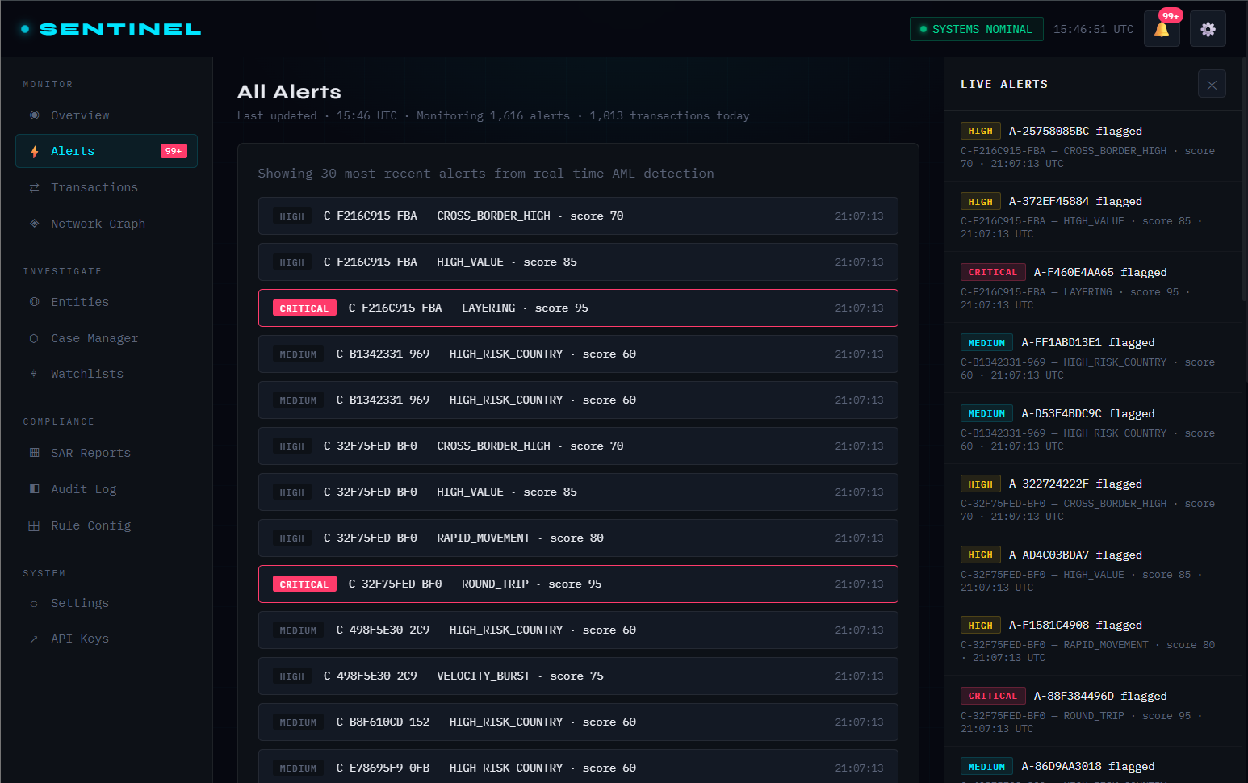
SYSTEM INTERFACES
SENTINEL Dashboard — Operational Overview
Alerts View
30 most recent real-time alerts
Severity badges: CRITICAL / HIGH / MEDIUM
Alert type and score display
Timestamp and customer ID linkage

Slide 16
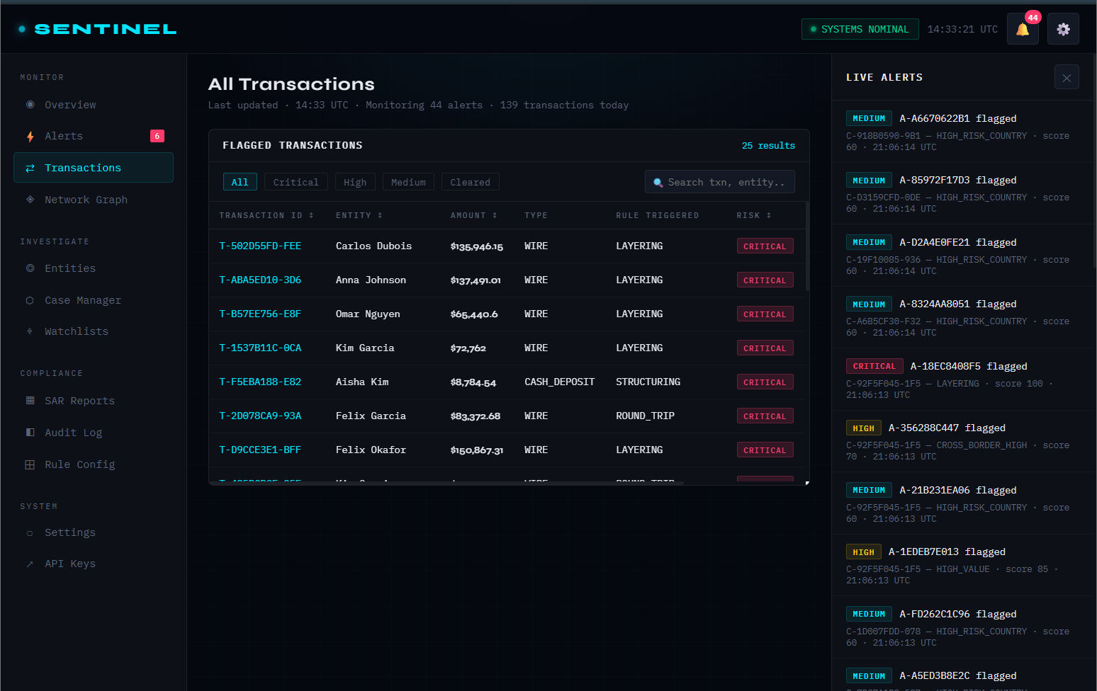
SYSTEM INTERFACES
SENTINEL Dashboard — Operational Overview
Transactions View
Filter by severity: All / Critical / High / Medium
Search by entity name or transaction ID
Rule triggered and risk score columns
Export to CSV functionality

Slide 17
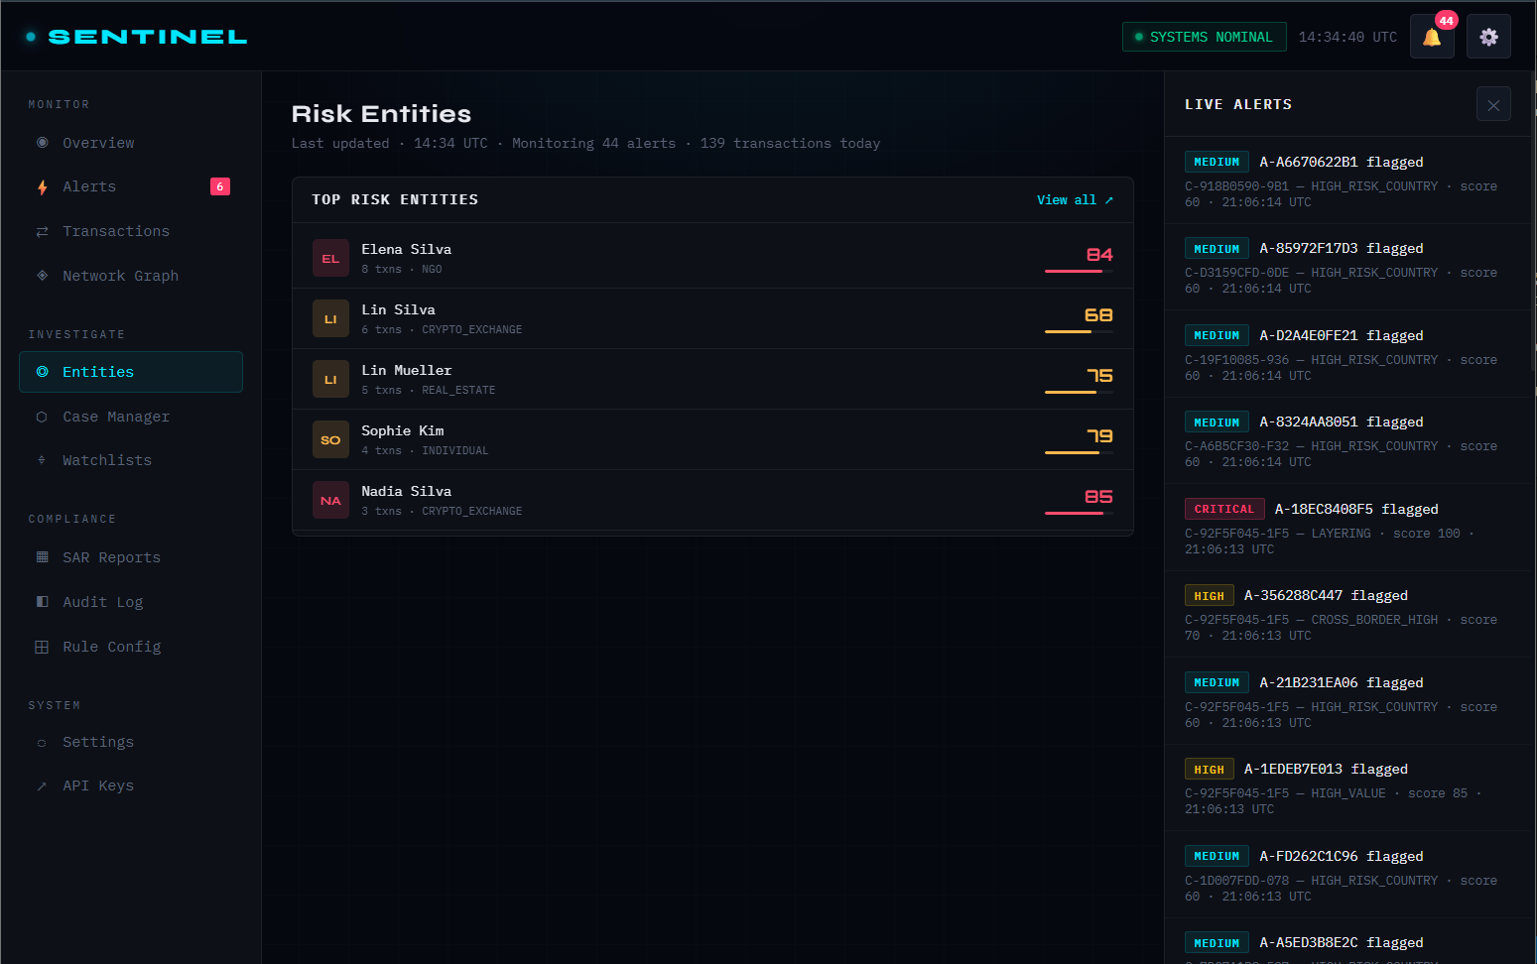
SYSTEM INTERFACES
SENTINEL Dashboard — Operational Overview
Entities View
Top-risk customer ranking
Alert count and avg score per entity
Business type and PEP flag display
Drill-down modal on click

Slide 18
TESTING
Testing Strategy
4-Layer Testing Approach
Component
Integration
Lambda isolated unit tests via AWS Console event payloads.
Validates schema, env vars, IAM.
Real AWS services in eu-north-1 — surfaces actual S3 consistency, Kinesis ordering, DynamoDB limits.
Data Quality
End-to-End
Athena SQL assertions: no future dates, no orphan alerts, no boolean-as-string mismatches.
Full pipeline trigger → Athena → Dashboard.

Slide 19
TESTING
Test Scenarios
6 Test Scenarios — All Passed ✓
Test | Scenario | Requirement | Result | Status
TS-1 | Cold Start End-to-End | FR-1, FR-2, FR-4 | 18–24 sec latency | ✓
TS-2 | Continuous 1-hour Operation | FR-2, NFR-2 | 60 cycles, 0 errors | ✓
TS-3 | Stateful DynamoDB Windowing | FR-15 | STRUCTURING correctly detected | ✓
TS-4 | DynamoDB TTL Expiry | FR-15, NFR-9 | Entry deleted ~7 min post-TTL | ✓
TS-5 | Glue Partition Discovery | FR-3, FR-10 | New dt= partition found in next run | ✓
TS-6 | Dashboard Live Refresh | FR-14 | Alerts appear within 30s window | ✓

Slide 20
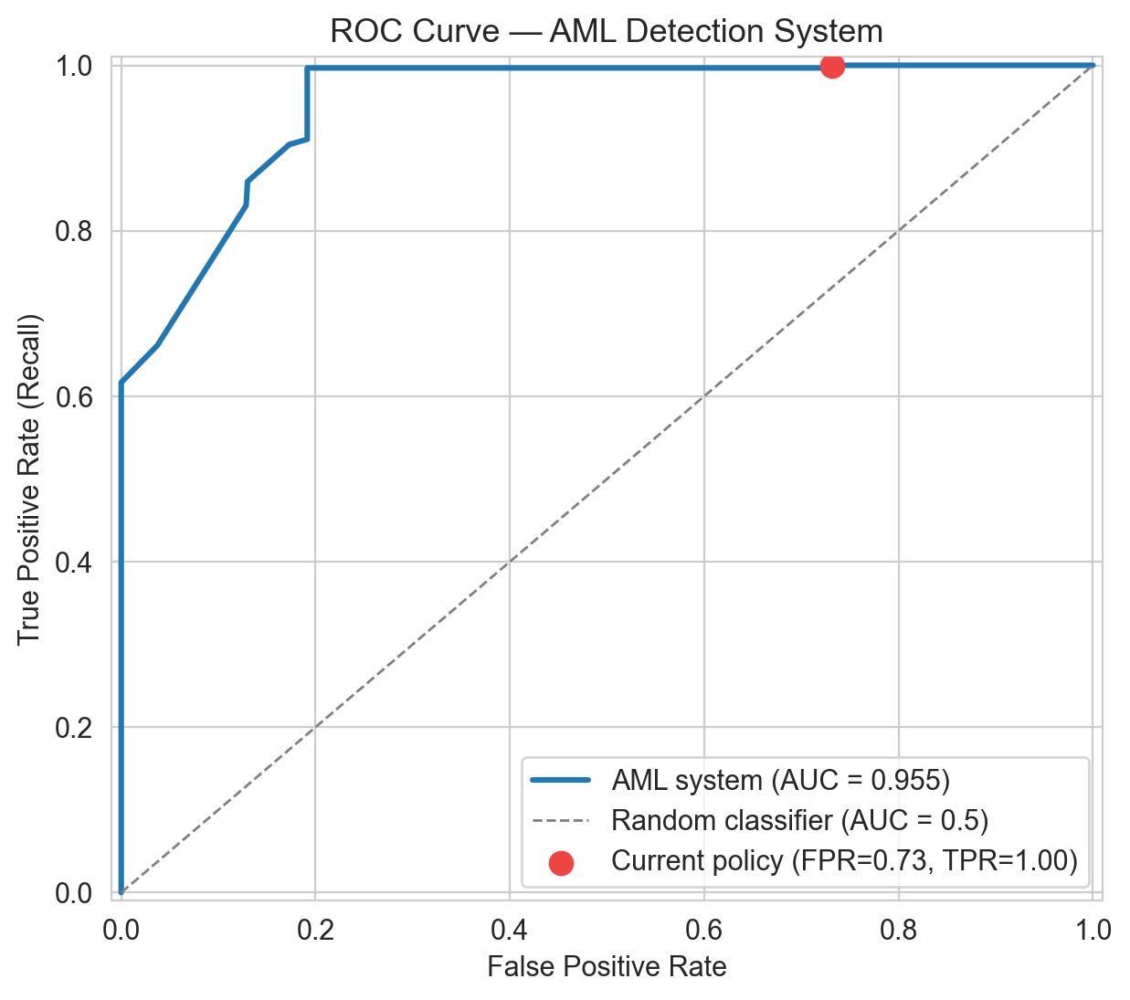
THRESHOLD ANALYSIS
ROC Analysis & Operational Thresholds
Threshold Sensitivity
Threshold | Precision | Recall | FPR | F1
Any Rule (≥0) | 0.38 | 1.00 | 0.73 | 0.55
≥ 30 (default) | 0.38 | 1.00 | 0.73 | 0.55
≥ 70 (sweet spot) | 0.69 | 0.91 | 0.19 | 0.78
≥ 80 (F1 optimum) | 0.75 | 0.86 | 0.13 | 0.80
≥ 90 (auto-escalate) | 0.89 | 0.66 | 0.04 | 0.76
= 100 (max precision) | 1.00 | 0.50 | 0.00 | 0.67
Threshold 70 — Sweet Spot
Strict Pareto improvement: FPR 0.73→0.19 (3.8× reduction), F1 0.55→0.78, recall 91%
Threshold 80 — F1 Optimum
Maximum F1=0.80, FPR=0.13. ~7× better than legacy >0.90 FPR. Recommended deployment point.
Threshold 90 — Auto-Escalate
Precision 0.89, FPR 0.04. Suitable for autonomous escalation without analyst review.

Slide 21
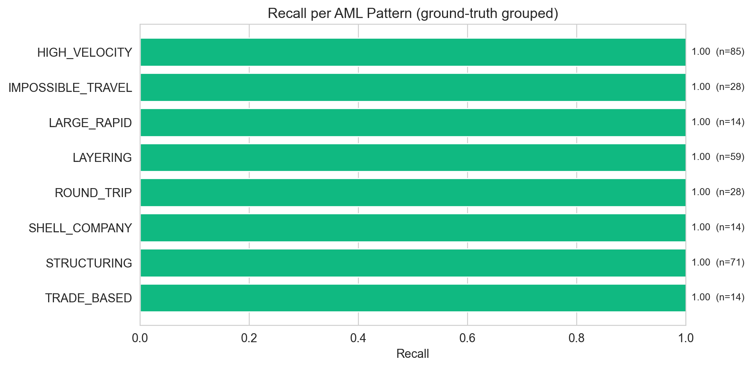
DETECTION ACCURACY
Per-Pattern Recall
Recall (TPR)
1.00
Zero missed suspicious txns
Key Insight: All 8 AML pattern categories achieve Recall = 1.00 · HIGH_RISK_COUNTRY (precision 0.30) is the single largest source of false positives — targeted for threshold tuning

Slide 22
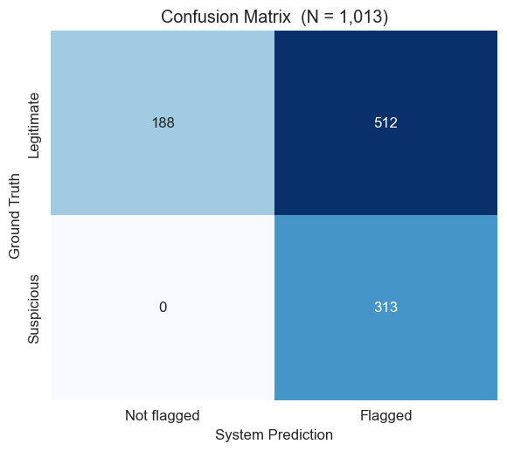
EVALUATION RESULTS
Detection Performance — Classification Metrics
Confusion Matrix (N = 1,013 transactions)
AUC (ROC)
0.955
Excellent discrimination
F1 @ Threshold 80
0.80
F1-optimal operating point
FPR @ Threshold 80
0.13
7× better than legacy (>0.90)
Precision @ any-rule
0.38
Dominated by HIGH_RISK_COUNTRY

Slide 23
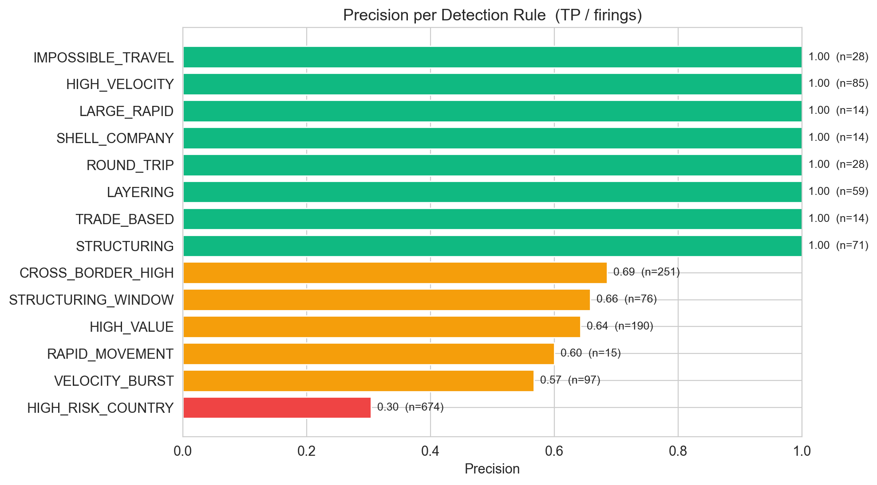
DETECTION ACCURACY
Per-Rule Precision
Key Insight: All 8 AML pattern categories achieve Recall = 1.00 · HIGH_RISK_COUNTRY (precision 0.30) is the single largest source of false positives — targeted for threshold tuning

Slide 24
RESULTS & DISCUSSION
Key Findings & Architectural Lessons
RQ1 Confirmed: Sub-Minute AML Latency
RQ2 Confirmed: Query-Layer DQ Resolution
Median end-to-end latency: 8–11 seconds (vs 8–24 hours legacy)
Kinesis + Lambda replaces Kafka cluster in 2h setup (vs ~25h estimated)
On-demand capacity: near-zero idle cost, automatic horizontal scale
6 data quality issues identified and resolved purely at Athena view layer
SCD deduplication via ROW_NUMBER() — no ingestion-time reprocessing needed
Partition projection eliminates Glue crawler delay for daily partitions
Complete Detection Coverage
Architectural Lessons Learned
Recall = 1.00 across all AML pattern categories — zero missed suspicious transactions
AUC = 0.955 (Excellent by medical/ML convention: 0.90–1.00)
Data quality view contract is more valuable than raw data itself
DynamoDB TTL is the correct stateful pattern for ephemeral Lambda state
SCD joins require explicit attention when dimensions regenerate at different cadences

Slide 25
CONCLUSION
Conclusion
14
100%
0.955
8–11s
7×
15/15
AML Rules
Implemented
Pattern
Coverage
AUC Score
(Excellent)
End-to-End
Latency
FPR Reduction
vs. Legacy
Functional Req.
Met (FR+NFR)
✓ Serverless beats cluster overhead
✓ Query-layer data quality
✓ Complete AML coverage
✓ Production-ready path
✓ Broader principle

Slide 26
FUTURE WORK
7 Planned Extensions
1
ML-Based Scoring
5
Production Deployment
Recalibrate HIGH_RISK_COUNTRY with logistic regression / gradient boosting. Direct benchmark against AUC=0.955 baseline.
S3+CloudFront (frontend) · Lambda+API Gateway (backend) · Cognito auth · Custom domain + TLS.
2
Cost-Sensitive Thresholds
6
Dead-Letter Queue
Weight false-negative cost proportionally to transaction value (Bahnsen et al.). Improve alert prioritisation.
SQS DLQ for failed Kinesis consumer batches. CloudWatch alarm + manual replay Lambda for zero data loss.
3
Graph Analytics (Neptune)
7
Idempotent Processing
Detect cross-customer layering via graph traversal — in-degree, fan-out, cycle detection. Powers 'Network Graph' view.
Transaction-ID deduplication cache to handle Kinesis at-least-once delivery guarantees in production.
4
Case Management Module
Persist analyst actions (review/close/escalate) in DynamoDB. Queue-based analyst workflow with audit trail.

Slide 27
REFERENCES
Key References
[1] Davuluri, P.S.L.N. (2025). Real-Time Compliance Architecture: Scalable Real-Time Regulatory Compliance Framework for Global Financial Platforms.
[2] Abbassi, H., et al. (2025). Adaptive, Privacy-Enhanced Real-Time Fraud Detection via Federated Learning and VAE-QLSTM Fusion. Big Data and Cognitive Computing, 9.
[3] Bahnsen, A.C., et al. (2018). Fraud Detection by Stacking Cost-Sensitive Decision Trees. (CSDT / CSLR ensemble approach).
[4] (2024). Scalable Data Ingestion Strategies: Comparative Performance of Kafka with Spark Structured Streaming and Flink.
[5–8] AWS Documentation: Kinesis Data Streams · Lambda · DynamoDB TTL · Athena Partition Projection.
[9] Financial Action Task Force (FATF). (2023). International Standards on Combating Money Laundering — FATF Recommendations.
[10] Tiangolo, S. (2024). FastAPI Framework Documentation. https://fastapi.tiangolo.com/
[11] Aidoo, S. (2025). The Cost of AML Compliance.

Slide 28
SENTINEL
Anti-Money Laundering Detection System
AWS · Serverless · Real-Time · AML Rules · AUC = 0.955
Thank You
Questions & Discussion
Moavia Mahmood | Student ID: 210208693
Supervisor: Asst. Prof. Dr. Yücel Tekin | OSTIM Technical University | May 2026
github.com/MoaviaMahmood/Financial-Transaction-Monitoring

