Slide 1
Lecture 4
Alphanumeric Codes
Binary Logic and gates

Slide 2
Quiz # 1
Perform the multiplication (762)8* (45)8.

Slide 3
Decimal Codes
The binary number system is the most natural one for a computer, but people are accustomed to the decimal system.
One way to resolve this difference is to convert decimal numbers to binary, perform all arithmetic calculations in binary, and then convert the binary results back to decimal.
This method requires that we store the decimal numbers in the computer in such a way that they can be converted to binary.
Since the computer can accept only binary values, we must represent the decimal digits by a code that contains 1s and 0s.
It is also possible to perform the arithmetic operations directly with decimal numbers when they are stored in the computer in coded form.

Slide 4
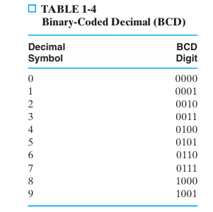
Binary-Coded Decimal (BCD)
Table 1-4 gives a 4-bit code for each decimal digit. A number with n decimal dig its will require 4n bits in BCD.
Example: decimal 396 is represented in BCD with 12 bits as 0011 1001 0110.

Slide 5
Cont.,
BCD numbers are decimal numbers and not binary numbers, even though they are represented using bits.
The only difference between a decimal and a BCD number is that decimals are written with the symbols 0, 1, 2, …, 9, and BCD numbers use the binary codes 0000, 0001, 0010, …, 1001.
Consider decimal 185 and its corresponding value in BCD and binary: (185)10 = (0001 1000 0101)BCD = (10111001)2.
The BCD value has 12 bits, but the equivalent binary number needs only 8 bits.
However, BCD representation of decimal numbers is still important, because computer input and output data used by most people needs to be in the decimal system.

Slide 6

Parity Bit
To detect errors in data communication and processing, an additional bit is some times added to a binary code word to define its parity.
A parity bit is the extra bit included to make the total number of 1s in the resulting code word either even or odd.
Consider the following two characters and their even and odd parity:

Slide 7
Gray Codes
As we count up or down using binary codes, the number of bits that change from one binary value to the next varies.
This is illustrated by the binary code for the octal dig its on the left in Table 1-7.
As we count from 000 up to 111 and “roll over” to 000, the number of bits that change between the binary values ranges from 1 to 3.
For many applications, multiple bit changes as the circuit counts is not a problem.
There are applications, however, in which a change of more than one bit when counting up or down can cause serious problems.

Slide 8
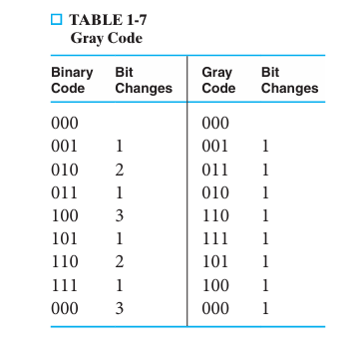
Gray codes: are binary codes with a 1-bit difference between successive codes which makes it reduces the error occurrence and provides accuracy.

Slide 9
Application of Gray Code
Gray codes are primarily used in:
Position encoders, (Robot Arm)
Digital communication,
Analog-to-digital converters
CNC machines
Motor control systems
K-map

Slide 10
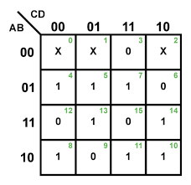
Labelling the Axes of Karnaugh Map
Karnaugh map uses gray code because the difference between consecutive cells of K-map should be of 1-bit only so that the adjacent cells can be grouped to minimize and simplify the Boolean function.

Slide 11
Binary Logic and gates
Digital circuits are hardware components that manipulate binary information.
The circuits are implemented using transistors and interconnections in complex semi- conductor devices called integrated circuits.
Each basic circuit is referred to as a logic gate.
For simplicity in design, we model the transistor- based electronic circuits as logic gates.
Thus, the designer need not be concerned with the internal electronics of the individual gates, but only with their external logic properties.
Each gate performs a specific logical operation.

Slide 12
Cont.,
The outputs of gates are applied to the inputs of other gates to form a digital circuit.
In order to describe the operational properties of digital circuits, we need to introduce a mathematical notation that specifies the operation of each gate and that can be used to analyze and design circuits.
This binary logic system is one of a class of mathematical systems generally called Boolean algebras.

Slide 13
Binary Logic
Binary logic deals with binary variables, which take on two discrete values (T/F or 1/0), and with the operations of mathematical logic applied to these variables.
Associated with the binary variables are three basic logical operations called AND, OR, and NOT.

Slide 14
Truth Table
A truth table is a mathematical table used in logic and Boolean algebra to determine the truth value of a compound statement for every possible combination of its component statements.
It displays the output of a logical operation for all possible inputs, helping to test the validity of arguments and analyze logical expressions.
Each row represents a unique combination of truth values (true or false) for the input variables, and the final column shows the resulting truth value of the entire expression.

Slide 15
How to Create a Truth Table for Given Logical Expression
A truth table has some elements that include Input Variables, Output Variables, and combinations of input variables.
The columns represent the number of input and output variables, and the rows represent the number of all possible combinations.
As in the truth table, we generally work with binary there will be 2^{n} number of rows, where n is the number of input variables.
Steps involving the construction of the truth table are:
Identification of input variables and determining the number of rows.
Listing all the possible combinations.
Determining the output for each combination using the logical expression.

Slide 16
AND Logical Operation
AND. This operation is represented by a dot or by the absence of an operator.
For example, Z = X . Y or Z = XY is read “Z is equal to X AND Y.”
The logical operation AND is interpreted to mean that Z = 1 if and only if X = 1 and Y = 1—otherwise Z = 0.
(Remember that X, Y, and Z are binary variables and can be equal to only 1 or 0.)

Slide 17
OR Logical Operation
OR. This operation is represented by a plus symbol.
For example, Z = X + Y is read “Z is equal to X OR Y,” meaning that Z = 1 if X = 1 or if Y = 1, or if both X = l and Y = 1.
Z = 0 if and only if X = 0 and Y = 0.

Slide 18
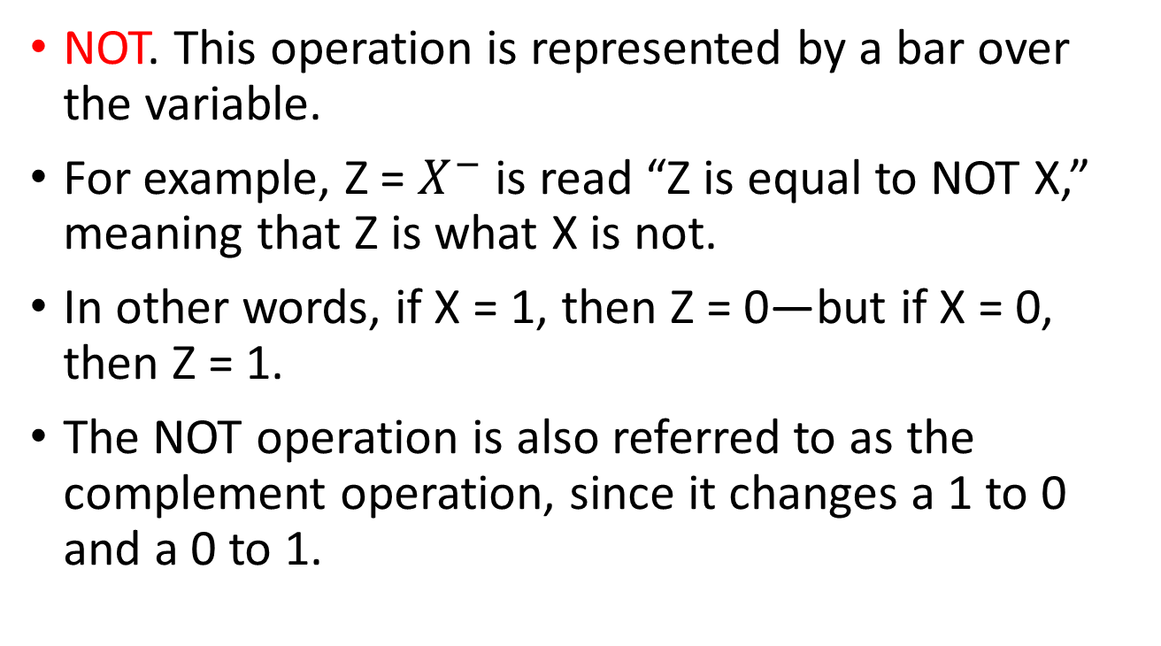
NOT Logical Operation
NOT. This operation is represented by a bar over the variable.
For example, Z = $X^{−}$ is read “Z is equal to NOT X,” meaning that Z is what X is not.
In other words, if X = 1, then Z = 0—but if X = 0, then Z = 1.
The NOT operation is also referred to as the complement operation, since it changes a 1 to 0 and a 0 to 1.

Slide 19
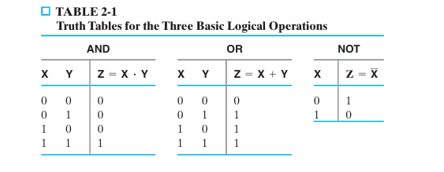

Slide 20
Logic Gates
Logic gates are electronic circuits that operate on one or more input signals to pro duce an output signal.
Electrical signals such as voltages or currents exist throughout a digital system in either of two recognizable values.
Voltage- operated circuits respond to two separate voltage ranges that represent a binary variable equal to logic 1 or logic 0, as illustrated in Figure 2-1.
The input terminals of logic gates accept binary signals within the allowable range and respond at the output terminals with binary signals that fall within a specified range.

Slide 21
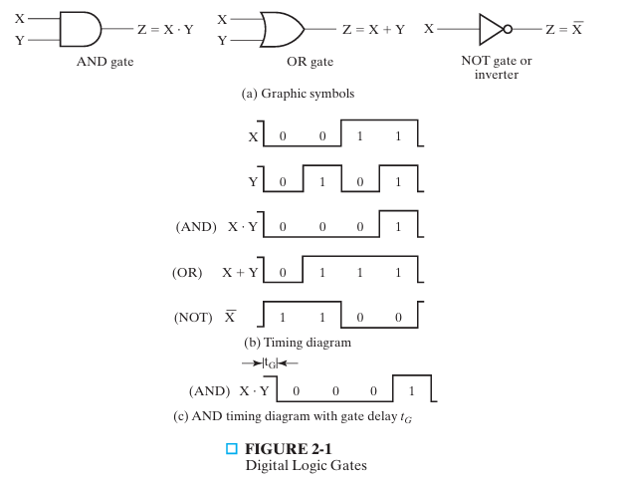

Slide 22
Gate Delay
In addition to its function, each gate has another very important property called gate delay, the length of time it takes for an input change to result in the corresponding output change.
Depending on the technology used to implement the gate, the length of time may depend on which of the inputs are changing.
For example, for the AND gate shown in Figure 2-1(a), with both inputs equal to 1, the gate delay when input B changes to 0 may be longer than the gate delay when the input A changes to 0.
Also, the gate delay when the output is changing from 0 to 1 may be longer than when the output is changing from 1 to 0, or vice versa.
When gates are attached together to form logic circuits, the delays down each path from an input to an output add together.

Slide 23
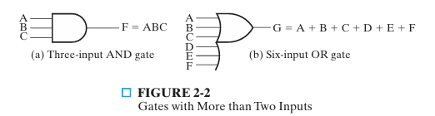
Fan-in of a logic gate
The fan-in of a logic gate is the maximum number of input signals it can accept.
It directly indicates how many inputs a gate can process at once, influencing circuit complexity and speed;
Higher fan-in generally means slower operation due to increased input capacitance and complexity.

Slide 24
Universal NAND Gate
NAND Gate is the special type of logic gate which is also known as the Universal Gate, because it can be used to implement other basic logic gates like AND, OR, and NOT.
It performs NAND(NOT AND) operation between two or more binary inputs and gives output binary signal.
This is a combination of AND gate and NOT gate.
It gives the output low(0) only when all of its inputs are high(1). In simple words we can say that NAND gate is the opposite (inverted) of AND Gate.

Slide 25
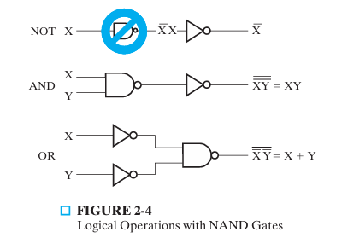
In fact, the one- input NAND is an invalid symbol and is replaced by the NOT symbol, as shown in the figure.
The AND operation requires a NAND gate fol lowed by a NOT gate.
The OR operation is achieved using a NAND gate with NOTs on each input.

Slide 26
Universal NOR Gate
NOR gate represents the complement of the OR operation.
It gives the output high(1) only when all of its inputs are low(0).
In simple words we can say that NOR gate is the opposite (inverted) of OR Gate.
It is also known as the Universal Gate because it can be used to implement other basic logic gates like AND, OR, and NOT gate by connecting NOR gates in specific configurations.

Slide 27
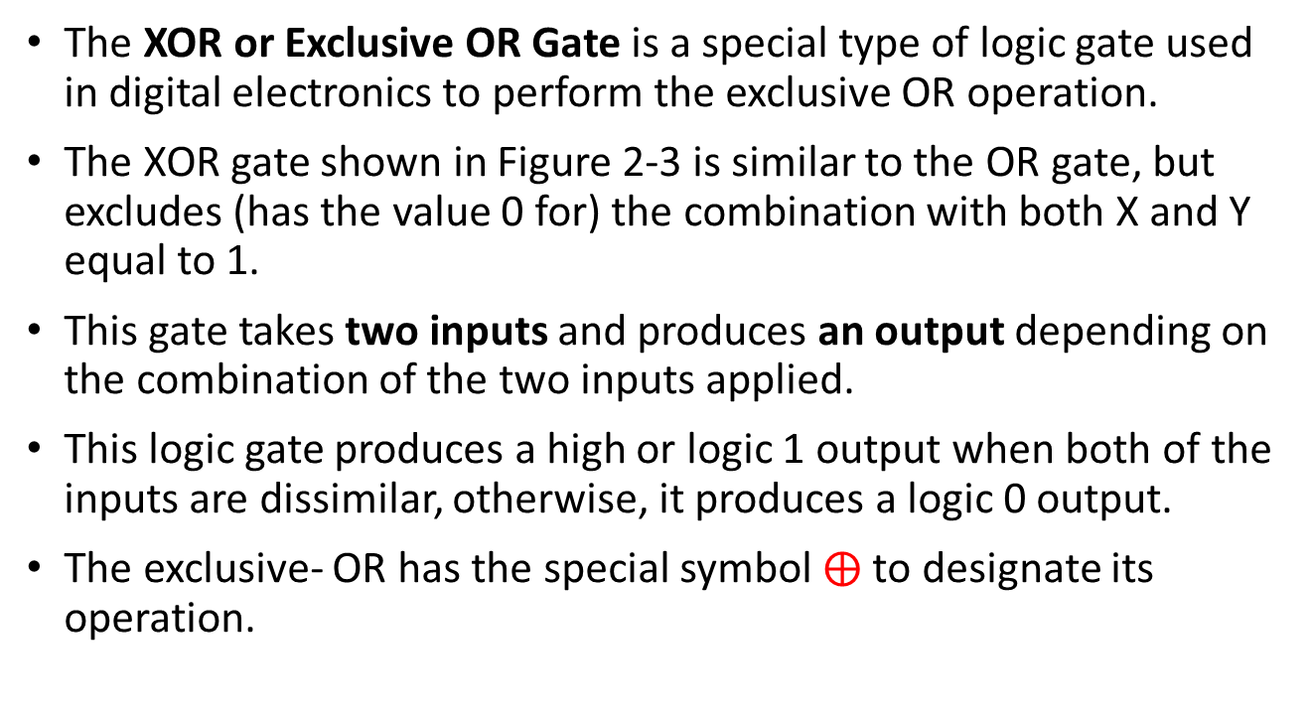
Exclusive OR Gate (XOR)
The XOR or Exclusive OR Gate is a special type of logic gate used in digital electronics to perform the exclusive OR operation.
The XOR gate shown in Figure 2-3 is similar to the OR gate, but excludes (has the value 0 for) the combination with both X and Y equal to 1.
This gate takes two inputs and produces an output depending on the combination of the two inputs applied.
This logic gate produces a high or logic 1 output when both of the inputs are dissimilar, otherwise, it produces a logic 0 output.
The exclusive- OR has the special symbol $⨁$ to designate its operation.

Slide 28
Exclusive NOR Gate (XNOR)
The XNOR gate is a logic gate that performs an exclusive NOR operation.
The output of the XNOR gate is logic 1 when both the inputs are logic 1 or logic 0.
In other words, the output of the XNOR gate is logic 1 when both the inputs are the same(either both true or both false).
For different inputs, the output of the XNOR gate is logic 0.
Hence, the XNOR gate is used to implement similarity checker circuits.
It is also known as the material biconditional.
This logic gate is denoted by this sign "⊙".

Slide 29
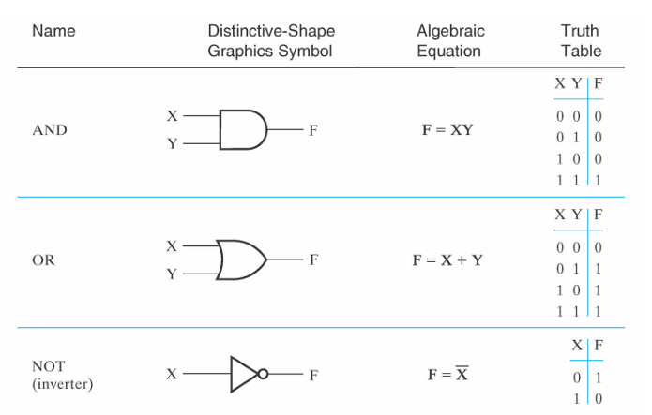

Slide 30
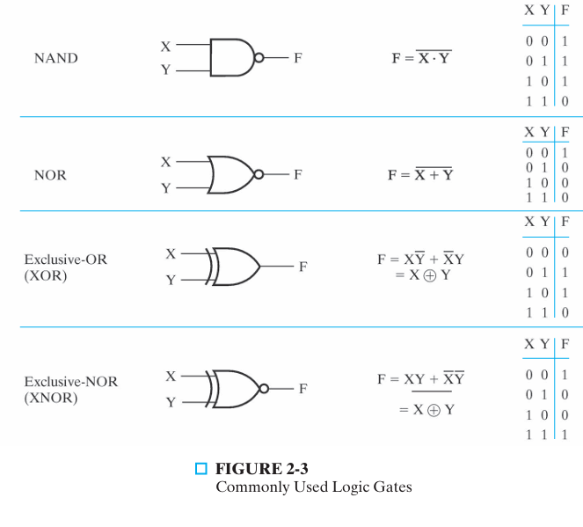

Slide 31
HDL Representations of Gates
While schematics using the basic logic gates are sufficient for describing small circuits, they are impractical for designing more complex digital systems.
In contemporary computer systems design, HDL has become intrinsic to the design process.
Initially, we justify such languages by describing their uses.
We will then briefly discuss VHDL and Verilog®, the most popular of these languages.

Slide 32
Cont.,
HDLs resemble programming languages, but are specifically oriented to describing hardware structures and behavior.
When a language is used in this fashion, it is referred to as a structural description, in which the language describes an interconnection of components.

Slide 33
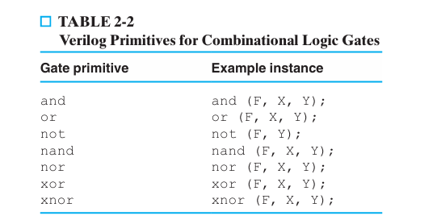

Slide 34
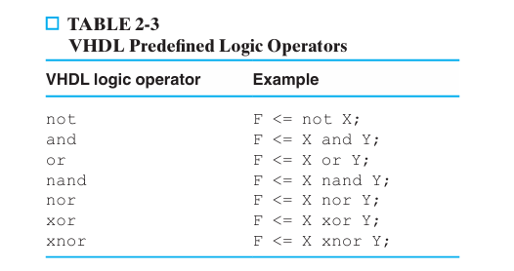

Slide 35
Assignment
"
Draw the logic circuit for the Boolean expression:
𝑌=(𝐴⋅𝐵)+𝐶
and complete its truth table."

